Slide 1
How website works?
Django-Mastery class one--

Slide 2




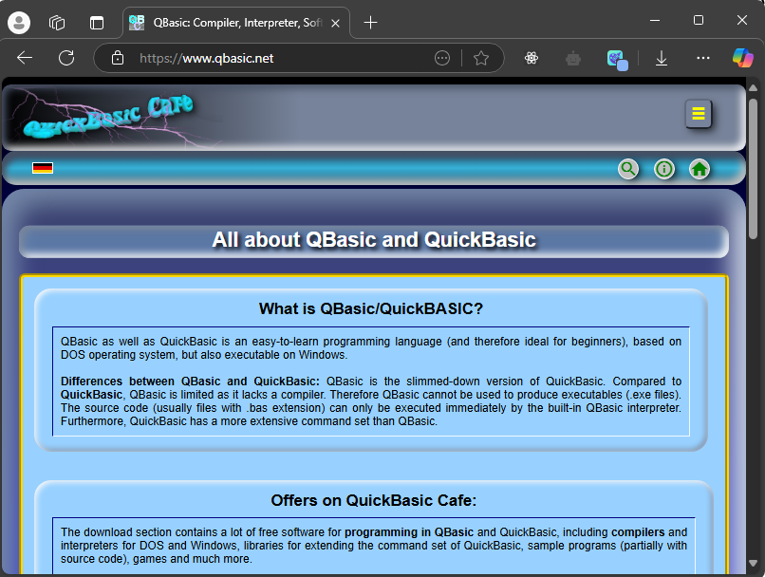
How is web-site accessed?
Device
DNS-Server
Server
http-response
http-request
http-request
DNS-(Domain name system)
Browser
http-response
Ip-Address:
192.122.1.12
Readable – URL
www.site_name.com

Slide 3
Django-Web Framework
Django provides a facility to run and make website and API.
HTTP-Requests
HTTP-Requests
HTTP-Requests
Server
Request
Django-App
Response
URLS - File
urls.py
Logic – File
Views.py
Database-File
models.py
www.example.com/home
Response
Object
Yes
Checks the requested URL
No
ERROR

Slide 4
Django-App
Creating Virtual environment
1. Creating project
Cmd: django-admin startproject [project name] [. For installing in current directory]
2. Creating app
Cmd: python manage.py startapp [app name]
3. Place app in settings of installed apps
4. Migrate the models
Cmd: python manage.py makemigrations [app_name]
Cmd:python manage.py migrate
5: Run the server
Cmd: python manage.py runserver
6. To activate shell
Cmd: python manage.py shell
Installation
Creating Project
Creating App
Virtual Environment
Migrating
Running
Creating
Cmd: python –m venv [path or name]
Creating requirement.txt
Cmd: pip freeze > requirements.txt
Installing from > requirement.txt
pip install -r requirements.txt
File – Structure:---
djangotutorial/ manage.py
mysite/
__init__.py settings.py urls.py
asgi.py wsgi.py
activating
Cmd: <venv>\Scripts\activate.bat
Installing django
Cmd: pip install django
deactivating
Cmd: deactivate

Slide 5
Practical session
Creating venv ,activating it , installing django , creating project , creating app , installing app creating requirement.txt installing from the requirement.txt, running project

