Slide 1
PyTorch Dispatcher
Wang Jin
2020/10/15

Slide 2
Contents
Dispatcher table
Kernel registration
Kernel dispatch

Slide 3
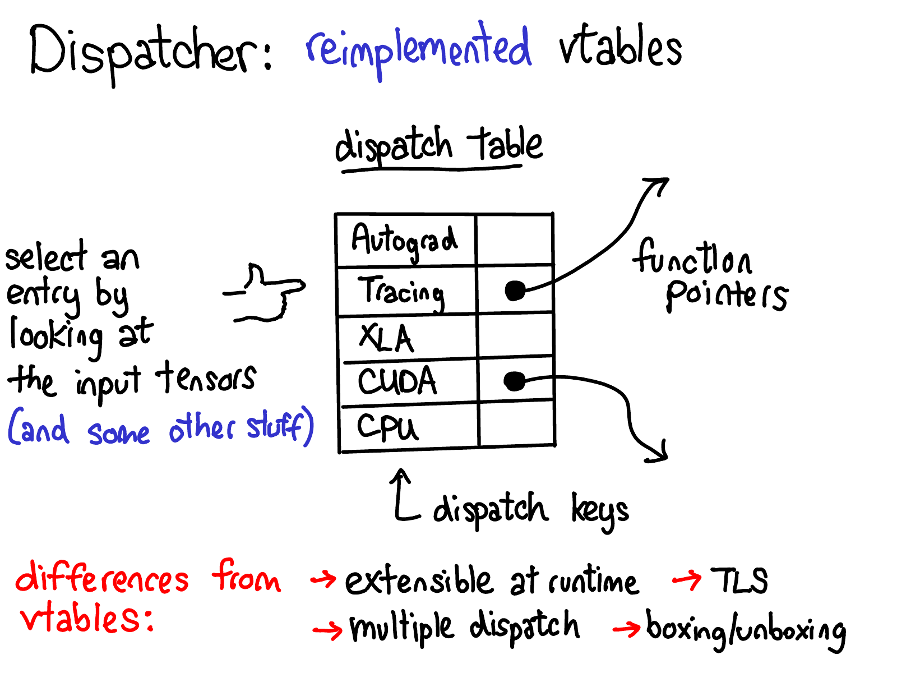
PyTorch Dispatcher
http://blog.ezyang.com/2020/09/lets-talk-about-the-pytorch-dispatcher/

Slide 4
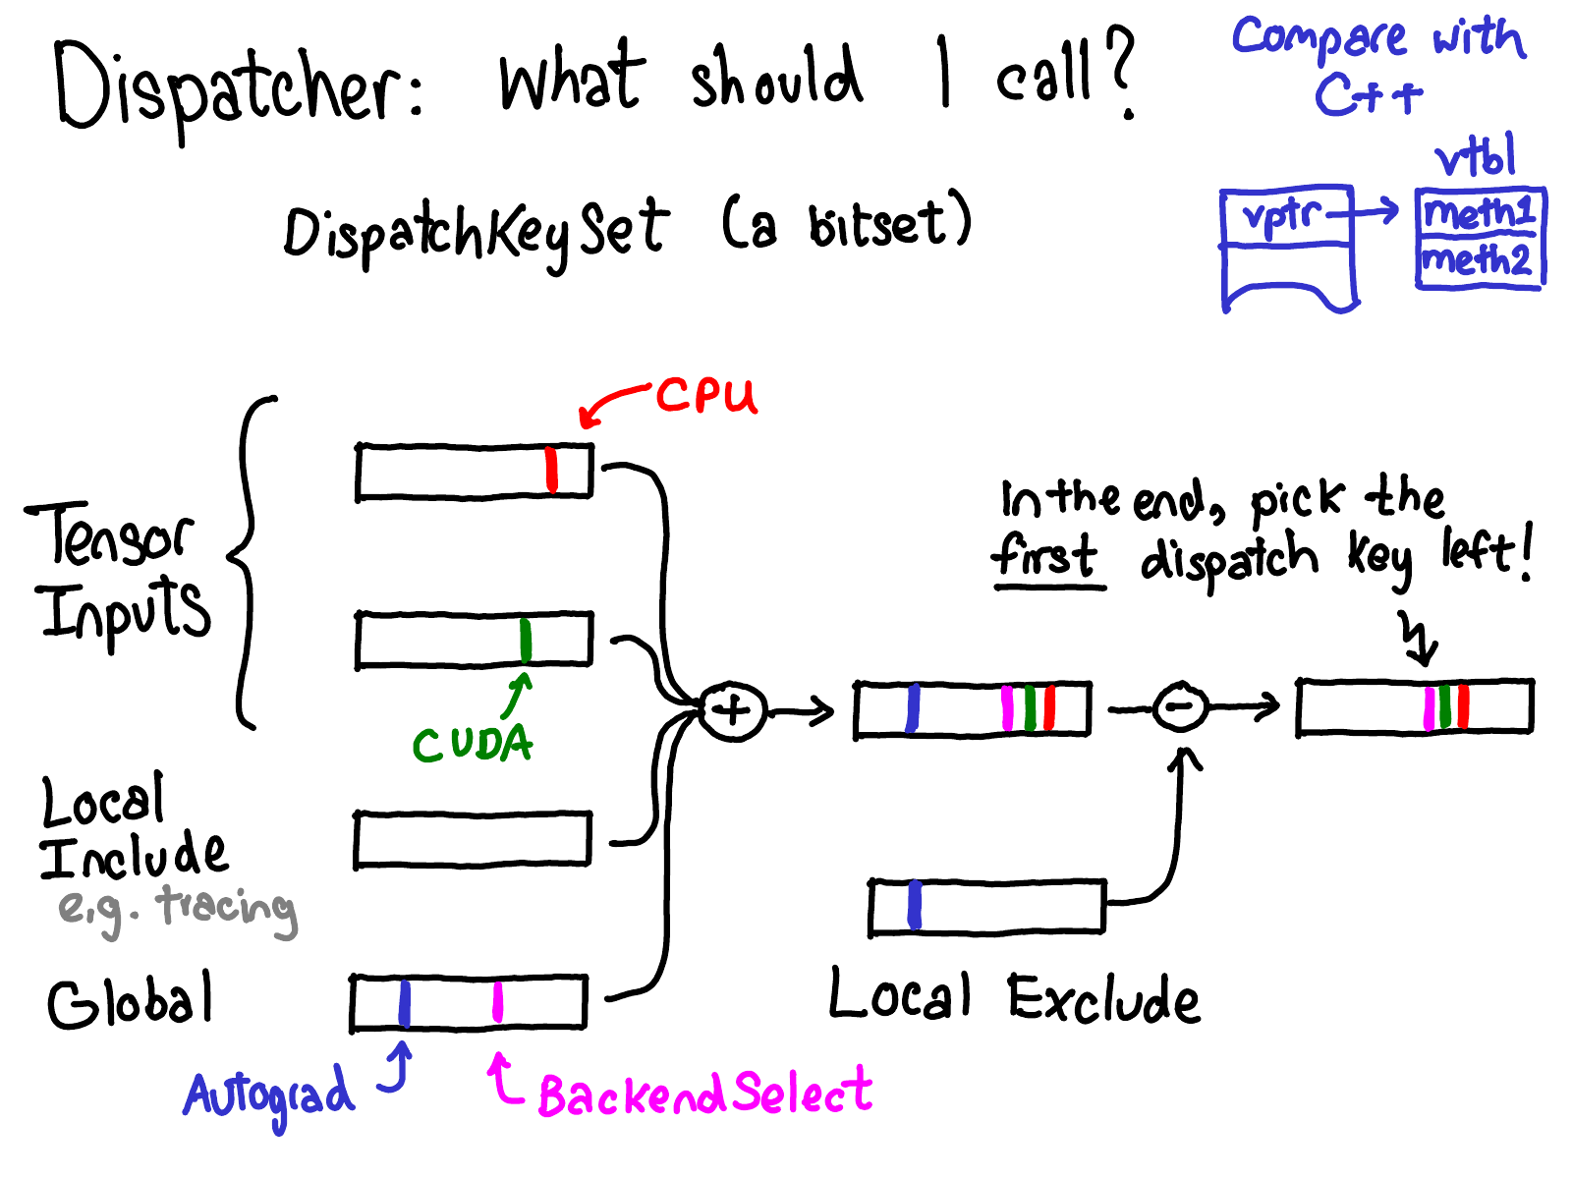
Dispatchkey calculation
http://blog.ezyang.com/2020/09/lets-talk-about-the-pytorch-dispatcher/

Slide 5
Dispatchkey calculation
DispatchKeySet Tensor::key_set() const { //Tensor::key_set in TensorBody.h
return impl_->key_set();
}
DispatchKeySet TensorOptions::key_set() const noexcept { // c10/core/TensorOptions.h
return DispatchKeySet(computeDispatchKey()).add(DispatchKey::BackendSelect);
}
inline DispatchKey computeDispatchKey() const {
switch (layout()) { //calculate the dispatch key based on layout and device
case Layout::Strided:
switch (device().type()) {
case DeviceType::CPU: {
auto dtype_tmp = typeMetaToScalarType(dtype());
if (isQIntType(dtype_tmp)) {
return DispatchKey::QuantizedCPUTensorId; }
return DispatchKey::CPUTensorId; }

Slide 6
Dispatchkey calculation
DispatchKey dispatchTypeId( DispatchKeySet ks,DispatchKeySet key_mask) {
c10::impl::LocalDispatchKeySet local = c10::impl::tls_local_dispatch_key_set();
return ((
(ks | local.included_ | always_included) - local.excluded_)
& key_mask).highestPriorityTypeId();
}

Slide 7
Dispatchkey for different classes
struct MultiDispatchKeySet : at::IterArgs<MultiDispatchKeySet> {
void operator()(const at::Tensor& x) { //combine multiple keys of arguments
ts = ts | x.key_set(); }
void operator()(const TensorOptions& x) {
ts = ts | x.key_set(); }
void operator()(at::ArrayRef<at::Tensor> xs) {
for (const auto& x : xs) {
ts = ts | x.key_set(); }
}
void operator()(at::Generator* gen) {
if (gen != nullptr) {
ts = ts | gen->key_set(); }
}

Slide 8
BackendSelect key
template<class... Args> //In class DispatchKeyExtractor.h
DispatchKey getDispatchKeyUnboxed(DispatchKeySet backendsWithoutFallthrough,
const Args&... args) const {
auto ks = detail::multi_dispatch_key_set(args...);
//BackendSelect is added to the set if one of the args’ type is TensorOption
return dispatchKeySetToDispatchKey_(backendsWithoutFallthrough, ks);
}
//In backendselect kernel
Tensor randn(IntArrayRef size, const TensorOptions & options={}) {
DispatchKey key = options.computeDispatchKey(); //compute the key based on layout
//and device, this routes the call to the real kernel, not backend select again.
static auto op = c10::Dispatcher::singleton().findSchemaOrThrow("aten::randn", "");
return op.callUnboxedWithDispatchKey<Tensor, IntArrayRef, const TensorOptions &>(key, size, options);
}

Slide 9
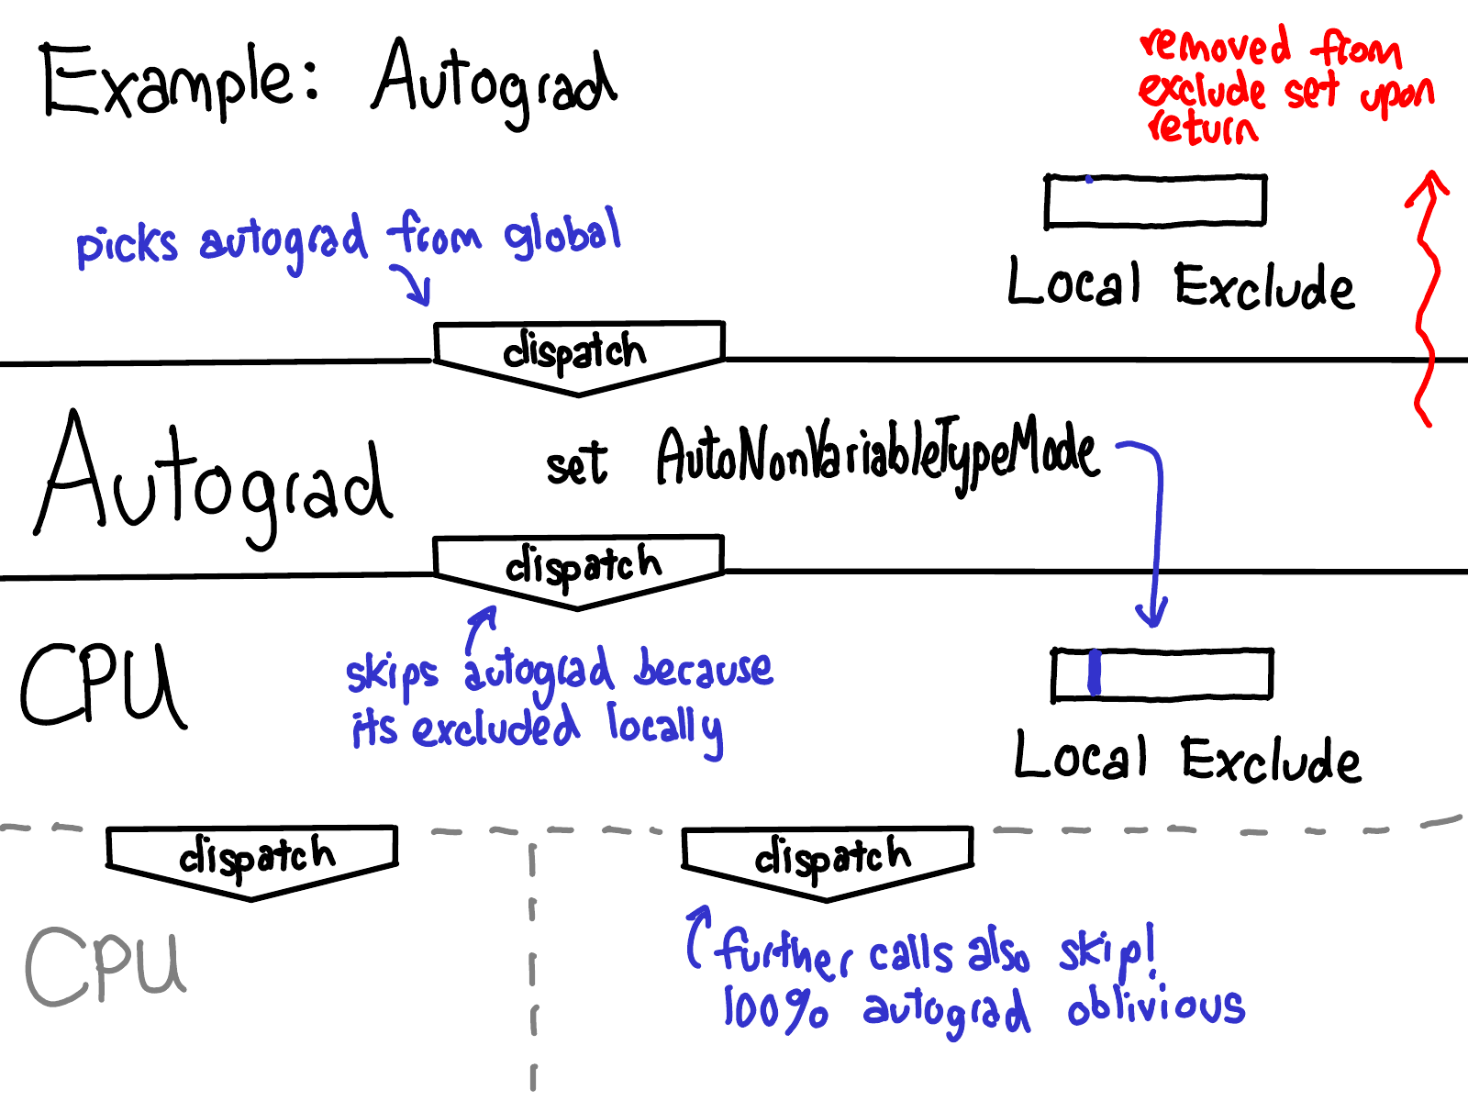
Dispatchkey removal
http://blog.ezyang.com/2020/09/lets-talk-about-the-pytorch-dispatcher/

Slide 10
Dispatchkey local removal
ExcludeDispatchKeyGuard::ExcludeDispatchKeyGuard(DispatchKey x)
: tls_(&raw_local_dispatch_key_set)
, id_(x)
, prev_state_(x == DispatchKey::Undefined ? true : tls_->excluded().has(x)) {
if (!prev_state_) {
tls_->set_excluded(tls_->excluded().add(x)); //locally remove the already dispatched
//keys, because we definitely want to try another key.
}
}
ExcludeDispatchKeyGuard::~ExcludeDispatchKeyGuard() {
if (!prev_state_) {
tls_->set_excluded(tls_->excluded().remove(id_));
}
}

Slide 11
Dispatcher Class
OperatorDef
OperatorDef
OperatorDef
……
operators_
key
value
operatorLookupTable_
OperatorName
OperatorHandle
flat_hash_map
backendWithoutFallthrough_ DispatchKeySet

Slide 12
OperatorEntry and DispatchTable Class
OperatorDef
OperatorEntry
FunctionSchema
schema_
size_t
DispatchTable
dispatchTable_
flat_hash_map
kernels_
KernelFunction *
0
KernelFunction *
kernels_
impl::KernelFunctionTable
……
catchallKernel_
KernelFunction
DispatchKeyExtractor
operatorName_
string
KernelFunction *
KernelFunction *
NumDispatchKeys-1

Slide 13
KernelFunction Class
KernelFunction
std::function<unique_ptr<OperatorKernel>()>
functorFactory_
std::shared_ptr<OperatorKernel>
functor_
Boxed_kernel_func_
boxed_kernel_func_
void *
unboxed_kernel_func_
OperatorKernel class
WrapRuntimeKernelFunctor class
FuncType kernel_func_;
auto operator()(…args) {
return kernel_func_(forward(args)…;
}
Usually it is a method routing call to functor’s kernel_func

Slide 14
Wrap_kernel_functor_unboxed Class
template<class KernelFunctor, class ReturnType, class... ParameterTypes>
struct wrap_kernel_functor_unboxed_
<KernelFunctor, ReturnType(ParameterTypes...)> final {
ReturnType call(OperatorKernel* functor, ParameterTypes... args){
KernelFunctor* functor_ = static_cast<KernelFunctor*>(functor);
return (*functor_)(std::forward<ParameterTypes>(args)...);
}
template<class KernelFunctor>
inline KernelFunction KernelFunction::makeFromUnboxedOnlyFunctor(std::unique_ptr<OperatorKernel> kernelFunctor) {
return KernelFunction(
nullptr,
std::move(kernelFunctor),
nullptr, // Don't create a boxed kernel for this
reinterpret_cast<void*>(&detail::wrap_kernel_functor_unboxed<KernelFunctor>::call)
);
}

Slide 15
Dispatch to kernel
inline const KernelFunction& Dispatcher::dispatch_(const DispatchTable& dispatchTable, DispatchKey dispatchKey) const {
const KernelFunction* backendKernel = dispatchTable.lookup(dispatchKey);
if (nullptr != backendKernel) { //first, kernel defined for the key
return *backendKernel;
}
const auto& backendFallbackKernel = backendFallbackKernels_[dispatchKey];
if (backendFallbackKernel.isValid()) {//second,fall back to dispatcher’s kernel?
return backendFallbackKernel;
}
const KernelFunction* catchallKernel = dispatchTable.lookupCatchallKernel();
if (C10_LIKELY(nullptr != catchallKernel)) { //at last,try the catch all kernel
return *catchallKernel;
}
}

Slide 16
AVX2 and AVX dispatch
template <typename rT, typename T, typename... Args>
struct CAFFE2_API DispatchStub<rT (*)(Args...), T> {
static FnPtr DEFAULT;
#ifdef HAVE_AVX_CPU_DEFINITION
static FnPtr AVX;
#endif
#ifdef HAVE_AVX2_CPU_DEFINITION
static FnPtr AVX2;
#endif
};
#ifdef HAVE_AVX2_CPU_DEFINITION
#define REGISTER_AVX2_DISPATCH(name, fn) REGISTER_ARCH_DISPATCH(name, AVX2, fn)
#endif
#define REGISTER_ARCH_DISPATCH(name, arch, fn) \
template <> decltype(fn) DispatchStub<decltype(fn), struct name>::arch = fn;
//The same file is compiled with AVX2/AVX enabled option //AVX2 here

Slide 17
AVX2 and AVX dispatch
FnPtr choose_cpu_impl() {
auto capability = static_cast<int>(get_cpu_capability());
(void)capability;
#ifdef HAVE_AVX2_CPU_DEFINITION
if (capability >= static_cast<int>(CPUCapability::AVX2)) {
AT_ASSERTM(AVX2, "DispatchStub: missing AVX2 kernel");
return AVX2; //highest priority
}
#endif
#ifdef HAVE_AVX_CPU_DEFINITION
if (capability >= static_cast<int>(CPUCapability::AVX)) {
AT_ASSERTM(AVX, "DispatchStub: missing AVX kernel");
return AVX; //higher priority
}
#endif
AT_ASSERTM(DEFAULT, "DispatchStub: missing default kernel");
return DEFAULT; //default implemntation
}

Slide 18
Dispatch on double float and int
#define AT_DISPATCH_ALL_TYPES_AND(SCALARTYPE, TYPE, NAME, ...) [&] {
switch (TYPE) {
AT_PRIVATE_CASE_TYPE(at::ScalarType::Byte, uint8_t, __VA_ARGS__)
AT_PRIVATE_CASE_TYPE(at::ScalarType::Char, int8_t, __VA_ARGS__)
AT_PRIVATE_CASE_TYPE(at::ScalarType::Double, double, __VA_ARGS__)
AT_PRIVATE_CASE_TYPE(at::ScalarType::Float, float, __VA_ARGS)
AT_PRIVATE_CASE_TYPE(at::ScalarType::Int, int32_t, __VA_ARGS
AT_PRIVATE_CASE_TYPE(at::ScalarType::Long, int64_t, __VA_ARGS__)
AT_PRIVATE_CASE_TYPE(at::ScalarType::Short, int16_t, __VA_ARGS
default
AT_ERROR(#NAME, " not implemented for '", toString(TYPE), "'");
} }()
#define AT_PRIVATE_CASE_TYPE(enum_type, type, ...) \
case enum_type: { \
using scalar_t = type; \
return __VA_ARGS__(); \ //scalar_t is consumed here
}

Slide 19
Register Operator
OperatorDef
OperatorDef
OperatorDef
……
operators_
RegisterOperators class
OperatorDef
Create new OperatorDef from the parameters, then insert it to the operators_ list.

Slide 20
Register::Options and RegisterOpeators
Register::Options
c10:optional<OperatorName,FunctionSchema>
schemaOrName_
std::vector<KernelRegistrationConfig>
kernels_
AliasAnalysisKind
aliasAnalysisKind_
KernelRegistrationConfig
dispatch_key
c10::optional<DispatchKey>
func
KernelFunction
std::unique_ptr<FunctionSchema>

Slide 21
RegisterOperators class
RegisterOperators
std::vector<OperatorRegistrar>
Registratrs_
op_
std::pair<RegistrationHandleRAII, OperatorHandle>
kernel_registration_handle_
c10::optional<RegistrationHandleRAII>

Slide 22
Register Schema
OperatorHandle Dispatcher::findOrRegisterSchema_(FunctionSchema&& schema) {
const auto found = findSchema(schema.operator_name());
if (found != c10::nullopt) {
//some code are removed, since it’s not relevant here.
return *found;
}
OperatorName op_name = schema.operator_name();
operators_.emplace_back(std::move(schema)); //create new node, insert to back
OperatorHandle handle(--operators_.end()); //point to the newly created node
operatorLookupTable_.write([&] (ska::flat_hash_map<OperatorName, OperatorHandle>& operatorLookupTable) { //setup hash map here
operatorLookupTable.emplace(op_name, handle);
});
return handle;
}

Slide 23
Kernel Registration Example
auto registerer = torch::RegisterOperators()
.op(torch::RegisterOperators::options()
.schema("aten::__irshift__.Scalar(Tensor(a!) self, Scalar other) -> Tensor(a!)")
.impl_unboxedOnlyKernel<decltype(VariableType::__irshift___Scalar),
&VariableType::__irshift___Scalar>(DispatchKey::VariableTensorId))
Register new schema
Populate the kernel function,dispatch key, so the kernel is ready to use

