Slide 1
Scientific Research & Experimental Development (SR&ED) – Phase 2 Content Optimization Project
Task scenario workshop
July 28, 2022

Slide 2
Agenda
Background
Review of discovery research
Call driver data
Introduction to job story creation
Overview of the process
Examples from previous projects
Questions?
Job story workshop
Development of job stories from call drivers
Next steps
Creation of task scenarios
Preparation for baseline testing

Slide 3



Meeting outcomes
Review evidence
Create job stories from call drivers
Evidence-based: Analysis of call centre drivers
Grouped into categories based on user’s intent/task
Produce job stories for the categories - We will turn these into task scenarios

Slide 4
BACKGROUND
Review optimization approach and proposed scope

Slide 5

Optimization approach
Process and timelines
Initiate
Discover
Design
Deliver
Monitor and refine
Operationalize
Identify project
Engage stakeholders and project team
Determine scope, timelines and key performance indicators (KPIs)
Kick-off meeting
Analyse content
Analyse call drivers, feedback tool data, social media and historical research
Task scenario workshop
Finalize scope
Baseline usability testing (if existing)
Prototype - content and navigation design based on evidence gathered and UX best practices
Iterative validation usability testing
Refinement of prototype to ensure KPIs are met
Translation
Approvals
Coding based on tested prototype
Accessibility and QA Feedback tool placed on all pages
Launch
Monitor Usability Performance Dashboard (call drivers, feedback widget, web analytics)
Adjust content if required
Validation testing after launch to drive continuous improvement
Ensure SMEs have proper tools and training for continuous improvement
Create summary report
Close-out project
Transition to Partner Services
3 weeks
Jun 27 – Jul 15
6 weeks
Jul 18 – Aug 26
11 weeks
Aug 29 – Nov 11
4 weeks
Nov 21 – Dec 9
5 weeks
Dec 12 – Jan 13
4 weeks
Jan 16 – Feb 10
July to December 2022
December to February 2023
Notes:
Yes

Slide 6
DISCOVERY RESEARCH
What do we know about the SR&ED?

Slide 7
Call drivers (Toronto West): Part 1
 | Example Inquiries | Percentage
Free Service | Looking for information regarding SR&ED – FTCAS (timeframe, what it entails, etc.) Looking for information as to when there will be a SR&ED Practitioners seminar. Wants to sign up. | 17.2%
Eligibility | A company has general questions re eligibility of SR&ED | 5.8%
General Inquiry | Taxpayer has a question regarding SR&ED. He wants to know if company has to file a separate SR&ED claim if the work is being done in an other province. Wanting to know if pre funding is available. Taxpayer said he is conducting an evening meeting called "Funding for Research and Development, and is looking for someone to come to speak for about 20 to 25 minutes regarding SR&ED. | 30.65%
Financial Claim Specific | Taxpayer is calling about claim which Aims shows was closed. Apparently, she talked to one of the Financial Reviewer and he indicated that the hold up had something to do with the TC deciding if it was a 35% or 20% file. | 14.4%

Slide 8
Call drivers (Toronto West): Part 2
 | Example Inquiries | Percentage
Technical Claim Specific | Taxpayer would like to talk to a Manager regarding technology of software science. | 1.5%
Asking for Status | Taxpayer called the Enquiry line and is looking for the status of their SR&ED claim. | 15.0%
Asking information on FR, and/or RTA or other staff | Taxpayer indicated that a Financial Review was being done for their file and wanted to know the name of the Financial Reviewer. Taxpayer called asking for the phone number for the director because he has a complaint. He indicated that RTA couldn't give him a timeframe for reviewing the file. | 1.6%
T661 Form | Taxpayer has a question regarding line 315 of the T661. | 2.08%
OITC | Looking for information regarding waiving OITC, etc. | 1.3%
ITC | Looking for information on How to transfer ITC to another corporation. | 3.0%
ORDTC | Taxpayer called to ask about S508 ORDTC balances. | 0.6%
Taxpayer left message | Taxpayer looking for information regarding their claim - left message for return call. | 6%

Slide 9
JOB STORY CREATION
What are job stories? How and why do we create them?

Slide 10
What is a task?
A task is whatever a user wants to do. A user performs various tasks to achieve a goal, or fulfill a need.
Task success is measurable; did the user fulfill their goal?
Task Example: Get a copy of my notice of assessment or reassessment Goal Example: So I can determine if I owe the CRA, or will get a refund
A task is:
A verb (action)
Apply, calculate, access
Based on what users are trying to do
Measurable, with an achievable goal
A task is not:
A noun (product, service)
Canada Recovery Benefit
Channel specific
Based on internal processes

Slide 11
Use job stories to craft task scenarios
Title | Task scenario posed to participants | Answer
CERB eligibility periods | Marc had to stop working on April 27, 2020. Marc used to make $700 a week. Find out which period he should apply for to receive the Canada Emergency Response Benefit. | May 10 - June 6
Claiming your home office work space | Jamie and his wife have been working from home since COVID-19 started. Jamie works from home at his dining room table while his wife works in the home office. She will be claiming the office as her work space on her taxes. Can Jamie claim anything? | Jamie can claim the dining room for his total work hours per week
Example: COVID-19 projects

Slide 12
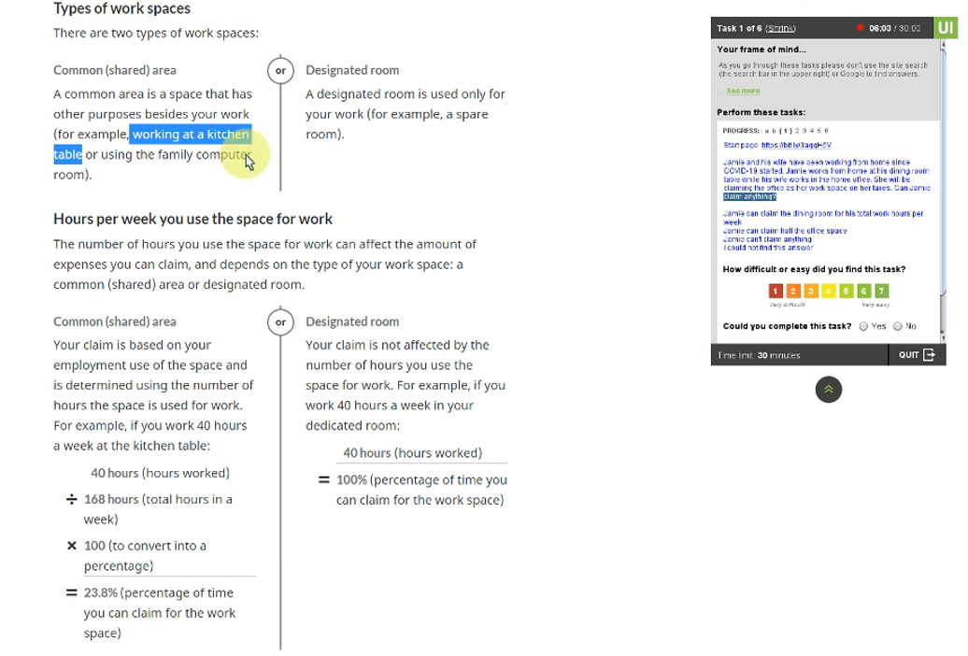
Example

Slide 13
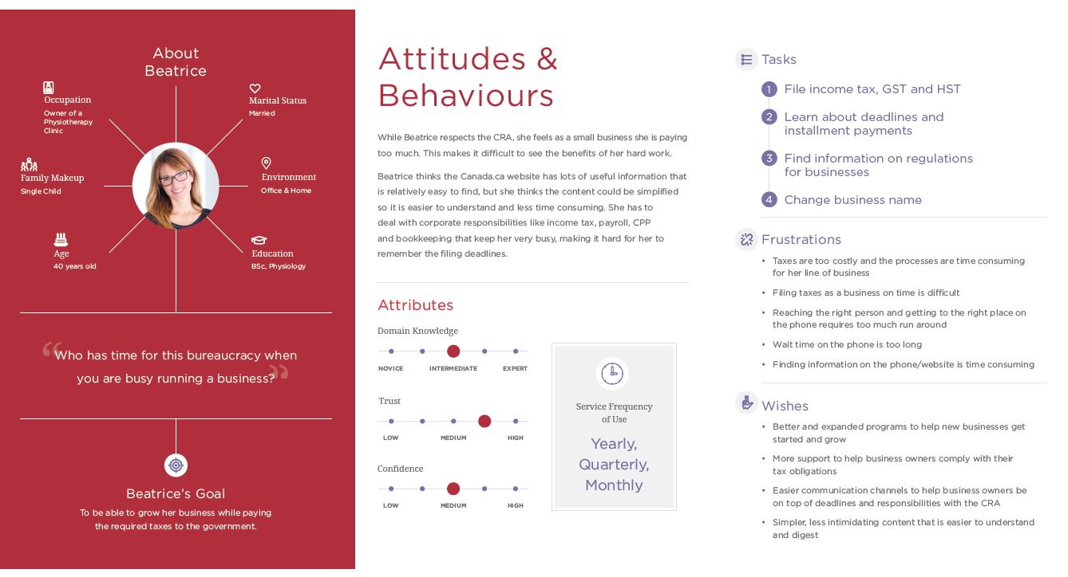
Persona

Slide 14
Task scenario creation process
Call Centre Drivers
Top Call Drivers
Why people call
Categories
Analytics
What links & pages people click
Today’s Focus
Job Stories
Google Search
When I [situation] I want to [action] so I can [expected outcome].
What people search for
Task Scenarios
How would you report your T4A…

Slide 15
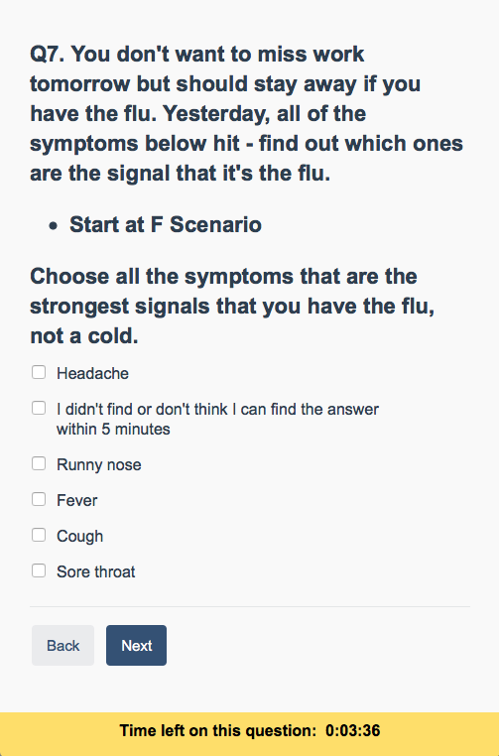
Job stories become task scenarios
When [situation], I want to [motivation], so I can [expected outcome]
When
I am feeling ill
I want to
Check if it is a cold or the flu
So I can
Decide whether to stay home

Slide 16
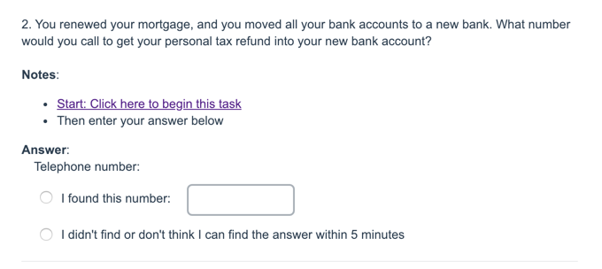
Job stories become task scenarios
When [situation], I want to [motivation], so I can [expected outcome]
When
My bank account changes
I want to
Tell the CRA
So I can
Get my refund at my new bank

Slide 17
Topics for job story creation
4 topics have self-service options appropriate for optimization
Determining eligibility
How to apply (incl. Guide to Form T661)
Expenditures (eligible and qualified)
Accessing/using services such as SR&ED service visits, pre-claim consultations
2 topics are potentially appropriate for optimization
Policy pages
ROT assessment and sunsetting of outdated content
1 topic is out of scope
SALT

Slide 18
WORKSHOP
Creating job stories for the call drivers

Slide 19
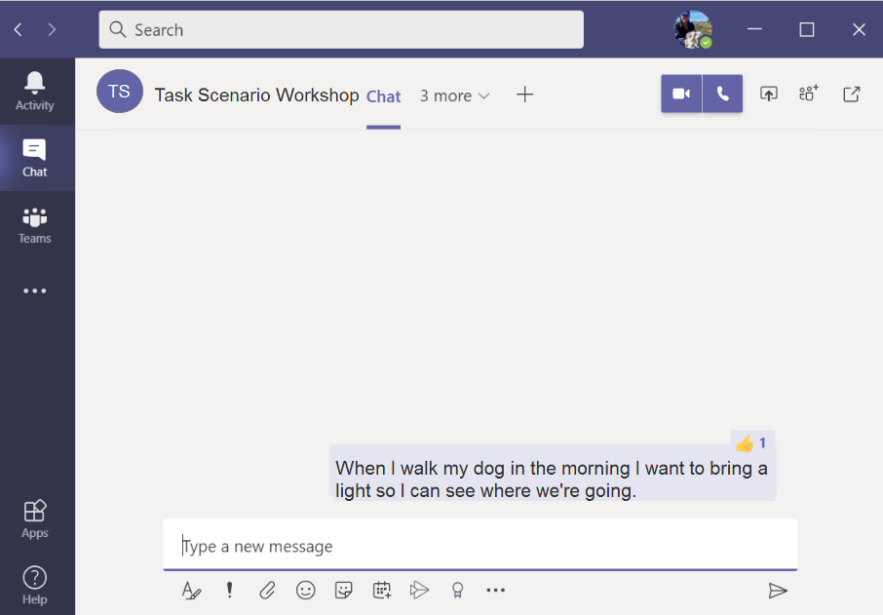
Meeting outcomes
Type your job story into this meeting chat to submit it
Please follow this format:
“When… I want to… so I can….”
« Lorsque... Je veux... pour que je puisse... »
1
2
After 3 minutes, vote for your TOP 3 job stories by using the thumbs up emoji. To unvote, click your thumbs up again
3 votes max per person

Slide 20
Practice topic: Groceries
Take 3 minutes to write up job stories for this practice task
When… | I want to… | So I can…
When I [situation]… I want to [action]… So I can [expected outcome]…

Slide 21
Topic 1: Determining eligibility
Take 3 minutes to write up job stories for this SR&ED task
When… | I want to… | So I can…
When I [situation]… I want to [action]… So I can [expected outcome]…

Slide 22
Topic 2: How to apply
Take 3 minutes to write up job stories for this SR&ED task
When… | I want to… | So I can…
When I [situation]… I want to [action]… So I can [expected outcome]…

Slide 23
Topic 3: Expenditures (eligible and qualified)
Take 3 minutes to write up job stories for this SR&ED task
When… | I want to… | So I can…
When I [situation]… I want to [action]… So I can [expected outcome]…

Slide 24
Topic 4: Services such as SR&ED service visits, pre-claim consultations
Take 3 minutes to write up job stories for this SR&ED task
When… | I want to… | So I can…
When I [situation]… I want to [action]… So I can [expected outcome]…

Slide 25
Topic 5: Policies
Take 3 minutes to write up job stories for this SR&ED task
When… | I want to… | So I can…
When I [situation]… I want to [action]… So I can [expected outcome]…

Slide 26
Anything we forgot?

Slide 27
Call Driver:
Take 3 minutes to write up job stories for this SR&ED task
When… | I want to… | So I can…
When I [situation]… I want to [action]… So I can [expected outcome]…

Slide 28

Next steps
Initiate
Discover
Design
Deliver
Monitor and refine
Operationalize
Identify project
Engage stakeholders and project team
Determine scope, timelines and key performance indicators (KPIs)
Kick-off meeting
Analyse content
Analyse call drivers, feedback tool data, social media and historical research
Task scenario workshop
Finalize scope
Baseline usability testing (if existing)
Prototype - content and navigation design based on evidence gathered and UX best practices
Iterative validation usability testing
Refinement of prototype to ensure KPIs are met
Translation
Approvals
Coding based on tested prototype
Accessibility and QA Feedback tool placed on all pages
Launch
Monitor Usability Performance Dashboard (call drivers, feedback widget, web analytics)
Adjust content if required
Validation testing after launch to drive continuous improvement
Ensure SMEs have proper tools and training for continuous improvement
Create summary report
Close-out project
Transition to Partner Services
Initiate
Discover
Design
Product team will use job stories to create task scenarios
Coordinate with subject matter experts to validate job stories and ensure we have concrete and correct answers to task scenarios
Identify content likely impacted by testing and finalize scope
Run baseline tests to evaluate how existing content performs
Identify project
Engage stakeholders and project team
Determine scope, timelines and key performance indicators (KPIs)
Kick-off meeting
Analyse content
Analyse call drivers, feedback tool data, social media and historical research
Task scenario workshop
Finalize scope
Baseline usability testing (if existing)
Prototype - content and navigation design based on evidence gathered and UX best practices
Iterative validation usability testing
Refinement of prototype to ensure KPIs are met

