Slide 1
Electronic Thesis and Dissertation
Geo-Alpha-Mandalay

Slide 2
Supervisor – Dr. Khaing Moe San
Presented By
Ma Ei Mon Theint (Dev2)
Ma Khaing Nyo Thein (UI/UX lead)
Ma Shwe Zin Oo (Lead Developer + DevOps)
Ma Nann Khaing Zar Thinn (Dev1)
Ma Yun Me Me Thaw (UI/UX dev)
Ma Ei Cho Zin (Team Lead, Test & Documentation)

Slide 3
Acknowledgements
We truly thank U Kyaw Swar Soe, Rector, Computer University (Mandalay) for his kind permission to send us internship Program.
Then, We would like to express any special thanks to Dr. Daw San San Tint, Pro-Rector, for her helpful recommendations and suggestions.
Then, We would like to extend our deepest gratitude to our supervisor Dr. Daw Khaing Moe San, Associate Professor, for teaching us how to create project and answering our never-ending questions.
Then also thanks to Mr. Ravi Chhabra, CEO of GMIT, for his trust to give us such a heavy responsibility project.

Slide 4
Abstracts
Electronic Thesis and Dissertation System is to search thesis data from online.
Users can learn thesis (from online) without time waste.
Admin can insert, delete and update data.
For Front End, the system was implemented using HTML, Materializecss, Material Design Lite and JavaScript.
For Back End, the system was implemented using Real-Time Database of Firebase, JavaScript.
We used methodologies such as SAD, UML diagrams during the project development.

Slide 5
Objectives
To develop Electronic Thesis and Dissertations System
To be accessible from anywhere at any time
To learn about electronic document preparation and digital libraries
To access multiple users simultaneously at one Electronic Thesis and Dissertations(ETDs)
To search easily and save time

Slide 6
Scope of Proposed System
The proposed project of Electronic Thesis and Dissertations is prescribed as follow:
Manage thesis data, user’s feedbacks, user’s search
View thesis data
Send questions and feedbacks
View details by Authors, Year, Titles and Degree
Search easily thesis data

Slide 7
Introduction
Electronic Thesis and Dissertations System will involve two stakeholders (Admin and Users).
Admin can insert, delete and update data associated with Thesis.
Users can search data easily.
System can report the required reporting process associated with author, year, title and degree.

Slide 8
Requirement Analysis
The description of the services and constraints are the requirements for the system. Requirement Analysis is the process of deriving the system requirements through observation of existing system.
We get all information of data for this project from our CU(Mdy) library.

Slide 9
Background
Our group has received order of Electronic Thesis and Dissertation System by Mr. Ravi Chhabra.
Manual searching thesis data process delays time. For example, users have to go library for search.
There are difficult to store and search thesis books in libraries.
There are many processes to develop manual system and it may be more cost and time waste.

Slide 10
Theory Background
For Front End, the system was implemented using HTML, Materializecss, Material Design Lite and JavaScript.
For Back End, the system was implemented using Real-Time database of Firebase and JavaScript.
We used methodologies such as SAD, UML diagrams during the project development.

Slide 11
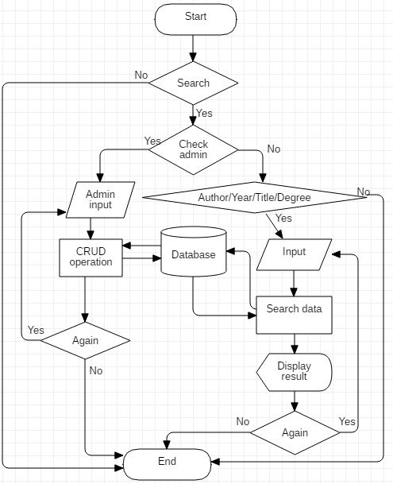
Flowchart Diagram for ETDs

Slide 12
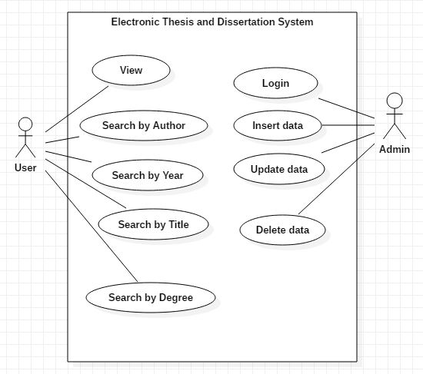
Use Case Diagram for ETDs

Slide 13
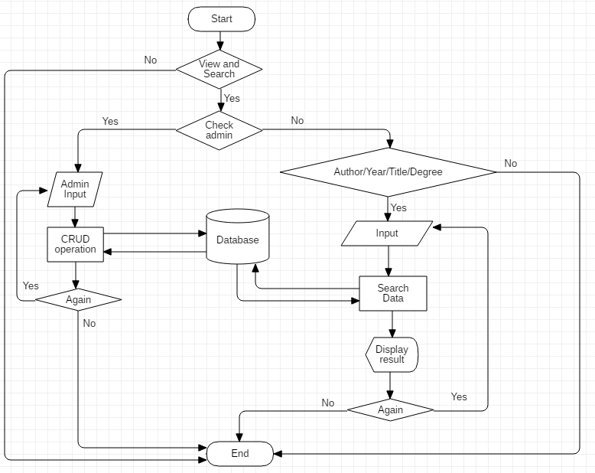
Flowchart Diagram for ETDs

Slide 14
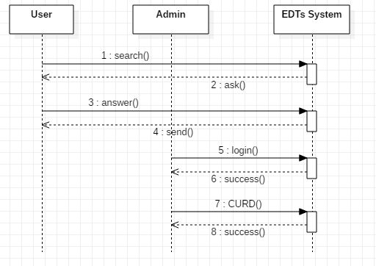
Sequence Diagram for ETDs

Slide 15
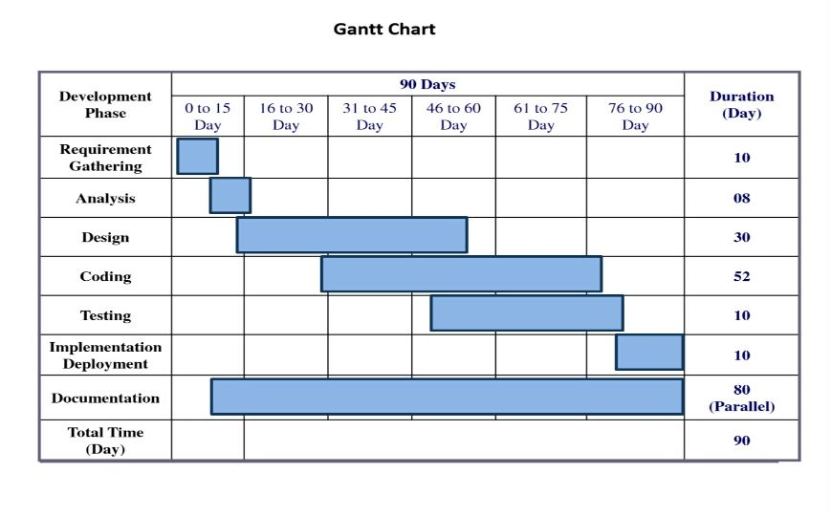
Milestones and Job distribution

Slide 16
Conclusions
By using our system, users not have to go library for search data, they can save time.
Accessible from anywhere at any time if users have internet connection.
Users can search data easily by entering author’s name or year in the search box.
The system displays author, year, title and degree.
Users can comment their opinions and ask some questions.
Users can use creditably because this system is up-to-date system(admin can insert, delete and update).

Slide 17
Thanks For Your Attention!

