Slide 1
Can a language model tell cause from correlation?
A neuro-symbolic pipeline that reads scientific text, builds a causal graph, and answers intervention questions — Phase 1, Applied Machine Learning.
Problem — Text often describes association without establishing causation.
Our approach — Separate causal-claim classification, relation extraction, and intervention reasoning.
CSAI Project 1 · repository alpha-sml/causal-nlp-reasoning · revision 971a8389

Slide 2
A link in the text is not a cause
Four questions that look similar but need different tools
Patients with mutation M often also show outcome Y. Does M cause Y — or does a hidden factor Z cause both?
1 · Observe
2 · Entail
3 · Extract
4 · Intervene
P(Y | X): the chance of Y while merely watching X. Association, not action.
Corr2Cause: does a causal claim follow from correlation / independence premises? Classification.
BioCause: find a candidate cause → effect edge in biomedical text.
P(Y | do(X)): the effect of setting X, given a causal graph.
Only the fourth is a causal question. Everything before it is a step toward it.
Why it matters — Most NLP mistakes come from answering question 1 and calling it question 4. The project keeps the steps separate on purpose.

Slide 3
Turning text into a testable causal claim
Stage 1 proposes candidate relations; Stage 2 reasons over them
Scientific text
→
Candidate relations
→
Causal graph
→
Bayesian network
→
Intervention query
Stage 1 — extract
Stage 2 — reason (graph + do-calculus)
Two datasets, two jobs. Corr2Cause is used only for diagnostics (claim classification, imbalance, shortcuts). BioCause is the biomedical corpus for relation extraction and graph building. Their results are never pooled.
Extracted relations are candidate edges, not verified facts. The graph makes the assumptions explicit; the Bayesian stage is synthetic and shows the mechanics of do-calculus, not biology.
Problem Relations extracted from text cannot by themselves answer causal questions.
Our approach Compile them into an explicit graph, then query it with do-calculus.
Why it matters This lets us ask 'what if we act?' rather than only 'what do we see?'

Slide 4
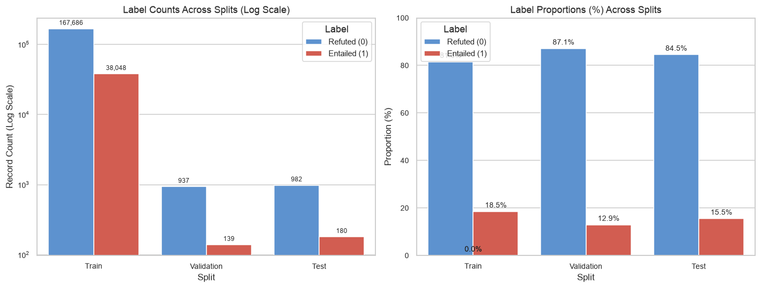
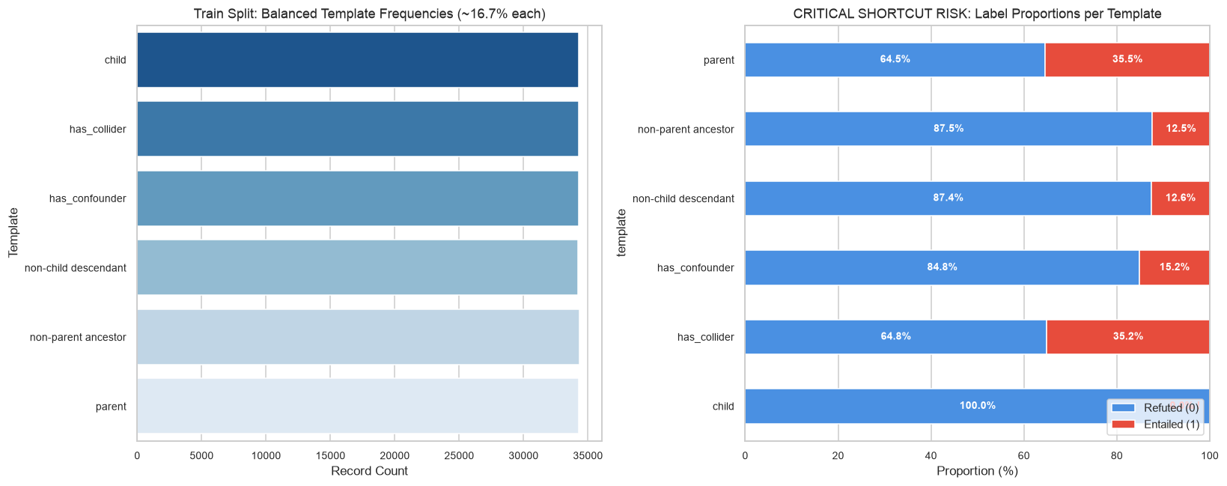
First finding: accuracy hides weak models
Corr2Cause · notebook figures from 01_eda.ipynb · train / validation / test
Notebook figure · label counts and proportions per split
Notebook figure · label share per template (the child shortcut)
Majority baseline: 87.08% accuracy but Macro-F1 0.4655 (validation). Depth-4 tree: 83.18% / 0.5946. child template: 0% entailed (177/177 refuted in validation).
Problem Class imbalance and template shortcuts can inflate apparent accuracy.
Our approach Audit label shares, majority baselines, and per-template behaviour on Corr2Cause.
Why it matters Always predicting 'no' already scores 87%; macro-F1 and template checks expose it.

Slide 5
Now the real task: extract relations from BioCause
BioCause · group split by article ID · causal prevalence ≈ 1:15
Split | Groups | Candidates | Gold relations | Causal %
Train | 12 | 10,086 | 621 | 6.16
Validation | 4 | 1,914 | 131 | 6.84
Test | 4 | 1,408 | 100 | 7.10
Two evaluation settings
Gold spans (Pathways 1–2): classify relations when entity spans are given.
Raw text (Pathway 3): full cascade with no spans — the realistic setting.
NaCTeM ships 19 source articles as 198 section files; article IDs are filename prefixes, giving 20 groups (12/4/4). Split isolation is verified at prefix-group level; publication-level isolation is not fully verified.
Problem Biomedical causal relations are sparse (about 1 in 15).
Our approach Split by article ID; score gold-span classification separately from raw text.
Why it matters Coverage (852/852) is a gold-span property, not evidence about raw text.

Slide 6
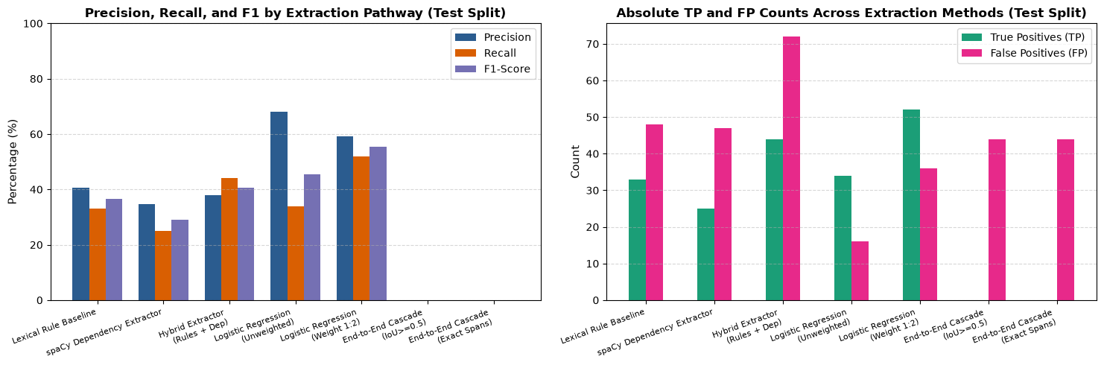
Main result: models beat rules — and raw text fails
BioCause · notebook figure from AML_05.ipynb · held-out test (4 articles, 100 gold)
Operating points (test)
LR 1:2 — F1-optimal
P 59.09 · R 52.00 · F1 55.32
LR unweighted — graph feeder
P 68.00 · R 34.00 · F1 45.33
Two different models — never averaged.
Notebook figure · precision, recall, F1 by pathway, and absolute TP/FP (test split)
Problem Rules plateau, and model settings trade precision against recall.
Our approach Compare rule baselines with two LR operating points, kept separate.
Why it matters 55.32% vs 40.74% hybrid (+14.58 pts, about 1.36×); raw text scores zero.

Slide 7
Why raw text scores zero
BioCause · held-out test · causal F1 (%) · new chart from AML_05 outputs
Where the loss comes from (observed)
Same model, two settings (LR unweighted): 45.33% F1 with gold spans, 0% from raw text.
The best gold-span model (1:2) reaches 55.32%, but the cascade runs the unweighted model — so 45.33 → 0 is the like-for-like comparison.
On the test split, relaxed span F1 is 12.20% (all BioCause spans) and 15.38% (conventional entities). Entity detection is an observed bottleneck; an ablation is needed to isolate it as the cause of the 0%.
New chart · built from AML_05 master benchmark + cascade cell (no notebook figure exists)
Problem The classifier works far better with correct spans than end-to-end.
Our approach Compare the same unweighted model: 45.33% vs 0.00% F1.
Why it matters Span recovery is an observed bottleneck; an ablation is needed to isolate it.

Slide 8
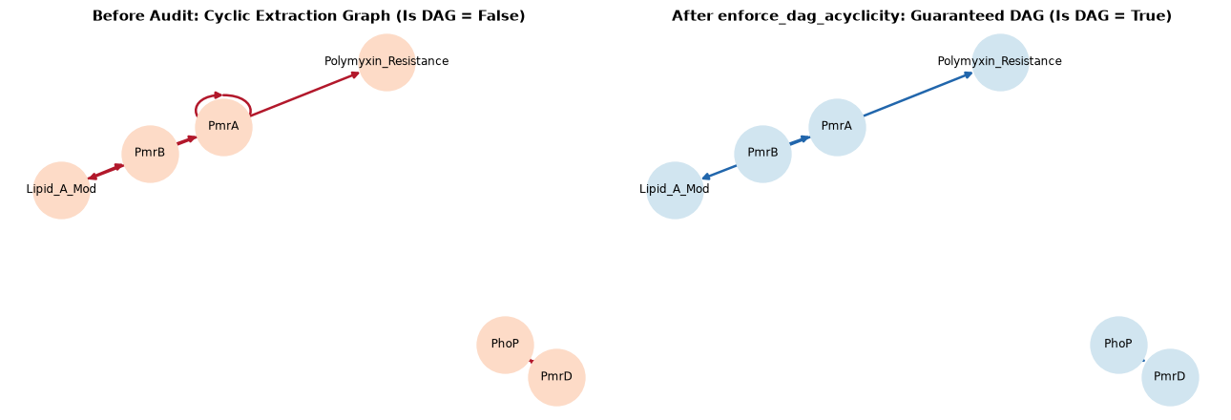
A valid graph is not a correct graph
BioCause · notebook figure from AML_04.ipynb · edge scores from the test split
Valid ≠ correct, or complete
Case study (PMC2714965)
P 100.00 · R 27.27 — 6 predicted vs 22 gold edges.
Corpus-wide (4 articles)
P 68.00 · R 34.00 — 50 predicted vs 100 gold.
The compiler guarantees acyclicity, not that each edge is true.
Notebook figure · cycle-breaking audit: cyclic graph → guaranteed DAG
Problem A graph can be acyclic yet still wrong or incomplete.
Our approach Compare predicted edges with gold; separate validity from edge accuracy.
Why it matters Recall is low (27.27% case, 34% corpus): careful but incomplete.

Slide 9
Observation is not intervention
BioCause · synthetic Bayesian network · P(Resistance = 1) · new chart from AML_04/AML_05 outputs
Illustrative — synthetic CPDs, three queries
Three different queries: baseline P(Res=1) = 0.359; observing the sensor P(Res=1 | PmrB=1) = 0.660; intervening on the regulator P(Res=1 | do(PmrA=1)) = 0.850.
They differ in both the variable and the type of query (observe vs act), so their gap alone does not establish confounding. A same-variable P(Y|X) vs P(Y|do(X)) comparison would be needed — the notebook does not compute one.
CPDs are synthetic: this illustrates do-calculus mechanics, not measured biological effects.
New chart · BN query outputs (no notebook figure exists); CPDs are synthetic
Problem Observing a variable and setting it answer different questions.
Our approach Show Bayesian-network query mechanics with explicitly synthetic CPDs.
Why it matters Their gap alone does not establish confounding; no same-variable query is computed.

Slide 10
Next: close the raw-text gap
Phase 2 — planned, not yet implemented
1
2
3
Domain transformer
Ablation
Reuse the symbolic stage
Fine-tune a compact BERT-family model on BioCause to tag biomedical spans and relations.
Separate entity detection from relation classification to confirm where the 0% comes from.
Feed transformer predictions into the existing graph compiler and Bayesian-network stage.
Problem The zero raw-text score is not yet attributed to a single cause.
Our approach Plan transformer extraction and controlled ablations; keep the symbolic stage.
Next step Phase 2 is planned, not implemented; it plugs into the existing graph compiler and Bayesian-network stage.

Slide 11
Sources and repository revision
Every chart traced to a notebook figure or output cell
Repository
alpha-sml/causal-nlp-reasoning — revision 971a8389 (verified)
Notebook figures reused directly
01_eda.ipynb — label counts/proportions; template × label (slides 4)
AML_05.ipynb — pathway comparison (slide 6)
AML_04.ipynb — cycle-breaking audit (slide 8)
Newly created from notebook outputs
Gold-span vs raw-text F1 (slide 7); observation vs intervention (slide 9). CPDs synthetic and labelled.
Sources
11

