Slide 1

Presentation on KUET
Presented by :
Avishek Roy
Roll : 1807053
Department of Computer Science
and Engineering (CSE)
01 09/03/2023

Slide 2
OUTLINE
Introduction
Campus and Facilities
Academic Programs
Faculties & Departments
Student Life
02 09/03/2023

Slide 3

Introduction to KUET
Location
KUET is a public engineering university located in Khulna, Bangladesh.
01
History
It was established in 1967 as Khulna Engineering College and
became a full-fledged university in 2003.
02
Mission
To provide high-quality engineering and technological education,
conduct innovative research.
03
03 09/03/2023

Slide 4


Campus and Facilities
Well-equipped
Laboratories
with Modern
Equipment
101 acres
Entertainment
LAB
Sports and Games
(including a gymnasium
and a swimming pool)
Area
04 09/03/2023

Slide 5



Campus and Facilities
Central Library
A vast collection of books and digital resources.
Medical center
Internet
Emergencies
High-Speed Internet
&
Advanced Softwares
Resource
Facilities
05 09/03/2023

Slide 6
Academic Programs
-Bachelor of Science (BSc)
in Engineering
M.Sc
-Master of Science (MSc)
in Engineering
B.Sc
-Master of Urban &
Regional Planning
(MURP)
BArch
BURP
-Bachelor of Architecture
(BArch)
06 09/03/2023

Slide 7
Faculties
01
Faculty of Electrical and Electronic Engineering
02
KUET
Faculty of Mechanical Engineering
03
Faculty of Civil Engineering
07 09/03/2023

Slide 8
Faculty of Electrical and Electronic Engineering
Departments
Department of Electrical and Electronic Engineering
Department of Computer Science and Engineering
Department of Electronics and Communication Engineering
Department of Biomedical Engineering
Department of Materials Science and Engineering
Faculty of Mechanical Engineering
Department of Mechanical Engineering
Department of Industrial Engineering and Management
Department of Energy Science and Engineering
Department of Leather Engineering
Department of Textile Engineering
Department of Chemical Engineering
Department of Mechatronics Engineering
KUET
Faculty of Civil Engineering
Department of Civil Engineering
Department of Urban and Regional Planning
Department of Building Engineering and Construction Management
Department of Architecture
Department of Mathematics
Department of Physics
Department of Chemistry
Department of Humanities
08 09/03/2023

Slide 9
Student Life
Accommodation
Clubs and organizations
Sports and fitness
Cultural events
Several dormitory buildings that provide housing for both male and female students.
Many clubs and organizations, including sports clubs, cultural clubs, debate clubs, and community service organizations.
Various cultural events, including the annual cultural program, which showcases traditional music, dance, and drama performances by students.
Variety of sports facilities, including a gymnasium, football & cricket ground, and indoor games room.
09 09/03/2023

Slide 10
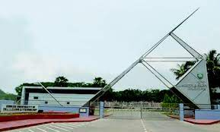

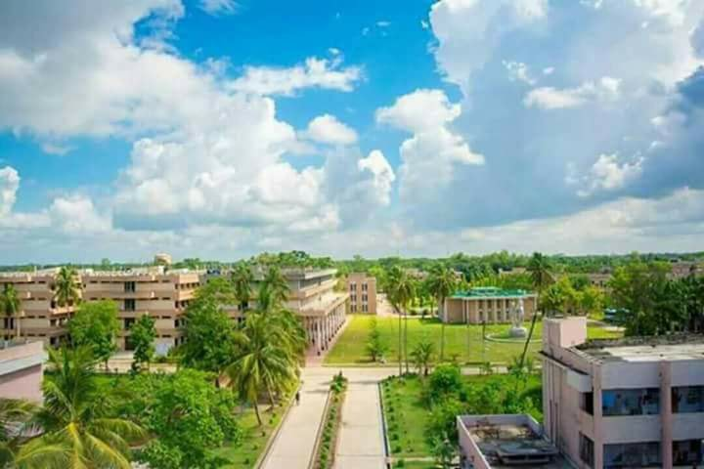
Beauty of KUET
10 09/03/2023

Slide 11
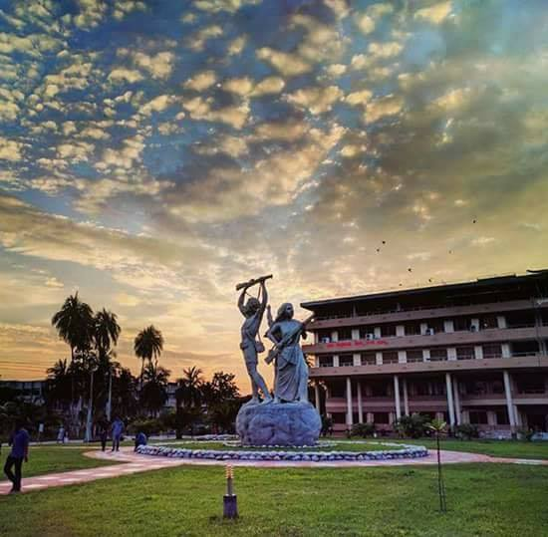
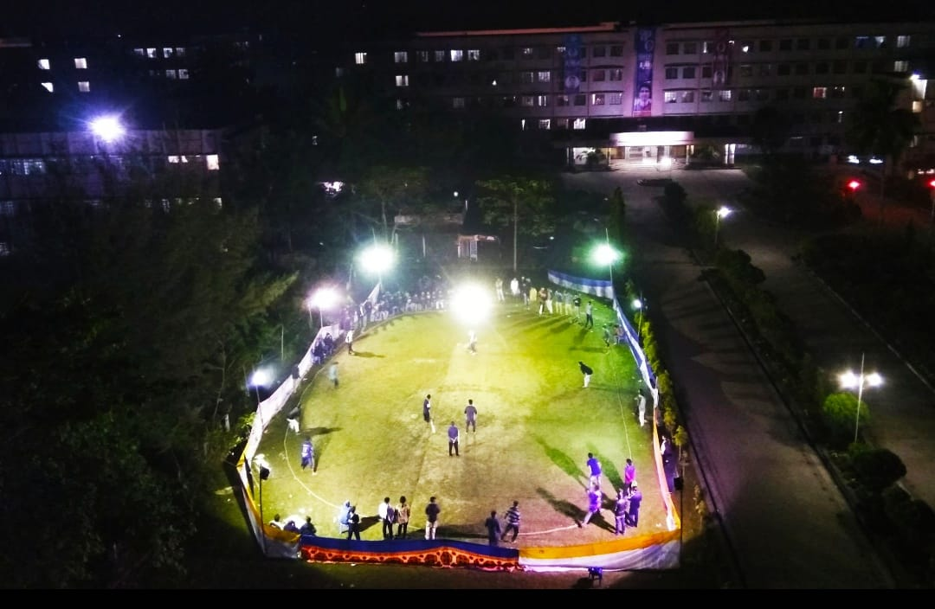
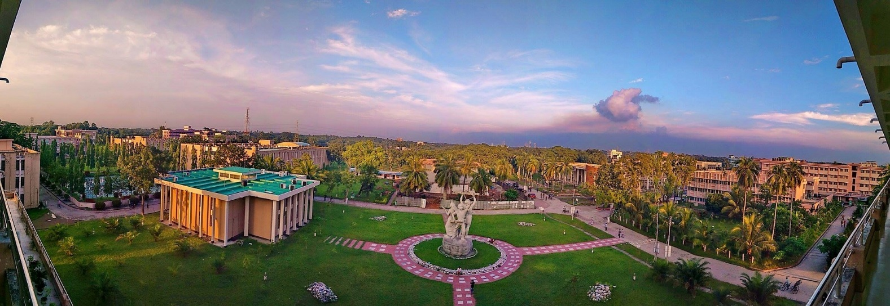
Beauty of KUET (cntd’)
11 09/03/2023

Slide 12
Conclusion
-Leading engineering university in Bangladesh
-Offers high-quality education and research opportunities
-Strong commitment to academic excellence, research, and innovation
-Strong and active alumni network
12 09/03/2023

Slide 13
THANK YOU
13 09/03/2023

