Slide 1
SieveQ: A Layered BFT Protection System for Critical Services
Miguel Garcia, Nuno Neves and Alysson Bessani
Presented By:
Avishek Roy
Roll:1807053
Department of Computer Science and Engineering
Khulna University of Engineering & Technology

Slide 2


Outlines:
Application Layer
Commands Submission
Commands Execution
Active Replication Layer
Committee Layer
Message and Signature Validation
Consensus Algorithm
Introduction
Flows
System Architecture
Visuals
Data Flow of the System
Benefits of the System
Conclusion

Slide 3

Introduction:
A layered architecture
Improves the existing firewall approaches against DoS attacks.
Offers Byzantine fault tolerance (BFT) .
Outperforming existing replicated-firewall approaches.

Slide 4
System Architecture:(Flows)
Application Layer
Active Replication Layer
Committee Layer
Base Consensus Layer
Command Submission
Commands Execution
Messages Signatures and Decisions
Figure 01:Data flow of core SieveQ System.

Slide 5
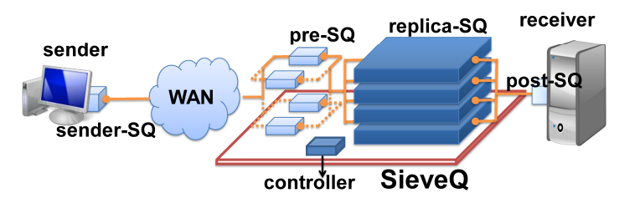
System Architecture:(Visuals)
The system architecture of SieveQ consists of pre-SQs, replica-SQs, and a trusted controller, providing a robust and distributed message processing framework.
The architecture follows a client-server-client model, where the client sends messages to replica-SQs through pre-SQs, ensuring message validation, authentication, and forwarding to the final receiver.
Figure 2 : SieveQ layered architecture.

Slide 6
Application Layer:
Represents the critical service that is being protected
Initiates the command submission process
Passing the commands to the Active Replication Layer

Slide 7
Commands Submission:
Responsible for accepting and validating the commands before submitting them for processing.
Commands Execution:
Processes the received commands for execution.
Ensures that the commands are executed correctly

Slide 8
Active Replication Layer:
Responsible for replicating and executing commands in parallel.
Ensures high performance.
Passing the commands to the Active Replication Layer

Slide 9
Committee Layer:
Organizes replicas into committees.
Ensures the presence of a sufficient number of replicas for validation and verification processes.

Slide 10
Message and Signature Validation:
Verifies the authenticity and integrity of the messages.
Validates the signatures attached to the messages.
Ensures the messages that come from trusted sources.

Slide 11
Consensus Algorithm:
Performs the consensus process to reach a decision outcome.
Considers the responses from the replicas and determines a common decision based on the agreed-upon rules.

Slide 12
Data Flow of the System:
Sender Node
Messages
Sender-SQ Module
Encapsulated Messages
Pre-SQ Filtering Module
Filtered
Messages
Receiver Node
Filtered Messages
Post-SQ Module
Filtered Messages
Replica-SQ Filtering Module

Slide 13
Benefits of the System:
Enhances message security.
Easy integration
TCP socket interface for easy deployment
Easy message authentication
Performance optimization

Slide 14
Benefits of the System(Cont.):
Provides fault tolerance
Flexibility and any language support
Improved security against DoS attacks
Minimal key size for performance
System works at simplified management

Slide 15
Conclusion:
Offers enhanced message authentication, filtering, and performance improvements.
Provides robust message authentication using HMAC and RSA with small key sizes.
Operates through pre-SQs, replica-SQs, and a trusted controller, ensuring message integrity and detecting potential attacks.
Future directions include scalability, advanced filtering techniques, enhanced security measures, and streamlined integration.

Slide 16
Thank You

