Slide 1

Project Idea Presentation
Presented by:
Avishek Roy
Roll :1807053
Md. Nishad Shahriair Roni
Roll:180705
Course no. CSE 4110

Slide 2
Game Name
Fantastic Four

Slide 3
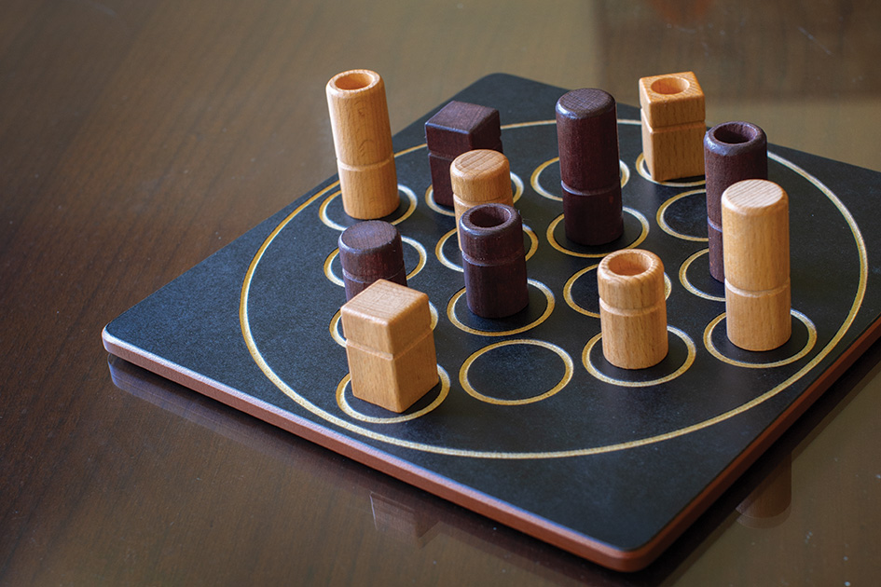
Game Interface

Slide 4
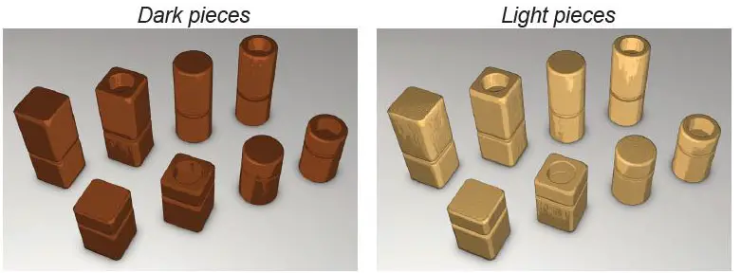
Game Description
Size : tall or short
Shape : round or square
Colour : black or white
Solidity : solid or hollow
Two-player strategy game
4x4 board
16 unique pieces, with four attributes

Slide 5
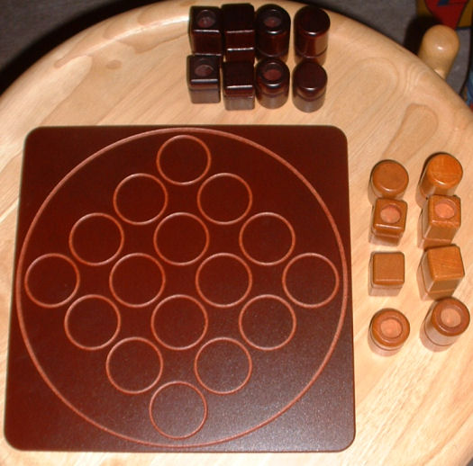
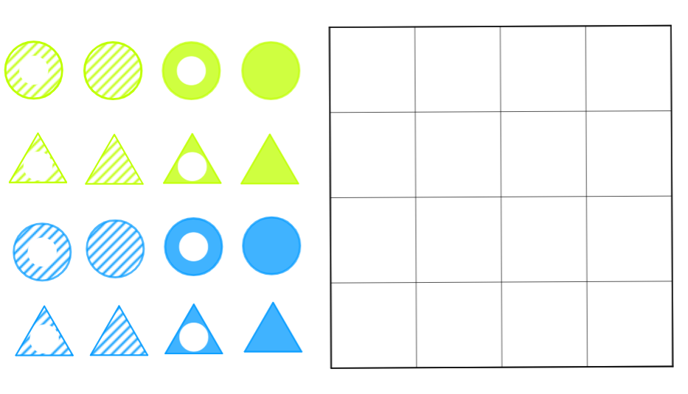
Game Setup
At the start of the game, all the 16 pieces are arranged outside of the board

Slide 6
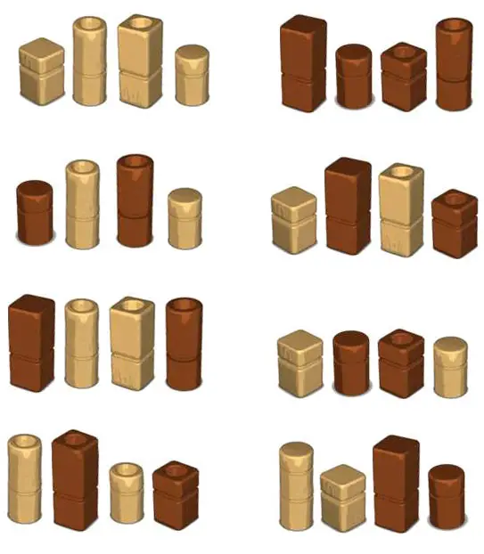
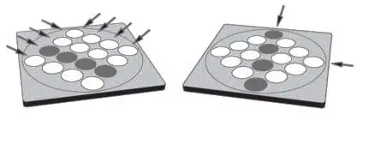
Game Objective
To establish a line of four pieces, with at least one common characteristic on the board.
The line of pieces may be across the board, up and down, or along a diagonal.

Slide 7
Game Play
In a turn:
One player chooses a remaining piece for opponent.
Opponent places that piece into an empty cell.
Opponent’s turn…

Slide 8
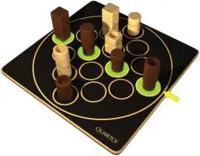
Winning the game
The game is won by the ﬁrst player to call “EUREKA!”
When any same types four pieces matches alongside
horizontal or
vertical or
diagonal

Slide 9
Conclusion
One of the interesting features of Fantastic Four is that, the player chooses the piece that the opponent will play next. This makes the game a bit more complex and strategic, as players must try to anticipate their opponent's next move while also planning their own moves carefully. Fantastic Four is a fun and challenging game that requires strategic thinking.

Slide 10
Reference
Real name: Quarto
Origin: Switzerland
Invented by: Swiss mathematician Blaise Müller

Slide 11

Thank You!

