Slide 1
Fault Detection in PV Systems Using Signal Processing and Statistical Methods
Hoang Khang Le

Slide 2
Content
Introduction
PV signal
Discrete Fourier Transform and Fast Fourier Transform
Moving Average Filter
Normal state and Fault behavior
Fault characteristic and detection

Slide 3
Introduction
- PV systems are prone to faults such as open circuit, short circuit, and partial shading.
- Fault detection improves reliability and efficiency.
- Focus: Digital signal processing techniques for fault detection.

Slide 4
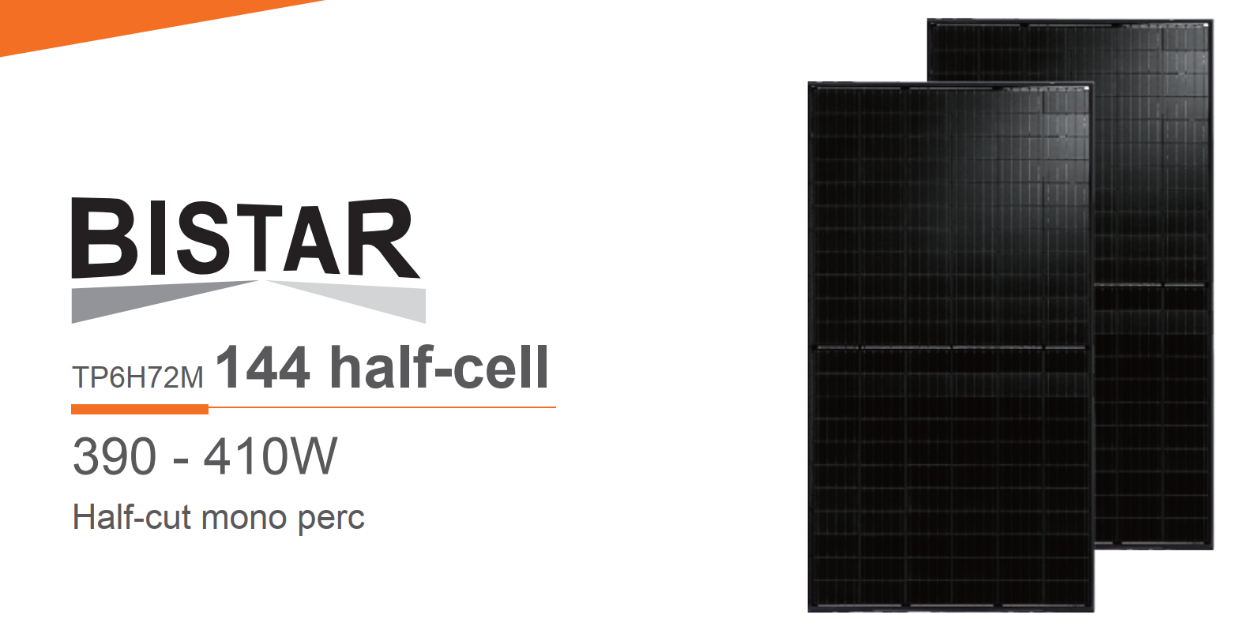
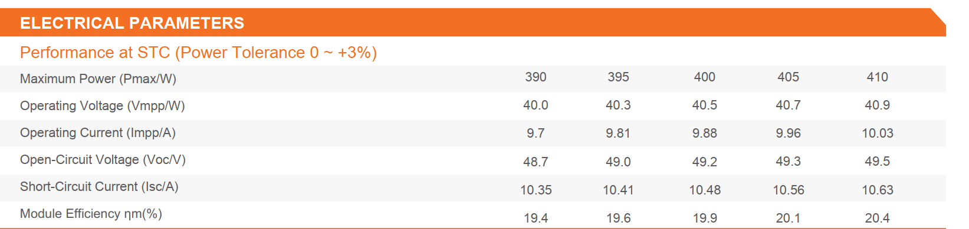
PV signal

Slide 5
Types of Faults
Open Circuit:
Caused by loose connections or environmental issues.
Short Circuit:
Leads to large fault currents, reducing performance.
Partial Shading:
Results from dirt, debris, or shadows, creating hotspots.

Slide 6
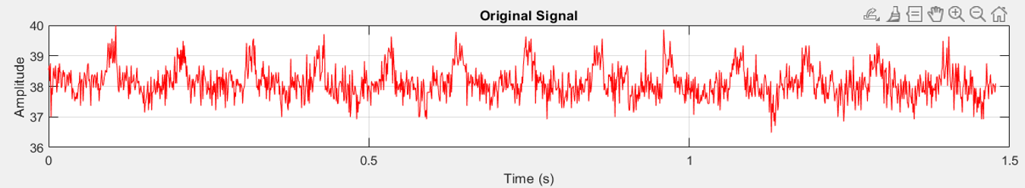
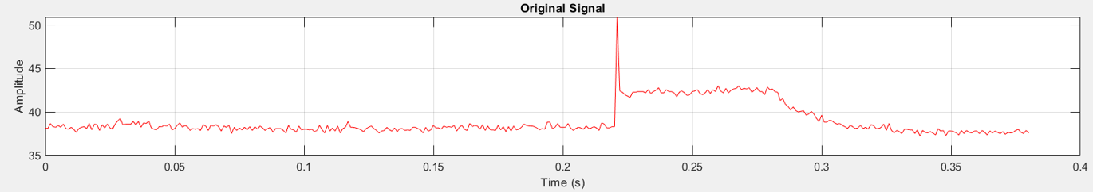
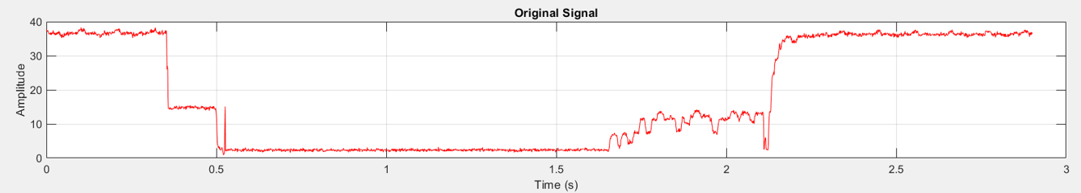
PV signal – voltage
Normal Condition
Short-circuit condition
Partial-shading condition

Slide 7
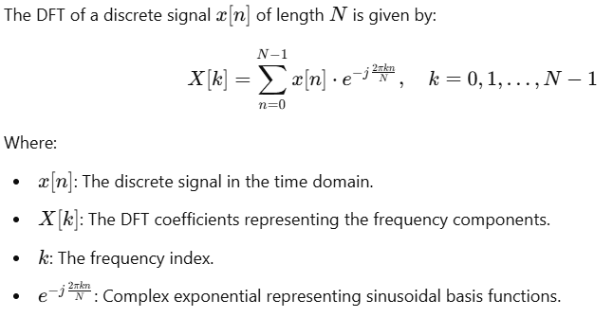
Discrete Fourier transform
https://www.desmos.com/calculator/oz3m4oez5f

Slide 8
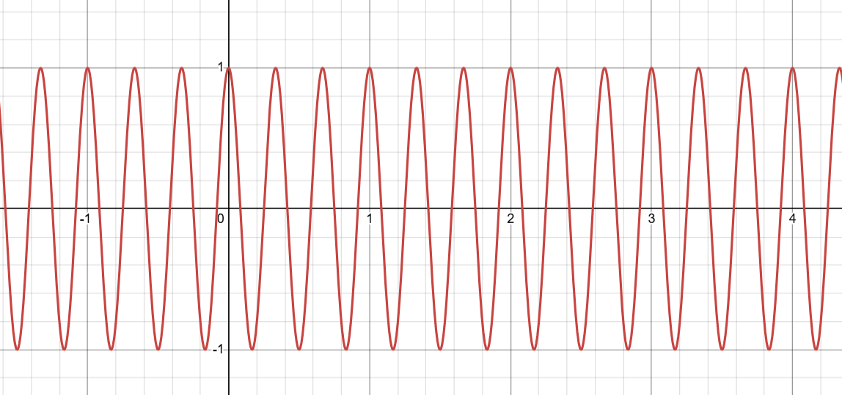
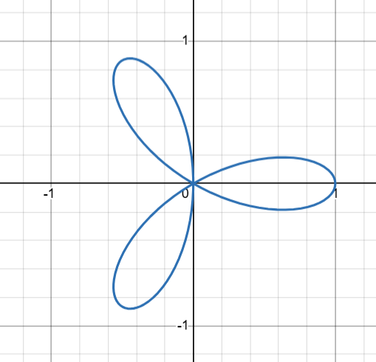
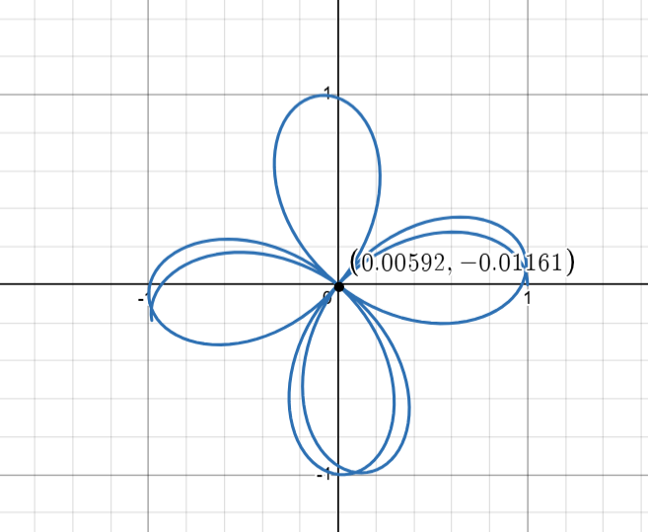
Discrete Fourier transform
Cos(6πx)

Slide 9
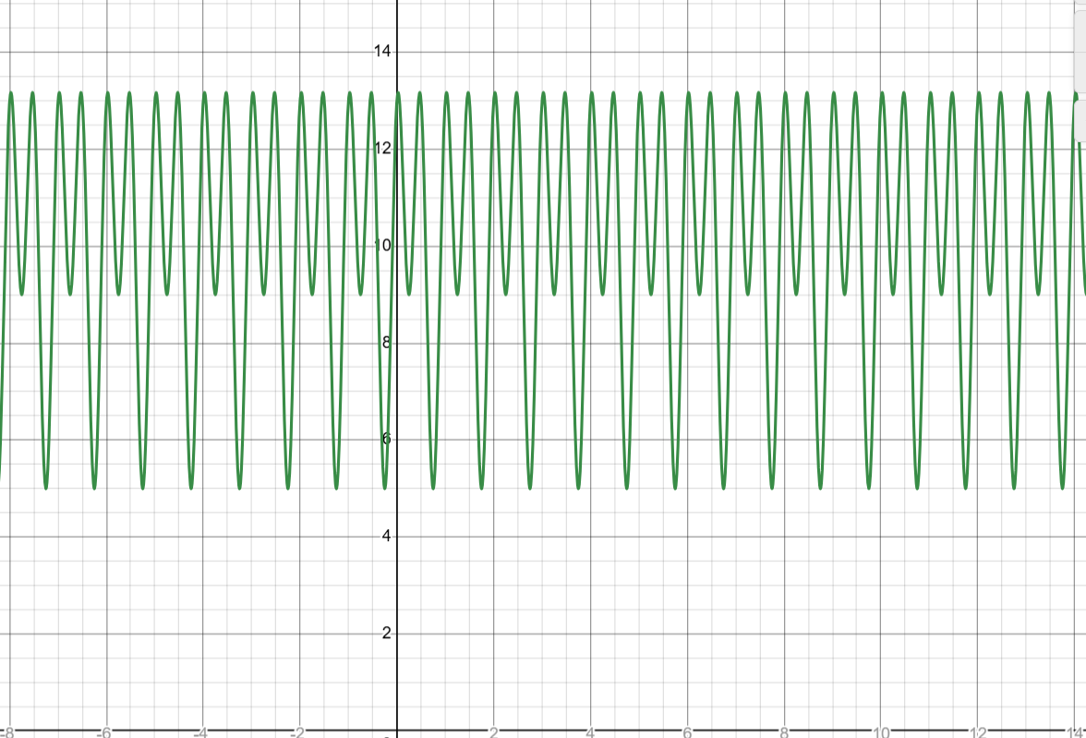
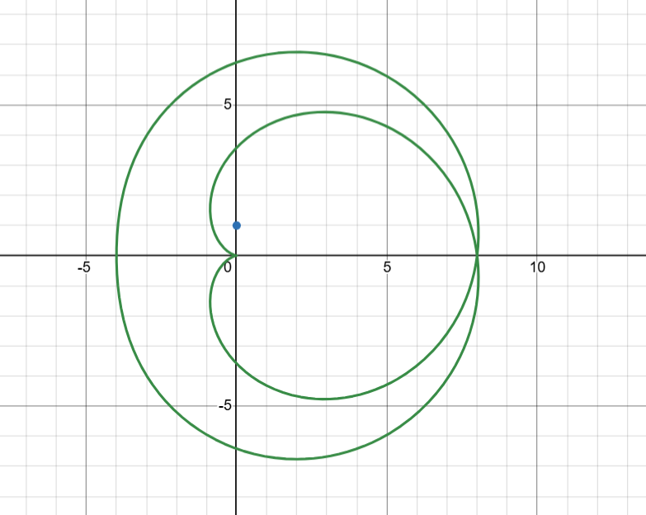
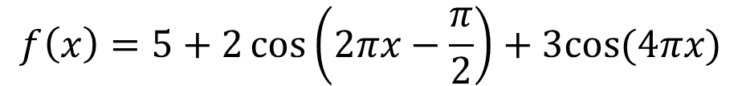
Discrete Fourier transform
$$f\left(x\right)=5+2\cos\left(2πx−\frac{π}{2}\right)+3cos⁡(4πx)$$
Take sampling rate at 4Hz -> x = kTs =k3/4

Slide 10

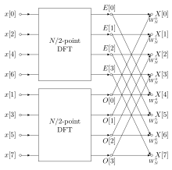

Fast Fourier Transform

Slide 11
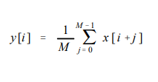
Moving average filter
operates by averaging a number of points from the input signal to produce each point in the output signal
x [ ] is the input signal,
y [ ] is the output signal, and
M is the number of points in the average

Slide 12
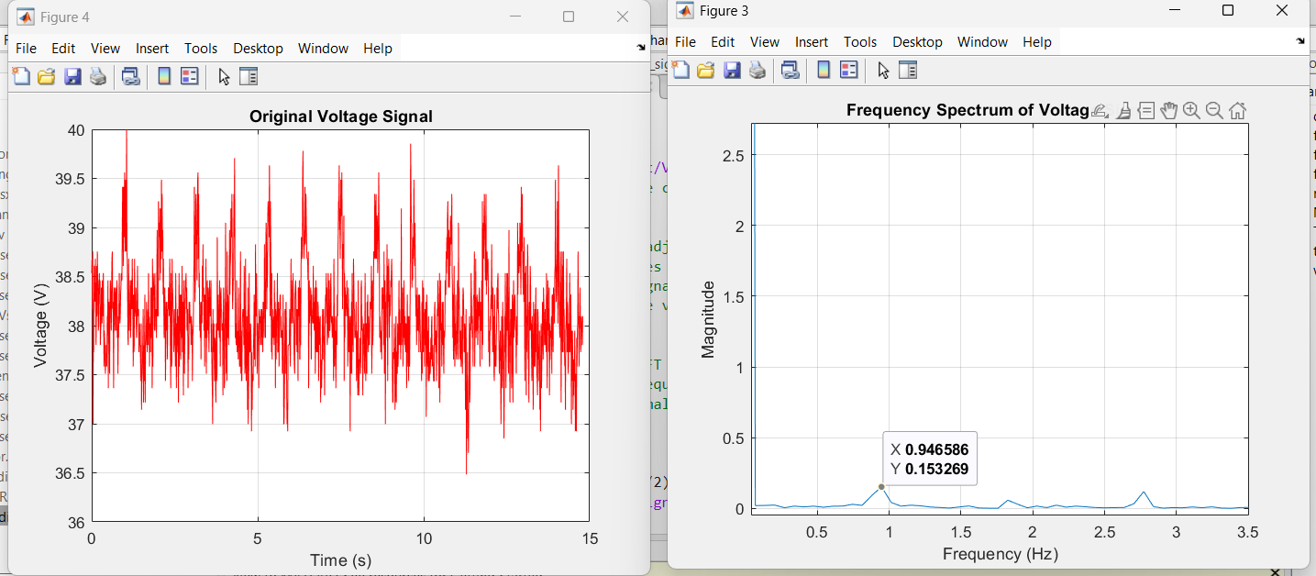
FFT – PV signal – normal condition

Slide 13
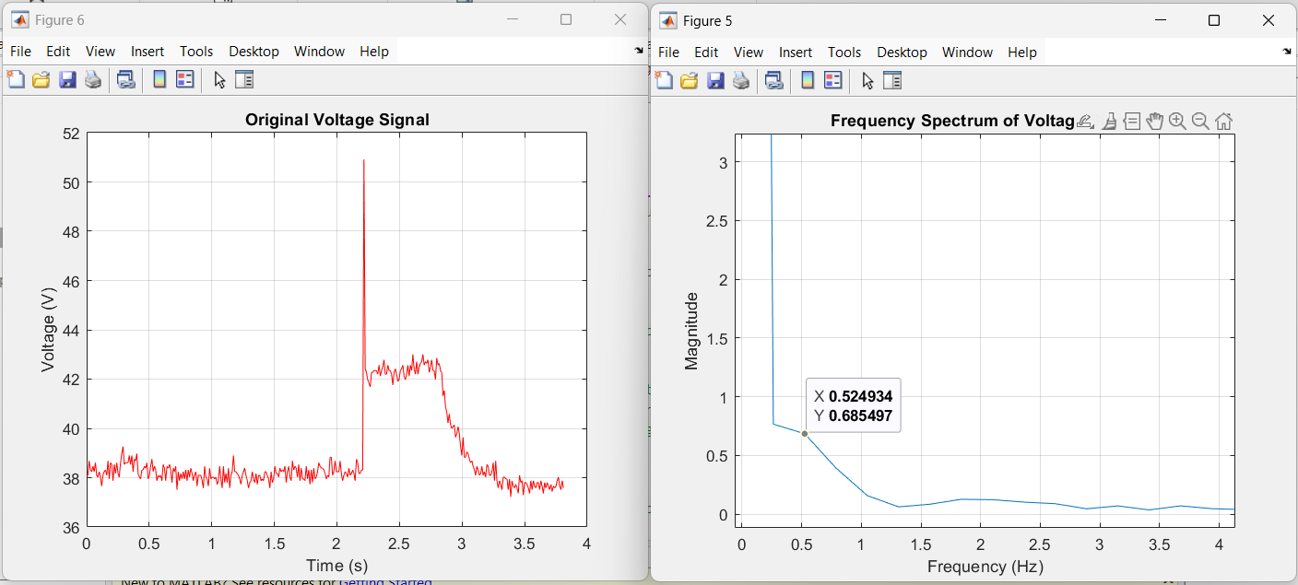
FFT – PV signal – SC condition

Slide 14
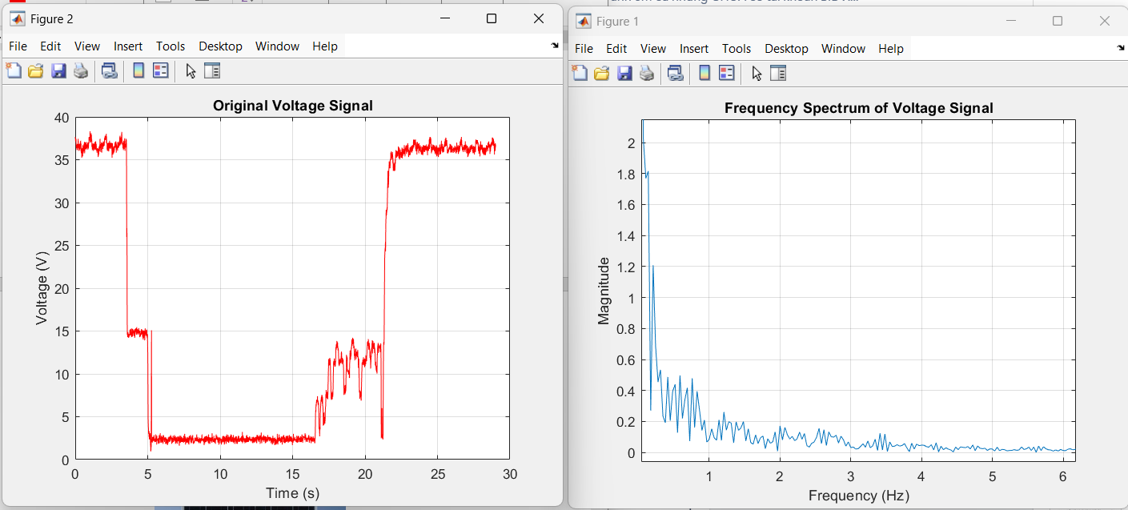
FFT – PV signal – Shading condition

Slide 15
Fault Detection
Smooth DC signals (optional) using moving average filter.
FFT (Fast Fourier Transform):
Converts signals to the frequency domain to identify specific faults.
Statistical Methods:
Detect anomalies using mean and standard deviation.
Threshold-Based Detection:
Sets upper and lower limits for fault identification.

Slide 16
Fault detection
Threshold method
Used when a specific limit is known (e.g., voltage exceeding 50V in a circuit).
Easy to implement in real-time systems.
Simple and computationally inexpensive.

Slide 18


Statistical Fault Detection
Mean calculate
Variance
Used when statistical fluctuations or trends indicate faults (e.g., noise increase, load imbalance).
More sensitive to gradual or subtle changes.
Requires statistical computation, which may introduce additional complexity.

Slide 20
Conclusion
Introduce about DFT and FFT
Apply FFT to analyze the fault behavior of the PV system
Apply 2 basic fault detection method for fault recognised

Slide 21
Reference
https://www.youtube.com/watch?v=spUNpyF58BY&t=635s
https://www.sciencedirect.com/science/article/pii/S0030402624001967
https://doi.org/10.1016/j.solener.2020.03.019

