Slide 1
Fuel Cell
Hoàng Khang Le

Slide 2
Content
Introduction
Theoretical part
Experiment
Conclusion
Reference

Slide 3
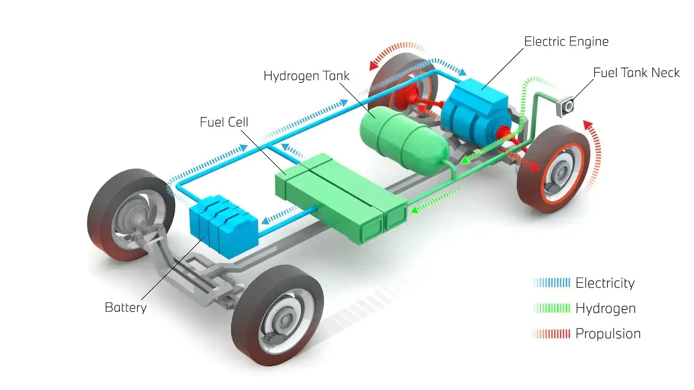
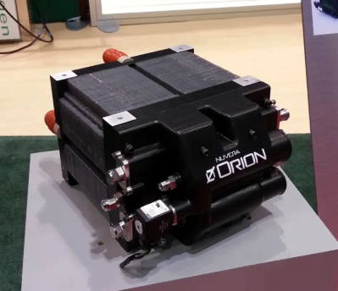
Introduction
Proton Exchange Membrane Fuel Cell [1]
Scheme of fuel cell electric vehicle [2]
Notes:
Nowaday due to the global warming the effect of the global warming on the weather this more stuff in the tropical area due to the war between Russia and ukraina with limit the natural fuel and the sieve of the global market to the Electric vehicle due to the Investment of tesla and Alamos in to this huge which has increase the important use of clean and renewable source. Fuel cell is one of them it had been researched and apply to electric vehicle covid branch electric vehicles which is only fuel cell electric vehicle.
The fuel cell is now focus on research and apply to vehicle dueto its adaptable and high power density.
In this project, the experiment of the \fuel cell is conducted and connect with the lecture to explore and understand characteristic, performance and phenomenon that can happen when using the fuel cell system.

Slide 4
Theory
Structure of a fuel cell
Performance of the fuel cell
Advantage and disadvantage

Slide 5
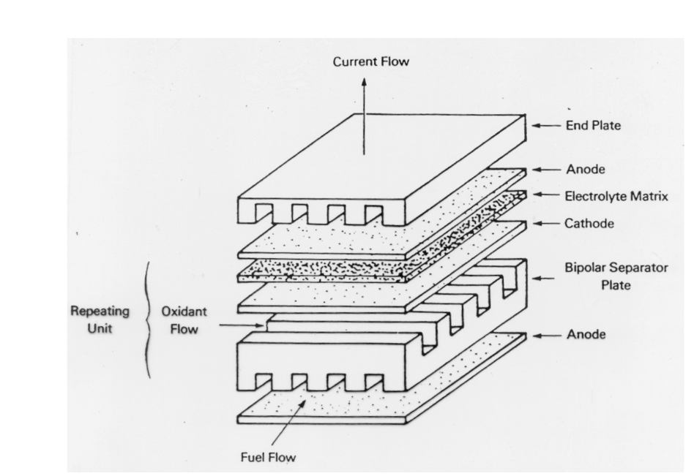
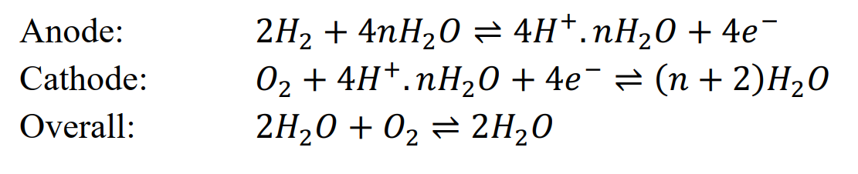
Structure of the fuel cell
Fuel Cell – [3]
Notes:
5 main layers:
Anode: Facilitates fuel oxidation, splitting hydrogen into protons and electrons. Made of porous carbon with a catalyst (e.g., platinum).
Cathode: Supports the reduction reaction where oxygen combines with protons and electrons to form water. Also made of porous carbon with a catalyst.
Electrolyte: A proton-conducting layer that allows only protons to pass while blocking electrons. It separates the anode and cathode.
Gas Diffusion Layers (GDLs): Thin, porous layers that ensure uniform gas distribution and manage water and heat transport.
Bipolar Plates: Provide structural support, distribute reactant gases, and conduct electrons between cells in a stack.
Catalyst Layers: Enhance reaction rates at both the anode and cathode, typically using platinum or other precious metals.
End Plates: Secure the fuel cell stack and prevent gas leaks.
Flow Field Channels: Deliver hydrogen and oxygen, while removing water and heat, ensuring efficient operation.

Slide 6
Performance of fuel cell

Slide 8
Reference
1. https://fchea.org/learning-center/fuel-cell-basics/
2. https://uk.pcmag.com/cars-auto/141086/hydrogen-powered-cars-fuel-cell-electric-vehicles-explained
Electrochemical Energy Stroage Systems – lecture

