Slide 1
Fuel Cell
Hoàng Khang Le

Slide 2
Content
Introduction
Theoretical
Experiment
Result
Conclusion
Reference

Slide 3
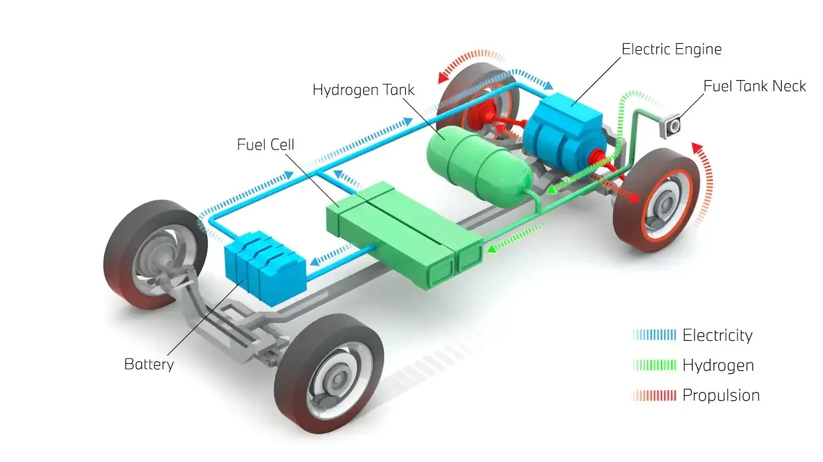
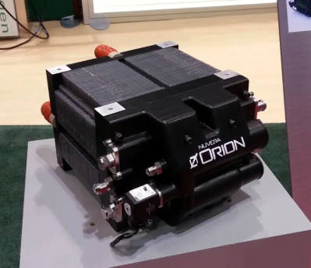
Introduction
Proton Exchange Membrane Fuel Cell [1]
Scheme of fuel cell electric vehicle [2]
Notes:
Nowadays due to the global warming the effect of the global warming on the weather this more stuff in the tropical area due to the war between Russia and Ukraine with limit the natural fuel and the sieve of the global market to the Electric vehicle due to the Investment of tesla and Alamos in to this huge which has increased the important use of clean and renewable source. Fuel cell is one of them it had been researched and apply to electric vehicle covid branch electric vehicles which is only fuel cell electric vehicle.
The fuel cell is now focus on research and apply to vehicle due to its adaptable and high-power density.
In this project, the experiment of the \fuel cell is conducted and connect with the lecture to explore and understand characteristic, performance and phenomenon that can happen when using the fuel cell system.

Slide 4
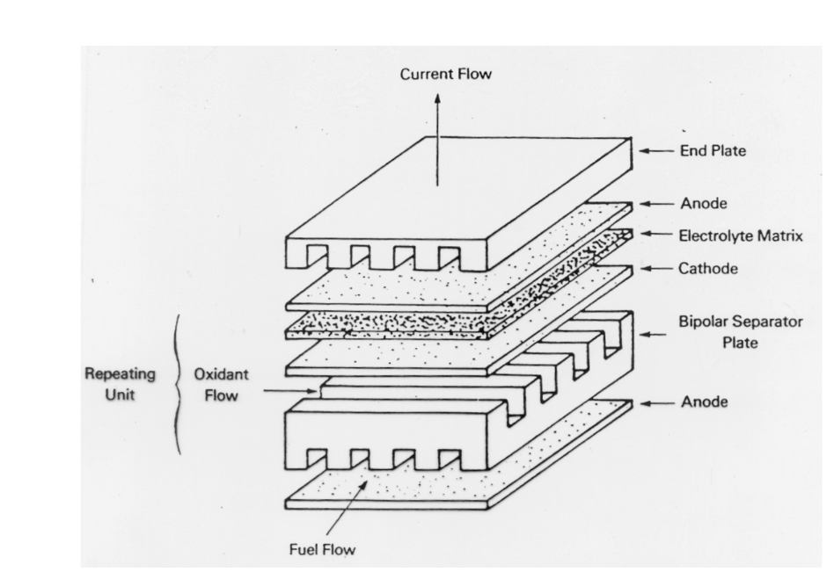
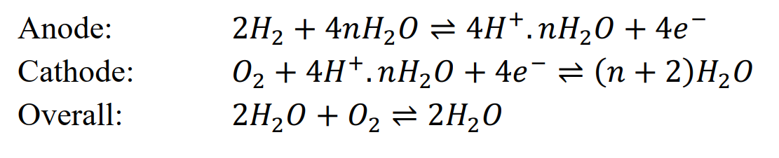
Theory - Structure of the fuel cell
Fuel Cell – [3]
Fuel Cell Structure – [3]
Notes:
5 main layers:
Anode: Facilitates fuel oxidation, splitting hydrogen into protons and electrons. Made of porous carbon with a catalyst (e.g., platinum).
Cathode: Supports the reduction reaction where oxygen combines with protons and electrons to form water. Also made of porous carbon with a catalyst.
Electrolyte: A proton-conducting layer that allows only protons to pass while blocking electrons. It separates the anode and cathode.
Gas Diffusion Layers (GDLs): Thin, porous layers that ensure uniform gas distribution and manage water and heat transport.
Bipolar Plates: Provide structural support, distribute reactant gases, and conduct electrons between cells in a stack.
Catalyst Layers: Enhance reaction rates at both the anode and cathode, typically using platinum or other precious metals.
End Plates: Secure the fuel cell stack and prevent gas leaks.
Flow Field Channels: Deliver hydrogen and oxygen, while removing water and heat, ensuring efficient operation.

Slide 5
Experiments

Slide 6
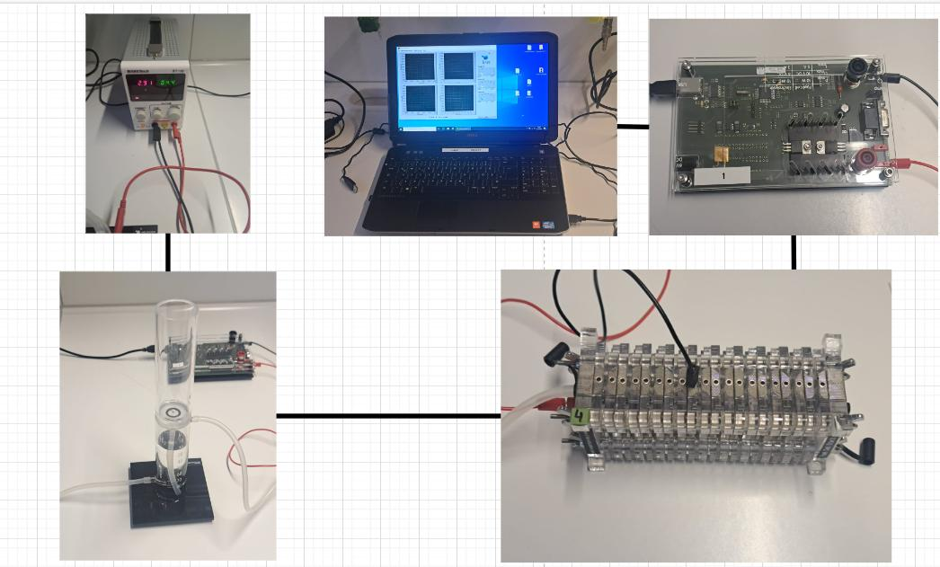
Characteristic curve of hydrogen Fuel Cell
Aim:
Build a characteristic curve of a hydrogen PEMFC
The Experiment Set Up
Notes:
Four cells from the lab's fuel cell system are utilized to examine the fuel cell’s characteristic curve.
To collect and store data on voltage, current, and power, a measurement device and a computer are connected to the fuel cell system.
A hydrogen generator, powered by a 4.5V supply, serves as the fuel source.
This generator separates hydrogen from water, supplying hydrogen directly to the fuel cell system.
Once the hydrogen is supplied, the measurement device simulates the load and captures data to generate the characteristic curve.
The collected data is displayed on the computer and stored in a text format for further analysis. Noted that in the app on the computer lab, the mode “Automatic” is chose.

Slide 7
Voltage controlled measurements
Aim:
Maintain the voltage – load at a consistent value, therefore, the data of current and power over time are collected.
The Experiment Set Up

Slide 8
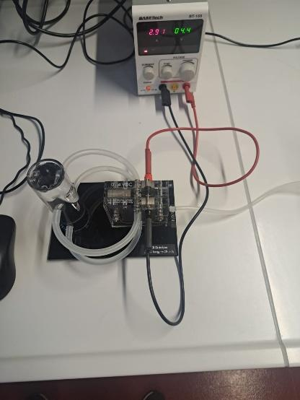
Determination of efficiency
Aims:
Measure the volume of hydrogen produced over time and use the collected data, along with data from Experiment 1
Calculate the efficiency and energy efficiency of the fuel cell system.
The Experiment Set Up

Slide 9
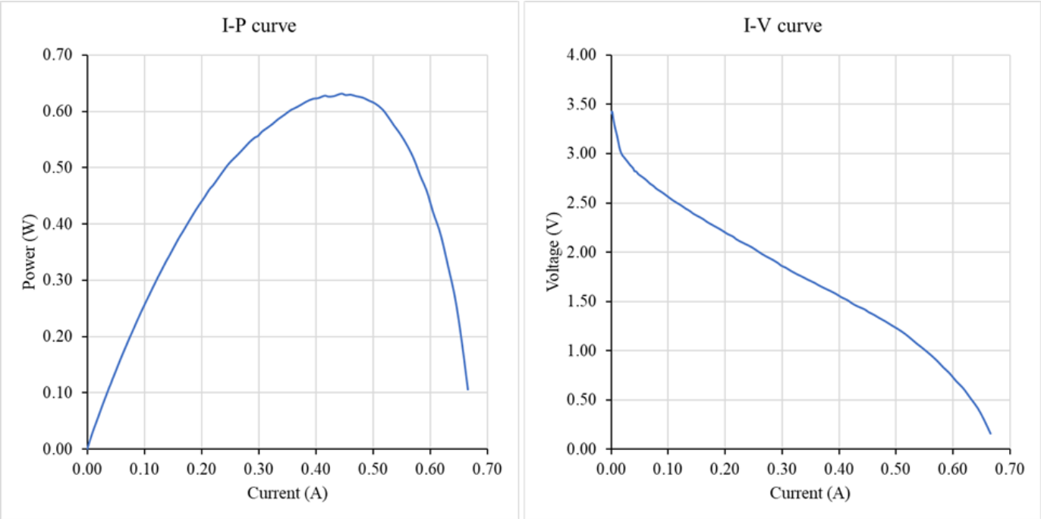
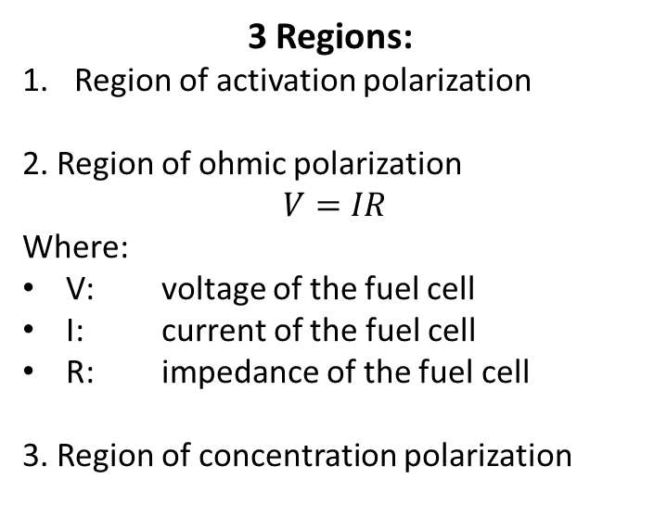
Result - Characteristic curve of hydrogen Fuel Cell 1st
3 Regions:
Region of activation polarization
2. Region of ohmic polarization
$V=IR$
Where:
V: voltage of the fuel cell
I: current of the fuel cell
R: impedance of the fuel cell
3. Region of concentration polarization
1
2
3
1
2
3
Characteristic curve of hydrogen Fuel Cell – 1st measurement

Slide 10
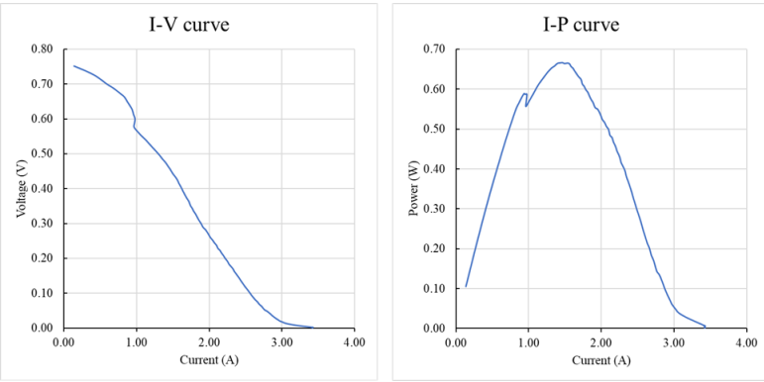
Result - Characteristic curve of hydrogen Fuel Cell 2nd
Special phenomenon:
One of the fuel cell stops working because bypass product blocks the ion transfer.
Characteristic curve of hydrogen Fuel Cell – 1st measurement

Slide 11
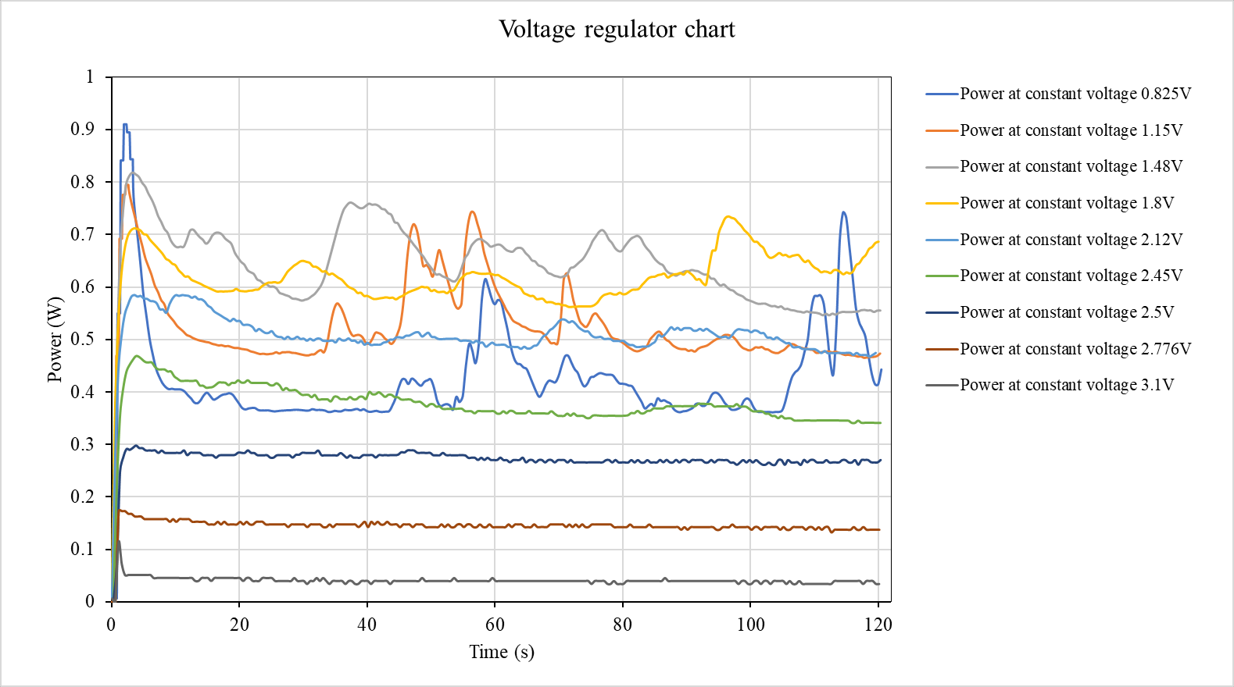
Voltage controlled measurements
Has the most power created by FC
Belong to the ohmic polarization

Slide 12
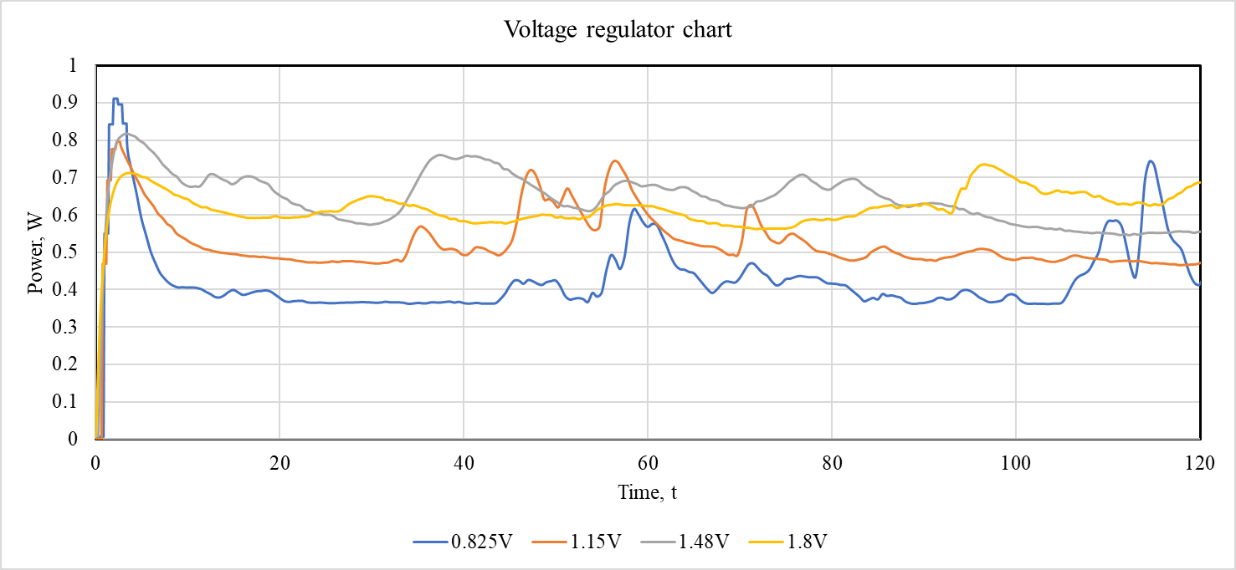
Voltage controlled measurements
Fluctuation
Notes:
Water is a by-product of the fuel cell reaction. Accumulation of water (flooding) at the electrodes can temporarily block the flow of reactants (hydrogen or oxygen) to the catalyst sites, reducing efficiency. When water clears, a spike in power may occur as reactant flow resumes.
Conversely, insufficient water can lead to membrane dehydration, reducing ionic conductivity, which could also cause temporary fluctuations.

Slide 13
Voltage controlled measurements
Cannot overcome the initialthe electrochemical reaction barriers at the electrodes

Slide 14
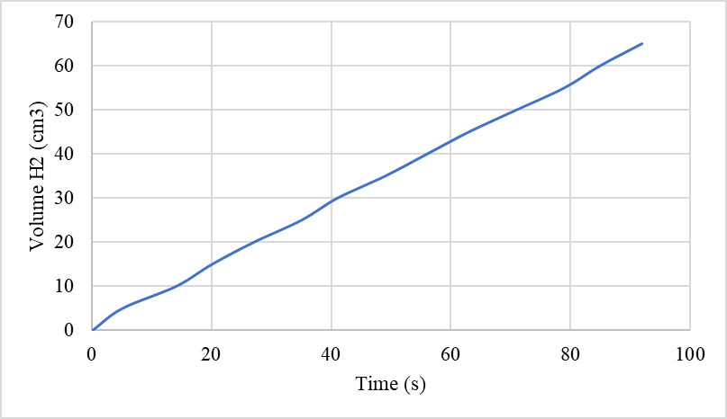
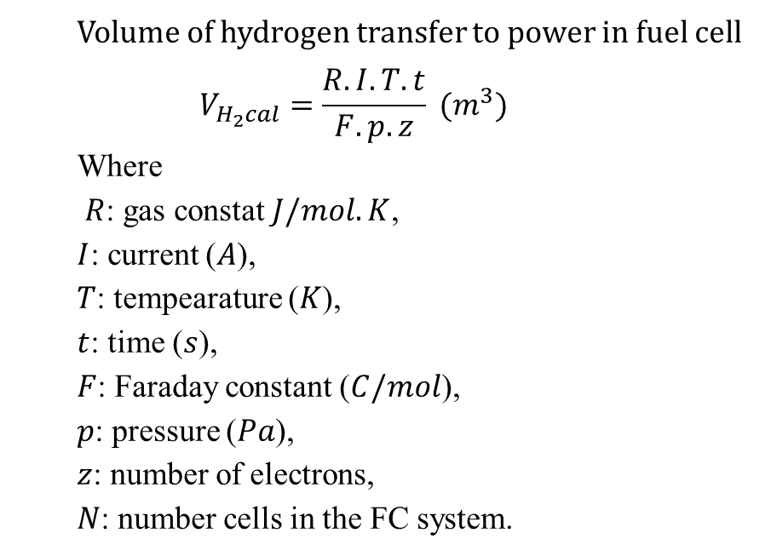
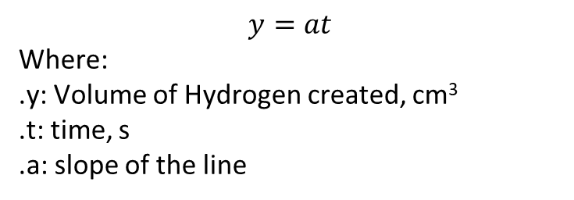
Determination of efficiency
Volume of the hydrogen produced by the fuel generator
Volume of hydrogen transfer to power in fuel cell
$$V_{H_{2}cal}=\frac{R.I.T.t}{F.p.z} (m^{3})$$
Where
$R$: gas constat$J/mol.K$,
$I$: current ($A$),
$T$: tempearature ($K$),
$t$: time ($s$),
$F$: Faraday constant ($C/mol$),
$p$: pressure ($Pa$),
$z$: number of electrons,
$N$: number cells in the FC system.
$$y=at$$
Where:
.y: Volume of Hydrogen created, cm³
.t: time, s
.a: slope of the line

Slide 15
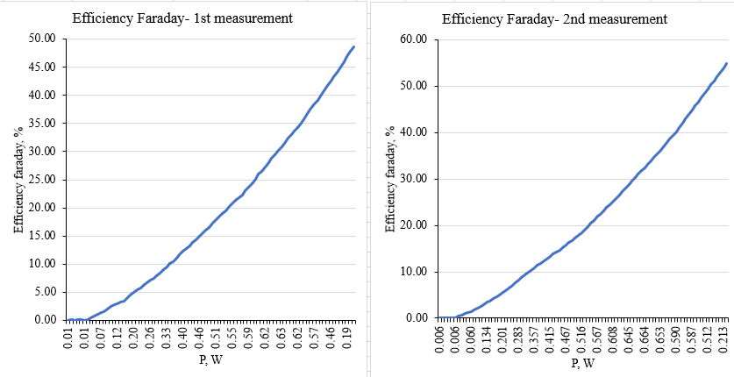
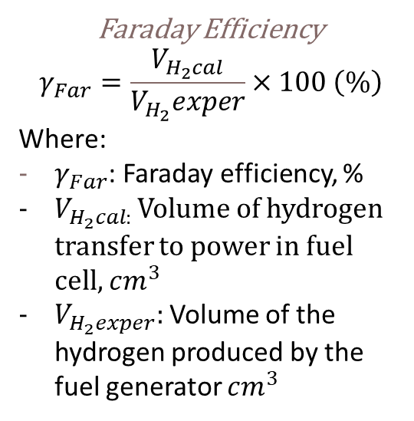
Determination of efficiency
Faraday Efficiency
$$γ_{Far}=\frac{V_{H_{2}cal}}{V_{H_{2}}exper}×100 \left(\%\right)$$
Where:
$γ_{Far}$: Faraday efficiency, %
$V_{H_{2}cal: }$Volume of hydrogen transfer to power in fuel cell, $cm^{3}$
$V_{H_{2}exper}:$Volume of the hydrogen produced by the fuel generator $cm^{3}$

Slide 16
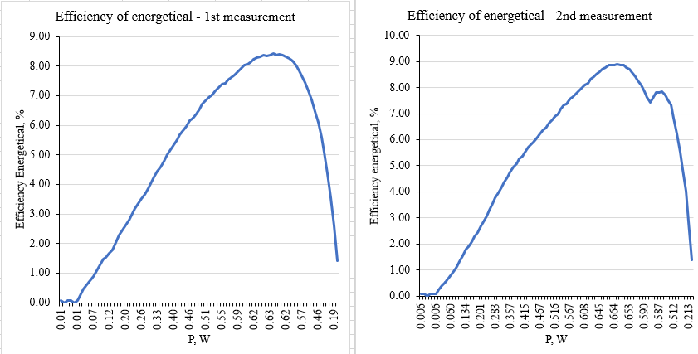
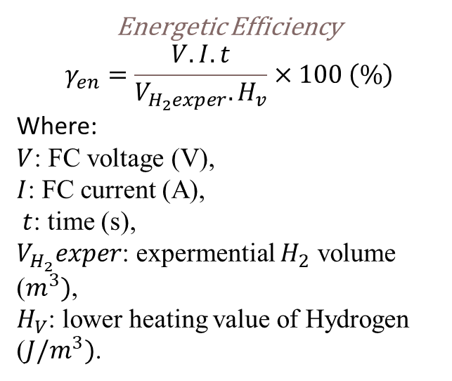
Determination of efficiency
Energetic Efficiency
$$γ_{en}=\frac{V.I.t}{V_{H_{2}exper}. H_{v}}×100 \left(\%\right)$$
Where:
$V$: FC voltage (V),
$I$: FC current (A),
$t$: time (s),
$V_{H_{2}}exper$: expermential $H_{2}$ volume ($m^{3})$,
$H_{V}$: lower heating value of Hydrogen ($J/m^{3})$.

Slide 17
Conclusion
Understand the structure and basic working principle of the PEM fuel cell.
Understand the characteristic I-V curve and efficiency of PEM fuel cell
Understand the behavior of the fuel cell under various condition.

Slide 18
Reference
1. https://fchea.org/learning-center/fuel-cell-basics/
2. https://uk.pcmag.com/cars-auto/141086/hydrogen-powered-cars-fuel-cell-electric-vehicles-explained
3. Karsten, P. (2024) Electrochemical storage system. Electrochemical storage system, Karlsruhe: Hochschule Karlsruhe, 7 October

Slide 19
Thank you for listening

