Slide 1
PICO-SATELLITE
(Structure & Components)
Submitted by:
Space_Bots

Slide 2
OBJECTIVE :
In our project, we plan to use a pico-satellite for the purpose of monitoring or controlling over a specific large area by linking it with a micro sized drone. This drone can be used for a number of tasks like :
Surveillance and gathering intel
Disaster Management
Tracking of moving objects
Collecting information on weather conditions.

Slide 3
The movement of the drone is controlled using the commands sent by the control system via the satellite.
Hence, the use of pico satellite helps increase the coverage area, which further increases the endurance capability of the drones, as well as allows them to fly at higher altitudes.

Slide 4
STRUCTURAL DESIGN AND TELEMETRY DETAILS
Basis component of a pico satellite
Antenna
Radio transmitter
IC board
Power supply system-solar cells

Slide 5
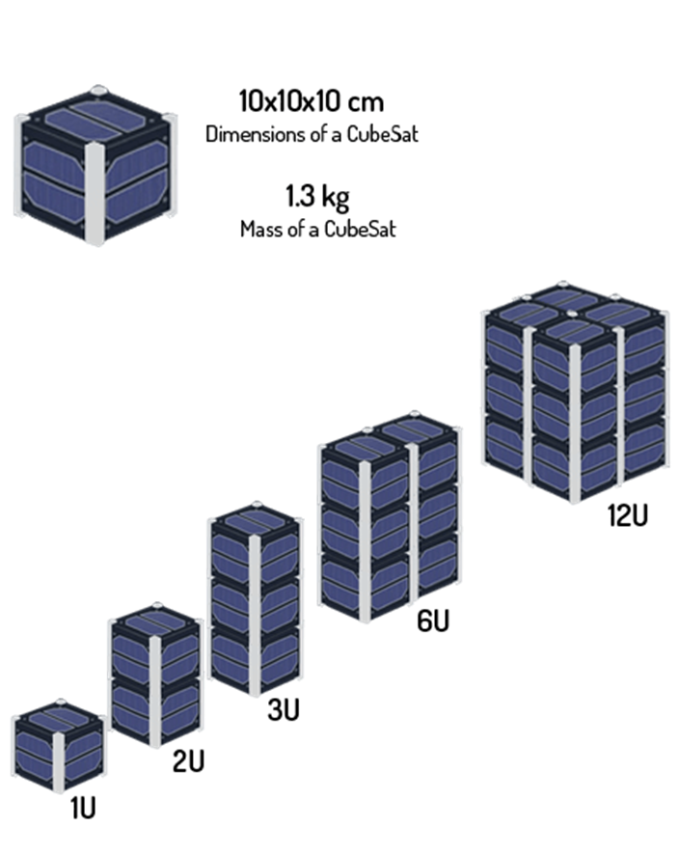
Basic Design

Slide 6
Advantages
The single side piece frames in this design minimize the amount of fasteners thereby increase structural strength against vibration.
The configuration comprises of four stack up PCBs screwed along tie bars to the support bars, which in turn transfers load to the rest of the frame structure.

Slide 7
Important points
The lateral section of the satellite must have its dimension span 100.0 ± 0.1mm in width, while its longitudinal section must span 113.5 ± 0.1mm and the weight is not to exceed 1.33kg.
The structure alone should not take more than 30% of the total satellite weight.

Slide 8
Material for frame
In this study, our material of choice for the frame is Aluminium 6061-T6 due to
a. Its strength-to-weight ratio is very high making it ideal for attaining a light-weight structure.
b. Excellent structural strength and toughness, indicating high stiffness and workability.
c. It has good finishing characteristics and responds well to anodizing.
d. It is readily available and has excellent machinability due to its chip characteristics.
e. Excellent joining characteristics and thermal expansion coefficient similar to that of the Poly-Picosatellite Orbital Deployer (P-POD) material, Al 7075-T73.

Slide 9
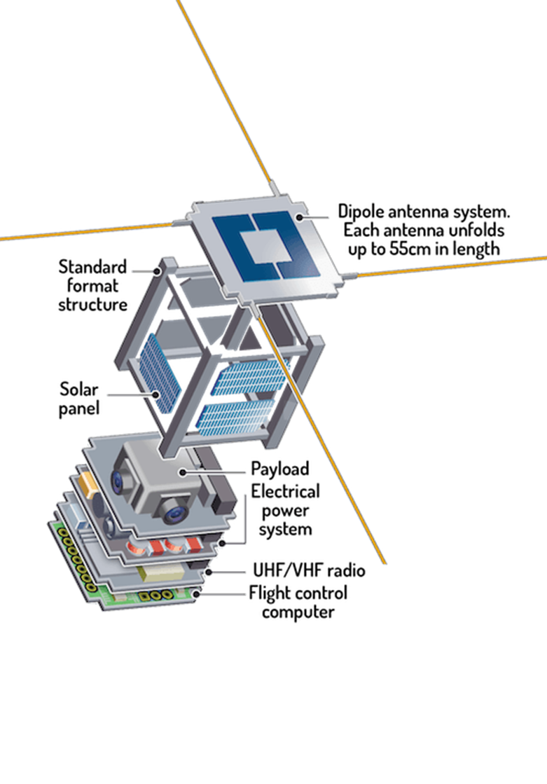
Connectors
Bolted screw joint connectors were considered for the analysis set up. The material of the screw is space qualified stainless steel (SS304) M3 × 0.45 mm screws

Slide 10
Materials for Pico satellite Antennas
One of the more popular materials used for small antennas is the Kapton Polyimide film. Its advantage include flexibility, good resistance over a number of chemical solvents, and compatibility to high temperatures ranging from −269∘C to +400∘C, making it suited for space applications.

Slide 11
Sensors to be used
Sun Sensors – provides a measurement of one or two angles between the sensor boresight direction and the sun, providing information about the line-of-sight vector to the sun in the satellite body-ﬁxed frame.
Star trackers , also referred to as star cameras, are the most accurate type of attitude sensor. Star tracker accuracies range from one arc-second to one arc-minute (0.0003◦ to 0.01◦), depending on the quality of the sensor.
Horizon sensors ,also known as Earth sensors ,are infrared sensors that detect the contrast between cold of space and the heat of Earth’s atmosphere. Accuracies between 0.1◦ and 0.25◦ are typical of horizon sensors.
Magneto meters measure the direction and magnitude of Earth’s magnetic ﬁeld Attitude-grade magnetometer accuracies typically range from 0.5◦ to 3◦. PNI MicroMag3 three axis magnetometer. The physical dimensions are 2.54 × 2.54 × 1.9 cm3 and the sensor requires 1.5 mW.
Rate gyroscopes, also referred to simply as gyros, but are commonly used in spacecraft as they provide a measurement for angular velocity.
GPS is also used to reach the desired co-ordinate.
Three-axis accelerometer is also installed.

Slide 12
BMP085 sensor which measures the pressure and send the value to the microcontroller via I2C protocol.
DHT11 sensor which measures the temperature and the humidity

Slide 13
Calibration of sensors:
On-orbit: This reduces satellite development time and cost through reduction in pre-ﬂight testing and integration requirements. In this dissertation, we develop methods for on-orbit sensor calibration of low-cost sensors that enables unprecedented attitude determination accuracies with these sensors while at the same time minimizing the pre-ﬂight testing and integration requirements.

Slide 14
Power subsystem
Sensors and modules are connected through our PCB with a rechargeable Li-Po battery [11.1V-1100mAh - 25C] as a power source, enough to power the entire system with full performance for a long time up to 2 hours based on our calculations. Miniature solar panels are also installed as a source of power

Slide 15
Processing unit
We used “Arduino mega” as our microcontroller which works with 16 MHZ frequency, it supports many communication protocols like (I2C, SPI, and UART) that are needed to connect the Arduino to other devices, and it also consumes lower power so it makes the battery lasts longer.

Slide 16
Camera and images storing subsystem
This subsystem consists of a camera module “LSY201” and SD card module to store the captured image for observation and further processing after landing, the used microcontroller reads each 32 byte of “JPEG” format of captured image and saves it in a buffer then writes the content of this buffer in an image file created in the SD card via UART (Universal Synchronous Receiver Transmitter) protocol

Slide 17
Data Transmission & Data Logging
Data like the spatial content in the data log which is also known as the weather parameters is captured using the Temperature and Relative Humidity Sensors accordingly are sent using Zig-Bee modules which are encrypted in their communication session using Advanced Encryption Standard with its main functions of mix columns, shift rows, round keys and a substitution table makes it uncrackable.

Slide 18
Thank You

