Slide 1
SUDOKU
Project
Amit Kushwaha (MIT2020031)
Chandra Mani(MIT2020112)
Indian Institute Of Information Technology Allahabad

Slide 2
Contents
Introduction
Algorithm
Future Development
Team Contribution
References

Slide 3
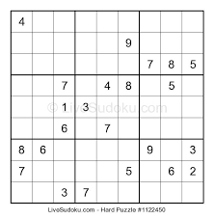
Introduction
Sudoku is logic-based, number placement puzzle.
Objective is to fill 9x9 grid , some are already filled as clue.
grid is divided into subgrid(also called block).
A sudoku with unique solution must have at least 17 clues.
Fill digit [1 .. 9]
Each row contain digit from 1 to 9
Each column contain digit from 1 to 9
Each subgrid contain digit from 1 to 9

Slide 4
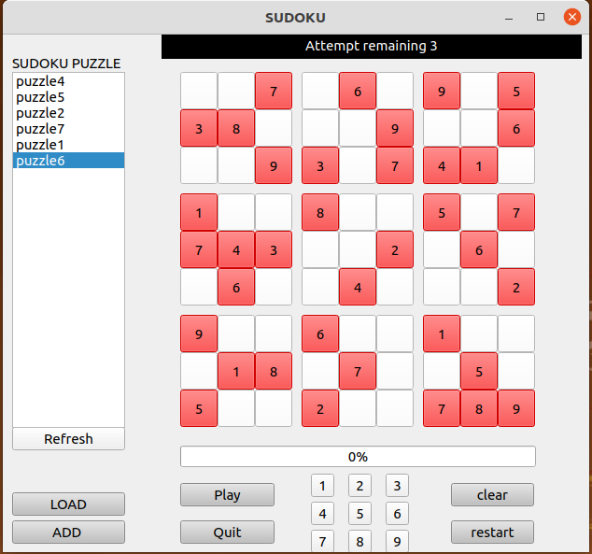
Intro(contd…)
Solve puzzle in 3 Attempts
User can Load a puzzle
Select a cell , fill choice[1-9]
If wrong entry Attempt decrease
If correct then fill next
User can add more puzzle

Slide 5
Programming Language and Packages
Python3
Pacakge
Pyqt5 - for interface design
Deepcopy - copy object
os - for reading files in directory

Slide 6
Interface
Message
List puzzle
Puzzle board
Refresh list
Clear cell
Load puzzle
Restart
Add Puzzle
Play Game
Quit

Slide 7
Backtracking
Systematically search for a solution
Build the solution one step at a time
If we hit a dead-end
Undo the last step
Try the next option
Exhaustively search through all possibilities.

Slide 8
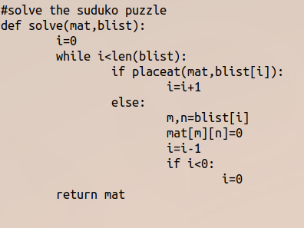
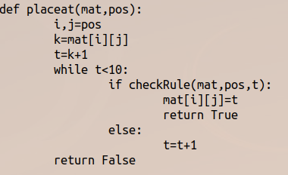
Algorithm

Slide 9
Future Development
Add timer
Add categories (Easy , Hard , Very Hard)
Separate solved and unsolved puzzle
Add puzzle more easily or have large database for puzzle.

Slide 10
Team Contribution
User Interface design - Amit Kushwaha(MIT2020031)
Sudoku(backtracking) , rule check - Chandra Mani(MIT2020112)

Slide 11
References
https://nptel.ac.in/courses/106/106/106106145/
https://www.geeksforgeeks.org/sudoku-backtracking-7/

Slide 12
THANK YOU!

