Slide 1

Text Summarizer Using Machine Learning
In partial Fulfillment of the Requirements
For the Degree of Bachelor of Technology
PROJECT TEAM MEMBERS:
AMIT KUSHWAHA (2015021012)
DEEPAK KUAMR(2015021029)
NITIN SINGH(2015021067)
Under Guidance of:
SMT. MEENU(ASSISTANT PROFESSOR)
Department of Computer Science and Engineering
MADAN MOHAN MALAVIYA UNIVERSITY OF TECHNOLOGY, GORAKHPUR(U.P.) INDIA
2018-2019

Slide 2
TABLE OF CONTENTS:
INTRODUCTION
TECHNOLOGY USED
TOOLS
WORKING
CONCLUSION
REFERENCES

Slide 3
INTRODUCTION
Overview of Problem Area
Finding relevant information from larger text.
Condensed form of text document.
Maintain general meaning of source.
Reducing user need to search entire document.
Time saving from unnecessary information.

Slide 4
What is Text Summarization?
Text Summarization is the process of creating a condensed form of text document which maintains significant information and general meaning of source text.
Type of Text Summarization
Extractive Summarization:
Extractive summarization extracts important sentences or phrases from the source documents and group them to generate summary without changing the source text
Abstractive Summarization
Abstractive summarization consists of understanding the source text by using the linguistic method to interpret and examine the text, conveying information in concise way.

Slide 5
PROBLEM SPECIFICATION:
Creating short, accurate, and fluent summaries from larger text documents using Machine learning.
Text summarizer learns the pattern to generate summary
Reducing text to readable form
Saving time from reading larger document
Relevant content from source as input

Slide 6
TECHNOLGY USED:
Machine Leaning:
Application of Artificial Intelligence.
Provides Systems ability to learn and improve from experience without being explicitly programmed.
Programs that can access data and use it to learn for themselves
Primary Aim is to allow computers to learn automatically without human intervention or assistance and adjust accordingly
Application in field of facial Recognition, Speech Recognition, Recommendation System, Image processing and etc.

Slide 7
Types of Machine Learning:
Supervised Learning:
Used when both input and output are known
Data is labeled
Unsupervised Learning:
Used when input is known but output is not known
Data is unlabeled
Reinforcement machine Learning:
Used when input and output for some input data, and grade data is present
Learn its behavior by feedback from Environment

Slide 8
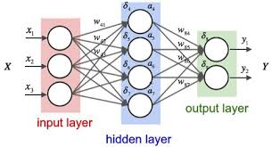
Neural Network:
It is a Information Processing paradigm that is inspired by the biological nervous system, such as the brain, process information.
The neural network itself isn’t and algorithm, but rather a framework for many different machine learning algorithms to work together and process complex data.
Notes:
<number>

Slide 9
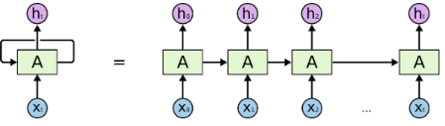
Recurrent Neural Network(RNN):
RNNs are used in Deep Learning and in the development of models that simulate the activity of neurons in the human brain
layered to process information in two directions.
In RNN neuron stores the state of previous input and combines with the current input thereby preserving some relationship of current input with the previous input.
RNN basically used in Speech Recognition, Translation, Generating Image description, Natural Language Processing

Slide 10
Sequence to Sequence model:
Encoder:
The encoder is responsible for stepping through the input time steps and encoding the entire sequence into a fixed length vector called a context vector.
Decoder
A decoder network to take this feature representation as input, process it to make its decision, and produce an output

Slide 11
Tools:
Data Manipulation
Pandas:
Python package, used for analyzing data.
Provides flexible reshaping of datasets
Easy handling of missing data
Suited for many different kinds of data such as sql table , excel spread sheet , arbitrary matrix data with row and columns labelled.
MODELLING:
Scikit Learn (sklearn)
Python package, free software machine learning library.
Provides large number of supervised and unsupervised learning algorithms such as kmeans , k-nearest , support vector machine

Slide 12
Keras:
Keras is high level neural networks API , written in Python which is capable of running on top of TensorFlow.
It was developed with a focus on enabling fast experimentation.
Support Convolutional Neural Network and Recurrent Neural Network
Runs seamlessly on CPU and GPU
User friendly as it has consistent interface optimized for common use.
Easy extensibility, new modules are simple to add.

Slide 13
Working:
Preparing the data
Convert to lower case
Remove any unwanted characters
Modelling
Training using Sequence to Sequence model with RNN
Generating model and storing
Testing
Testing for accuracy.
Predicting
Predicting result for user input using model generated.

Slide 14
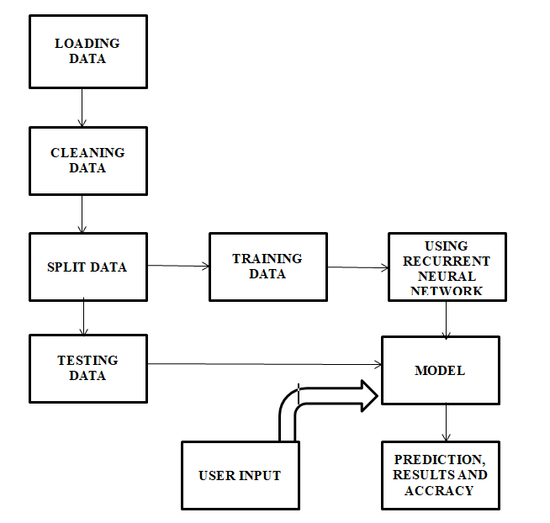

Slide 15
Conclusion:
Algorithm to solve problem related to human intelligence.
Can be used in many places such as news summarization, customer reviews summarization, research paper summarization, preparation of notes from documents.
Textual Information more useful if lesser and accurate.
Use of Technology to save time.

Slide 16
References:
https://www.wikipedia.org
https://towardsdatascience.com/text-summarization-with-amazon-reviews-41801c2210b
Deep Learning with Keras by Antonio Gulli and Sujit Pal

Slide 17
THANK YOU

