Slide 1

Louis de Looze

Slide 2

THE HERO
He needs to protect Paris!
[remy]

Slide 3








THE VILAINS
They are on their way to conquer Paris!
[ARES]
[LUKE]
[HANS]
[PABLO]
They all have their method of attack:

Slide 4
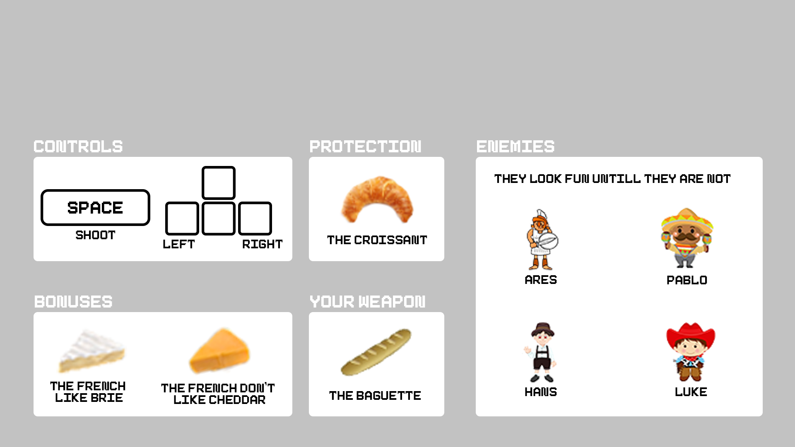
GAMEPLAY

Slide 5
FEATures
Resizable window and fullscreen mode
Animated characters
3 game levels
In-game music
User interface with mouse input
Pause screen

