Slide 1
IGSO Governance Model
Implementing an Information Governance (IG) Program to govern EIM across an organization
Corporate Governance
Enterprise Information Management (EIM) managing all of the data and information across an enterprise
Committee
IG-Program
Information
Governance
IT Governance
IT Governance
Information Governance
policies
rules
metrics
IT-Infrastructure
Performance & Risk
IT Process
Input & Output
Information
Management
Content Management
Records
Management
Digital Asset
Management
v
Data
of Value
Records
Assets
Information
Data
Information lifecycle management assigns appropriate value to information and specifies adequate storage policies
ALM – Critical asset lifecycle
Data lifecycle begins with the creation and extends through till disposition of data
RLM refers to the creation, classification, maintenance, and disposition of a record
*Informal

Slide 2
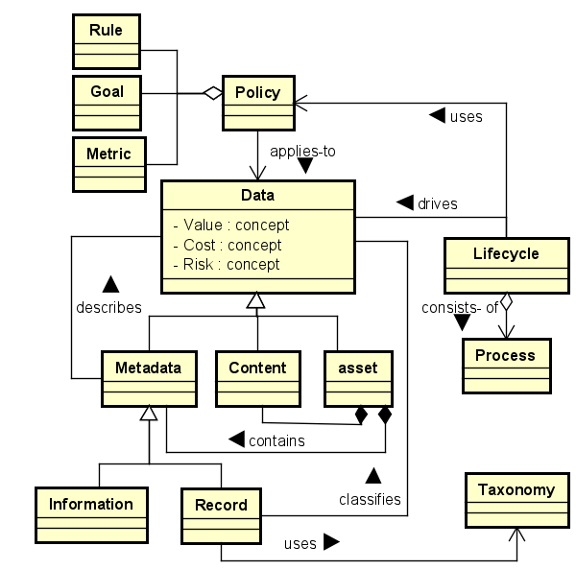
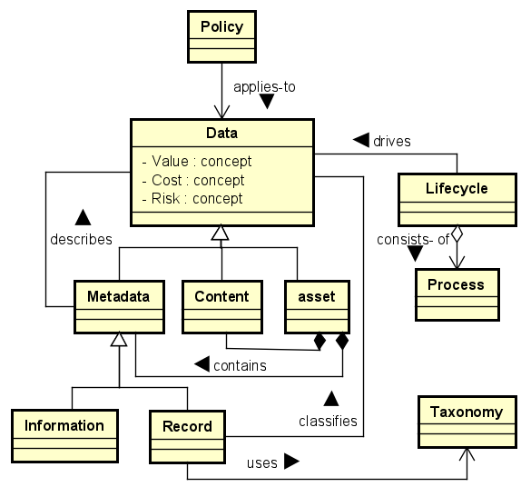
IGSO - Semantic Data & Policy Model

Slide 3
IGSO - Semantic Organization Model
Higher Management
instate
define
set
Committee & Execution Team
Regulation
define
advice
guides
manage
review
Is used by
IG-Program
ensure
IG-Goal
has goal
Maturity
Governance
achives maturity
Is computed from
Org Unit
IG Level
Legal
Risk & Compliance
Records Management
Business Unit
Architecture & Design
IT
Metric
defined by
defined by
generates
IG Requirements
IG Compliance
Lifecycle
govern
monitors
created from
Policy
Data
capture
Process
Service
Operations
Rule
applies to
Metadata
Asset
Best Practice
classifies
Implementation Model
Deployment Model
Retention
Deletion
Transfer
Information
Record
Include
Semantic Data Model
is a
Ontology
Knowledge Base
Model
Vocabulary
Relationship
Attribute
Constraint
Data Model
Concept Model
Architecture Blueprint

Slide 4
IGSO - Information Governance Semantic Model
Organization
supports
Enterprise
Governance
defines
complements
Business Unit
IM-Program
IG-Program
defines
defines
Information Model
Governance Model
defines
has goal
supports
B-Process
B-Goal
IM-Process
IG-Process
IG-Goal
drives
Risk
Value
Cost
Lifecycle
Goal
exposes
has
produces
Data
Policy
Rule
applies to
has
applies
Retention
Meta Data
Content
Asset
produces
Metric
Disposition
Is monitored
Transfer
is a
has
has
Information
Record
classifies
defines

Slide 5
IGSO Information Governance Semantic Model
Business Domain
governs
Governance Domain
governs
Implementation Domain
is governed by
has maturity
Organization
instate
define
set
Organization
responsible
Committee & Execution Team
defined by
define
advice
guides
manage
Is reviewed by
B-Model
Enterprise
Governance
has goal
IG-Goal
Maturity
guide
has goal
Is computed from
B-Goal
IG-Program
ensure
has goal
Org Unit
govern
Org Unit
IG Level
is supported by
satisfies
uses
has maturity
Business Unit
Development
IT
Legal
Risk & Compliance
Records Management
IT
Metric
review
B-Process
B-Service
Regulation
IG Requirements
IG Compliance
generates
capture
created by
defined by
produces
produces
has
Policy
Data
Lifecycle
monitors
Cost
Goal
rule
Is monitored
Operations
has
Lifecycle
applies
implements
Value
Data
Rule
Process
Service
exposes
monitor
Metadata
Content
Asset
Risk
is a
Metric
IG Services
Best Practice
Record
Information
Implementation Model
Deployment Model
Meta Data
Content
Asset
defined by
Include
has
has
Semantic Data Model
is a
Ontology
Knowledge Graph
Model
is a
Information
Record
classifies
Data Model
Concept Model
Architecture Blueprint

Slide 6
IGSO – Concept Artifacts Goals, Objectives, Strategy, and Programs
Role Agent Board Shareholders: disclose, monitors, Senior Executive Team: develops_straegy, defines_desirable_behavior Organization Enterprise / Corporation / Campany Department Management Legal RecordsManagement PrivacyAndCompliance Architecture Development IT BusinessSupportServices OperationsSupportServices BusinessUnit InformationManagement EnterpriseContentManagement InformationGovernanceServices RecordsManagementServices eDiscoveryServices Stragegy DesirableBehavior Data Metadata: Index: RelationalIndex, FullTextIndex Records: Classification, Policy: {Collection, Classification, Retention, Disposition, Hold, Transfer} Rule: {Collection, Classify, Retain, Dispose, Transfer} Asset: Information Assets: has Individuals:{Human, Financial, Physical, Intellect, Relation, IT} requires governance mechanism has Individuals:{planning, policies, program, budgets, measure,..]

Slide 7
IG-Program - Implementation Concept Artifacts
Architecture & Design
IG Services Implementation Model using Standards and Products Components:
Content Services:
Collect, Load, Store, Archive, Dispose
Index, Search & Retrieval Services;
Classification, Taxonomies,
Information Lifecycle, Workflows;
Security, Privacy Framework, Authentication & Authorization
Monitoring
Implementation Domain
Standards Services
CMIS / JSR 170 /OASIS
Vendors / Products / Services
Alfresco, OpenText, IBM Content Manager, Oracle, MS Office 365
Operations Domain
IG Cloud Services Domain Specific Language (IGS-DSL) based on TOSCA-DSL and YAML Grammar
TOSCA Cloud Platform Agnostic Services
TOSCA Base Services
Cloud Platform Agnostic IG Services
Platform Domain
RedHat OpenShift, Microsoft Azur, Amazon Cloud, Google Cloud
. Software Technology &Tools; Business Support Services;
. Cloud, Orchestrators, Applications & Services;
. Cloud, Servers, Storage, Network & Connectivity;
. Operations Support Services: Monitoring & Metering;

Slide 8
Information Governance Process Maturity Model and its Ontology
Personal data processed for any purpose or purposes shall not be kept for longer than is necessary
for that purpose or purposes. Time limits should be established by the controller for erasure or for periodic review.
— Regulation (EU) 2016/679 of the European Parliament and of the Council, 27 April 2016
Information assets are often the worst governed
Information assets are often the least understood
Information assets are often the most poorly utilized key asset
Data Is increasingly easy to collect and digitize
Data Has increasing importance in products and services
Data Is very hard to value or price
Data Has a decreasing half-life
Data Has increasing security and privacy risk exposure
Data Is a significant expense in most enterprises
is governed by an IG Program
is metadata / tagging of -> data
classified, taxonomy, ML, AI
is collected, stored, searched, retrieved, disposed, archived
is_classified, is_categorized
has value, has price, has half-life, has_importance, has risk,
has cost,
is secured by, is_hard_to, is managed by, is administered by
is_an_expense, is_easy_to_collect, is_easy_to_digitize
Information assets, governed, key asset, collect, digitize, importance, products, services, Data, value, price, half-life, security, privacy, risk, exposure, expense, enterprises, Data Governance, decision rights, accountability framework, behaviors, Data, Data Governance design,
Relations: has Decreasing, has Increasing, is Significant, is Hard To, is Significant, to encourage, desirable, collection effort, business, use, lays out, alignment processes,
Metrics: importance, value or price estimate, half-life, decay-time, security risk exposure, privacy risk exposure, associated expense,

Slide 9
Information Governance Solutions Blueprint
Information Governance Services & Management eDiscovery & Retention Policy Syndication
Retention Policy, Schedule, Disposal and eDiscovery Processes, IT Governance
Functions: Execute - Classify, Store & Archive - Retain, Dispose & Deliver
Known Data Sources
Data Collection
Policy-Driven Collection from known sources
Enterprise Records
Case Management
Platform Services
IG-Lifecycle
<Component>
<Component>
Process
Scaled-out Storage (e.g. GPFS, SAN)
Process
Process
Repository
Content Management
Archive
<Component>
Data Assessment
Provenance
Quality
Integrity
Content in the “Wild”
Dispose
Fast Storage for Database & Text Index
Text Index
Catalog - RDB
<Component>
<Component>
Analyzing
eDiscovery
Data
Classification
Data Lakes
Content Analytics
Sources
<Component>
<Component>
Pre-processing
Processing
Persisting
Post-processing
Resources

Slide 10





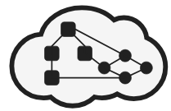
IGONTO Framework
IGONTO Governance Implementation Framework & Components
Tools
Protégé’-UI
Gruff Graph-UI
Query & Retrieval
Content Services
Rest /SPARQL
Gruff
Jena
TBD
Fuseki
CMIS / Rest
Domain
IG & EIM Domain Knowledge Acquisition from Frameworks &
Best Practices
Knowledge Assessment
Vocabulary Harmonization
Taxonomy & Classification
Semantic Model
OWL Description logic
Fuseki – SPARQL Protocol
Artefacts
Jena TDB
Triple Store
Standards
Semantic Schema Repository
Standards Requirements
Regulations & Compliance
Architecture Design Models
IG Solution Components
Component Usage Notes
Component Description
TOSCA Service Templates
TOSCA Topology Templates
TOSCA Built Plan
Design Artefacts
Open Source
Cloud Native Technology
Open Source Framework
Service Templates
Content
Repository
PostgreSQL
OpenTOSCA
Vendors
Vendor Platform Services
Vendor Software Services
OS Service Components
Vendor Platform Offerings
Usage Notes
Service Descriptions
Acquisition
Pre-processing
Processing
Repository
Post-processing

Slide 11
IGONTO Framework Data Pipeline
Acquisition
Processing
Access
Delivery
Solution
Blueprint
Execution
Environment
Domain Knowledge
Taxonomy,
Concepts
Ontology
Graph Store
Artefact Repository
Vocabulary
Guidelines
Standards
Best Practices
Vocabulary Terms
Sematic Model
Design Models
Build
Plans
Rule Sets
Component Models
Descriptions
Service Templates
Service Templates
Triple Store
Design Artefacts Usage Notes
Platform Build Plan
Sematic
Model
Design
Model
Content Repository
Service
Template
Component
Model
OpenTOSCA

Slide 12
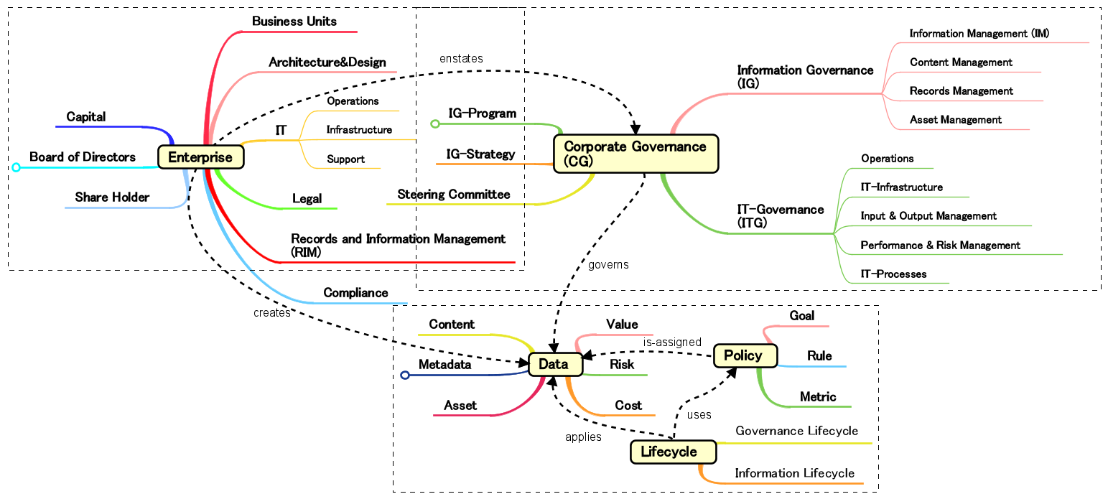
Appendix IGS Information Model

Slide 13
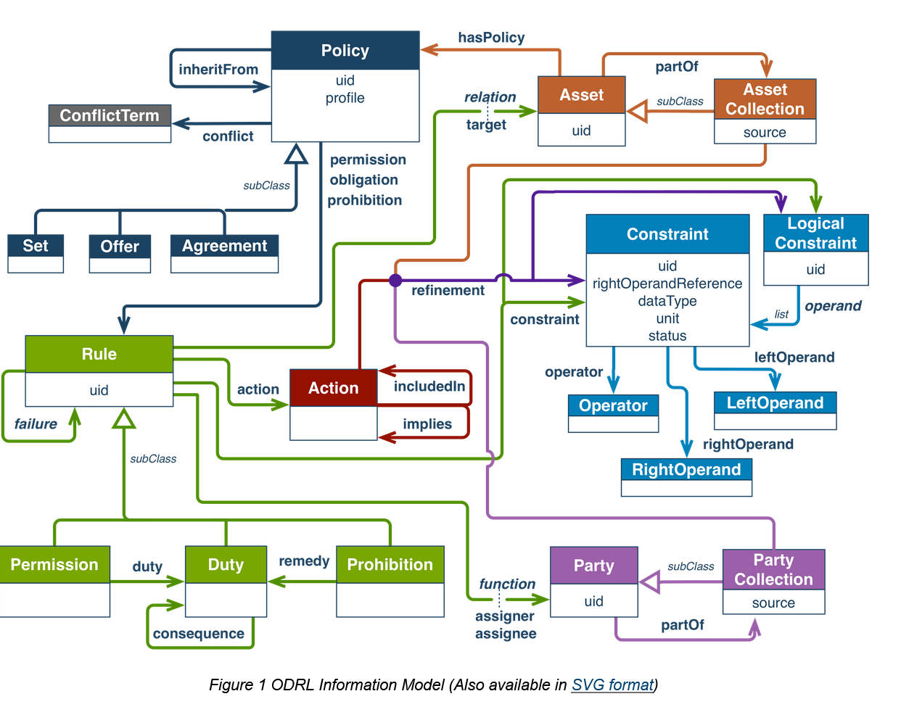
Appendix W3C ODRL Information Model
Link

Slide 14
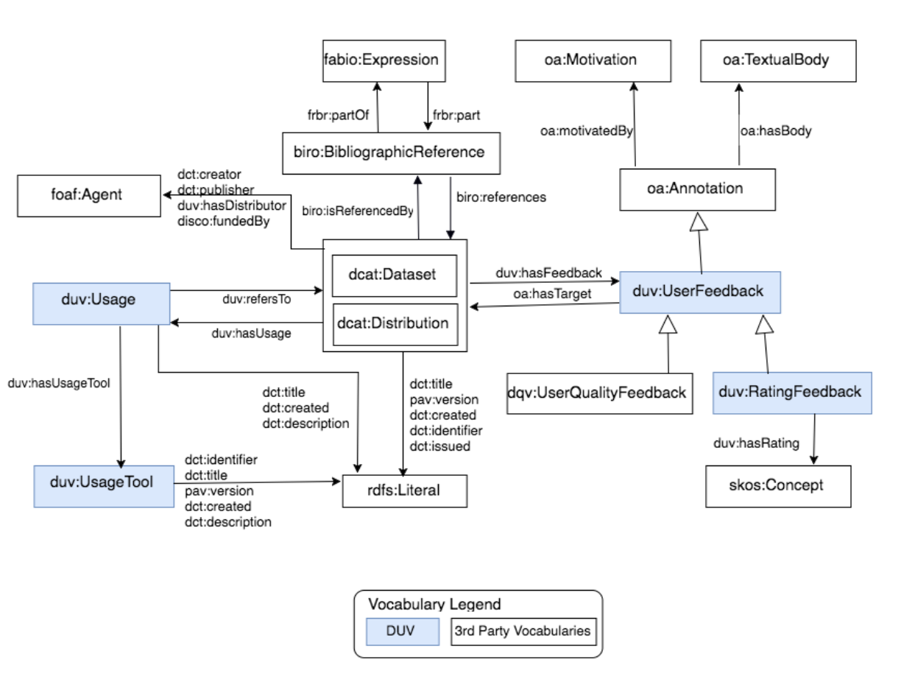
Appendix W3C Dataset Model
Link

