Slide 1

Getting started with version control and
Subversion
Thái Thanh Phong
Đỗ Gia Cường
Saigon Studio

Slide 2
Objectives
Introducing the concept of version control.
Understanding the importance and benefit of version control in software development.
Introducing fundamental principles on version control and version control system.
Getting started with Subversion and the TortoiseSVN client on Windows.
Questions & Comments

Slide 3
What is Version Control?
From Wikipedia:
  Revision control (also known as version control) is the management of multiple revisions of the same unit of information.
To be simpler, it is:
  The practice which tracks and provides controls over changes to data (source code, gfx, documents,…).
Version control system (VCS):
  Software which ‘serves’ that practice.

Slide 4
Why use it?
Provides a consistent and reliable method to keep multiple versions of a set of information.
The ability to track changes,
  Who did what and when?
Easy to 'roll back' to an earlier version of the information,
  If a serious mistake was made during a change.
Reduce duplication of work,
  Status of a project is always updated to every member of a team (what has been done, what is being done, etc…).

Slide 5
Subversion
Open-source version control system.
Many good features.
Easy to use.
Gameloft’s worldwide standard.

Slide 6
Getting started with TortoiseSVN
Daily use guide
Further references:
  GameloftSVNGuide102.doc
  GameloftSVNBestPractices100.doc
  Gameloft-SVN-Usage1.0.2.pdf

Slide 7
Basic Terms & Concepts
Repository: is where data are stored, often on a server. Also called repo or depot.
Working Copy: is user’s copy of a piece of data in the repository.
Network
Client
Server
Working copy
Repository

Slide 8
Basic Terms & Concepts
Revision (also called rev. or r.): A version of a file or a group of files.
HEAD: The latest revision of a file or folder in the repository.
BASE: The “pristine” revision of an item in a working copy (or, to put it simply: it’s the latest unmodified version).

Slide 9
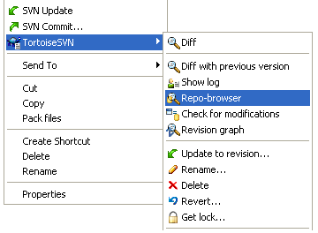
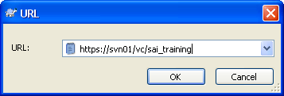
Basic Terms & Concepts
Open browser on Repository: Right-click. Choose Repo-browser (left image). And enter your svn link (right image):

Slide 10
Basic Terms & Concepts
Import: uploads a local file/folder into the repository.
import
Local folder
Repository
Check-out: creates a local working copy from the repository.
Working copy
checkout
Local folder
Repository
In sync

Slide 11
Basic Terms & Concepts
Commit (or Check-in): uploads changes made in the working copy to the repository. Every successful commit results in a new revision on the repository.
Working copy
commit
Local folder
Repository
In sync
* Atomic commit: means an all-or-nothing operation. That is, when the commit succeeds, all of its changes are stored permanently; when it fails, they're completely reversed.

Slide 12
Basic Terms & Concepts
Export: similar to a check-out except that it creates a clean directory tree without the version control metadata used in a working copy. Often used prior to publishing the contents.
“clean” source
export
Local folder
Repository

Slide 13
Basic Terms & Concepts
Update: brings the working copy in sync with the changes being made in the repository.
Working copy A
commit
update
Local folder
Repository
Working copy B
In sync
In sync

Slide 14
TortoiseSVN: Icon status
A fresh checked out working copy has a green checkmark as overlay. That means the Subversion status is normal.
As soon as you start editing a file, the status changes to modified and the icon overlay then changes to a red exclamation mark. That way you can easily see which files were changed since you last updated your working copy and need to be committed
If during an update a conflict occurs then the icon changes to a yellow exclamation mark.
This icon shows you that some files or folders inside the current folder have been scheduled to be deleted from version control or a file under version control is missing in a folder.
The plus sign tells you that a file or folder has been scheduled to be added to version control.

Slide 15
Basic Terms & Concepts
Conflict: occurs when two or more persons made changes to the same place within a document. Since the software may not be intelligent enough to decide which change is 'correct', a user is required to resolve the conflict.
Resolve: the act of user intervention to address a conflict between different changes to the same document and decide which change should be applied.

Slide 16
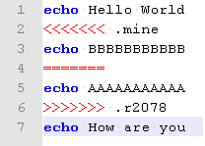



Basic Terms & Concepts
Conflict:
commit
Working copy A
update
Local folder
update
Repository
Working copy B
In sync
Out of date
In sync

Slide 17
Basic Terms & Concepts
Revert: undo the changes you made to a file or a set of files.
There are 2 types of revert:
  - To the BASE revision.
  - To any previous revision.

Slide 18
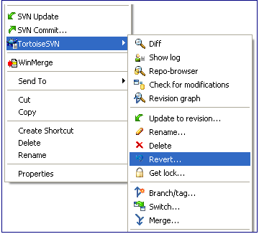
Basic Terms & Concepts
Revert 1: to the BASE revision.

Slide 19
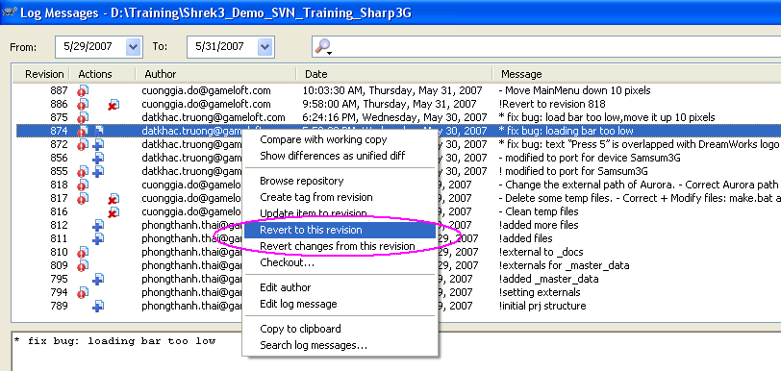
Basic Terms & Concepts
Revert 2 (1): to a specific revision.

Slide 20
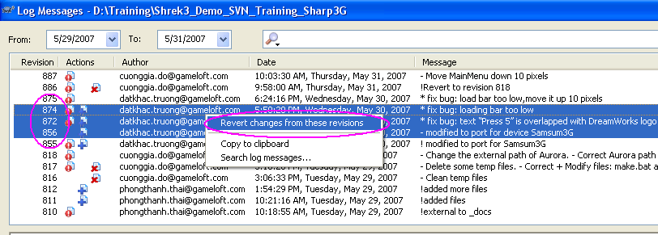
Basic Terms & Concepts
Revert 2 (2): undo all actions in some revisions.

Slide 21
Basic Terms & Concepts
Externals: SVN feature for constructing a working copy that is made out of a number of different checkouts. (For example, you may want different subdirectories to come from different locations in a repository, or perhaps from different repositories altogether).
External is only a link. The actual data are not on the folder that contains the external.

Slide 22
Basic Terms & Concepts
For Externals: only update, don't commit.
To change resources of externals -> create new resource on an own folder -> use “bat” script to copy new one to overwrite external one.

Slide 23
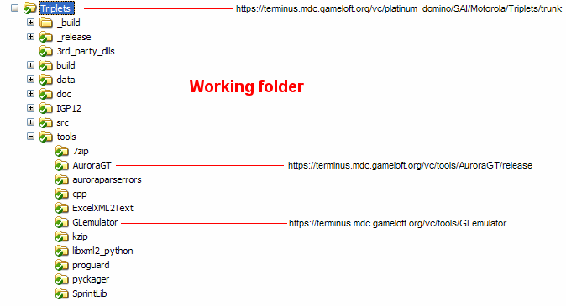
Basic Terms & Concepts
Externals (cont.)‏

Slide 24
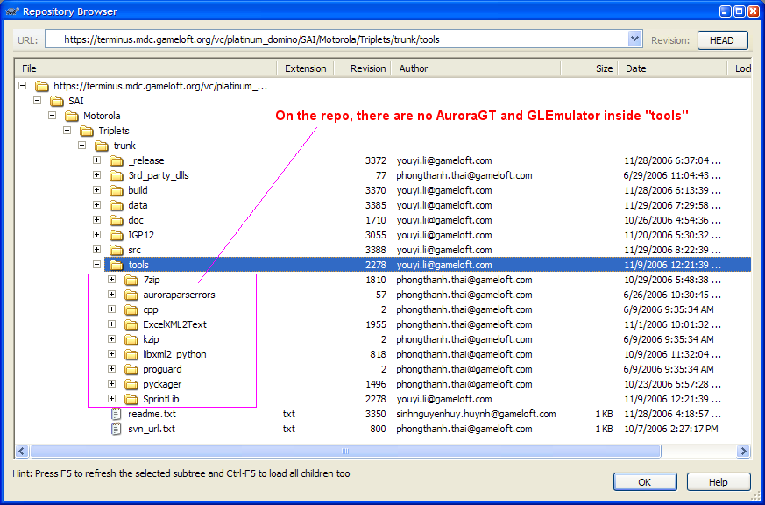
Basic Terms & Concepts
Externals (cont.)‏

Slide 25
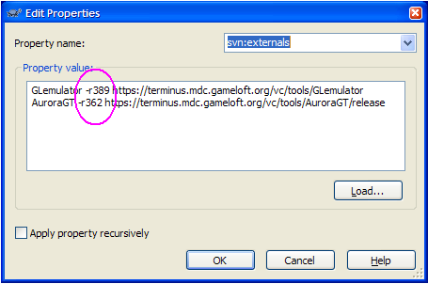
TortoiseSVN: more about external
External with a fixed revision.

Slide 26
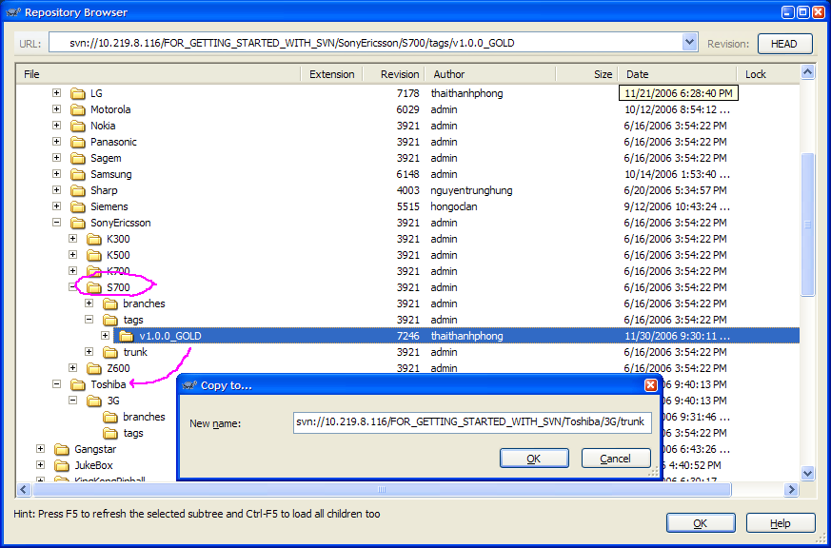
Copy to...
Starting a project using “copy to” (do this when source is GOLD).

Slide 27
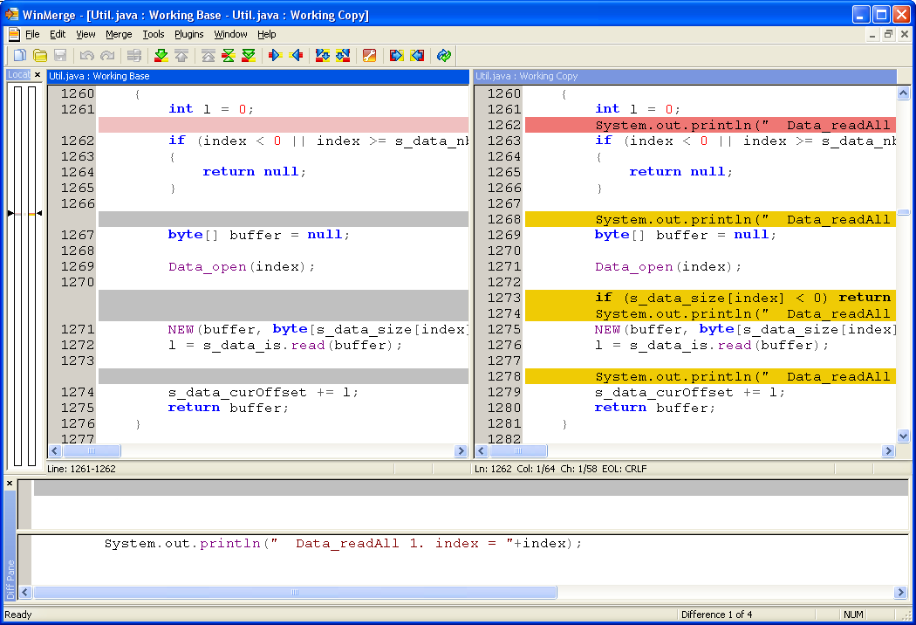
TortoiseSVN: show differences
Right click on a modified file -> TortoiseSVN -> Diff

Slide 28
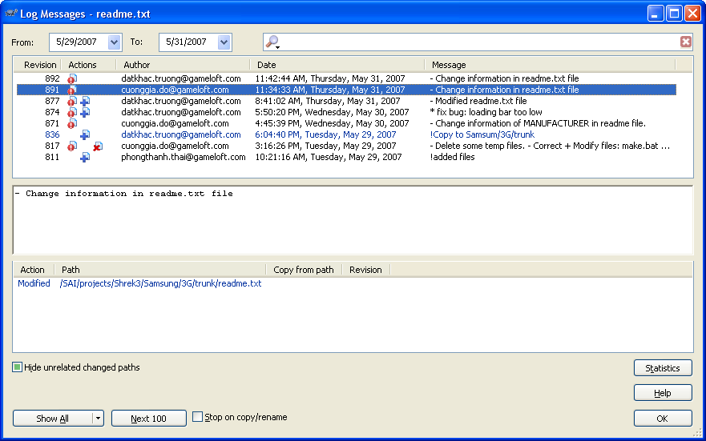
TortoiseSVN: show log
Right click on any file/folder -> TortoiseSVN -> Show log

Slide 29
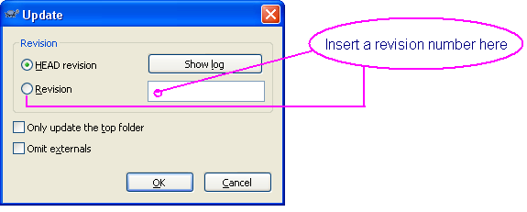
TortoiseSVN: update to revison
Right click on any file/folder -> TortoiseSVN -> Update to revision...

Slide 30
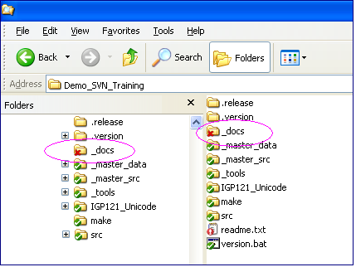
TortoiseSVN: delete
Don't use delete function of MSWindows.
Right click on file/folder that need be deleted -> TortoiseSVN -> Delete

Slide 31
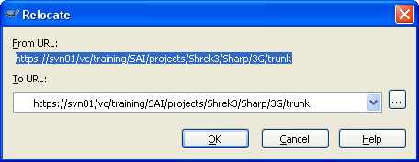
TortoiseSVN: relocate
Right click on the a specific folder -> TortoiseSVN -> Relocate...

Slide 32
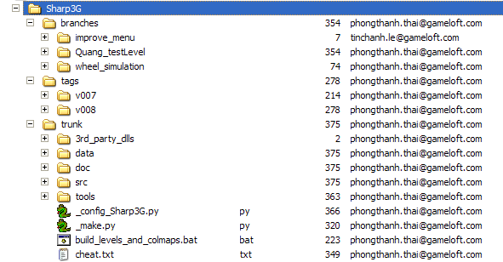
Repository Layout
Trunk: root folder which contains a project’s resource (source code, data, etc…) and is the main line of development.
Branch: a separate copy of the trunk for creating features in parallel with ongoing development of the trunk. Also called feature branches.
Tag: contains copies of the trunk used for creating releases and snapshots. Also called release branches.

Slide 33
Basic Terms & Concepts
Merge: the action of taking 2 versions of a file and combining the changes.
CGame.java
(revision 10)‏
CGame.java
(revision 12)‏
The differences between rev.10 and rev.12
CGame.java
(a newer revision)‏

Slide 34
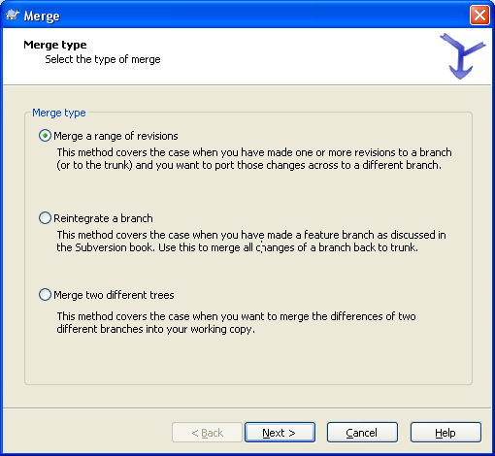
TortoiseSVN: Merge
Right click on the a folder -> TortoiseSVN -> Merge...

Slide 35
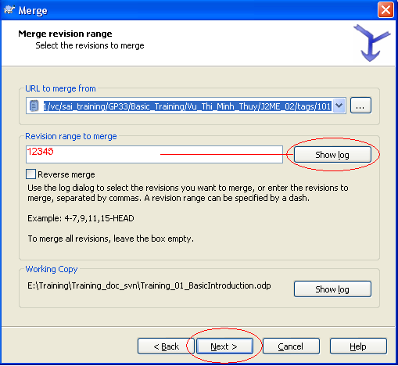
TortoiseSVN: Merge
Merge (cont.)‏

Slide 36
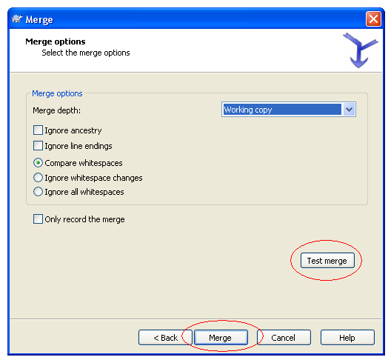
TortoiseSVN: Merge
Merge (cont.)‏

Slide 37
Commit policy
Commit soon, commit often.
Best to commit one conceptual change at a time: 1 bug fix or 1 feature implemented = 1 commit.
Source code should at least compile.
Don’t put “garbages” (intermediate files, backup files, etc…) on the repo.

Slide 38
Commit policy
Prefix your log message using:
+ for a new feature
- for a modified feature
* for a bugfix
! for an important note
Write clear, useful log messages.
  Bad:
    - Update
    * Fixed all bugs
    ! Backup 23/10/2006
  Good:
  + Added OTT sounds for Nokia MIDP1 + code to play them.
  - Updated IGP logo for WHAT'S NEW and BEST SELLERS.
  * Fixed bug #13754: wrong calculation of player’s scores.

Slide 39
Log message writing
Write the CONTENT of the action. Don't write the surface of the action. Example:
  - OK to write: “Move position of loading bar up to 5 pixels”.
  - Don't write: “Modify file Interface.java”.
To answer some questions like: for what? Why need to add/modify? To fix which bug?...
Adding files or folders is NOT always new feature. May be that is bug fixed.

Slide 40
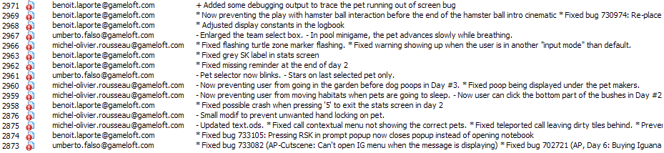
Log message references
M:\Specialized\Programming\Training\Training_08_SVN_good_log_messages.png.
M:\Specialized\Programming\Training\_Training_Suggestion.txt.

Slide 41
Questions & Comments
Feel free to ask questions and
contribute suggestions, ideas.
☺

