Slide 1

Tortoise SVN
SAI Training
Huynh Thanh Thao

Slide 2
Tortoise SVN
Version Control
1. What is Version Control?
2. Why use it?
Tortoise SVN
1. Basic Terms & Concepts
2. To Use Tortoise SVN
3. Policy SVN

Slide 3
Getting started with
Version Control!

Slide 4
What is Version Control?
Revision control (also known as version control) is the management of multiple revisions of the same unit of information.
Version control system (VCS):
Software which ‘serves’ that practice.

Slide 5
Why use it?
To keep multiple versions of a set of information
Who did what and when?
Easy to 'roll back' to an earlier version
Reduce duplication of work
Status of a project is always updated to every member of a team

Slide 6
Getting started with
Tortoise SVN!

Slide 7
Basic Terms & Concepts

Slide 8
Basic Terms & Concepts
Repository: is where data are stored, often on a server.
Working Copy: is user’s copy of a piece of data in the repository.
Revision (also called rev. or r.): A version of a file or a group of files.
HEAD: The latest revision of a file or folder in the repository.
BASE: The “pristine” revision of an item in a working copy (or, to put it simply: it’s the latest unmodified version).

Slide 9

Basic Terms & Concepts
Import & Export
“clean” source
Import
Export

Slide 10
Basic Terms & Concepts
Check-out:
Commit:
Atomic commit: means an all-or-nothing operation. That is, when the commit succeeds, all of its changes are stored permanently; when it fails, they're completely reversed.

Slide 11
Basic Terms & Concepts
Update: brings the working copy in sync with the changes being made in the repository.

Slide 12
Icon status
A fresh checked out working copy has a green checkmark as overlay. That means the Subversion status is normal.
As soon as you start editing a file, the status changes to modified and the icon overlay then changes to a red exclamation mark. That way you can easily see which files were changed since you last updated your working copy and need to be committed
If during an update a conflict occurs then the icon changes to a yellow exclamation mark.
This icon shows you that some files or folders inside the current folder have been scheduled to be deleted from version control or a file under version control is missing in a folder.
The plus sign tells you that a file or folder has been scheduled to be added to version control.

Slide 13
Basic Terms & Concepts
Conflict: occurs when two or more persons made changes to the same place within a document. A user is required to resolve the conflict.
Resolve: the act of user intervention to address a conflict between different changes to the same document and decide which change should be applied.

Slide 14
Basic Terms & Concepts
Conflict

Slide 15
Basic Terms & Concepts
Externals
SVN feature for constructing a working copy that is made out of a number of different checkouts.
Is only a link. The actual data are not on the folder that contains the external.
Only update, don't commit
To change resources of externals -> create new resource on an own folder -> use “bat” script to copy new one to overwrite external one.

Slide 16
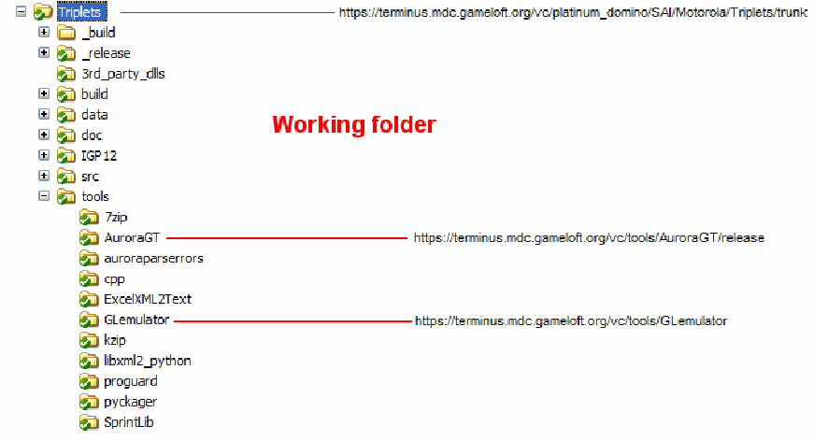
Basic Terms & Concepts
Externals (cont)

Slide 17
Basic Terms & Concepts
Externals (cont)

Slide 18
Basic Terms & Concepts
External with a fixed revision

Slide 19
Tortoise SVN
Open browser on Repository

Slide 20
Tortoise SVN
Repository Layout
Trunk: root folder which contains a project’s resource (source code, data, etc…) and is the main line of development.
Branch: a separate copy of the trunk for creating features in parallel with ongoing development of the trunk. Also called feature branches.
Tag: contains copies of the trunk used for creating releases and snapshots. Also called release branches.

Slide 21
Tortoise SVN
Copy to...
Starting a project using “copy to” (do this when source is GOLD).

Slide 22
Tortoise SVN
Show differences:
Right click on a modified file -> Tortoise SVN -> Diff
Difference between information on Working Copy and BASE

Slide 23
Tortoise SVN
Show log:
Right click on any file/folder -> Tortoise SVN -> Show log

Slide 24
Tortoise SVN
Update to revision:
Right click on any file/folder -> Tortoise SVN -> Update to revision...
Relocate
Right click on the a specific folder -> TortoiseSVN -> Relocate...

Slide 25
Tortoise SVN
Delete:
Don't use delete function of MS Windows.
Right click on file/folder that need be deleted -> Tortoise SVN -> Delete

Slide 26
Tortoise SVN
Revert
Undo the changes you made to a file or a set of files. There are 2 types of revert:
Revert 1: to the BASE revision

Slide 27
Tortoise SVN
Revert (cont)
Revert 2 (1): to a specific revision

Slide 28
Tortoise SVN
Revert (cont)
Revert 2 (2): undo all actions in some revisions

Slide 29
Tortoise SVN
Merge
The action of taking 2 versions of a file and combining the changes.
If a serious mistake was made during a change.

Slide 30
Tortoise SVN
Merge (cont)
Right click on the a folder -> TortoiseSVN -> Merge...

Slide 31
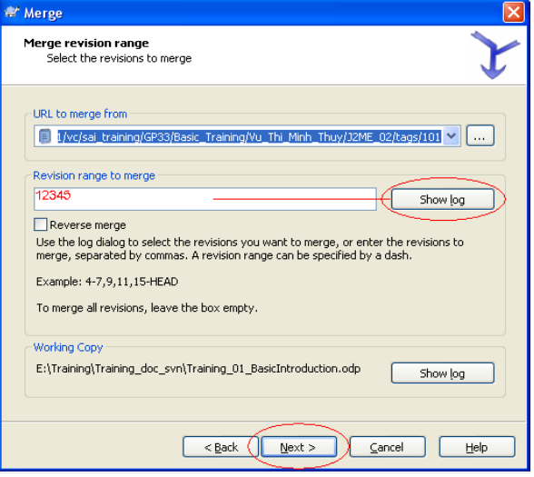
Tortoise SVN
Merge (cont)

Slide 32
Policy SVN
Commit
Commit soon, commit often.
Best to commit one conceptual change at a time: 1 bug fix or 1 feature implemented = 1 commit.
Source code should at least compile.
Don’t put “garbage” (intermediate files, backup files, etc…) on the repo.

Slide 33
Policy SVN
Commit (cont)
Prefix your log message using:
+ for a new feature
- for a modified feature
* for a bugfix
! for an important note
Write clear, useful log messages.
Bad:
- Update
* Fixed all bugs
! Backup 23/10/2006
Good:
+ Added OTT sounds for Nokia MIDP1 + code to play them.
- Updated IGP logo for WHAT'S NEW and BEST SELLERS.
* Fixed bug #13754: wrong calculation of player’s scores.

Slide 34
Policy SVN
Log message writing
Write the CONTENT of the action. Don't write the surface of the action. Example:
OK to write: “Move position of loading bar up to 5 pixels”.
Don't write: “Modify file Interface.java”.
To answer some questions like: for what? Why need to add/modify? To fix which bug?...
Adding files or folders is NOT always new feature. May be that is bug fixed.

Slide 35
Policy SVN
Log message references

Slide 36
Questions & Comments

