Slide 1
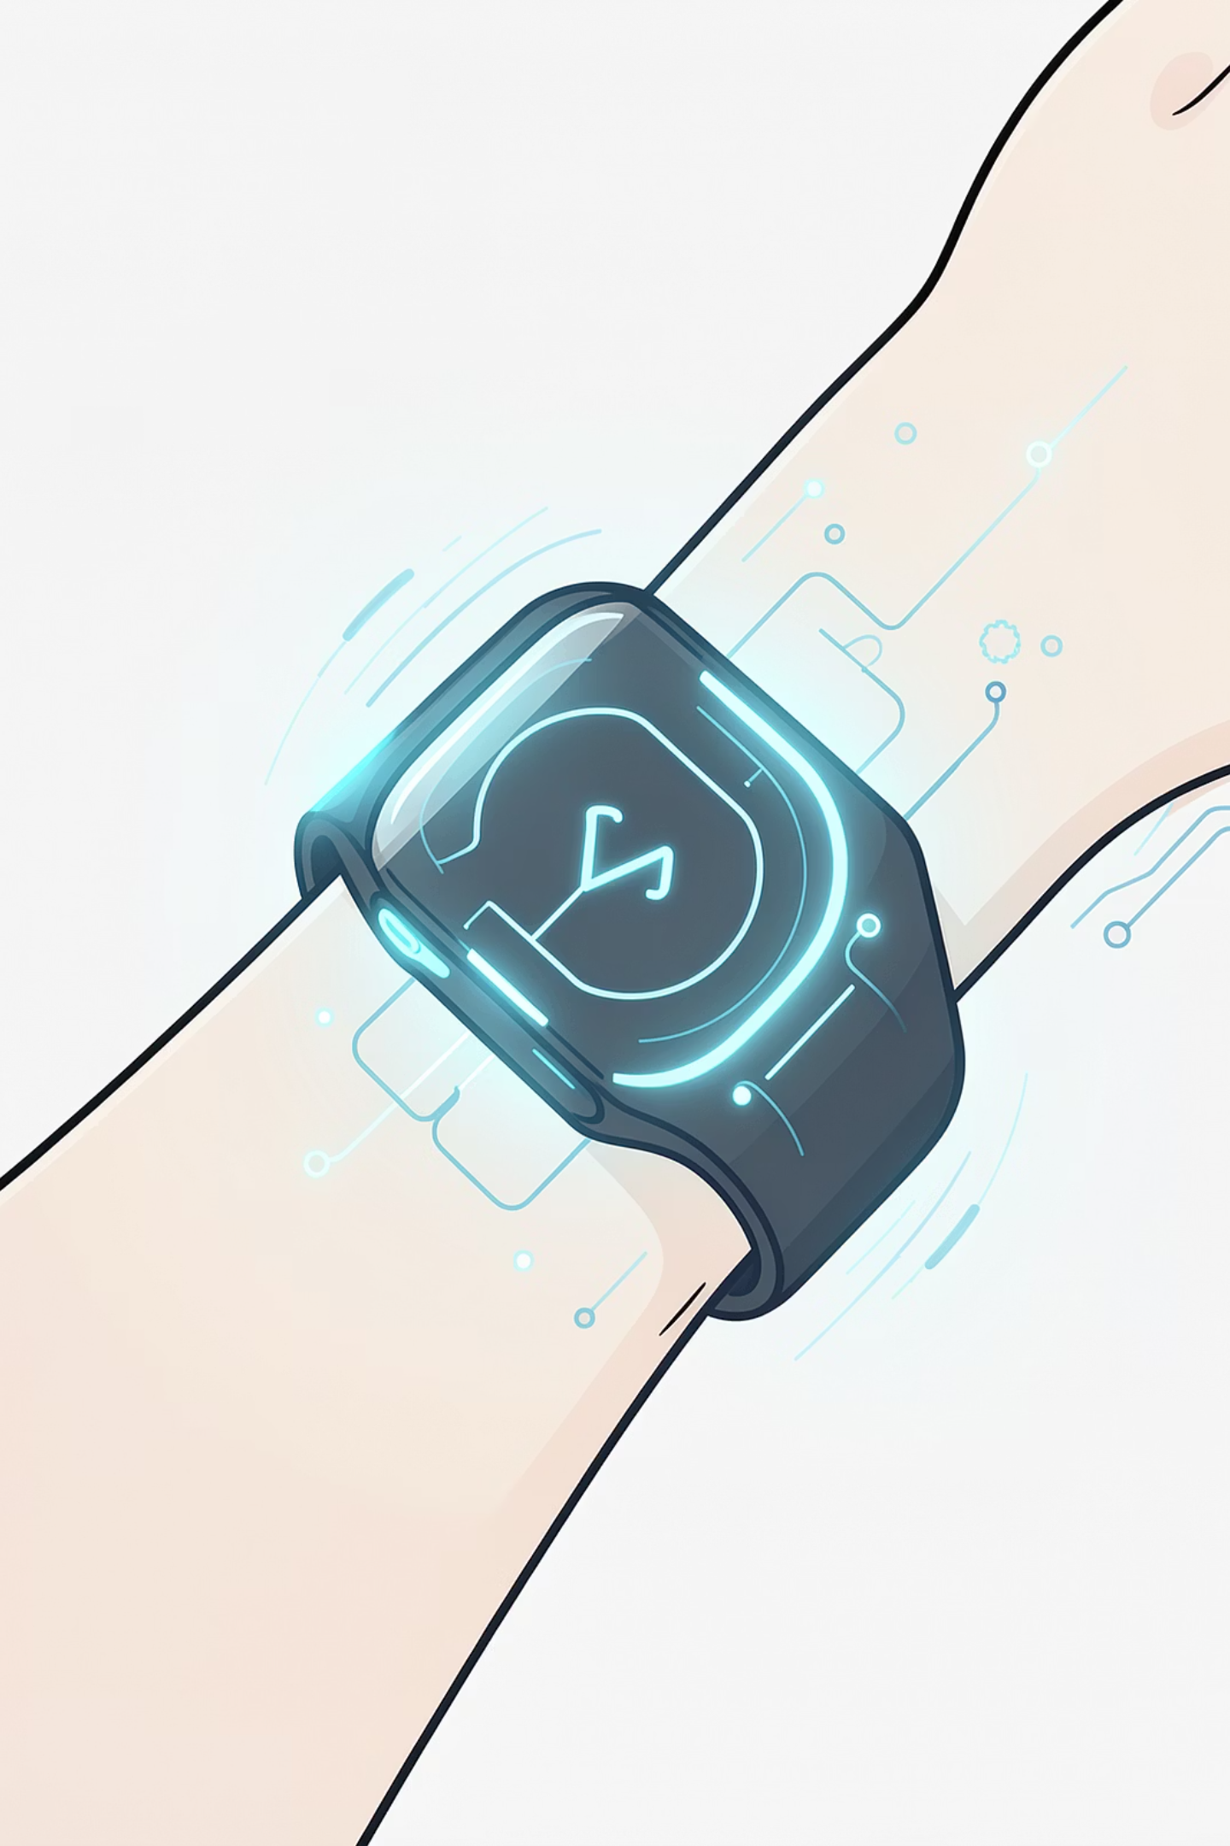
ENGINEERING PROJECT PRESENTATION
Real-Time Stress
Detection
using Physiological Signals
and Machine Learning
ESP32 wearable • leakage-safe ensemble • live web application
[Student name(s)] · [Roll number(s)]
Supervisor: Dr. Anupam Kumar
ECE Department · NIT Patna
CONCEPT VISUAL
01
Notes:
This project connects a multi-sensor wearable to a real-time machine-learning service and browser dashboard. The presentation focuses on the complete engineering pipeline, from sensing through a practical breathing response.

Slide 2
INTRODUCTION
From biosignals to action
A wearable-to-web system that senses physiological changes, estimates stress probability, visualizes it live, and guides a calming response.
01
02
03
04
SENSE
PROCESS
PREDICT
RESPOND
Three physiological
sensors
30 s windows
18 features
Baseline vs. stress
every ~5 seconds
Live dashboard
guided breathing
5
SENSORS
18
FEATURES
16
SUBJECTS
0.913
DEPLOYED ACCURACY
Accuracy shown for deployed stacking under nested subject-independent evaluation.
02
Notes:
The system has four linked jobs: sense, process, predict, and respond. These proof points summarize the scale of the implementation before we look at each stage in detail.

Slide 3
MOTIVATION
Why real-time stress monitoring?
“Can a wearable recognize
sustained stress early enough
to support self-regulation?”
PROBLEM
01
Physiological change
Heart rate · skin conductance · temperature
02
OBJECTIVE
Classify in near real time
Stress can alter several signals at once. A multi-sensor view is more useful than relying on a single instantaneous reading.
Distinguish baseline from stress using fused wearable signals
03
OUTCOME
Make the result actionable
Probability · live view · history · breathing prompt
ENGINEERING PROTOTYPE - NOT A MEDICAL DIAGNOSTIC DEVICE
03
Notes:
Stress is not read directly from one sensor. The goal is to combine three physiological signals, estimate a probability, and present it in a way that supports timely action without making a medical diagnosis.

Slide 4
SYSTEM DESIGN
How the system works
01
02
03
04
05
1
2
3
4
5
WEARABLE
ACQUIRE
PROCESS
INFER
PRESENT
MAX30105 · GSR
MLX90614
ESP32
USB serial
30 s window
18 features
Stacking
EMA smoothing
WebSocket
React + SQLite
PLUGGABLE INPUT
LIVE CADENCE
Serial hardware · CSV replay · TCP · Synthetic/demo
A new prediction about every 5 seconds after the first window fills.
115200 baud • authenticated WebSocket • train/serve feature parity
04
Notes:
The three-sensor hardware produces a one-hertz summary over USB serial. The service buffers thirty seconds, extracts the same eighteen features used in training, classifies and smooths the result, then pushes it to the browser and session database.

Slide 5
HARDWARE
Three-sensor wearable
MAX30105
Optical heart rate / BPM
MLX90614
ESP
Temperature
GSR SENSOR
Electrodermal activity · raw ADC
ESP32 DEVKIT V1
Acquisition + USB serial streaming
1 Hz SENSOR SUMMARY
USB · 115200 BAUD
MAX30105 heart rate, GSR skin conductance, and MLX90614 temperature form the complete hardware input.
Research prototype - not a medical diagnostic device.
05
Notes:
Three sensors feed the ESP32: MAX30105 supplies heart rate, GSR supplies skin conductance, and MLX90614 supplies temperature.

Slide 6
SIGNAL PROCESSING
From raw signals to model features
LIVE FEATURE PIPELINE
DATASET
16
1 Hz
✓
30 s
5 s
18
subjects
SENSOR SUMMARY
QUALITY CHECKS
WINDOW
STRIDE
FEATURES
15 WESAD + 1 project-hardware subject
5,462
HEART RATE / PPG
GSR
windows
7
8
mean · variation · range
slope · pNN proxy
level · variation · range
slope · area · peaks
BASELINE 3,498
STRESS 1,964
64%
36%
3
TEMPERATURE
QUALITY GATE
mean · variation · slope
BPM 40–200 · at least 70% valid samples per window
Same 18-feature ordering in training and live inference.
WESAD - Schmidt et al., 2018
06
Notes:
The evaluation combines fifteen WESAD subjects with one project-hardware subject. Every thirty-second window becomes a fixed eighteen-feature vector, and the exact same extraction code and column order are used offline and in the live service.

Slide 7
MACHINE LEARNING
Leakage-safe multi-model ensemble
P
RBF SVM
P
RANDOM FOREST
P
XGBOOST
P
MLP 64–32–16
baseline + fallback
tree ensemble
gradient boosting
neural network
FOUR P(STRESS) OUTPUTS
SOFT VOTING
STACKING
DEPLOYED
Average the four model probabilities
Logistic Regression learns the combination
LEAKAGE GUARD
Hold out one subject → train on the others → grouped out-of-fold probabilities → train meta-model → test once
No data from the held-out subject enters tuning or training.
07
Notes:
Four base models produce separate stress probabilities. Soft voting averages them, while the deployed stacking model learns their combination from grouped out-of-fold predictions, ensuring the held-out subject never leaks into model selection or training.

Slide 8
EVALUATION
Subject-independent model results
NESTED LOSO · 16 SUBJECTS · 5,462 WINDOWS
0.918 / 0.910
weighted soft voting · accuracy / macro-F1
0.913 / 0.906
deployed stacking · accuracy / macro-F1
0.897 / 0.889
SVM baseline · accuracy / macro-F1
HONEST INTERPRETATION
Ensembles lead on pooled metrics, but the per-subject difference from SVM is not statistically significant at n = 16.
Source: project evaluation reports · ROC-AUC: stacking 0.962 · SVM 0.955
08
Notes:
Weighted soft voting has the highest pooled score, while stacking is the deployed model because it learns its combination from out-of-fold data. The gap is small relative to between-subject variation, so the defensible claim is comparable performance rather than proven superiority.

Slide 9
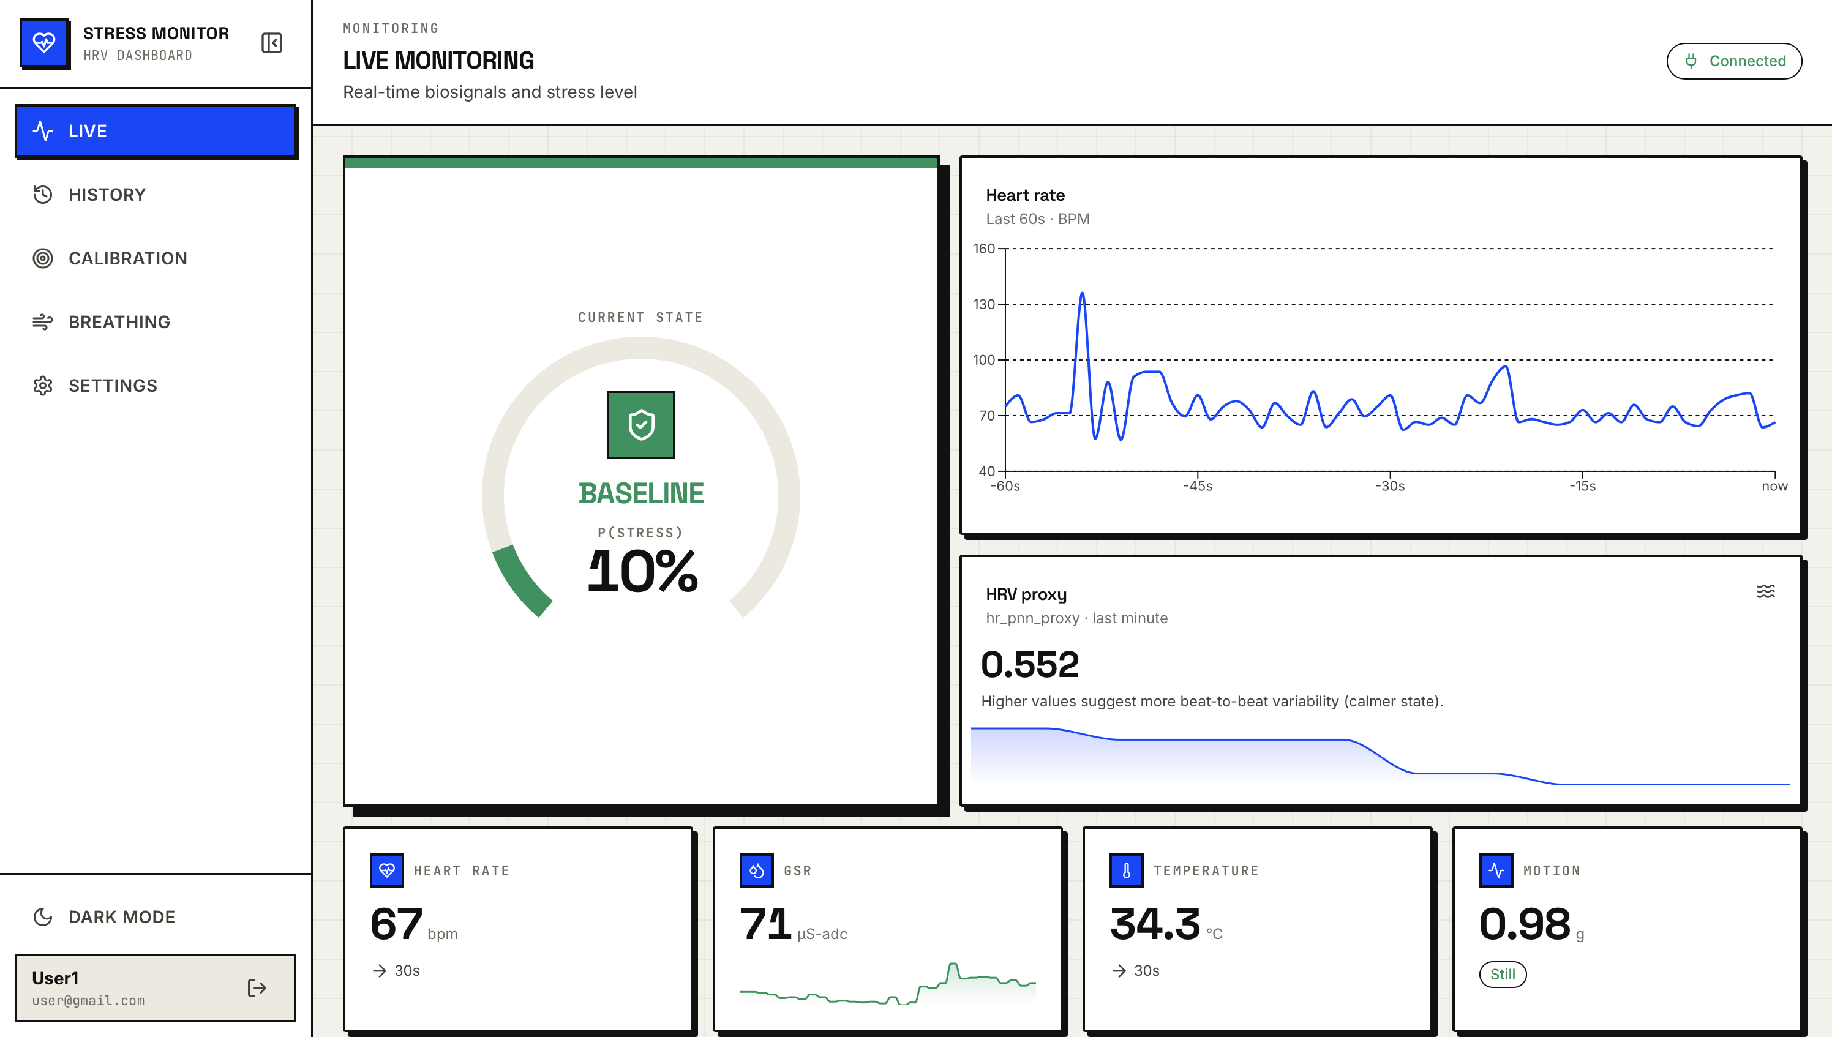
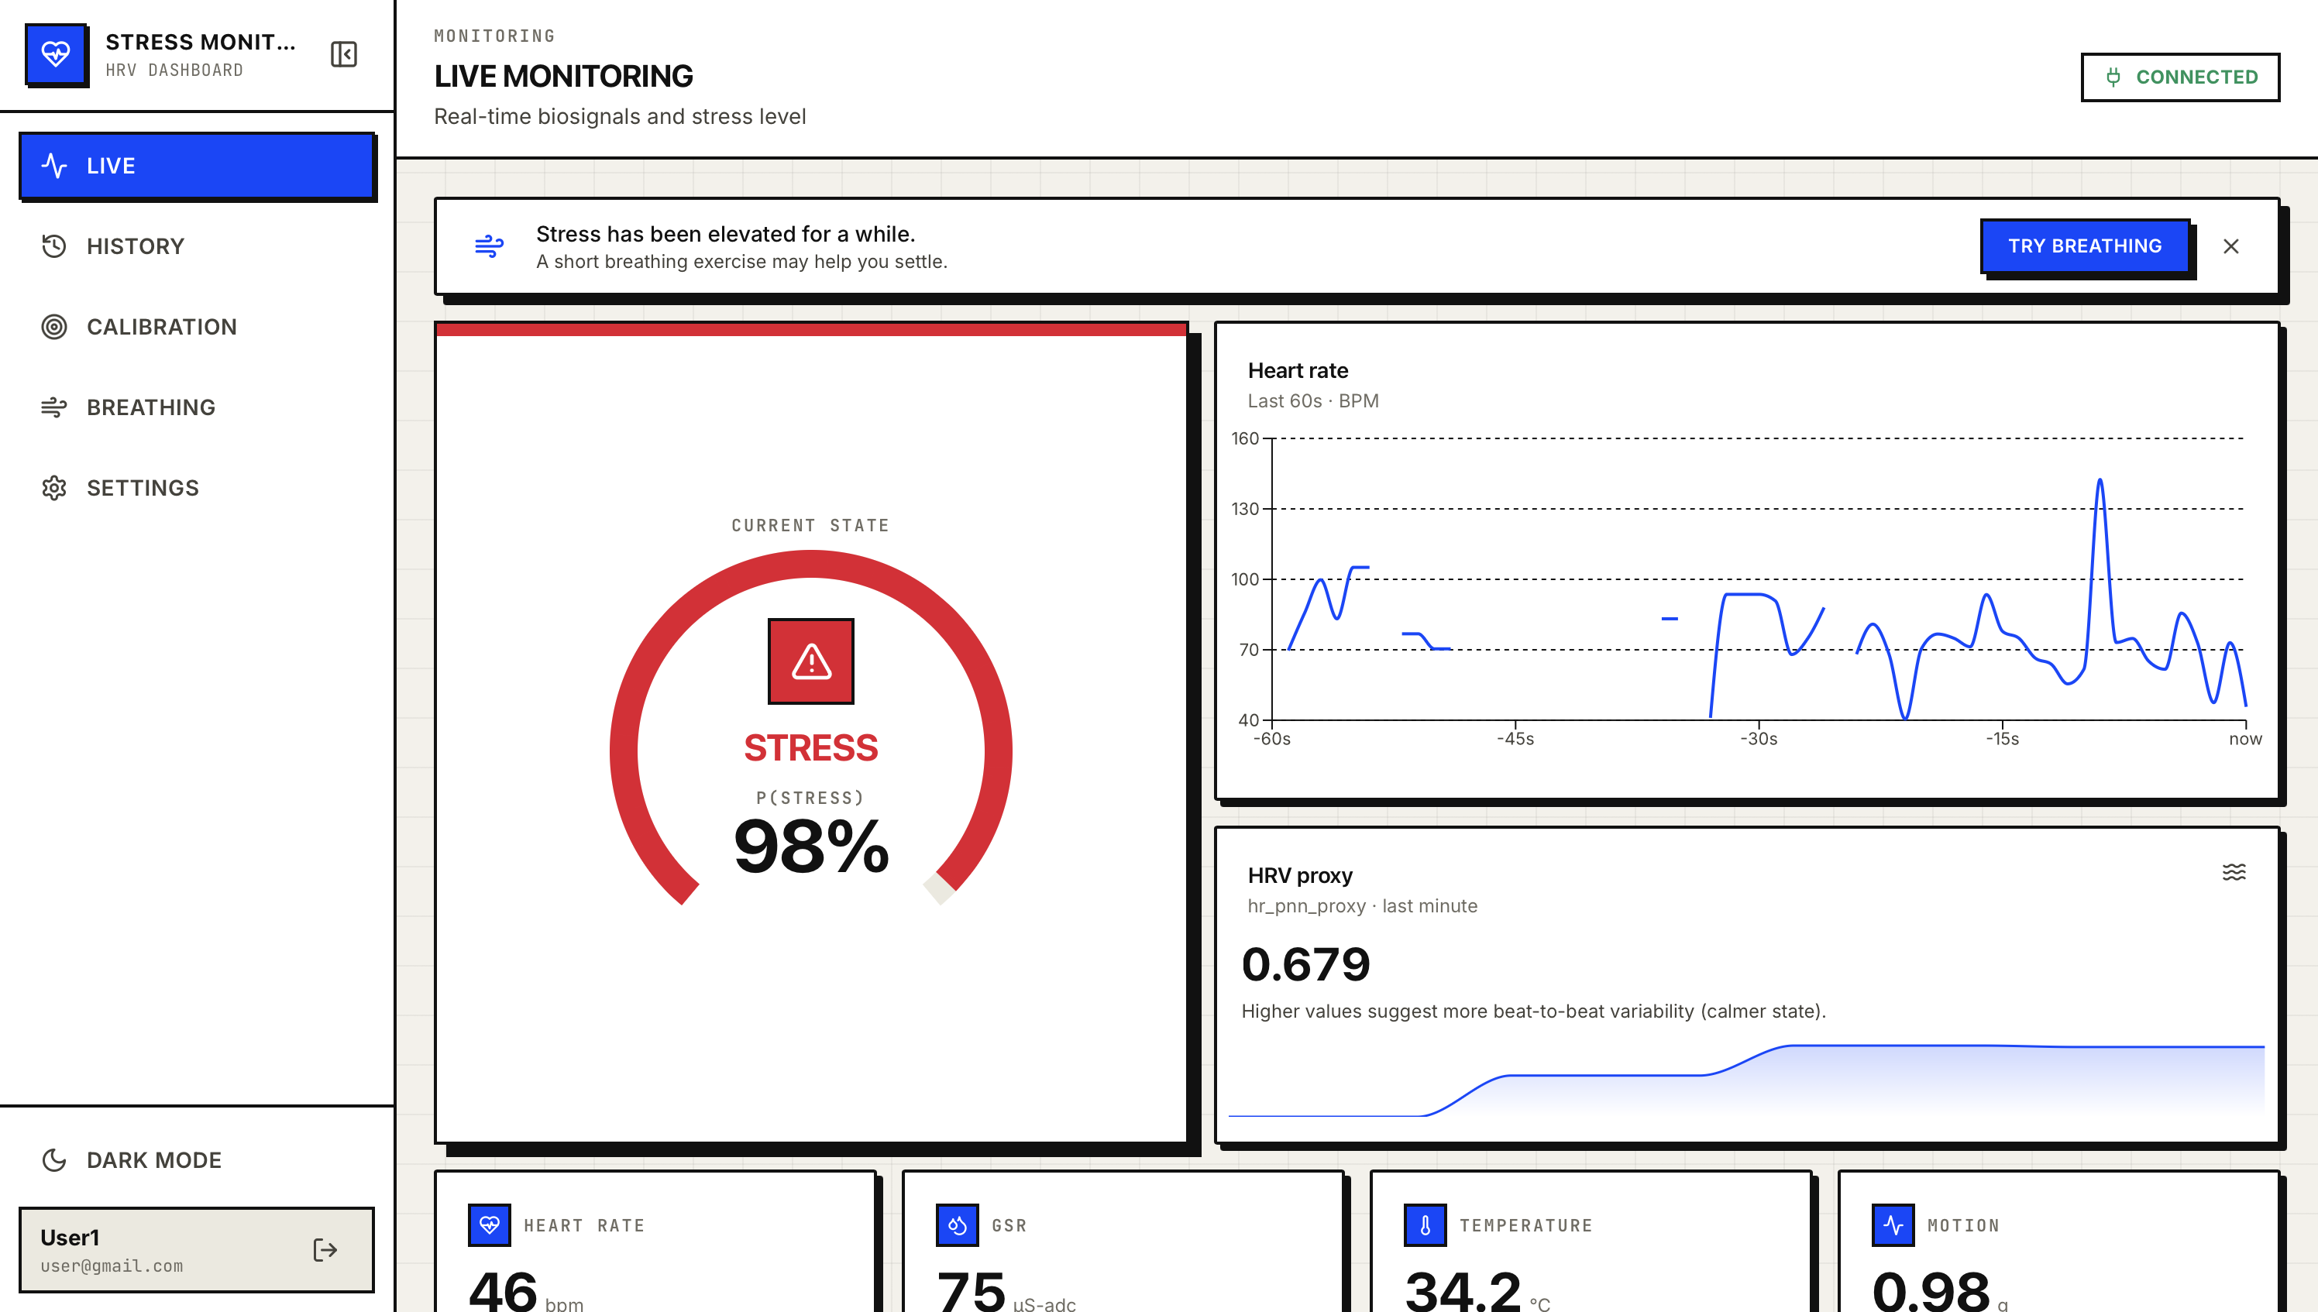
LIVE APPLICATION
Baseline to stress alert - live
BASELINE · P(STRESS) 10%
STRESS ALERT · P(STRESS) 98%
•
LIVE SIGNALS
•
SENSOR CONTEXT
•
ACTION
Heart-rate trace + HRV proxy
Heart rate · GSR · temperature
Sustained stress → breathing prompt
Snapshots from the working dashboard/demo pipeline · authenticated WebSocket updates · EMA smoothing reduces flicker
09
Notes:
These are real application screenshots. The service streams samples, feature vectors, and predictions over an authenticated WebSocket, and the exponential moving average prevents the displayed state from flickering between individual windows.

Slide 10
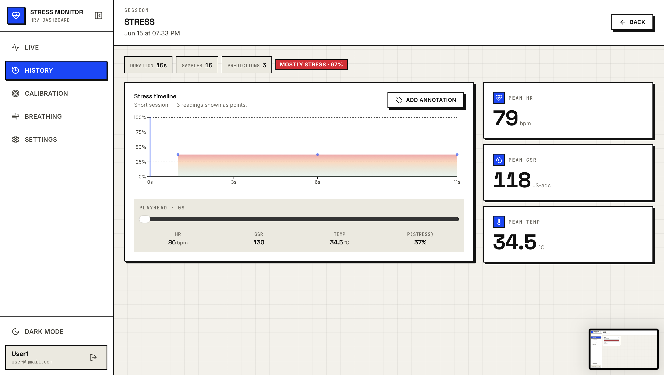
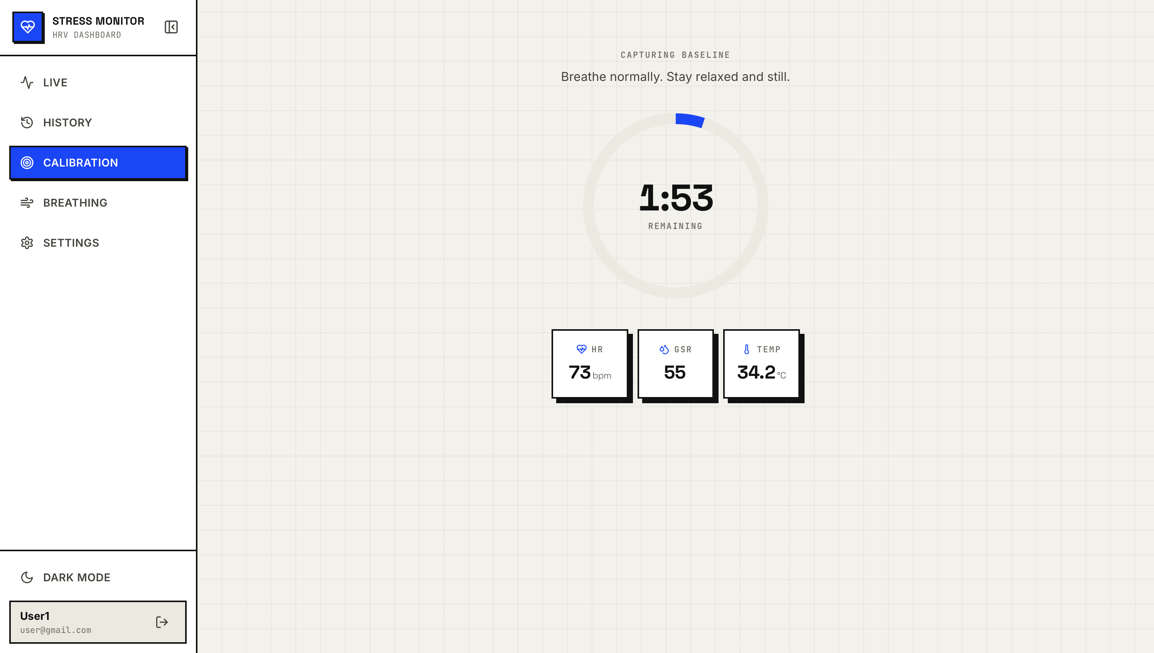
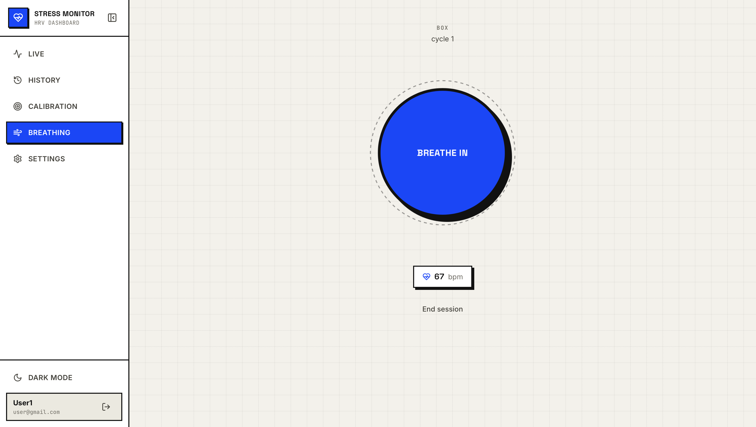
APPLICATION EXPERIENCE
Beyond detection: track, personalize, respond
TRACK
PERSONALIZE
RESPOND
Session history
Resting baseline
Guided breathing
Timeline, annotations, and CSV / JSON export.
Optional per-user calibration, clearly labelled as a heuristic.
Box, 4-7-8, and coherent breathing patterns.
JWT LOGIN
SQLITE PERSISTENCE
WEBSOCKET AUTO-RECONNECT
HARDWARE-FREE DEMO MODE
EXPORTABLE SESSIONS
A complete path from wearable biosignals to leakage-aware ML, live visualization, and a practical response.
10
Notes:
The application does more than display a label. It records sessions, supports an explicitly heuristic personal baseline, and connects sustained stress to a guided breathing exercise, while remaining demonstrable without the physical wearable.

