Slide 1
EDA Loan Default Analysis
Analyzing the Key Factors Influencing Loan Defaults BY : Abhinav Jha

Slide 2
Problem Statement & Analysis Approach
Problem Statement:
The consumer finance company wants to identify key factors leading to loan defaults.
By understanding these factors, the company can mitigate financial losses and improve risk assessment.
Analysis Approach:
Data Cleaning: Handle missing data and standardize formats.
Univariate Analysis: Understand the distribution of key variables.
Bivariate Analysis: Explore relationships between loan status and key variables.
Multivariate Analysis: Identify correlations and key drivers of default.

Slide 3
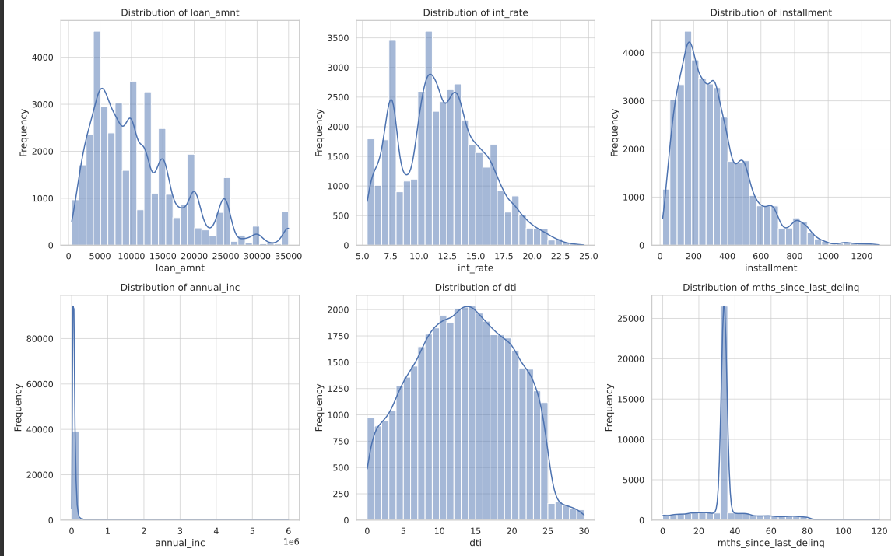
Univariate Analysis
The univariate analysis focused on understanding the distribution of key variables like:
Loan Amount
Interest Rate
Debt-to-Income Ratio (DTI)
Months Since Last Delinquency
These distributions provide insights into the common ranges and outliers.

Slide 4
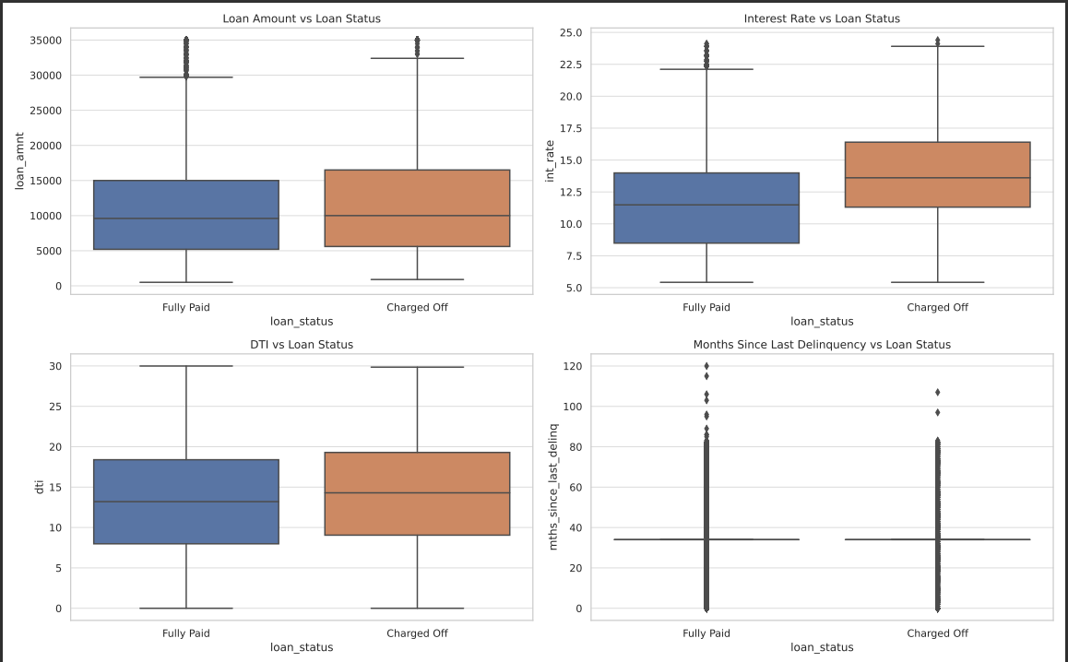
Bivariate Analysis
The bivariate analysis explored the relationship between loan status and variables such as:
Loan Amount vs. Loan Status
Interest Rate vs. Loan Status
DTI vs. Loan Status
Months Since Last Delinquency vs. Loan Status
Key Insight: Higher interest rates and higher DTI ratios are associated with a greater likelihood of loan defaults.

Slide 5
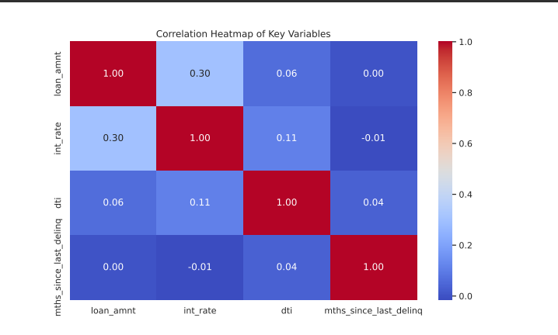
Correlation Analysis
The multivariate analysis involved generating a correlation heatmap to identify relationships between variables:
Moderate positive correlation between interest rates and DTI ratios.
Slight positive correlation between loan amount and interest rate.
These insights can help in predicting the likelihood of defaults.

Slide 6
Key Insights & Recommendations
Key Insights:
Higher interest rates and DTI ratios are significant indicators of loan defaults.
Recent delinquencies are strong predictors of future defaults.
Recommendations:
Adjust lending criteria based on DTI ratios and interest rates.
Consider recent delinquency history when evaluating loan applications.
Implement risk-based pricing to mitigate potential losses.

