Slide 1

Building a dashboard
For dinero.dk
A danish accounting SaaS (Software as a service)

Slide 2
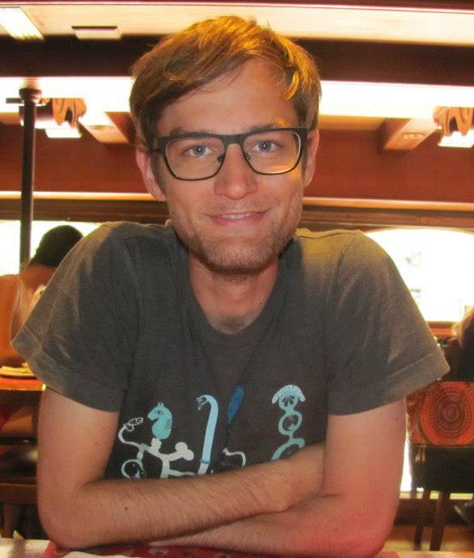
Who am I?
- My name is Anders Hørsted
- Started at DTU in 2009 (BSc in mathematics and technology)
- Haven’t finished my BSc yet. Aiming for summer 2015 otherwise it is too late
- Co-founded dinero.dk with David Andersen, Martin Thorborg and Nicolai Frisch in the late summer of 2012
- Have been working full time on dinero.dk since summer 2012

Slide 3
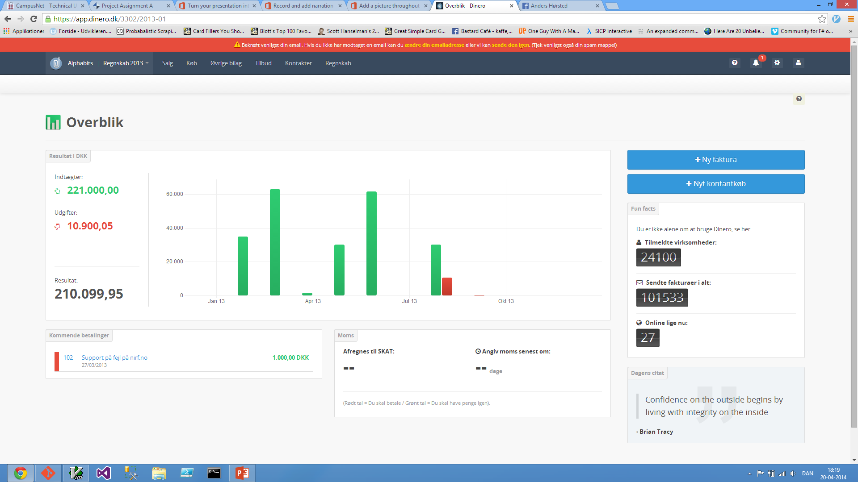
What is Dinero.dk?
- A simple accounting application for small businesses
- Went public in April 2013.
- A paid version was released in October 2013
- More than 24.000 businesses have signed up for the free version
- Some of them have been converted to paying customer, but we would love to convert more

Slide 4
Is Dinero a success?

Slide 5
We don’t know

Slide 6
A few things we don’t know
- How many active users we have. (And how do we define an active user?)
- What is the average timespan from a user signs up until he becomes a paying customer?
- What percentage of users stop using the application in a specific month?
- How much should we pay our affiliate partners for a sign-up?
- How likely is a user to become a paying customer?
- How likely is a specific user to cancel his/her subscription?
- Do our users like the application?
- And how is the mood affected when we release new features?
- Has the conversion rate from active user to paying customer increased in the last month?
- Has the conversion rate from signup to active user increased in the last month?

Slide 7
Project description
- Create scripts to get data that answers the questions from the previous slide
- Create a dashboard that presents the data so all our stakeholders have access to the data
- Build a decision tree to identify users that are likely to become paying customers
- Build a decision tree to identify users that are likely to cancel their subscription. (We may not have enough data for this task)

Slide 8
Implementation
- Most of our data is kept in a SQL-database
- Most of the scripts that are needed can probably be written in SQL. A few python scripts may be needed as well
- To get data about the happiness level of our customers, I need to get data from our Twitter and Facebook accounts
- The dashboard will be included in our online application, but only our administrators will have access to the dashboard
- The visualizations will be created with the D3 library and possibly another library build on top of D3. Haven’t decided which one yet
- The decision tree will probably be created using the code from our exercises

Slide 9
Thank you
Anders Hørsted - anders@dinero.dk
We are looking for a full-time programmer:
https://dinero.dk/om-dinero/jobs/

