Slide 1
Nuclear Effective Field Theories on the Lattice
Takashi Abe
the University of Tokyo
@ RIKEN on 2010/09/26(SUN)

Slide 2
Contents
“Ab-initio” Calculations in Nuclear Physics
EFTs in Nuclear Physics
Nuclear EFTs on the Lattice
Some Results from Lattice EFTs
Summary & Outlook
In this talk, we restrict nucleon dof in nuclei.
(Hyperons are not considered)

Slide 3
1. “Ab-initio” Calculations in Nuclear Physics
Definition of an “ab-initio” calculation in nuclear physics
Solve (non-relativistic) Schroedinger eq. w.r.t. nucleons w/ realistic nuclear forces
Nucleons (protons & neutrons) -> point-particles
Realistic nuclear forces (NN + NNN + NNNN + … forces)
NN interactions
Phase shifts & some deuteron properties are reproduced.
-> phase-shift equivalent (chi^2 /dof ~ 1)
Nijmegen, CD-Bonne, Argonne V18 (AV18), Chiral N3LO, …
NNN interactions
-> NNN forces are determined in accordance w/ NN forces
AV18 NN + IL2 NNN, Chiral N3LO NN + N2LO NNN …

Slide 4

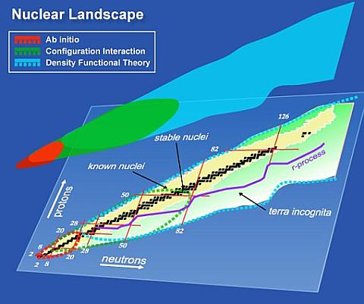
UNEDF SciDAC Collaboration: http://unedf.org/
DFT
CI
Ab initio
Notes:
GFMC, NCSM, NCFC, FCI, CC

Slide 5
Major Calculation Methods in Nuclear Physics
Few-body system (A ≤ 4)
Faddeev (A = 3), Faddeev-Yakubovsky (A = 4), …
Many-body system
Green’s Function Monte Carlo (GFMC), No-Core Shell Model(NCSM), … (A ≤ 12)
Coupled Cluster (CC) Theory (closed-shell nuclei +/- 1-2 nucleons)
Density Functional Theory (DFT) (entire region in mass table)
Matter system
…

Slide 6
Some Results in “ab-initio” Calculations
Ab-initio methods in Few-body system (A = 4)
Green’s Function Monte Carlo (GFMC)
No-Core Shell Model (NCSM)

Slide 7
Some Results in “ab-initio” Calculations
Ab-initio methods in Few-body system (A = 4)
Green’s Function Monte Carlo (GFMC)
No-Core Shell Model (NCSM)

Slide 8
Benchmark Test Calculation of a Four-Nucleon Bound State
H. Kamada, A, Nogga, W. Gloeckle, E. Hiyama, M. Kamimura, K. Varga, Y. Suzuki, M. Viviani, A. Kievsky, S. Rosati, J. Carlson, Steven C. Pieper, R. B. Wiringa, P. Navratil, B. R. Barrett, N. Barnea, W. Leidemann, G. Orlandini, Phys. Rev. C64, 044001 (2001)
Solve non-relativistic Schroedinger eq. w/ AV8’ NN potential w/o Coulomb effect
8 ab-initio methods in non-relativistic few-body systems
Faddeev-Yakubovsky (FY) method
Coupled-rearrangement-channel Gaussian-basis variational (CRCGV) method
Stochastic variational methods (SVM) w/ correlated Gaussians
Hyperspherical harmonic (HH) variational method
Green’s function Monte Carlo (GFMC)
No-core shell model (NCSM)
Effective interaction hyperspherical harmonic (EIHH) method

Slide 9
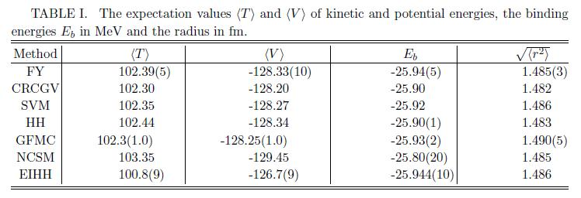
Benchmark Test Calculation of a Four-Nucleon Bound State
H. Kamada et al., Phys. Rev. C64, 044001 (2001)

Slide 10
Some Results in “ab-initio” Calculations
Ab-initio methods in Few-body system (A = 4)
Green’s Function Monte Carlo (GFMC)
No-Core Shell Model (NCSM)

Slide 11
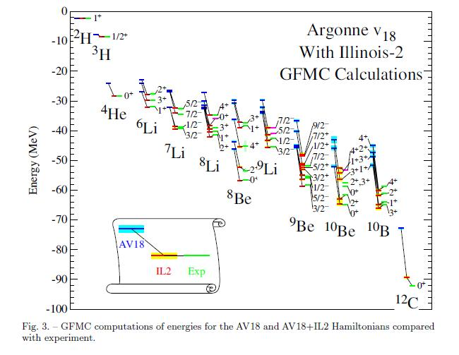
Current Status of Green’s Function Monte Carlo (GFMC)
S.C. Pieper, Enrico Fermi Lecture (2007)

Slide 12
Some Results in “ab-initio” Calculations
Ab-initio methods in Few-body system (A = 4)
Green’s Function Monte Carlo (GFMC)
No-Core Shell Model (NCSM)

Slide 13
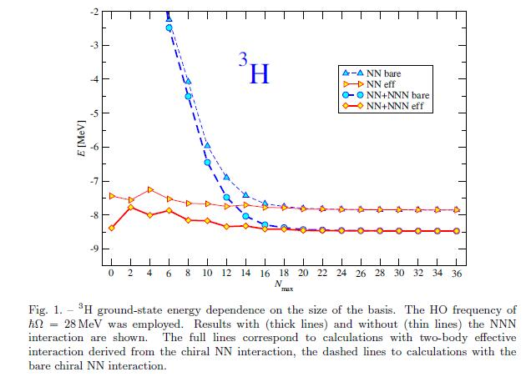
Current Status of No-Core Shell Model (NCSM)
P. Navratil, Enrico Fermi Lecture (2007)

Slide 14
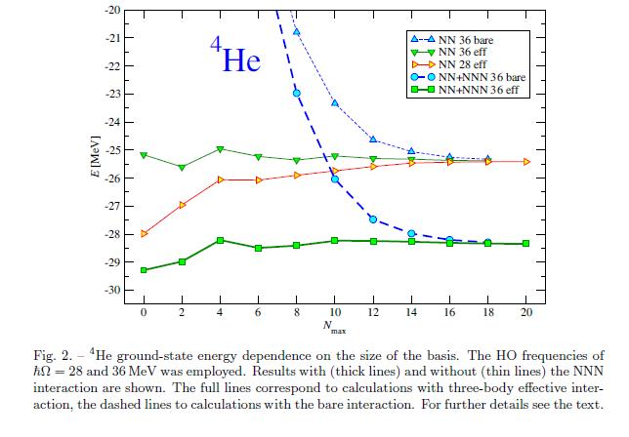
Current Status of No-Core Shell Model (NCSM)
Nmax-truncation (NCSM, NCFC)
Max. # of HO quanta of many-body basis
Nmax = 4 (A = 4)
.
.
.
.
.
.
N = 4 (2s, 1d, 0g)
N = 3 (1p, 0f)
N = 2 (1s, 0d)
hw
N = 1 (0p)
N = 0 (0s)
N = ∑_{i} 2n_{i} + l_{i} ≤ N_{max}
P. Navratil, Enrico Fermi Lecture (2007)

Slide 15
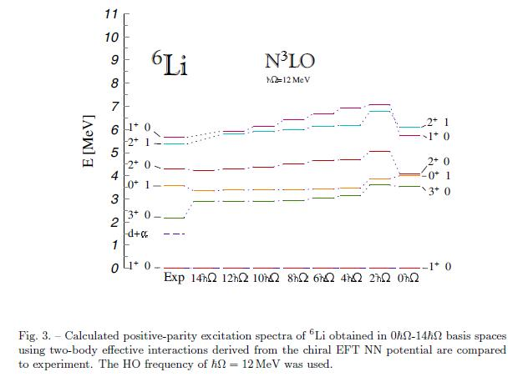
Current Status of No-Core Shell Model (NCSM)
P. Navratil, Enrico Fermi Lecture (2007)

Slide 16
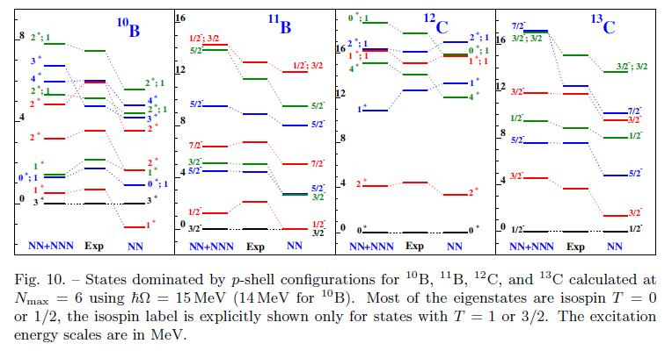
Current Status of No-Core Shell Model (NCSM)
P. Navratil, Enrico Fermi Lecture (2007)

Slide 17
Current Status of “ab initio” Calculations in Nuclear Physics
various calculation methods @ various regions in mass table
rare (direct) connections w/ QCD
Nuclei directly from Lattice QCD
(T. Yamazaki, et al., for PACS-CS Collaboration, arXiv:0912.1383)
“Ab initio” calculations w/ nuclear forces derived from lattice QCD
(N. Ishii et al., PRL 99, 022001 (2007), …, for HAL QCD Collaboration)
Lattice EFT
“Ab initio” calculations w/ realistic nuclear forces
Nucleon-Nucleon Scatterings/interactions from Lattice QCD
(NPLQCD Collaboration)
Bridges btw QCD & Nuclear Physics
Computationally expensive
Theoretically approximating

Slide 18
2. EFTs in Nuclear Physics
Multi-Meson (One-baryon) sector
Chiral Perturbation Theory (ChPT)
Multi-Baryon sector
Pionless EFT (Nucleon dof)
Chiral Effective Field Theory (EFT): Pionful EFT (Pion + Nucleon dof)
Chiral EFT w/ Delta (Pion + Nucleon + Delta dof)
…
Review articles for chiral EFT
U. van Kolck, Prog. Part. Nucl. Phys. 43, 337 (1999)
P.F. Bedaque and U. van Kolck, Ann. Rev. Nucl. Part. Sci. 52, 339 (2002)
E. Epelbaum, Prog. Part. Nucl. Phys. 57, 654 (2006)
E. Epelbaum, H.-W. Hammer, and U.-G. Meissner, Rev. Mod Phys. 81, 1773 (2009)
S. Weinberg, Physica A 96, 327 (1979)
J. Gasser, H. Leutwyler, Ann. Phys. 158, 142 (1984)
J. Gasser, H. Leutwyler, Nucl. Phys. B 250, 465 (1985)
S. Weinberg, Phys. Lett. B 251, 288 (1990)
S. Weinberg, Nucl. Phys. B 363, 3 (1991)

Slide 19
Ideas of Nuclear EFT
- EFT
low-energy physics long-distance dynamics
Symmetries of underlying theory (QCD)
Low-energy theory with the relevant degrees of freedom (N, π, etc.)
based on the relevant symmetries of the underlying theory (QCD) in low-energy physics (Lorentz, parity, time-reversal etc.)
- Power counting
Systematic expansion in powers of p / Q
(p: long-distance scale, Q: short-distance scale)
Coupling constants Experimental data (phase shift …)
connection to the underlying theory of QCD
systematic improvement of the calculations

Slide 20
Power Counting in Chiral EFT
Chiral EFT: extension of ChPT to multi-baryon (nucleon) sector
Weinberg power counting
2N
3N
4N
LO
Q⁰
（２）
NLO
Q²
（７）
N2LO
Q³
（０）
FM
D-
E-
（２）
Q⁴
N3LO
（１５）
（０）
（０）
() shows the # of unknown coefficients @ that order
Chiral EFT is organized in powers of Q/Λ
Q: low momentum scale associated w/ external nucleon momenta or the pion mass
Λ : high momentum scale where the EFT breaks down

Slide 21
3. Nuclear EFTs on the Lattice
Lattice EFTs
-> Lattice method + chiral EFT (EFT w/ pions) / pionless EFT (EFT w/o pions)
Review article
D. Lee, Prog. Part. Nucl. Phys. 63, 117 (2009)
Procedure (how to measure the obs.)
construct the effective chiral lagrangian (Hamiltonian)
all unknown operator coefficients are fitted by low-energy scattering data (and some binding energies)
calculate the partition functions through path integral (by Monte Carlo sampling) and extract the binding energies

Slide 22
Some References of Lattice EFT calculations
Nuclear Matter
H.-M. Mueller, S.E. Koonin, R. Seki, and U. van Kolck, PRC61, 044320 (2000)
Neutron Matter
D. Lee and T. Schaefer, PRC72, 024006 (2005) (pionless)
D. Lee, B. Borasoy, and T. Schaefer, PRC70, 014007 (2004)
T. Abe and R. Seki, PRC79, 054002 (2009) (NLO, pionless)
B. Borasoy, E. Epelbaum, H. Krebs, D. Lee, and U.-G. Meissner, Eur. Phys. J. A35, 357 (2008) (NLO)
E. Epelbaum, H. Krebs, D. Lee, and U.-G. Meissner, Eur. Phys. J. A40, 199 (2009) (NLO)
G. Wlazlowski and P. Magierski, arXiv:0912.0373
Finite Nuclei
B. Borasoy, H. Krebs, D. Lee, and U.-G. Meissner, Nucl. Phys. A768, 179 (2006)
B. Borasoy, E. Epelbaum, H. Krebs, D. Lee, and U.-G. Meissner, Eur. Phys. J. A31, 105 (2007)
E. Epelbaum, H. Krebs, D. Lee, and U.-G. Meissner, Eur. Phys. J. A41, 125 (2009) (LO, A=3 system)
Unitary Fermi gas
D. Lee, PRB73, 115112 (2006)
D. Lee, PRB75, 134502 (2007)
D. Lee, PRC78, 024001 (2008)
T. Abe and R. Seki, PRC79, 054003 (2009)
Review article
D. Lee, Prog. Part. Nucl. Phys. 63, 117 (2009)

Slide 23
Pionless EFT on the Lattice
Power counting in Pionless EFT up to NLO
LO (NN & 3N contact terms)
NLO (NN p²-dep. contact term)
c₂
c₀
Pauli principle (neutron matter )
D₀
3N contact term already appears @ LO in pionless EFT
P. F. Bedaque, H. W. Hammer, U. van Kolck, Nucl. Phys. A676, 357 (2000)
c.f.) 3N contact term @ N2LO in pionful EFT

Slide 24

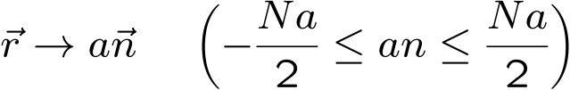



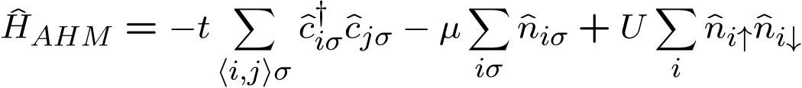
Lattice Hamiltonian in Pionless EFT up to NLO
T. Abe, R. Seki, & A. N. Kocharian, PRC 70, 014315 (2004)
Non-relativistic Hamiltonian
w/
Non-relativistic Lattice Hamiltonian
c.f.) Attractive Hubbard Model
Extended Attractive Hubbard Model
c₀ (LO)
c₀ & c₂ (NLO)

Slide 25
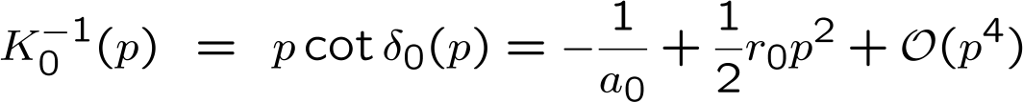


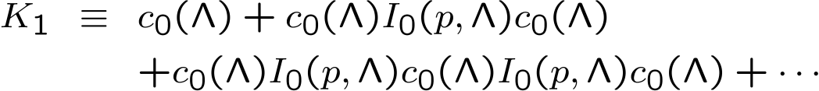

Effective Range Expansion on the Lattice
Potential Terms
K (reaction) Matrix
Luscher’s method ~ K matrix with asymptotically standing-wave boundary condition
R. Seki, & U. van Kolck, PRC 73, 044006 (2006)

Slide 26
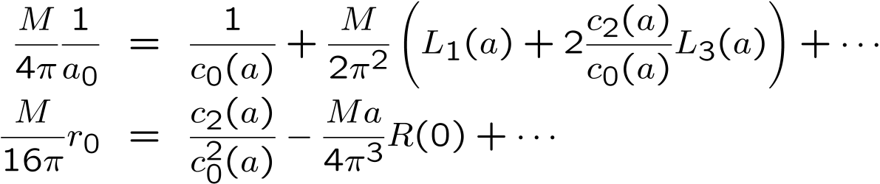
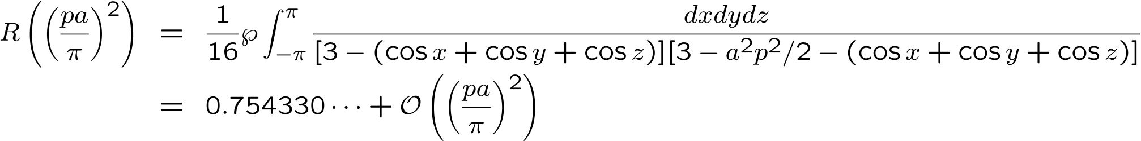
Observables
(a₀, r₀)
Coupling Constants & Regularization Scale
(c₀, c₂, …, Λ(~π/a))
where
Potential parameters, c₀ & c₂, are determined from the above coupled equations
by reproducing the ¹S₀ scattering length, a₀, & effective range, r₀, on the lattice
R. Seki, & U. van Kolck, PRC 73, 044006 (2006)

Slide 27
4. Some Results from LEFTs
Pairing gap in neutron matter (pionless EFT)
Universal quantities in unitary Fermi gas (pionless EFT)
BEs in finite nuclei (pionful EFT)

Slide 28
4. Some Results from LEFTs
Pairing gap in neutron matter (pionless EFT)
Universal quantities in unitary Fermi gas (pionless EFT)
BEs in finite nuclei (pionful EFT)

Slide 29
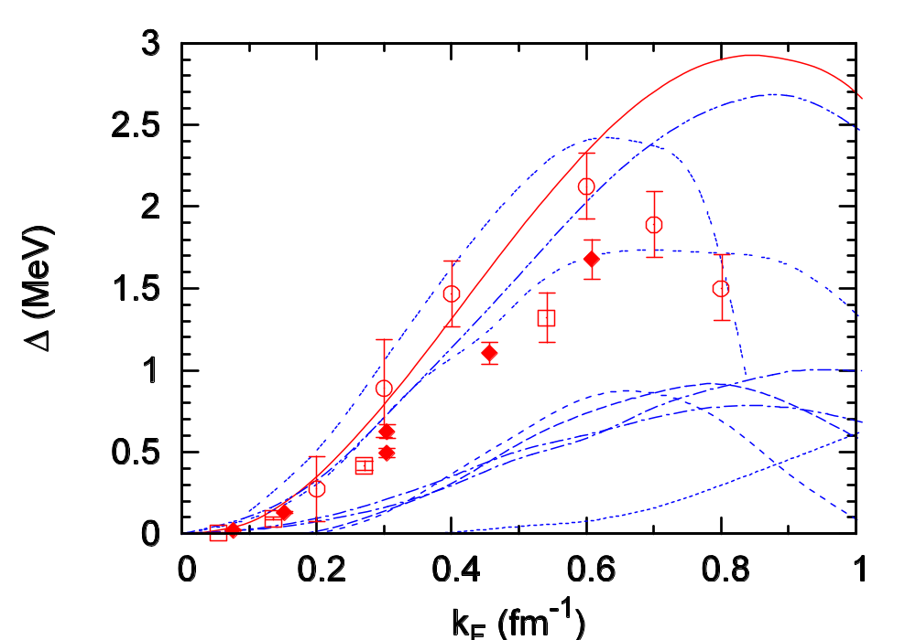
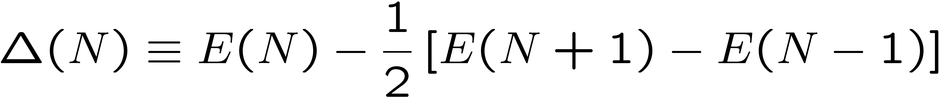

Comparison of various calculations of ¹S₀ pairing gap of neutron matter
BCS
Our results are consistent w/ GFMC’s within statistical errors
Lattice EFT
AFDMC
GFMC
Approx. calc.
(RPA, HFB, CBF, …)
Data taken from S. Gandolfi et al., PRL 101, 132501 (2008)
T. Abe & R. Seki, Phys Rev C79, 054002 (2009)

Slide 30
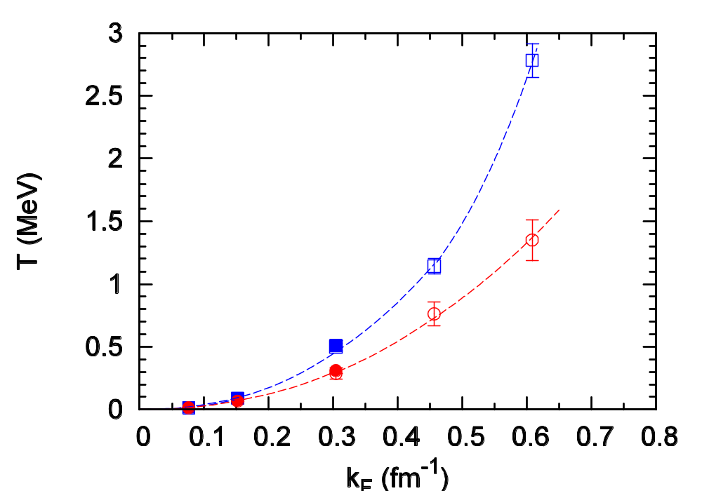
Phase Diagram @ Thermodynamic & Continuum Limits
T. Abe & R. Seki, Phys Rev C79, 054002 (2009)
T*
pseudo gap
Tc
normal
LO (c₀ only)
NLO( c₀ & c₂)
¹S₀ superfluid

Slide 31
4. Some Results from LEFTs
Pairing gap in neutron matter (pionless EFT)
Universal quantities in unitary Fermi gas (pionless EFT)
BEs in finite nuclei (pionful EFT)

Slide 32
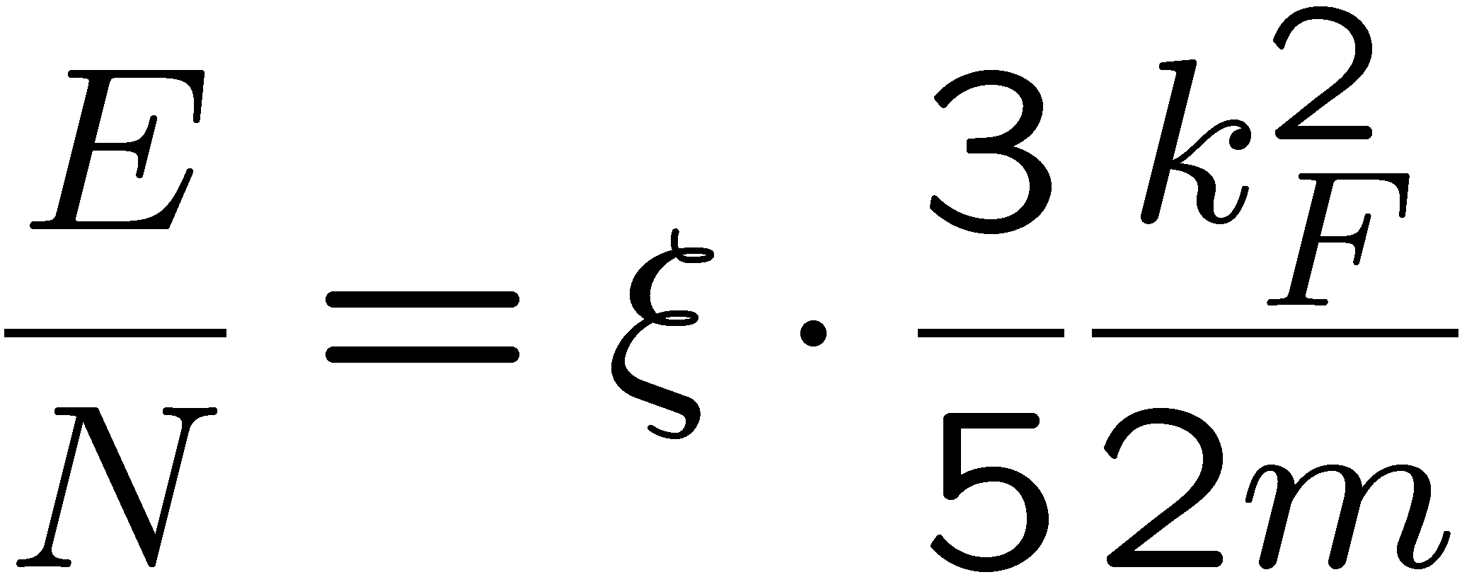
Unitary Fermi Gas
George Bertsch “Many-Body X Challenge” (1999)
Atomic gas: r₀ (= 10 Å) << k_{F}⁻¹ (= 100 Å) << |a| (= 1000 Å)
(0 <-) r₀ << k_{F}⁻¹ << |a| (-> ∞)
Spin-1/2 fermions interacting via a zero-range,
infinite scattering length contact interaction
k_{F} is the only scale to describe the systems
ξ is independent of the systems
c.f.) dilute neutron matter
|a_{nn}| ~ 18.5 fm >> r₀ ~ 1.4 fm
Strong coupling limit (ak_{F} = ∞)
no expansion parameter

Slide 33
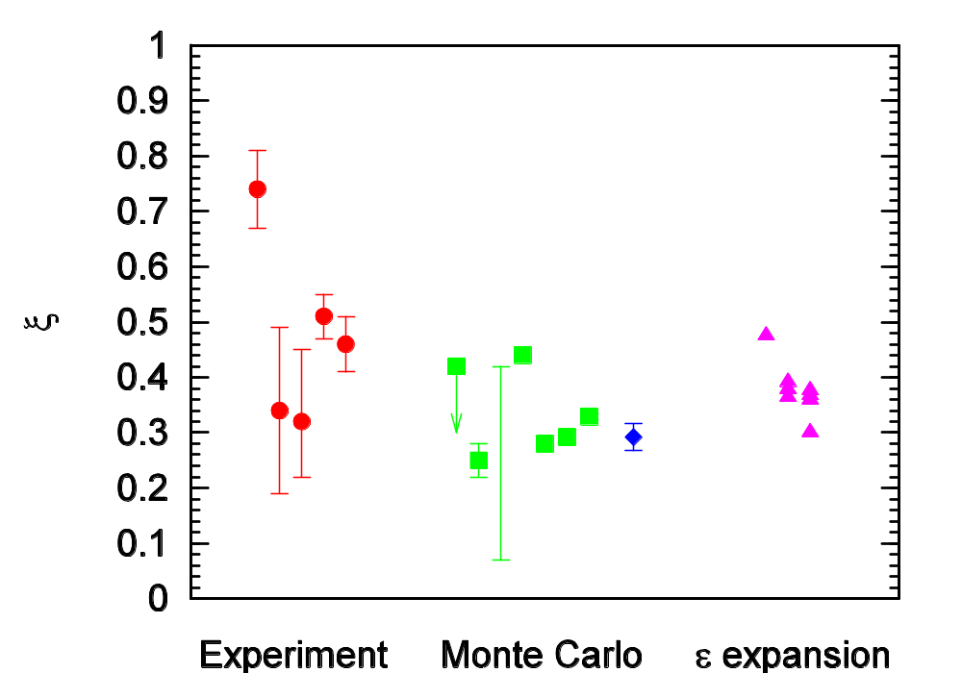
T. Abe & R. Seki, Phys Rev C79, 054003 (2009)
ξ in the Unitary Limit (Ns -> ∞, n -> 0)
Duke ‘02
Pade: NNLO 4-ε& NLO 2+ε; Arnold, Durt, Son ‘06
Pade: NLO 4-ε& NLO 2+ε; Nishida, Son ‘06
NLO 4-ε; Nishida, Son ‘06
GFMC; Carlson et al. ‘03
Duke ‘05
QMC; Bulgac et al. ‘06
Lattice; Lee, Schäfer ‘06
Rice ‘06
Innsbruck ‘04
ENS ‘04
Lattice; Lee ‘08
Lattice; Lee ‘08
Lattice; Lee ‘07
Lattice; Lee ‘06
Our MC calc. ξ ~ 0.29(2)

Slide 34
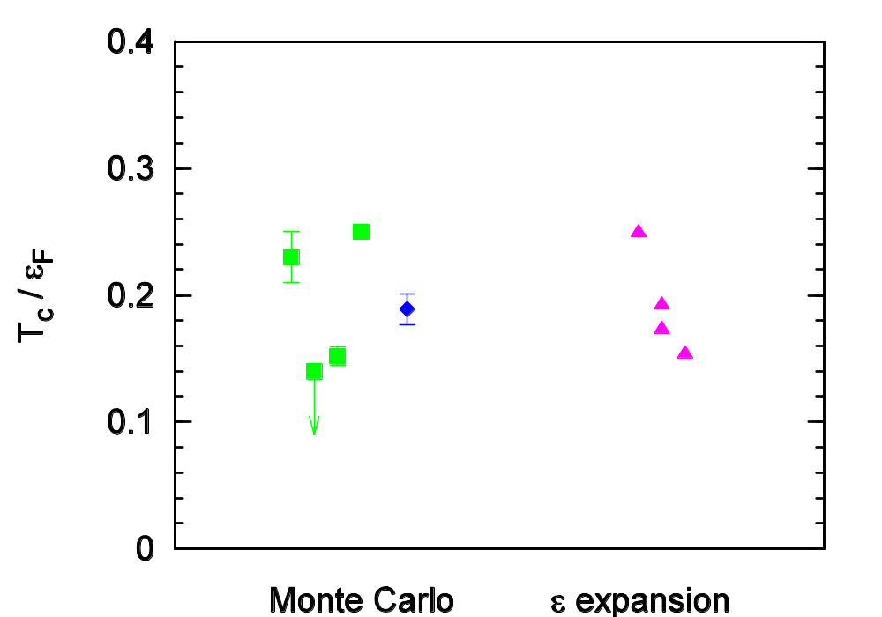
T. Abe & R. Seki, Phys Rev C79, 054003 (2009)
Tc/ε_{F} in the Unitary Limit (Ns -> ∞, n -> 0)
QMC; Akkineri et al. ‘06
QMC; Bulgac et al. ‘06
Pade: NLO 4-ε& NLO 2+ε
NLO 4-ε
QMC; Burovski et al. ‘06
Lattice; Lee, Schäfer ‘06
NLO 2+ε
Our MC calc Tc/ε_{F} ~ 0.19(1)

Slide 35
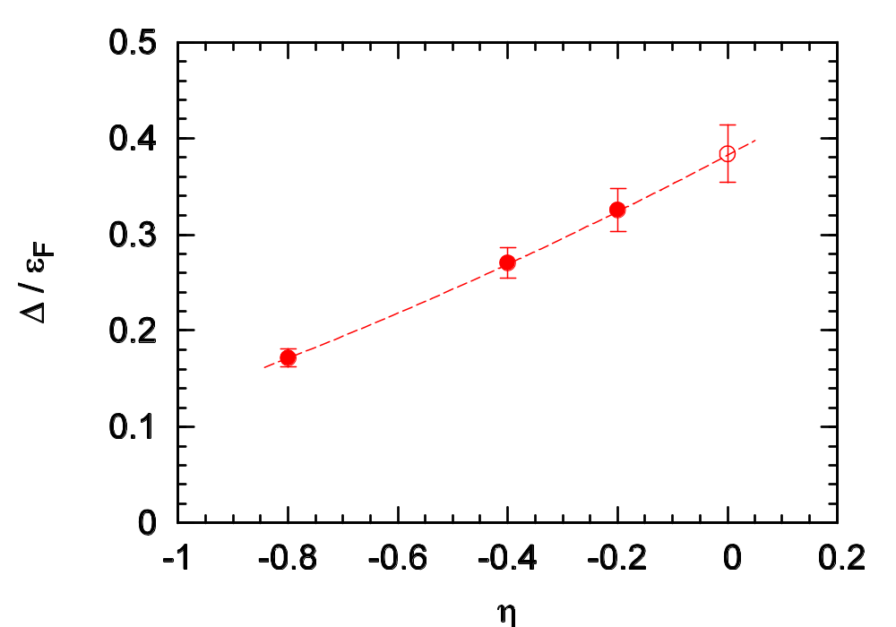
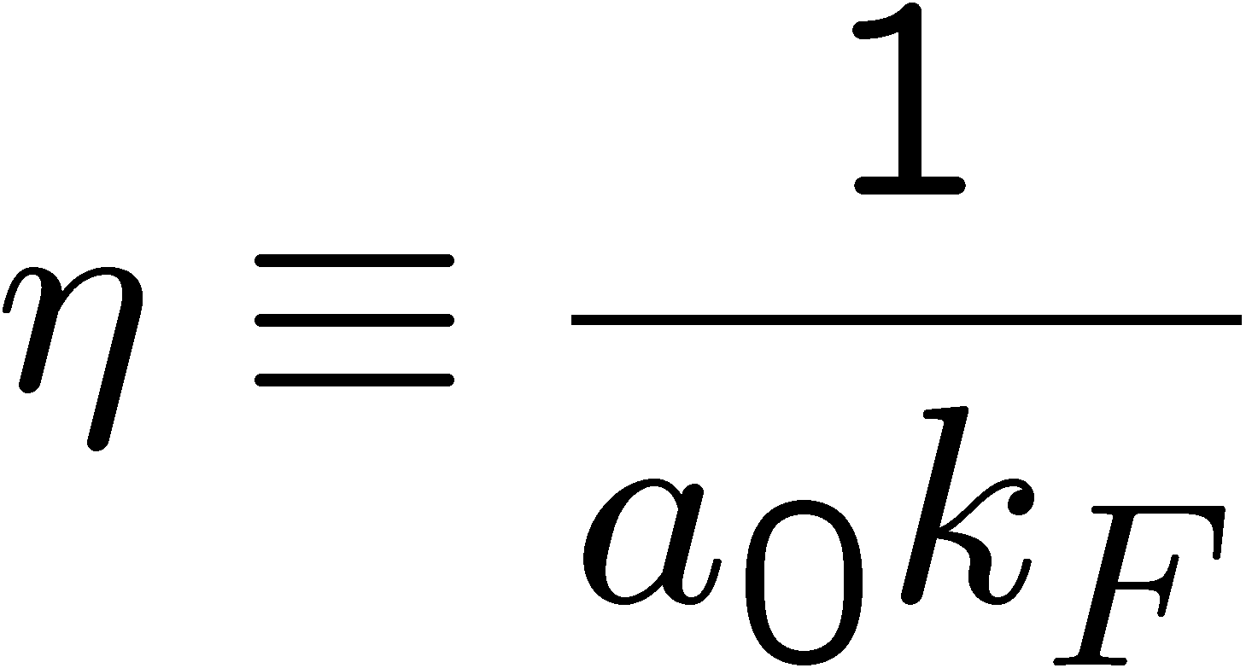
T. Abe & R. Seki, Phys Rev C79, 054003 (2009)
Extrapolation of Δ/ε_{F} in the Unitary Limit (Ns -> ∞, n -> 0)
Unitary Limit
Our Δ/ε_{F} ~ 0.38(3) (Δ/E_{GS} ~ 2.2(4) )
Roughly confirming Δ/E_{GS} ~ 2
J. Carlson et al., PRL 91, 050401 (2003)

Slide 36
4. Some Results from LEFTs
Pairing gap in neutron matter (pionless EFT)
Universal quantities in unitary Fermi gas (pionless EFT)
BEs in finite nuclei (pionful EFT)

Slide 37
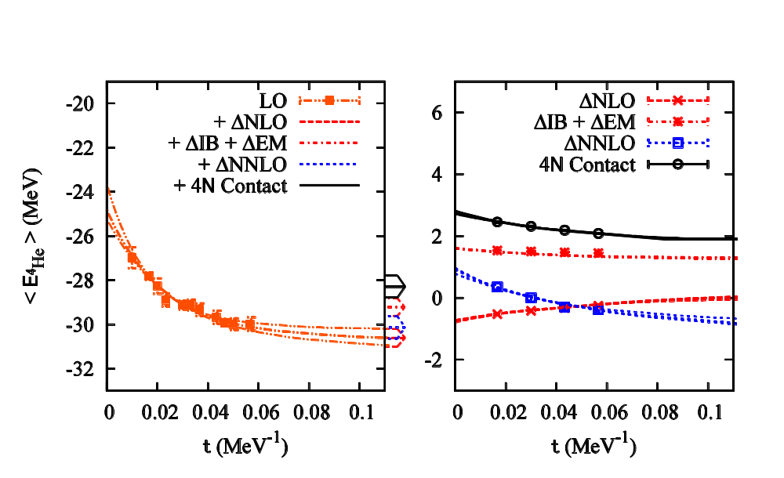
Results for g.s. energy of 4He
E. Epelbaum, H. Krebs, D. Lee, and U.-G. Meissner, Eur. Phys. J. A45, 335 (2010)
L = 9.9 fm
a ~ 1.97 fm
-30.5(4) MeV @ LO
-30.6(4) MeV @ NLO, -29.2(4) MeV @ NLO w/ IB & EM corrections
-30.1(5) MeV @ NNLO
c_{D} = 1 fixed -> B.E. decreases 0.4(1) MeV for each unit increase in c_{D}
Λ = π/a = 314 MeV ~ 2.3 m π -> 1~2 MeV error from higher-order terms expected
Effective 4N contact int. is introduced to estimate the size of error from higher-order terms by fitting the physical 4He g.s. energy (-28.3 MeV)
t = Lt x at

Slide 38
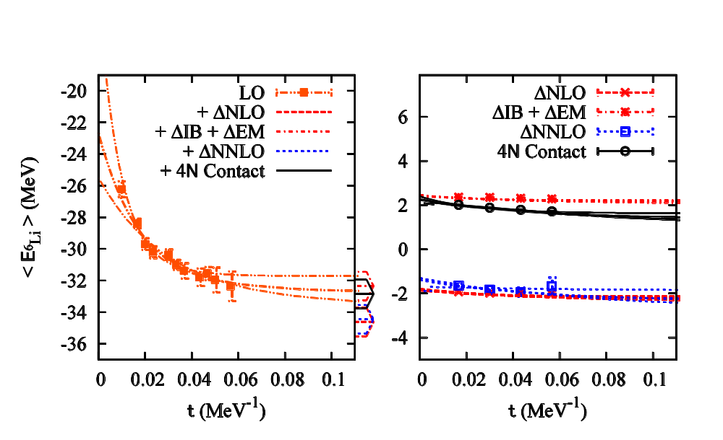
Results for g.s. energy of 6Li
E. Epelbaum, H. Krebs, D. Lee, and U.-G. Meissner, Eur. Phys. J. A45, 335 (2010)
L = 9.9 fm
a ~ 1.97 fm
-32.6(9) MeV @ LO
-34.6(9) MeV @ NLO, -32.4(9) MeV @ NLO w/ IB & EM corrections
-34.5(9) MeV @ NNLO
-32.9(9) MeV @ NNLO w/ effective 4N contact int.
-32.0 MeV Physical value
c_{D} = 1 fixed -> B.E. decreases 0.7(1) MeV (0.35(5) MeV) for each unit increase in cD w/o (w/) effective 4N contact int.
Need to check the volume dependence for accounting 0.9 MeV deviation

Slide 39
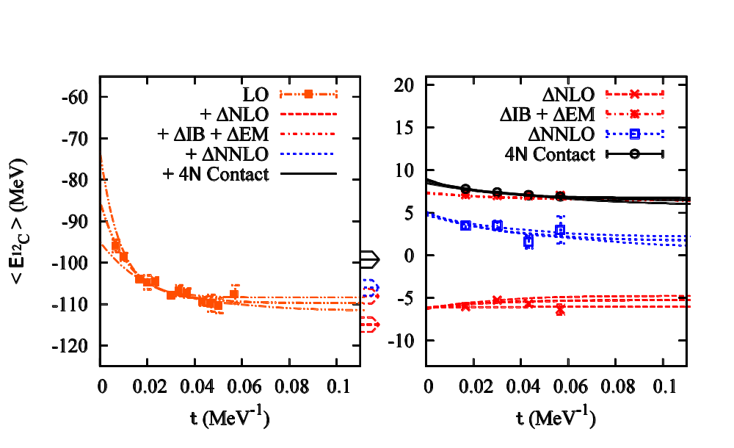
Results for g.s. energy of 12C
E. Epelbaum, H. Krebs, D. Lee, and U.-G. Meissner, Eur. Phys. J. A45, 335 (2010)
L = 13.8 fm
a ~ 1.97 fm
-109(2) MeV @ LO
-115(2) MeV @ NLO, -108(2) MeV @ NLO w/ IB & EM corrections
-106(2) MeV @ NNLO
-99(2) MeV @ NNLO w/ effective 4N contact int.
-92.2 MeV (EXP)
c_{D} = 1 fixed -> B.E> decreases 1.3(3) MeV (0.3(1) MeV) for each unit increase in c_{D} w/o (w/) effective 4N contact int.
Need to check the volume dependence for accounting 7 % overbinding
Reduced dependence on c_{D} for 6Li & 12C is consistent w/ the universality hypothesis.

Slide 40
5. Summary & Outlook
Summary
Lattice EFT approach has one of the possibilites to calculate observables for many-nucleon systems from finite nuclei to infinite matter based on the symmetries hold by QCD @ low-energy.
Outlook
Larger volume, smaller lattice spacing, and inclusion of higher-order interactions (N3LO, …)
Larger nuclei (computational cost ~ A^{1.7} w/ fixed volume & ~ V^{1.5} for A ≤ 16, -> 1.8 Tflops-yr for ¹⁶O)
E. Epelbaum, H. Krebs, D. Lee, and U.-G. Meissner, Eur. Phys. J. A45, 335 (2010)

Slide 41
END

