Slide 1
Development of new Graphic User Interface program for nuclear reaction
Y.-H. Song(RISP,IBS)
2020.Nov.05 KPS meeting(online)

Slide 2
Introduction
There are many direct nuclear reaction codes available(DWUCK, ECIS, FRESCO, TWOFNR, …)
Most of them are written in Fortran and require specific input file format
Usually they are not easy for beginner to use
Usually they need separate plotting tools
The aim of the new GUI is to make it easy and intuitive to do a simple nuclear reaction calculation.
(DWBA calculation)

Slide 3
Introduction
GUI code is developed by Y.-H. Song and I.J. Shin.
Combines Qt + Fresco + other utility codes
Plan to improve the code to satisfy user’s needs.
(yhsong@ibs.re.kr for suggestions, errors, troubles)

Slide 4
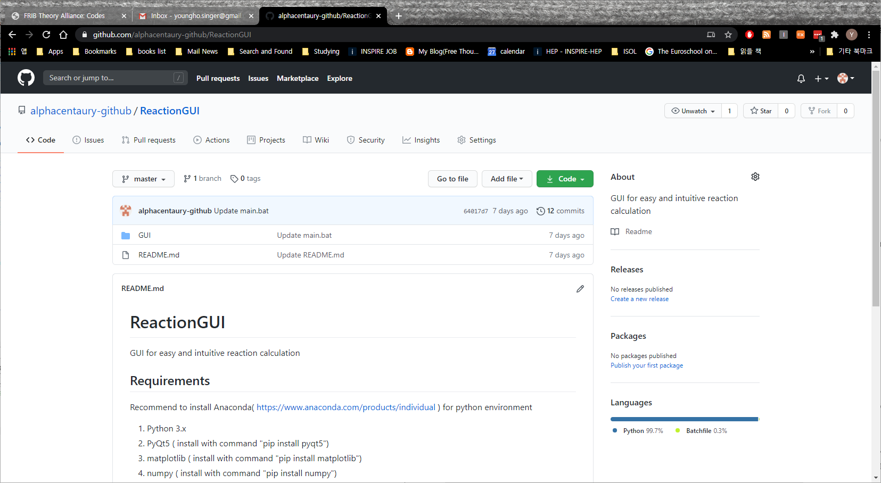
Installation
Search “ReactionGUI” at GitHub
https://github.com/alphacentaury-github/ReactionGUI

Slide 5
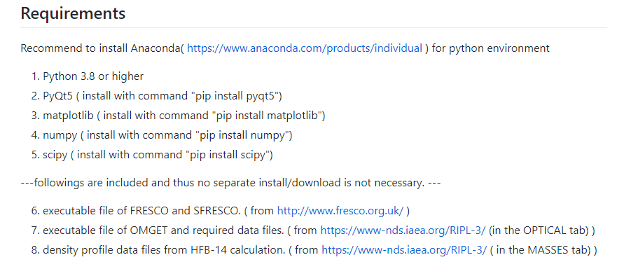
Installation

Slide 6
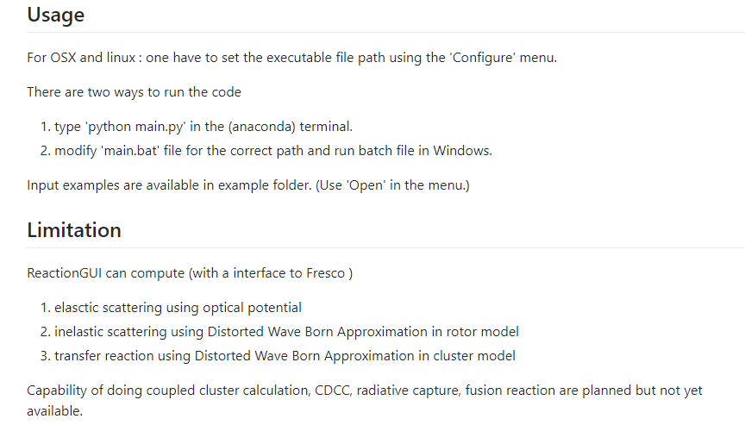

Slide 7
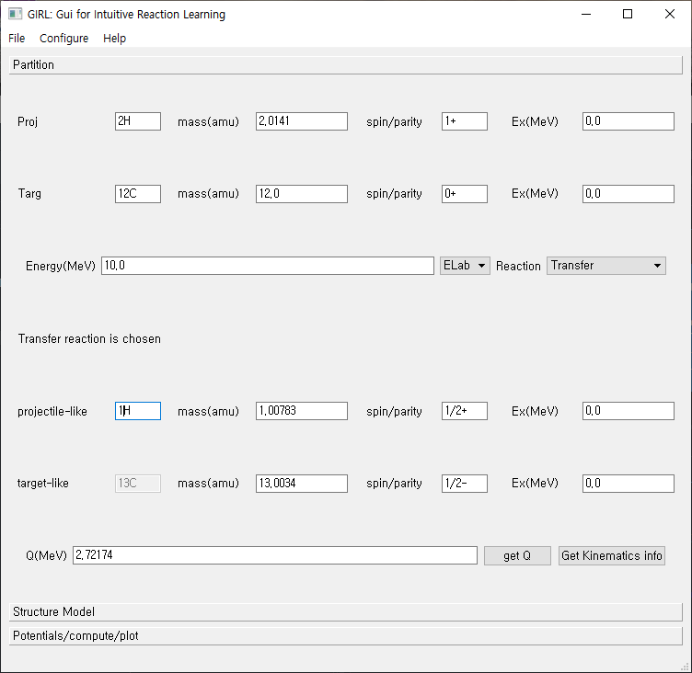
File:
Save/Load
Input parameter values
Three tabs
Partition
Structure Model
Potentials/compute/plot

Slide 8
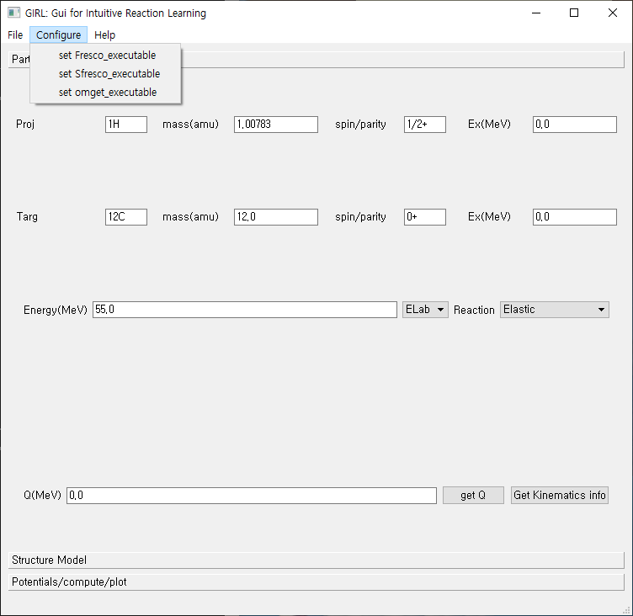
Configure:
Specify
the executable file
Locations
(OS(osx,linux) other than Windows)

Slide 9
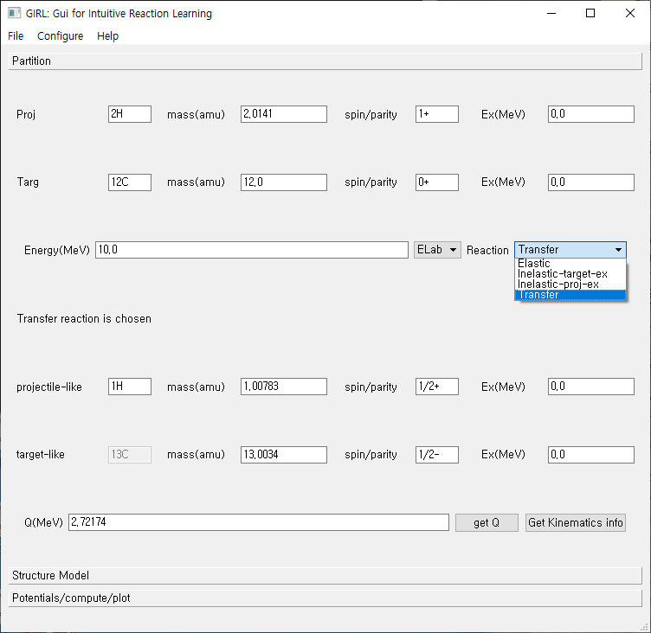
Neutron : 1n
Proton : 1H
Deuteron : 2H
projectile
target
Incident Energy/
Type of reaction
kinematics

Slide 10
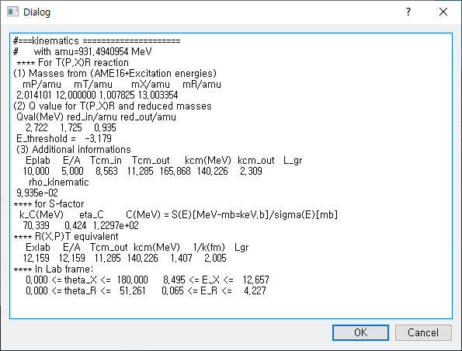
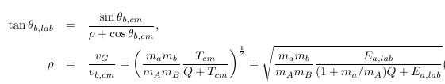

Get kinematics
button

Slide 11



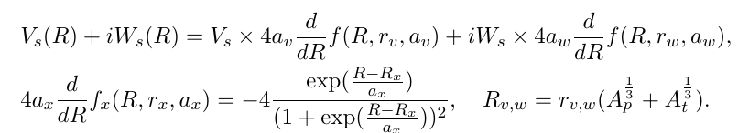
Elastic scattering: Optical model

Slide 12
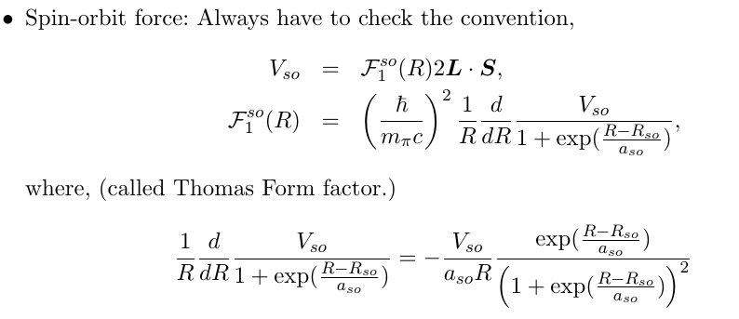
Elastic scattering: Optical model

Slide 13
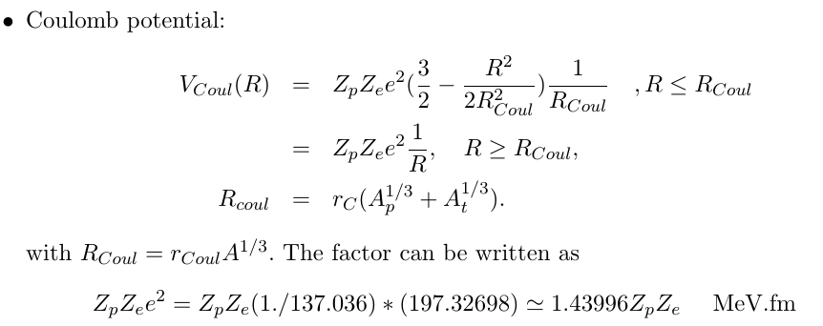
Elastic scattering: Optical model

Slide 14
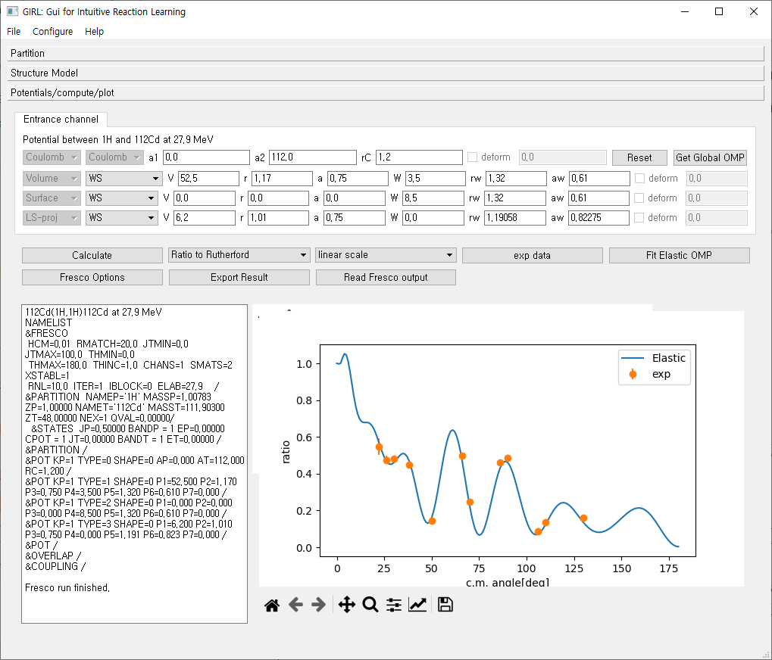

Slide 15
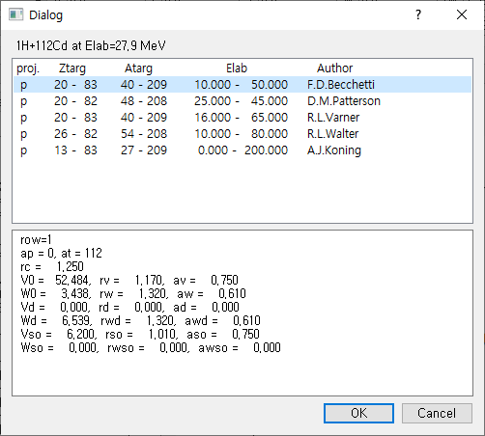
Get Global OMP
Get optical potential parameters
from RIPL-3 If available.
(p,n, 2H, 3H, 4He projectiles)

Slide 16
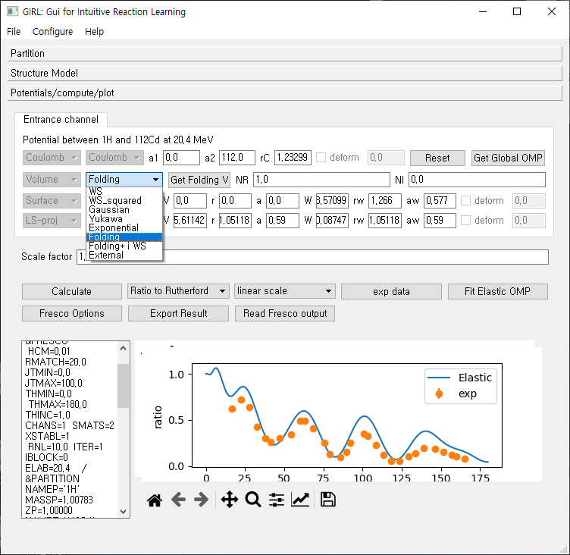
Various potential shapes

Slide 17
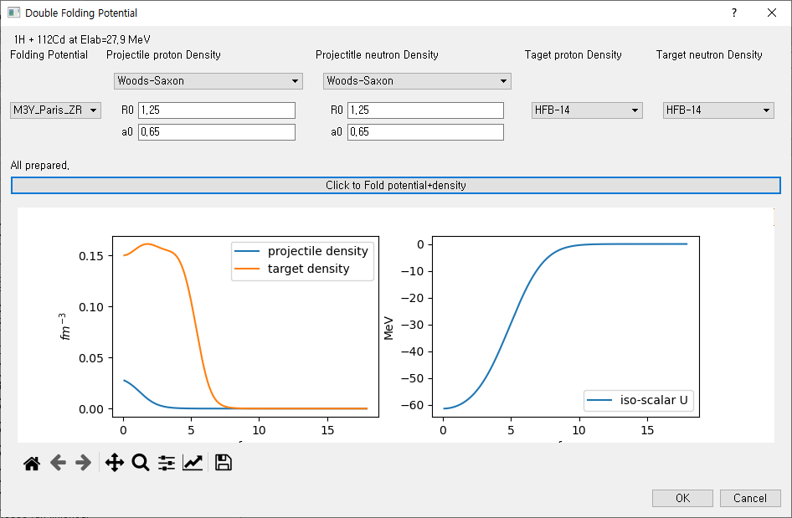
Get Folding V
Get density profile from HFB-14 results If available.
(From RIPL-3)
Or User input of density profile

Slide 18
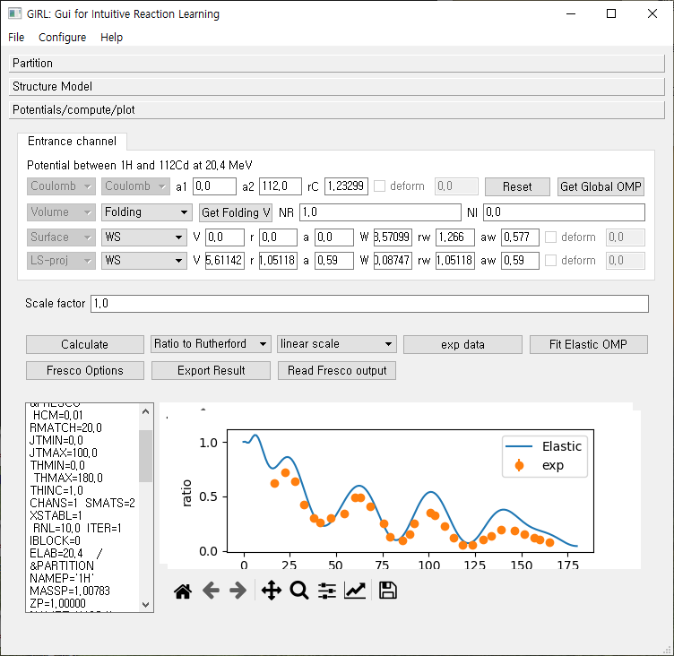
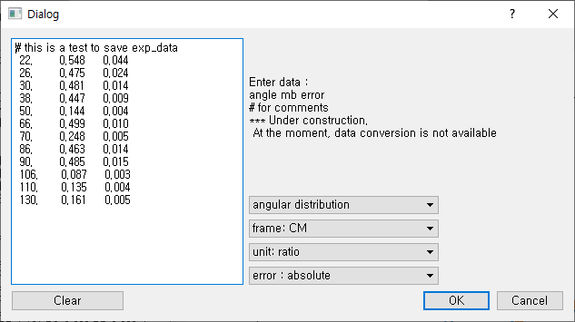
Exp
data

Slide 19
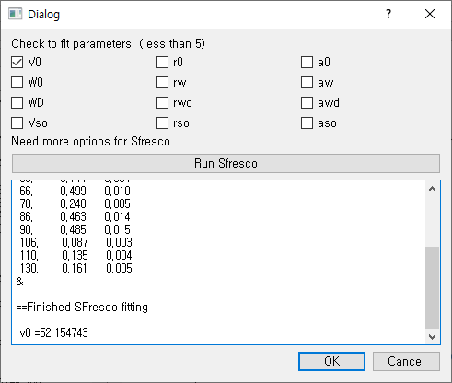
Fit
Elastic
OMP

Slide 20
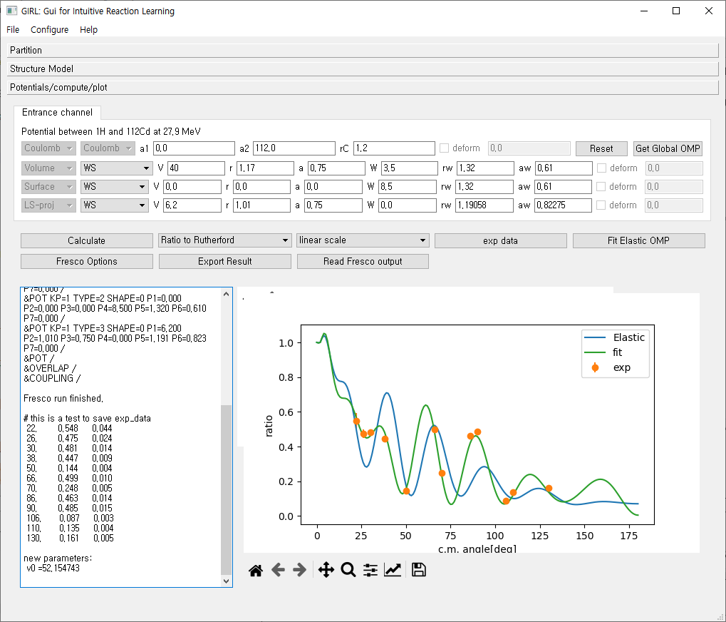
At the moment, no automatic update of parameter after fitting available

Slide 21


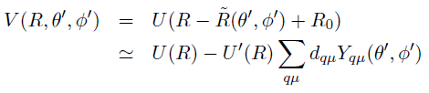
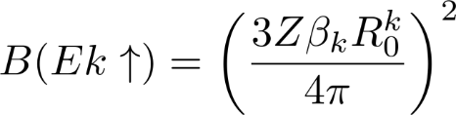
Inelastic scattering (Rotational Model)
I
I : spin of nuclei
K: bandhead ,
Spin projection at body-fixed frame
K
Symmetry axis
Deformed Nucleus
Deformed potential
In z’-axis, R0(1+beta)
R

Slide 22
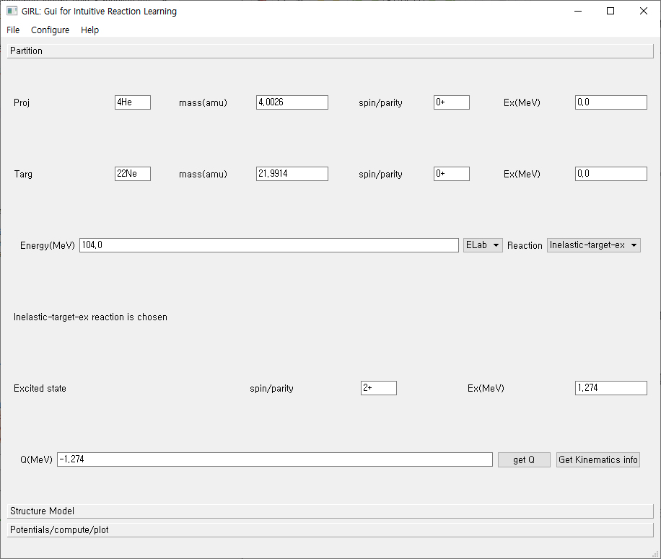

Slide 23
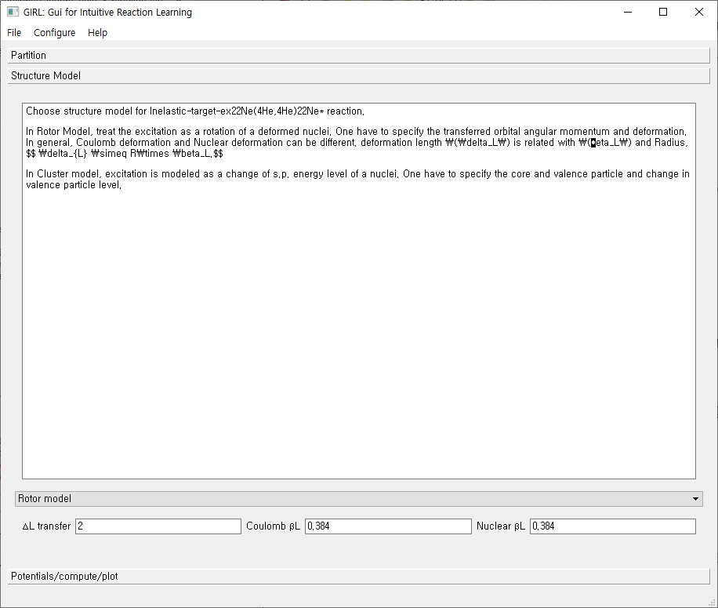
Deformation length
Is calculated
With r0=1.2

Slide 24
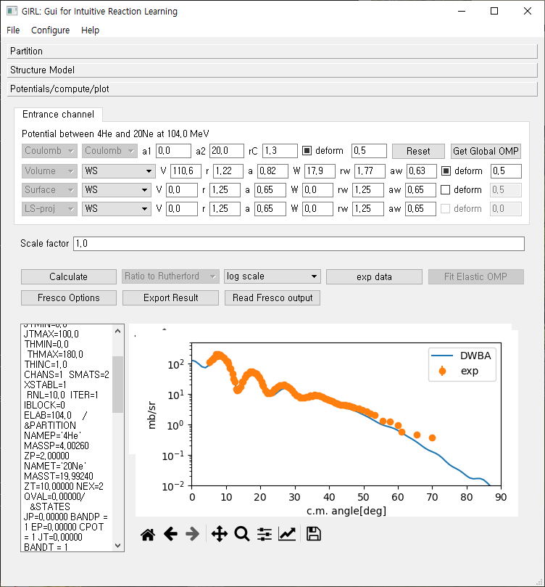

Slide 25






Transfer reaction
Consider the stripping reaction,
p(=c+n)+c’ → c+t(=c’+n)
In rearrangement,
initial and final partition is different.
n
c
DWBA need
Optical potential in entrance channel
Optical potential in exit channel
Binding potential in entrance channel
Binding potential in exit channel
(optional) Core-Core potential
c’
p=c+n
t=n+c’

Slide 26
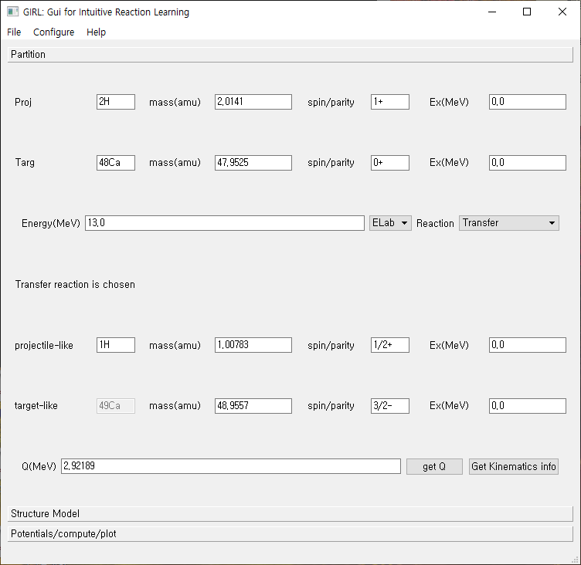

Slide 27
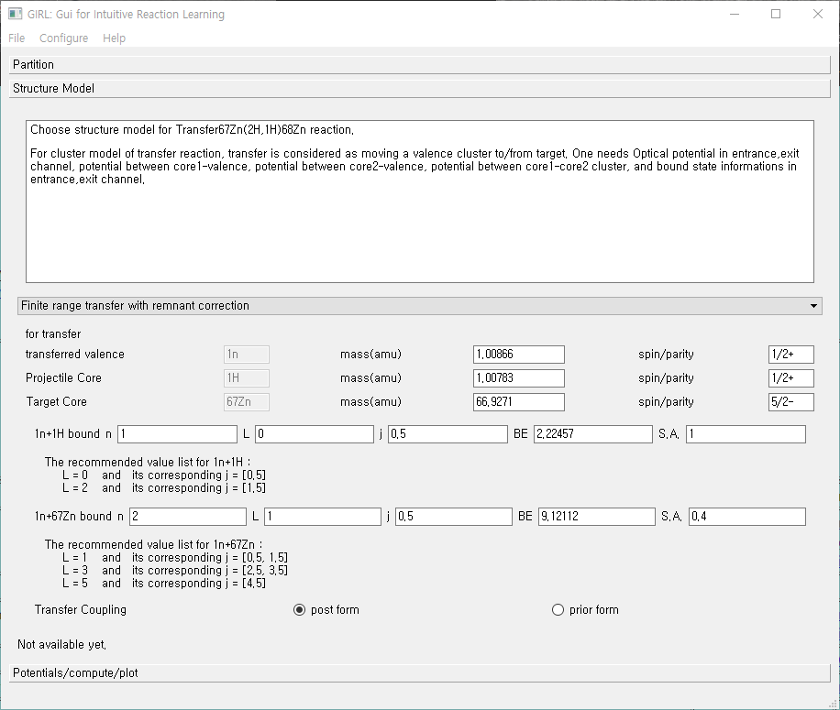
N, L, J of cluster state
S.A. = spectroscopic
amplitude
Post/prior form

Slide 28
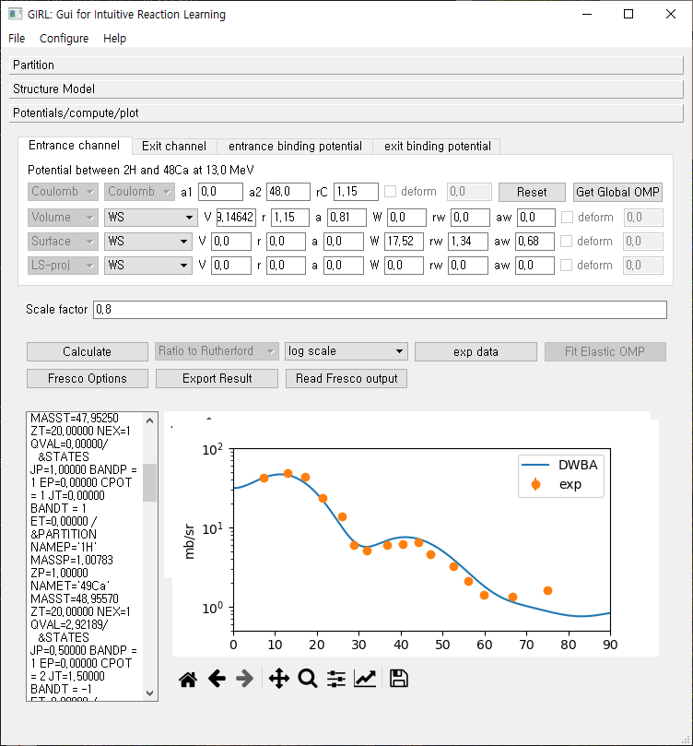
Bound state
Wave functions
Are obtained in
Well-depth
Prescription
Always check
Parameters.
No automatic
Determination
Of potential parameter
Is Available.
One can export
The result of DWBA
Calculation as a file.

Slide 29
Summary/Plan
Development of a simple GUI program for RAON Users to do reaction calculation.
At the moment, it is aimed to do DWBA calculation for elastic , in-elastic, transfer reaction in a very simple structure model.
Later, plan to add radiative capture, fusion reaction and coupled channel methods(also ADWA, CDCC).
Also, trying to include several useful functions for the convenience of Users. (Larger collection of optical potential, frame conversion etc.)

