Slide 1
Quantum Many-Body Calculations using Body-Centered Cubic Lattices
Young-Ho Song
(RISP, Institute for Basic Science)
연세대학교 물리학과 그룹세미나, 2020.09.28

Slide 2
Outline
Introduction
Formalism
Results
Discussion

Slide 3
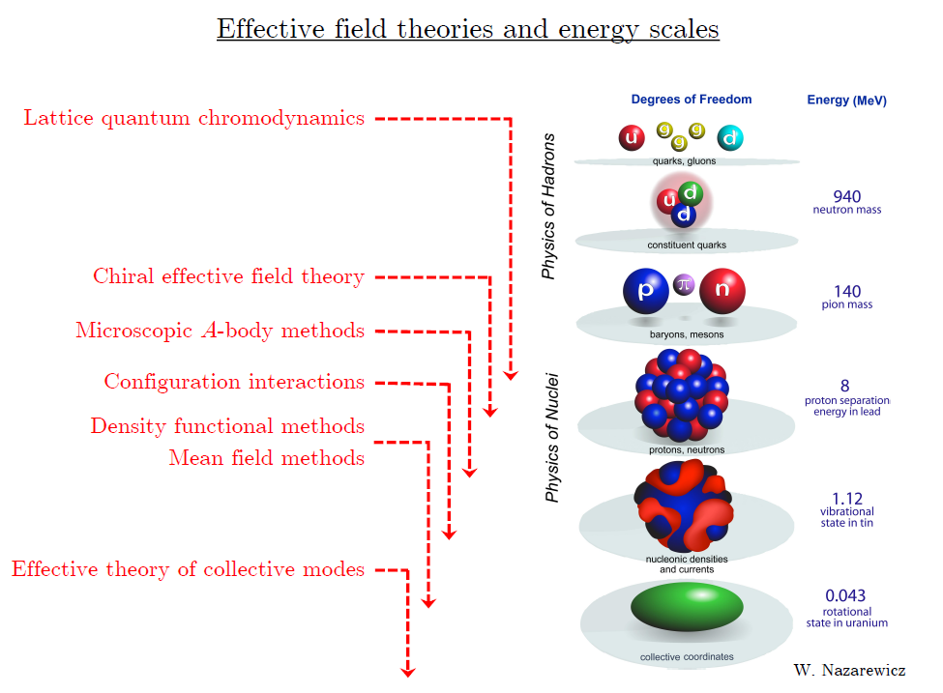

Slide 4
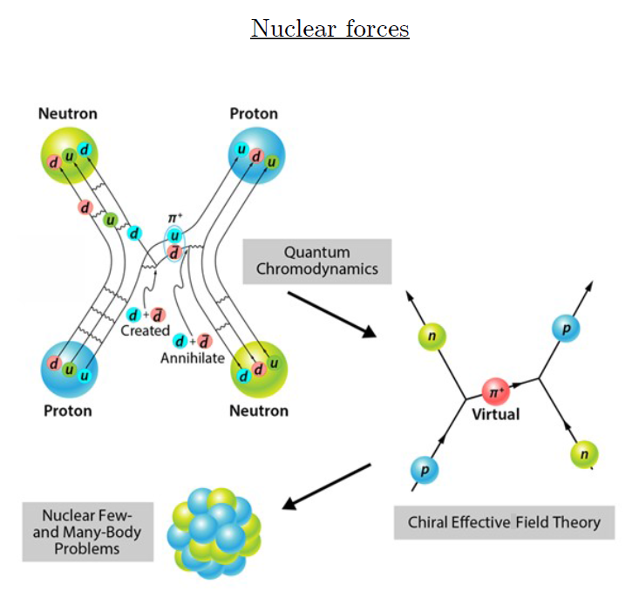
Ab-initio method
Ab-initio can mean many different things.
In nuclear physics, ab-initio means to start from nucleon-nucleon interaction.

Slide 5
Non-perturbative many-body problem
QCD is non-perturbative at long distance scale.
→ Lattice QCD : Compute Path integral in Euclidean time
Nuclear many body problem
Requires Non-perturbative method.
Ab-initio nuclear many body methods
Greens function Monte Carlo
No-core shell model
Coupled Cluster
Nuclear Lattice Effective Field Theory

Slide 6
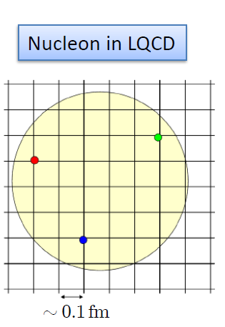

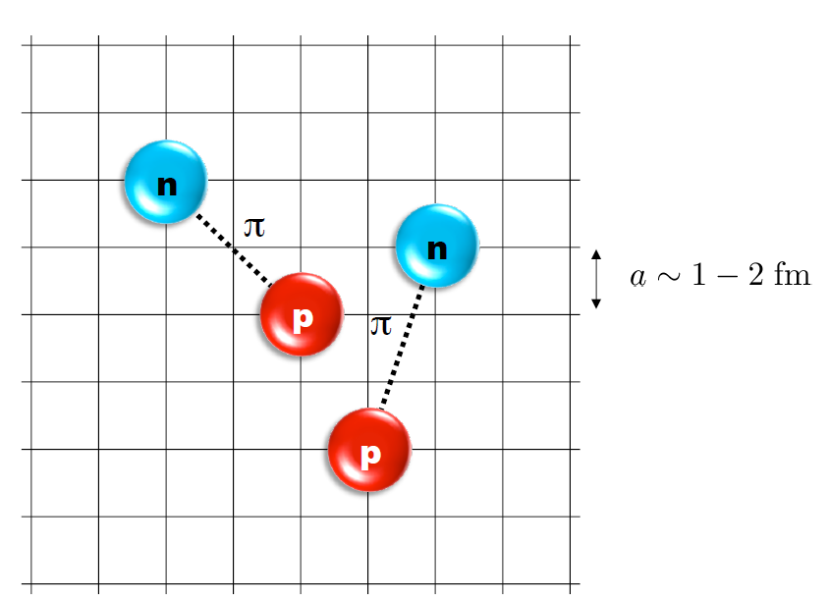
Nuclear Lattice Effective Field Theory

Slide 7
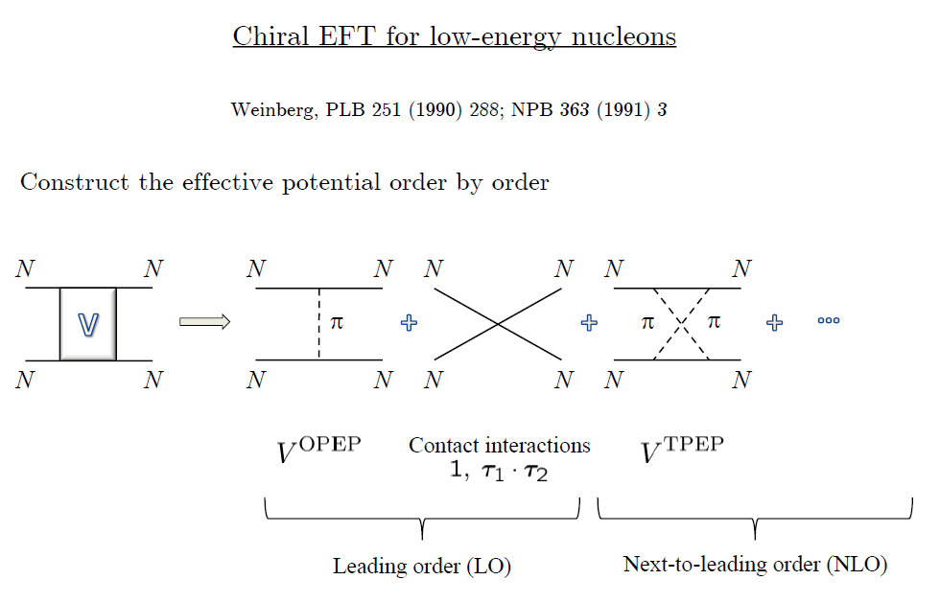
Chiral Effective Field Theory

Slide 8
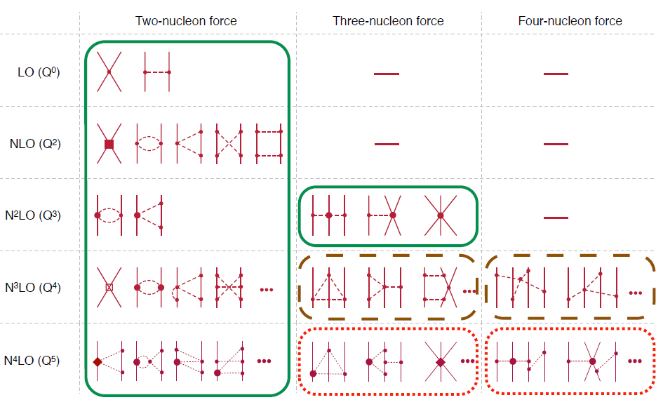
Chiral Effective Field Theory

Slide 9
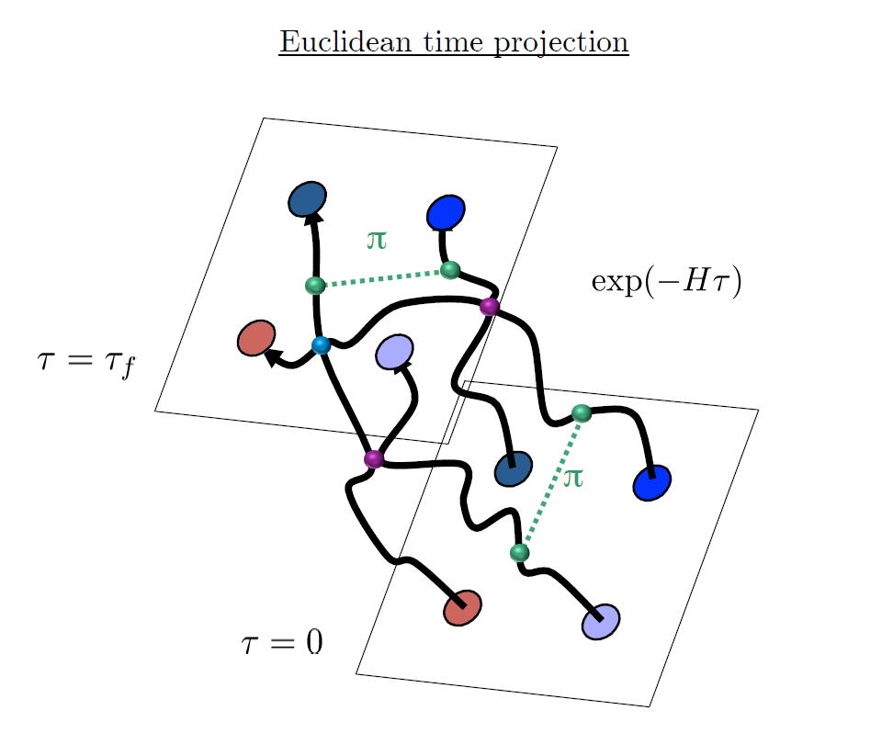
Path Integral (Euclidean time evolution)

Slide 10
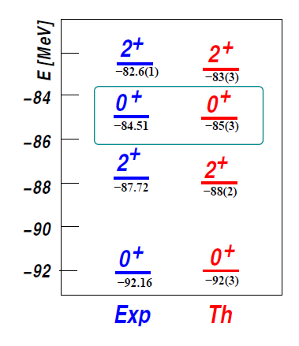

Applications of NLEFT
Has been successfully applied to
Nuclear matter, Cold atom, dilute fermion system
Finite nuclei (A<=50)
First ab-initio calculation of Hoyle state
Cluster structure of ¹²C and ¹⁶O
NN scattering, N-D scattering
Alpha-alpha scattering
radiative capture, fusion
Etc.
The first ab-initio calculation of
Hoyle state

Slide 11




Lattice Method (Path Integral)

Slide 12
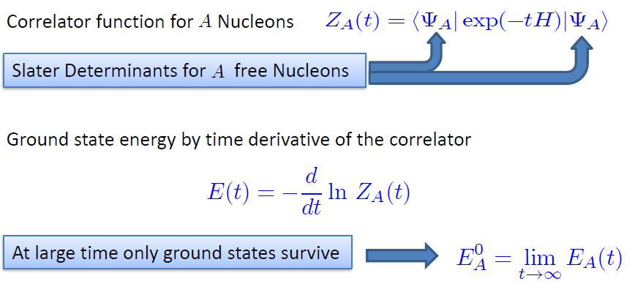
Transfer matrix method

Slide 13
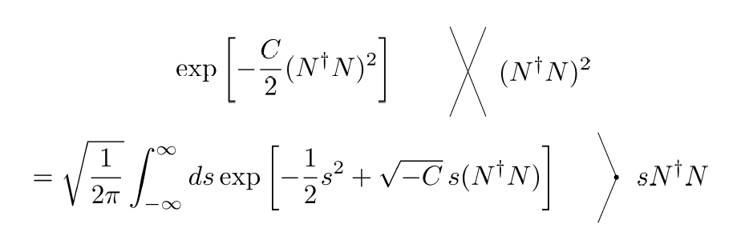
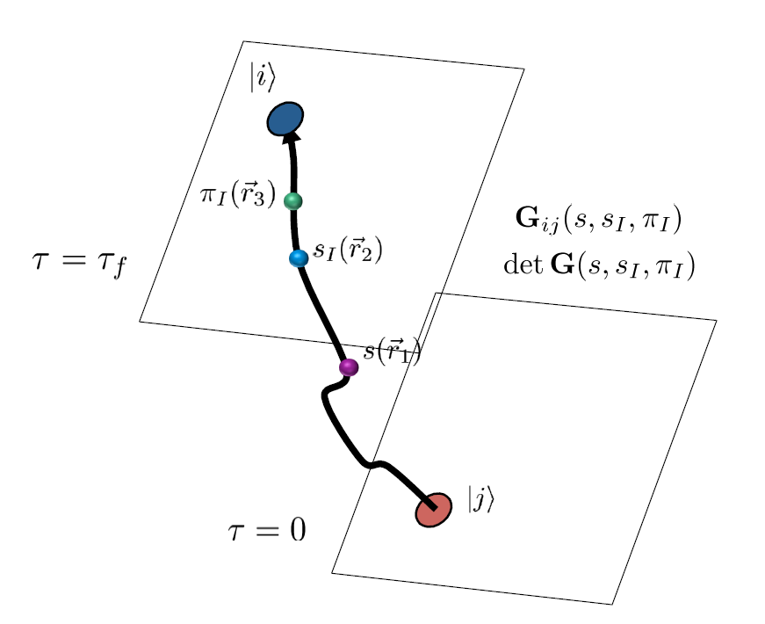
Auxiliary Field Monte Carlo

Slide 14
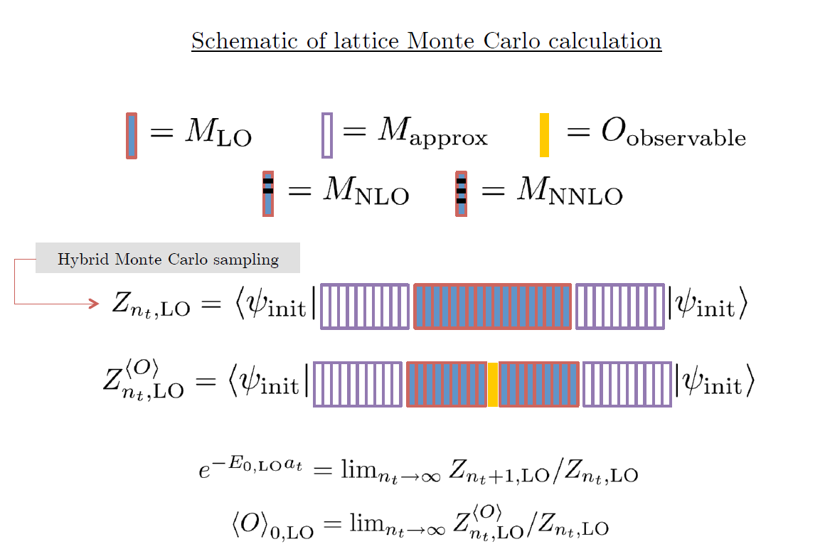

Slide 15
Chiral Effective Field Theory on the lattice
Nuclear Interaction itself is not known exactly.
Because of lattice, one can not directly use the conventional interaction.
→ Start from finding proper nuclear interaction and fix their coefficients on the lattice.

Slide 16
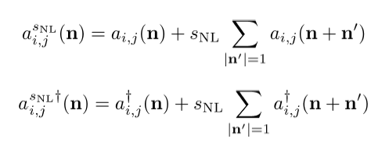

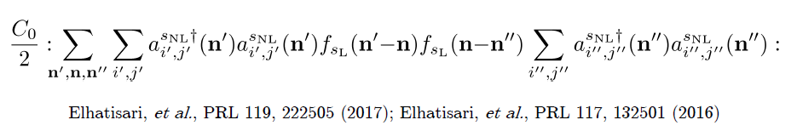
Non-local smeared creation and annihilation operator
LO (short range) SU(4) contact interaction
LO (long range) One Pion exchange

Slide 17
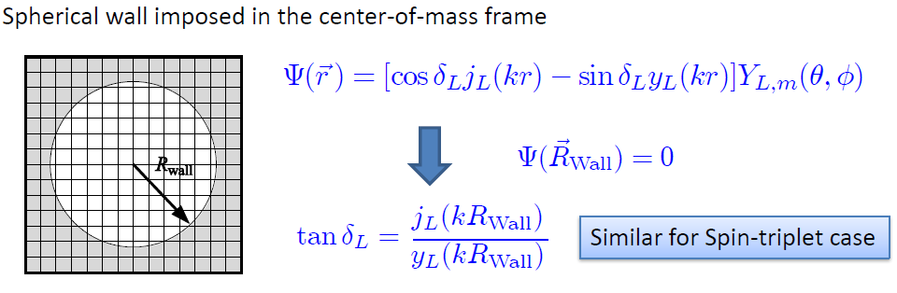
Low energy constants in lattice EFT
All LECs(parameters in the Hamiltonian) are fixed in A<=3
(They have to be fixed for given lattice regularization)
N-P scattering phase shifts, Deuteron binding energy
Triton binding energy, Triton beta decay.
Scattering phase shifts on the Lattice:

Slide 18
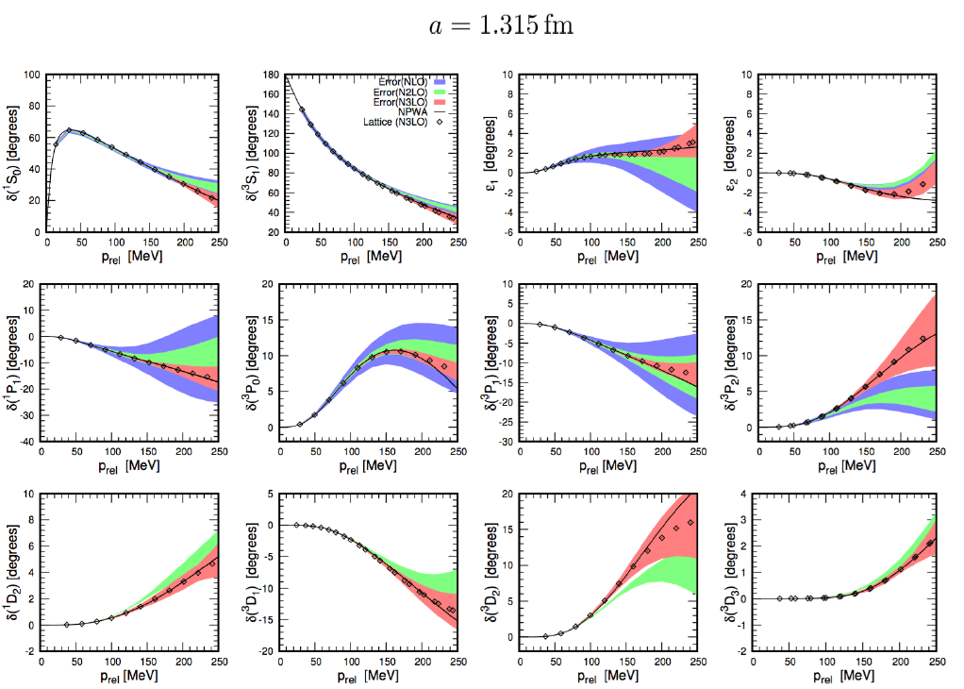

Slide 19
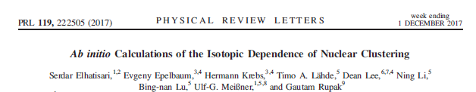
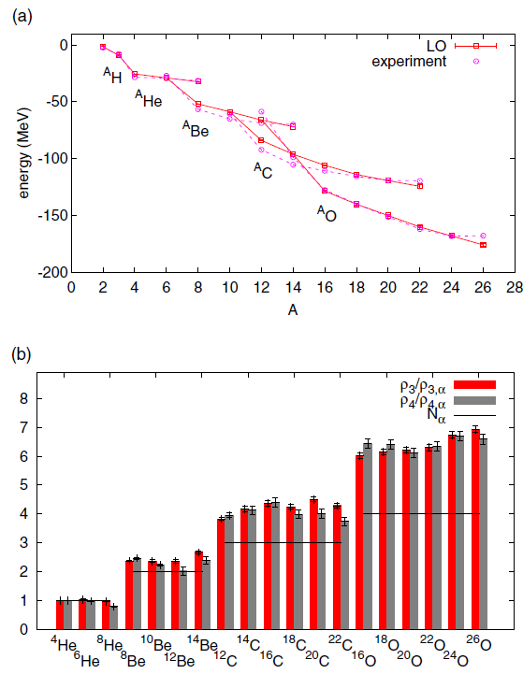
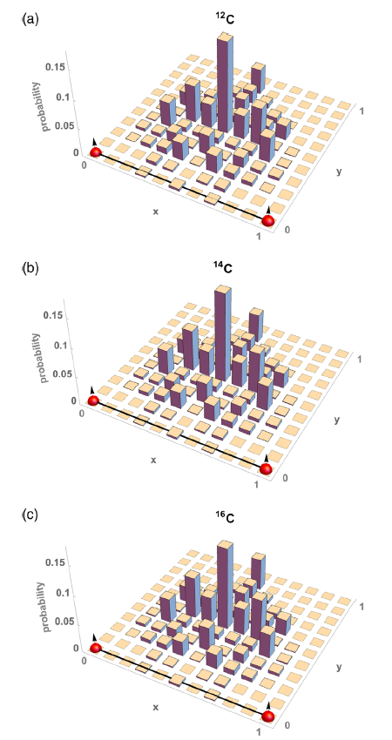
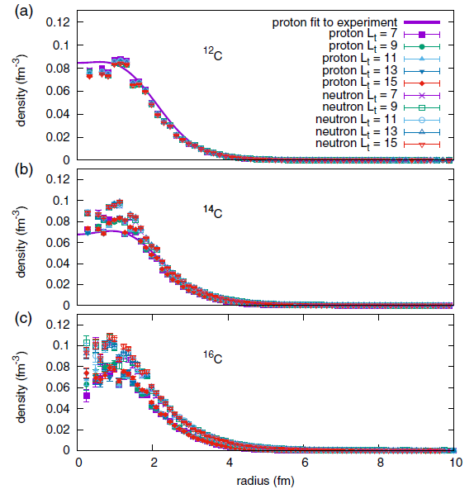


Slide 20
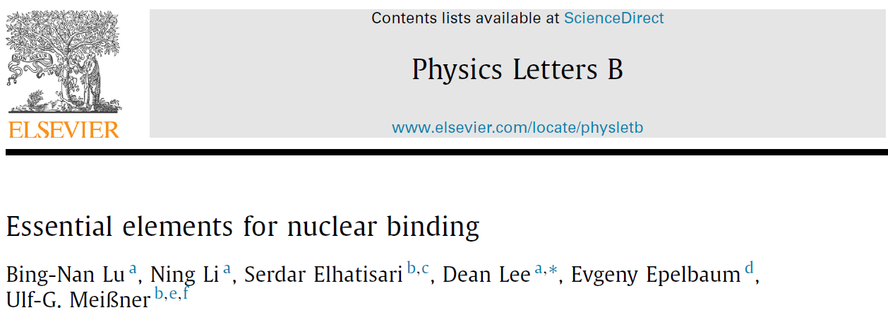
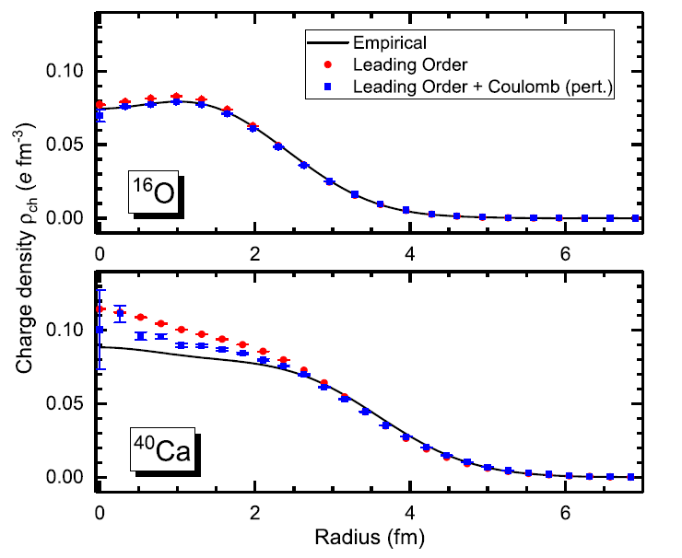



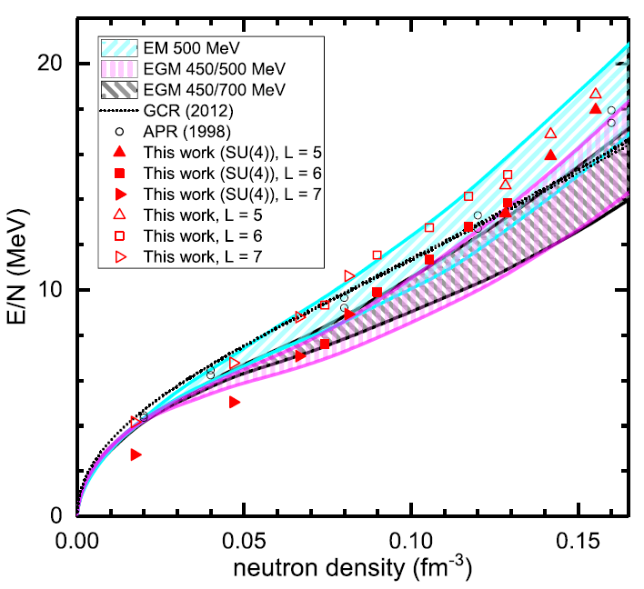
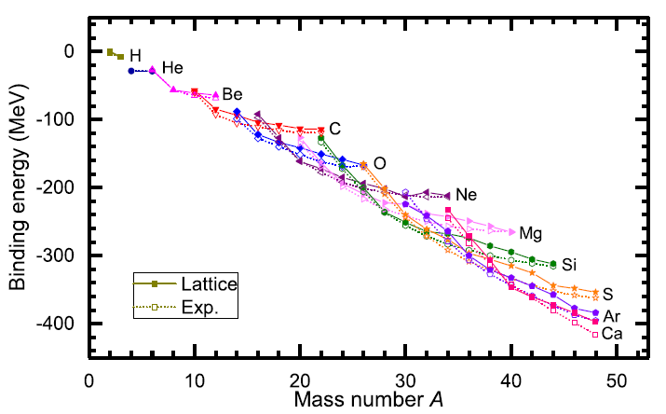

Slide 21
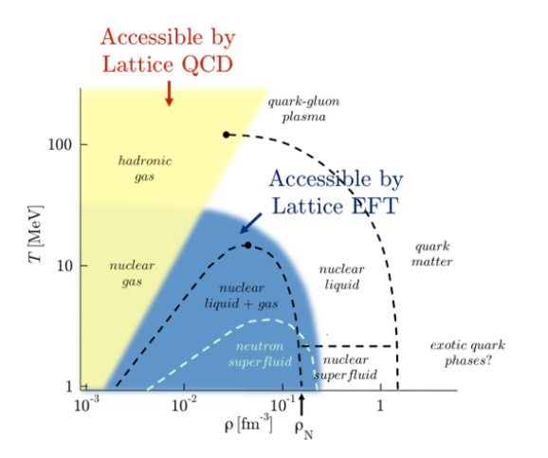
Unitary Fermion Gas in BCC lattice
Studying the bulk properties of many nucleon system
→ relation between realistic nuclear interaction and symmetric/asymmetric nuclear matter EOS.
→ requires very accurate nuclear force which reproduce both few-body system(NN scattering, binding energies)
And infinite nuclear matter (nuclear matter saturation )

Slide 22

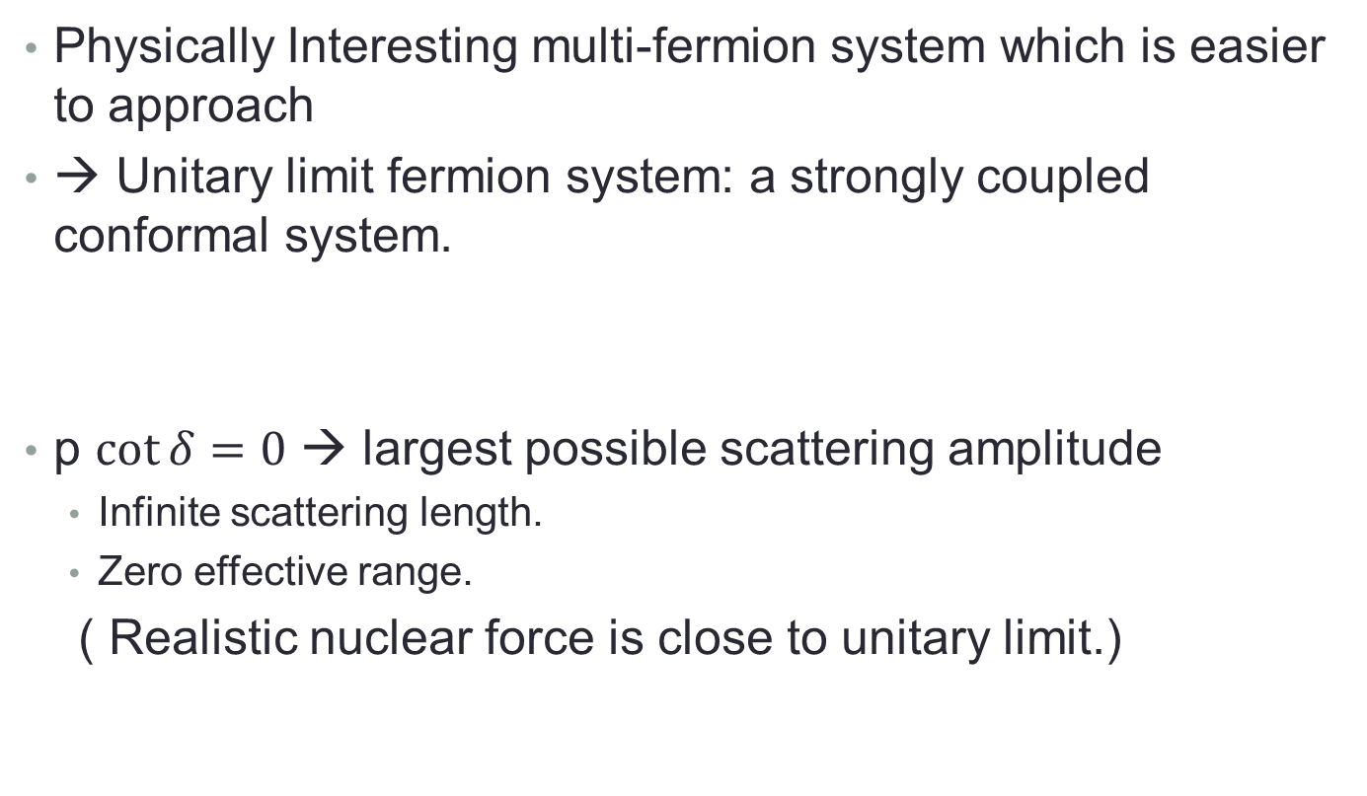
Unitary Fermion Gas in BCC lattice
Physically Interesting multi-fermion system which is easier to approach
→ Unitary limit fermion system: a strongly coupled conformal system.
p $\cot{δ}=0$ → largest possible scattering amplitude
Infinite scattering length.
Zero effective range.
( Realistic nuclear force is close to unitary limit.)

Slide 23
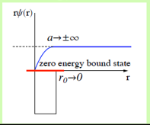
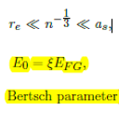
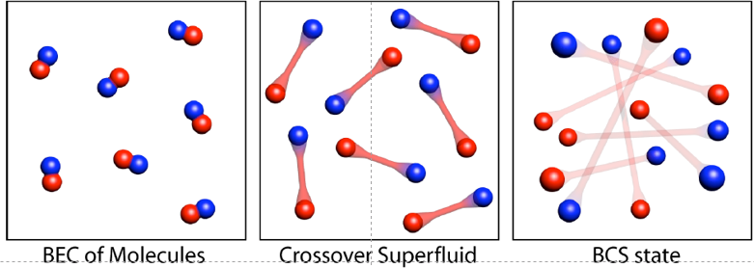
Unitary Fermion Gas in BCC lattice
Universality of unitary limit
Of many fermion system
→ Bertsch Parameter
Experiment in
Ultracold trapped atoms
(M. J. H. Ku et al, Science 335, 563-567 (2012).)
Bertch parameter ~ 0.376(4)
Many theoretical calculation exists including NLEFT.
Previous NLEFT calculation was done in cubic lattice.
Here we applied NLEFT in BCC lattice .

Slide 24
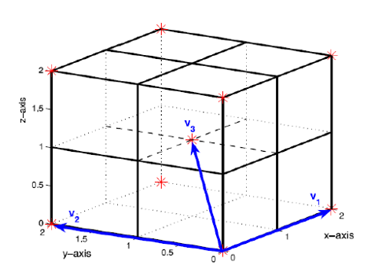
BCC lattice
Because of convenience, all NLEFT calculation has been done on cubic lattice
Physical result should not depends on the specific lattice
structure. (lattice size, spacing, type)
BCC lattice is constructed as
Two cubic lattice
Lattice spacing a=1/100 MeV^-1
Lattice Time step at = 1/1000 MeV^-1
(For outer region at’=1/200 MeV^-1)

Slide 25



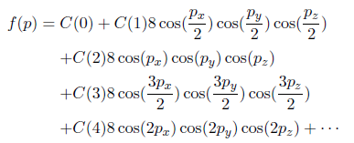

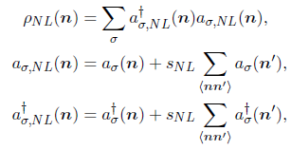
Unitary limit Hamiltonian in BCC

Slide 26
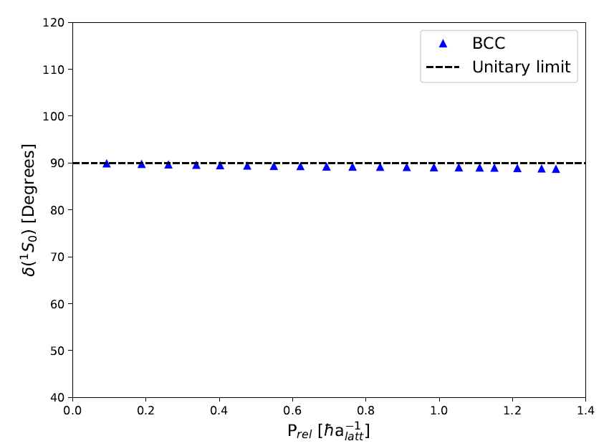
Unitary limit Hamiltonian in BCC
1S0 NN scattering phase shift is fitted
For unitary limit .
C0= -0.7449172 [l.u.]
sNL = - 0.0009533729
→
a0 = 125658 fm, r0 = 0.110 fm

Slide 27


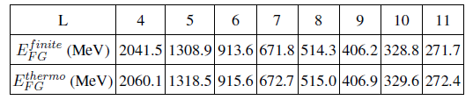
Results
N=66 neutrons (33 spin up, 33 spin down)
Ground state energy are calculated by using transfer matrix formalism
Euclidean time extrapolation
Free fermion gas energy can be defined in two way.
‘Finite’ : NLEFT result of free fermions
‘thermo’ : Thermodynamic limit expression of free fermion gas

Slide 28
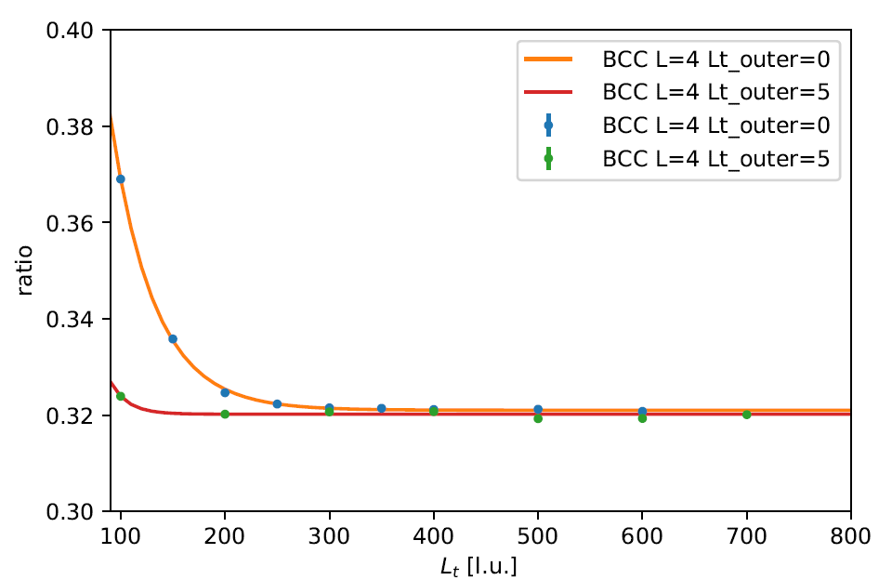
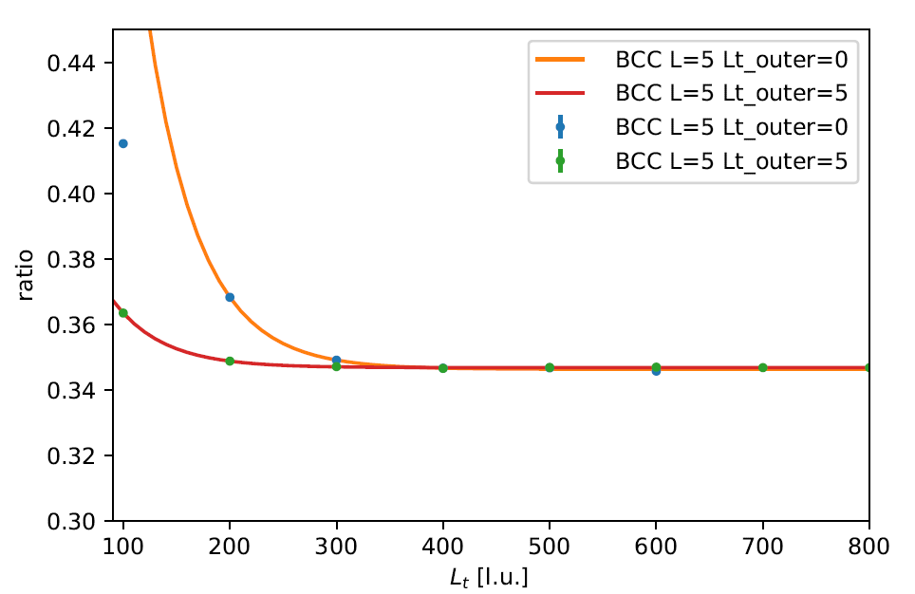
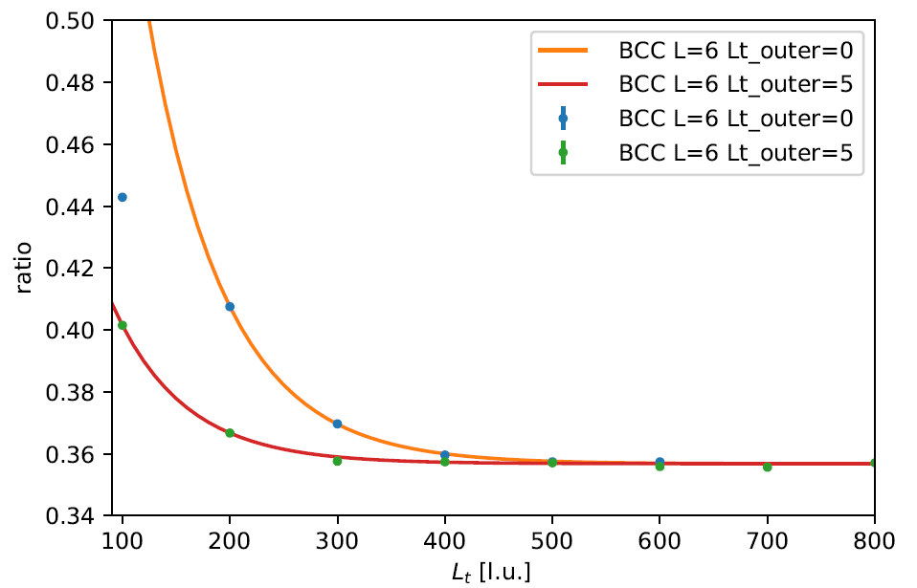
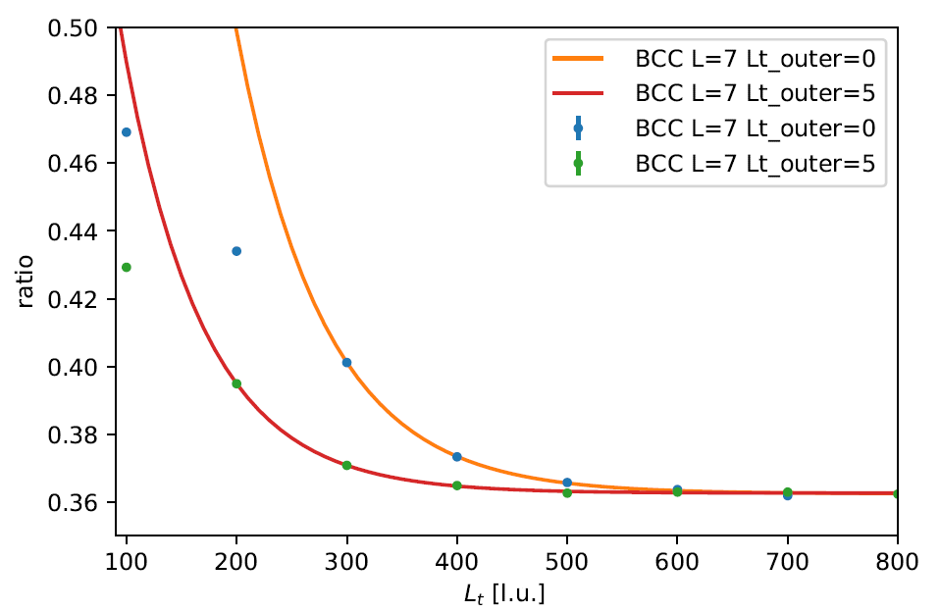
Results : Lt extrapolation

Slide 29
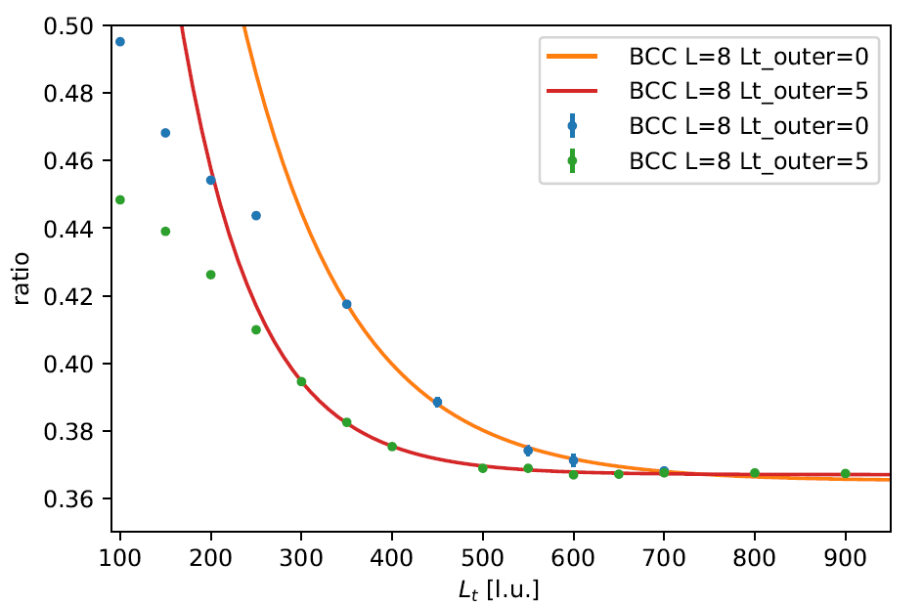
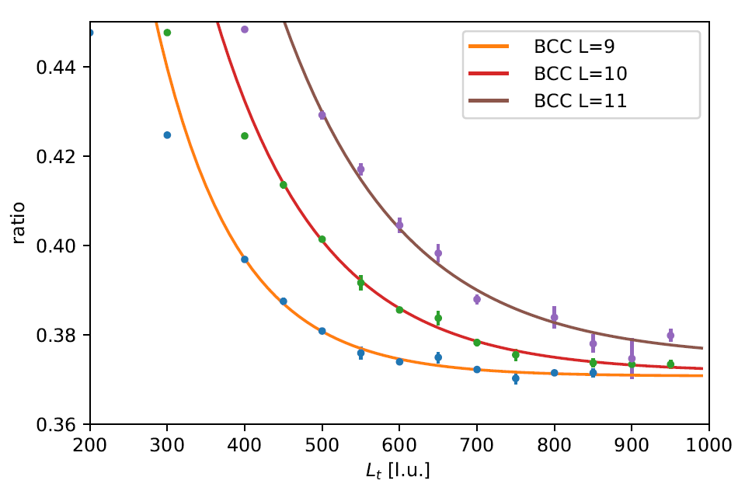
Results : Lt extrapolation

Slide 30
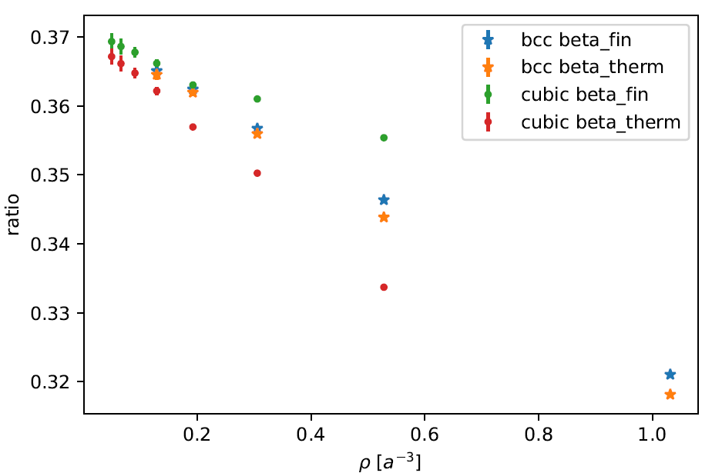
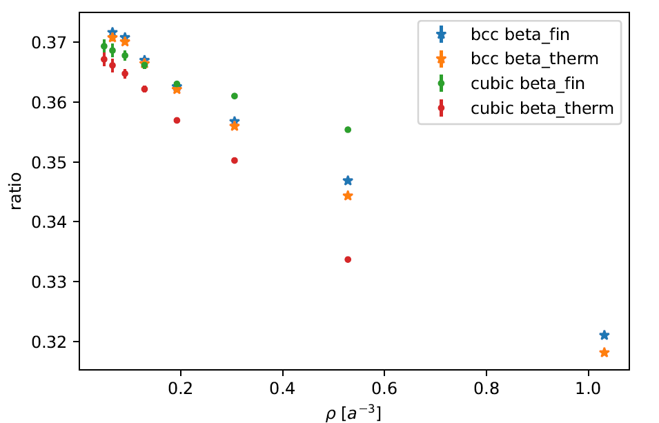
Results: L dependence
Lt_outer=0
Lt_outer=5

Slide 31
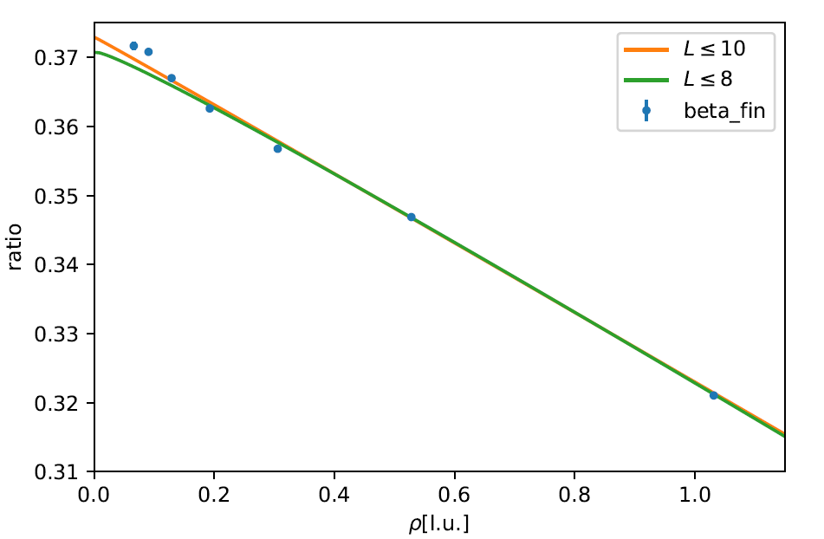





Results
NLEFT in Cubic lattice calculation :
Consistent with
QMC calculations : 0.366(2) in zero-temperature
0.367(7) zero-temperature extrapolation
Fixed node diffusion MC and DFT : upper bound 0.383(1)
Experiment : 0.376(4)

Slide 32
Discussion
We confirm the regularization independence of NLEFT calculation for Unitary Fermion Gas.
Bertsch parameter of UFG estimated 0.369(3) ~ 0.373(2)
BCC lattice calculation shows faster convergence between beta^finite and beta^therm. BCC lattice requires larger number of lattice points for the same lattice size. However, for the similar number of lattice points, computational cost is similar for BCC and cubic lattice.

