Slide 1


Graphic User Interface for
easy nuclear reaction calculation
Young-Ho Song (IRIS, IBS)
2026.04.23. KPS spring meeting, Daejeon

Slide 2

Introduction
A development of Graphic User Interface for nuclear reaction calculation
For novice and experts who wants a quick calculation.
Actually, this is not a new work.
Presentated at KPS
Motivation of presentation again?
Updates in the GUI since last time
Force myself to work.

Slide 3
Introduction
There are many direct nuclear reaction codes available
DWUCK, ECIS, FRESCO, TWOFNR, CCFULL, PIKOE…
Most of them are written in Fortran
Require specific input file format
Require knowledge on the reaction theory
Usually they are not easy for beginner to use
Usually they need separate plotting tools
The aim of the GUI is to make it easy and intuitive to do a nuclear reaction.
However, there are large room for improvements.

Slide 4
Introduction
GUI code is developed by Y.-H. Song and I.J. Shin.
Combines Qt + Fresco + other utility codes
Plan to improve the code according to user’s needs.
(yhsong@ibs.re.kr for suggestions, errors, troubles)
Search “ReactionGUI” at GitHub
https://github.com/alphacentaury-github/ReactionGUI

Slide 5
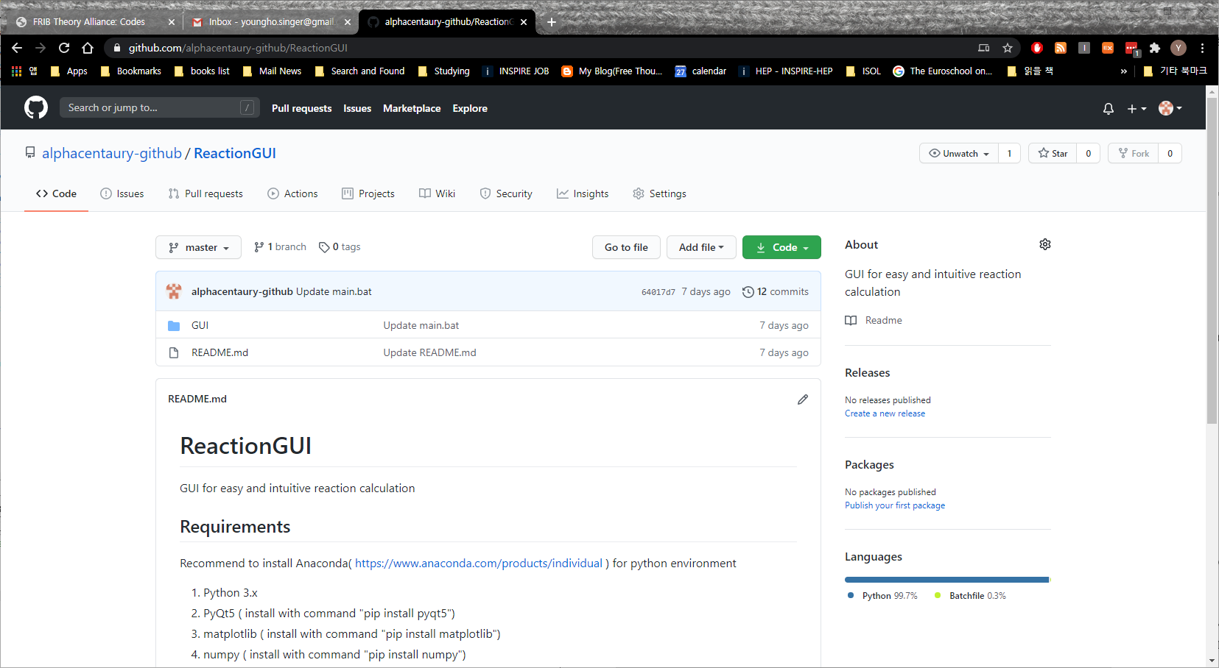
Introduction

Slide 6
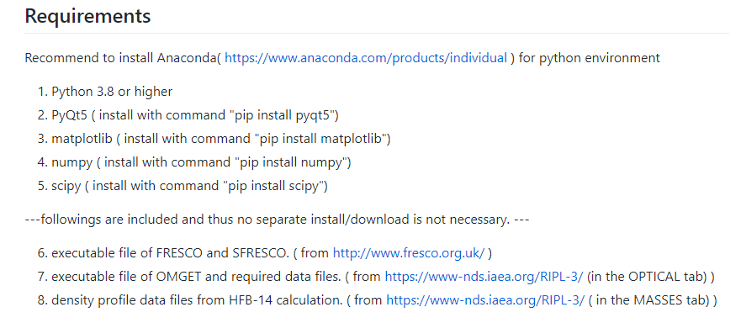
Introduction
To run GUI: in command prompt
python main.py

Slide 7
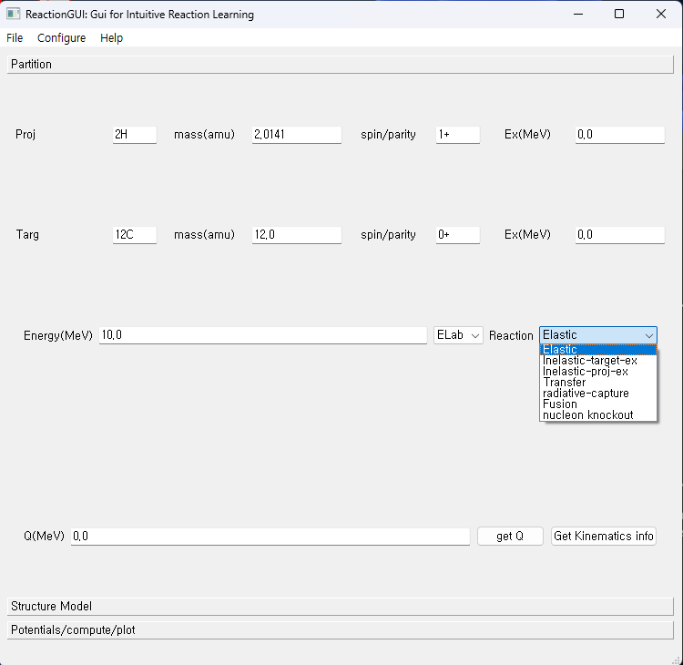
GUI
File:
Save/Load
Input parameter values
Configure:
Set executables (fresco, sfresco)
Three tabs
Partition
Structure Model
Potentials/compute/plot

Slide 8
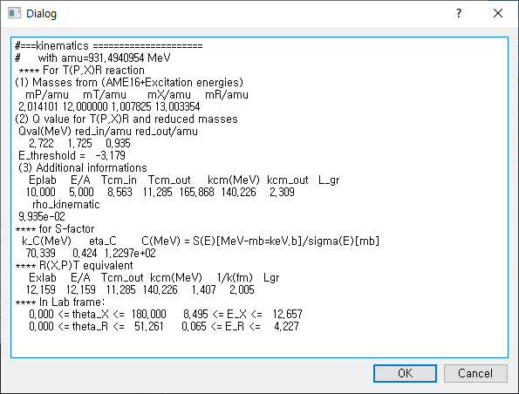
GUI
Get kinematics
button

Slide 9
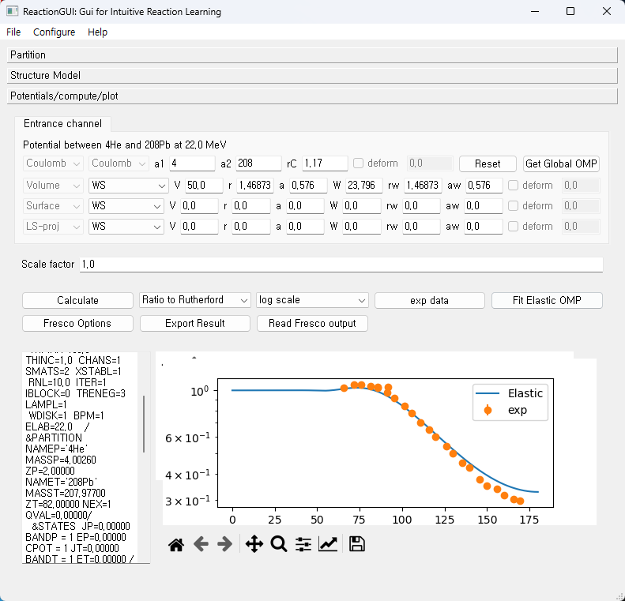
Elastic scattering: Optical model

Slide 10
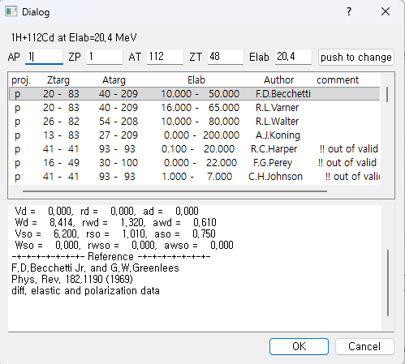
Elastic scattering: Optical model
OMGET: get global optical potential parameters

Slide 11
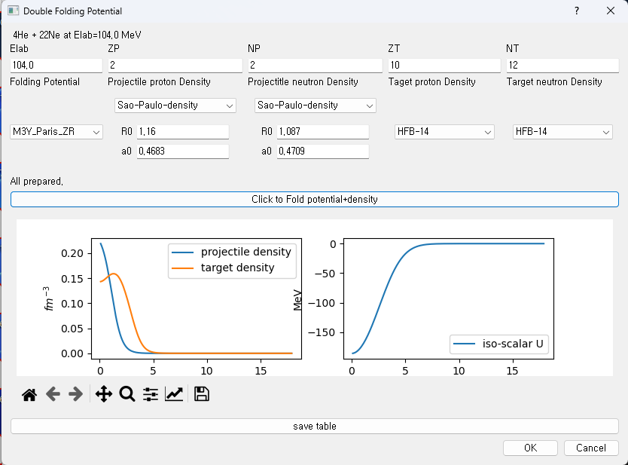
Elastic scattering: Optical model
Double Folding

Slide 12
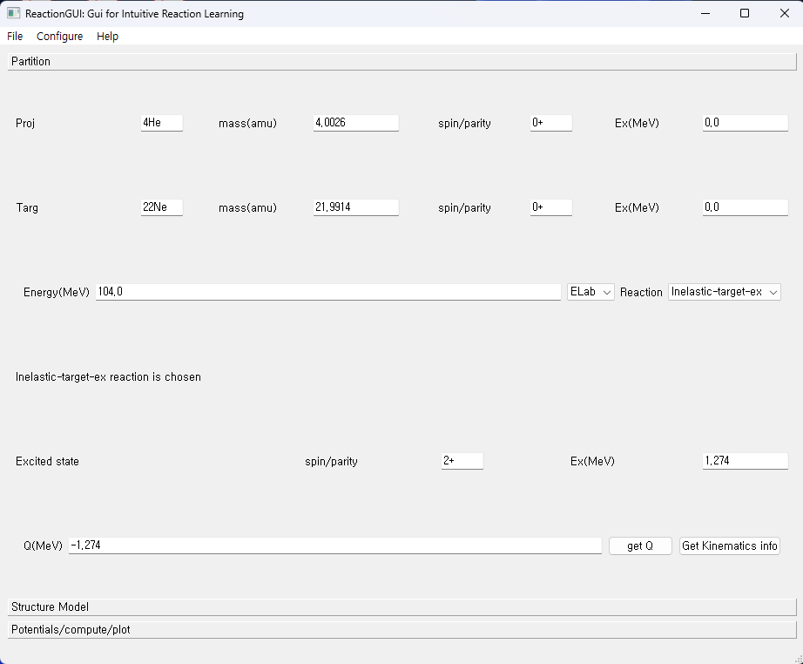
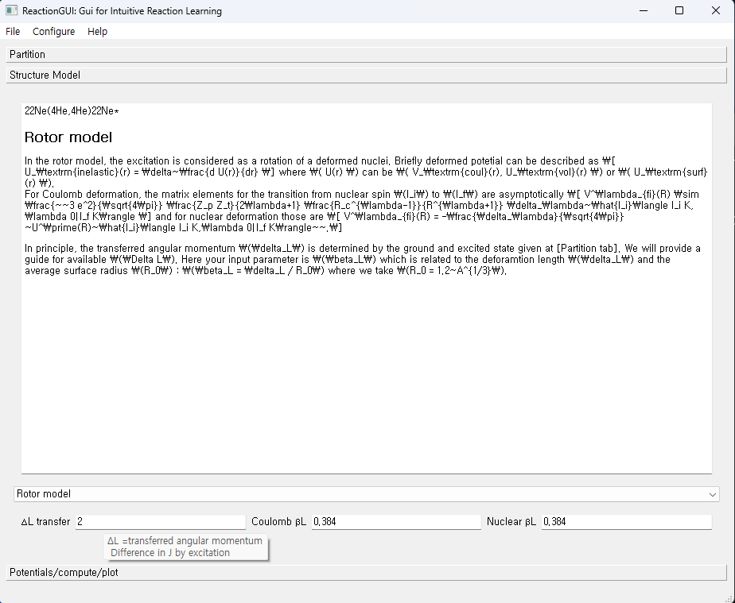
Inelastic scattering: DWBA(Rigid Rotor model)

Slide 13
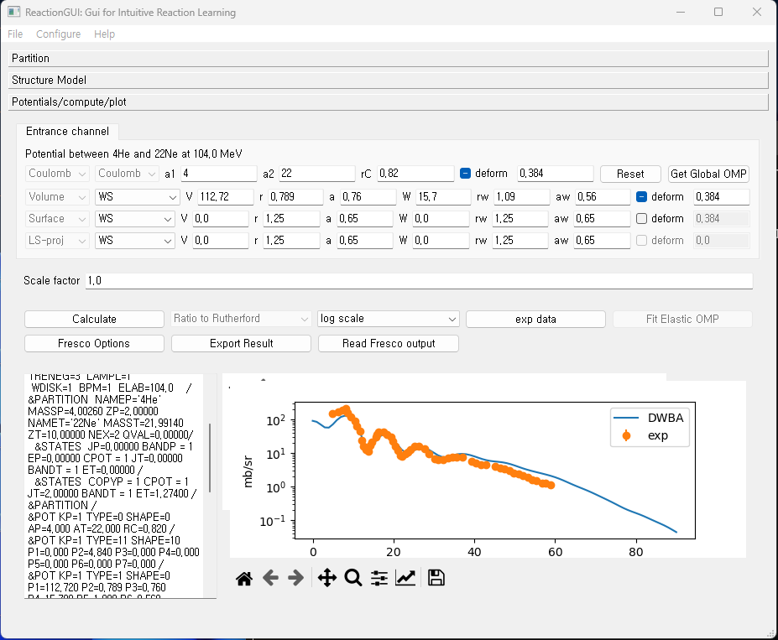
Inelastic scattering: DWBA(Rigid Rotor model)

Slide 14
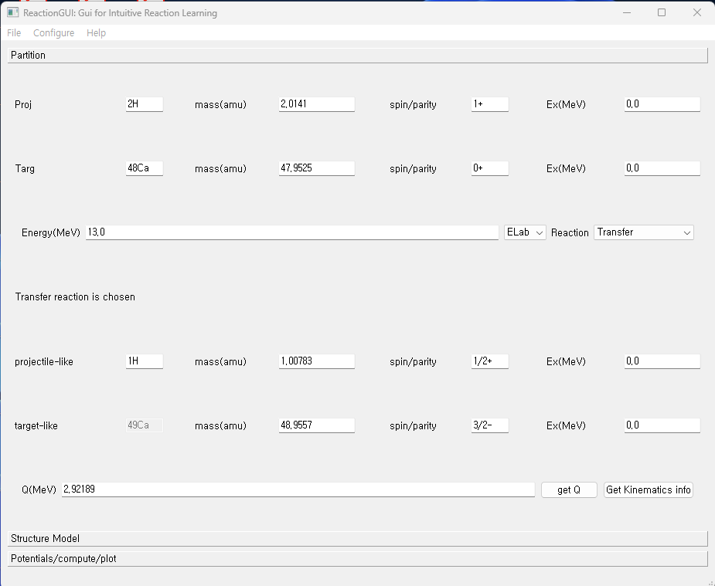
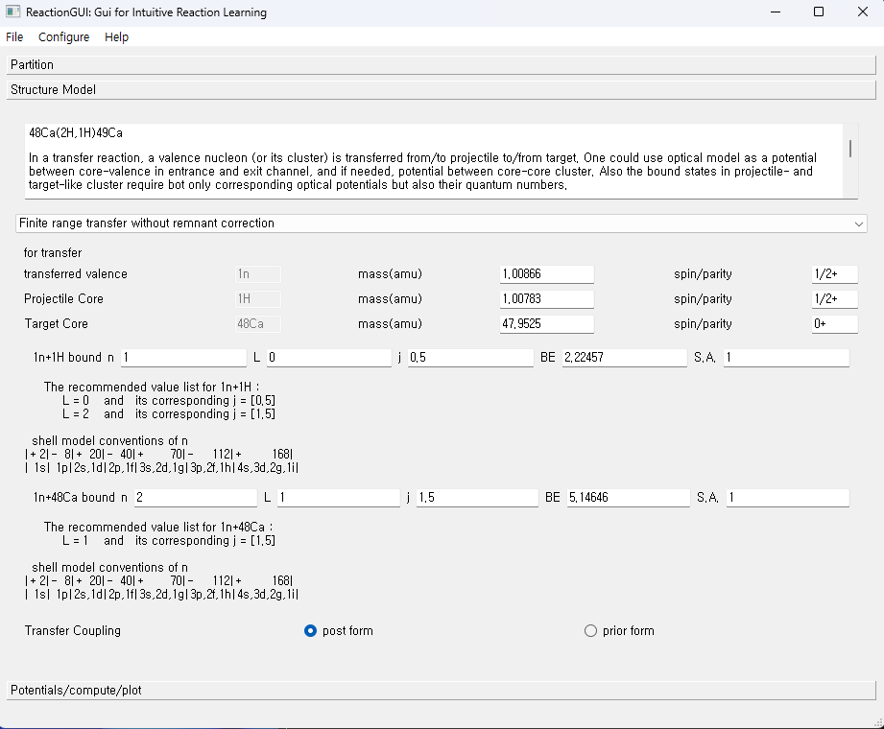
Transfer reaction: DWBA

Slide 15
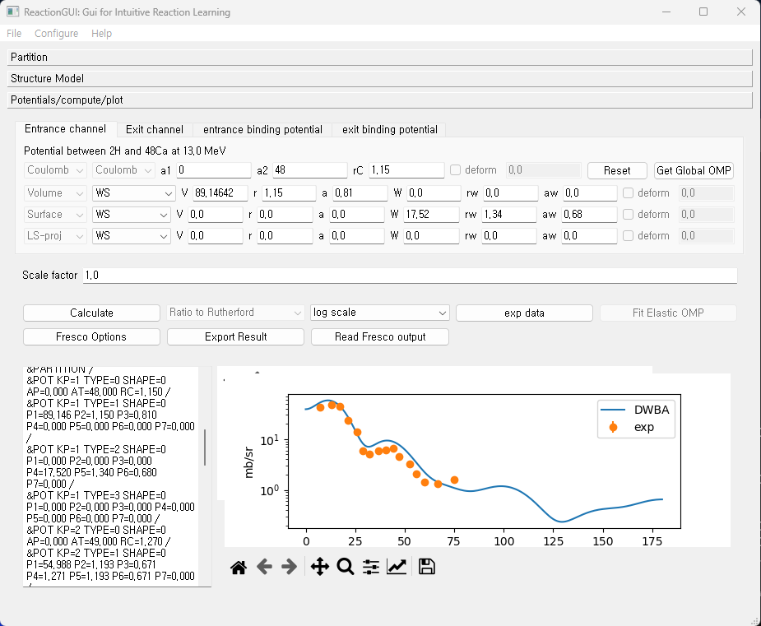
Transfer reaction: DWBA

Slide 16
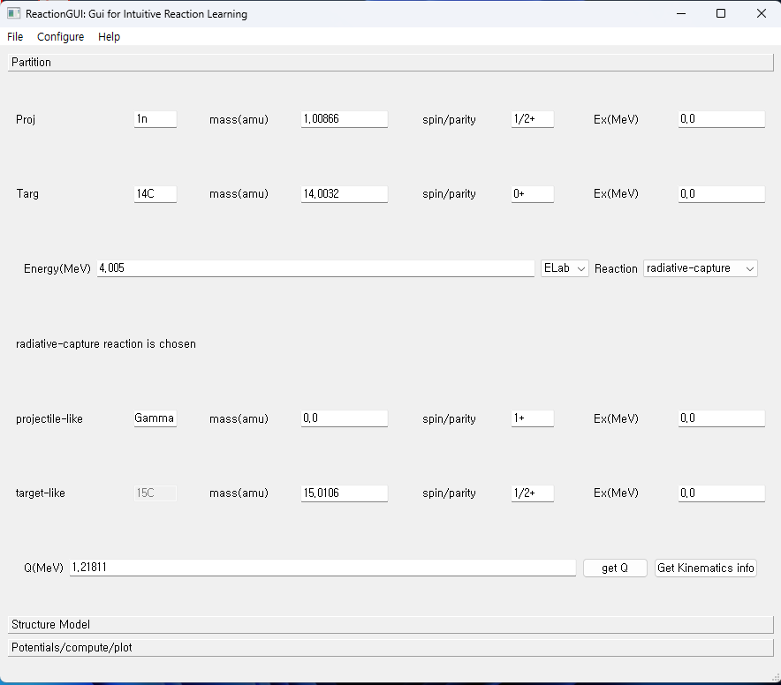
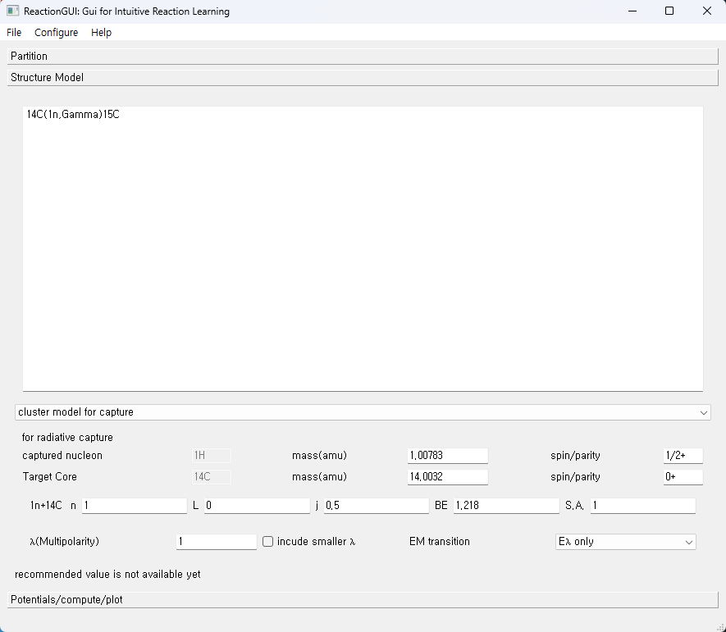
Radiative capture reaction: DWBA

Slide 17
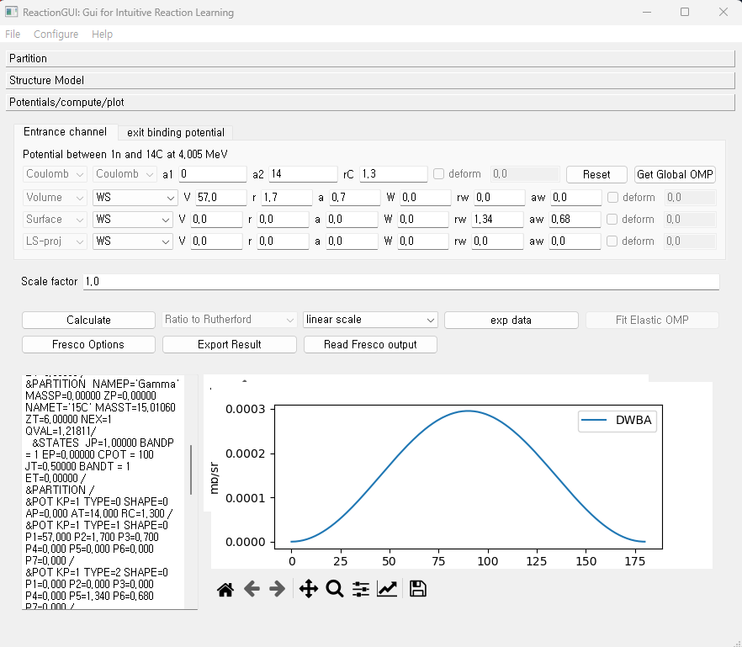
Radiative capture reaction: DWBA

Slide 18
Works to do
Fusion reaction:
Fusion cross section in optical model is available in elastic scattering.
GUI of coupled channel fusion reaction(CCFULL) is included, but as a separate window
Knock-out reaction:
GUI of MOMDIS is included, but as a separate window
GUI of PIKOE is under development, but as a separate program.
→ Need to improve the interface and integrate all.
Need to generalize GUI for coupled channel calculations.

Slide 19
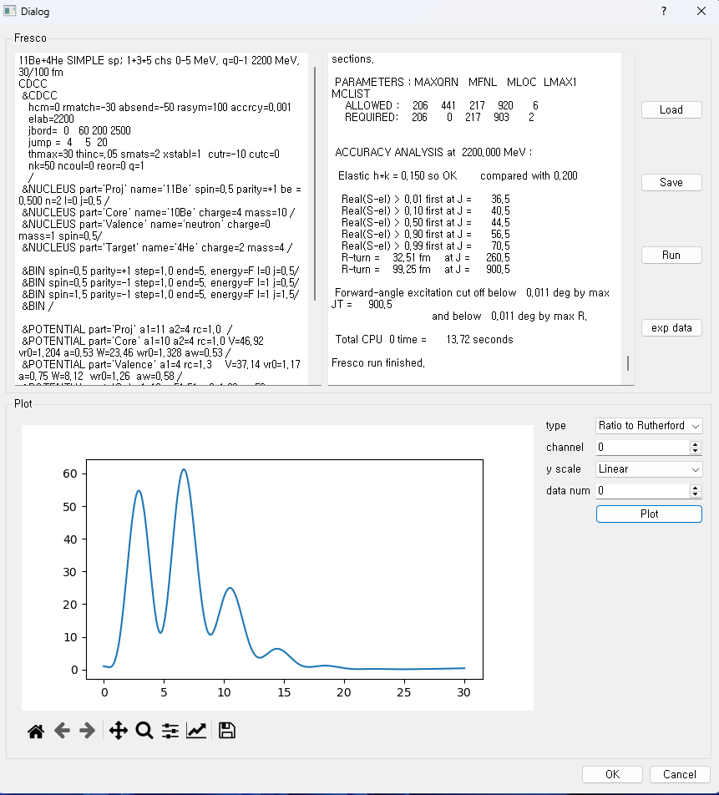
Works to do
Fusion reaction:
Fusion cross section in optical model is available in elastic scattering.
GUI of coupled channel fusion reaction(CCFULL) is included, but as a separate window
Knock-out reaction:
GUI of MOMDIS is included, but as a separate window
GUI of PIKOE is under development, but as a separate program.
Need to improve the interface and integrate all.
Need to generalize GUI for coupled channel calculations.
For the moment, “qt_fresco.py” can be used
Edit the fresco input file
Run the code
Plot the output

