Slide 1


Carbon isotopes in Nuclear Lattice Effective Field Theory
Young-Ho Song (중이온가속기연구소, IBS)
NLEFT collaboration
KPS Spring meeting 2023.04.19., 대전

Slide 2
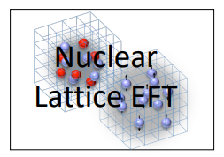
Nuclear Lattice Effective Field Theory Collaboration
Serdar Elhatisari(Gaziantep Islam Science and Technology)
Lukas Bovermann(Ruhr)
Evgeny Epelbaum (Bochum)
Dillon Frame (Juelich)
Fabian Hildenbrand(Darmstadt)
Hermann Krebs(Ruhr)
Timo A. Lähde (Juelich)
Dean Lee (MSU)
Ning Li(Sun Yat-sen)
Bing-Nan Lu( Graduate School of China Academy of Engineering Physic)
Myungkuk Kim(CENS,IBS)
Youngman Kim (CENS,IBS)
Young-Ho Song(중이온가속기연구소,IBS)
Yuanzhuo Ma(Peking)
Ulf-G. Meißner (Bonn/Juelich)
Gautam Rupak(Mississippi State)
Shihang Shen (Juelich)
Gianluca Stellin( CEA Paris-Saclay)

Slide 3
Ab initio many-body
(ab initio) 2N , 3N interaction.
No phenomenological model.
Nuclear many body problem
Requires Non-perturbative method.
Ab-initio nuclear many body methods
Greens function Monte Carlo(GFMC)
No-core shell model(NCSM)
Coupled Cluster (CC)
IM-SRG, VS-SRG
Nuclear Lattice Effective Field Theory(NLEFT)
And more
With recent progress in ab-initio methods
Binding energies for wide range of nuclei
Some reaction calculation for light nuclei.

Slide 4
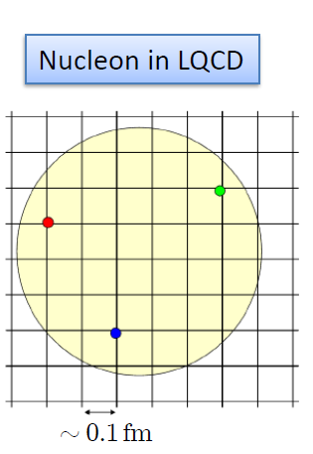

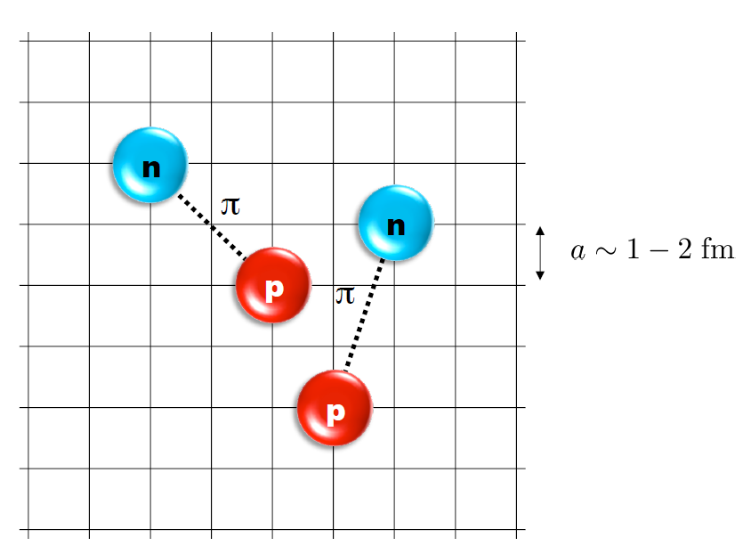
Nuclear Lattice Effective Field Theory
ab initio method for many fermion system

Slide 5
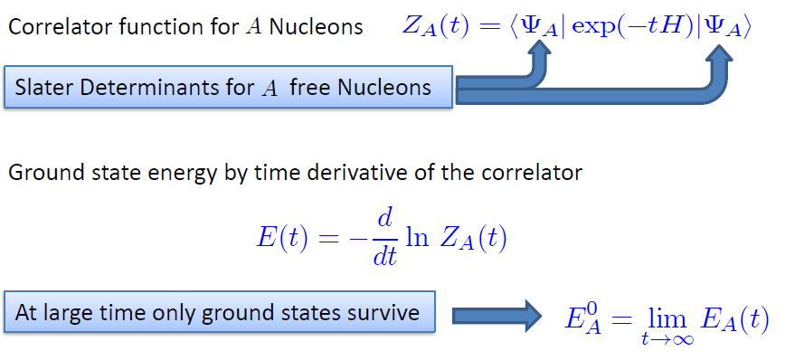

Path integral

Slide 6
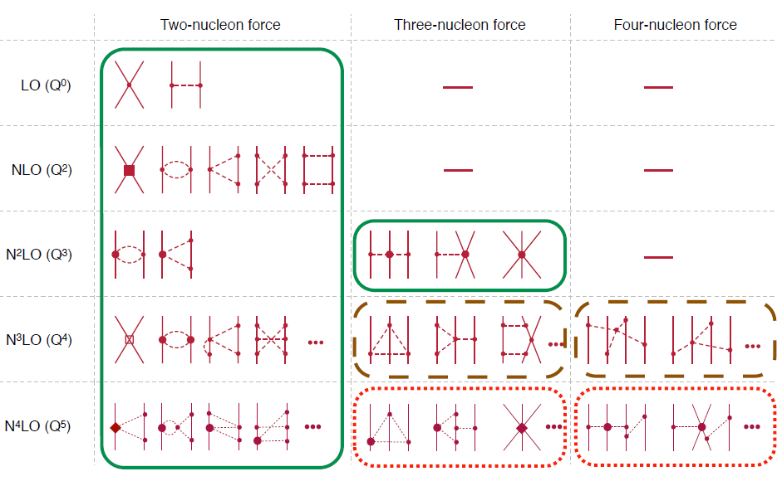
Chiral Effective Field Theory

Slide 7
Lattice Hamiltonian
We need to introduce a lattice scale in space and time:
momentum space cutoff ~ 150 MeV → lattice size a= 1.316 fm
Time cutoff ~ 1000 MeV
We need to determine coefficients of interaction for the lattice size. (regularization scale.)
Two-body interaction coefficients can be determined from phase shifts of np scattering.
Three-body interaction can be fixed from binding energy of A>=3.

Slide 8
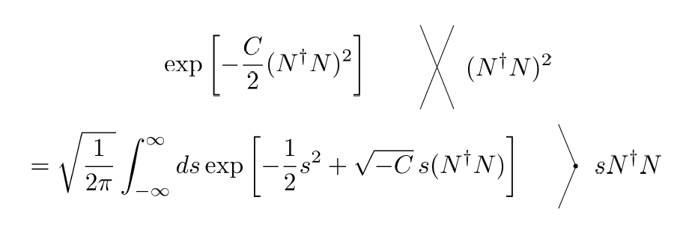
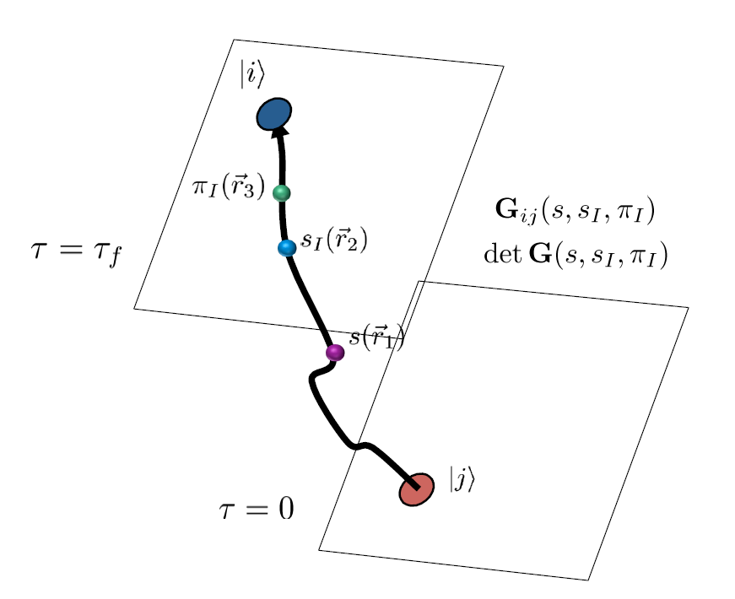
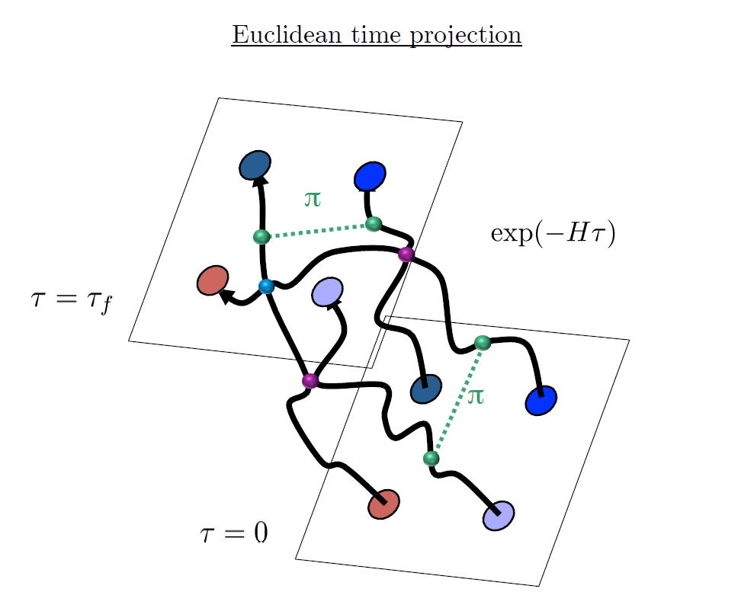
Auxiliary Field Monte Carlo

Slide 9
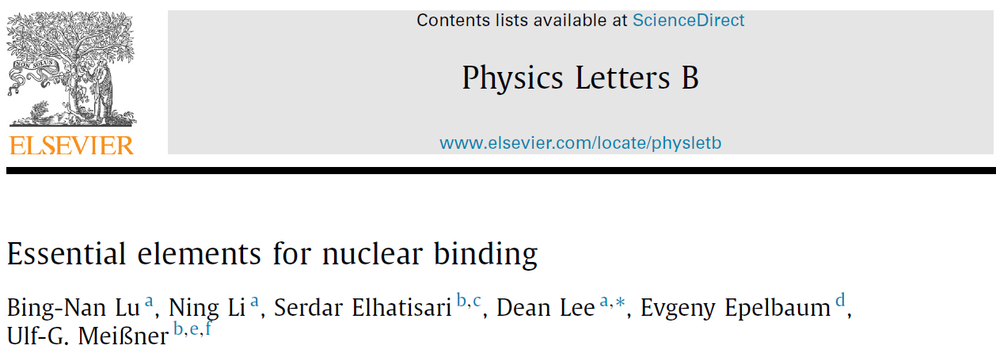



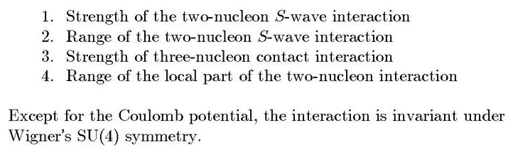
Minimal nuclear interaction
Which reproduce
Light nuclei
medium mass nuclei
neutron matter
simultaneously up to few percent error in binding energy and charge radius
Only Four parameters

Slide 10
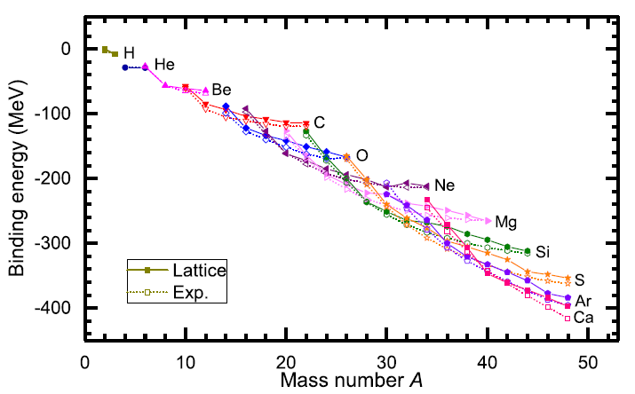
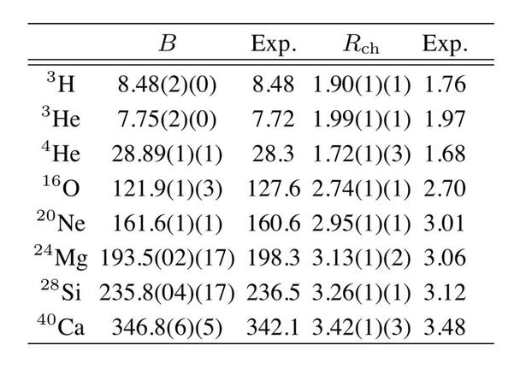
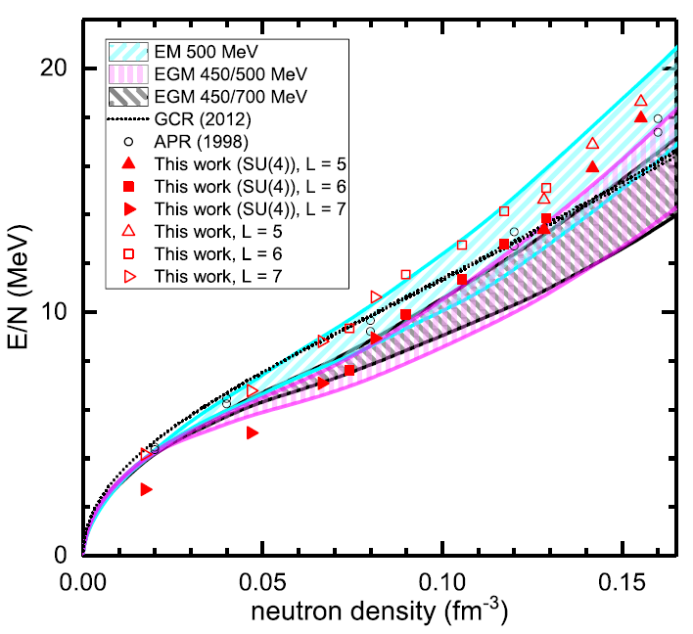
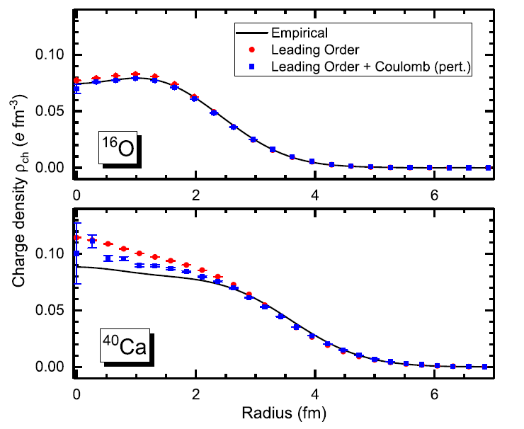
Can we improve it by
Including higher order corrections?

Slide 11
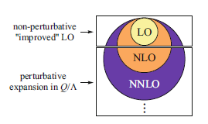
Lattice chiral Hamiltonian (N3LO)
Full N3LO Hamiltonian includes
Free Hamiltonian(Kinetic term)
Short range (nonlocal smeared) contact interactions up to Q^4 order
Isospin-breaking short range interactions
One pion exchange potential
Two pion exchange potential up to Q^4 order
Coulomb interaction
Long range isospin breaking interaction( isospin dependence in OPE)
Galilean Invariance Restoration (GIR) term (because of non-local interaction.)
Three nucleon interaction

Slide 12
Difficulty with full chiral interaction
Sign problem
NLEFT suffers sign problems at large Euclidean time limit
Large cancellation between positive and negative contributions→ large uncertainty.
SU(4) symmetric interaction does not have sign problem
One pion exchange and higher order chiral interaction
Difficulty with Asymmetric nuclei
Needs a remedy to extend to neutron rich isotopes.
A new approach to reduce the sign problem.
→ Wave function matching Hamiltonian.

Slide 13
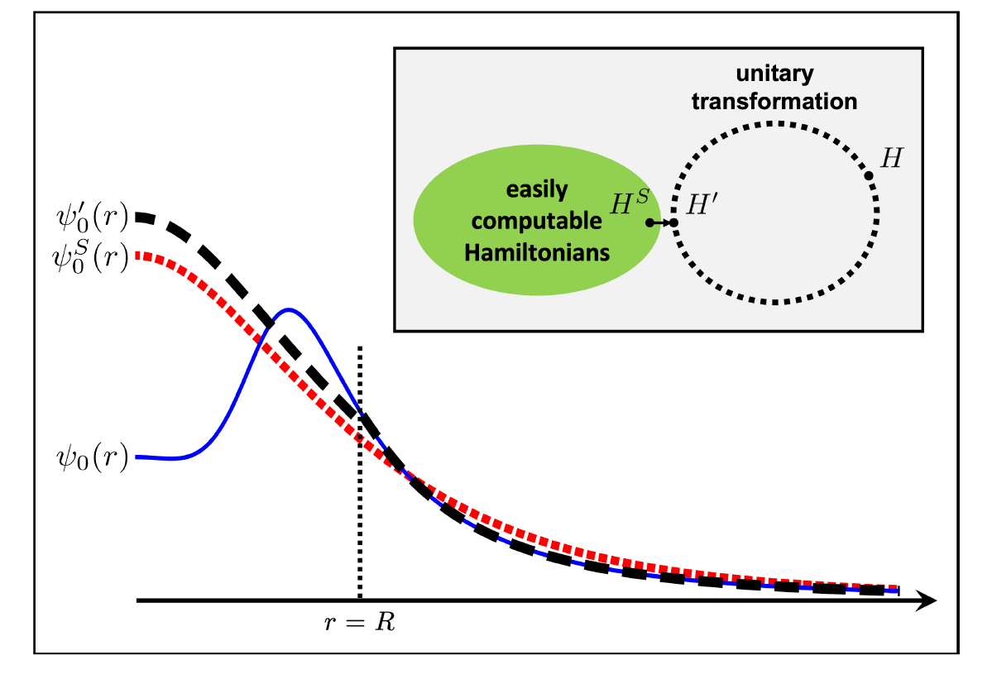



Wave function matching
H and H’ are fully equivalent to two-body observables
The goal is to make the perturbation expansion from “simple” wave function gives a good convergence
U is only active
At r < R

Slide 14
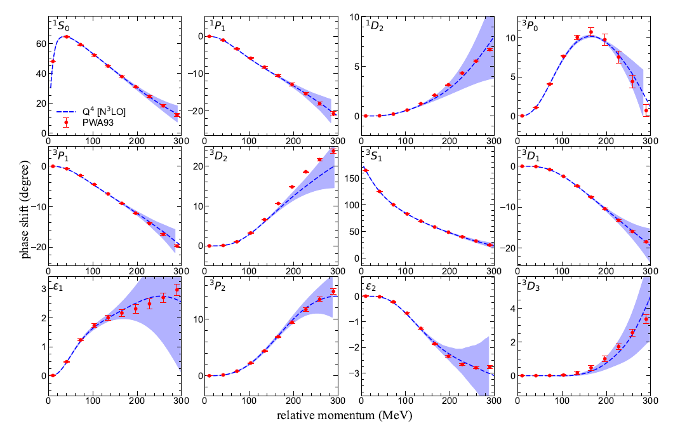
NN phase shifts from WFM
Original Hamiltonian is fitted to phase shifts.
H’ is equivalent to original Hamiltonian.

Slide 15
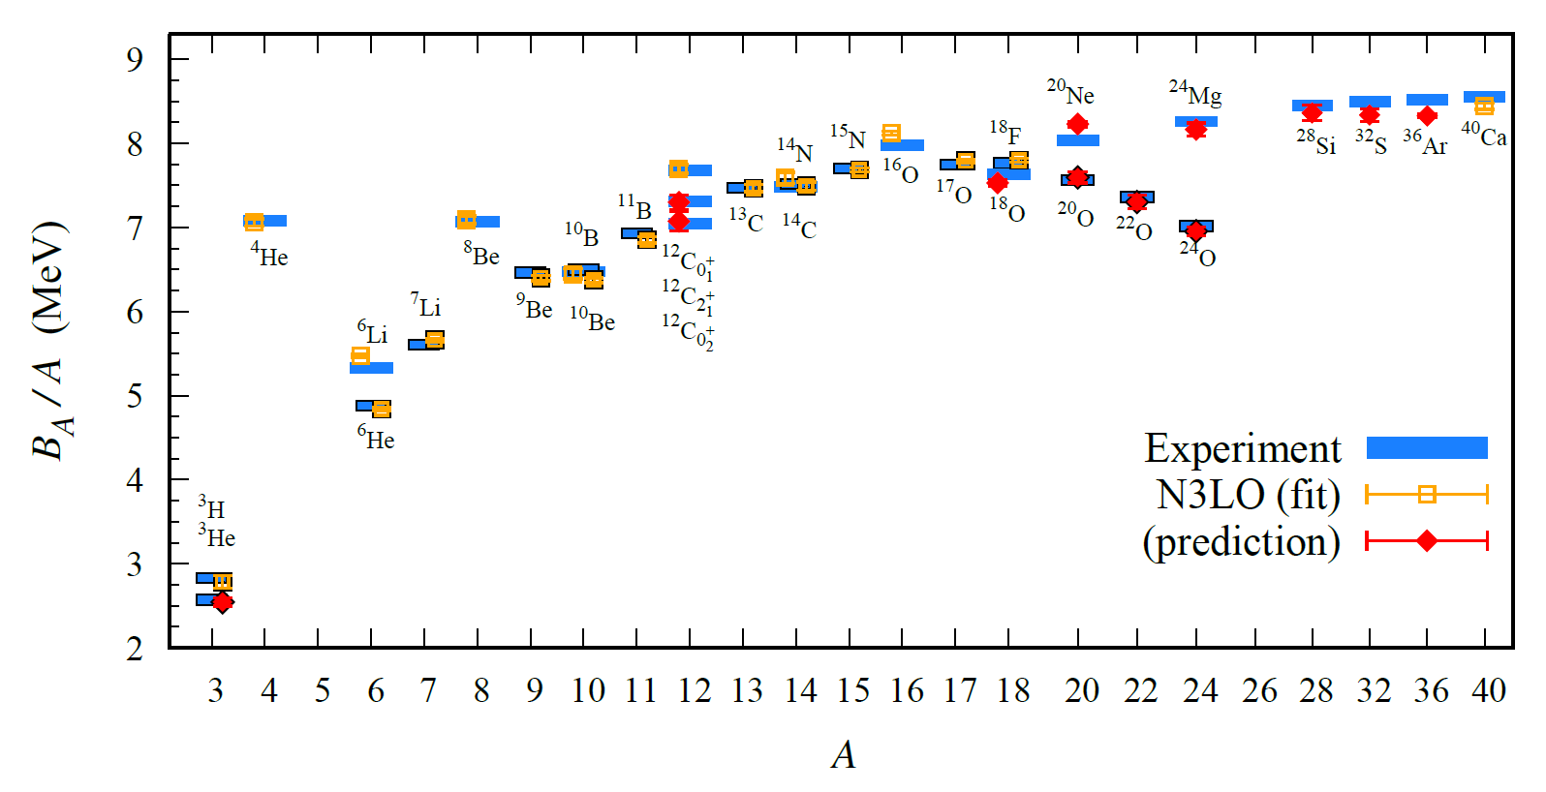
BE/A from WFM
Preliminary

Slide 16
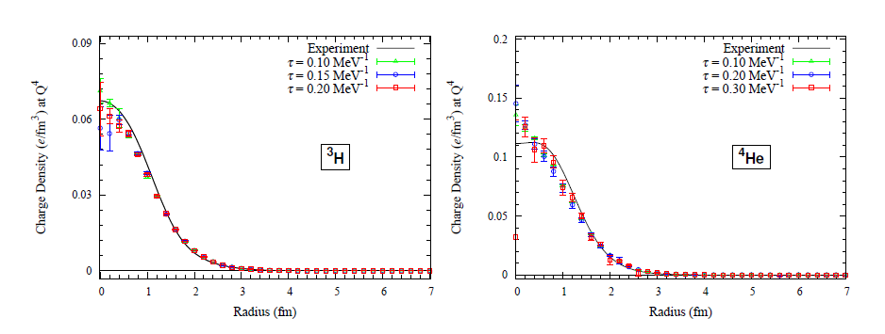
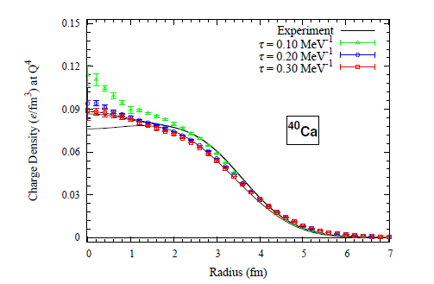
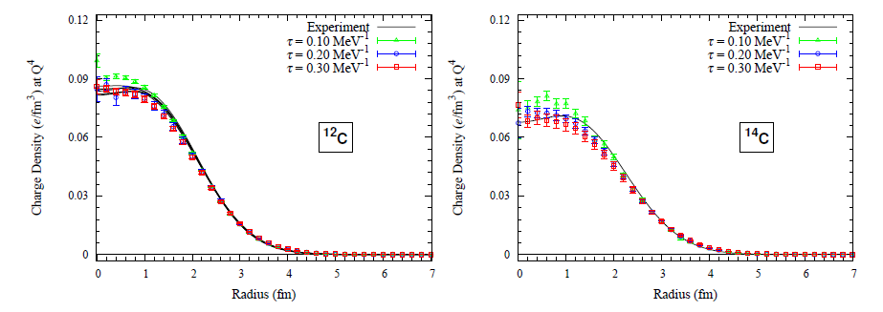
Charge density from WFM
Preliminary

Slide 17
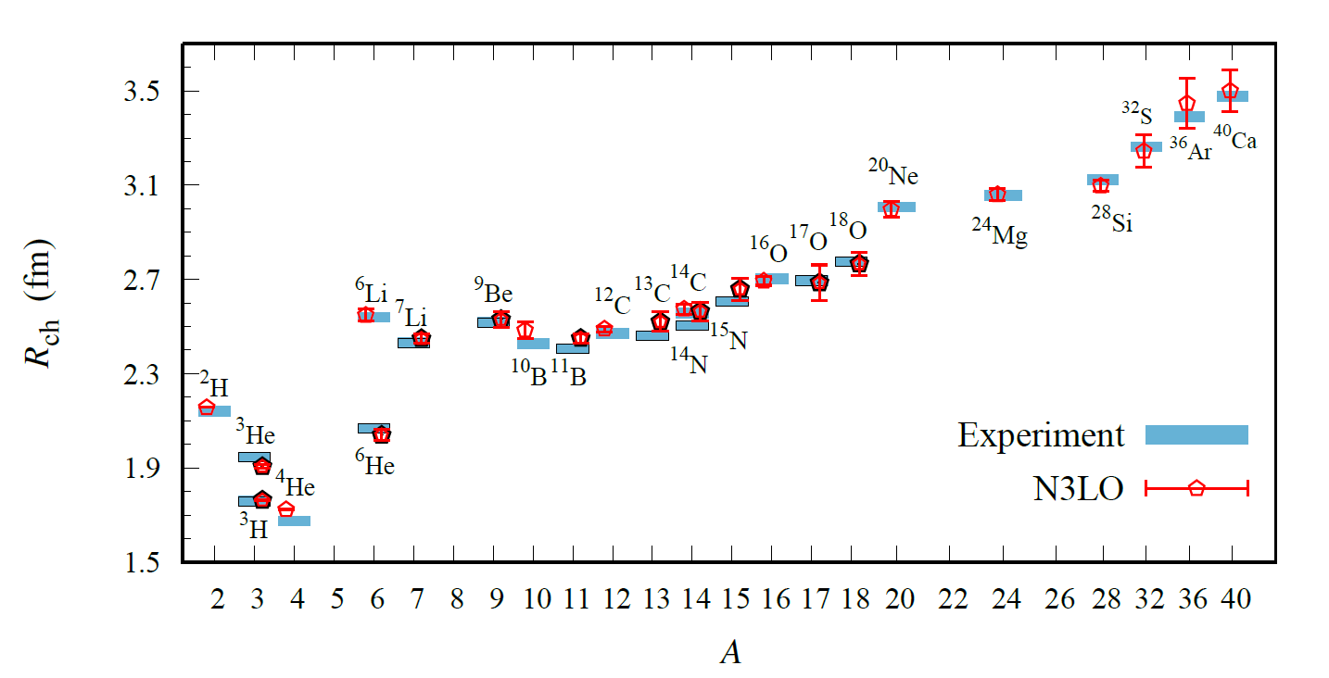
Charge Radius
Preliminary

Slide 18
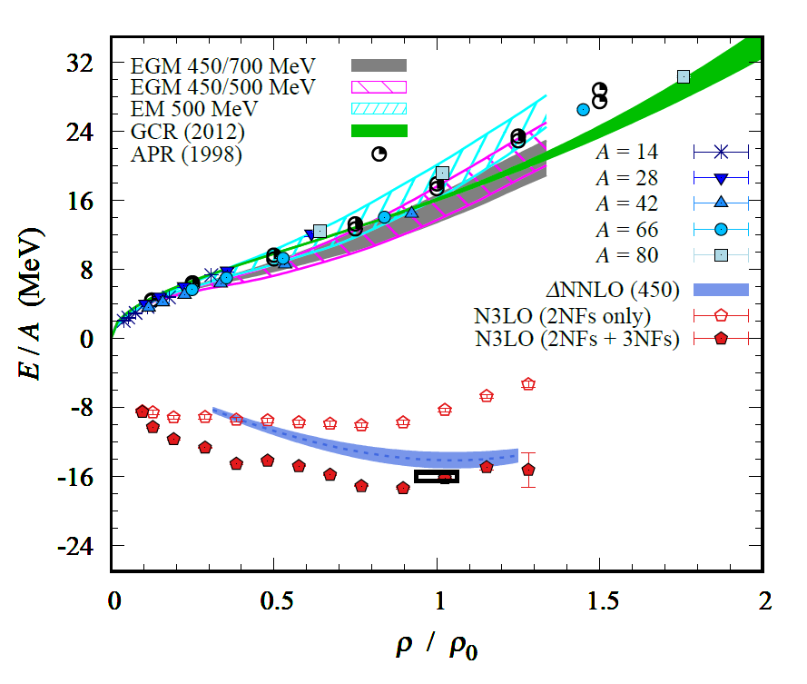
Nuclear/Neutron Matter
Neutron matter:
A=4~80
box size 6.6 ~ 13.2 fm.
Nuclear matter:
A=4 ~ 160
Box size 7.92~9.24 fm.
Preliminary

Slide 19
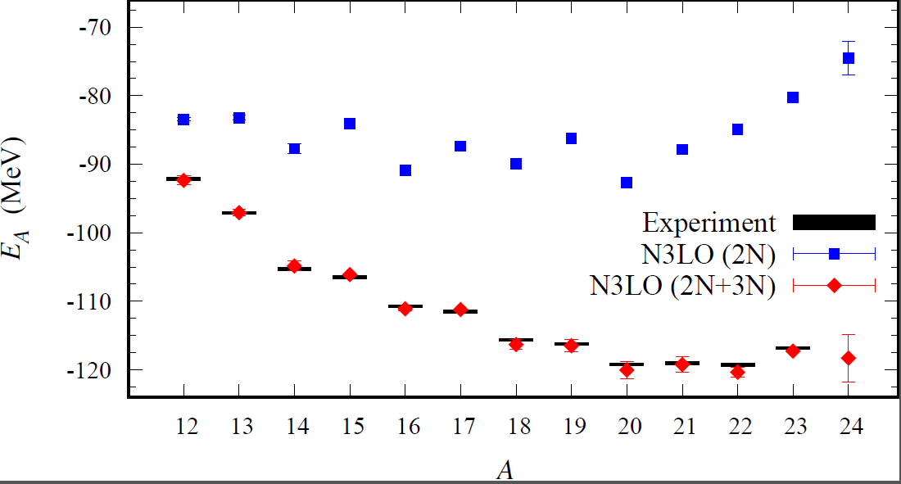
Carbon isotopes
Preliminary

Slide 20
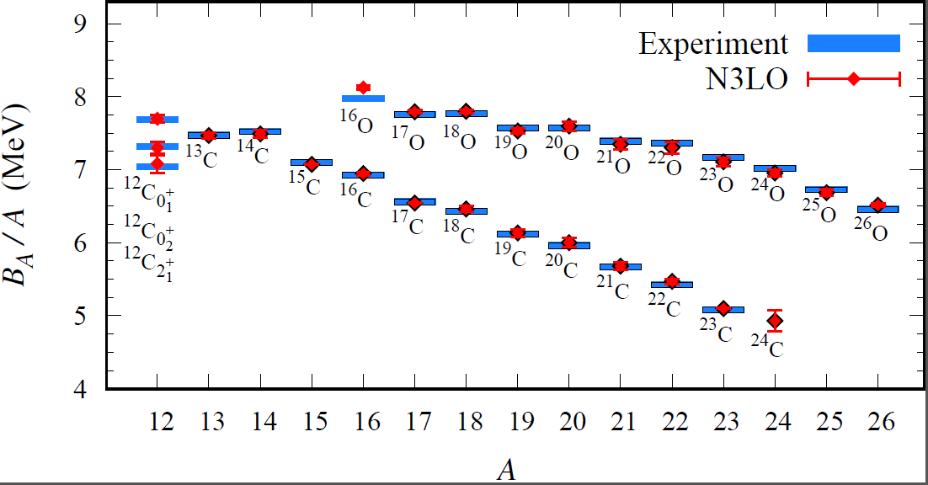
Carbon and Oxygen
Preliminary

Slide 21
Summary
Wave function matching method seems to be promising
New method to improve the N3LO calculation of NLEFT
Preliminary study shows promising results for wide range of observables in one scheme (same interaction and many-body method)
NN scattering
Binding energy (from 3H to 40Ca)
Symmetric Nuclear matter
Neutron matter
NLEFT can be applied for nuclei near the dripline. (Carbon and Oxygen)

