Slide 1


Carbon isotopes in Nuclear Lattice Effective Field Theory
Young-Ho Song (중이온가속기연구소, IBS)
NLEFT collaboration
2023.05.09. 연세대학교

Slide 2
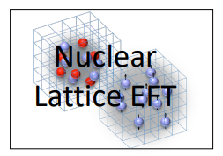
Nuclear Lattice Effective Field Theory Collaboration
Serdar Elhatisari(Gaziantep Islam Science and Technology)
Lukas Bovermann(Ruhr)
Evgeny Epelbaum (Bochum)
Dillon Frame (Juelich)
Fabian Hildenbrand(Darmstadt)
Hermann Krebs(Ruhr)
Timo A. Lähde (Juelich)
Dean Lee (MSU)
Ning Li(Sun Yat-sen)
Bing-Nan Lu( Graduate School of China Academy of Engineering Physic)
Myungkuk Kim(CENS,IBS)
Youngman Kim (CENS,IBS)
Young-Ho Song(중이온가속기연구소,IBS)
Yuanzhuo Ma(Peking)
Ulf-G. Meißner (Bonn/Juelich)
Gautam Rupak(Mississippi State)
Shihang Shen (Juelich)
Gianluca Stellin( CEA Paris-Saclay)

Slide 3
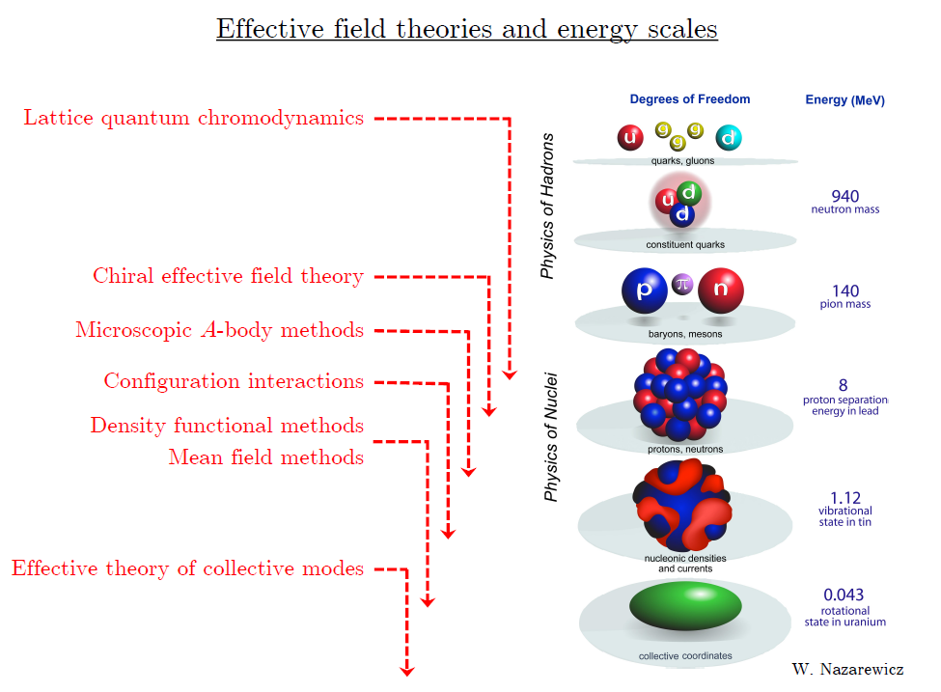
Ab initio approach
Ab initio (my definition)
= Start from nucleon-nucleon interaction
Ab initio
Nuclear
Theory
Direct understanding of nuclear force and
nuclear structure/reaction

Slide 4
Ab initio many-body
(ab initio) 2N , 3N interaction.
No phenomenological model assumption.
Nuclear many body problem
Requires Non-perturbative method.
Ab-initio nuclear many body methods
Greens function Monte Carlo(GFMC)
No-core shell model(NCSM)
Coupled Cluster (CC)
IM-SRG, VS-SRG
Nuclear Lattice Effective Field Theory(NLEFT)
And more
With recent progress in ab-initio methods
Binding energies for wide range of nuclei
Some reaction calculation for light nuclei.

Slide 5
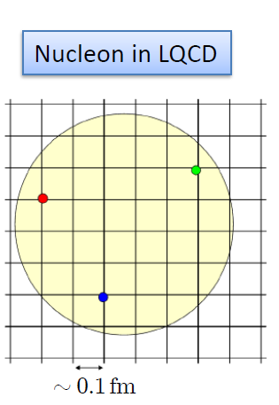

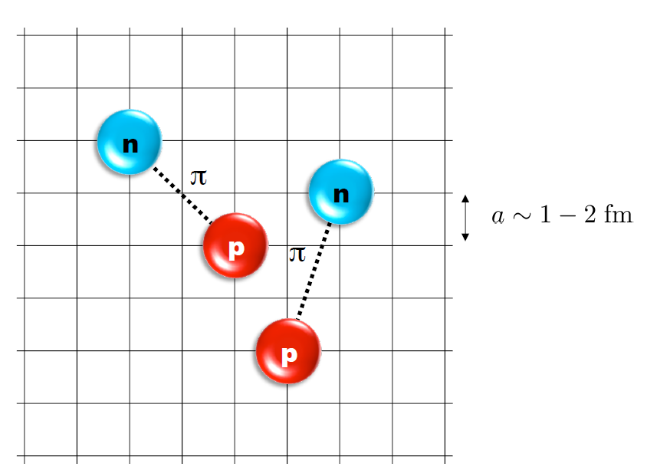
Nuclear Lattice Effective Field Theory
ab initio method for many fermion system

Slide 6
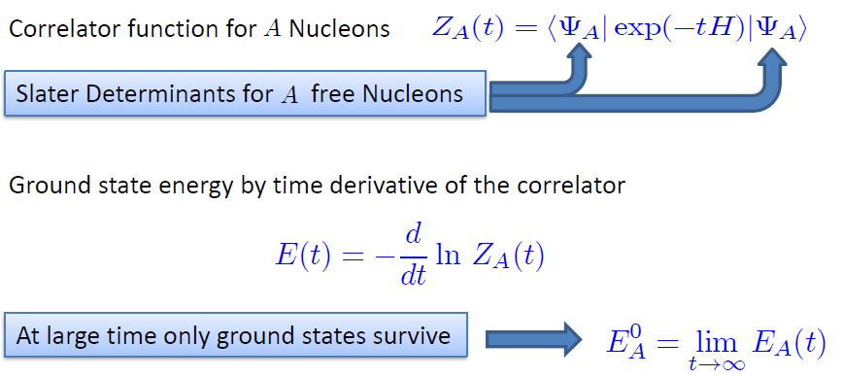

Path integral

Slide 7
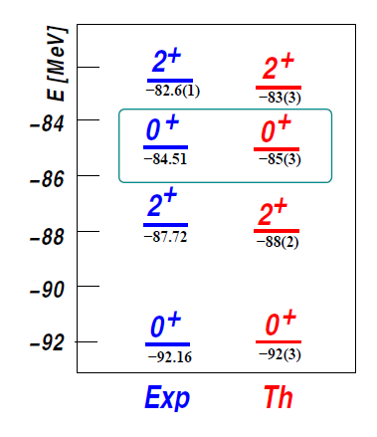

Applications of NLEFT
Has been successfully applied to
Nuclear matter, Cold atom, dilute fermion system
Finite nuclei (A<=50)
First ab-initio calculation of Hoyle state
Cluster structure of ¹²C and ¹⁶O
NN scattering, N-D scattering
Alpha-alpha scattering
radiative capture, fusion
Etc.
The first ab-initio calculation of
Hoyle state

Slide 8
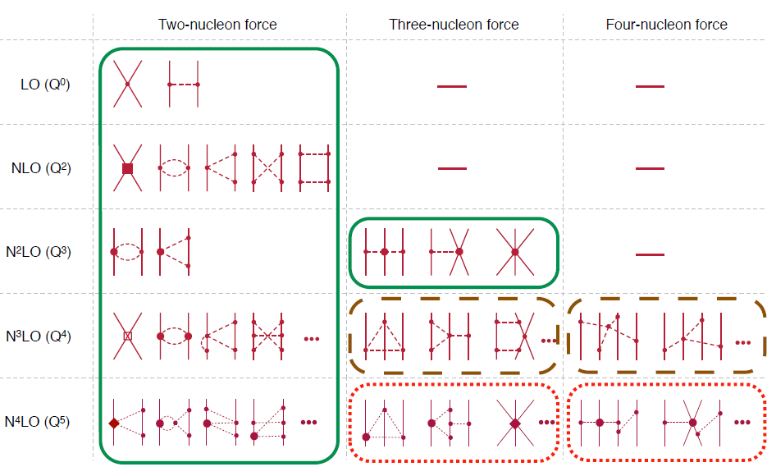
Chiral Effective Field Theory

Slide 9
Lattice Hamiltonian
We need to introduce a lattice scale in space and time:
momentum space cutoff ~ 150 MeV → lattice size a= 1.316 fm
Time cutoff ~ 1000 MeV
We need to determine coefficients of interaction for the lattice size. (regularization scale.)
Two-body interaction coefficients can be determined from phase shifts of np scattering.
Three-body interaction can be fixed from binding energy of A>=3.

Slide 10
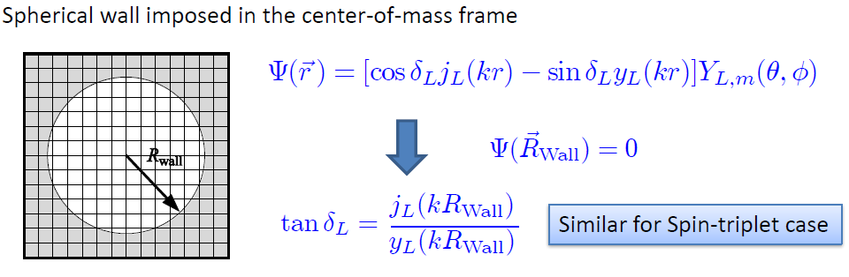
Low energy constants in lattice EFT
LECs(parameters in the Hamiltonian) can be fixed in A<=3
(They have to be fixed for given lattice regularization)
n-p scattering phase shifts, Deuteron binding energy
Triton binding energy, Triton beta decay.
Scattering phase shifts on the Lattice:
Phase shift can be obtained from
The energy spectrum of E(or k) in lattice and imposed Wall size.

Slide 11
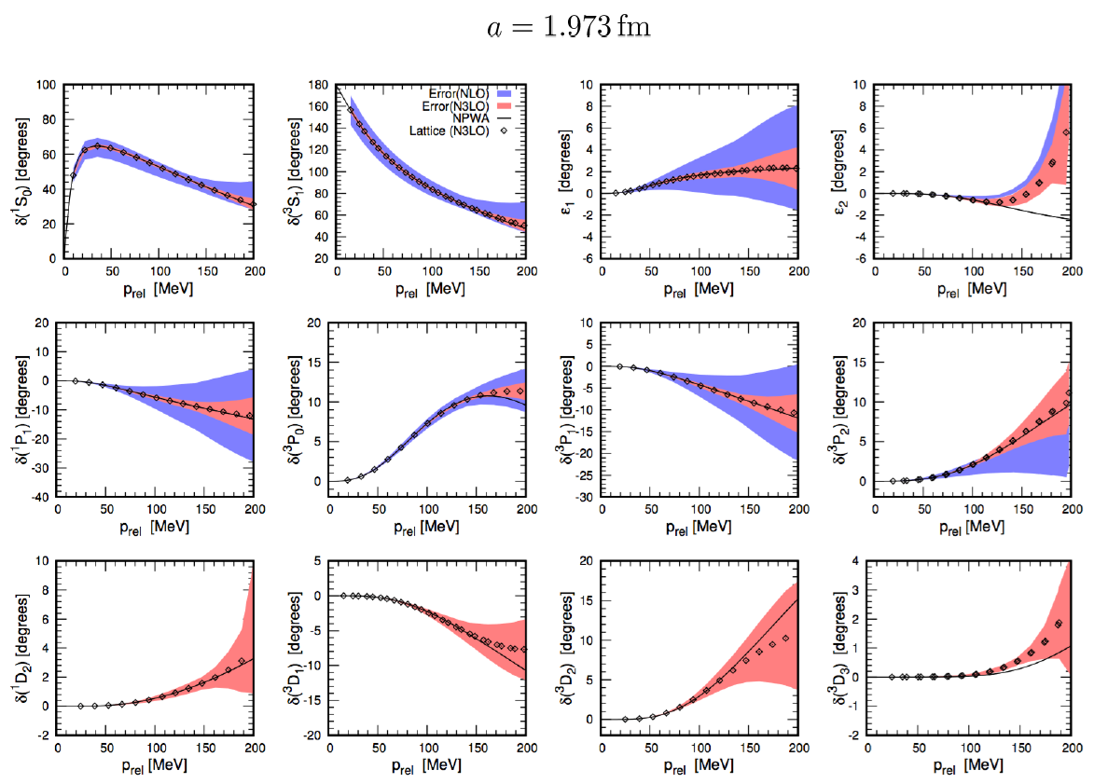
Determine LECs by fitting phase shifts of N-N scattering

Slide 12
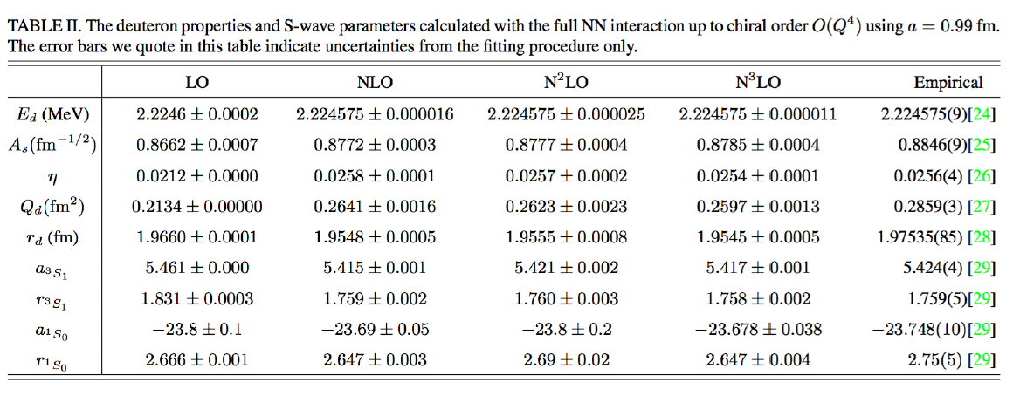

Slide 13

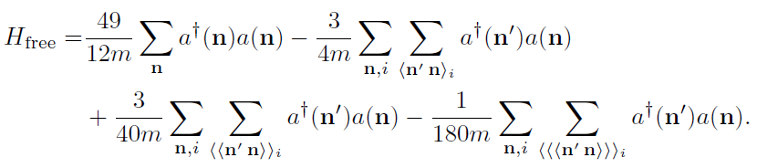
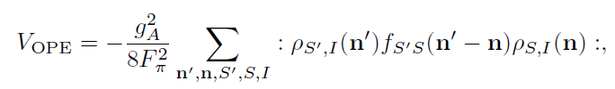


Lattice chiral Hamiltonian at Leading order
At Leading order, kinetic energy + contact interaction + one pion exchange
Kinetic
Long range OPE
(Perturbative) Coulomb
Contact

Slide 14
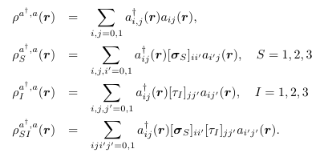
Lattice chiral Hamiltonian at Leading order
Density operators ( two-body interactions ~ rho^2 forms )
Two nucleon interaction
in exponential function
Not easy to directly compute
for many-body
→ Use auxiliary field

Slide 15
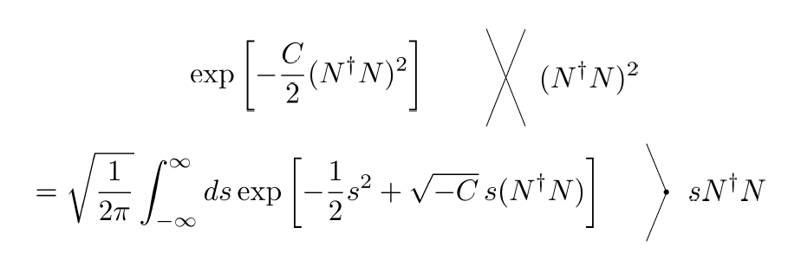
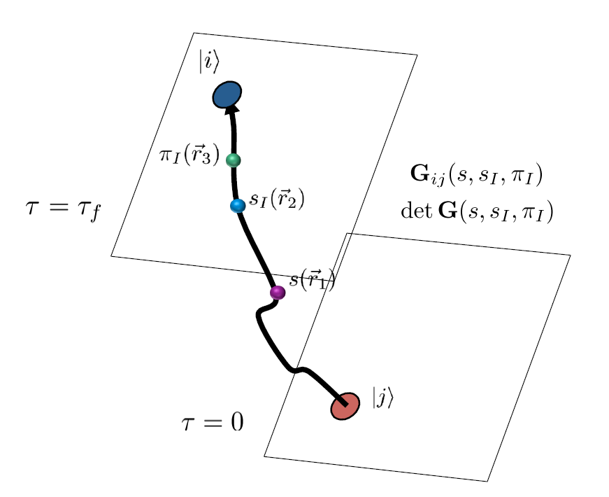
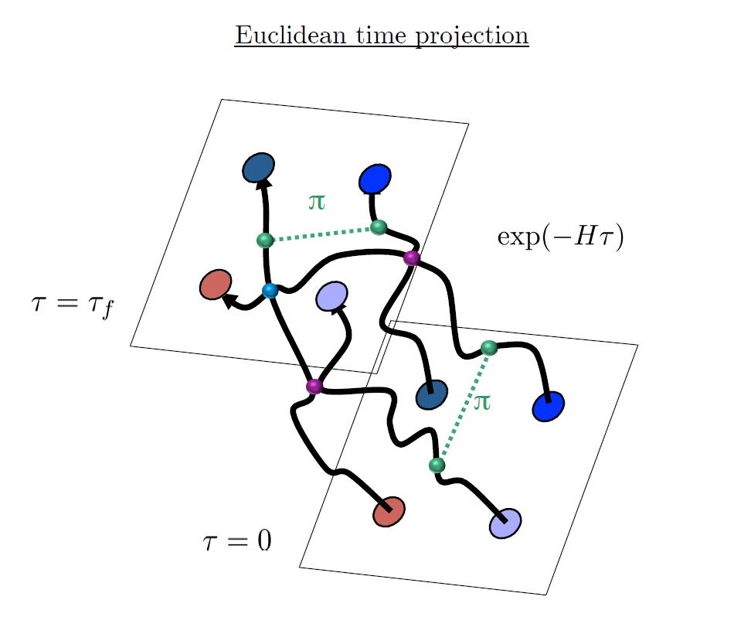
Auxiliary Field Monte Carlo

Slide 16




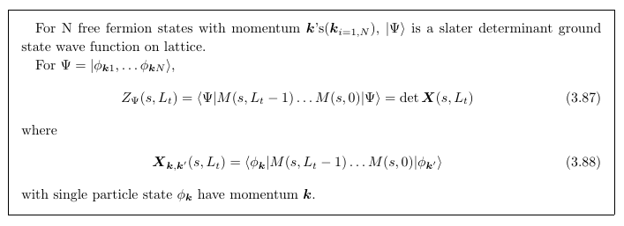
Transfer Matrix Formalism
Monte Carlo integration
By importance sampling of auxiliary fields

Slide 17
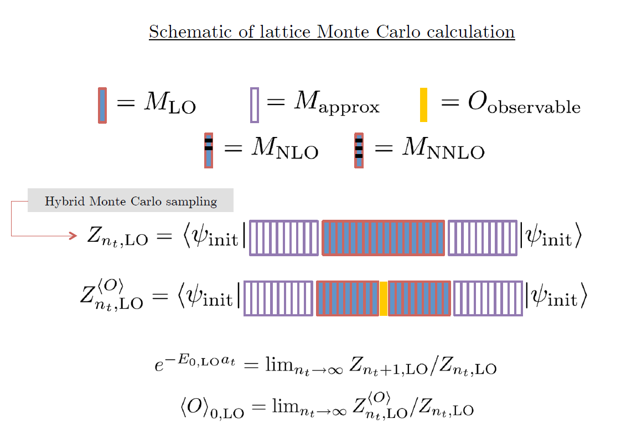

Slide 18
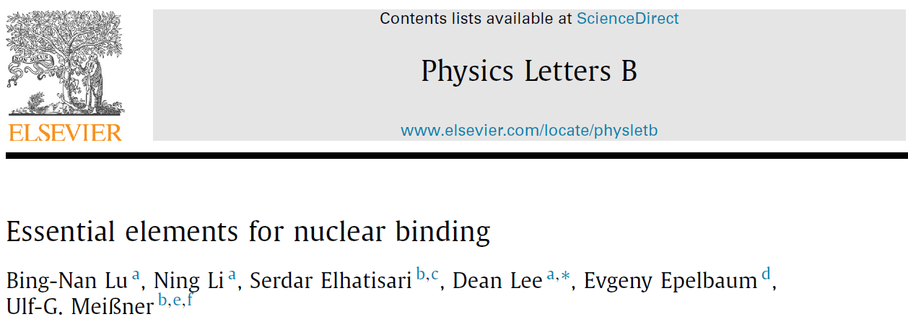



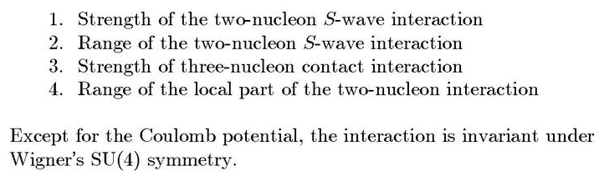
Minimal nuclear interaction
Which reproduce
Light nuclei
medium mass nuclei
neutron matter
simultaneously up to few percent error in binding energy and charge radius
In other words, what is the most important
feature the interaction should have?
Only Four parameters

Slide 19
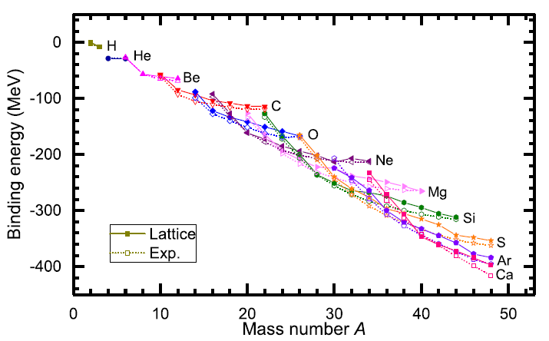
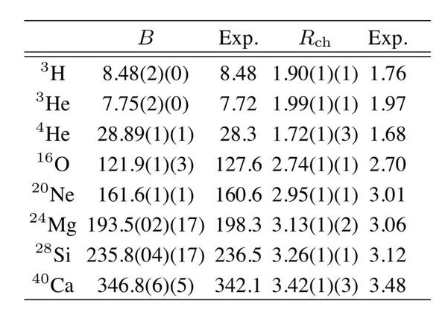
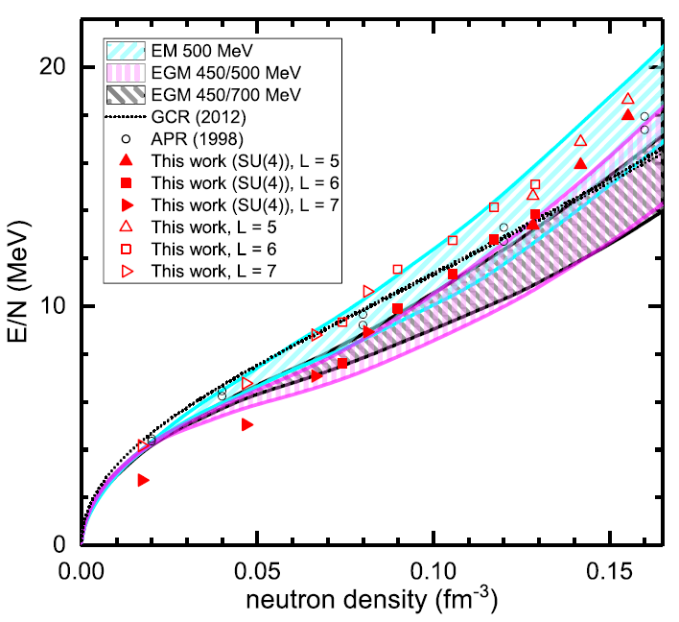
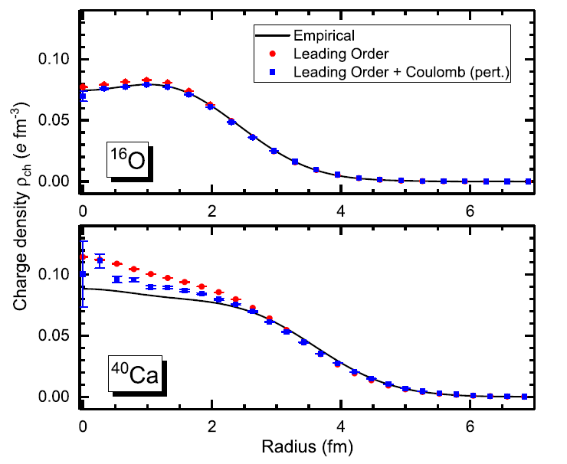
Can we improve it by
Including higher order corrections?

Slide 20
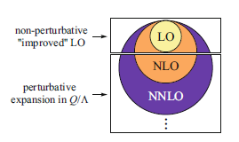
Lattice chiral Hamiltonian (N3LO)
Full N3LO Hamiltonian includes
Free Hamiltonian(Kinetic term)
Short range (nonlocal smeared) contact interactions up to Q^4 order
Isospin-breaking short range interactions
One pion exchange potential
Two pion exchange potential up to Q^4 order
Coulomb interaction
Long range isospin breaking interaction( isospin dependence in OPE)
Galilean Invariance Restoration (GIR) term (because of non-local interaction.)
Three nucleon interaction

Slide 21
Difficulty with full chiral interaction
Sign problem
NLEFT suffers sign problems at large Euclidean time limit
→ large uncertainty.
SU(4) symmetric interaction does not have sign problem
One pion exchange and higher order chiral interaction
Difficulty with Asymmetric nuclei
Needs a remedy to extend to neutron rich isotopes.
A new approach to reduce the sign problem.
→ Wave function matching Hamiltonian.

Slide 22
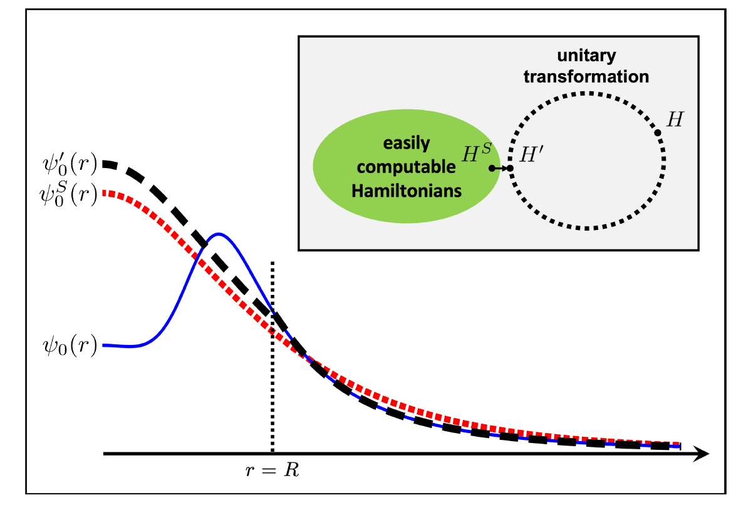



Wave function matching
H and H’ are fully equivalent to two-body observables
The goal is to make the perturbation expansion from “simple” wave function gives a good convergence
U is only active
At r < R

Slide 23
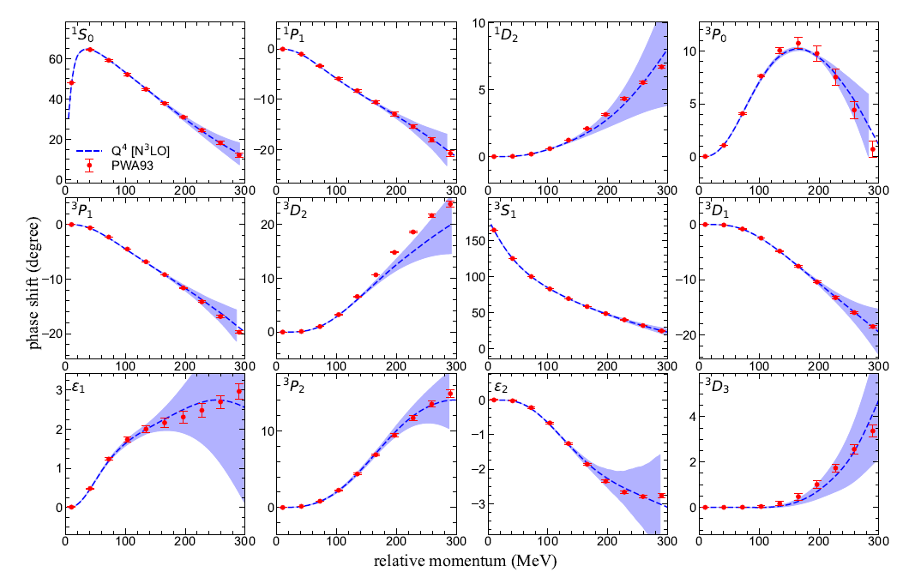
NN phase shifts from WFM
Original Hamiltonian is fitted to phase shifts.
H’ is equivalent to original Hamiltonian.
There is no new parameter.

Slide 24

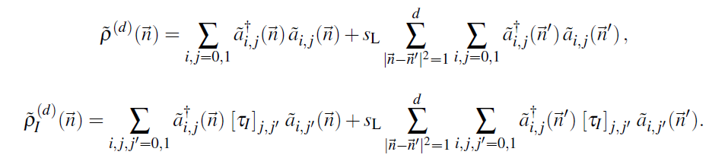

Wave function matching Hamiltonian
“Simple” Hamiltonian
(local,non-local smeared operators)

Slide 25

Wave function matching Hamiltonian
N3LO Hamiltonian
V_2N : short range NN interactions
W_2N: GIR restoration term for V_2N
V_2N,WFM : difference from H_s
W_2N,WFM: GIR restoration correction to V_2N,WFM
V_3N : contains short range 3N interaction parameters(to be fitted)
and two pion exchange correction to 3N

Slide 26
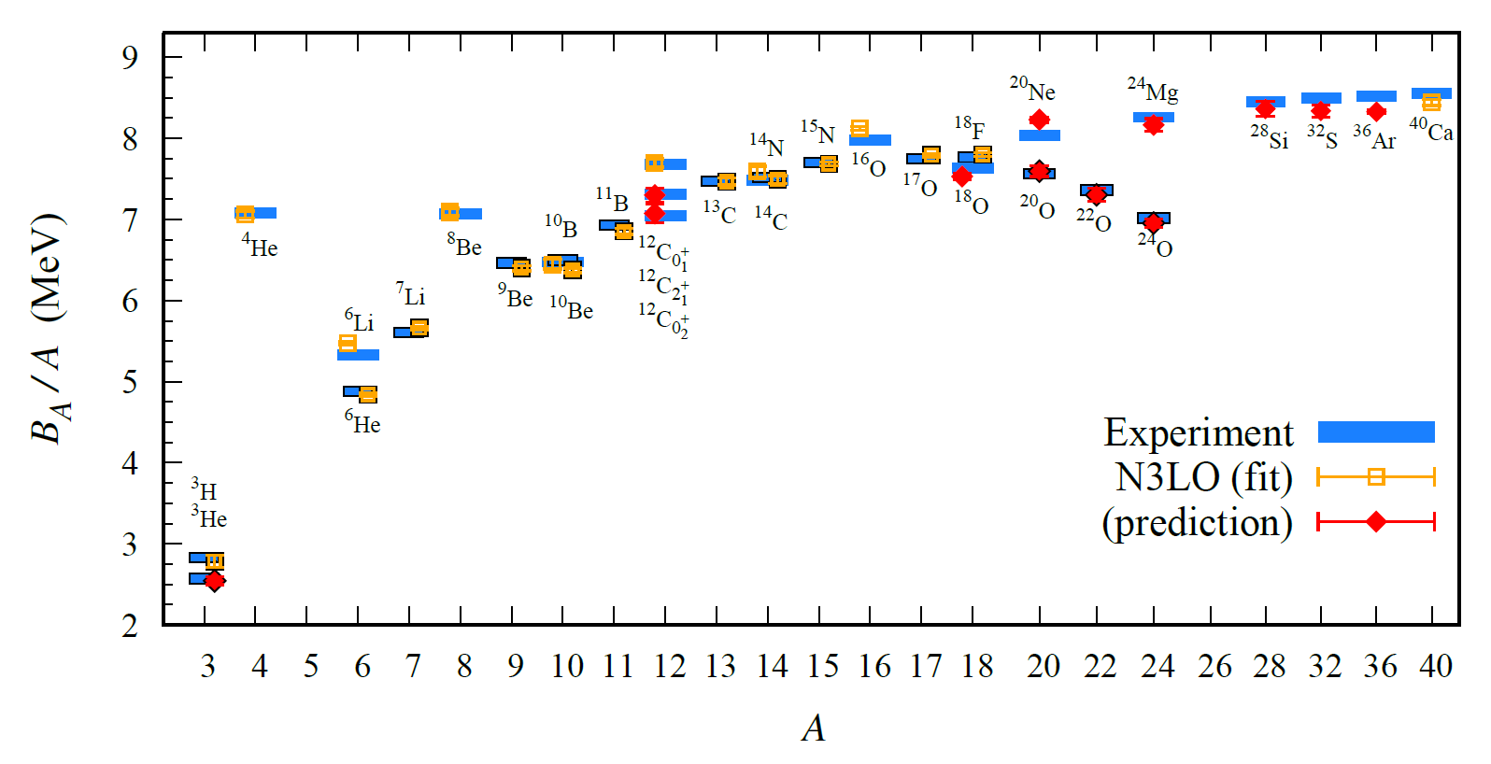
BE/A from WFM
Preliminary

Slide 27
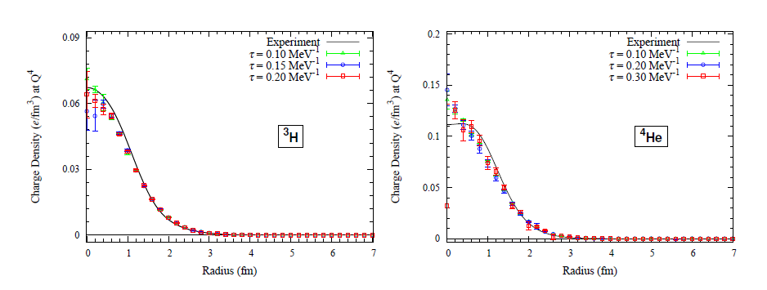
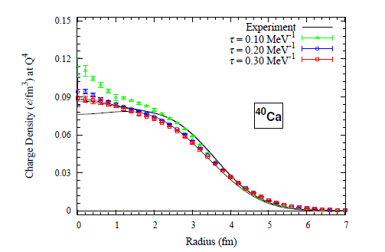
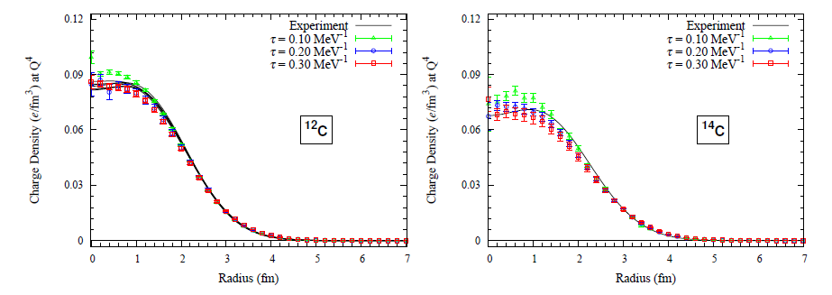
Charge density from WFM
Preliminary

Slide 28
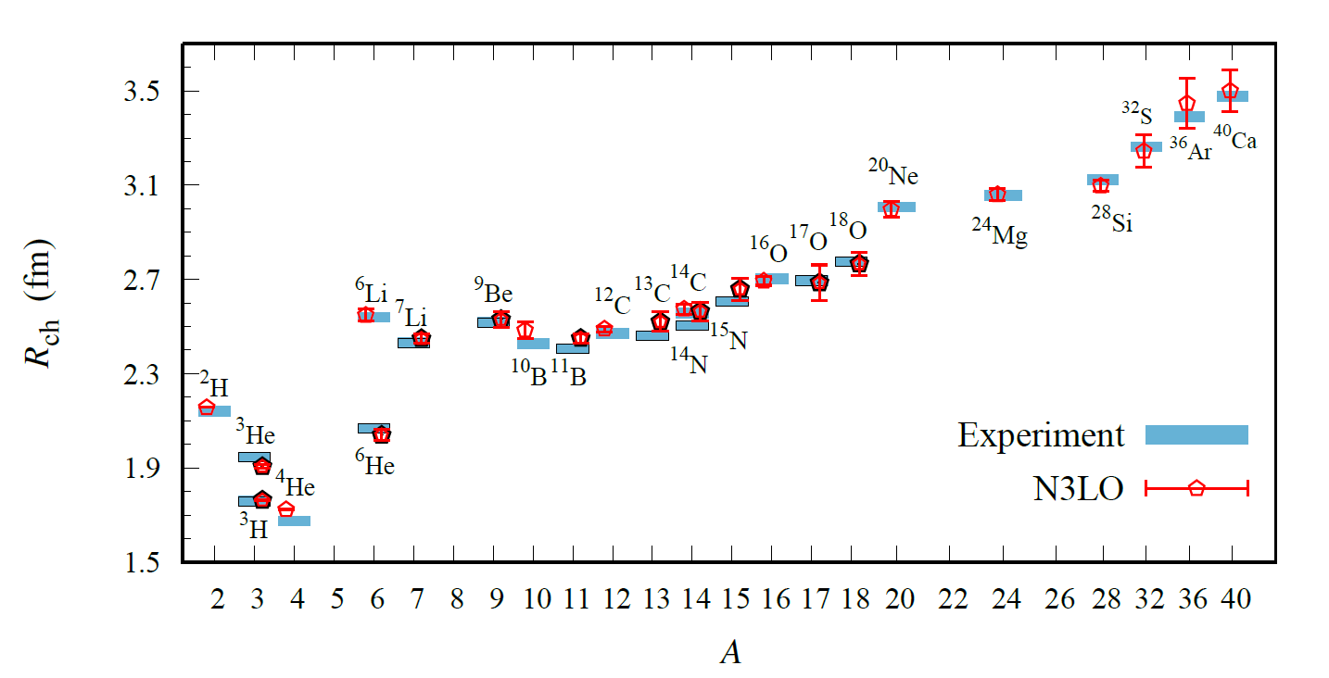
Charge Radius
No fitting, all prediction
Preliminary

Slide 29
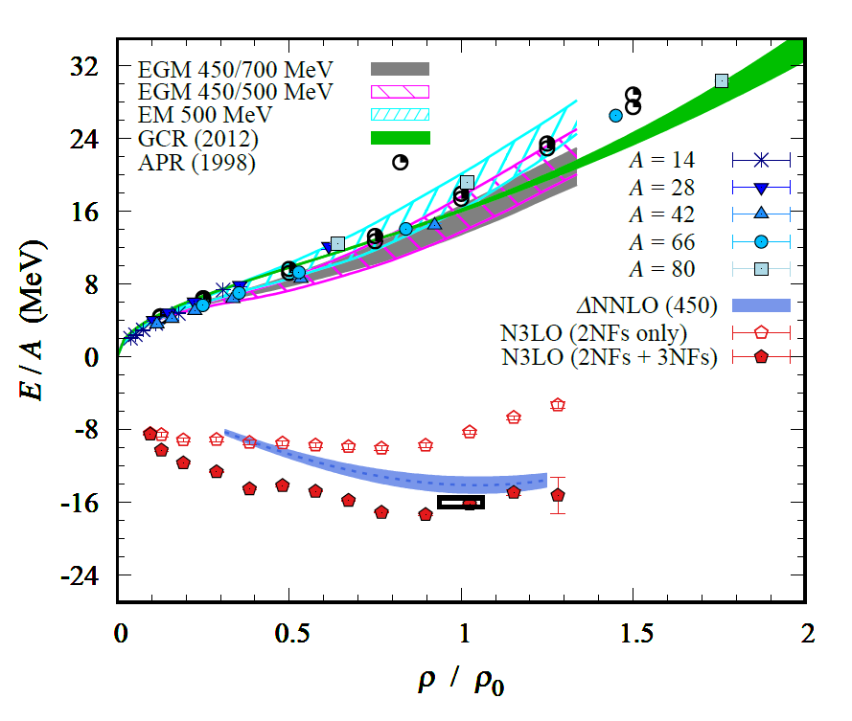
Nuclear/Neutron Matter
Neutron matter:
A=4~80
box size 6.6 ~ 13.2 fm.
Nuclear matter:
A=4 ~ 160
Box size 7.92~9.24 fm.
Preliminary

Slide 30
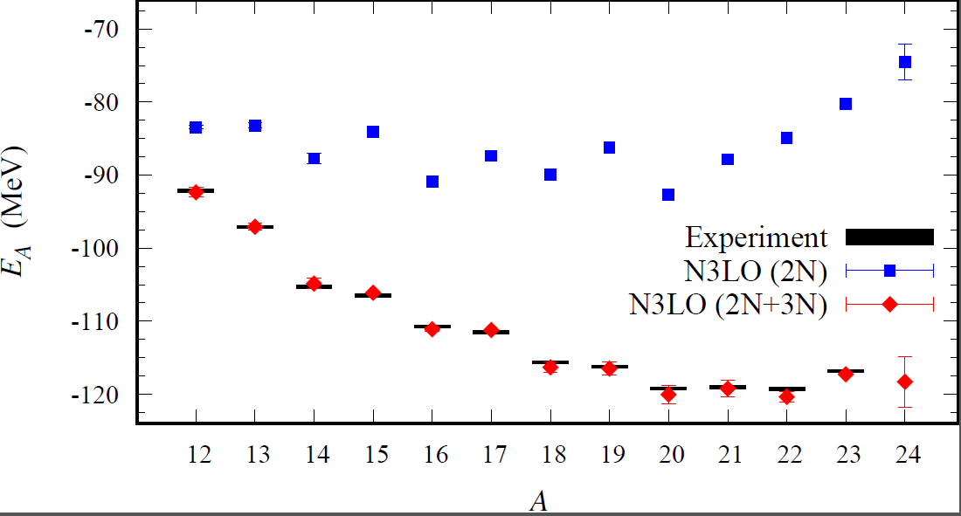
Carbon isotopes
Preliminary

Slide 31
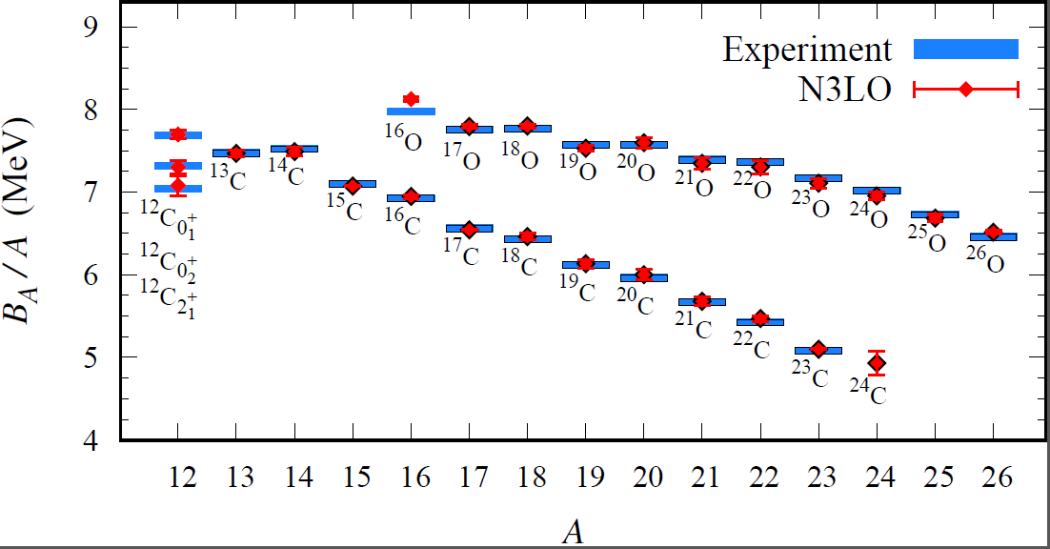
Carbon and Oxygen
Preliminary
Charge radius are not available yet.

Slide 32
Summary
Wave function matching method seems to be promising
New method to improve the N3LO calculation of NLEFT
Preliminary study shows promising results for wide range of observables in one scheme (same interaction and many-body method)
NN scattering
Binding energy (from 3H to 40Ca)
Symmetric Nuclear matter
Neutron matter
NLEFT can be applied for nuclei near the dripline. (Carbon and Oxygen)

