Slide 1


Introduction to Hartree-Fock Theory and code
Young-Ho Song (중이온가속기연구소, IBS)

Slide 2
Introduction
How to compute the energy of nuclei?
Independent particle model
Simplest many-body problem
Approximation treating H ~ H0 = T+ U as one-body operator
Exact solution is known
→ Slater determinant of single particle wave functions
What is U ?
naive shell model : H.O. potential or W.S. potential
U simulate the mean effects of V as much as possible

Slide 3

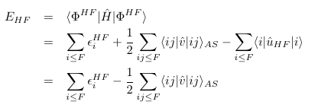


Introduction
Hartree-Fock method
Basically the same as independent particle model
→ Assumption: a Slater-determinant of single particle wave functions.
What is U? (H = T+V = T+U + V-U)
→ try to find the optimal U such that
(1) s.p. wave functions are determined by U
(2) Thus, Slater determinant is determined by U
(3) Choose U such that the <Psi| H| Psi> to be a variational minimum.

Slide 4
Introduction
Hartree-Fock method
Use Slater Determinant of s.p. wave functions as a A-body w.f.
s.p. wave functions are obtained from HF equation. (1-body problem.)
HF potential U depends on both V and s.p. waves
Compute Energy of the system using exact Hamiltonian H=T+V

Slide 5
HF code example
For Skyrme interaction, which is local contact interaction
two-body matrix elements < a b| V| c d> can be easily computed because of delta function. Only 1-dimensional integration is necessary.
Thus, it is convenient to solve w.f. in coordinate space directly.
For finite-range interactions
Calculation of matrix element < a b| V| cd > becomes complicate and requires multi-dimensional integration, angular momentum decompositions.
Thus, it is convenient to use a basis functions and compute their matrix elements separately.
Usually, Harmonic Oscillator basis are used.
Here, let us consider a simple example of HF code in H.O. basis.
Assume All TBME are already calculated separately.

Slide 6

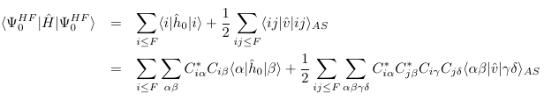
HF theory in basis expansion
Let the s.p. wave can be expressed as a sum of known basis functions
→ only need to know coefficients
HF energy can be written as
all matrix elements for basis are known
→ If one have coefficients [C]→ one can have HF energy.

Slide 7

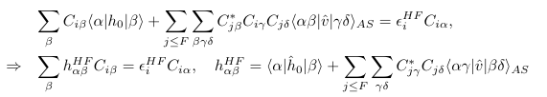
HF theory in basis expansion
Minimization of HF energy w.r.t [C] under constraint
(s.p. wave functions are ortho-normal)
(H.F. equation in H.O. basis)

Slide 8
HF theory in basis expansion
HF equation
Once [C] are given→ one can construct matrix
H^{HF}_{alpha,beta}
Once H^{HF}_{alpha,beta} is given
→ one can solve eigen-value equation to get [C]
But, H_{alpha,beta} depends on [C] !
→Solve self-consistently (by iteration.)

Slide 9


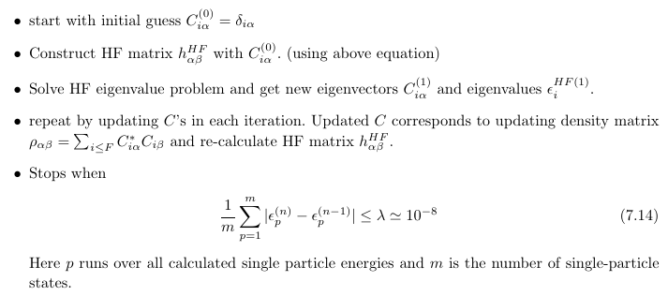
HF theory in basis expansion
HF equation
Only need density matrices

Slide 10
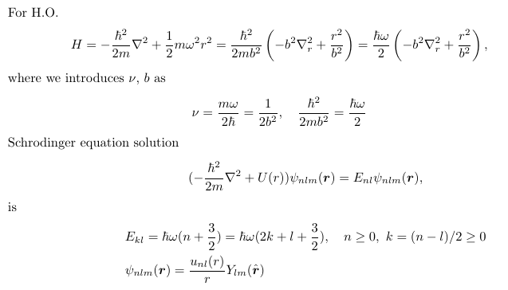
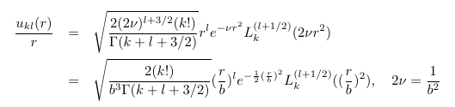
HF code example
H.O. basis
s.p. basis is denoted by
Quantum numbers
( n, l, m )
If (n,l,m) are known, one can compute s.p. wave function and its HO energy E_{nl}.

Slide 11

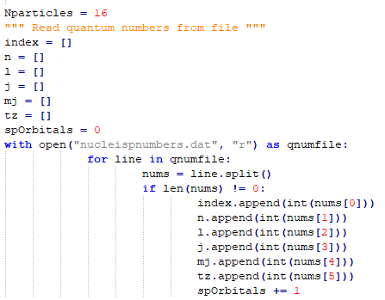
HF code example
H.O. Basis states

Slide 12
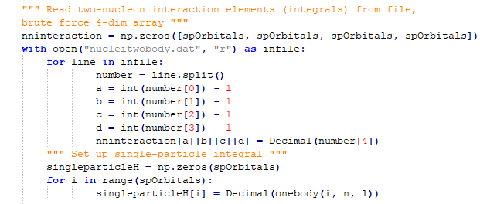
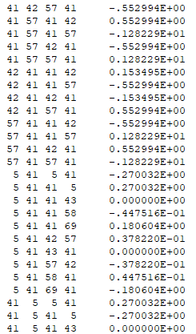



HF code example
TBMEs in H.O. basis

Slide 13
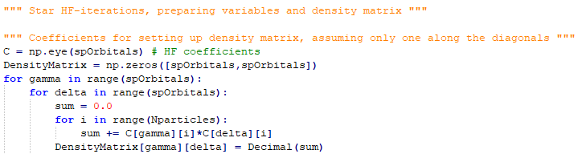

HF code example
Initialize Density matrix

Slide 14

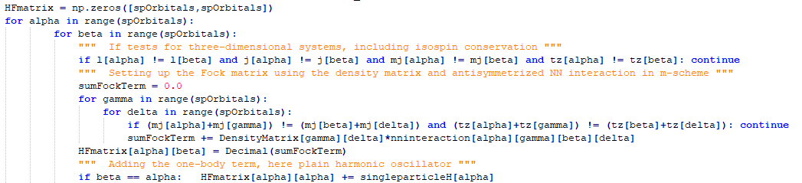

HF code example
Loop until converge
1. Construct H^{HF}_{alpha,beta} matrix
2. Solve HF eigenvalue equation

Slide 15
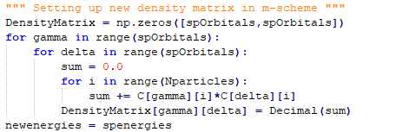
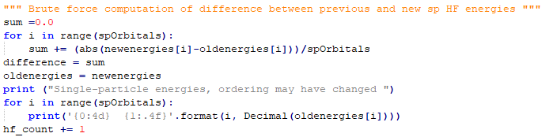
HF code example
3. Update Density matrix
4. compute convergence indicator→ Go back to 1.

Slide 16
HF code example
Problems of the example code
(1) TBMEs have to be provided as an input
→ Can be complicate
(2) m-scheme basis without angular momentum conservation
→ inefficient
(3) H.O. potential contribution is not subtracted.
→ actual HF energy is not calculated yet
(4) C.M. motion is not subtracted.
→ Resulting energy can have non-zero C.M. energy

Slide 17
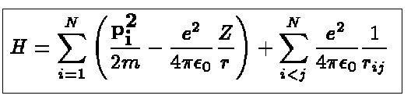


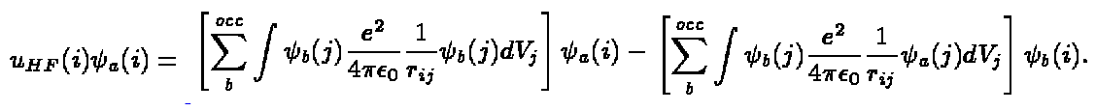
HF for electrons in a atom
HF equation
https://folk.uib.no/nfylk/Hartree/H-F/LINK/lindex.html

Slide 18

HF for electrons in a atom
(1) No need to consider C.M. motion
(2) Coulomb interaction only
(3) it would be better to use Laguerre functions as basis.
(4) Note that there are spinors in the wave functions.
https://folk.uib.no/nfylk/Hartree/H-F/LINK/lindex.html
Provides a simple code of Hartree method (not H.F.)

