Slide 1

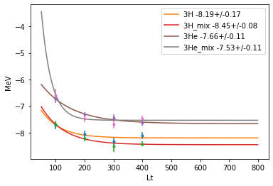
Trial : Mixed Sampling
Working on mixed sampling approach
Preliminary
Instead of projection operator, fix the Jz of initial wave functions
Preliminary calculation 3H->3He
Better convergence than re-weight method
<3He| GT| 3H> ~ 1.0 for all Lt
(Only LO wave function)
BE(3He)= 7.718 (exp.)
BE(3H) = 8.482 (exp.)
<3He| GT| 3H> ~ 0.958 (exp.)

Slide 2
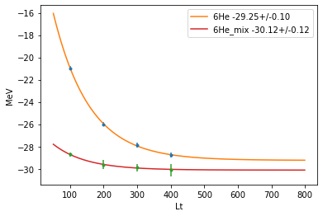
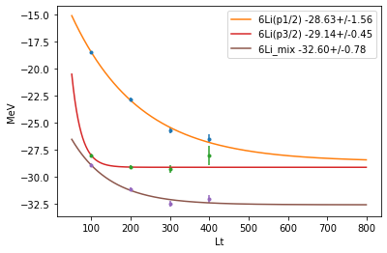
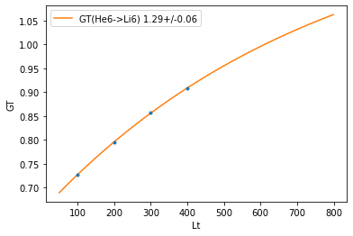
Trial : Mixed Sampling
Preliminary
Mixed Sampling
6He(0+)→6Li(1+)
B.E. Lt dependence changed
<6Li| (GT) |6He> have Lt dependence
BE(6He) =29.27(exp.)
BE(6Li) =31.99(exp.)
<6Li| (GT) |6He> ~ 1.25 (exp)

Slide 3
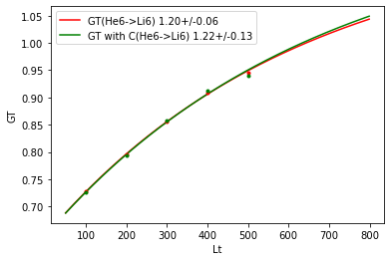
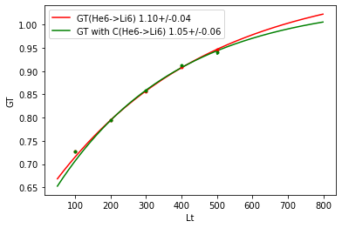
One more point and Coulomb correction

Slide 4
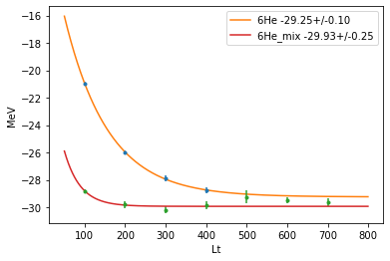
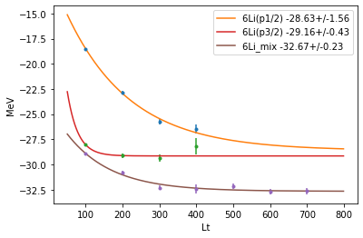

Slide 5
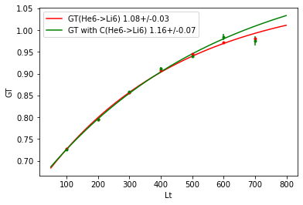
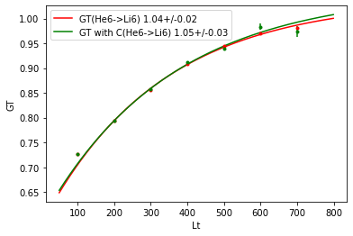
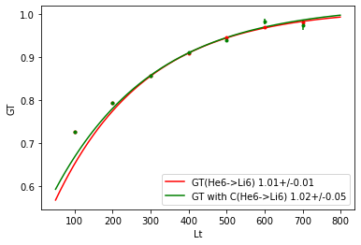

Slide 6
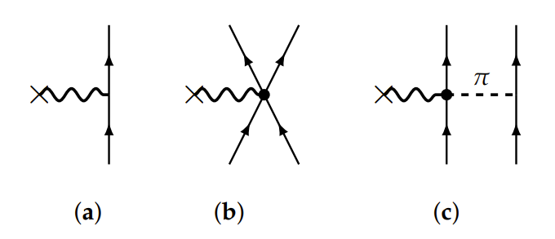
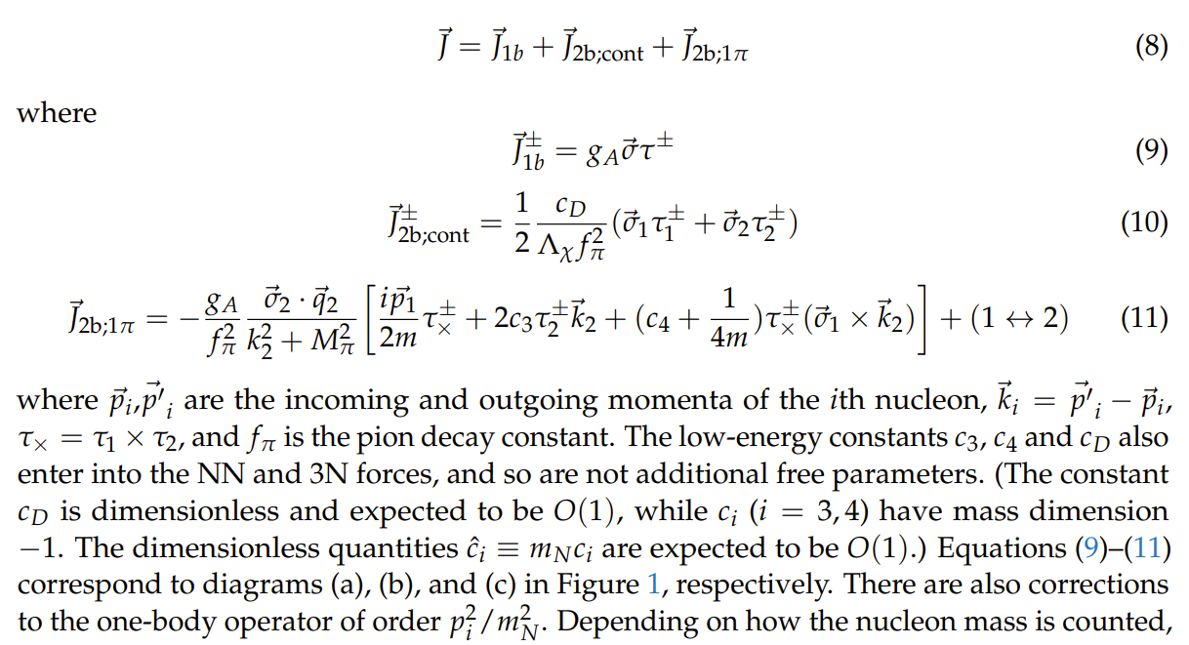

Slide 7
Summary
G.T. Transition amplitudes
Two nuclei with different Z at the same time
→ re-weighting method was not successful
→ mixed sampling seems to work
To do :
2BC correction
higher order wave function correction

