Slide 1


Carbon isotopes in Nuclear Lattice Effective Field Theory
Young-Ho Song (IRIS, IBS)
NLEFT collaboration
14th APCTP-BLTP JINR Joint Workshop, 2023.07.11, APCTP

Slide 2
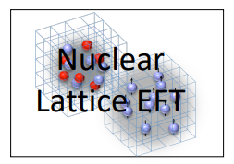
Nuclear Lattice Effective Field Theory Collaboration
Serdar Elhatisari(Gaziantep Islam Science and Technology)
Lukas Bovermann(Ruhr)
Evgeny Epelbaum (Bochum)
Dillon Frame (Juelich)
Fabian Hildenbrand(Darmstadt)
Hermann Krebs(Ruhr)
Timo A. Lähde (Juelich)
Dean Lee (MSU)
Ning Li(Sun Yat-sen)
Bing-Nan Lu( Graduate School of China Academy of Engineering Physic)
Myungkuk Kim(CENS,IBS)
Youngman Kim (CENS,IBS)
Young-Ho Song(IRIS,IBS)
Yuanzhuo Ma(Peking)
Ulf-G. Meißner (Bonn/Juelich)
Gautam Rupak(Mississippi State)
Shihang Shen (Juelich)
Gianluca Stellin( CEA Paris-Saclay)

Slide 3
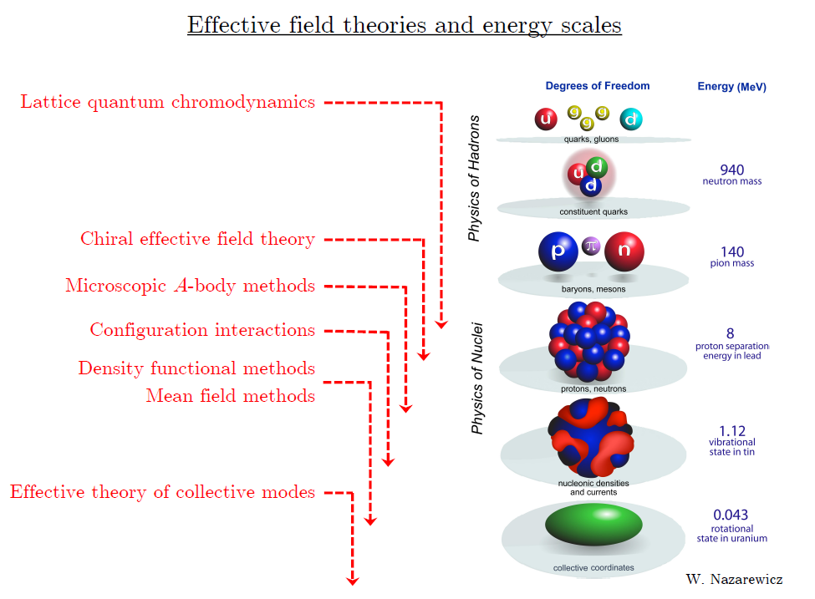
Ab initio
Nuclear
Theory

Slide 4
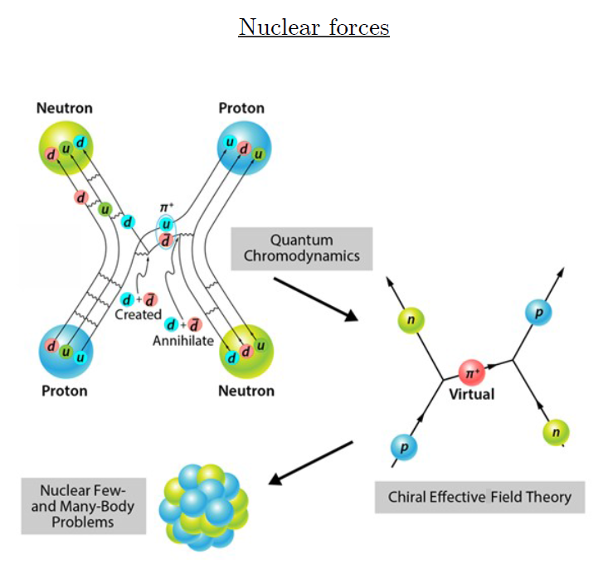
Ab-initio method
Ab-initio can mean many different things.
ab-initio Nuclear Physics
(1) nucleon degrees of freedom
(2) nucleon-nucleon interaction
Goal: predict wide range(structure, reaction, nuclear matter) of nuclear phenomena (without parameter fitting, model assumption) from nuclear interaction (for 2-body,3-body, many-body, based on QCD)

Slide 5
Ab initio many-body
(ab initio) Nuclear physics is challenging.
Nuclear many body problem
Requires Non-perturbative method.
Ab-initio nuclear many body methods
Greens function Monte Carlo(GFMC)
No-core shell model(NCSM)
Coupled Cluster (CC)
IM-SRG, VS-SRG
Nuclear Lattice Effective Field Theory(NLEFT)
And more
With recent progress in ab-initio methods
Binding energies for wide range of nuclei
Some reaction calculation for light nuclei.

Slide 6
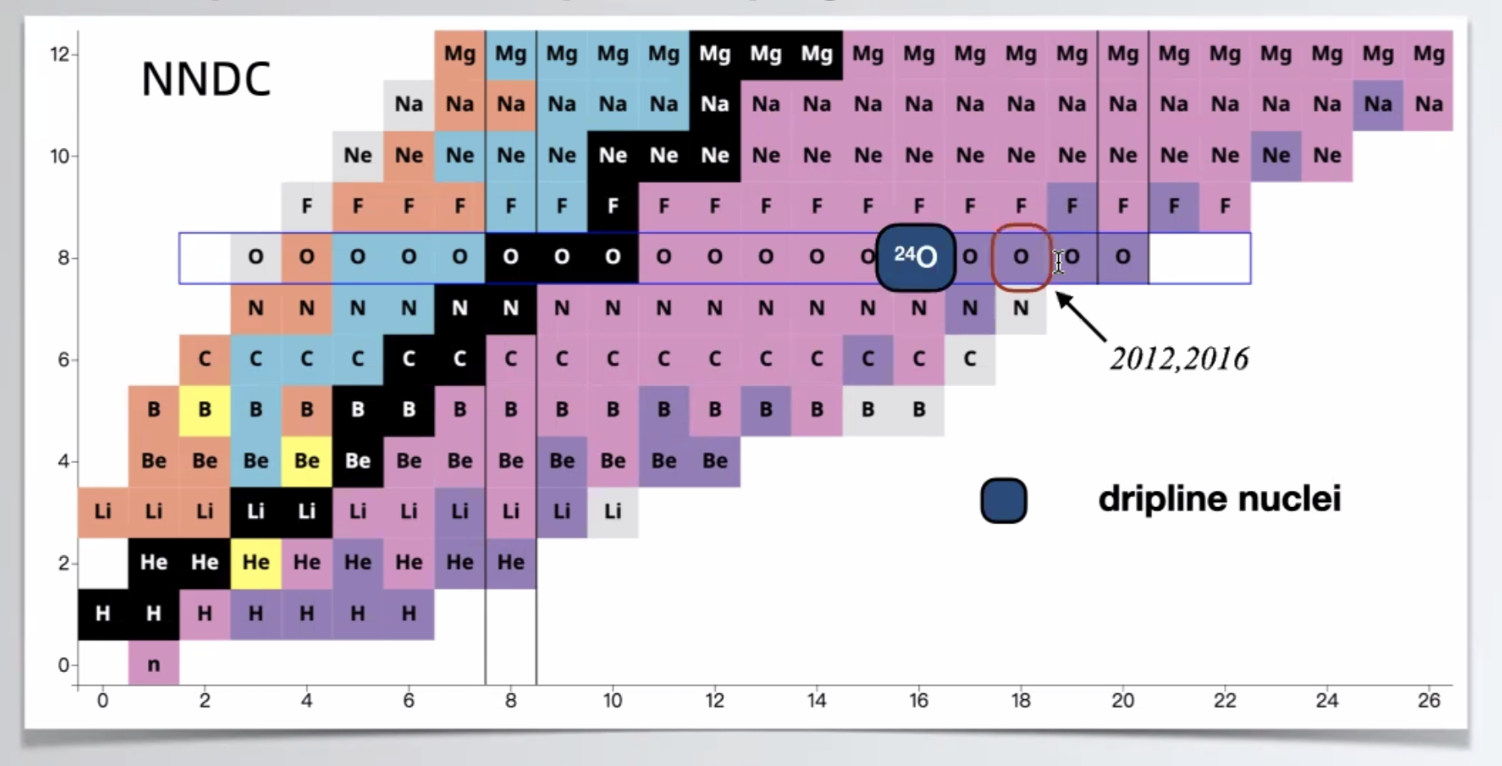
Dripline
Can we explain the dripline of Carbon, Oxygen isotopes in NLEFT?
Role of 3-body force?

Slide 7
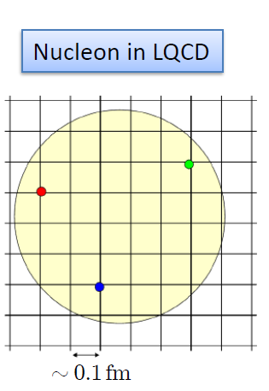

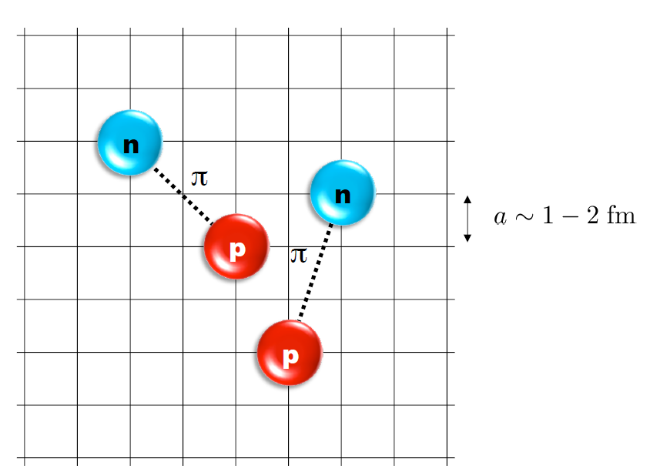
Nuclear Lattice Effective Field Theory
One of ab initio method for many fermion system

Slide 8
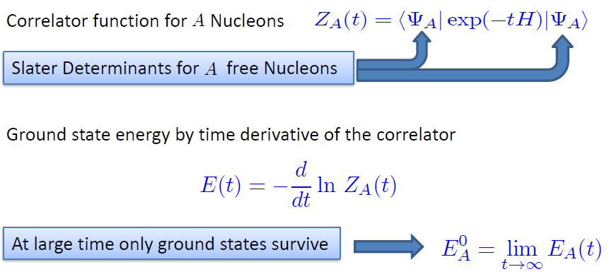

Path integral

Slide 9
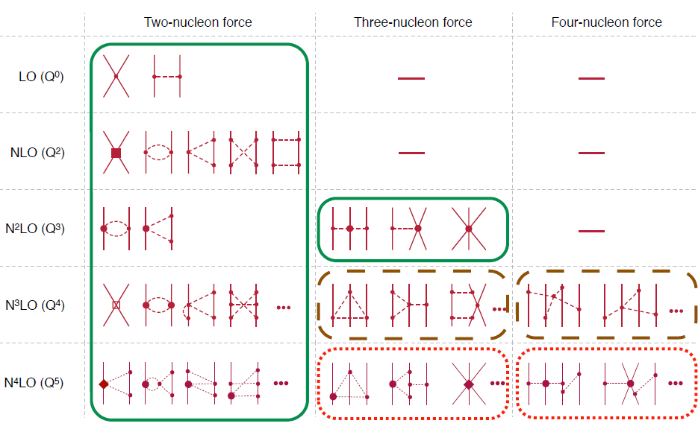
Chiral Effective Field Theory

Slide 10

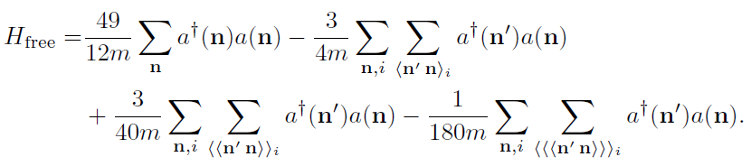
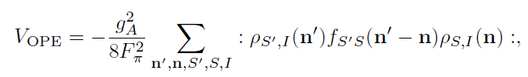


Lattice chiral Hamiltonian at Leading order
At Leading order, kinetic energy + contact interaction + one pion exchange
Kinetic
Long range OPE
(Perturbative) Coulomb
Contact

Slide 11
Lattice Hamiltonian
We need to introduce a lattice scale in space and time:
momentum space cutoff ~ 150 MeV → lattice size a= 1.316 fm
Time cutoff ~ 1000 MeV
We need to determine coefficients of interaction for the lattice size. (regularization scale.)
Two-body interaction coefficients can be determined from phase shifts of np scattering.
Three-body interaction can be fixed from binding energy of A>=3.

Slide 12
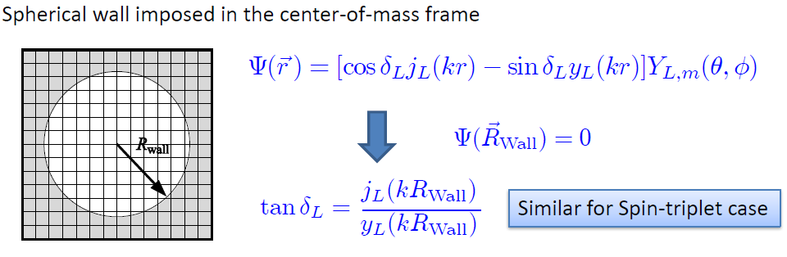
Low energy constants in lattice EFT
All LECs(parameters in the Hamiltonian) are fixed in A<=3
(They have to be fixed for given lattice regularization)
N-P scattering phase shifts, Deuteron binding energy
Triton binding energy, Triton beta decay.
Scattering phase shifts on the Lattice: Wall method.
Phase shift can be obtained from
The energy spectrum of E(or k) in lattice and imposed Wall size.

Slide 13
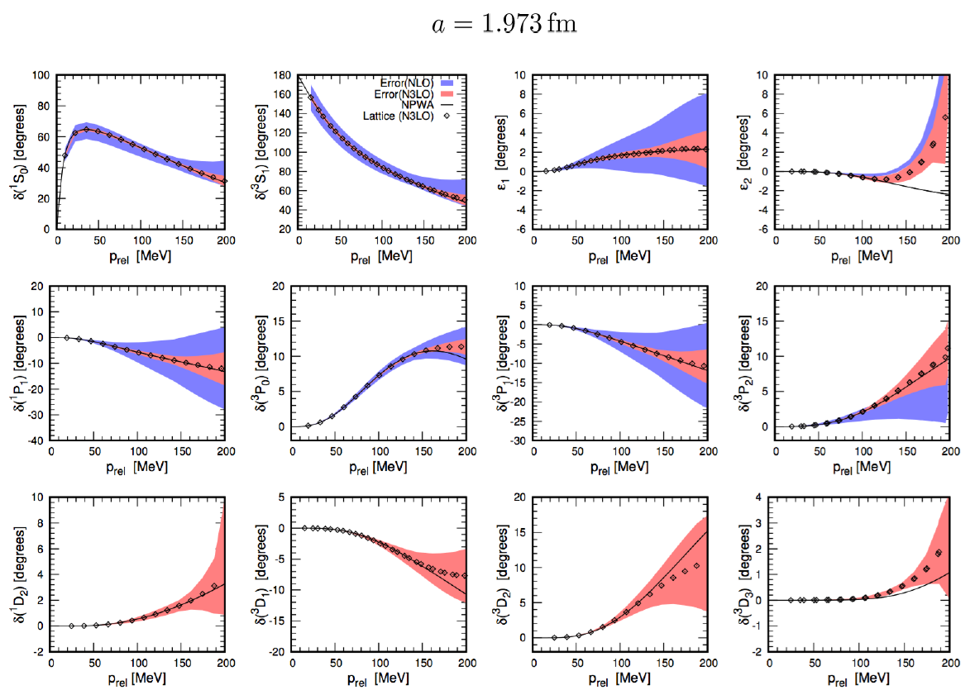
Determine LECs by fitting phase shifts of N-N scattering

Slide 14
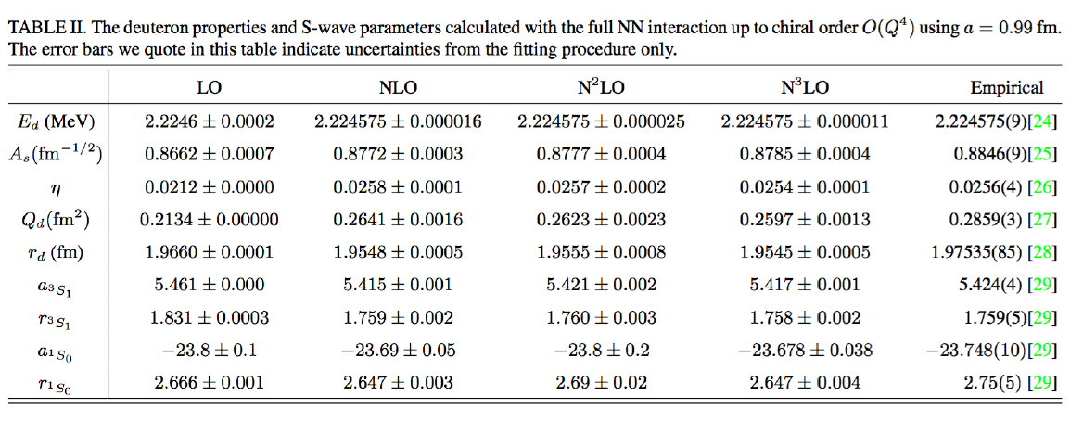

Slide 15
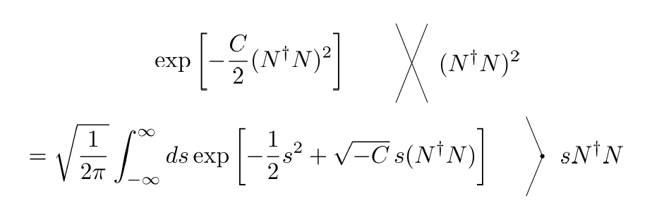
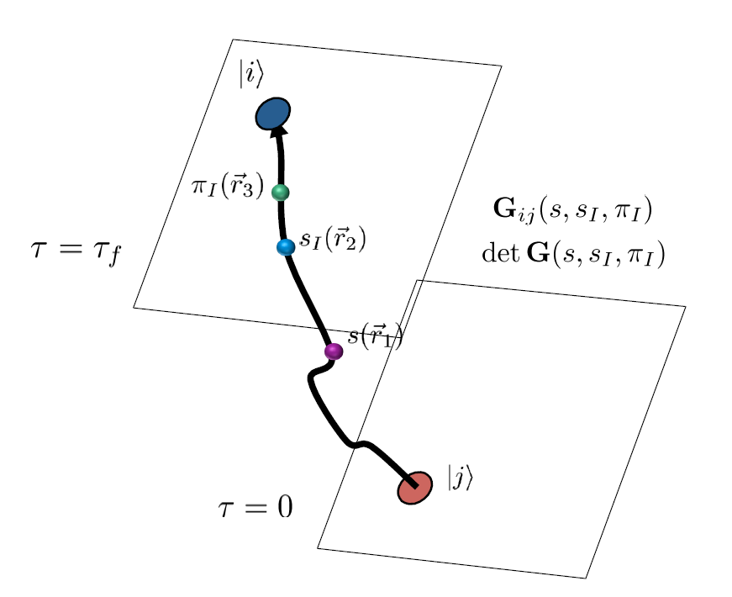
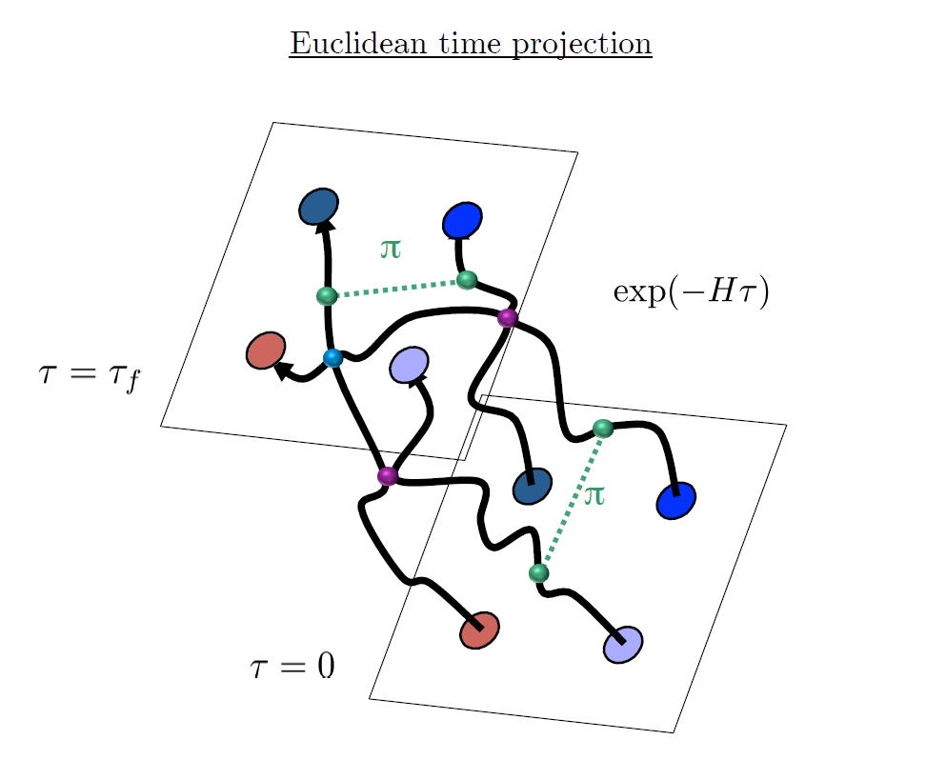
Auxiliary Field Monte Carlo

Slide 16
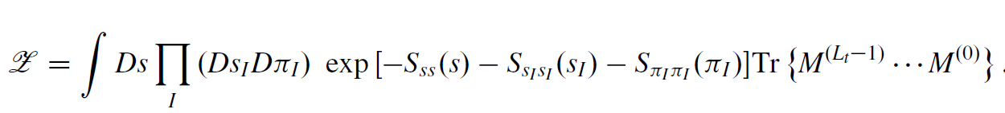

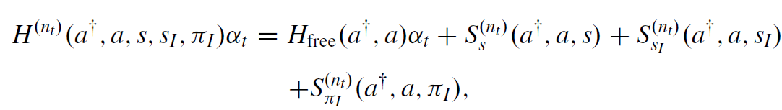
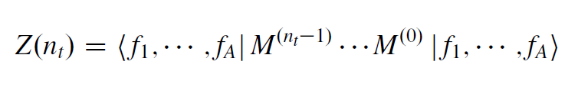
Hamiltonian in auxiliary field lattice
compute fermion amplitude
Integration over auxiliary fields
M.C. integral

Slide 17
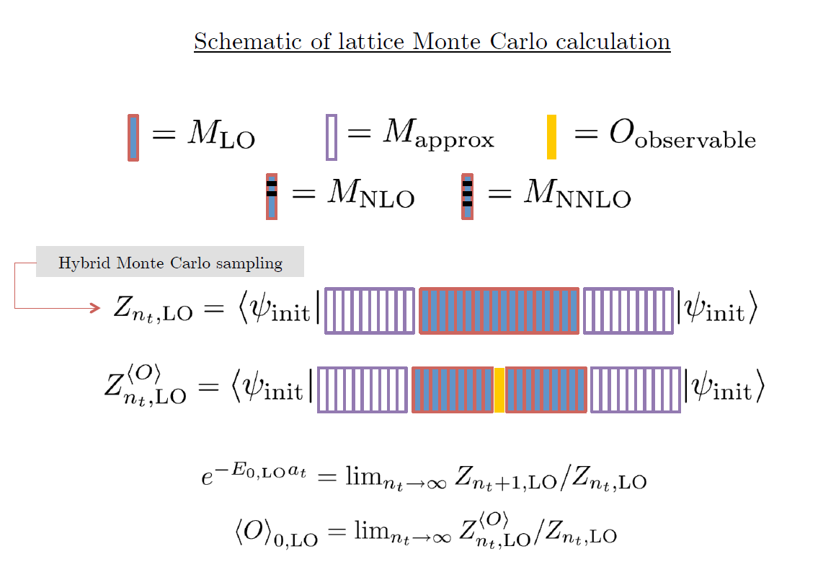

Slide 18
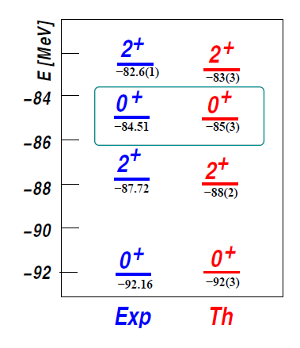

Applications of NLEFT
Has been successfully applied to
Nuclear matter, Cold atom, dilute fermion system
Finite nuclei (A<=50)
First ab-initio calculation of Hoyle state
Cluster structure of ¹²C and ¹⁶O
NN scattering, N-D scattering
Alpha-alpha scattering
radiative capture, fusion
Etc.
The first ab-initio calculation of
Hoyle state

Slide 19
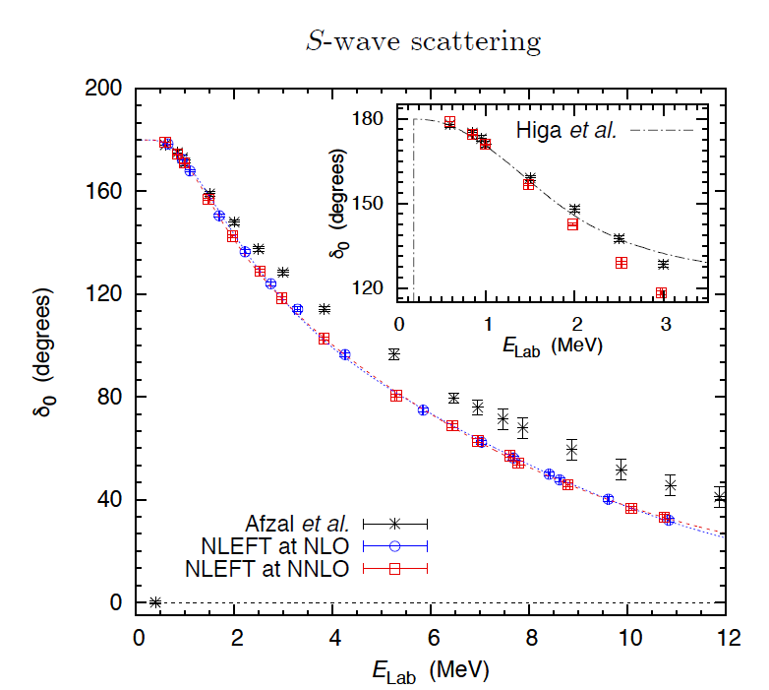
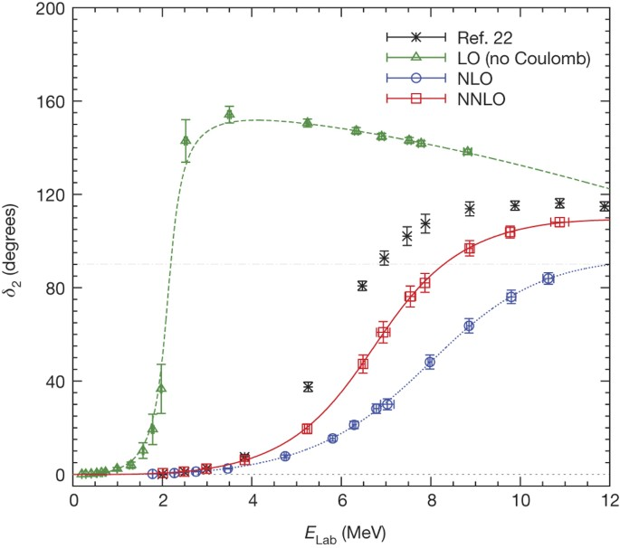
Adiabatic projection method
Ab initio alpha-alpha scattering
( Nature 528, 111-114(2015))

Slide 20
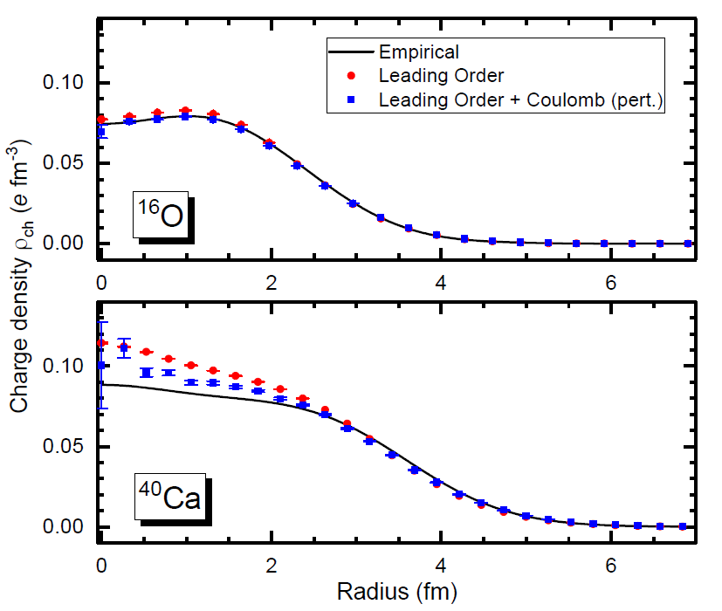
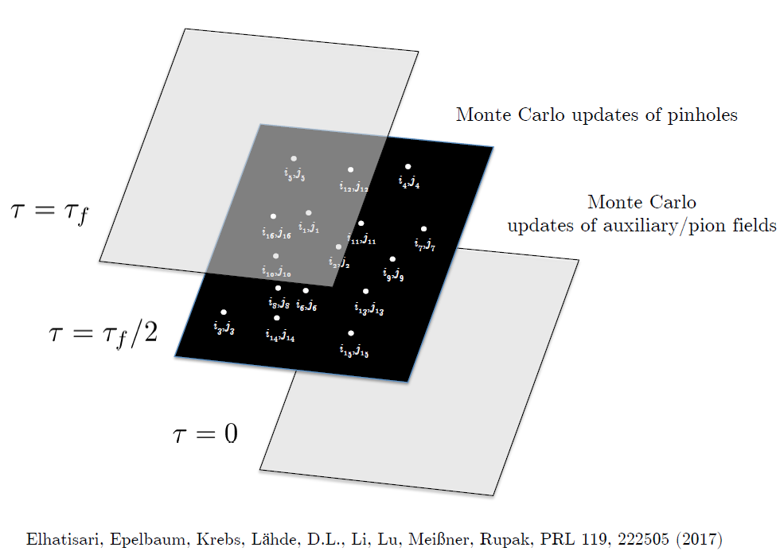
Pinhole Algorithm

Slide 21

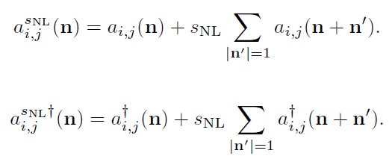
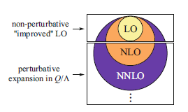
Improved action with non-locality
In practical calculation, sign problem and convergence of perturbation have to be taken care of.
To improve the non-perturbative calculation, modified non-local contact interaction are used.

Slide 22
Lattice chiral Hamiltonian (N3LO)
Full N3LO Hamiltonian includes
Free Hamiltonian(Kinetic term)
Short range (nonlocal smeared) contact interactions up to Q^4 order
Isospin-breaking short range interactions
One pion exchange potential
Two pion exchange potential up to Q^4 order
Coulomb interaction
Long range isospin breaking interaction( isospin dependence in OPE)
Galilean Invariance Restoration (GIR) term (because of non-local interaction.)
Three nucleon interaction

Slide 23
Difficulty with full chiral interaction
Sign problem
NLEFT suffers sign problems at large Euclidean time limit
Large cancellation between positive and negative contributions→ large uncertainty.
SU(4) symmetric interaction does not have sign problem
One pion exchange and higher order chiral interaction
Difficulty with Asymmetric nuclei
Needs a remedy to extend to neutron rich isotopes.
A new approach to reduce the sign problem.
→ Wave function matching Hamiltonian.

Slide 24
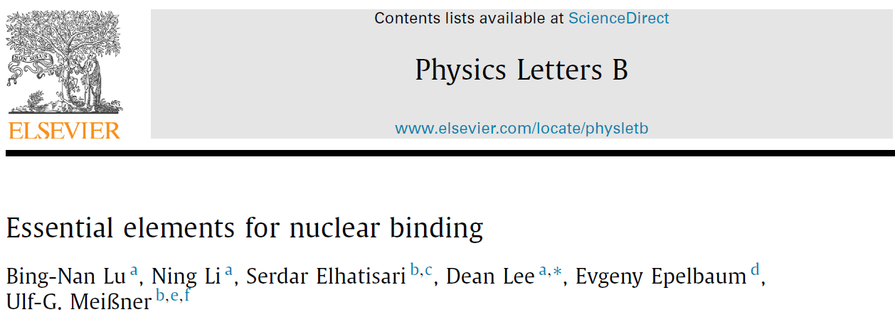



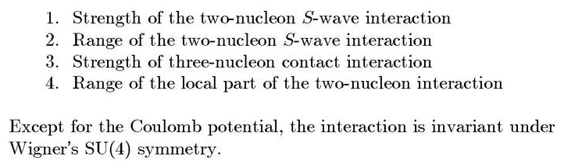
Minimal nuclear interaction
Which reproduce
Light nuclei
medium mass nuclei
neutron matter
simultaneously up to few percent error in binding energy and charge radius
Only Four parameters

Slide 25
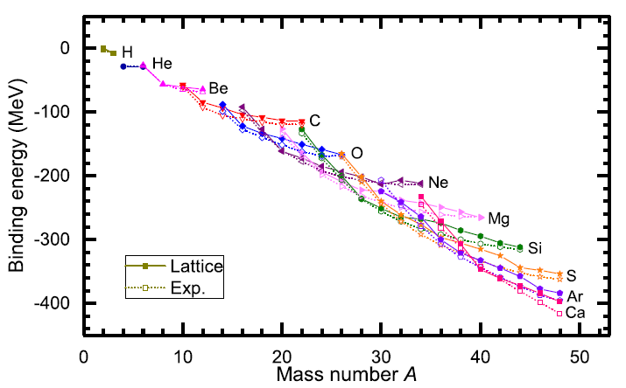
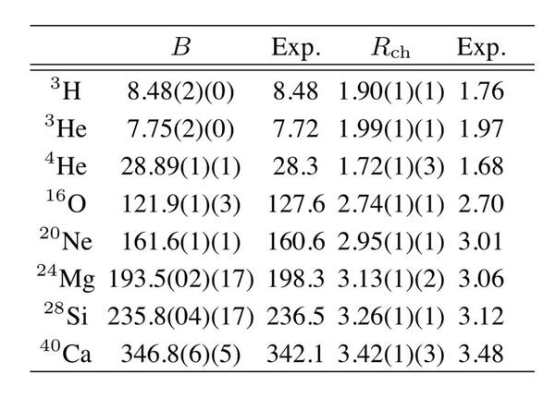
Can we improve the agreement by
Including higher order corrections?

Slide 26
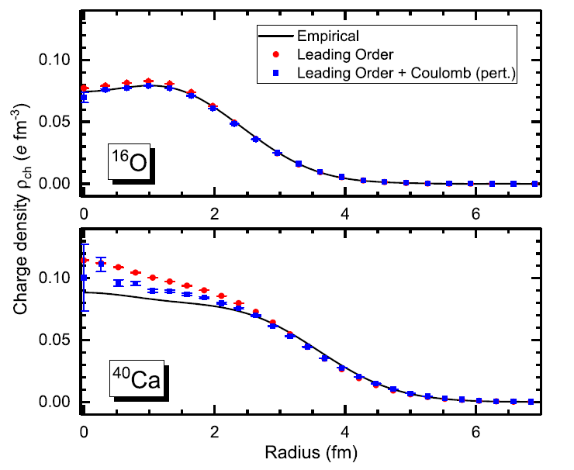
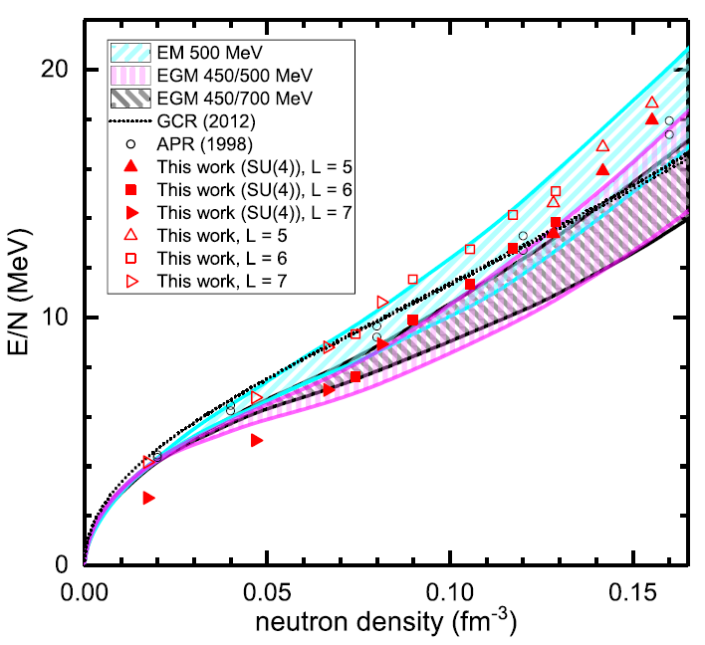
Can we improve the agreement by
Including higher order corrections?

Slide 27
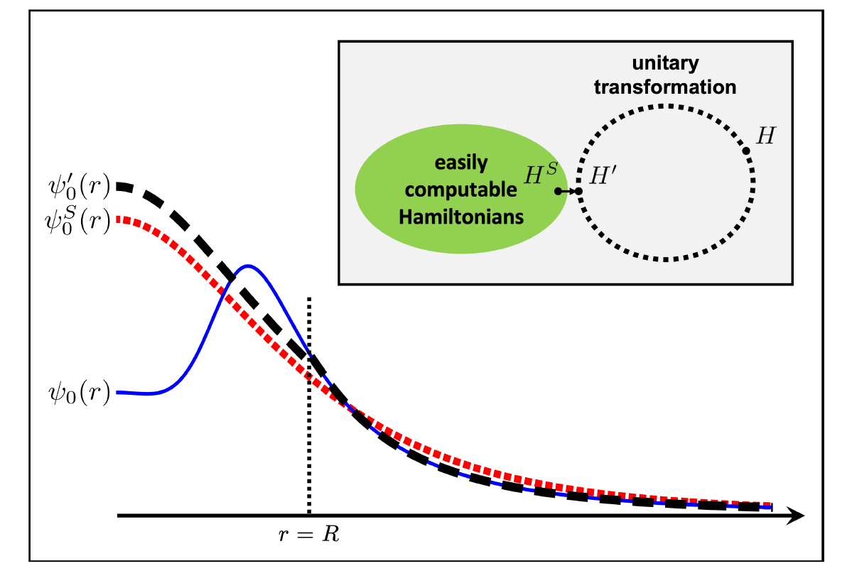



Wave function matching
H and H’ are fully equivalent to two-body observables
The goal is to make the perturbation expansion from “simple” wave function gives a good convergence
U is only active
At r < R

Slide 28
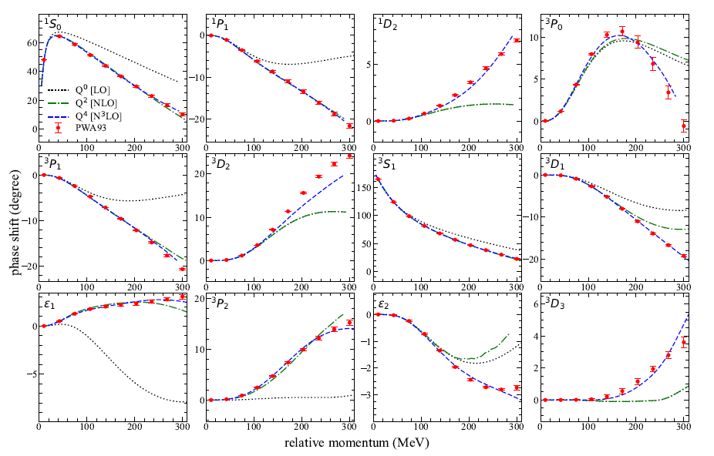
NN phase shifts from WFM
Original Hamiltonian is fitted to phase shifts.
H’ is equivalent to original Hamiltonian.

Slide 29

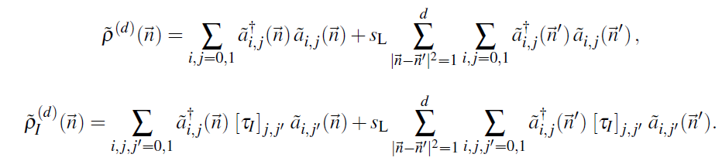

Wave function matching Hamiltonian
“Simple” Hamiltonian
(local,non-local smeared operators)

Slide 30

Wave function matching Hamiltonian
N3LO Hamiltonian
V_2N : short range NN interactions
W_2N: GIR restoration term for V_2N
V_2N,WFM : difference from H_s
W_2N,WFM: GIR restoration correction to V_2N,WFM
V_3N : contains short range 3N interaction parameters(to be fitted)
and two pion exchange correction to 3N

Slide 31
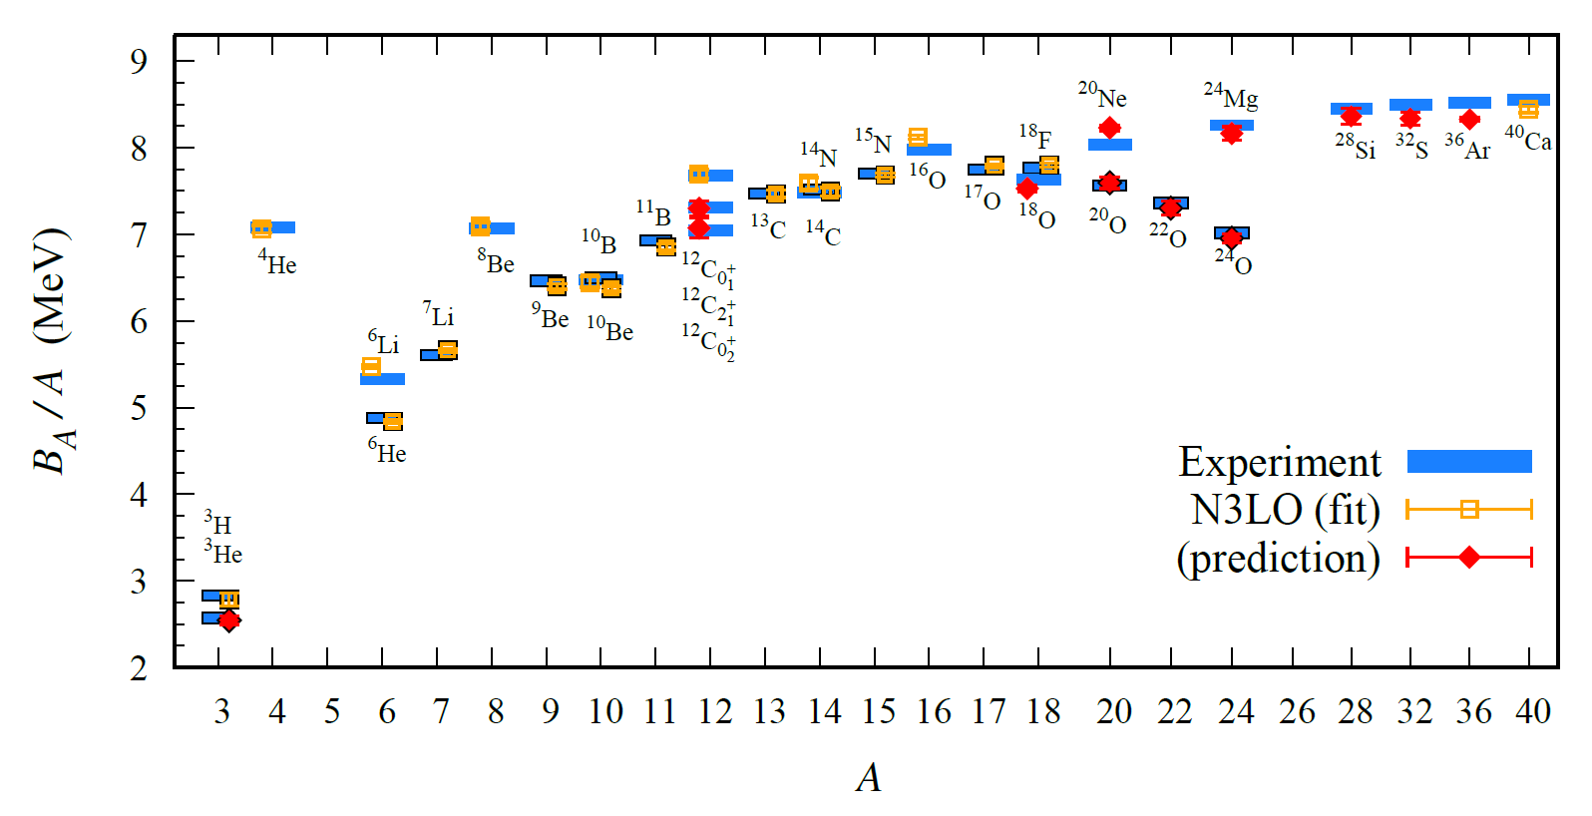
BE/A from WFM
Preliminary

Slide 32
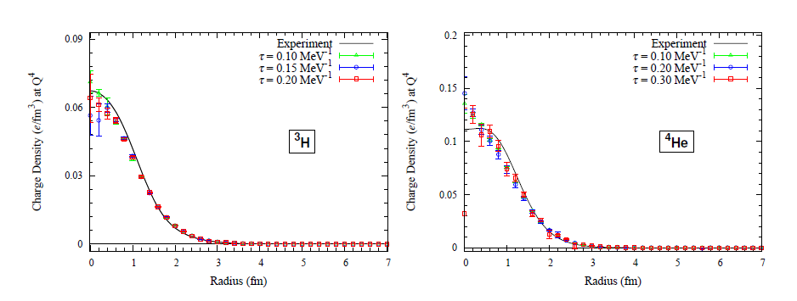
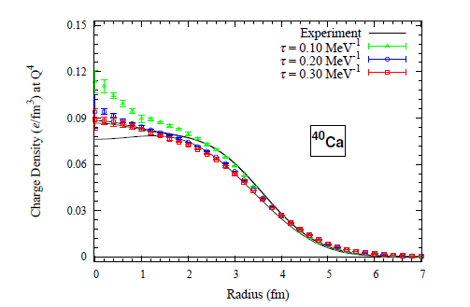
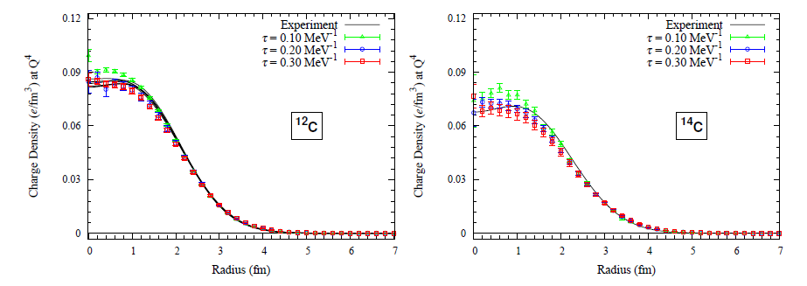
Charge density from WFM
Preliminary

Slide 33
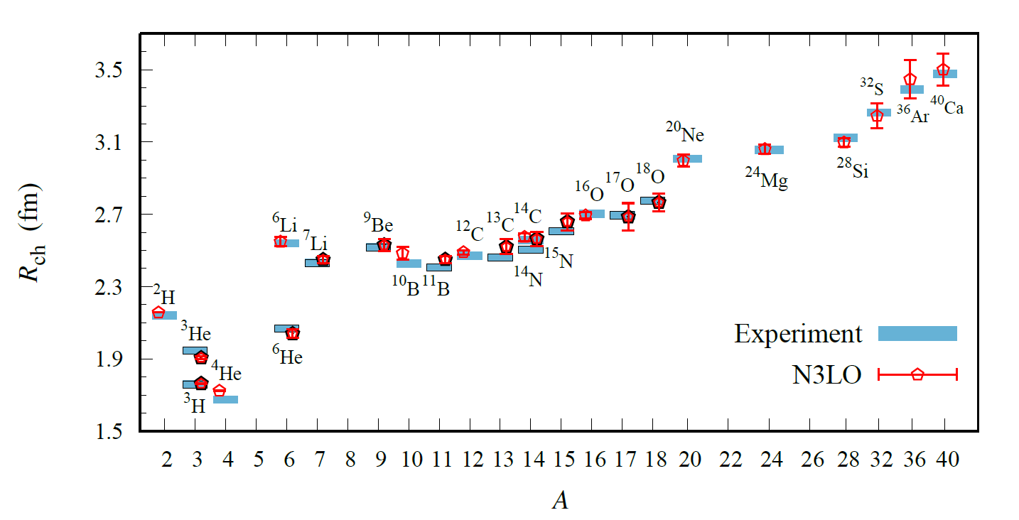
Charge Radius
Preliminary

Slide 34
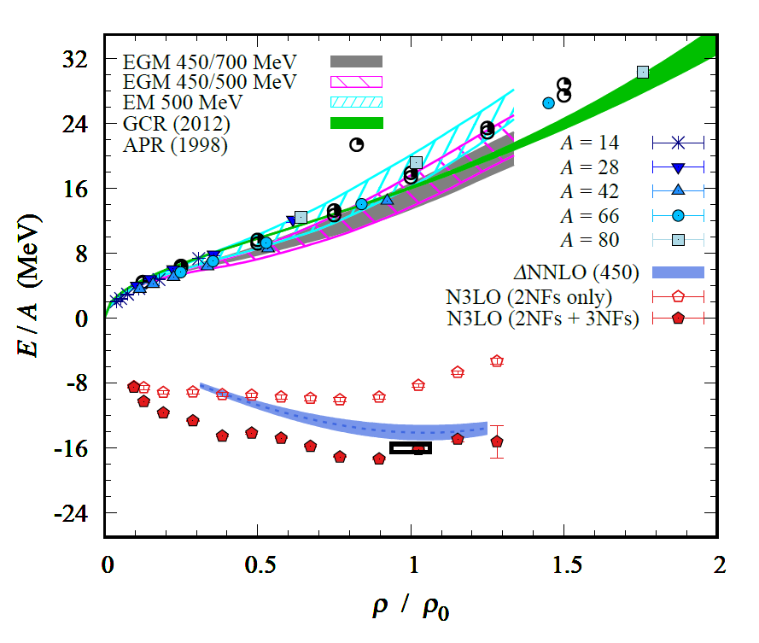
Nuclear/Neutron Matter
Neutron matter:
A=4~80
box size 6.6 ~ 13.2 fm.
Nuclear matter:
A=4 ~ 160
Box size 7.92~9.24 fm.
Preliminary

Slide 35
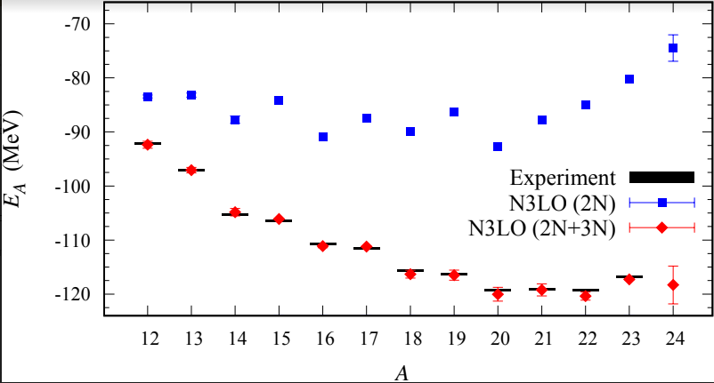
Carbon isotopes

Slide 36
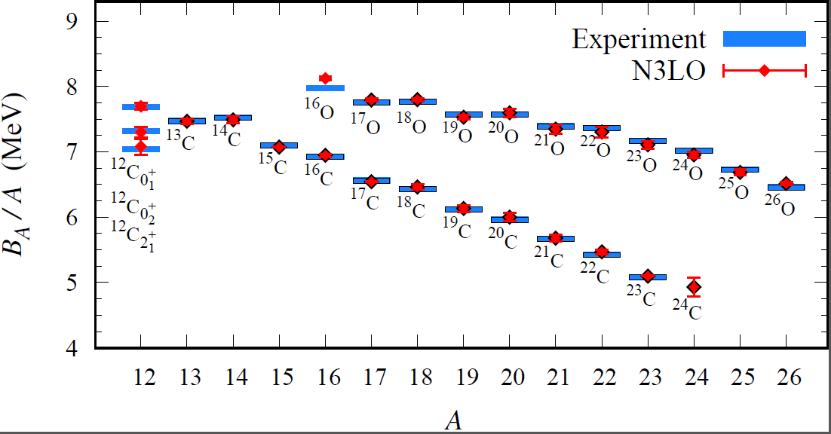
Carbon and Oxygen
Preliminary

Slide 37
Summary
Wave function matching method seems to be promising
New method to improve the N3LO calculation of NLEFT
Preliminary study shows promising results for wide range of observables in one scheme (same interaction and many-body method)
NN scattering
Binding energy (from 3H to 40Ca)
Symmetric Nuclear matter
Neutron matter
Dripline of Oxygen isotope.
Carbon excited states
Further investigation on the finite volume effects is on-going.
Also, Carbon isotopes, odd Oxygen isotopes, Cluster structure, excited states will be studied.

