Slide 1


Towards dripline:
Nuclear Lattice Effective Field Theory approach
Young-Ho Song (중이온가속기연구소, IBS)
NLEFT collaboration
KPS 2022 Fall meeting 2022.10.20., 부산

Slide 2
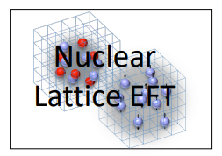
Nuclear Lattice Effective Field Theory Collaboration
Serdar Elhatisari(Gaziantep Islam Science and Technology)
Lukas Bovermann(Ruhr)
Evgeny Epelbaum (Bochum)
Dillon Frame (Juelich)
Fabian Hildenbrand(Darmstadt)
Hermann Krebs(Ruhr)
Timo A. Lähde (Juelich)
Dean Lee (MSU)
Ning Li(Sun Yat-sen)
Bing-Nan Lu( Graduate School of China Academy of Engineering Physic)
Myungkuk Kim(CENS,IBS)
Youngman Kim (중이온가속기연구소,IBS)
Young-Ho Song(중이온가속기연구소,IBS)
Yuanzhuo Ma(Peking)
Ulf-G. Meißner (Bonn/Juelich)
Gautam Rupak(Mississippi State)
Shihang Shen (Juelich)
Gianluca Stellin( CEA Paris-Saclay)

Slide 3
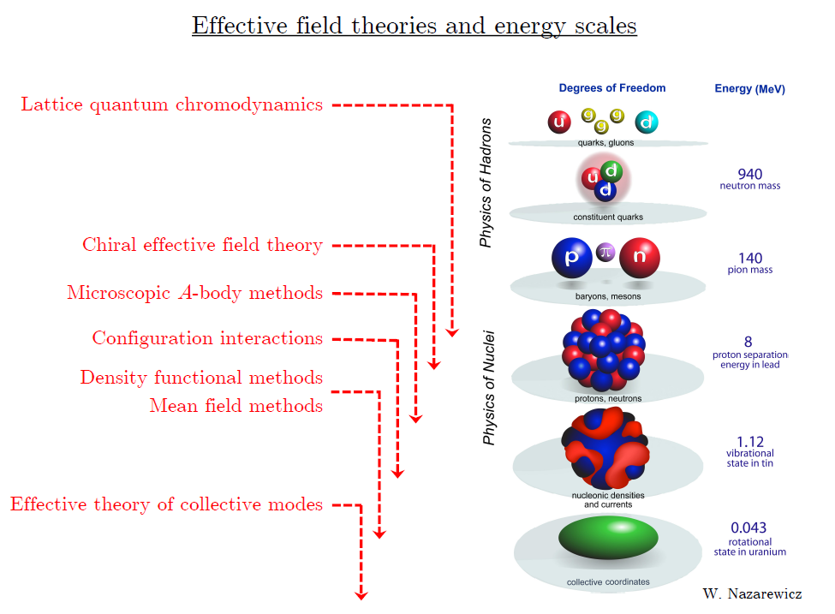
Ab initio approach
Ab initio
= Start from nucleon-nucleon interaction
Ab initio
Nuclear
Theory
Direct understanding of nuclear force and
nuclear structure/reaction

Slide 4
Non-perturbative many-body problem
Nuclear many body problem
Requires Non-perturbative method.
Ab-initio nuclear many body methods
Greens function Monte Carlo(GFMC)
No-core shell model(NCSM)
Coupled Cluster (CC)
IM-SRG, VS-SRG
Nuclear Lattice Effective Field Theory(NLEFT)
And more
With recent progress in ab-initio methods
Binding energies for wide range of nuclei
Some reaction calculation for light nuclei.

Slide 5
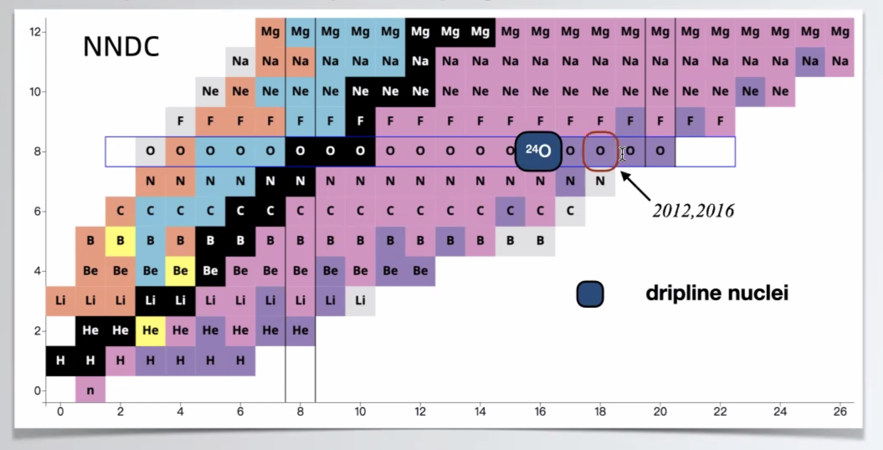
Oxygen isotopes
Can we explain the dripline of Oxygen isotopes?
Role of 3-body force?
In NLEFT?

Slide 6
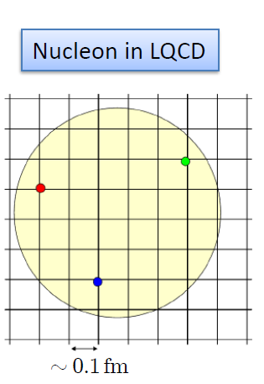

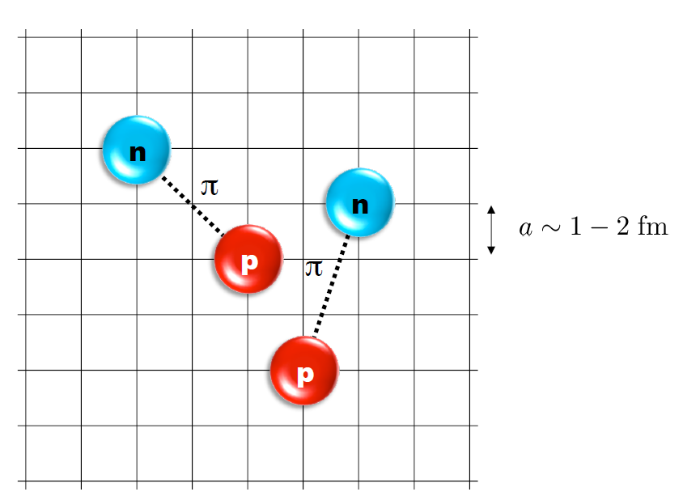
Nuclear Lattice Effective Field Theory
ab initio method for many fermion system

Slide 7
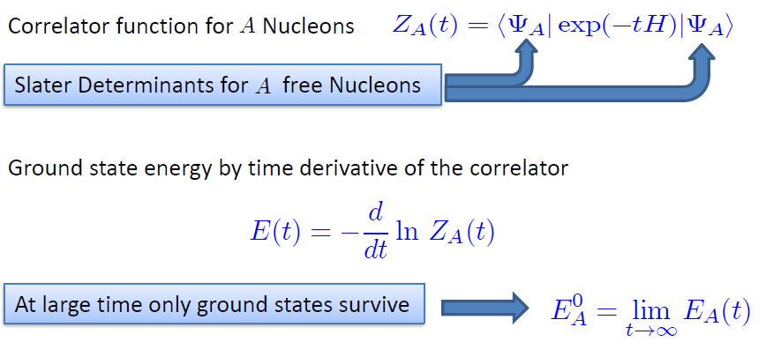

Path integral

Slide 8
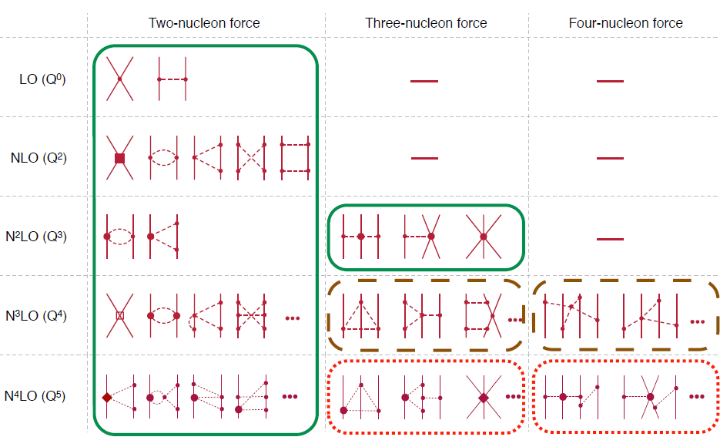
Chiral Effective Field Theory

Slide 9
Lattice Hamiltonian
We need to introduce a lattice scale in space and time:
momentum space cutoff ~ 150 MeV → lattice size a= 1.316 fm
Time cutoff ~ 1000 MeV
We need to determine coefficients of interaction for the lattice size. (regularization scale.)
Two-body interaction coefficients can be determined from phase shifts of np scattering.
Three-body interaction can be fixed from binding energy of A>=3.

Slide 10
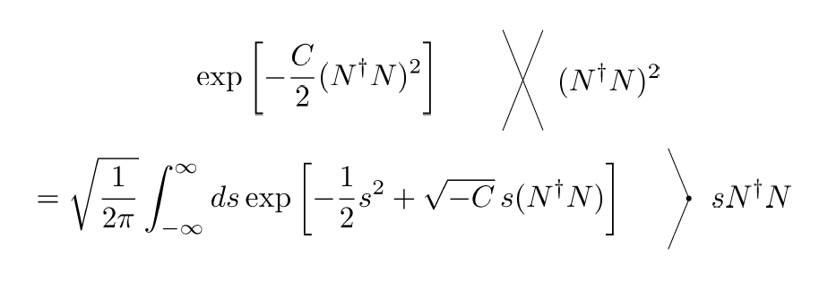
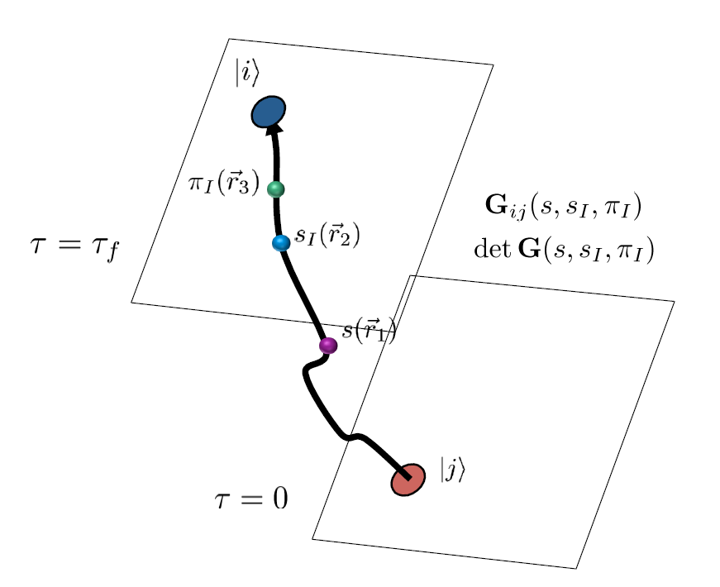
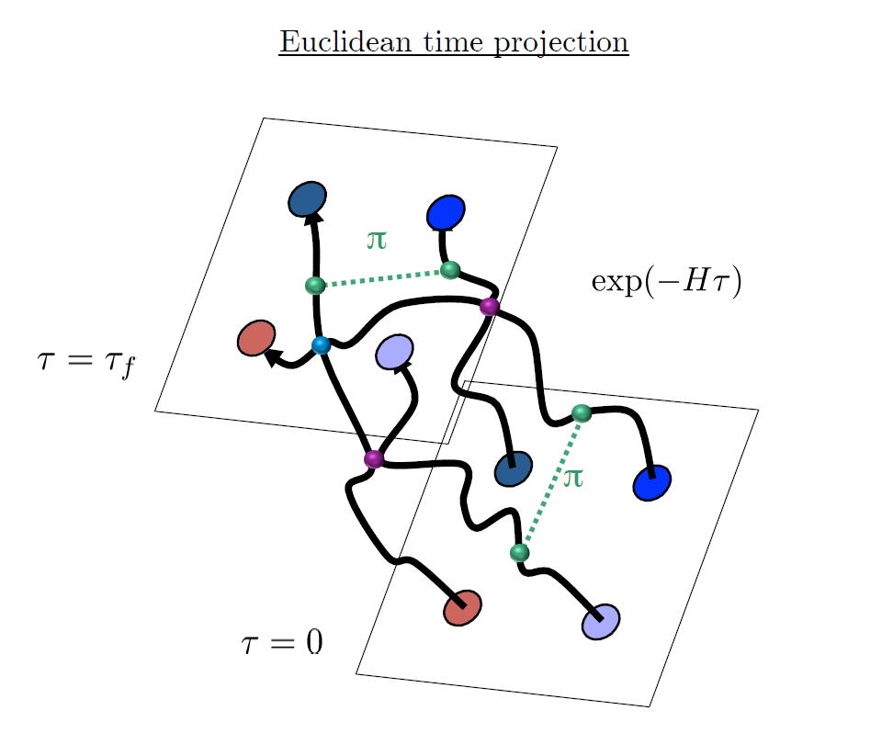
Auxiliary Field Monte Carlo

Slide 11
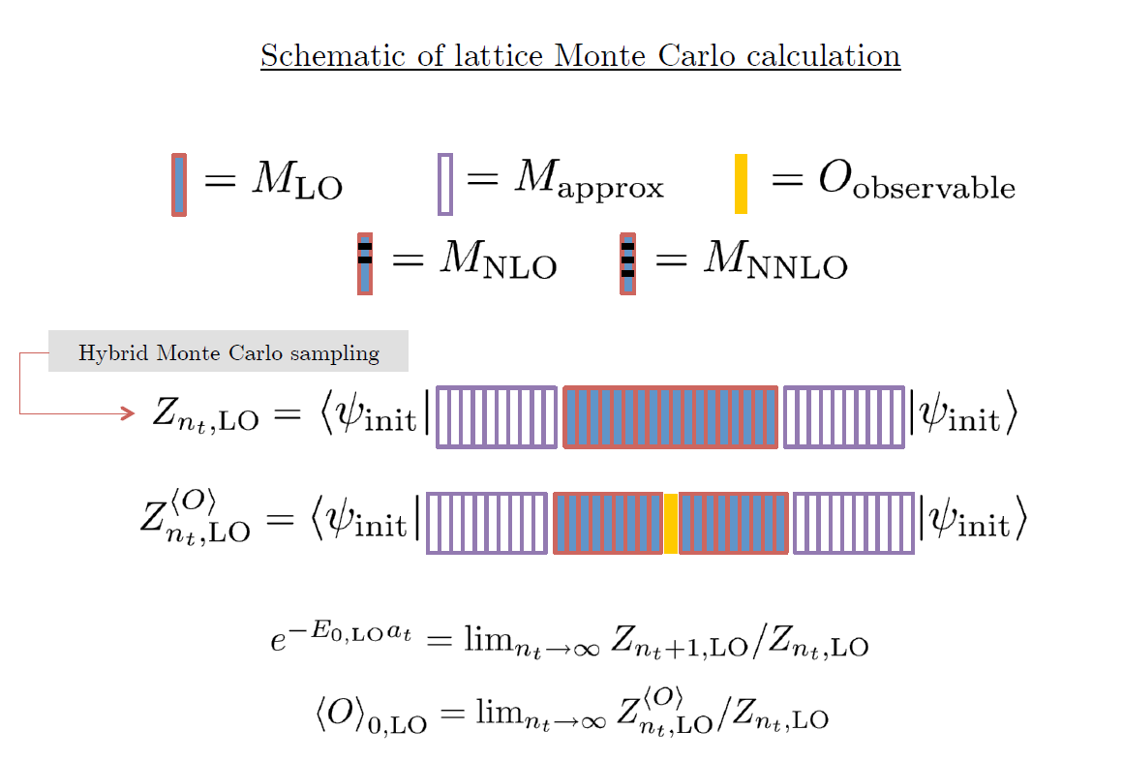

Slide 12
Applications of NLEFT
Has been successfully applied to
Nuclear matter, Cold atom, dilute fermion system
Finite nuclei (A<=50)
First ab-initio calculation of Hoyle state
Cluster structure of ¹²C and ¹⁶O
NN scattering, N-D scattering
Alpha-alpha scattering
radiative capture, fusion
Etc.

Slide 13

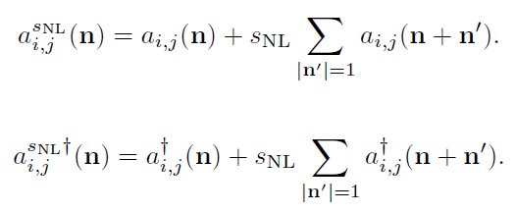
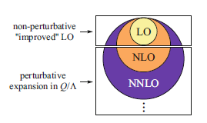
Improved action with non-locality
In practical calculation, sign problem and convergence of perturbation have to be taken care of.
To improve the non-perturbative calculation, modified non-local contact interaction are used.

Slide 14
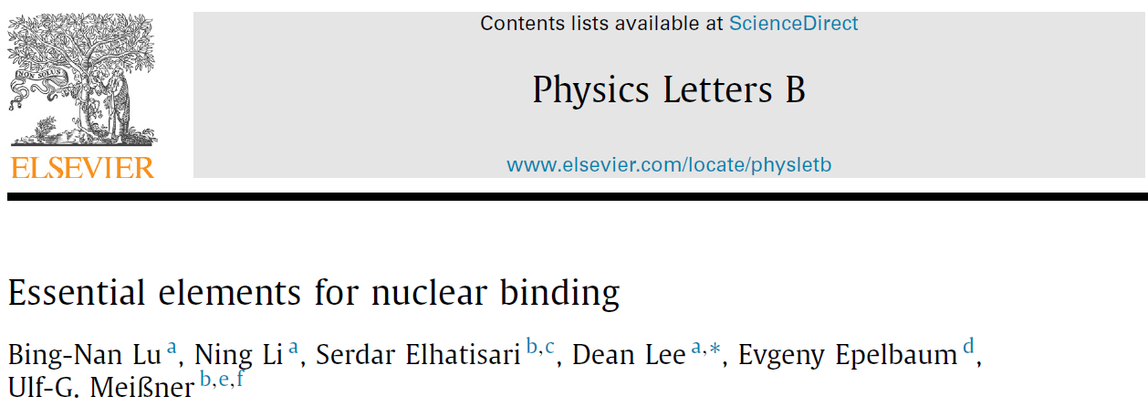



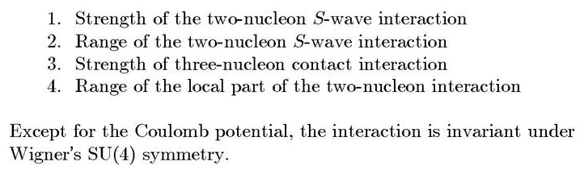
Minimal nuclear interaction
Which reproduce
Light nuclei
medium mass nuclei
neutron matter
simultaneously up to few percent error in binding energy and charge radius
Only Four parameters

Slide 15
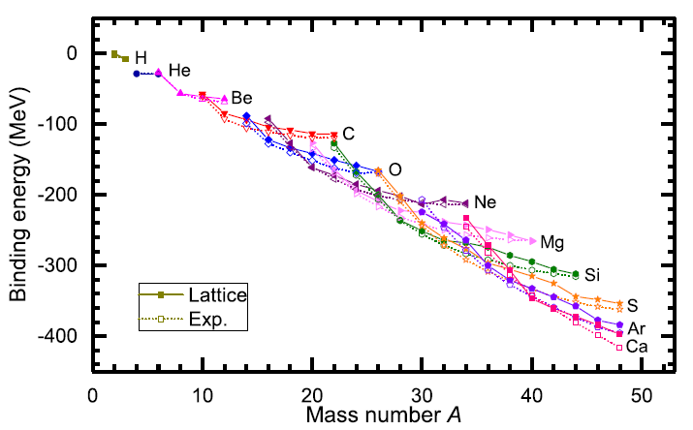
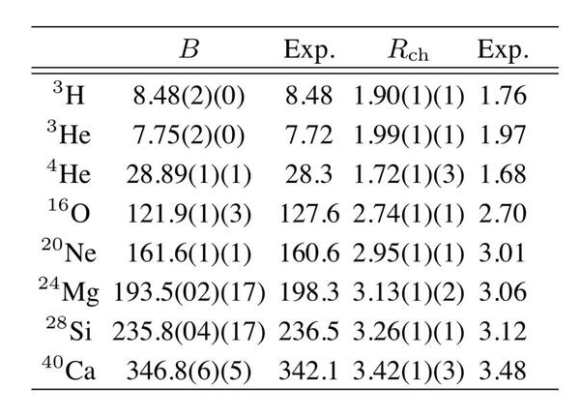
Can we improve the agreement by
Including higher order corrections?

Slide 16
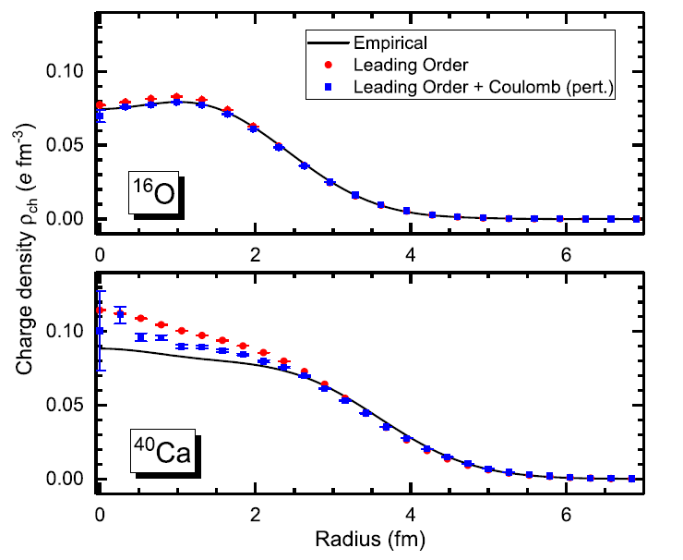
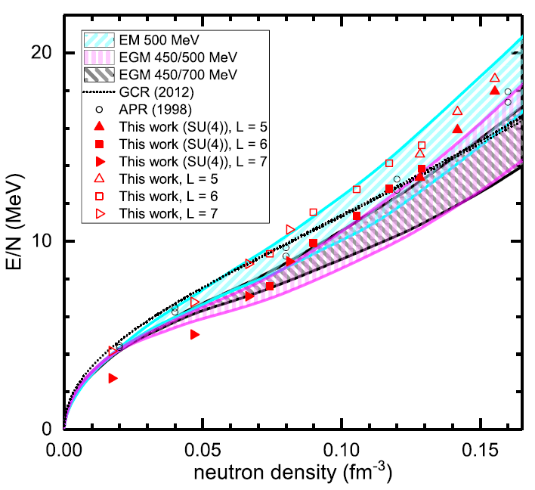
Can we improve the agreement by
Including higher order corrections?

Slide 17
Lattice chiral Hamiltonian (N3LO)
Full N3LO Hamiltonian includes
Free Hamiltonian(Kinetic term)
Short range (nonlocal smeared) contact interactions up to Q^4 order
Isospin-breaking short range interactions
One pion exchange potential
Two pion exchange potential up to Q^4 order
Coulomb interaction
Long range isospin breaking interaction( isospin dependence in OPE)
Galilean Invariance Restoration (GIR) term (because of non-local interaction.)
Three nucleon interaction

Slide 18
Difficulty with full chiral interaction
Sign problem
NLEFT suffers sign problems at large Euclidean time limit
Large cancellation between positive and negative contributions→ large uncertainty.
SU(4) symmetric interaction does not have sign problem
One pion exchange and higher order chiral interaction
Difficulty with Asymmetric nuclei
Needs a remedy to extend to neutron rich isotopes.
A new approach to reduce the sign problem.
→ Wave function matching Hamiltonian.

Slide 19


Wave Function Matching Hamiltonian
Wave function matching by Unitary transformation
Original Hamiltonian has a strong repulsion at short distance
→ origin of the difficulty of non-perturbative calculation.
new Hamiltonian
such that the eigenstate wave function becomes
Same as “original” w.f. at long distance
Same as “soft” w.f. at short distance
The goal is to make the perturbation expansion with “soft” wave function gives a good convergence

Slide 20
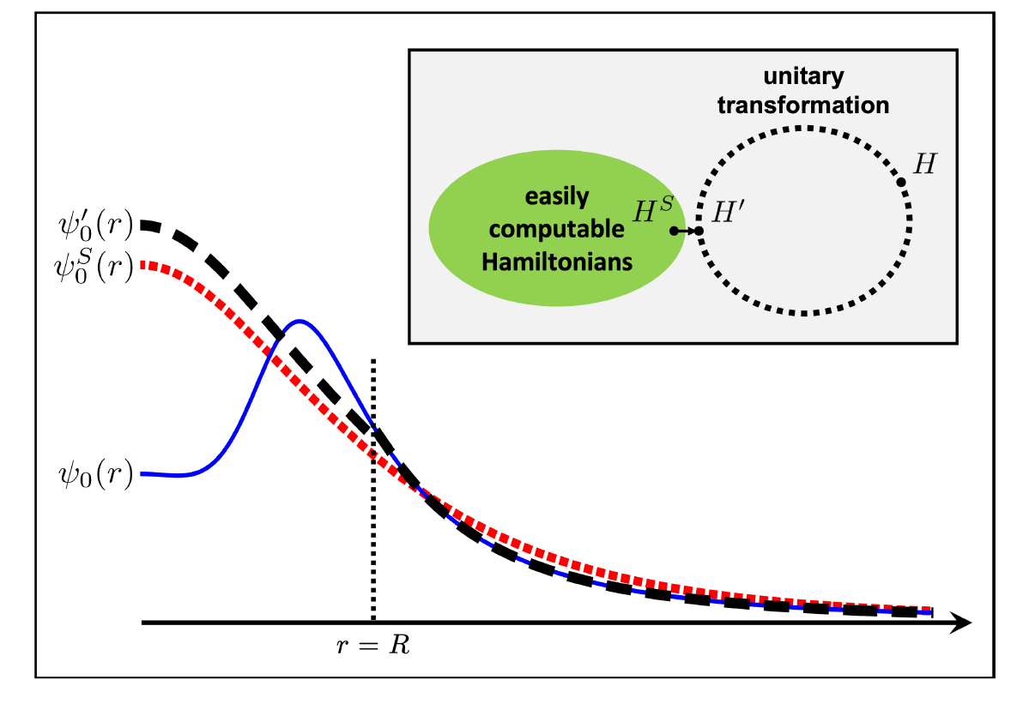
Wave function matching
U is only active
At r < R
U is not active
At r > R

Slide 21

Wave Function Matching Hamiltonian
new Hamiltonian is not the same as original Hamiltonian
Naturally need correction terms
H_soft has better property for non-perturbative calculation
Perturbative expansion for the corrections
No new LECs in 2-body interaction
(H_soft is a choice. U^dagger H U is computable for 2-body.)
Drawback : Induces many body interactions
In principle, one may compute the induced many-body interactions
In practice, highly non-trivial.
→ introduce additional 3-body interactions and fit them.

Slide 22
Three-body force
Chiral EFT TBF at N2LO have two parameters: cD, cE
at N3LO have many-diagrams, but no new parameters
Here we have 4-parameters for TBF at N3LO:
local smeared cD
local smeared cE
point-split cE_1, cE_2
These corresponds to a fine-tuning of
α- α S-wave scattering, α -N scattering, α-N-N scattering, α - α - α scattering,
Introducing more TBF parameters only give minor improvements.

Slide 23
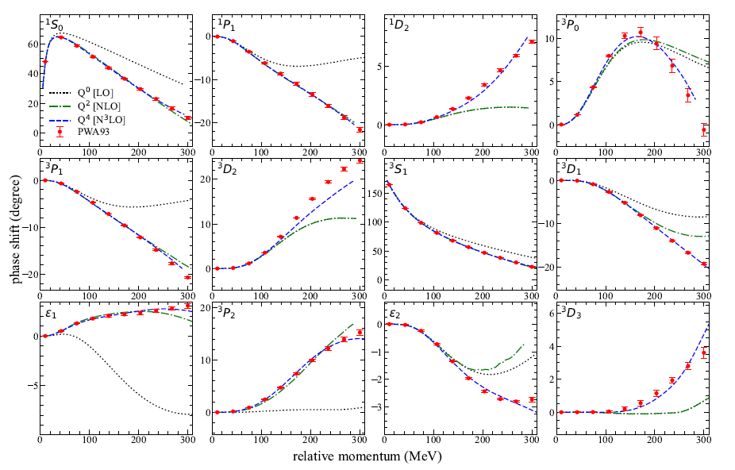
NN phase shifts from WFM

Slide 24
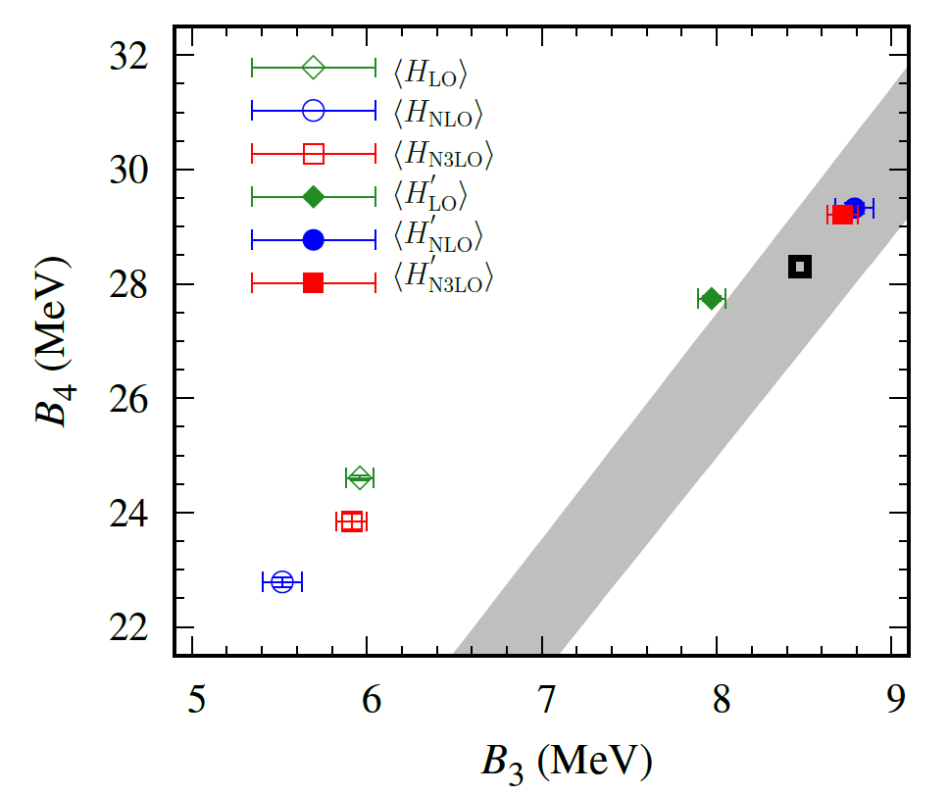
Tjon line
Open symbols: chiral EFT
(non-perturbative LO
+ perturbative higher orders)
Closed symbols: W.M.
(non-perturbative H’
+perturbative higher orders)
Preliminary

Slide 25
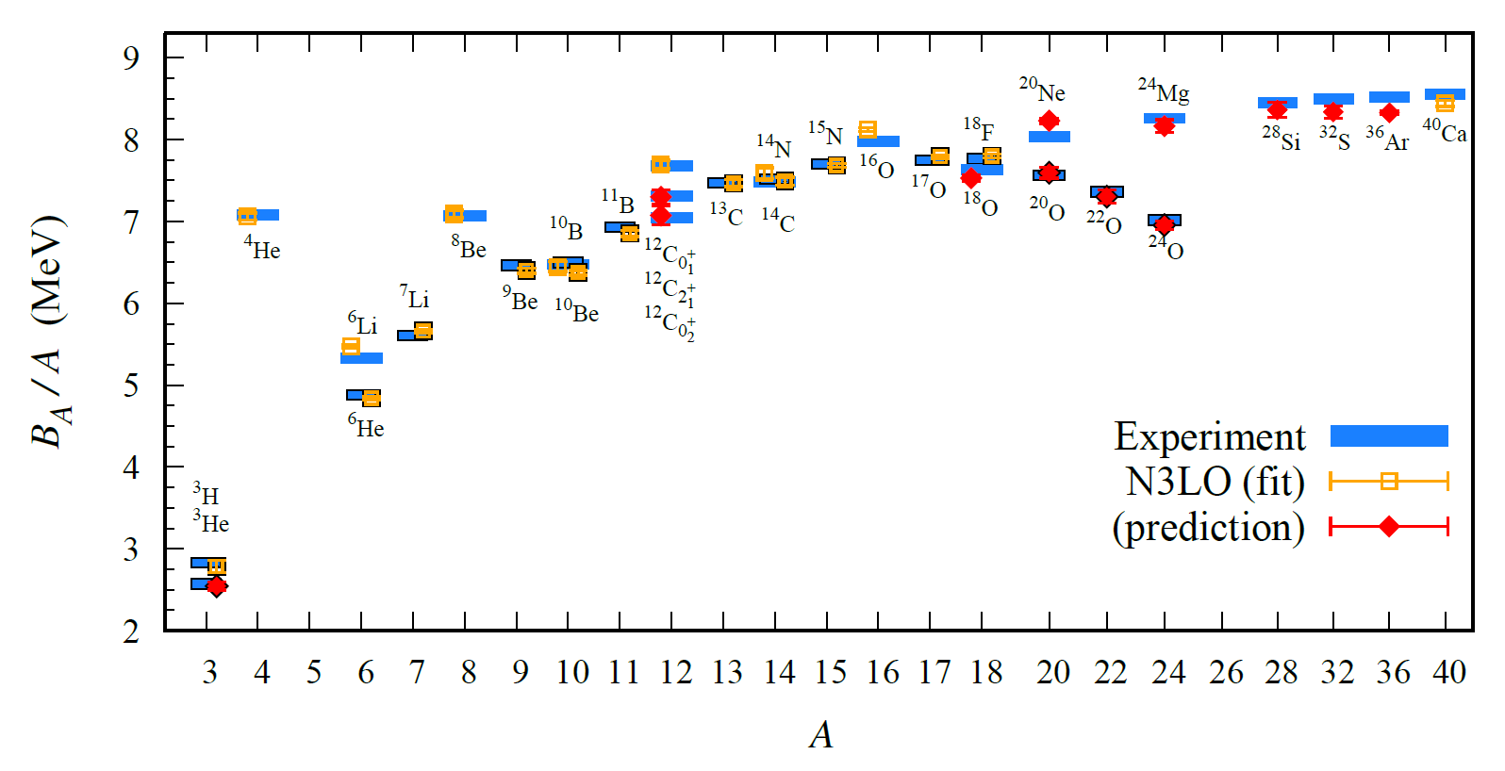
BE/A from WFM
Preliminary

Slide 26
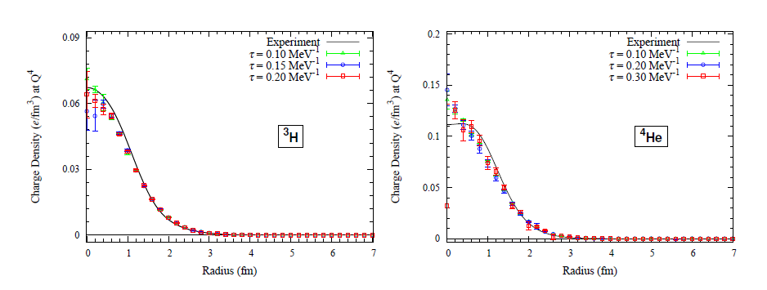
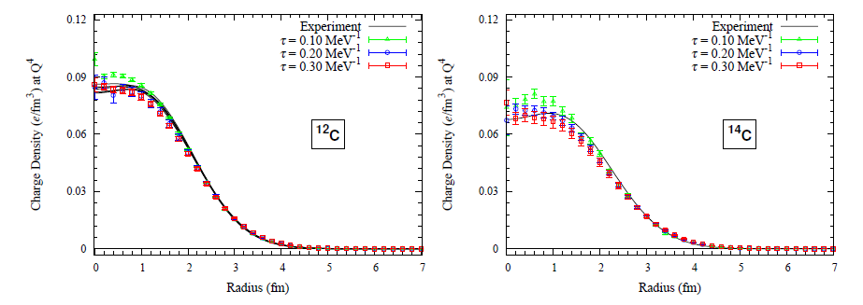
Charge density from WFM
Preliminary

Slide 27
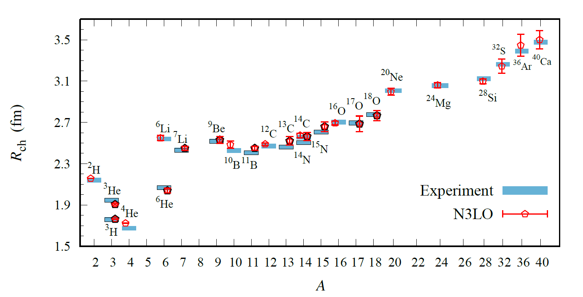
Charge Radius
Preliminary

Slide 28
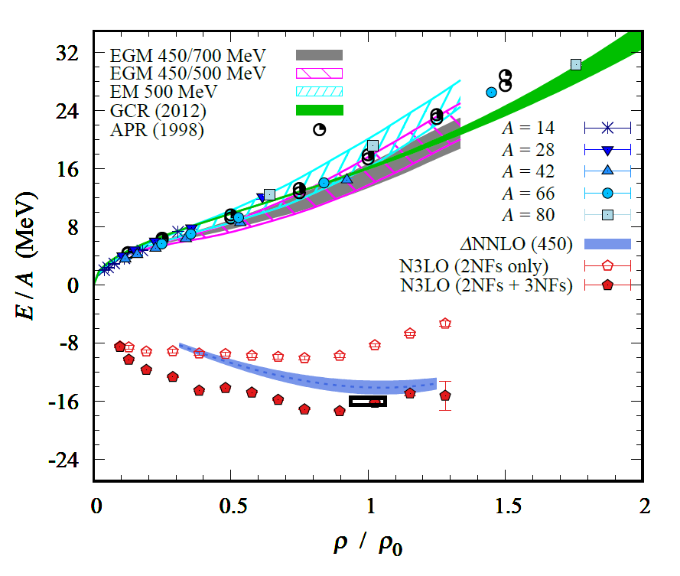
Nuclear/Neutron Matter
Neutron matter:
A=4~80
box size 6.6 ~ 13.2 fm.
Nuclear matter:
A=4 ~ 160
Box size 7.92~9.24 fm.
Preliminary

Slide 29
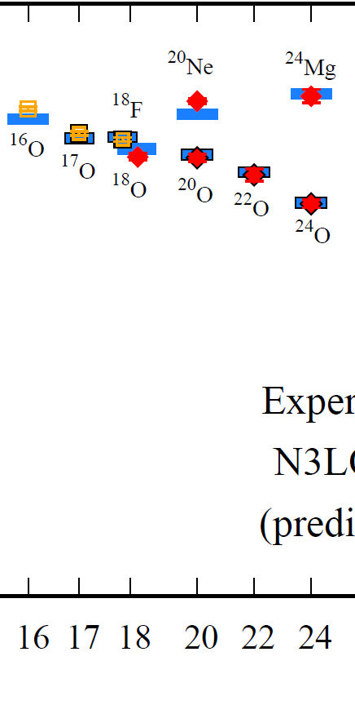
Oxygen isotopes in NLEFT
Reasonable agreement with experiments
Correct dripline at O24
Slight over binding in O26.
→ finite volume effects?
Preliminary

Slide 30
Summary
Wave function matching method seems to be promising
New method to improve the N3LO calculation of NLEFT
Preliminary study shows promising results for wide range of observables
NN scattering
Binding energy (from 3H to 40Ca)
Symmetric Nuclear matter
Neutron matter
Dripline of Oxygen isotope.
Carbon excited states
Further investigation on the finite volume effects is on-going.
Also, Carbon isotopes, odd Oxygen isotopes, Cluster structure, excited states.

