Slide 1

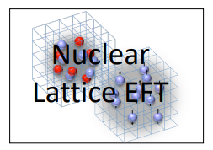

Neutron correlations in
Nuclear Lattice Effective Field
Theory
Young-Ho Song (IRIS, IBS)
NLEFT collaboration(Myungkuk Kim, Youngman Kim, Kihyeon Cho,
Serdar Elhatisari, Dean Lee, Yuan-Zhuo Ma, Ulf-G. Meißner)
2025.04.23., KPS Spring meeting

Slide 2
Ab initio Quantum many-body
Challenge to ab initio quantum many-body problem.
Requires:
1. Reliable theoretical tools
NLEFT : Auxiliary field Monte Carlo Method
→ Sign problem !
Goal 1 : reduce the sign problem in NLEFT calculation
2. Nuclear interaction which explain simultaneously scattering, binding energies, charge radius of wide range of nuclei and nuclear matter, neutron matter
Goal 2: find out what properties of nuclear interactions are necessary.

Slide 3
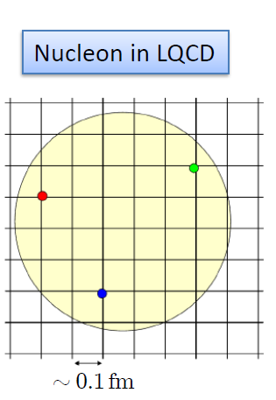

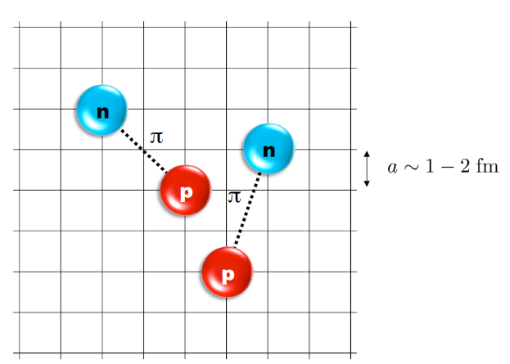
Nuclear Lattice Effective Field Theory
NLEFT = Chiral EFT + Lattice + Monte Carlo
Chiral EFT
2N interaction
3N interaction
Lattice
Lattice spacing a ~ 1 fm
Lattice size L ~ 10 a
Cutoff of the theory
Monte Carlo
Expectation value
by Auxiliary field MC
Polynomial scaling

Slide 4
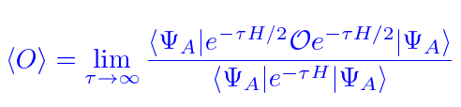

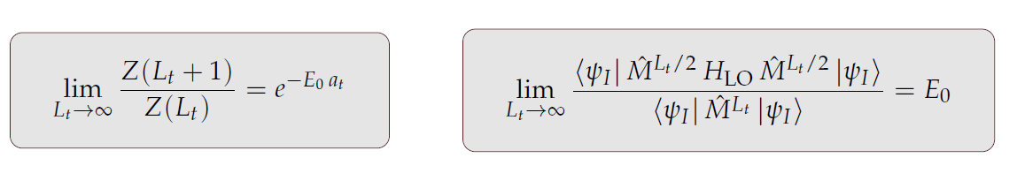
Auxiliary Field Monte Carlo
Expectation value of an observable by projecting WF at large Euclidean time
Discretization in Euclidean time evolution by transfer matrix

Slide 5
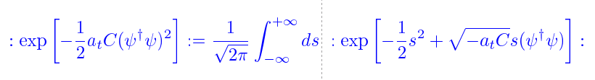
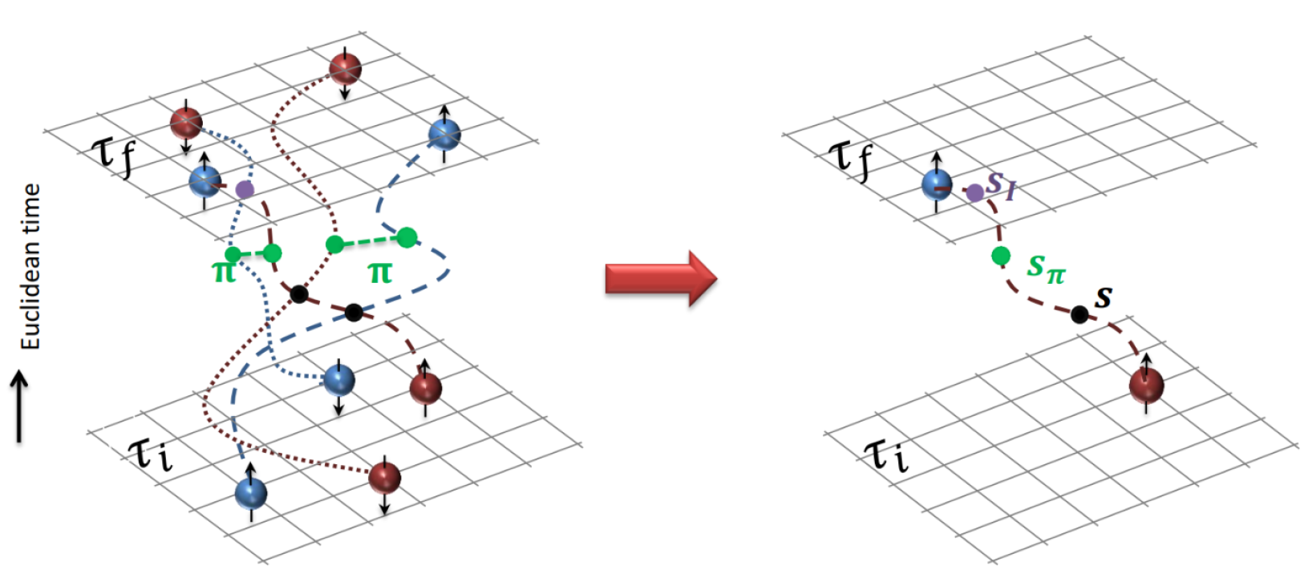
Auxiliary Field Monte Carlo
Transform transfer matrix via Gaussian integral of auxiliary fields
Interacting nucleons
Nucleons interacts with auxiliary fields
(no direct interaction
between nucleons)
computing fermion
Correlator amplitude
Integration
over auxiliary fields
M.C. integral
(sampling auxiliary field)

Slide 6
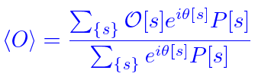


Auxiliary Field Monte Carlo
Auxiliary field integration → M.C. Sum of Auxiliary Fields Samplings
Probability and Phase factor
Sign oscillation from complex phase factor
→ Major limitation in practical calculation.

Slide 7
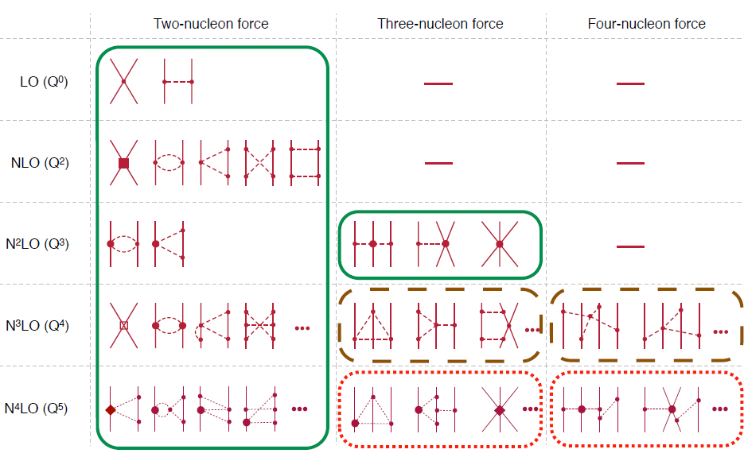
Chiral Effective Field Theory

Slide 8
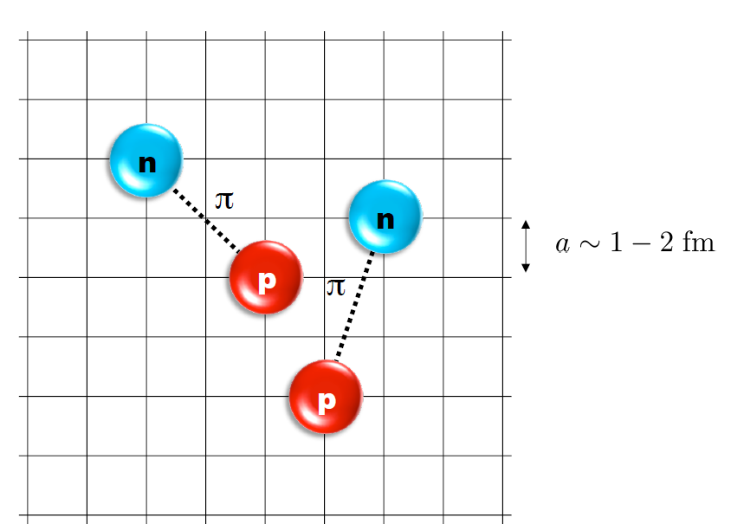
Lattice Hamiltonian
However, one cannot simply adopt the chiral interaction in continuum into lattice.
momentum space cutoff ~ 150 MeV → lattice spacing a= 1.316 fm
Time cutoff ~ 1000 MeV
We need to determine coefficients of interaction for the lattice size. (regularization scale.)
Two-body interaction coefficients can be determined from phase shifts of np scattering.
Three-body interaction can be fixed from binding energy of A>=3.

Slide 9
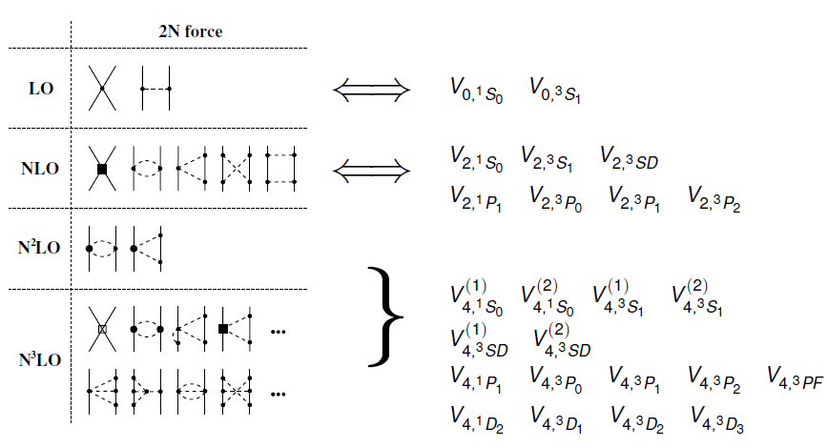
Lattice chiral Hamiltonian (N3LO)

Slide 10
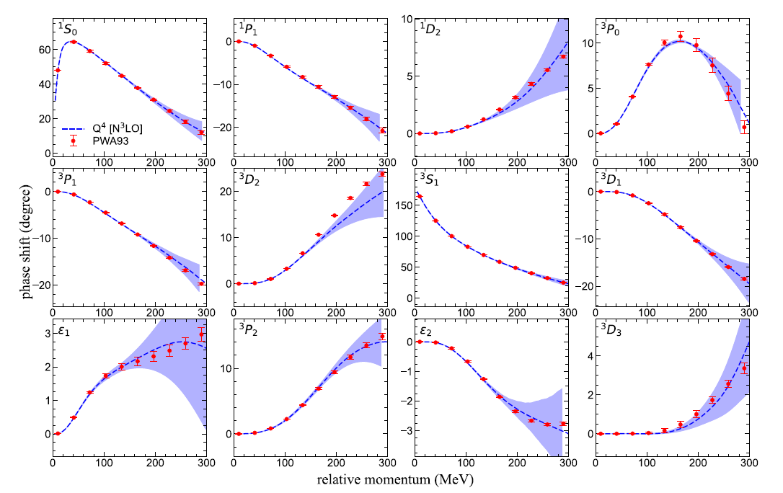
Lattice chiral Hamiltonian (N3LO)
Determine
Higher order NN
interaction
From the
phase shifts of NN scattering.

Slide 11
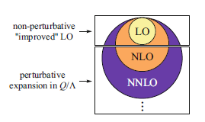
Lattice chiral Hamiltonian (N3LO)
Full N3LO Hamiltonian includes
Free Hamiltonian(Kinetic term)
Short range (nonlocal smeared) contact interactions up to Q^4 order
Isospin-breaking short range interactions
One pion exchange potential
Two pion exchange potential up to Q^4 order
Coulomb interaction
Long range isospin breaking interaction( isospin dependence in OPE)
Galilean Invariance Restoration (GIR) term (because of non-local interaction.)
Three nucleon interaction
Severe Sign problem
need to reduce the sign problem

Slide 12
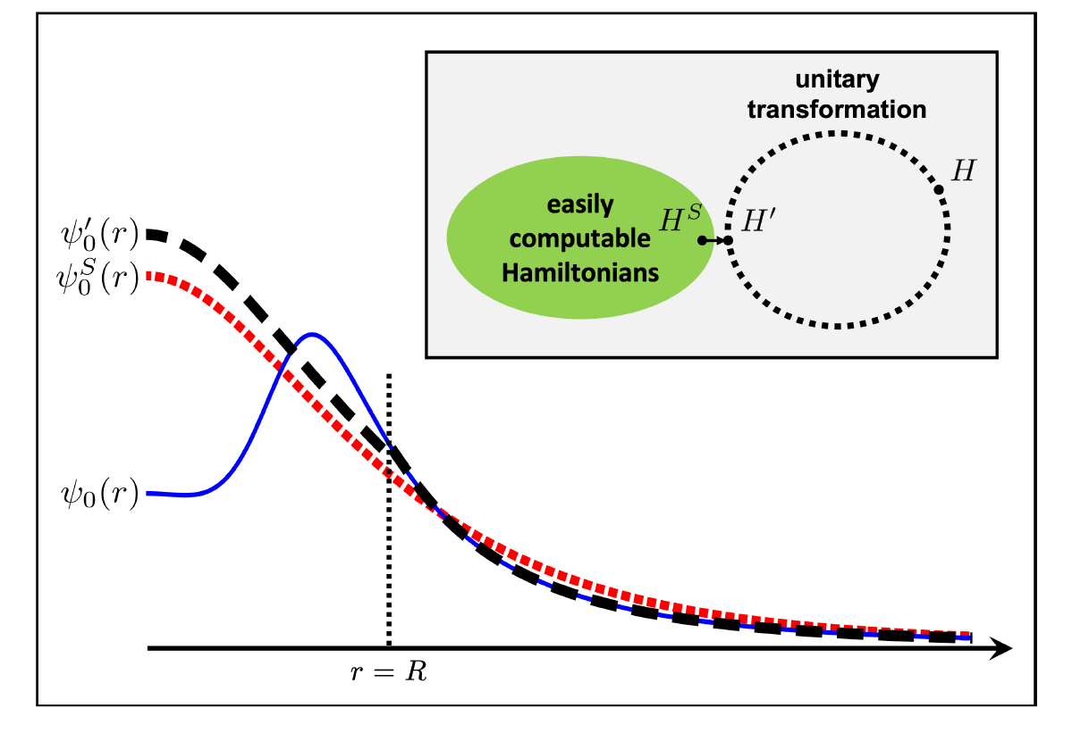




Wave function matching
H and H’ are fully equivalent to two-body observables
The goal is to make the perturbation expansion from “simple” wave function gives a good convergence
U is only active
At r < R
Two potentials V_A and V’_A are unitarily equivalent.
Same phase shifts.
H’_A has eigenvectors of H_B, but eigenvalues of H_A

Slide 13

Wave function matching Hamiltonian
N3LO Hamiltonian
V_2N : short range NN interactions
W_2N: GIR restoration term for V_2N
V_2N,WFM : difference from H’-H
W_2N,WFM: GIR restoration correction to V_2N,WFM
V_3N : contains short range 3N interaction parameters(to be fitted)
and two pion exchange correction to 3N

Slide 14
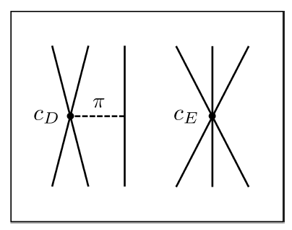


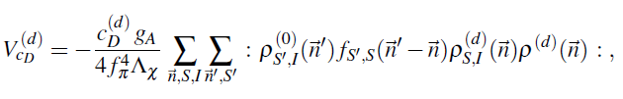
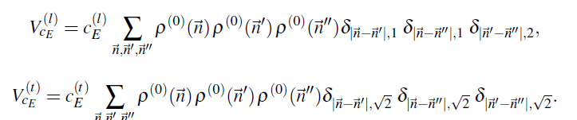





3-body force
NNLO
At N3LO:
TPE and
Adjustments to
cD and cE terms.

Slide 15
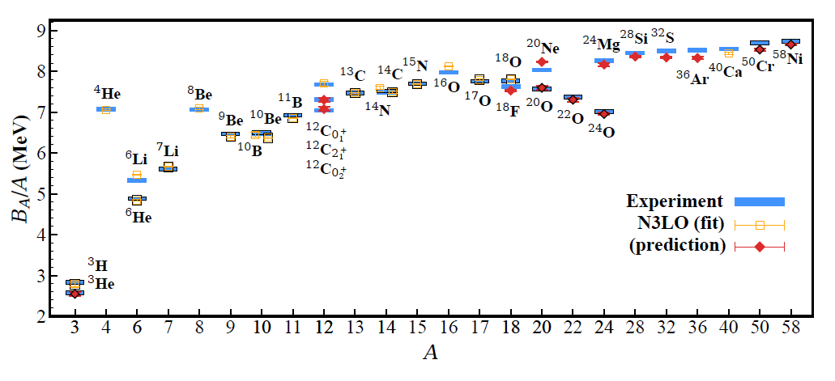
BE/A from WFM
RMSD ~ 0.1 MeV per nucleon

Slide 16
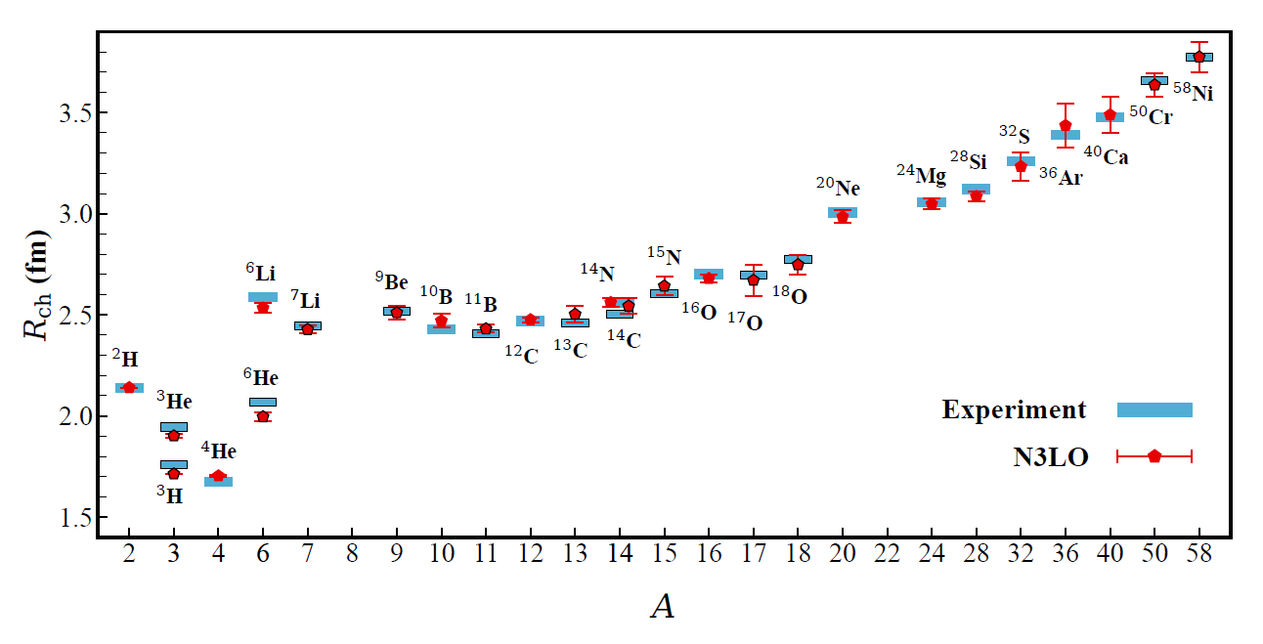
Charge Radius
No fitting! RMSD~ 0.03 fm

Slide 17
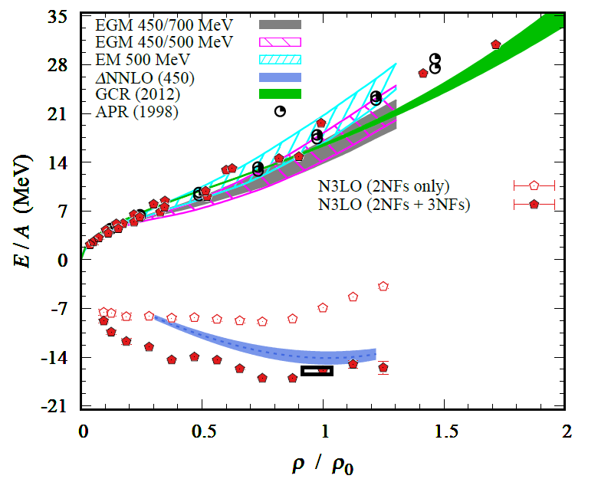
Nuclear/Neutron Matter
Neutron matter:
A=4~80
box size 6.6 ~ 13.2 fm.
Nuclear matter:
A=4 ~ 160
Box size 7.92~9.24 fm.
Uncertainties from
finite system size correction

Slide 18
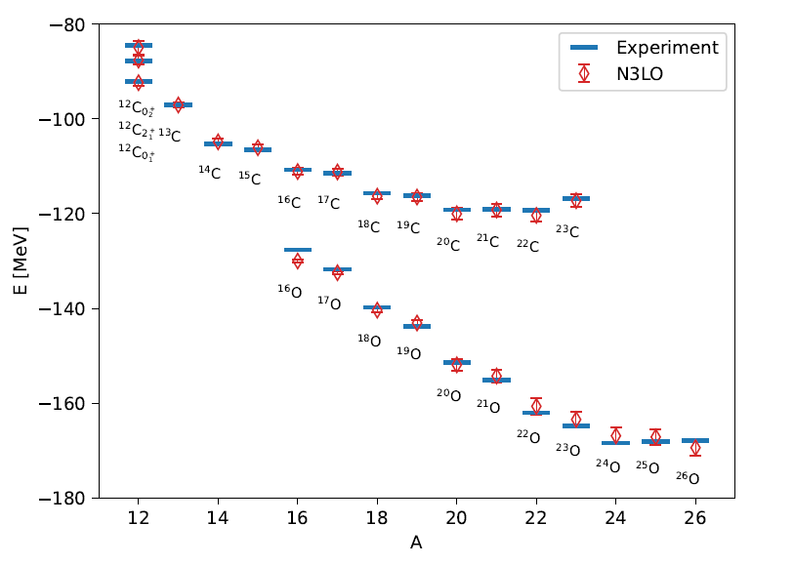
Carbon and Oxygen

Slide 19
Carbon isotopes (Lt=200)

Slide 20
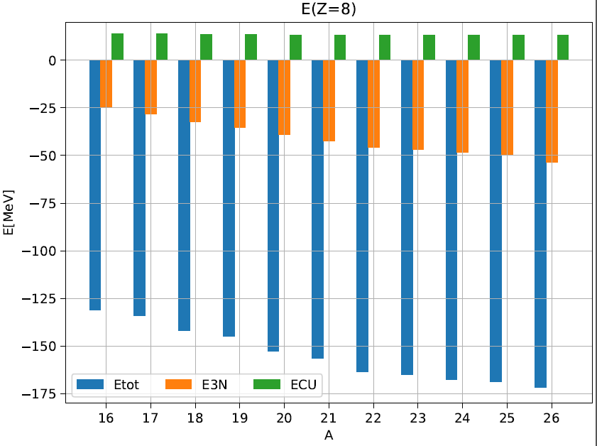
Oxygen isotopes (Lt=200)

Slide 21





Measure of correlation
among extra neutrons
A(1,Tz) is a two nucleon annihilation operator
which gives isospin change by (1, Tz)
f(-1) : two proton operators ( two-body interaction) expectation value
f(0) : proton-neutron two-body interaction expectation value
f( 1) : two neutron operators ( two-body interaction) expectation value

Slide 22

Measure of correlation
among extra neutrons
If each of extra neutrons are uncorrelated with each other
Additional correlations produced by extra neutrons will be additive.
(only correlation with core neutrons )
→ Difference between left and right is
a measure of correlation between additional neutrons.

Slide 23
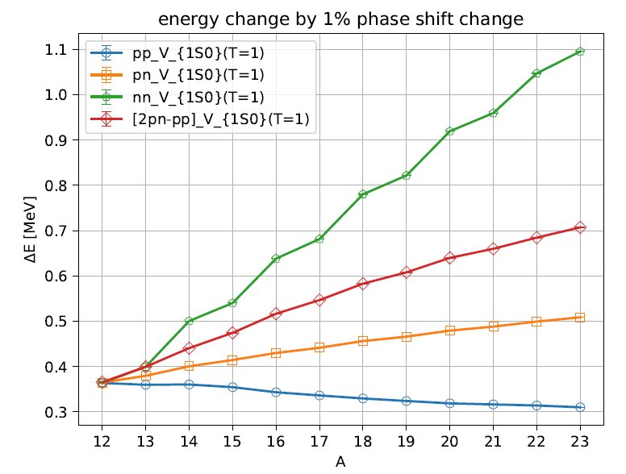
LEC(or phase shift fit) dependence (Lt=200)
1% Phase shift change
At p=150 MeV in 1S0
Z= 6
<pp1S0>
→ near constant
<nn1S0>
→ strong correlation among paired neutrons
Adding unpaired
one neutron
gives similar
slope for
<nn> and <2pn-pp>
Unpaired neutron
correlation with
core nucleons.

Slide 24
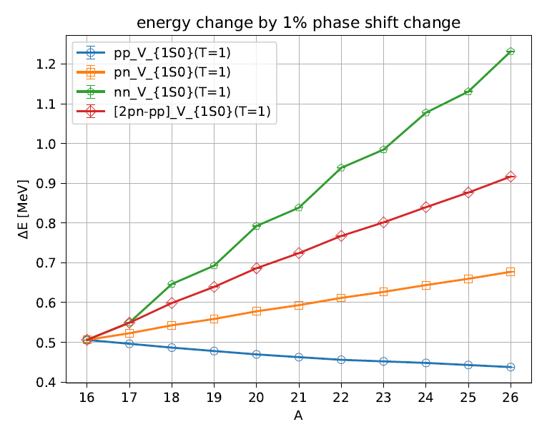
LEC(or phase shift fit) dependence (Lt=200)
Z= 8

Slide 25
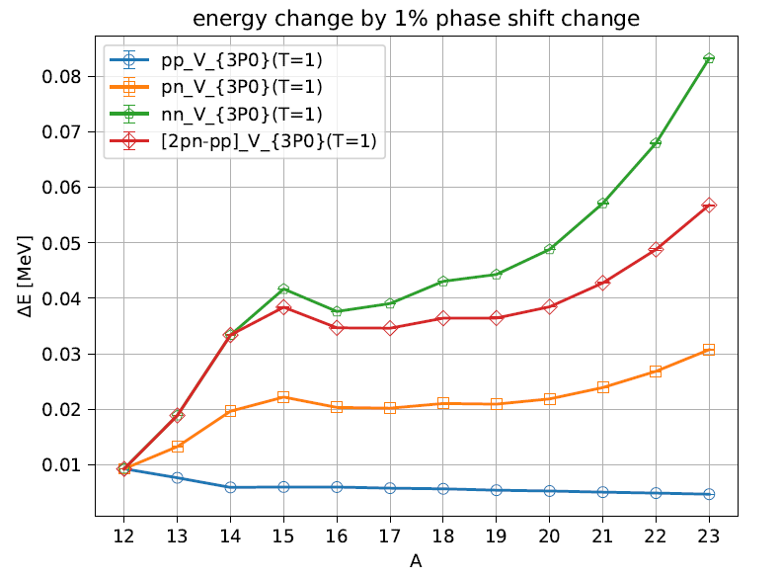
LEC(or phase shift fit) dependence (Lt=200)
<pp 3P0> decrease faster
than <pp 1S0>
→ Correlation between alpha clusters may become weaker
Z= 6

Slide 26
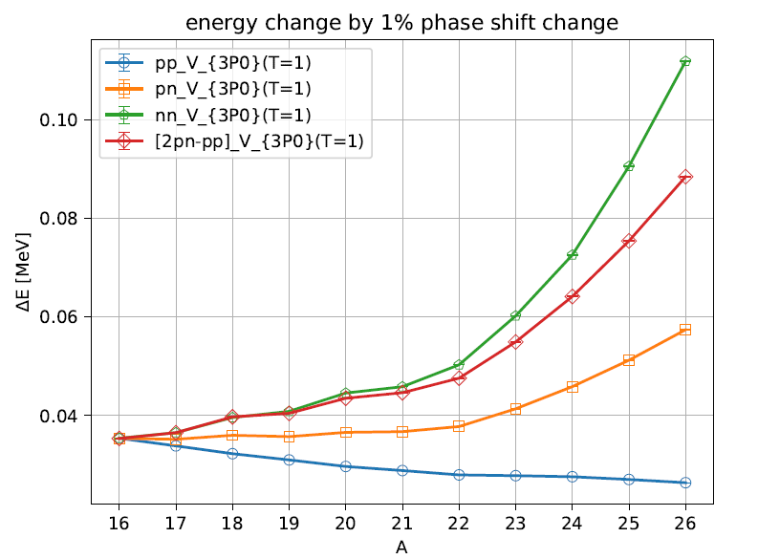
LEC(or phase shift fit) dependence (Lt=200)
Slope change in 22O
→ closure of 1d5/2 subshell
Z= 8

Slide 27
Summary
Wave function matching method seems to be promising
Carbon, Oxygen isotope up to dripline shows good agreement with experimental data
systematic error(finite volume effects) estimation may be necessary.
Additional neutrons in 1S0 have strong pairing correlation
Unpaired neutrons correlated primarily to the nuclear core.

Slide 28
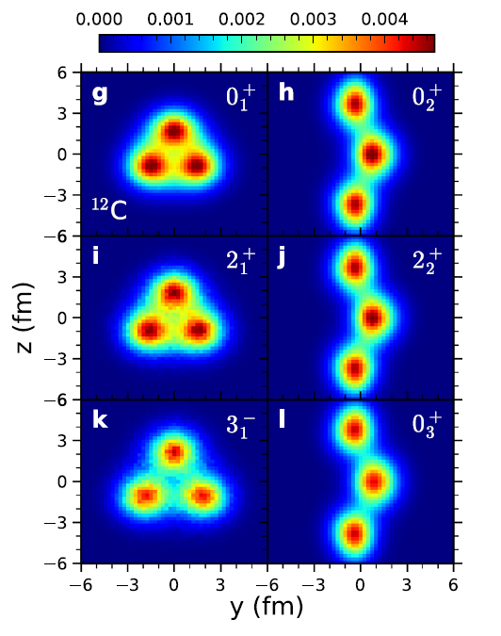
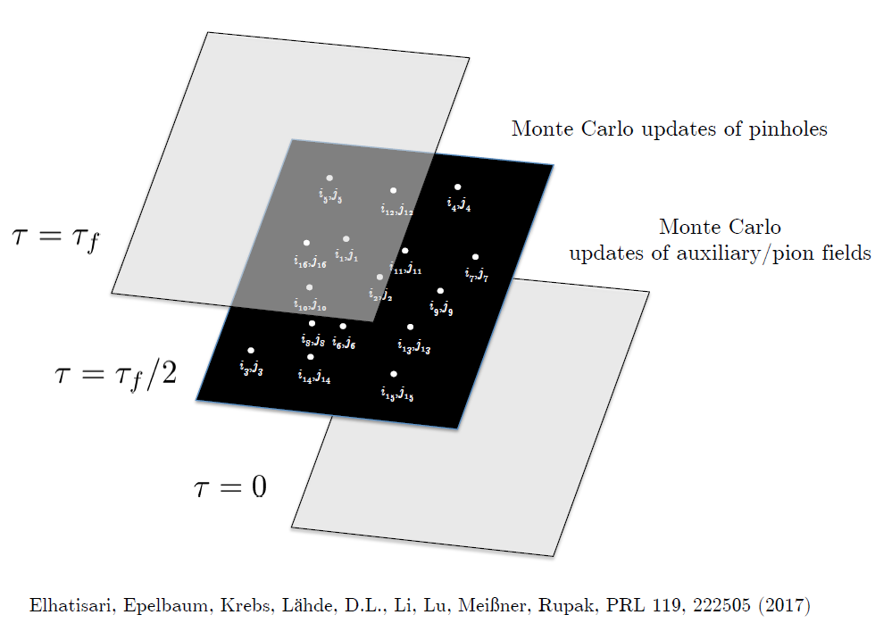
Neutron correlations in density
Charge density, Radius
Nuclear Clustering
Pinhole algorithm
SS et al. Nature Communications (2023) 14:2777

Slide 29
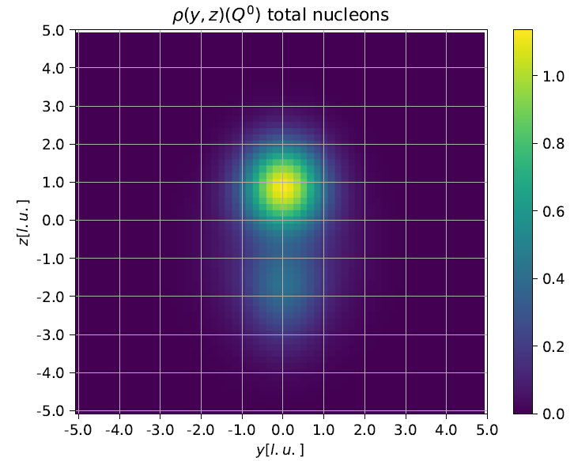
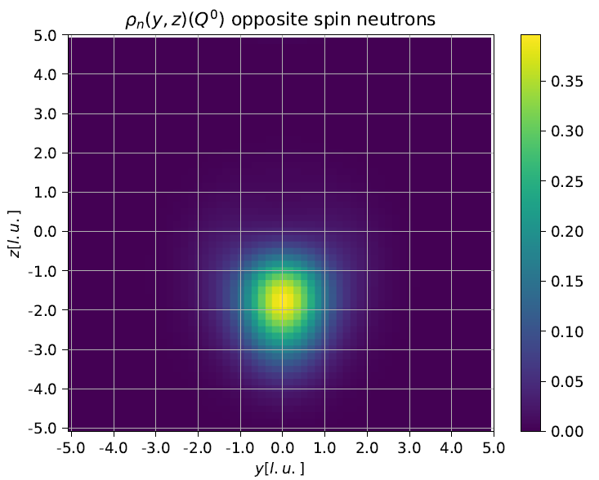
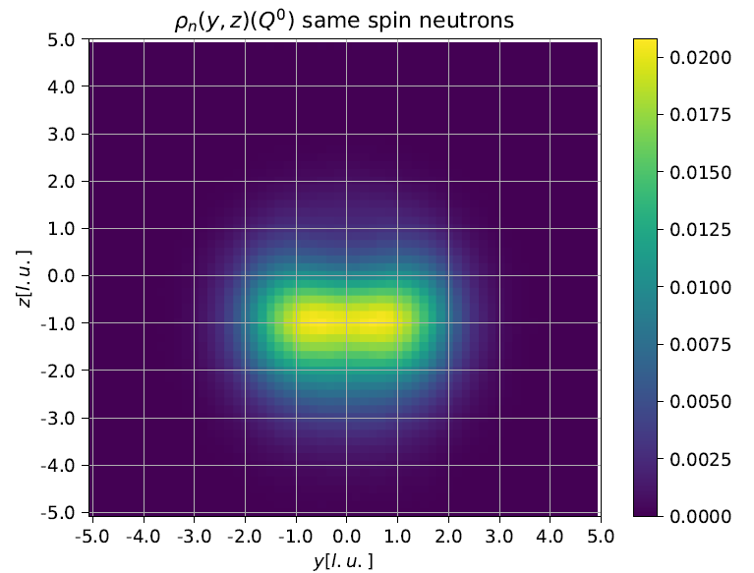
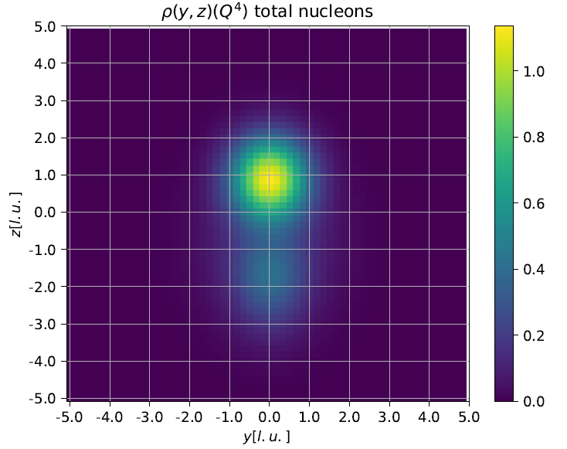
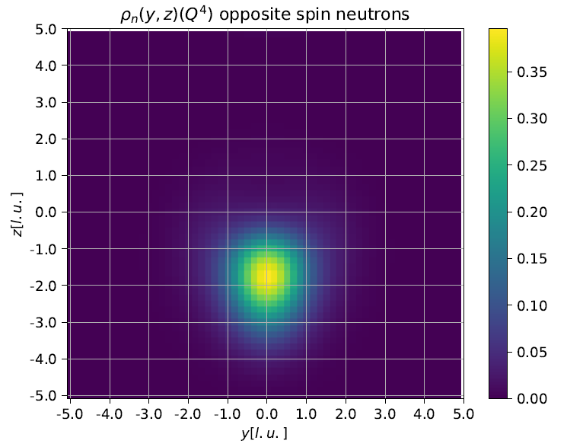
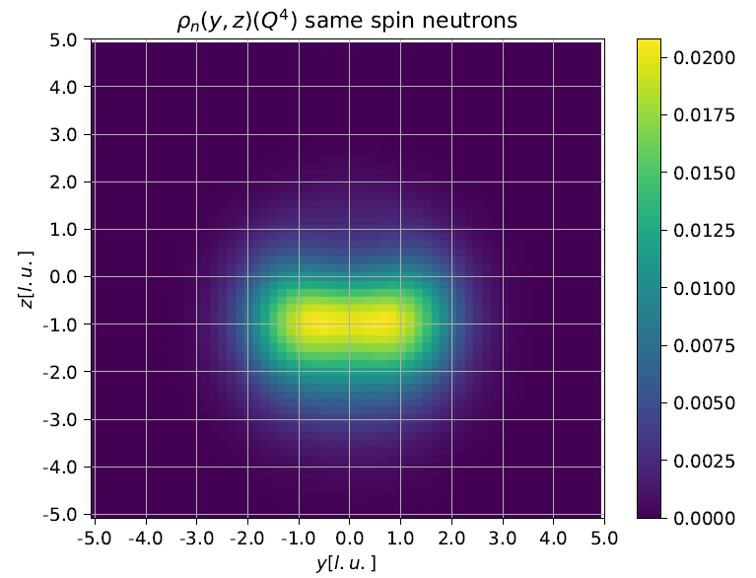
6He pinhole calculation( SU4 “essential”)

Slide 30
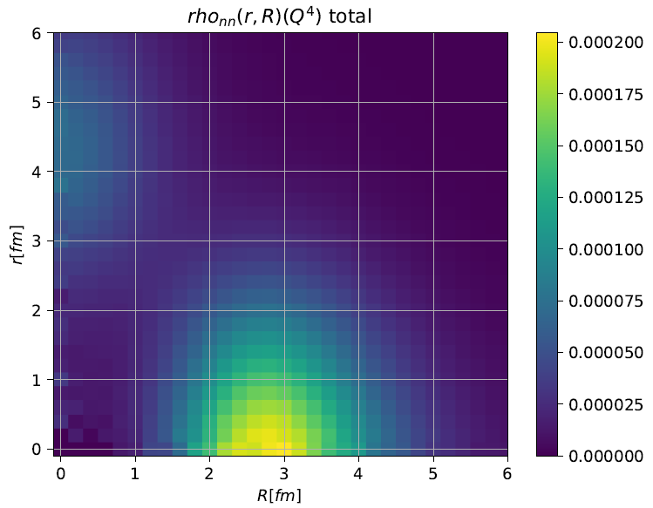
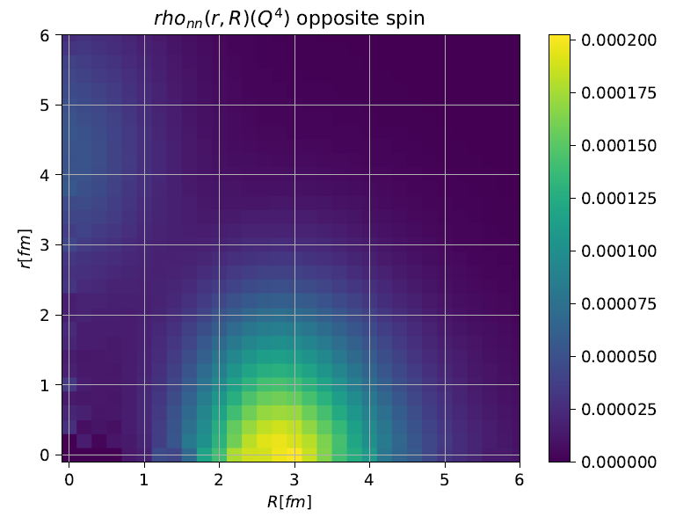
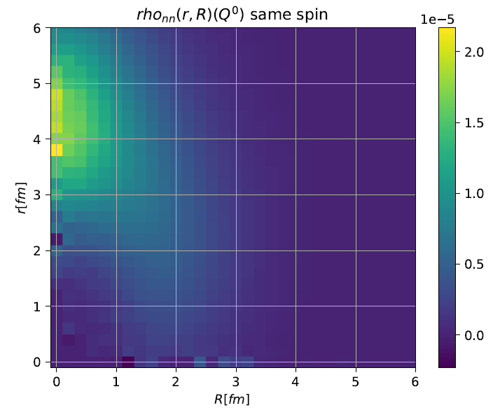
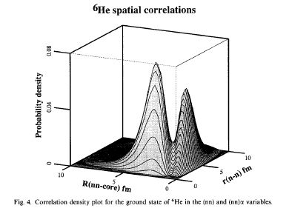
6He pinhole calculation( SU4 “essential”)

Slide 31
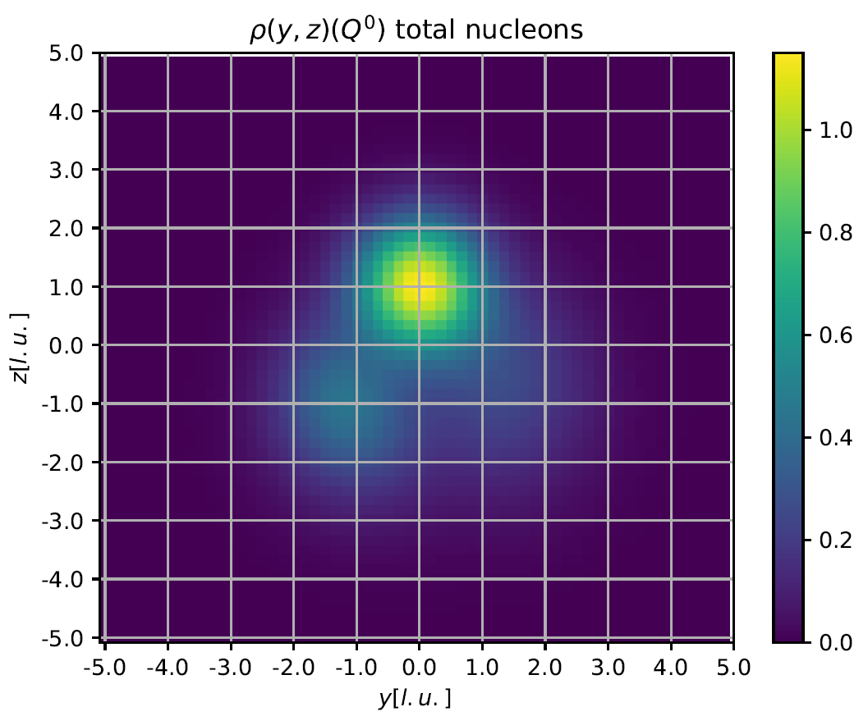
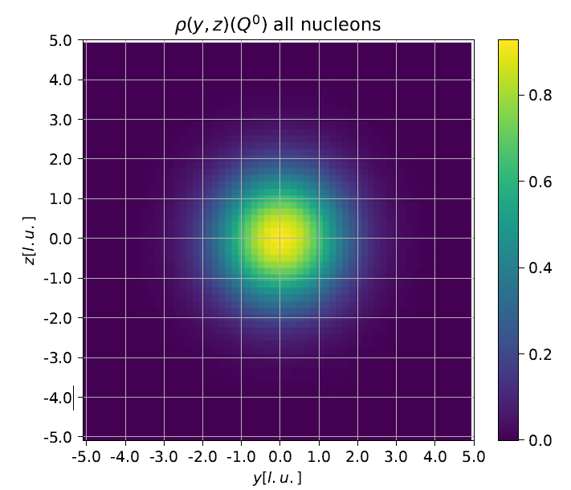
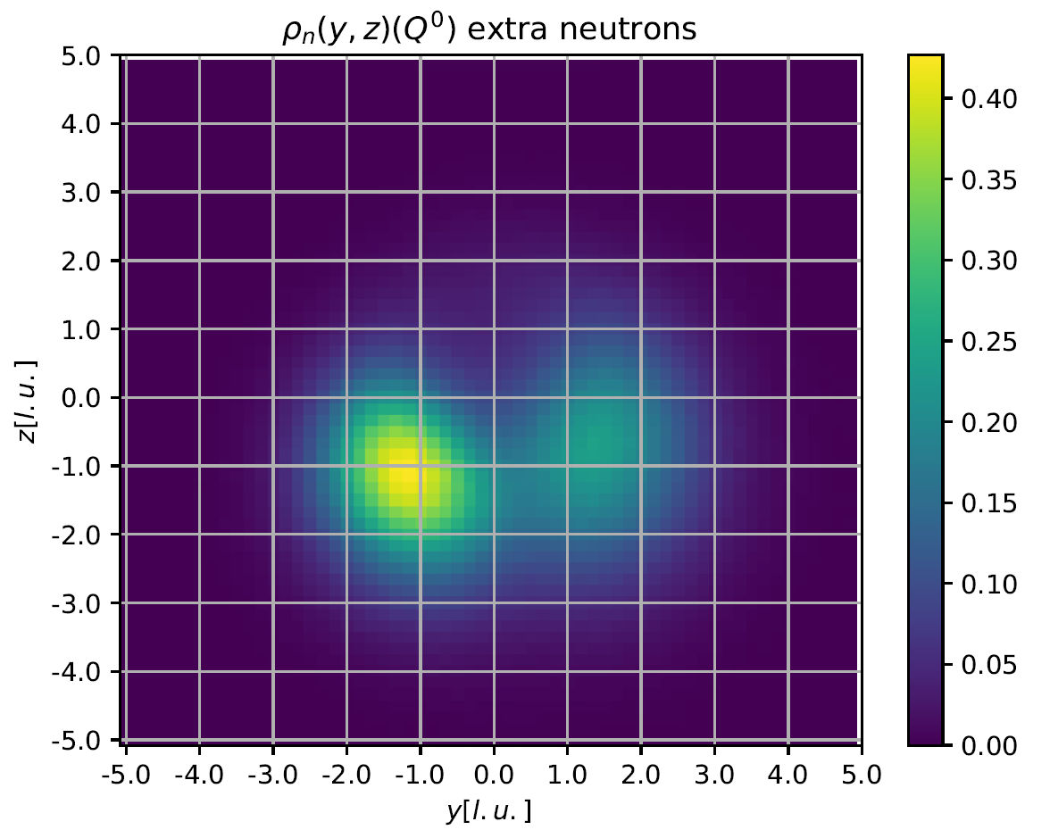
8He pinhole calculation

Slide 32

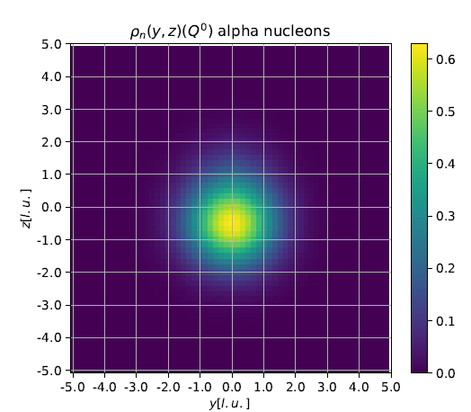
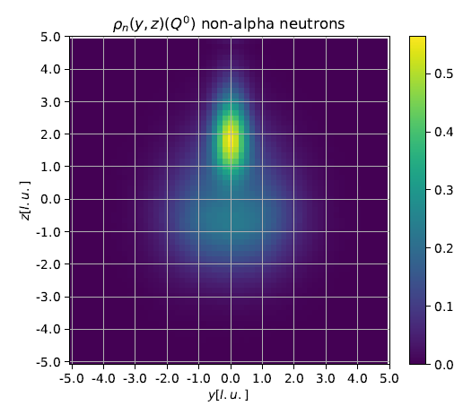
8He pinhole calculation
At Lt=0, pinhole accpentance of 3 spin up 3 spin down neutrons ~ 0.5

Slide 33
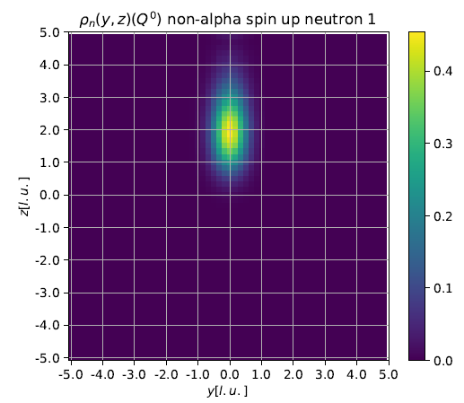
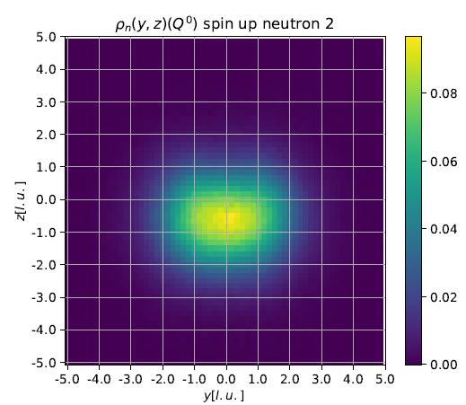
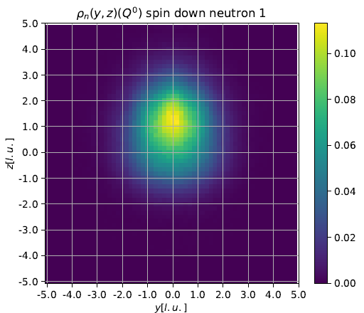
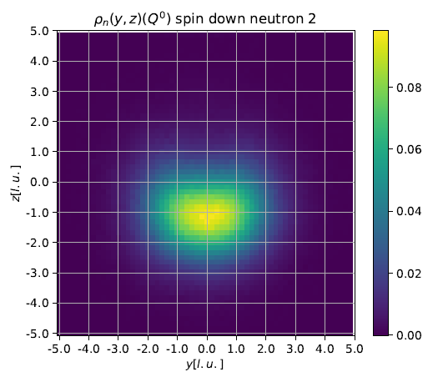
8He pinhole calculation

