Slide 1

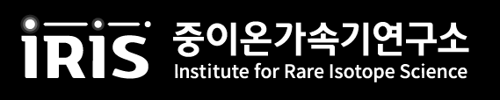
Neutron correlations in Helium isotopes
  Young-Ho Song (IRIS, IBS),
  Yuanzhuo Ma(FRIB,MSU) and Dean Lee(FRIB,MSU)
  2026.09.15. JPS meeting, University of Tokyo

Slide 2
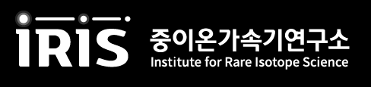
OUTLINE
Introduction
  Multimodal Superfluidity of Neutrons
No core shell model analysis
  Daejeon16 interaction
  Partial wave contributions in 3-point energy difference
  Attractive rank
  Four-body cumulants
Summary
Based on
Young-Ho Song, Yuan-Zhuo Ma, Dean Lee
‘Evidence for Quartet Binding of Valence Neutrons in 8He’
arXiv:2608.25883

Slide 3
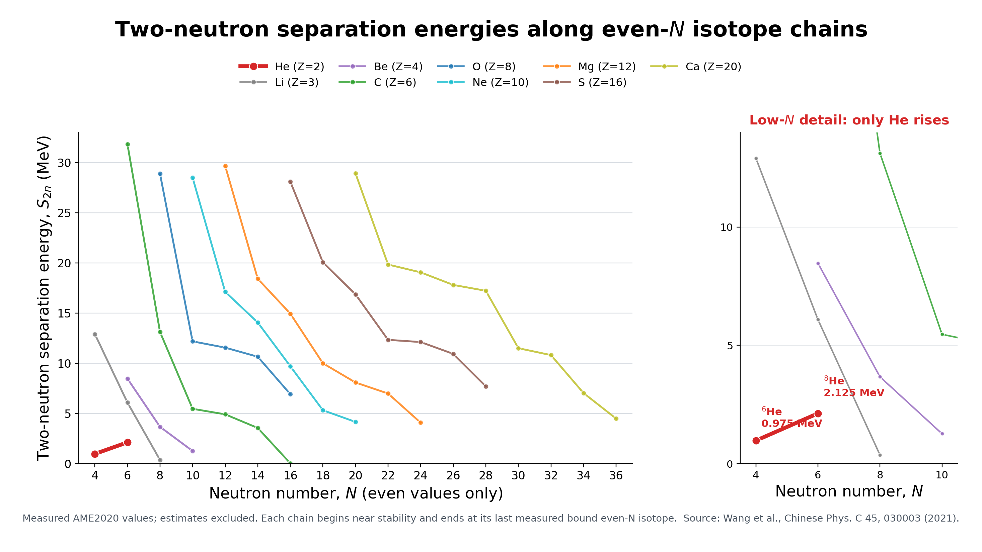
Introduction
8He
  Only neutron rich light nuclei which shows binding of neutron pairs increase
  with additional neutron pairs
Simplest explanation :
Shell closure at (0p3/2) orbit
But, there may be something more.
→ pairing structure of neutrons

Slide 4
Multimodal superfluidity
Conventional picture
  Nuclear binding exhibits strong neutron-pairing correlations
  Neutron superfluidity is often described by one dominant pairing mode
Multimodal neutron superfluidity
  spin-singlet s-wave pairs
  p-wave pairs
  Quartets formed as bound states of two s-wave pairs
Motivating question
  Could the four valence neutrons of ⁸He realize a finite-system analogue?
Y.-Z. Ma et al., arXiv:2602.17611 (2026), “Evidence for Multimodal Superfluidity of Neutrons”,
Notes:
How might we interpret the enhanced binding of the second neutron pair in helium-8?
Pairing is, of course, familiar in nuclear physics. In finite nuclei, pairing produces characteristic binding-energy effects, while in extended neutron matter it leads to superfluidity. Conventionally, we often describe such a system in terms of one dominant pairing mode.
Recent work by Ma and collaborators proposes a richer phase called multimodal neutron superfluidity. In their calculations, several correlated structures coexist: spin-singlet s-wave pairs, p-wave pairs appearing in entangled double-pair combinations, and neutron quartets that can be viewed as bound states of two s-wave pairs.
This result concerns extended neutron matter, so we should not identify it directly with helium-8. Instead, it motivates a question: could the four valence neutrons of helium-8 realize a finite-system analogue of the same quartet-binding mechanism?
To investigate that question, we will use a different ab initio framework—the no-core shell model.

Slide 5
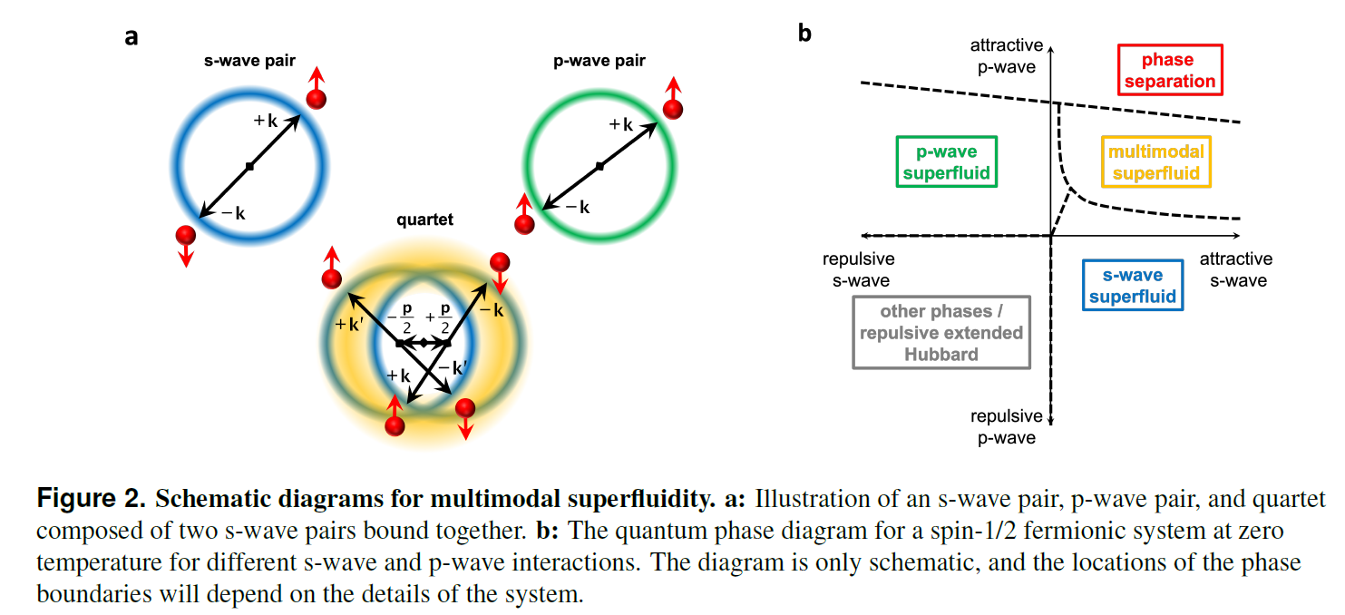
Multimodal superfluidity of neutrons
Yuan-Zhuo Ma et al, “Evidence for Multimodal Superfluidity of Neutrons”,
arXiv:2602.17611
Notes:
This figure summarizes the concept of multimodal superfluidity.
On the left are the relevant correlated structures. We have the familiar spin-singlet s-wave pair, a p-wave pair, and a quartet composed of two s-wave pairs bound together.
The schematic phase diagram on the right shows what happens as the s-wave and p-wave interactions are varied. With attraction in only one channel, the system may favor an ordinary s-wave or p-wave superfluid. When both interactions provide sufficient attraction, an intermediate region appears in which several modes coexist—the multimodal-superfluid phase.
The precise phase boundaries are model dependent. The important point for this talk is that the quartet is not an isolated four-neutron state. It is a correlated structure embedded in a many-body system together with pair correlations.

Slide 6
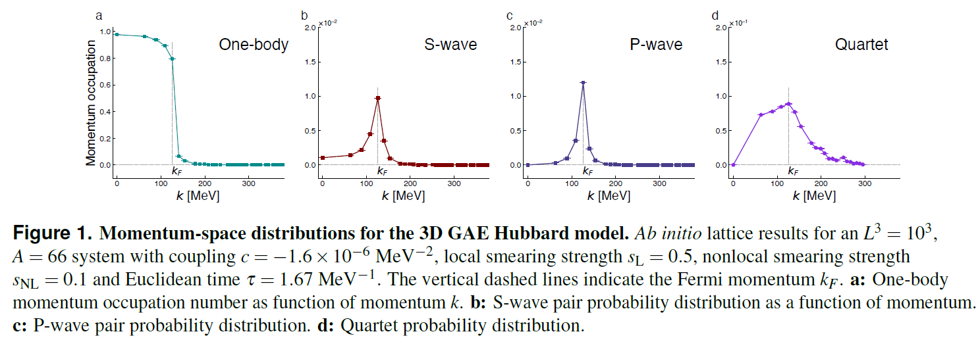
Multimodal superfluidity of neutrons
generalized attractive extended (GAE) Hubbard model in 3D lattice
Yuan-Zhuo Ma et al, “Evidence for Multimodal Superfluidity of Neutrons”,
arXiv:2602.17611
Notes:
The authors first demonstrate this behavior in a generalized attractive extended Hubbard model on a three-dimensional lattice.
Panel a shows the one-body momentum distribution and the location of the Fermi momentum. Panels b and c show nonzero s-wave and p-wave pair distributions, while panel d shows a substantial quartet distribution.
These signals occur simultaneously in the same calculated ground state. Therefore, the system cannot be characterized adequately by only one pairing channel.
This model provides a controlled demonstration of the mechanism, but it is still a generic fermionic lattice model. The next question is whether the same qualitative structure survives for a realistic neutron interaction.

Slide 7
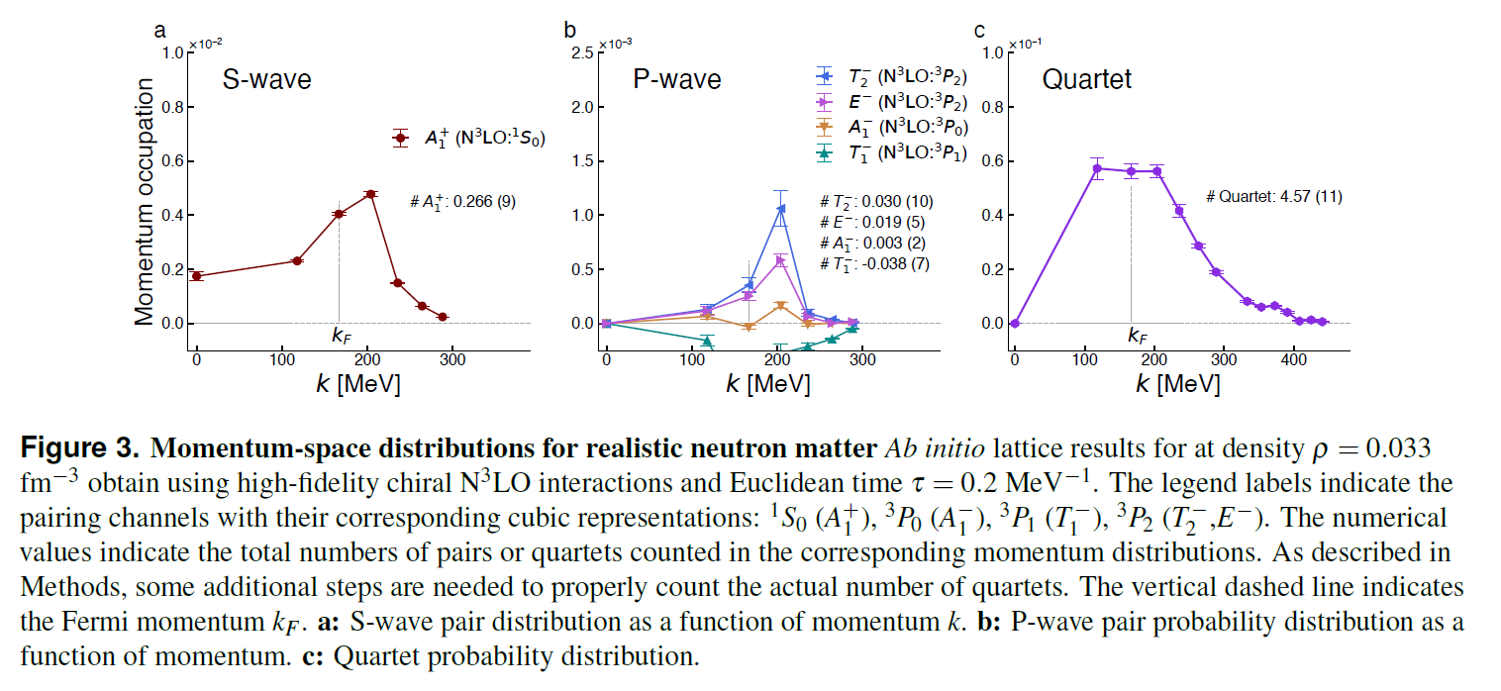
Multimodal superfluidity of neutrons
Realistic ab initio NLEFT interaction in 3D lattice
Yuan-Zhuo Ma et al, “Evidence for Multimodal Superfluidity of Neutrons”,
arXiv:2602.17611
Notes:
Here, the calculation is repeated for neutron matter using a realistic ab initio nuclear-lattice interaction.
The three panels show the momentum distributions associated with s-wave pairing, several p-wave pairing channels, and quartets. All three sectors exhibit nonzero correlated strength. This demonstrates that the multimodal pattern is not restricted to the generalized Hubbard model; it also appears in the realistic neutron-matter calculation.
This result provides the conceptual motivation for our study of helium-8. However, helium-8 is a finite nucleus, so we should not describe it as possessing a thermodynamic superfluid phase or a condensate.
Instead, we ask a more limited question: do its four valence neutrons display a finite-system binding mechanism related to the pair and quartet structures seen here? We now examine that question using no-core shell-model calculations.

Slide 8
Scope and method
Scientific question
  Do the four valence neutrons in ⁸He exhibit a finite-system analogue of quartet binding?
Method
  Ab initio no-core shell-model calculations of ⁴He, ⁶He, and ⁸He
  Daejeon16 nucleon–nucleon interaction plus Coulomb interaction
  Two-body matrix elements: NuHamil (T. Miyagi, EPA J59, 150 (2023). )
  Many-body diagonalization: BIGSTICK (C. W. Johnson et al, CPC 184, 2761 (2013) )
Why this framework?
  An independent, non-lattice test of the proposed mechanism
Interpretation and limitations
  A neutron quartet is not a free tetraneutron
  We study correlations and a binding mechanism—not a distinct bound quartet state
  Conclusions are specific to the Daejeon16 NCSM calculation
  Continuum asymptotics are not treated explicitly
Notes:
Before presenting the calculation, let me clarify its scope.
We ask whether the four valence neutrons of helium-8 exhibit a finite-system binding mechanism analogous to the neutron quartets found in multimodal neutron superfluidity.
We calculate helium-4, helium-6, and helium-8 consistently within the ab initio no-core shell model. We use the Daejeon16 two-nucleon interaction together with the Coulomb interaction. The two-body matrix elements are generated with NuHamil, and the many-body calculations are performed with BIGSTICK.
This framework gives us an independent, non-lattice test of the proposed mechanism. Daejeon16 is particularly useful because its comparatively rapid convergence makes calculations in large model spaces feasible. Nevertheless, convergence remains demanding for halo nuclei, and the harmonic-oscillator basis does not describe continuum asymptotics explicitly.
I also want to emphasize what we mean by a neutron quartet. It is not a free tetraneutron state in vacuum. Here, it refers to a correlated four-neutron structure embedded in a nucleus.
Therefore, our results should be interpreted as evidence about a binding mechanism and connected correlations—not as direct observation of a separate bound quartet. The conclusions are also specific to the Daejeon16 NCSM calculation and do not establish interaction independence.

Slide 9
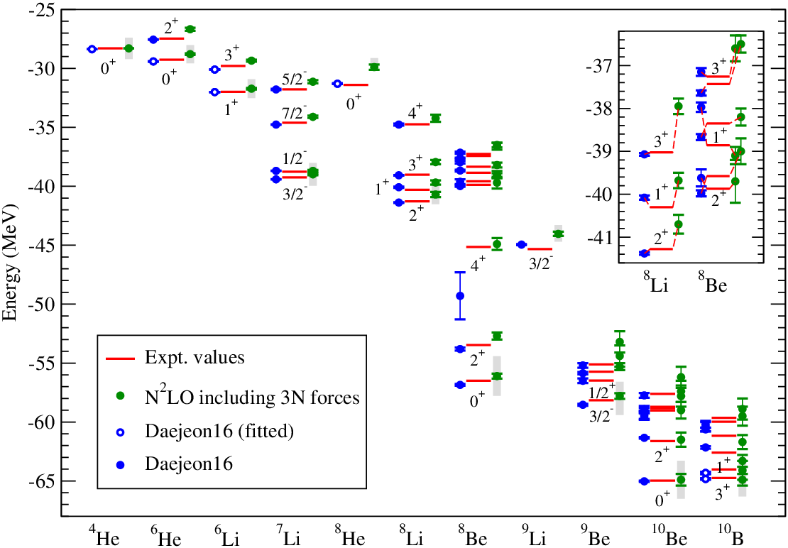
Daejeon 16 interaction
Daejeon 16 (A. M. Shirokov et al, Phys. Lett. B 761, 87 (2016))
  Based on SRG evolved chiral N3LO interaction
  Phase Equivalent transformation
  Adjusted to light nuclei
  Good Nmax convergence behavior
  Good binding energy prediction without explicit 3-body force
https://arxiv.org/html/1908.00155v1

Slide 10
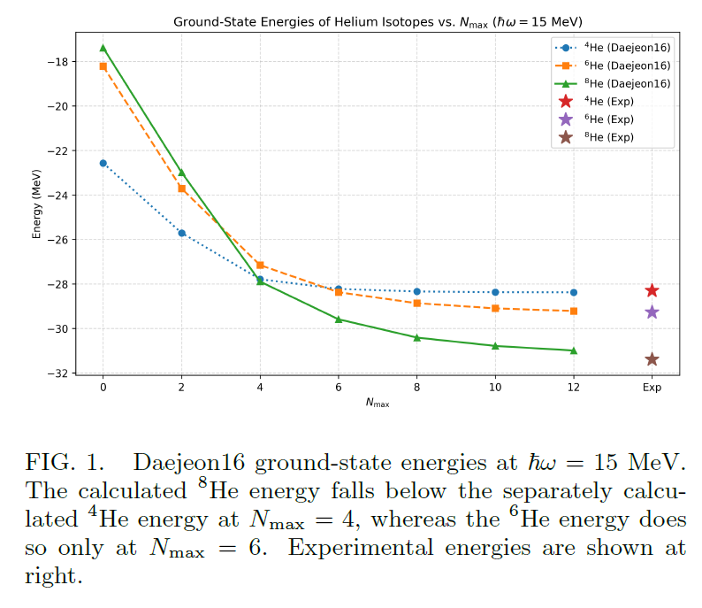




Three point energy difference
Second mass difference
Simple independent particle model
Or
Simple additive pairing model
Nonzero value quantifies nonlinearity
w.r.t. neutron numbers

Slide 11
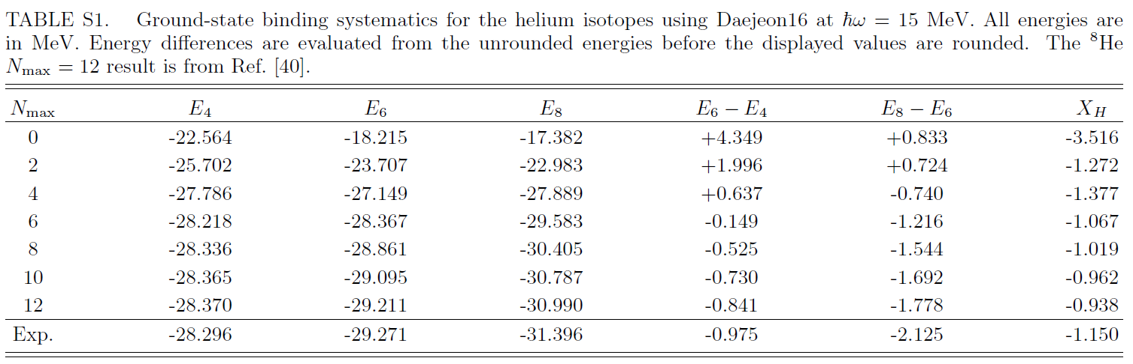
Three point energy difference

Slide 12
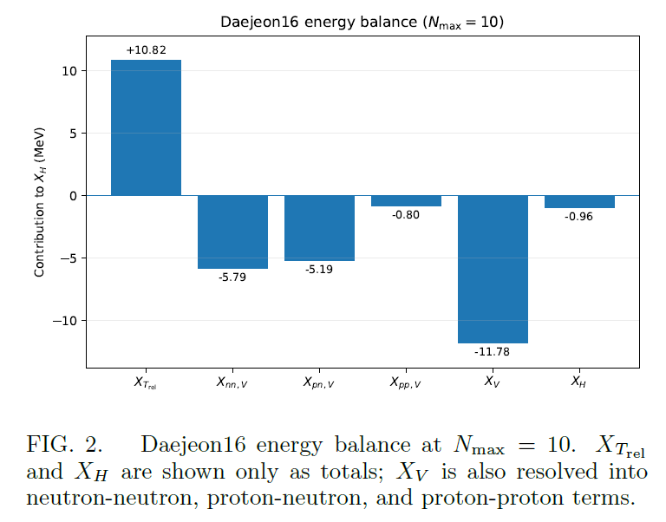
Anatomy of Energy
X_H is a residual of large cancellation
Both pn interaction and nn interaction are significant in X_H
X_H < 0 alone does not give much information on the structure.

Slide 13


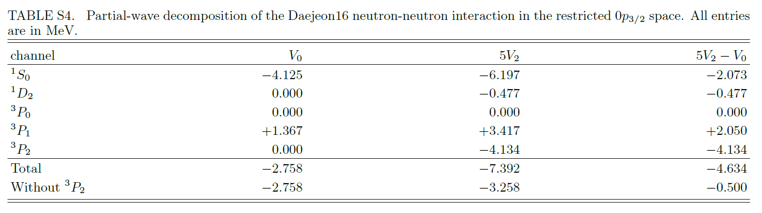
Restricted (0p3/2) model
n = 0, 2, 4 (0p3/2)^n
Allowed neutron pair J = 0 and J=2
nn interaction is the major source of the Nmax=0 X_H
Restricted (0p3/2) model is close to X_nnV at Nmax=10

Slide 14
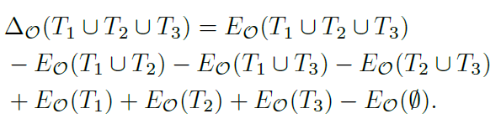
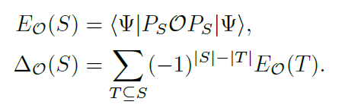

Subshell Cluster energy
S=(0p3/2) (size=1)
S= (size=3)
Sum of All S
Sum of other partial wave = -0.026 MeV

Slide 15
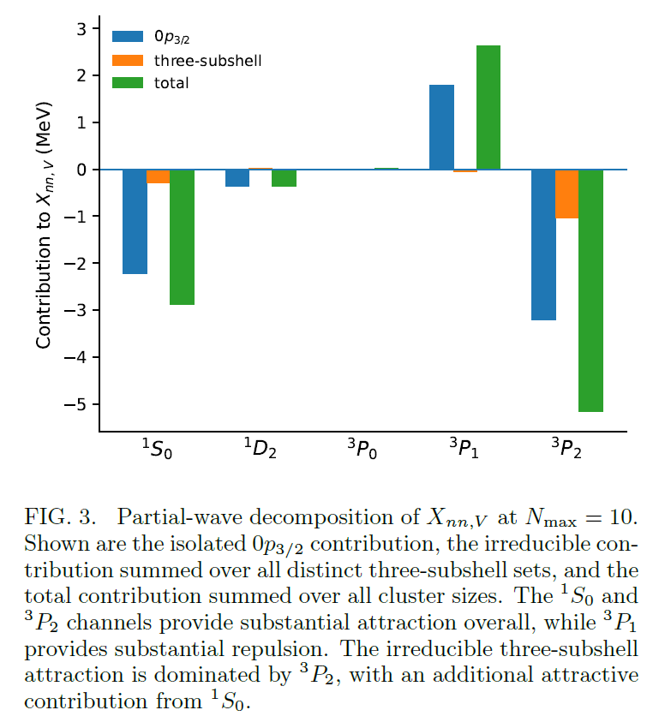
Subshell Cluster energy
Sum of other partial wave = -0.026 MeV
Importance of 3P2 attraction
spanning multiple subshells

Slide 16

Attractive rank
Attractive part of two neutron interactions
in the chosen model space
In chosen attraction threshold strength
Attractive rank = number of orthonormal eigenstates with sufficient attraction
Thus attractive rank is model dependent
It have to be counted after all attractions and repulsions
Depends on the choice of threshold strength

Slide 17



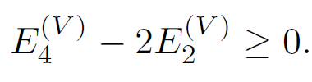
Attractive rank
If the interaction has strictly attractive rank one
→ There is a maximum attraction bound in four neutron system
→ From Pauli blocking
The lowest eigenvalue of attractive interaction in N-particle sector
(proof in arXiv:2608.25883 )
To have non-additive attraction of four neutrons, attractive rank have to be larger than one !
3P2 attraction provides this additional attraction.

Slide 18
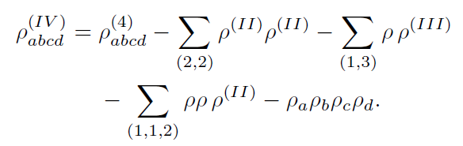
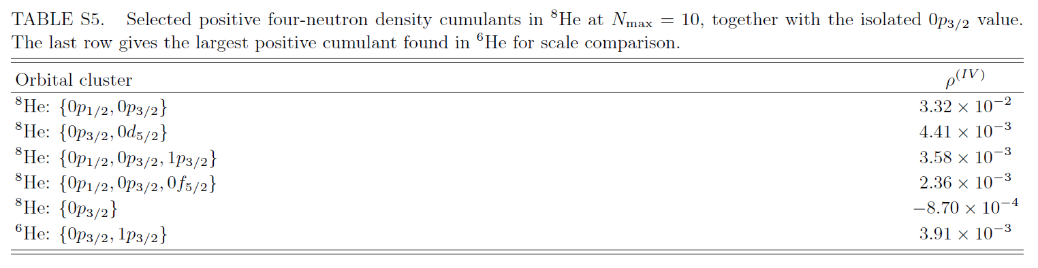
Four-body Cumulants
Irreducible four neutron s.p. density

Slide 19
Summary
We studied neutron sector of three-point energy difference in He-isotopes
X_H < 0 alone is not a signal of neutron quartet formation
Although not a direct evidence, we found signals supporting
the possibility of neutron quartet
  Negative X_H : non-additive binding along isotope chain
  1S0 and 3P2 are dominant source of attraction among neutrons
  Repeated use of one pairing structure is not enough for non-additivity
  3P2 provides additional attractive pairing structure
  Irreducible three-subshell 3P2 and four-body density cumulants
  → relevant four-neutron structure extends across multiple subshells
  Complementarily support possibility of quartet formation (two 1S0 pairing and additional attraction in 3P2 partial wave.)

Slide 20
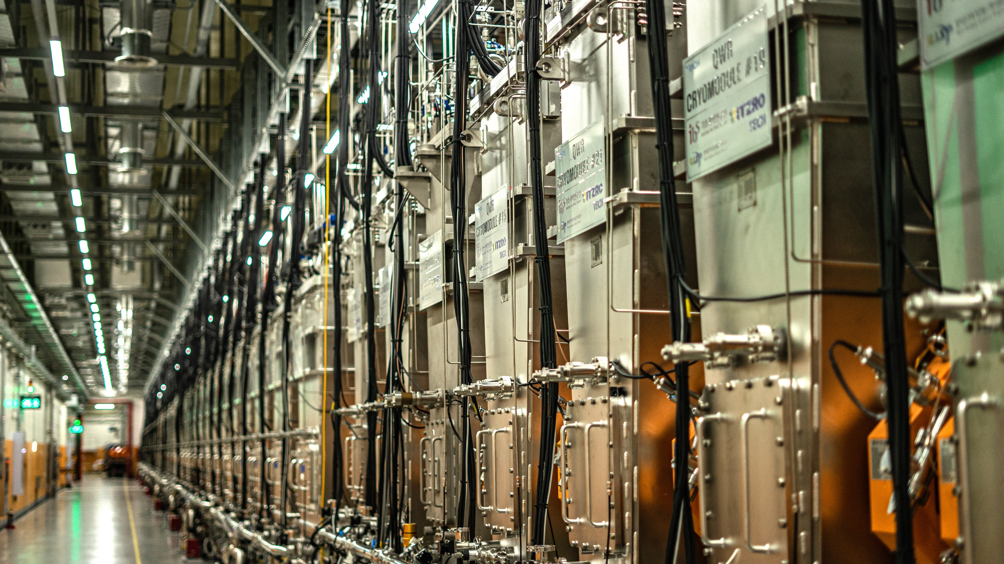
Thank You

