Slide 1



Oxygen isotopes in Nuclear Lattice Effective Field Theory
Young-Ho Song (RISP, IBS)
NLEFT collaboration
KPS meeting 2022.04.22, on-line

Slide 2
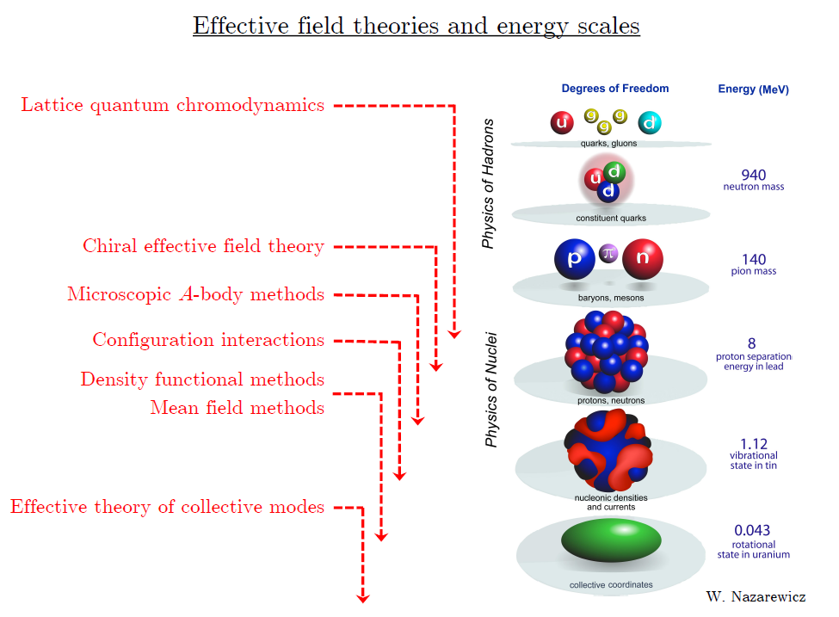
Ab initio approach
Ab initio
Nuclear
Theory
Direct understanding of nuclear force and
nuclear structure/reaction

Slide 3
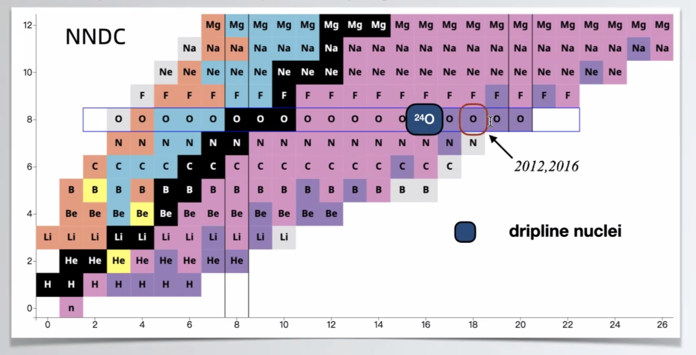
Oxygen isotopes
Can we explain the dripline of Oxygen isotopes?
Role of 3-body force?

Slide 4
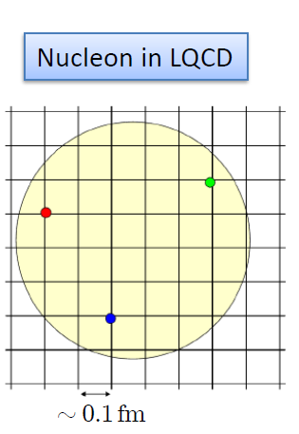

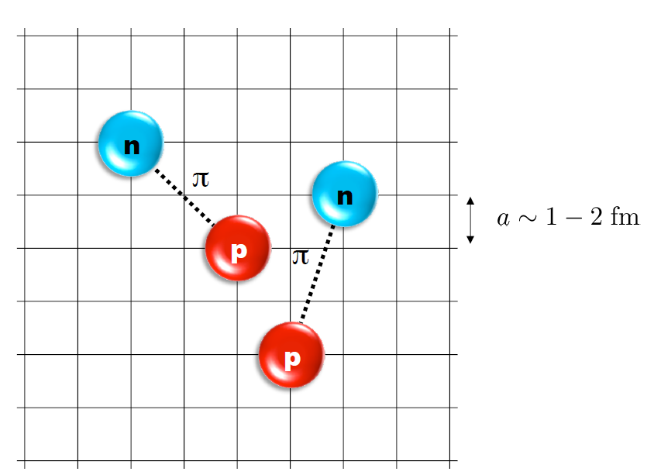
Nuclear Lattice Effective Field Theory
ab initio method for many fermion system

Slide 5
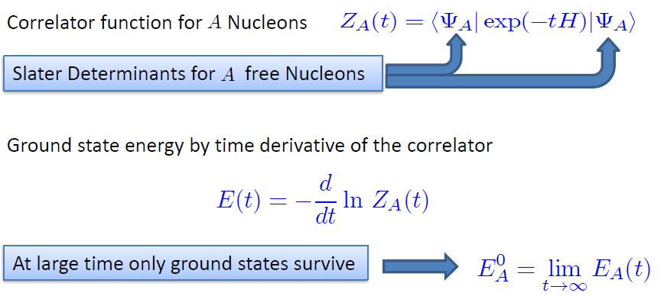
Path integral

Slide 6
Characters of NLEFT
NLEFT is not a molecular dynamics
→ fully quantum mechanical.
NLEFT does not require truncated basis expansions, many-body perturbation theory, or any constraints on the nuclear wave function. Regularization/Truncation is in the lattice spacing.
Alpha clustering emerges naturally.

Slide 7
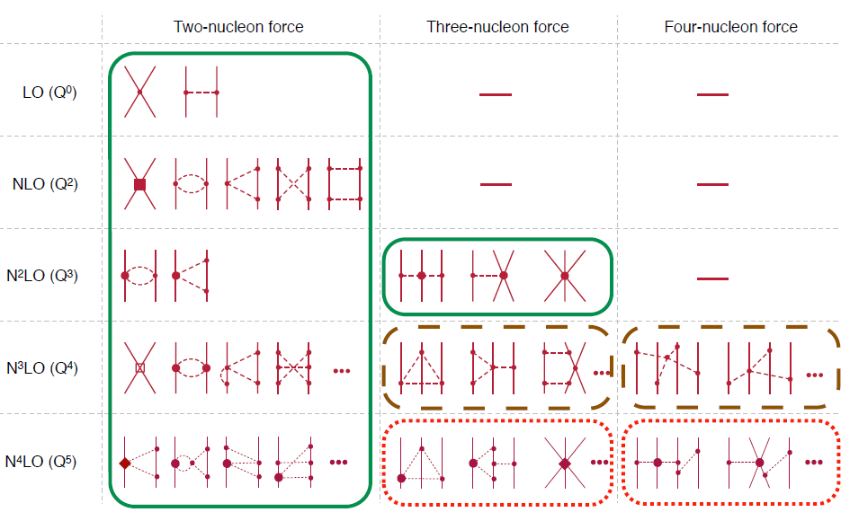
Chiral Effective Field Theory

Slide 8
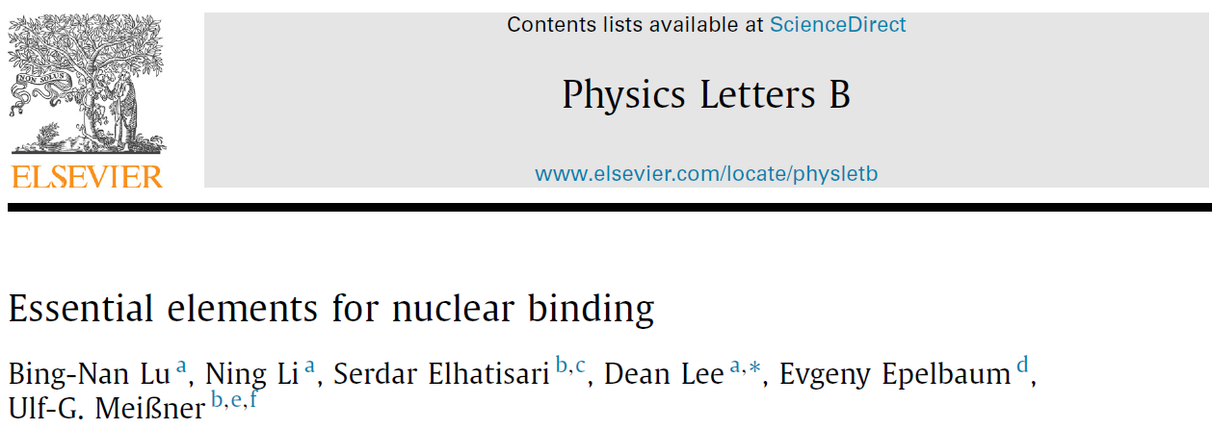
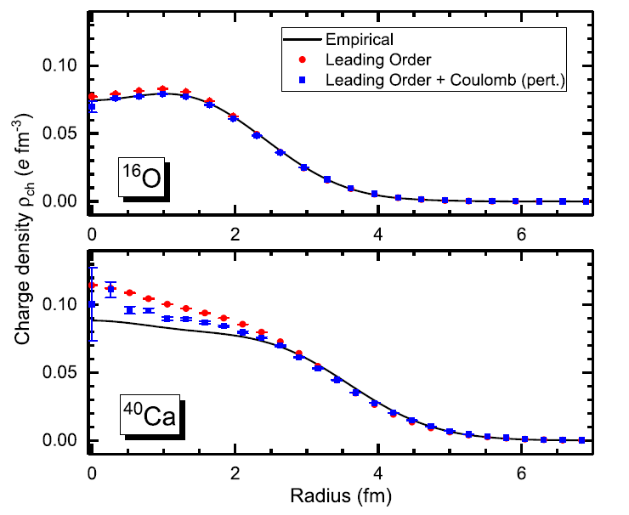



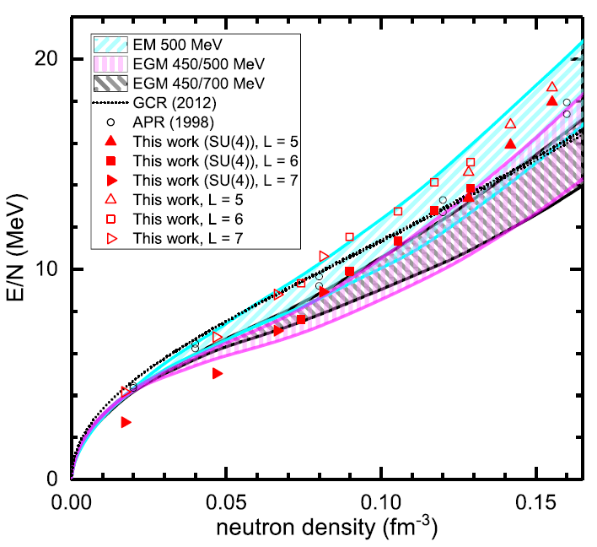
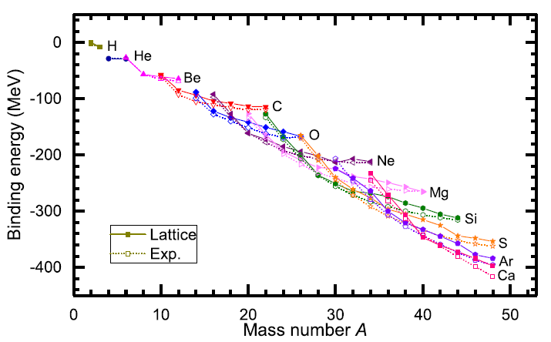
Non-local smeared SU(4) interaction

Slide 9

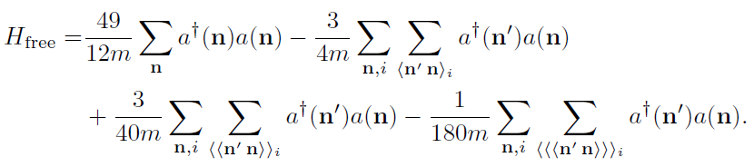

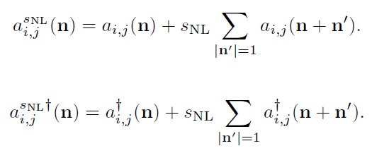
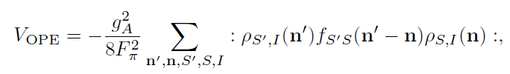
Lattice chiral Hamiltonian Leading order

Slide 10
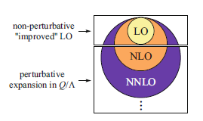
Lattice chiral Hamiltonian (N3LO)
Full N3LO Hamiltonian includes
Free Hamiltonian(Kinetic term)
Short range (nonlocal smeared) contact interactions up to Q^4 order
Isospin-breaking short range interactions
One pion exchange potential
Two pion exchange potential up to Q^4 order
Coulomb interaction
Long range isospin breaking interaction( isospin dependence in OPE)
Galilean Invariance Restoration (GIR) term
Three nucleon interaction

Slide 11
Difficulty with full chiral interaction
Sign problem
NLEFT suffers sign problems at large Euclidean time limit
SU(4) symmetric interaction does not have sign problem
One pion exchange and higher order chiral interaction
Difficulty with Asymmetric nuclei
Needs a remedy to extend to neutron rich isotopes.
A new approach to reduce the sign problem.
→ Wave function matching Hamiltonian.

Slide 12


Wave Function Matching Hamiltonian
Wave function matching by Unitary transformation
Original Hamiltonian has a strong repulsion at short distance
→ origin of the difficulty of non-perturbative calculation.
new “soft” Hamiltonian
such that the eigenstate wave function becomes
Same as “original” w.f. at long distance
Same as “soft” w.f. at short distance
“Soft” Hamiltonian is not the same as original Hamiltonian
Naturally need correction terms
H_wf = H_soft + (U^dagger H U - H_soft)
H_soft has better property for non-perturbative calculation
Perturbative expansion for the corrections
No new LECs in 2-body interaction
Induces many body interactions

Slide 13


Lattice Hamiltonian

Slide 14
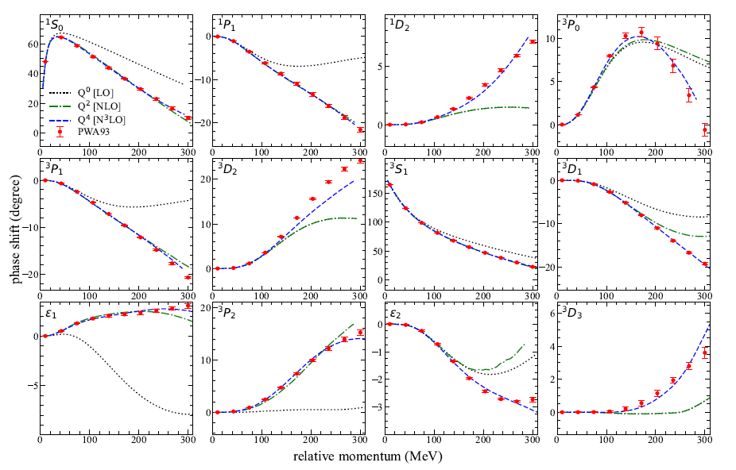
NN phase shifts from WFM

Slide 15
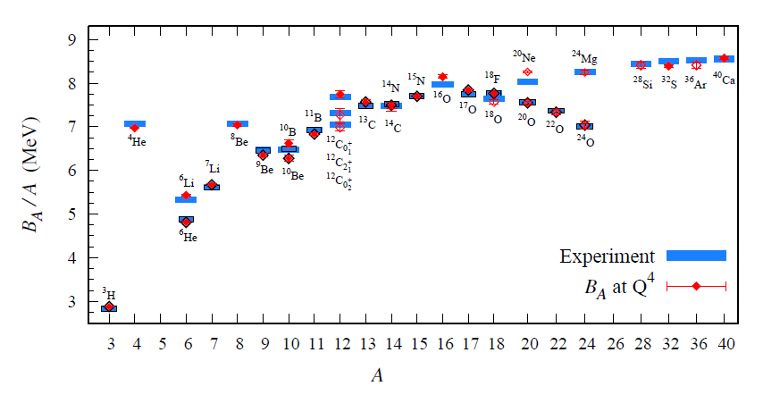
BE/A from WFM
Preliminary

Slide 16
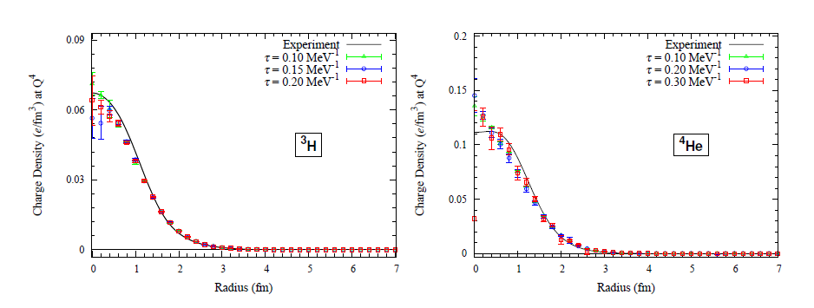
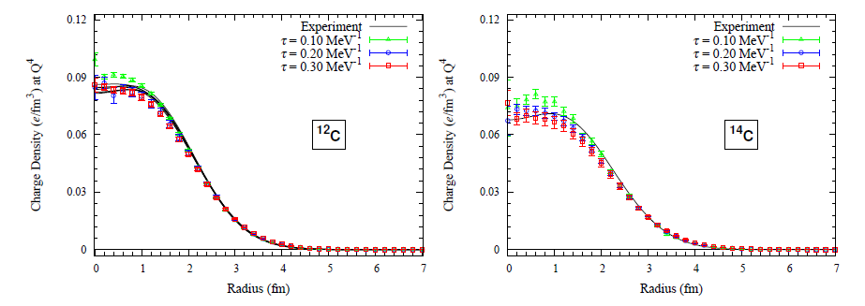
Charge density from WFM
Preliminary

Slide 17
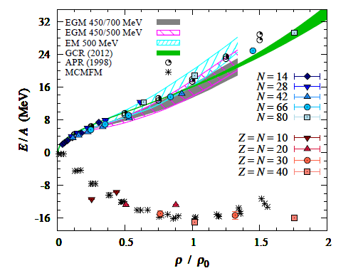
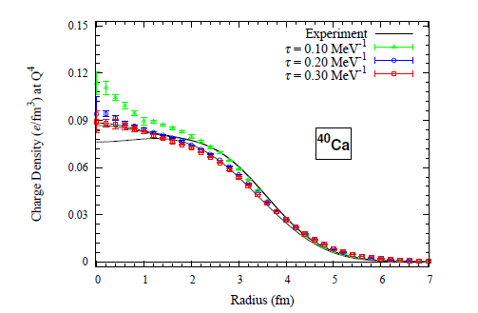
Nuclear Matter from WFM
Preliminary

Slide 18
Oxygen isotopes in NLEFT
BE agrees well with experimental values for Oxygen isotopes

Slide 19
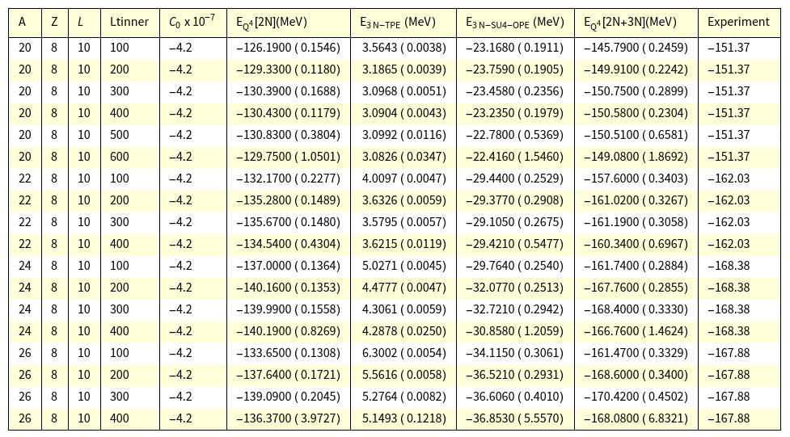
Oxygen isotopes in NLEFT
Preliminary

Slide 20
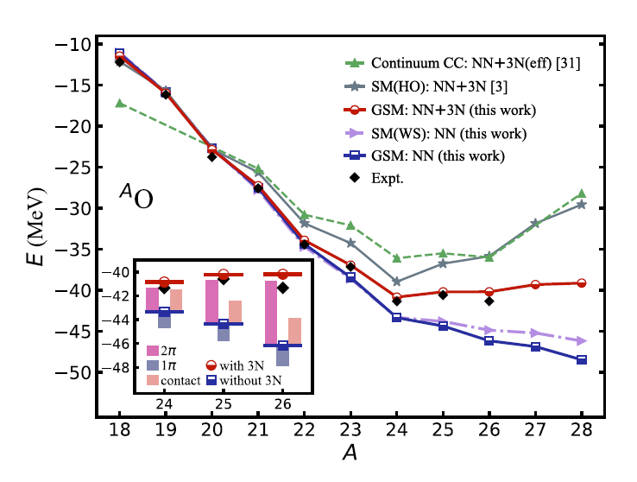

Oxygen isotopes in NLEFT
Reasonable agreement with experiments
Correct dripline at O24
3N interaction contribution is important but somewhat smaller than C.C.
→ continuum effects?
Slight over binding in O26.→ finite volume effects?
Gamow Shell model calculation
( BE w.r.t 16O core)

Slide 21
Summary
Wave function matching method seems to be promising
New method to improve the N3LO calculation of NLEFT
Preliminary study shows promising results for wide range of observables
NN scattering
Binding energy (from 3H to 40Ca)
Symmetric Nuclear matter
Neutron matter
Dripline of Oxygen isotope.
Carbon excited states
Further investigation on the finite volume effects is on-going.
Also, Carbon isotopes, odd Oxygen isotopes, Cluster structure, excited states.

