Slide 1


Towards dripline:
Nuclear Lattice Effective Field Theory approach
Young-Ho Song (중이온가속기연구소, IBS)
NLEFT collaboration
저에너지희귀동위원소빔활용워크숍, 2022.07.20-21, 대전, 중이온가속기연구소

Slide 2
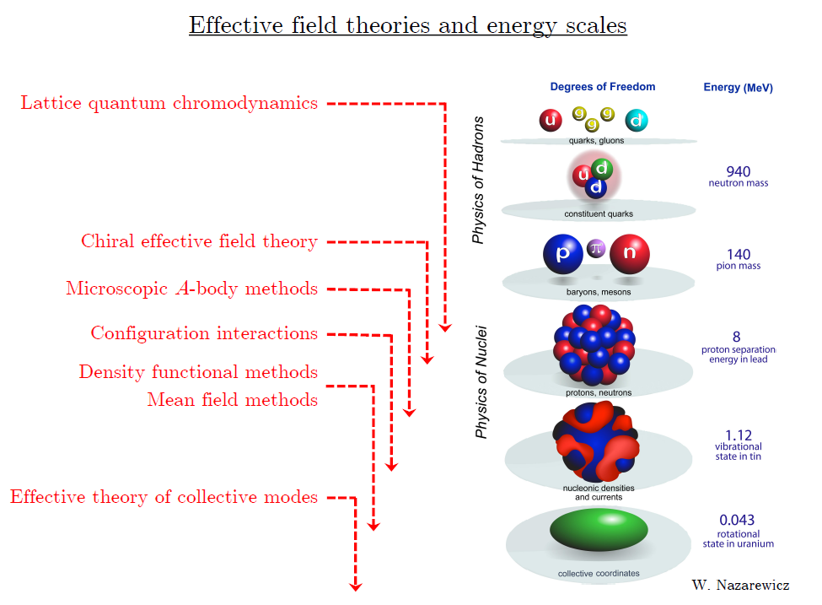
Ab initio approach
Ab initio (my definition)
= Start from nucleon-nucleon interaction
Ab initio
Nuclear
Theory
Direct understanding of nuclear force and
nuclear structure/reaction

Slide 3
Non-perturbative many-body problem
Nuclear many body problem
Requires Non-perturbative method.
Ab-initio nuclear many body methods
Greens function Monte Carlo(GFMC)
No-core shell model(NCSM)
Coupled Cluster (CC)
IM-SRG, VS-SRG
Nuclear Lattice Effective Field Theory(NLEFT)
With recent progress in ab-initio methods
Binding energies for wide range of nuclei
Some reaction calculation in light nuclei.

Slide 4
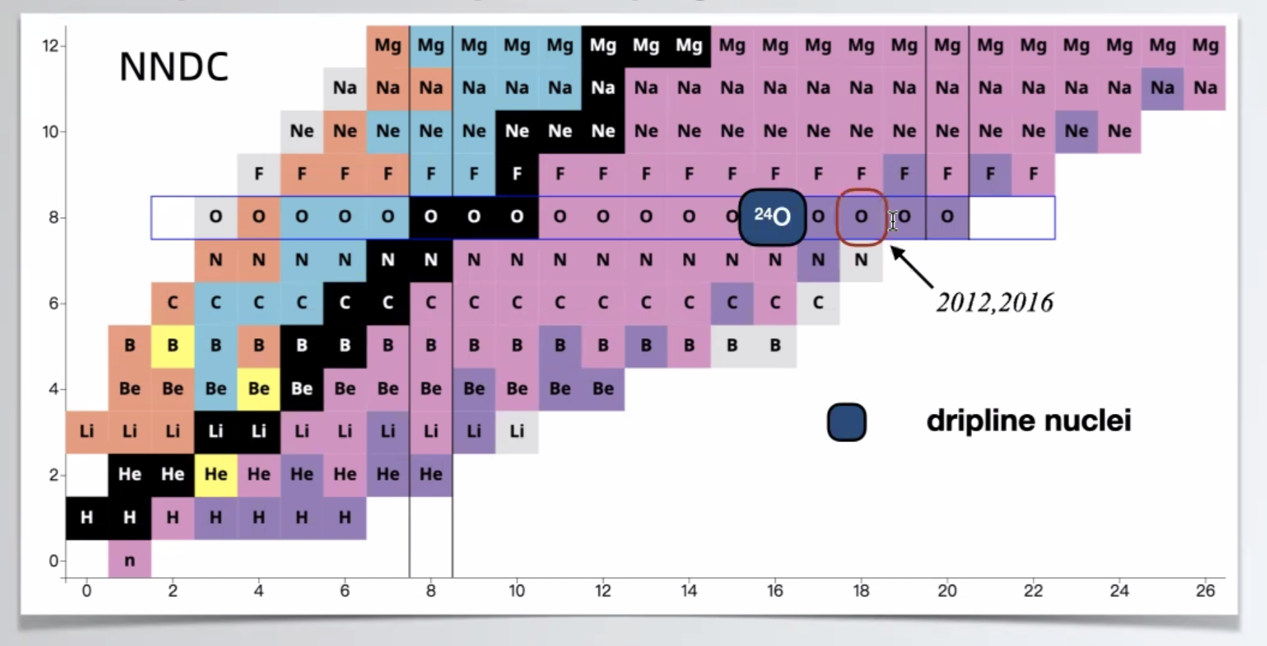
Oxygen isotopes
Can we explain the dripline of Oxygen isotopes?
Role of 3-body force?

Slide 5
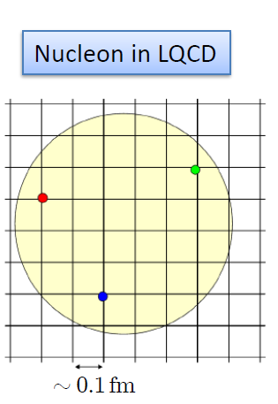

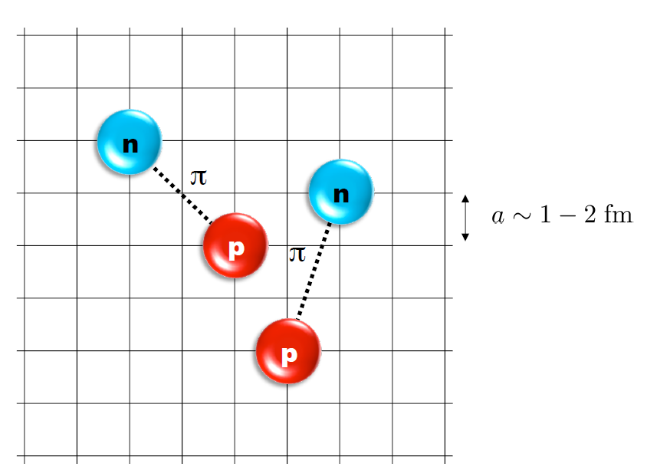
Nuclear Lattice Effective Field Theory
ab initio method for many fermion system

Slide 6
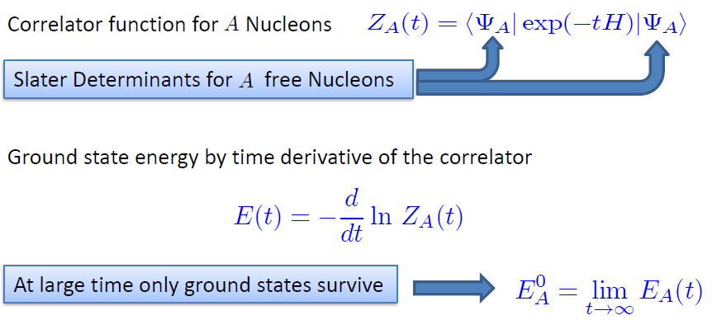

Path integral

Slide 7
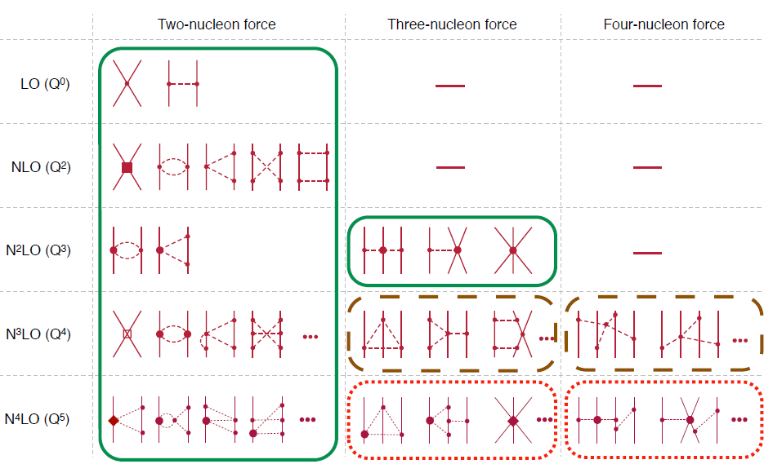
Chiral Effective Field Theory

Slide 8
Lattice Hamiltonian
We need to introduce a lattice scale in space and time:
momentum space cutoff ~ 150 MeV → lattice size a= 1.316 fm
Time cutoff ~ 1000 MeV
We need to determine coefficients of interaction for the lattice size. (regularization scale.)
Two-body interaction coefficients can be determined from phase shifts of np scattering.

Slide 9
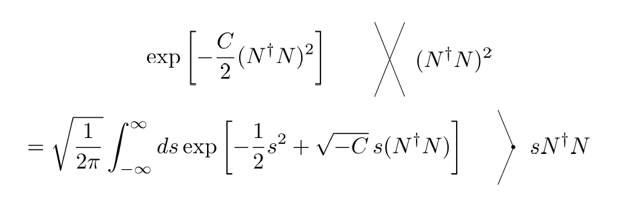
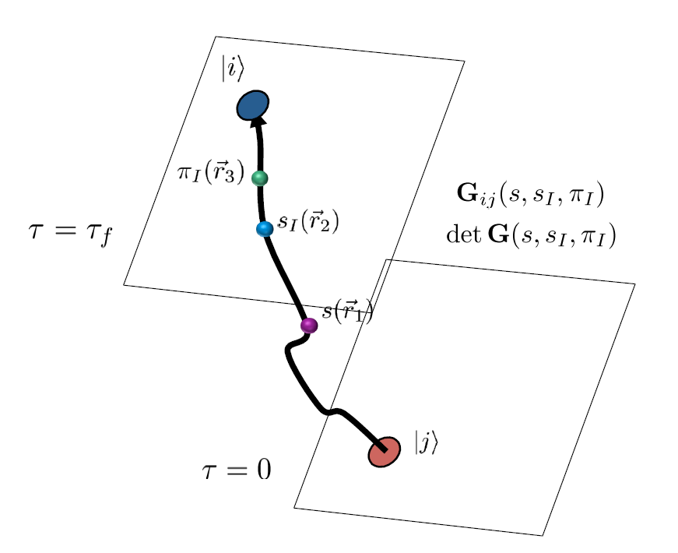
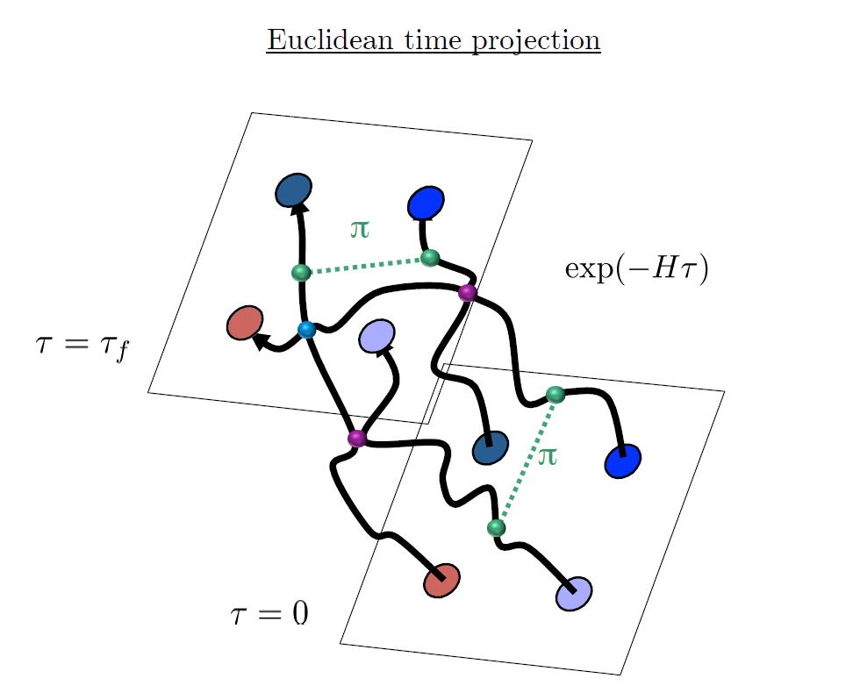
Auxiliary Field Monte Carlo

Slide 10
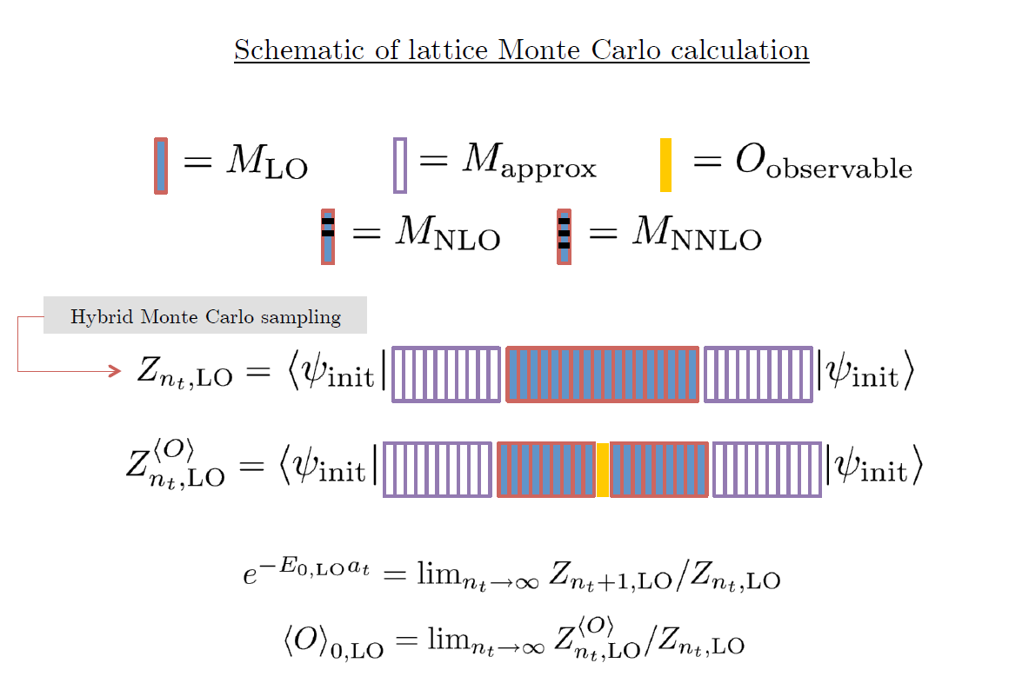

Slide 11

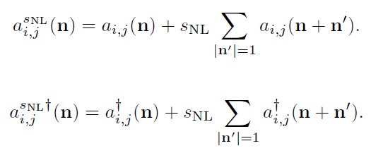
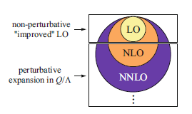
Improved action with non-locality
In practical calculation, sign problem and convergence of perturbation have to be taken care of.
To improve the non-perturbative calculation, modified non-local contact interaction are used.

Slide 12
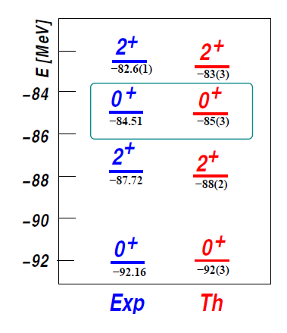

Applications of NLEFT
Has been successfully applied to
Nuclear matter, Cold atom, dilute fermion system
Finite nuclei (A<=50)
First ab-initio calculation of Hoyle state
Cluster structure of ¹²C and ¹⁶O
NN scattering, N-D scattering
Alpha-alpha scattering
radiative capture, fusion
Etc.
The first ab-initio calculation of
Hoyle state

Slide 13
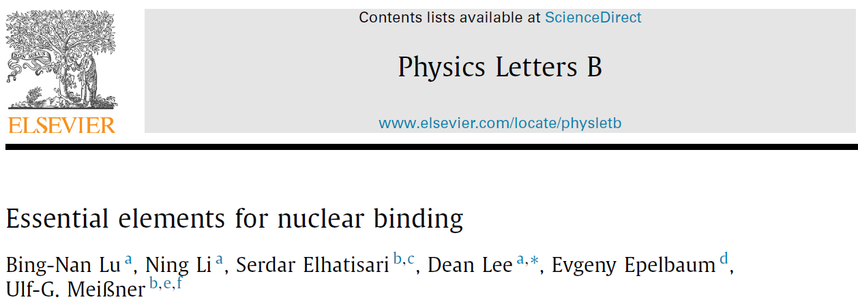



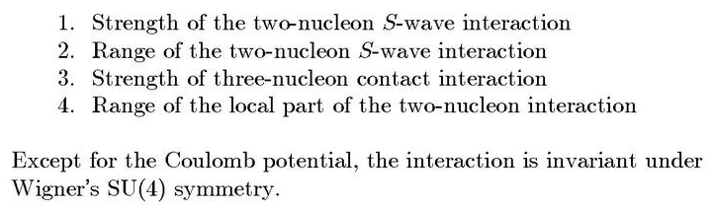
Minimal nuclear interaction
Which reproduce
Light nuclei
medium mass nuclei
neutron matter
simultaneously up to few percent error in binding energy and charge radius
Only Four parameters

Slide 14
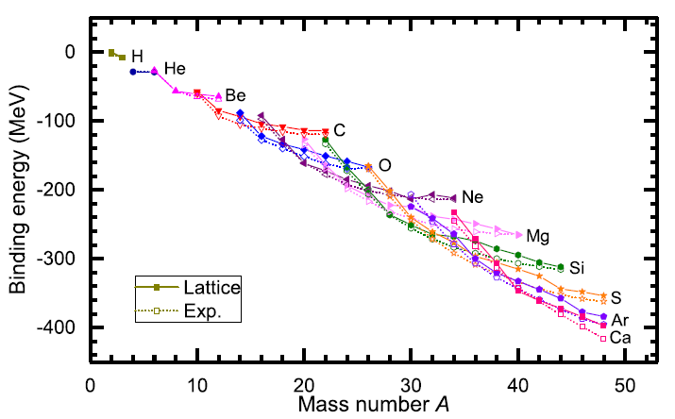
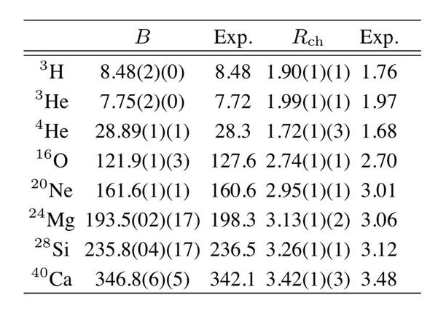
Can we improve the agreement by
Including higher order corrections?

Slide 15
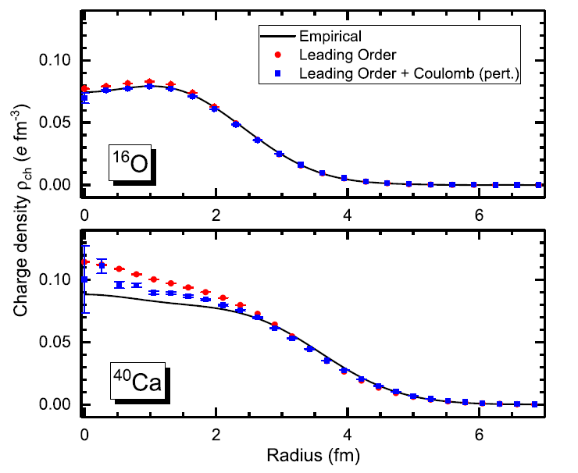
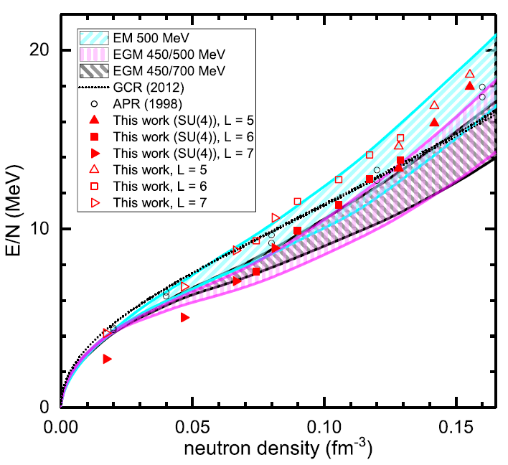
Can we improve the agreement by
Including higher order corrections?

Slide 16
Lattice chiral Hamiltonian (N3LO)
Full N3LO Hamiltonian includes
Free Hamiltonian(Kinetic term)
Short range (nonlocal smeared) contact interactions up to Q^4 order
Isospin-breaking short range interactions
One pion exchange potential
Two pion exchange potential up to Q^4 order
Coulomb interaction
Long range isospin breaking interaction( isospin dependence in OPE)
Galilean Invariance Restoration (GIR) term (because of non-local interaction.)
Three nucleon interaction

Slide 17
Difficulty with full chiral interaction
Sign problem
NLEFT suffers sign problems at large Euclidean time limit
SU(4) symmetric interaction does not have sign problem
One pion exchange and higher order chiral interaction
Difficulty with Asymmetric nuclei
Needs a remedy to extend to neutron rich isotopes.
A new approach to reduce the sign problem.
→ Wave function matching Hamiltonian.

Slide 18


Wave Function Matching Hamiltonian
Wave function matching by Unitary transformation
Original Hamiltonian has a strong repulsion at short distance
→ origin of the difficulty of non-perturbative calculation.
new Hamiltonian
such that the eigenstate wave function becomes
Same as “original” w.f. at long distance
Same as “soft” w.f. at short distance
The goal is to make the perturbation expansion with “soft” wave function gives a good convergence

Slide 19
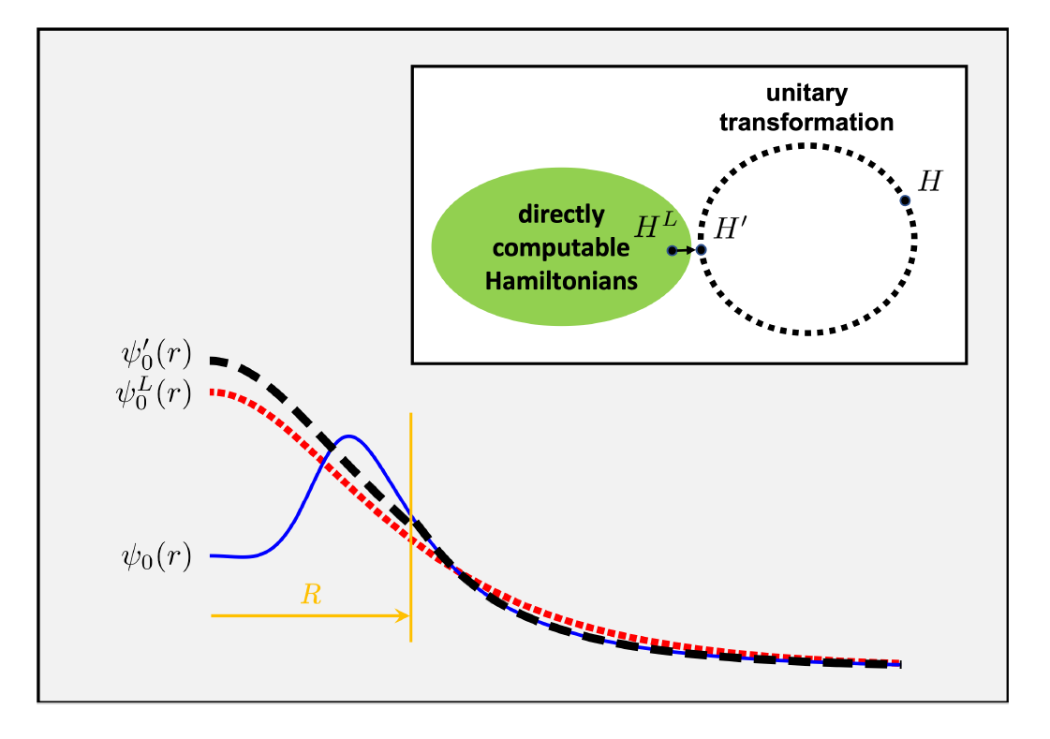
Wave function matching

Slide 20

Wave Function Matching Hamiltonian
new Hamiltonian is not the same as original Hamiltonian
Naturally need correction terms
H_soft has better property for non-perturbative calculation
Perturbative expansion for the corrections
No new LECs in 2-body interaction
(H_soft is a choice. U^dagger H U is computable for 2-body.)
Drawback : Induces many body interactions
In principle, one may compute the induced many-body interactions
In practice, highly non-trivial.
→ introduce additional 3-body interactions and fit them.

Slide 21
Three-body force
Chiral EFT TBF at N2LO have two parameters: cD, cE
at N3LO have many-diagrams, but no new parameters
Here we have 4-parameters for TBF at N3LO:
local smeared cD
local smeared cE
point-split cE_1, cE_2
Introducing more TBF parameters only give minor improvements.

Slide 22
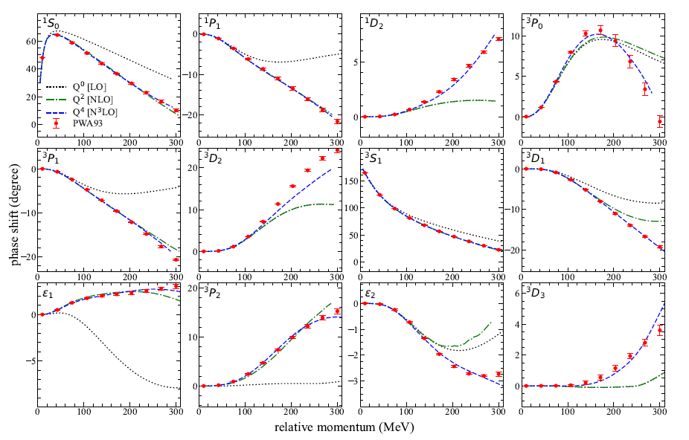
NN phase shifts from WFM

Slide 23
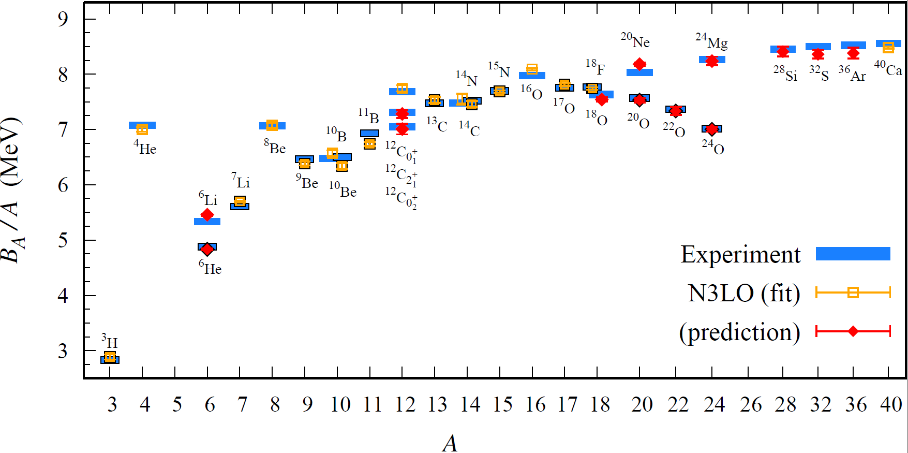
BE/A from WFM
Preliminary

Slide 24
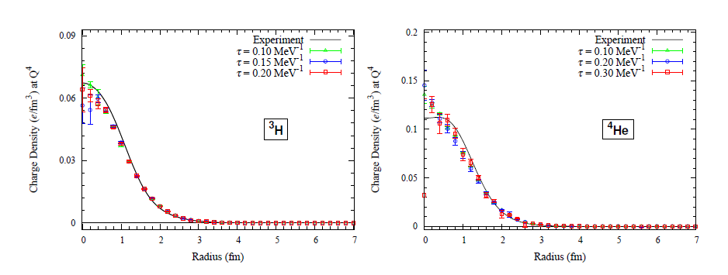
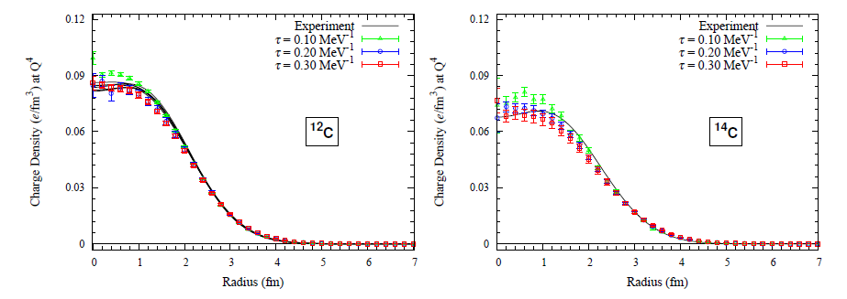
Charge density from WFM
Preliminary

Slide 25
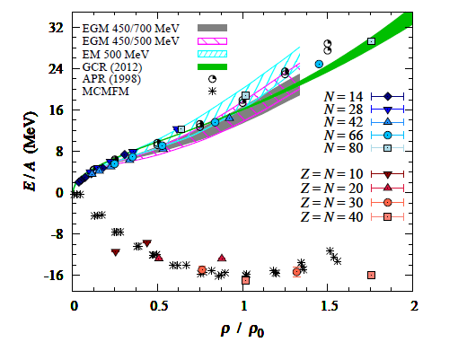
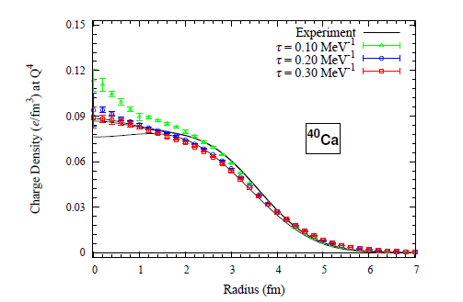
Nuclear Matter from WFM
Preliminary

Slide 26
Oxygen isotopes in NLEFT
Reasonable agreement with experiments
Correct dripline at O24
Slight over binding in O26.
→ finite volume effects?
Preliminary

Slide 27
Summary
Wave function matching method seems to be promising
New method to improve the N3LO calculation of NLEFT
Preliminary study shows promising results for wide range of observables
NN scattering
Binding energy (from 3H to 40Ca)
Symmetric Nuclear matter
Neutron matter
Dripline of Oxygen isotope.
Carbon excited states
Further investigation on the finite volume effects is on-going.
Also, Carbon isotopes, odd Oxygen isotopes, Cluster structure, excited states.

Slide 28
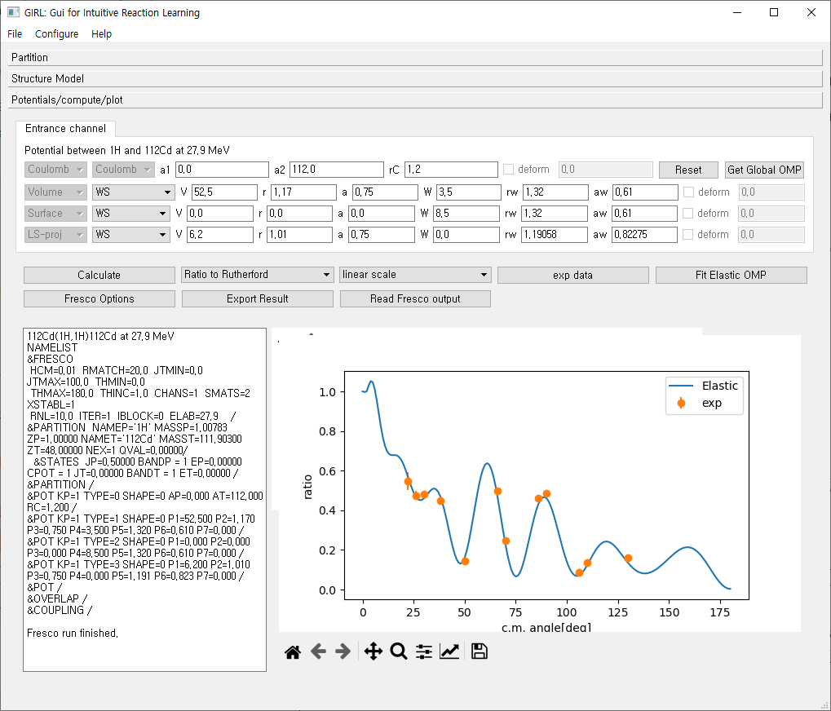
ReactionGUI
Search “ReactionGUI” at GitHub
https://github.com/alphacentaury-github/ReactionGUI
GUI interface to reaction codes
And additional codes related.
AME data , Kinematics
elastic scattering using optical potential
inelastic scattering using Distorted Wave Born Approximation in rotor model
transfer reaction using Distorted Wave Born Approximation in cluster model
fusion reaction in complex optical potential or incoming wave boundary condition in coupled channel method.
one nucleon knockout reaction in eikonal approximation.
Radiative capture reaction (not yet uploadad)
Global optical potential
Double Folding potential (M3Y)
FRESCO, CCFULL, MOMDIS
Plan for additional features

