Slide 1


How to solve BHF equation
in nuclear matter
Young-Ho Song (중이온가속기연구소, IBS)
mini-workshop 2022.12.01., 숭실대

Slide 2
Introduction
Many-body problem
Interacting A-nucleon system
H = T + V = T+U + (V – U)
H can have one-body, two-body, three-body… operators
Exact solution H |Psi> = E |Psi> is very difficult to get.
Many-body perturbation theory does not converge well.
How to compute the energy of nuclear matter?
Finite box periodic boundary condition
Ab initio calculation with varying number of nucleons in the box
Brueckner-Hartree-Fock method
Non-perturbative sum of particular type of diagrams.
Most likely, some code to solve BHF in nuclear matter may be available.
I decided to write my own code which is easy to understand.
Main reference:
M. Haftel, F. tabakin, Nuclear Physics A158 (1970)1-42
K. Amos et al, Advances in Nuclear Phsyics, vol 25, chapter 3

Slide 3
Introduction
How to compute the energy of nuclear matter?
Independent particle model
Simplest many-body problem
Approximation treating H ~ H0 = T+ U as one-body operator
Exact solution is known
→ Slater determinant of single particle wave functions
What is U ?
naive shell model : H.O. potential or W.S. potential
U simulate the mean effects of V as much as possible

Slide 4

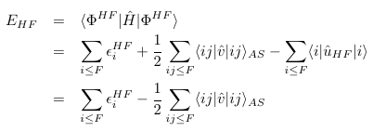


Introduction
Hartree-Fock method
Basically the same as independent particle model
→ Assumption: a Slater-determinant of single particle wave functions.
What is U? (H = T+V = T+U + V-U)
→ try to find the optimal U such that
(1) s.p. wave functions are determined by U
(2) Thus, Slater determinant is determined by U
(3) Choose U such that the <Psi| H| Psi> to be a variational minimum.

Slide 5

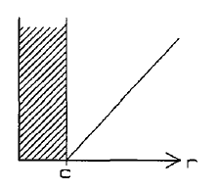
Introduction
Starting from HF, one can compute MBPT to compute energy corrections
However, naïve application of MBPT to realistic NN interaction raises a problem.
Many realistic NN interaction has a hard-core. (Very repulsive at short distance)
The matrix elements of potential for Slater-determinant becomes very large. → perturbative approach does not work.

Slide 6


T-matrix
Non-perturbative treatment of two-body interaction is necessary.
→ incorporate correlation between two particles
→ two nucleon scattering in medium
But, even when matrix elements are large, their infinite sum can be finite.
Two nucleon scattering T-matrix in free space
Sum of infinite series of ladder diagrams
Scattering T-matrix is well defined/behaved
even when potential matrix element is large. (non-perturbative)
T-matrix converts free plane wave to scattering wave function.

Slide 7



T-matrix
Lippman-Schwinger equation
k : two-nucleon relative momentum
L-S equation for wave function
L-S equation for T-matrix

Slide 8
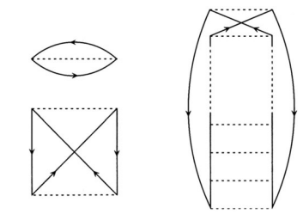
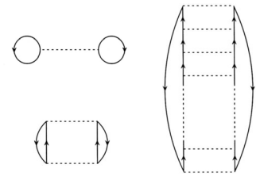



Brueckner-Hartree-Fock
Brueckner approach:
Sum all order of two-nucleon scattering (ladder diagrams) in medium
Replace matrix elements of V to matrix elements of G-matrix.
G-matrix is well defined even with hard-core interaction.

Slide 9

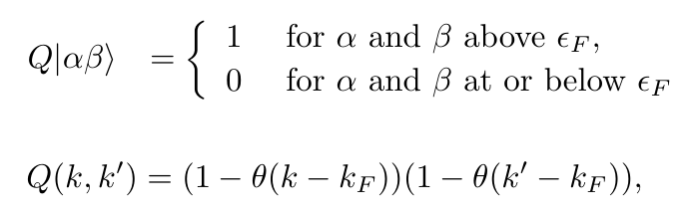
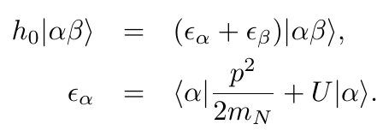
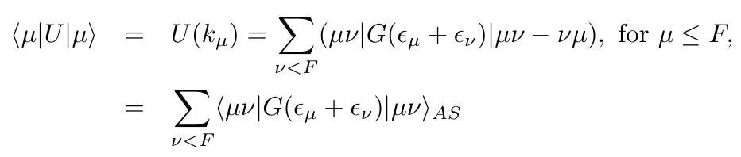
Brueckner-Hartree-Fock
Medium effects enters
(1) Pauli exclusion
(2) Dispersion relation( relation between energy and momentum)
BHF or Bethe-Goldstone equation
Self consistent : s.p. wave function, energy, potential, g-matrix

Slide 10
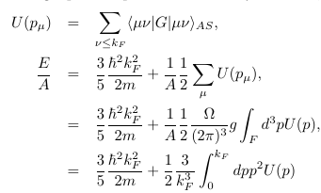
Nuclear matter
From symmetry of infinite nuclear matter
Wave function must be a plane wave. (No need to solve s. p. waves)
Dispersion relation will be changed. (One have to find self consistent potential U )
Energy of nuclear matter can be obtained from U

Slide 11

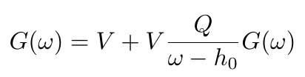



G-matrix calculation
CM momentum and relative momentum of two nucleons
G-matrix equation → integral equation
Same code can be used for scattering in free space.
Set U=0. Q=1. G matrix→ T matrix

Slide 12


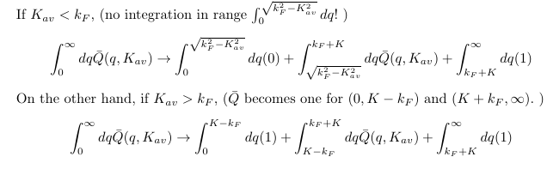
Angle average approximation of Q
Q depends on the angle between relative momentum and CM momentum.
In general, Q can couple different relative angular momentum states
→ Simplification : angle average (no mixing between partial waves)

Slide 13




Angle average approximation of denominator
Denominator energy depends on the angle between momentum
Simplification: angle-averaged c.m. momentum prescription
When argument in potential is larger than Fermi momentum?
Standard choice
Continuous choice

Slide 14
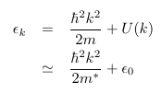


Dispersion relation
Typical two choices
(1) parametrize with effective mass
(2) momentum dependence of U(p)
In the code, different definition of effective mass is used.
( defined as an overall fit of U(p) )

Slide 15


Partial wave expansion of G-matrix
angular momentum conservation
→ better to use partial wave expansion.
When k0 is below Fermi momentum, the denominator never have pole.
→ G-matrix is real
When k0 is above Fermi momentum, the denominator can have pole
→ G-matrix becomes complex.

Slide 16


Integral equation
Discretize integral equation→ quadrature method
Pole of denominator→ Principal value integral

Slide 17
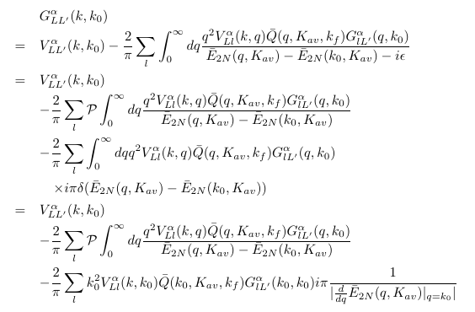

Integral equation
G-matrix equation

Slide 18
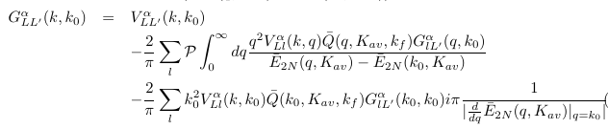
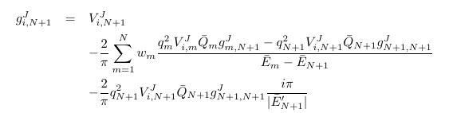

Integral equation
G-matrix equation
Trick for principal
value integration

Slide 19
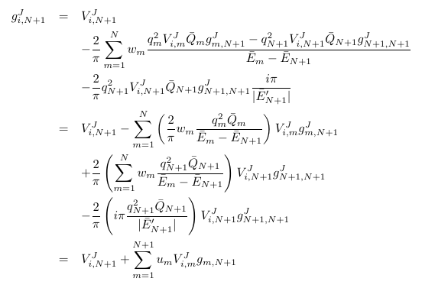
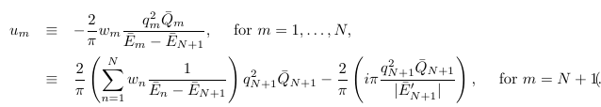
Integral equation
G-matrix equation( assume U(p), i.e. E(p) is already given)

Slide 20

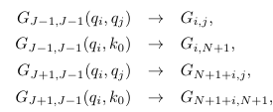


Solve g-matrix
G-matrix equation (with out tensor interaction)
G-matrix equation (with tensor interaction for S=1)
G-matrix can be obtained by matrix inversion

Slide 21



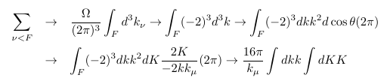

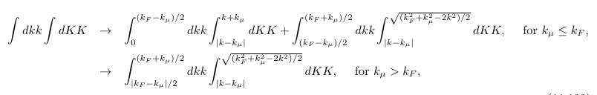
U(p) from g-matrix
For particular s.p. momentum
Range of integration are constrained.

Slide 22

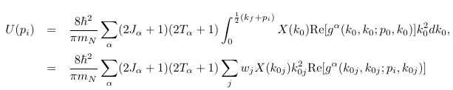

U(p) from g-matrix
For particular s.p. momentum
average CM momentum approximation

Slide 23

Algorithm
Choose interested values of U(p)
Start with initial U(p) → compute e(p)
(effective mass method, start with initial two parameters)
Compute g-matrix
calculate U(p) from obtained g-matrix
Check convergence of U(p) or e(p)
If not converged, repeat from (3) updating U(p) or effective mass

Slide 24
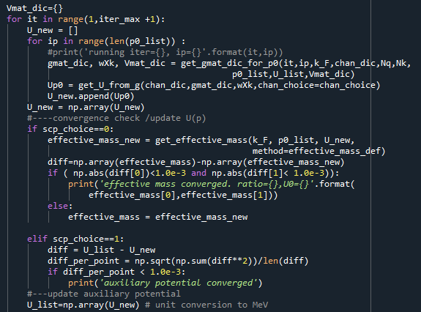
Code

Slide 25
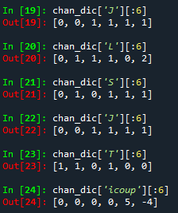
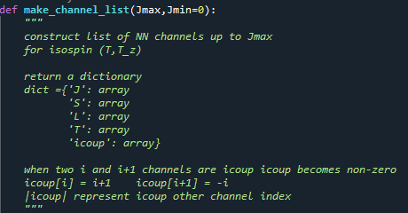
Code

Slide 26
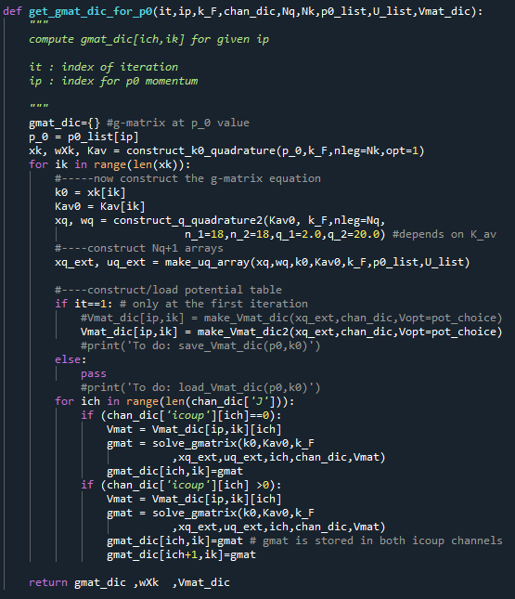
Code

Slide 27
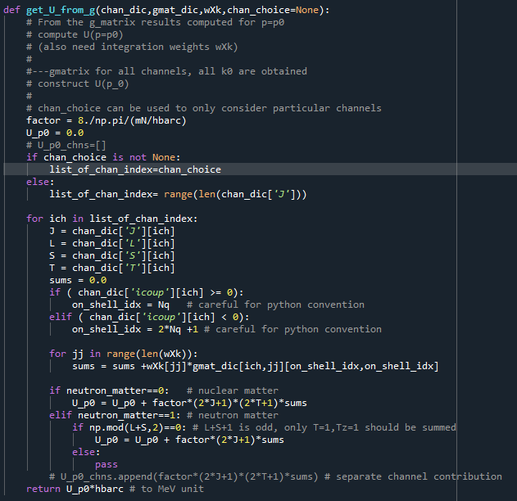
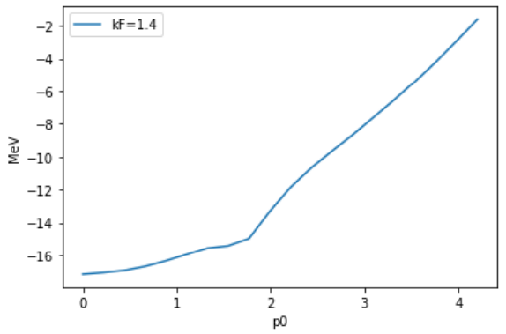
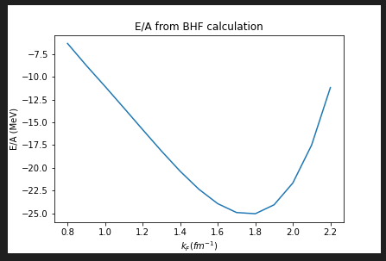
Code
Bonn B potential result

Slide 28
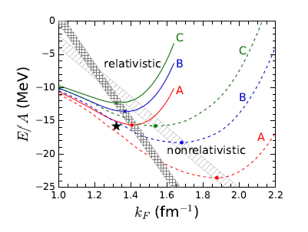
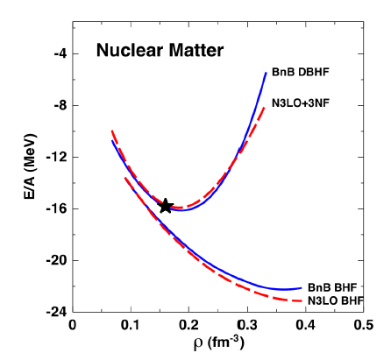
However…
It is well known that the BHF with realistic NN interaction does not give correct saturation property of Nuclear matter
To get better saturation, one have to
(1) Include 3 nucleon force, or
(2) relativistic Dirac BHF
Figures from
S. Shen et al., Progress in Particle and Nuclear Physics, 109, (2019), 103713

Slide 29
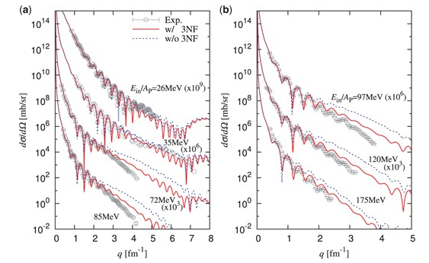
Plan
Include 3NF in chiral EFT
Compute optical potential by folding the g-matrix or self energy U(p)
→ In fact, similar work already exists.
Masakazu Toyokawa et al, Progress of Theoretical and experimental physics, (2018) 023D03
Figure from
The Reference
Masakazu Toyokawa et al
4He scattering on 208Pb.

Slide 30
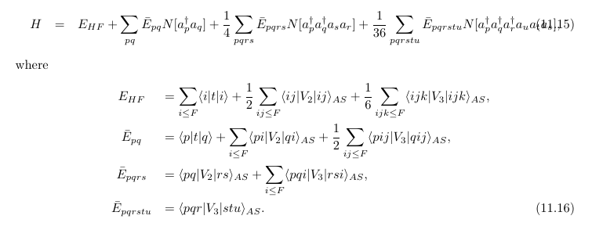
How to include 3NF ?
Currently,
confused for the moment about the correct factor.
Difficulty in understanding the Chiral 3BF code.
REF 1. M. Kohno, Phys. Rev. C. 88, 064005(2013)
REF 2. J. Holt et al, Frontiers in Physics, vol. 8, 100 (2020)

