Slide 1
Quantum Many-Body Calculations using Body-Centered Cubic Lattices
Young-Ho Song
(RISP, Institute for Basic Science)
1st OMEG, 2021.10.02

Slide 2
Outline
Introduction
Nuclear Lattice Effective Field Theory
BCC lattice
Unitary Fermion Gas
Formalism
More details of NLEFT method
Details of UFG in BCC lattice
Results
Discussion

Slide 3
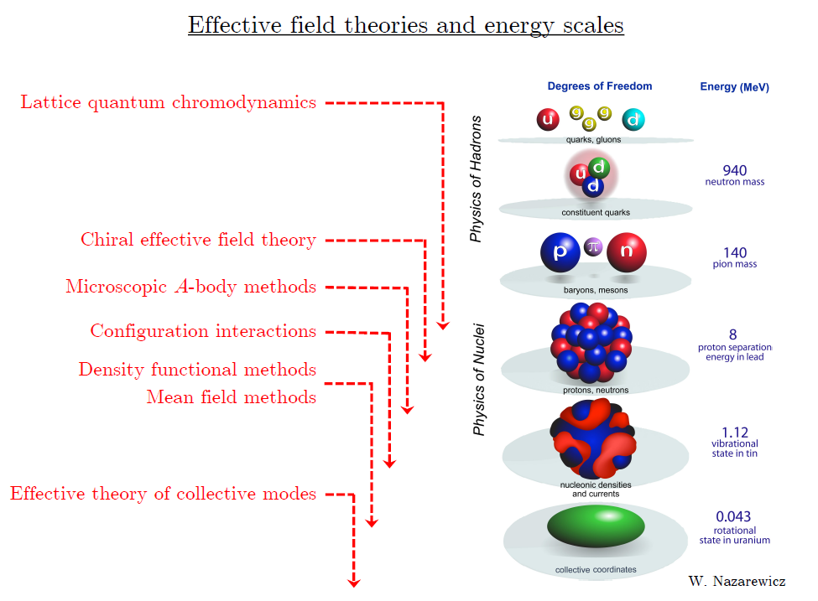
At each scale, there are effective d.o.f. and effective interaction

Slide 4
Ab initio
Nuclear
Theory

Slide 5
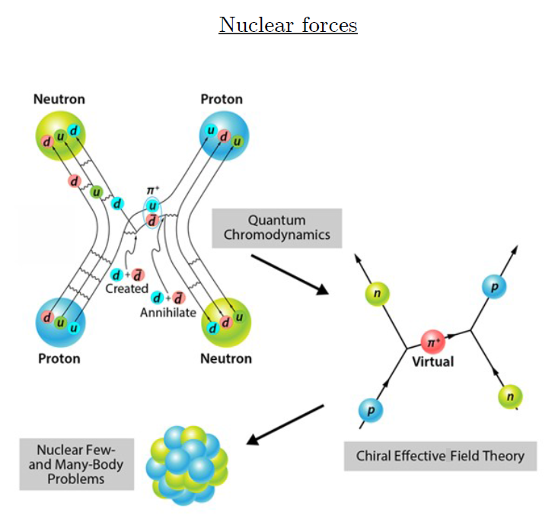
Ab-initio method
Ab-initio can mean many different things.
ab-initio in my definition
(1) nucleon degrees of freedom
(2) nucleon-nucleon interaction
Goal: predict nuclear phenomena (without parameter fitting) from fundamental nuclear interaction.
→ rare isotopes, dripline,
r-process,
extreme conditions

Slide 6
Non-perturbative many-body problem
Nuclear many body problem
Requires Non-perturbative method.
Ab-initio nuclear many body methods
Greens function Monte Carlo(GFMC)
No-core shell model(NCSM)
Coupled Cluster (CC)
IM-SRG, VS-SRG
Nuclear Lattice Effective Field Theory(NLEFT)
With recent progress in ab-initio methods
Binding energies for wide range of nuclei
Some reaction calculation in light nuclei.

Slide 7
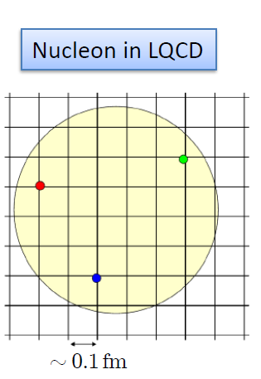

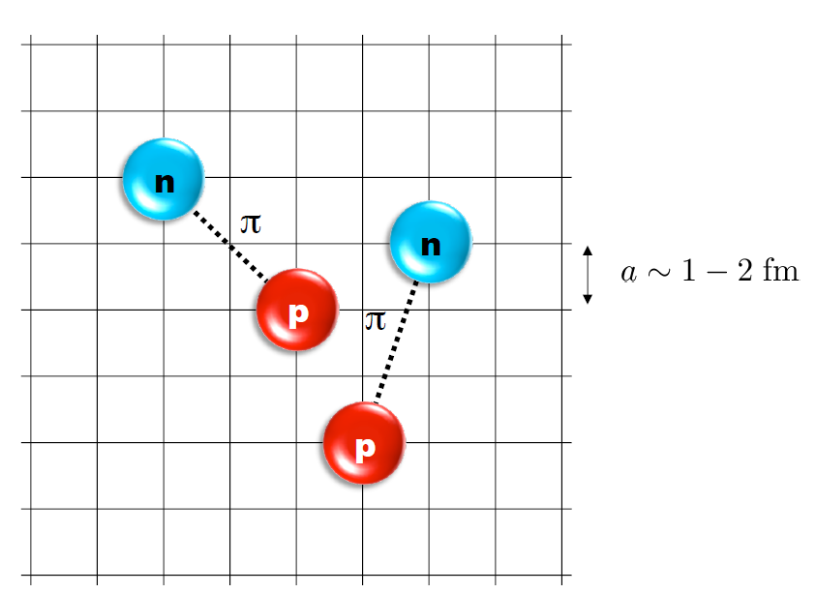
Nuclear Lattice Effective Field Theory
One of ab initio method for many fermion system

Slide 8
Characters of NLEFT
NLEFT is not a molecular dynamics
→ fully quantum mechanical.
NLEFT does not require truncated basis expansions, many-body perturbation theory, or any constraints on the nuclear wave function. Regularization/Truncation is in the lattice spacing.
Alpha clustering emerges naturally.

Slide 9

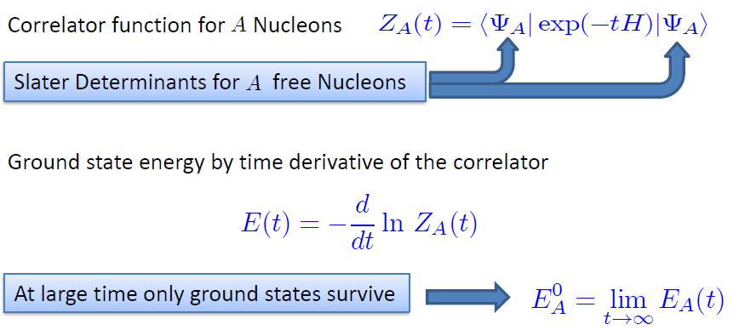
Path integral

Slide 10
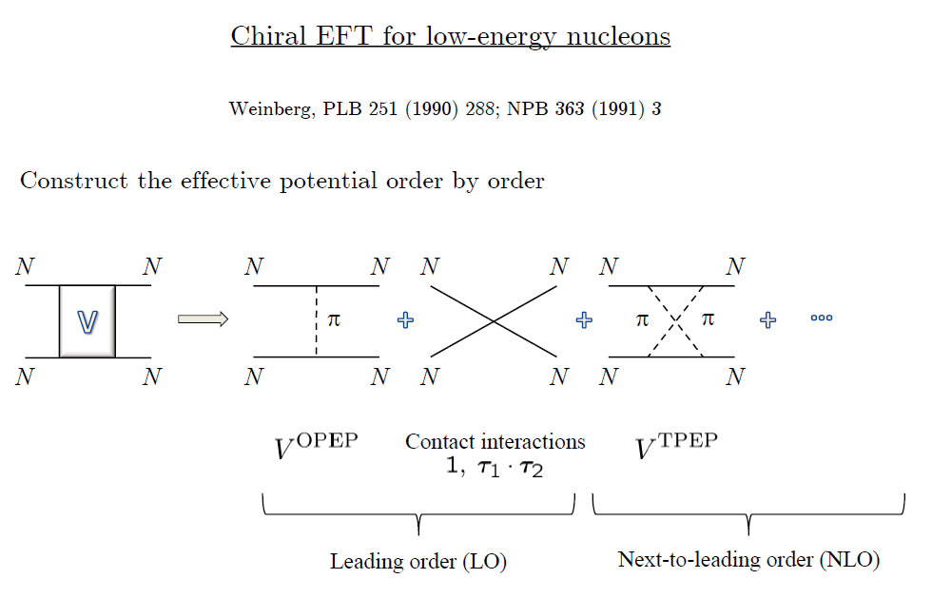
Chiral Effective Field Theory

Slide 11
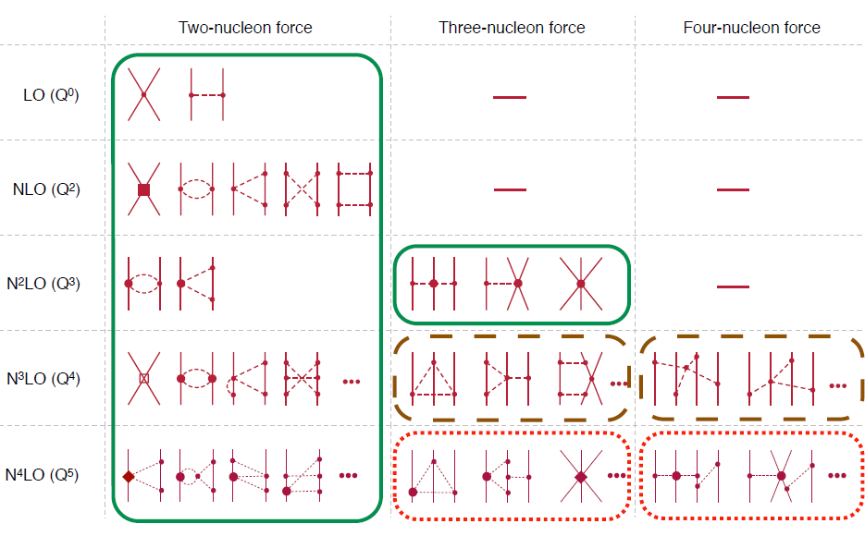
Chiral Effective Field Theory

Slide 12
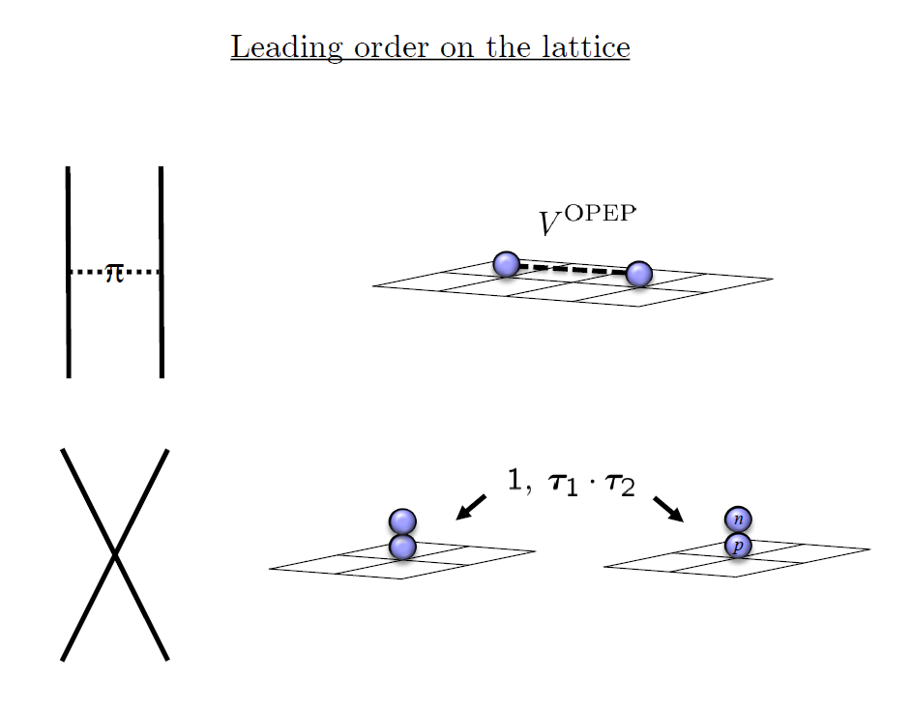

Slide 13
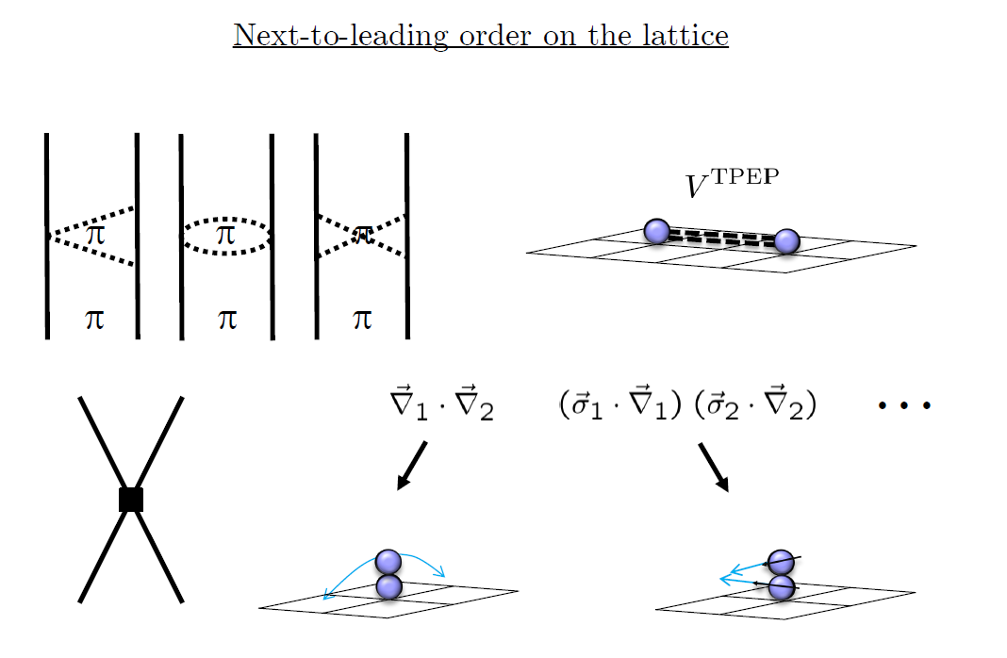

Slide 14
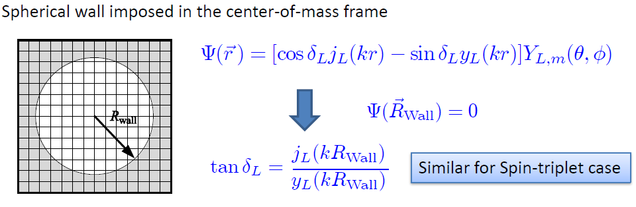
Low energy constants in lattice EFT
All LECs(parameters in the Hamiltonian) are fixed in A<=3
(They have to be fixed for given lattice regularization)
N-P scattering phase shifts, Deuteron binding energy
Triton binding energy, Triton beta decay.
Scattering phase shifts on the Lattice:

Slide 15
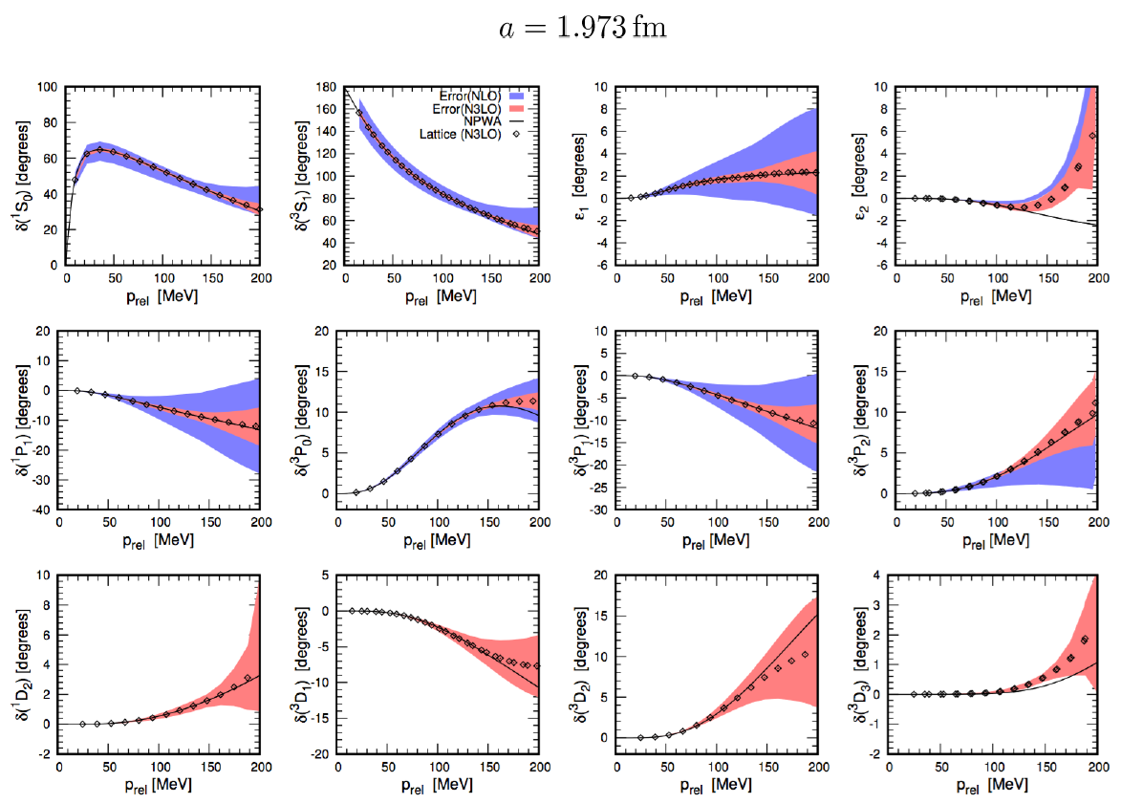
Determine LECs by fitting phase shifts of N-N scattering

Slide 16
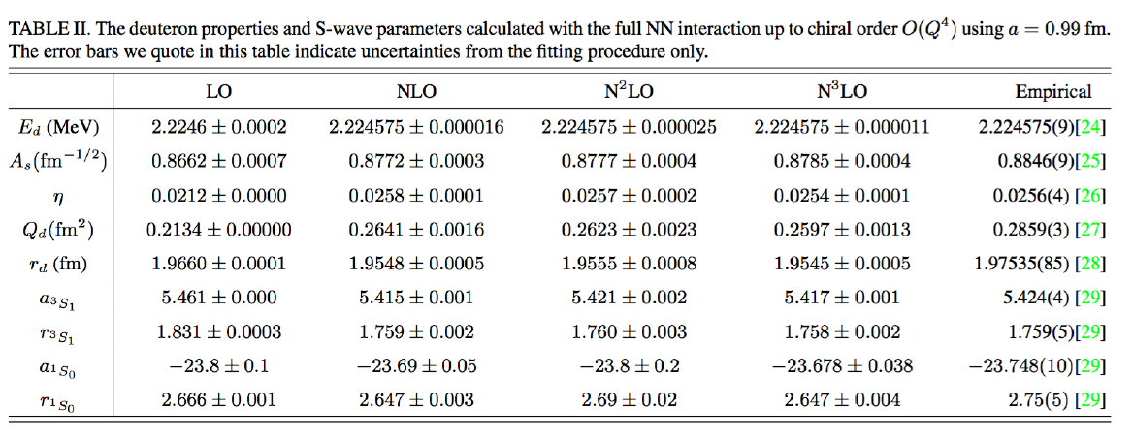

Slide 17
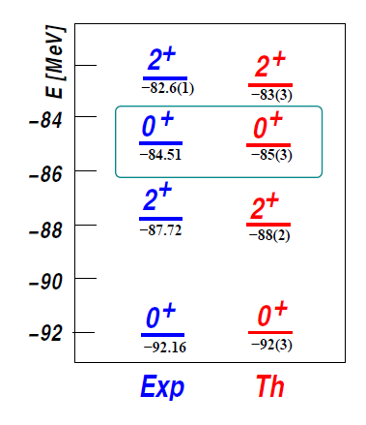

Applications of NLEFT
Has been successfully applied to
Nuclear matter, Cold atom, dilute fermion system
Finite nuclei (A<=50)
First ab-initio calculation of Hoyle state
Cluster structure of ¹²C and ¹⁶O
NN scattering, N-D scattering
Alpha-alpha scattering
radiative capture, fusion
Etc.
The first ab-initio calculation of
Hoyle state

Slide 18
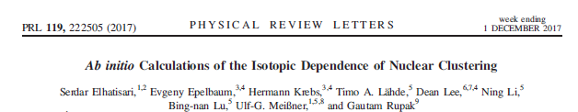
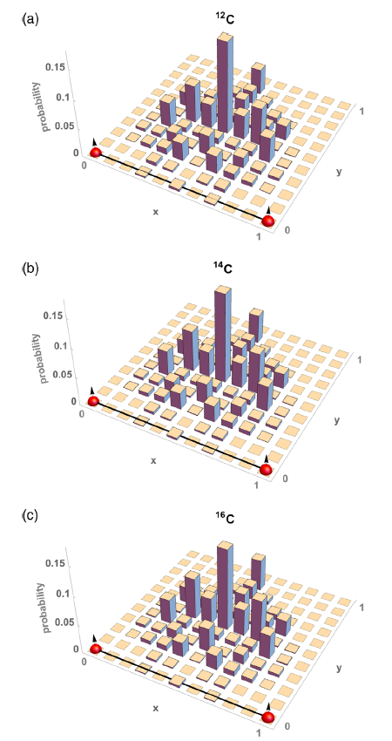
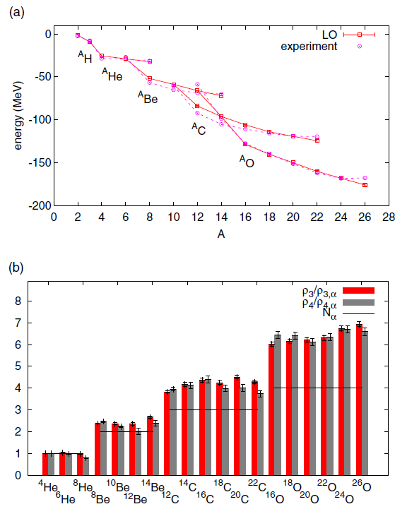
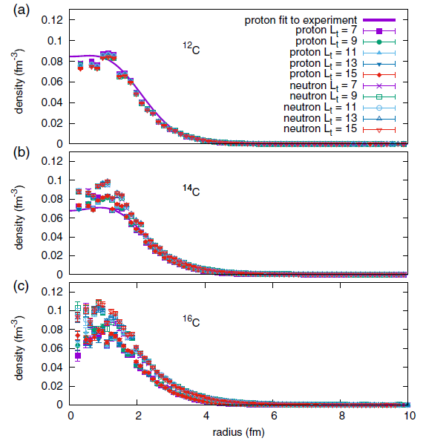

Pinhole algorithm

Slide 19
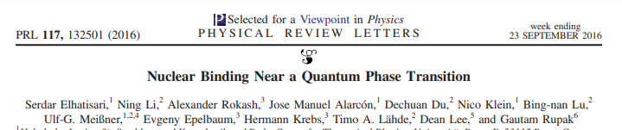
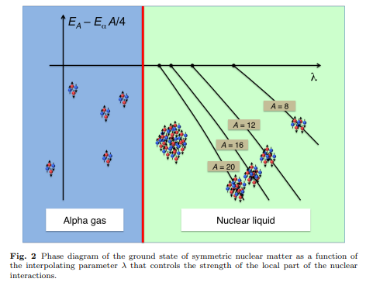
Changing the range and locality of nuclear force
Quantum phase transition
between a nuclear liquid and a Bose-Einstein condensate of alpha clusters
two N-N interaction
which reproduce phase shifts
Can give very different alpha-alpha
interaction depending the range and
(non)locality of force.

Slide 20
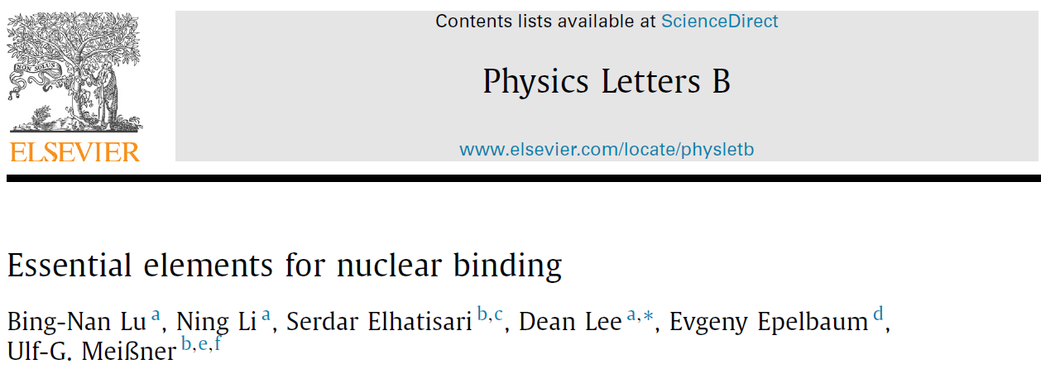
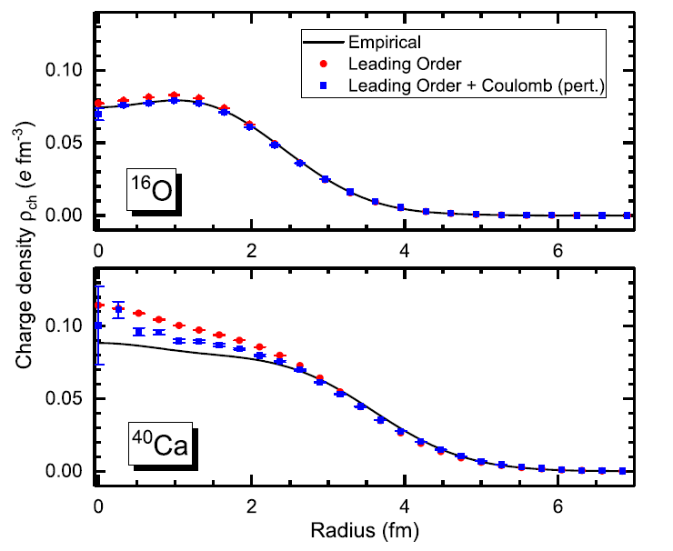



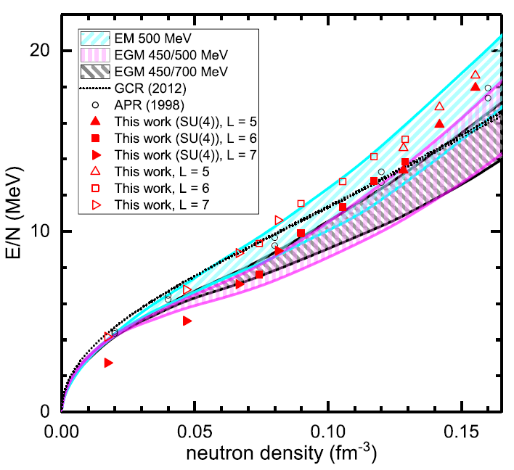
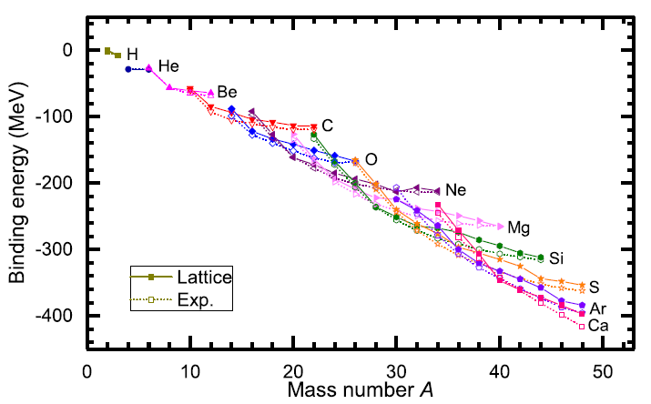

Slide 21
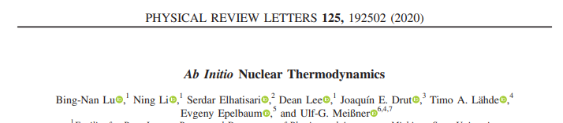
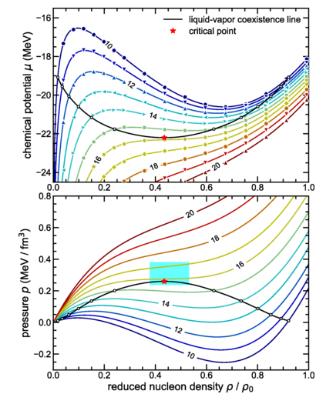
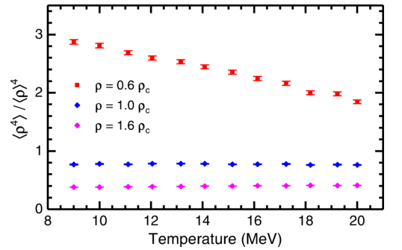
determine the location of the critical point
and the liquid-vapor coexistence line
for symmetric nuclear matter
with equal numbers of protons and neutrons.
the first ab initio study of the density
and temperature dependence of nuclear clustering.
Pinhole trace algorithm

Slide 22
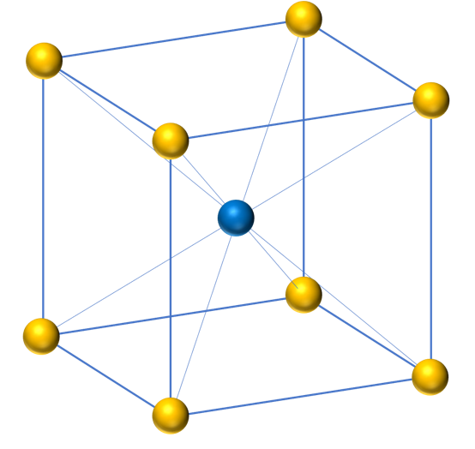
BCC lattice
Because of convenience, all NLEFT calculation has been done on cubic lattice
Physical result should not depends on the specific lattice
structure. (lattice size, spacing, type)
BCC lattice is constructed as
Two cubic lattice
(shifted by (1/2,1/2,1/2) in lattice unit)
Lattice spacing a=1/100 MeV^-1
Lattice Time step at = 1/1000 MeV^-1
(For outer region at’=1/200 MeV^-1)

Slide 23
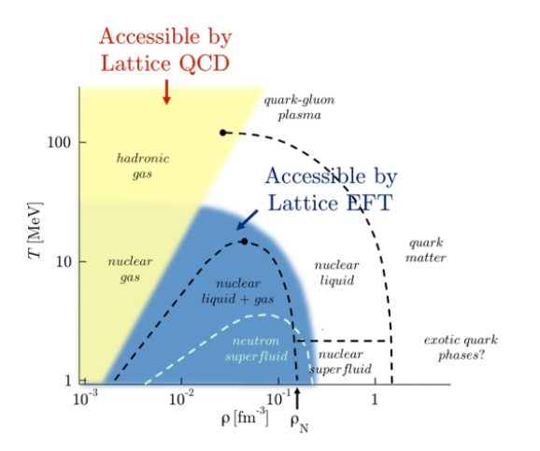
Unitary Fermi Gas in BCC lattice
Studying the bulk properties of many nucleon system
→ relation between realistic nuclear interaction and symmetric/asymmetric nuclear matter EOS.
→ requires very accurate nuclear force which reproduce both few-body system(NN scattering, binding energies)
And infinite nuclear matter (nuclear matter saturation )

Slide 24

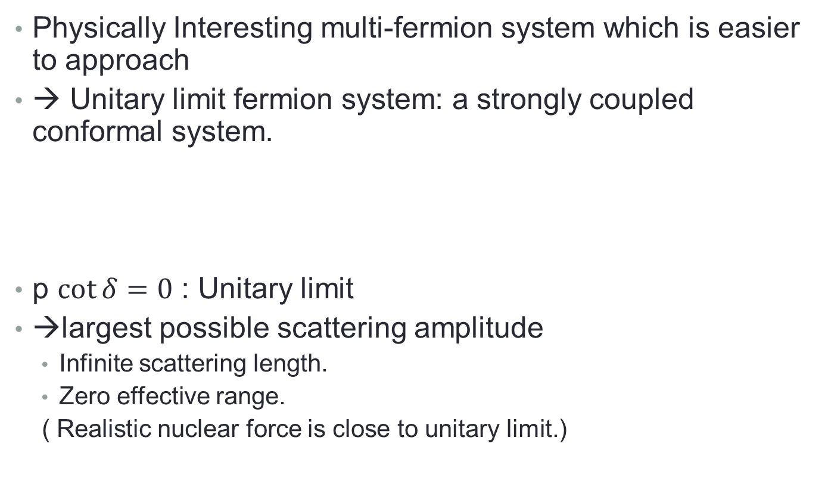
Unitary Fermion Gas in BCC lattice
Physically Interesting multi-fermion system which is easier to approach
→ Unitary limit fermion system: a strongly coupled conformal system.
p $\cot{δ}=0$ : Unitary limit
→largest possible scattering amplitude
Infinite scattering length.
Zero effective range.
( Realistic nuclear force is close to unitary limit.)

Slide 25
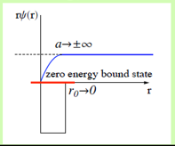
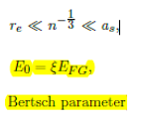
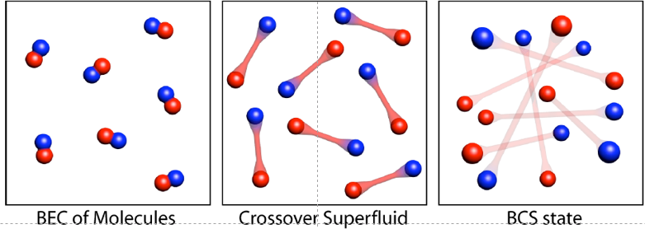
Unitary Fermion Gas in BCC lattice
Universality of unitary limit
Of many fermion system
→ Bertsch Parameter
Experiment in
Ultracold trapped atoms
(M. J. H. Ku et al, Science 335, 563-567 (2012).)
Bertch parameter ~ 0.376(4)
Many theoretical calculation exists including NLEFT.
Previous NLEFT calculation was done in cubic lattice.
Here we applied NLEFT in BCC lattice .

Slide 26
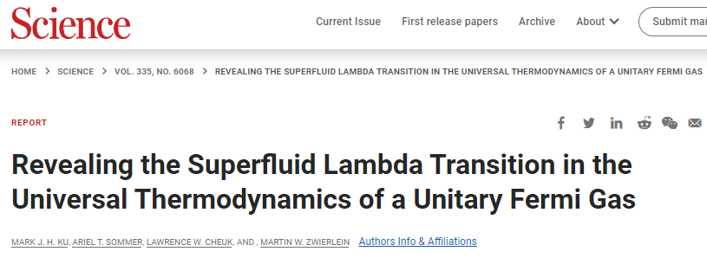
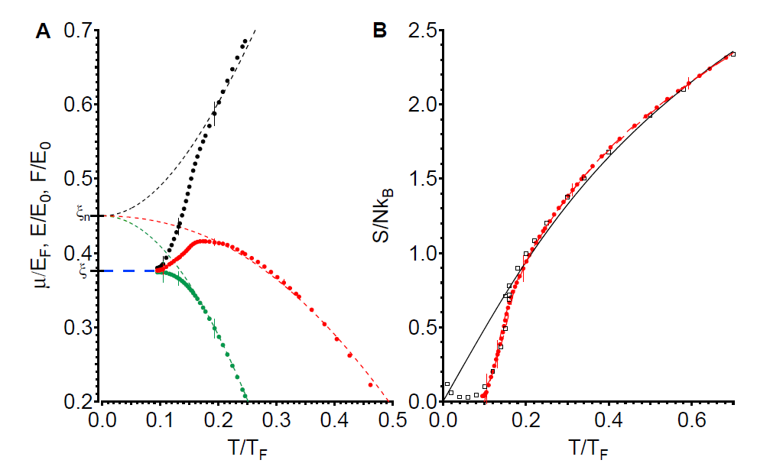
(M. J. H. Ku et al, Science 335, 563-567 (2012).)
Bertch parameter ~ 0.376(4)
Chemical potential, energy, free energy and Entropy per particle

Slide 27
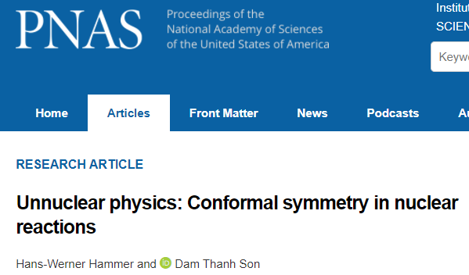
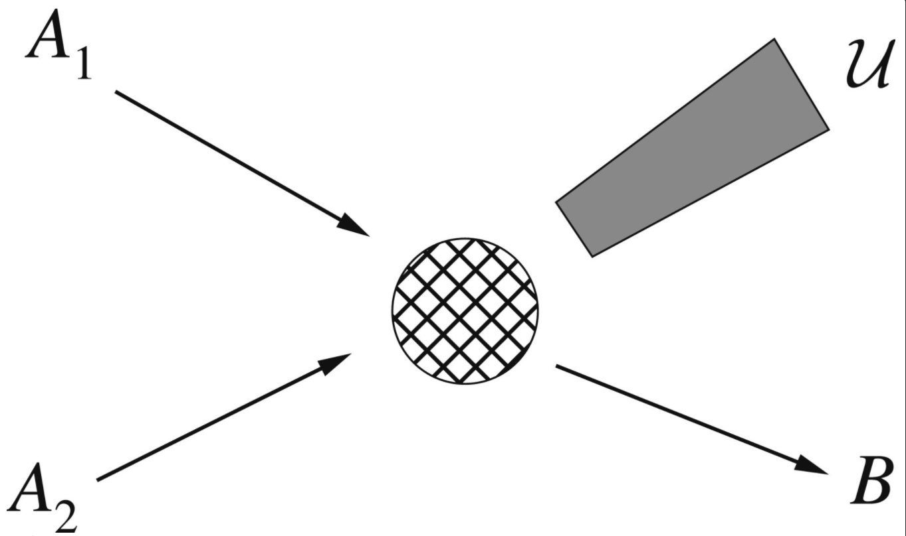

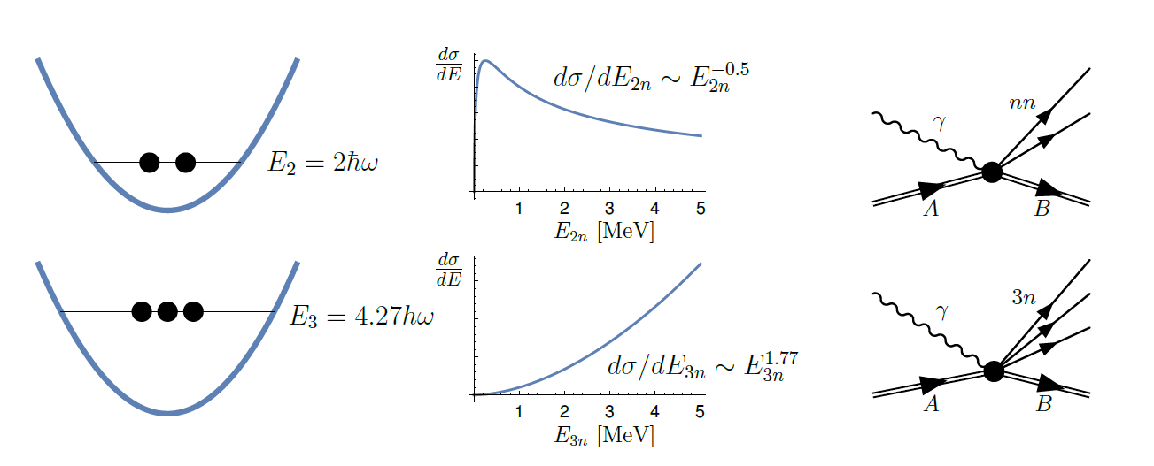
Fig. from
arXiv: 2109.06924
Simple scaling behavior of nuclear reactions
involving emission of several loosely bound neutrons (approximate conformal symmetry)

Slide 28

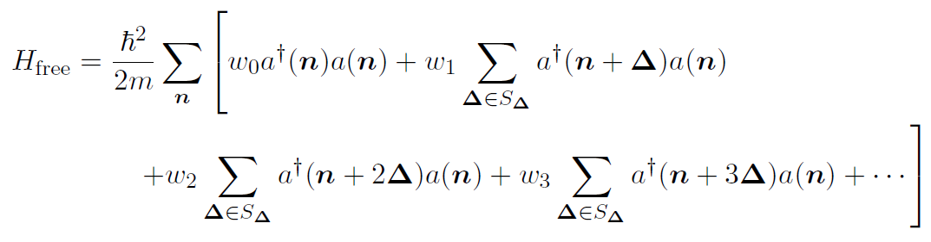
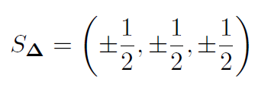
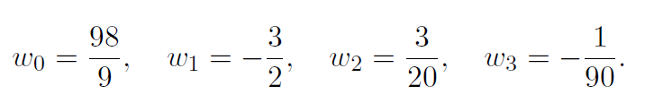
Unitary limit Hamiltonian in BCC
BCC lattice is constructed as
Two cubic lattice
(shifted by (1/2,1/2,1/2) in lattice unit)
2 L^3 lattice points
Lattice spacing a=1/100 MeV^-1
Lattice Time step at = 1/1000 MeV^-1
(For outer region at’=1/200 MeV^-1)

Slide 29

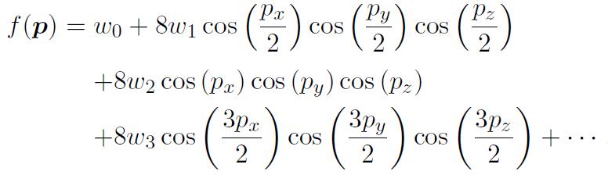
Unitary limit Hamiltonian in BCC
Our choice is valid up to O(p^6) : f(p) = p^2 +O(p^6)

Slide 30

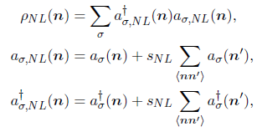
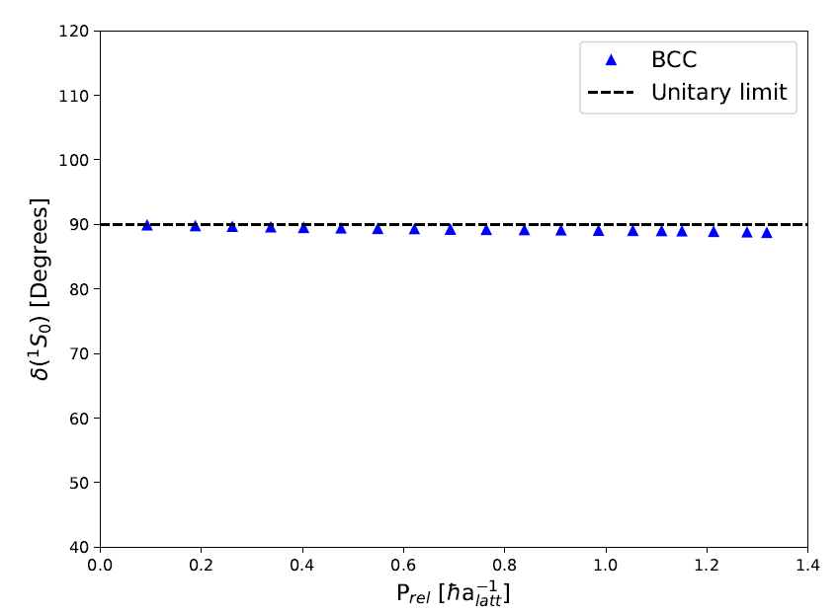
Unitary limit Hamiltonian in BCC
1S0 NN scattering phase shift is fitted
For unitary limit .
C0= -0.7449172 [l.u.]
sNL = - 0.0009533729
→
a0 = 125658 fm, r0 = 0.110 fm
Spherical Wall Method

Slide 31
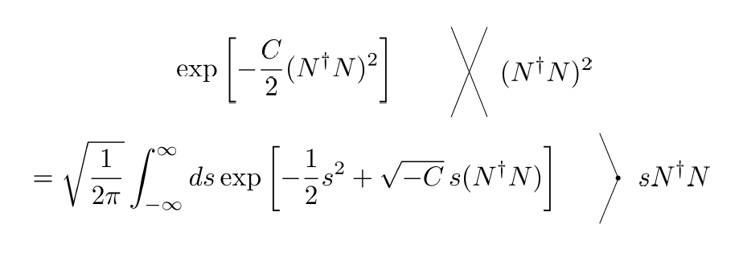
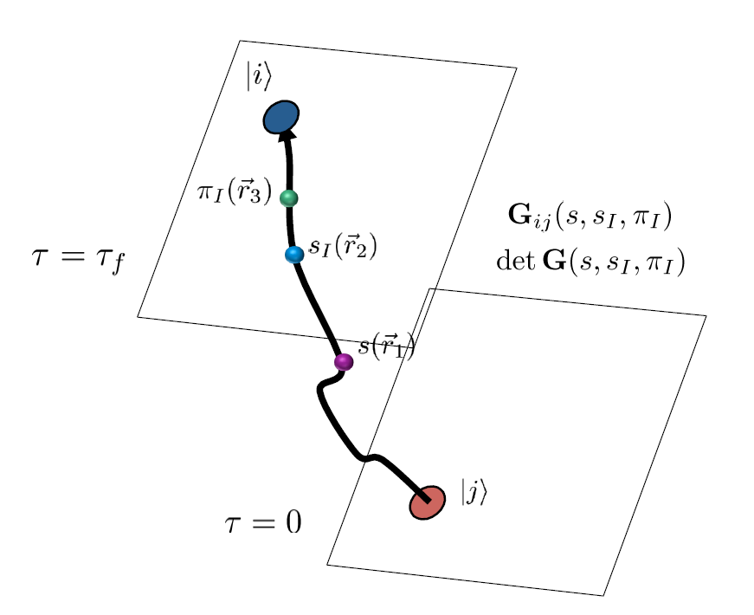
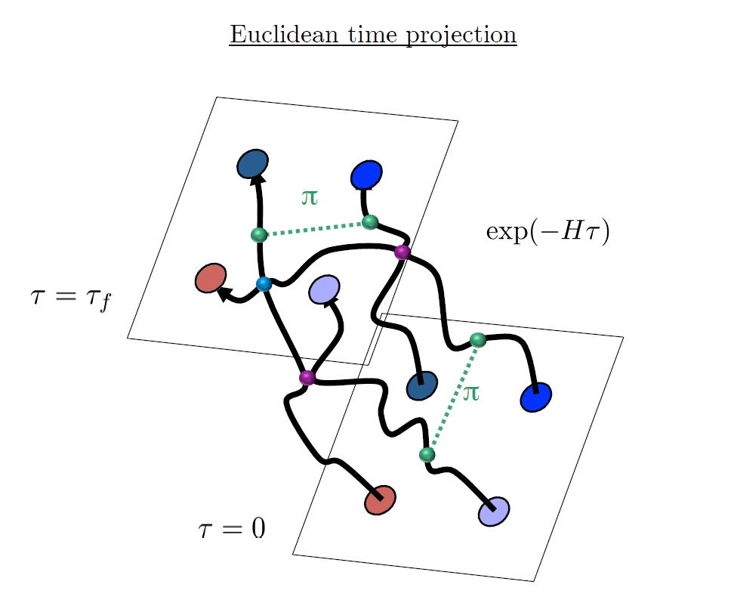
Auxiliary Field Monte Carlo

Slide 32
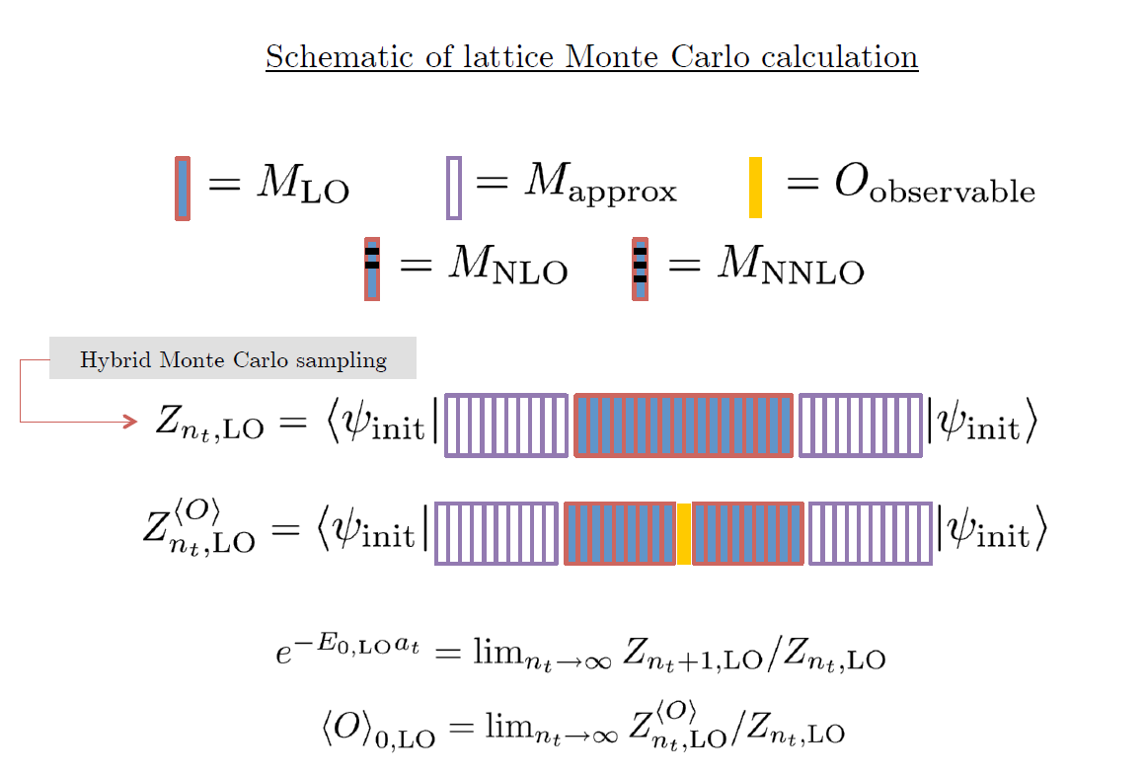

Slide 33

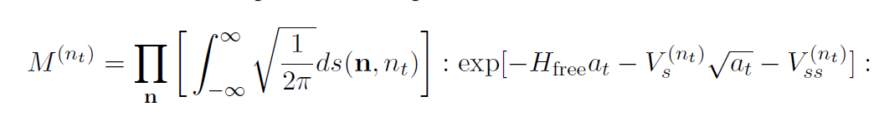
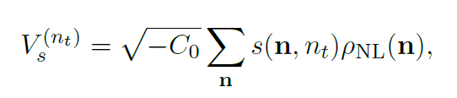
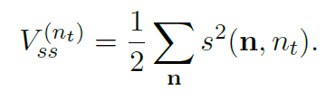
Outer region uses 1.6 stronger interaction for faster convergence

Slide 34





Results
N=66 neutrons (33 spin up, 33 spin down)
L = 4,…, 10

Slide 35




Infinite Euclidian time extrapolation
We performed Simultaneous fits using asymptotic form , if available,
With different Lt’ results.

Slide 36



Slide 37




Slide 38






Slide 39
Discussion
We confirm the regularization independence of NLEFT calculation for Unitary Fermi Gas.
Bertsch parameter of UFG estimated 0.369(2) , 0.371(2)
Consistent with Previous Cubic Lattice Calculation:
[He et al., Phys. Rev. A 101, 063615 (2020)].
0.369(2), 0.372(2).
Good agreement with other theoretical calculations
Good agreement with the experimental measurement 0.376(4).
BCC lattice calculation shows faster convergence between beta^few and beta^therm. BCC lattice requires larger number of lattice points for the same lattice size. However, for the similar number of lattice points, computational cost is similar for BCC and cubic lattice.
Plan for nuclear system with realistic interaction.

