Slide 1
Introduction to Nuclear lattice effective field theory
Young-Ho Song
(RISP, Institute for Basic Science)
RI meeting, Daejeon, 2016.02.25

Slide 2
Outline
Introduction
Formalism
Results
Discussion
Review articles:
Lattice simulations for few- and many-body systems
Dean Lee , Prog.Part.Nucl.Phys. 63 (2009) 117-154
The long and winding road from chiral effective Lagrangians to nuclear structure
Ulf-G Meißner , e-Print: arXiv:1510.03230

Slide 3
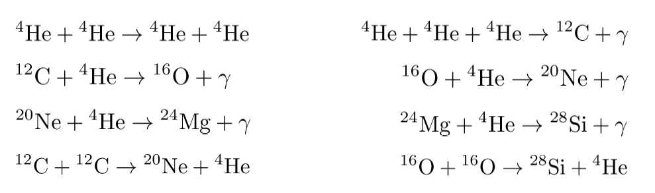
Questions of Nuclear Physics
Ultimate questions of Nuclear Physics :
How the nuclear force emerges from QCD(quarks and gluons)?
How can we explain the various nuclear phenomenon from the nuclear force?
How the various elements are generated in the Universe?
The recent progresses in ab-initio approach are promising
EFT : pionless EFT, chiral EFT, Halo EFT
Various Ab-initio methods: GFMC, NCSM, CC …
Unification of structure and reaction

Slide 4
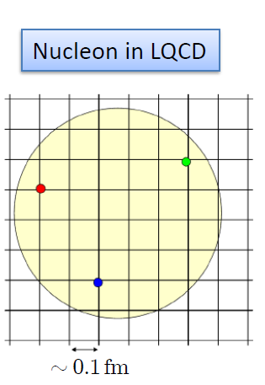

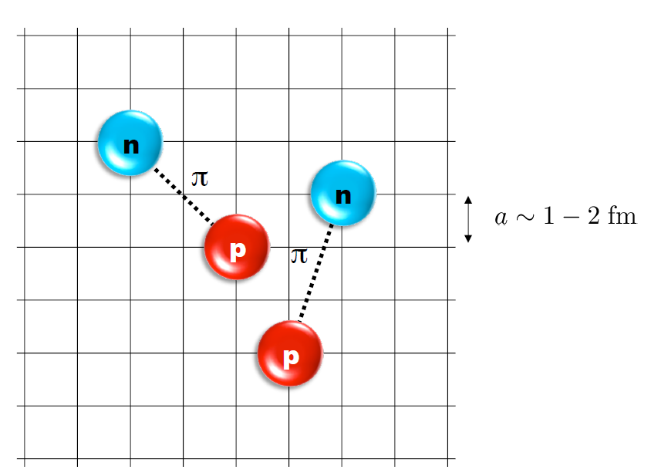
Nuclear Lattice Effective Field Theory

Slide 5
Characters of NLEFT
NLEFT does not require truncated basis expansions, many-body perturbation theory, or any constraints on the nuclear wave function.
Alpha clustering emerges naturally

Slide 6
Applications of NLEFT
Nuclear Matter : NLEFT started from nuclear matter calculation.
Cold atom, dilute fermion system
Nuclear Structure : published up to A<=28 for alpha-clusters. (current code have A<=40.) :
Computing time scales as ~ 79.7 A+7.11 A²
d, ³H, ³He, ⁴He, ⁶Li, ⁸Be, ¹²C, ¹⁶O,²⁰Ne, ²⁴Mg, ²⁸Si
First ab-initio calculation of Hoyle state
Cluster structure of ¹²C and ¹⁶O
Nuclear Scattering/Reaction:
NN scattering, N-D scattering
Alpha-alpha scattering
N-p radiative capture, p-p fusion

Slide 7




Lattice Method (Path Integral)

Slide 8
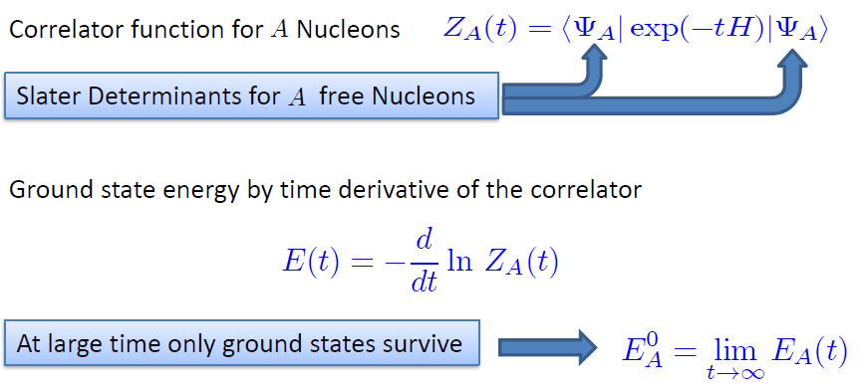
Transfer matrix method

Slide 9
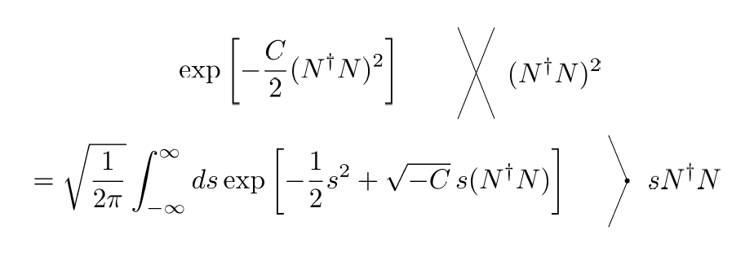
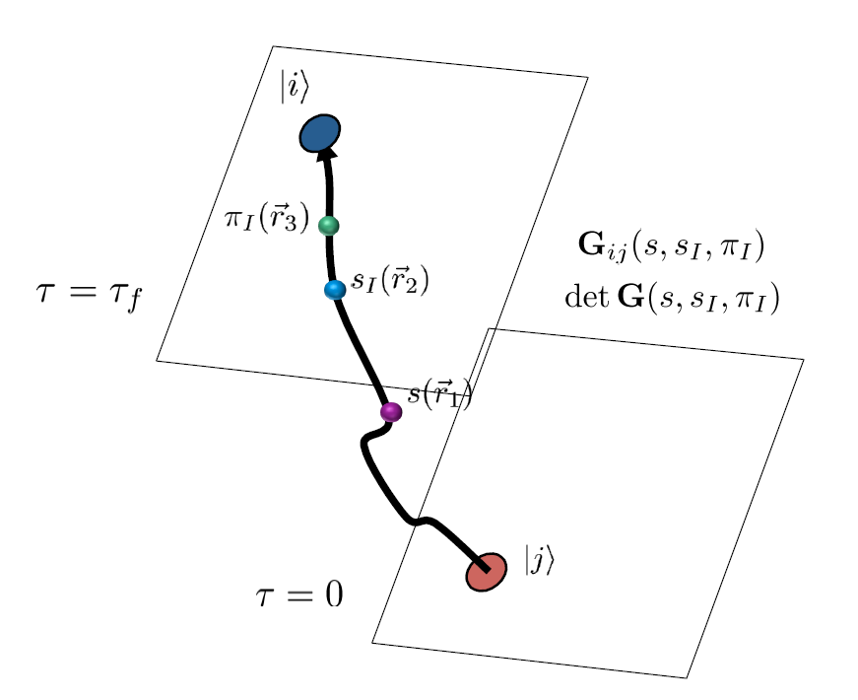
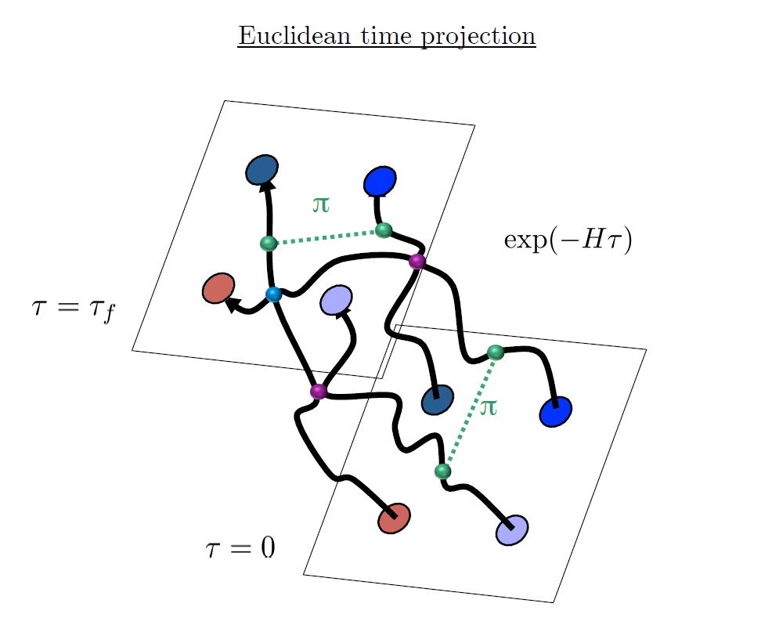
Auxiliary Field Monte Carlo

Slide 10
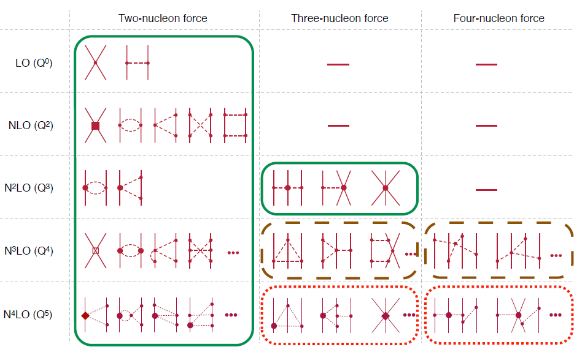
Chiral Effective Field Theory

Slide 11
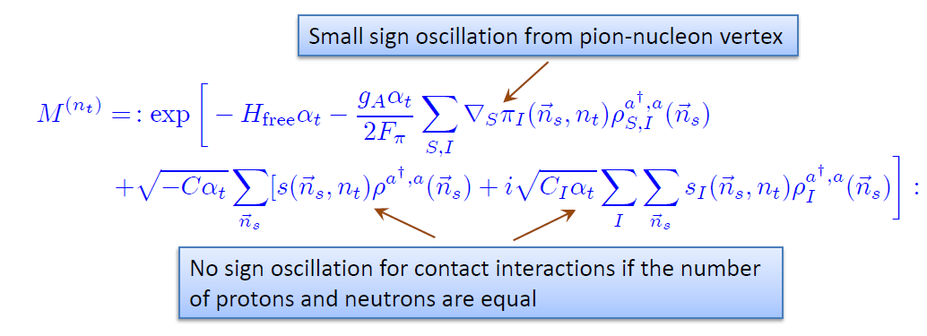
Transfer operator at LO
SU(4) symmetry gives no sign problem.
→ Nuclear force have approximate SU(4) symmetry

Slide 12
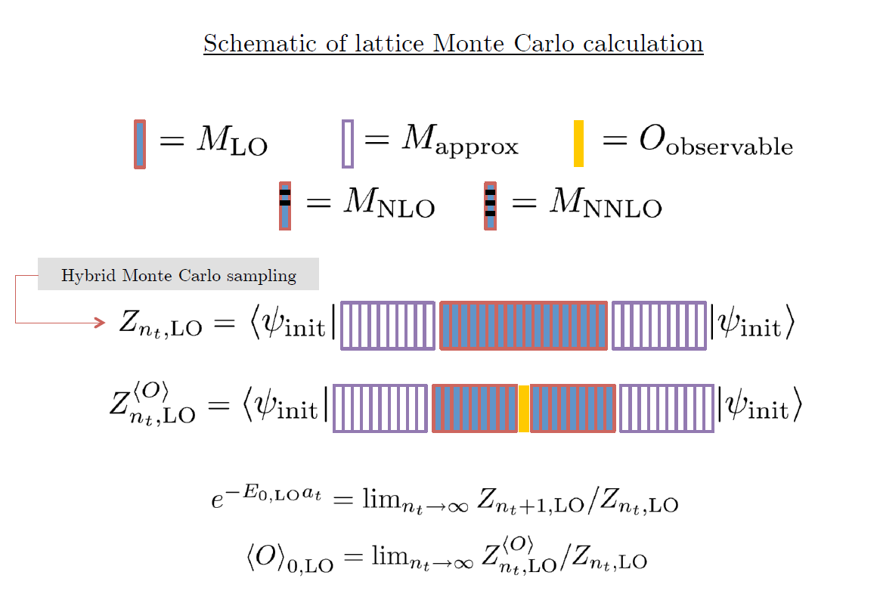

Slide 13
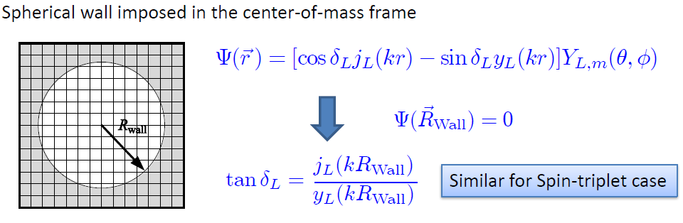


Low energy constants in lattice EFT
All LECs(parameters in the Hamiltonian) are fixed in A<=3
(They have to be fixed for given lattice regularization)
N-P scattering phase shifts, Deuteron binding energy
Triton binding energy, Triton beta decay.
Scattering phase shifts on the Lattice:
Luscher’s formula: two nucleon energy in cubic lattice

Slide 14
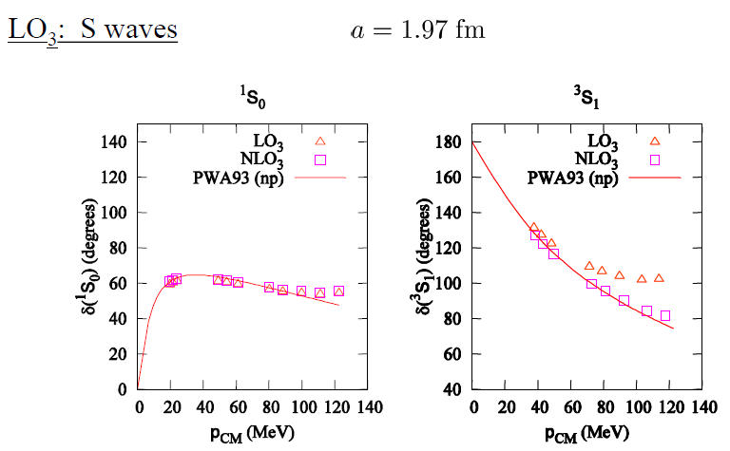
n-p scattering on lattice

Slide 15
Applications of NLEFT
Nuclear Matter : NLEFT started from nuclear matter calculation.
Cold atom, dilute fermion system
Nuclear Structure : published up to A<=28 for alpha-clusters. (current code have A<=40.) :
Computing time scales as ~ 79.7 A+7.11 A²
d, ³H, ³He, ⁴He, ⁶Li, ⁸Be, ¹²C, ¹⁶O,²⁰Ne, ²⁴Mg, ²⁸Si
First ab-initio calculation of Hoyle state
Cluster structure of ¹²C and ¹⁶O
Nuclear Scattering/Reaction:
NN scattering, N-D scattering
Alpha-alpha scattering
N-p radiative capture, p-p fusion

Slide 16
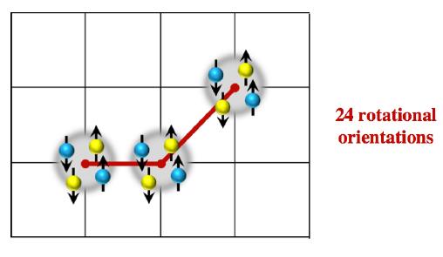
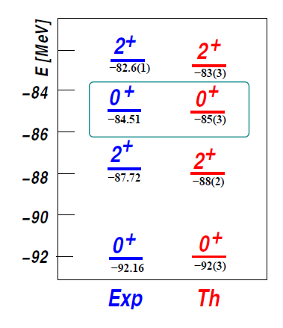
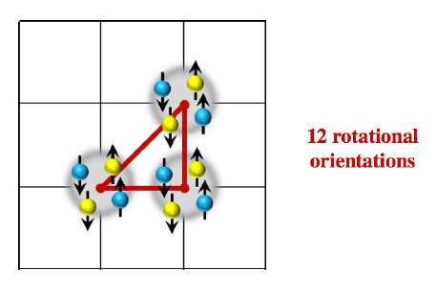

Ab initio calculation of Hoyle state and its structure
The first ab-initio calculation of
Hoyle state

Slide 17

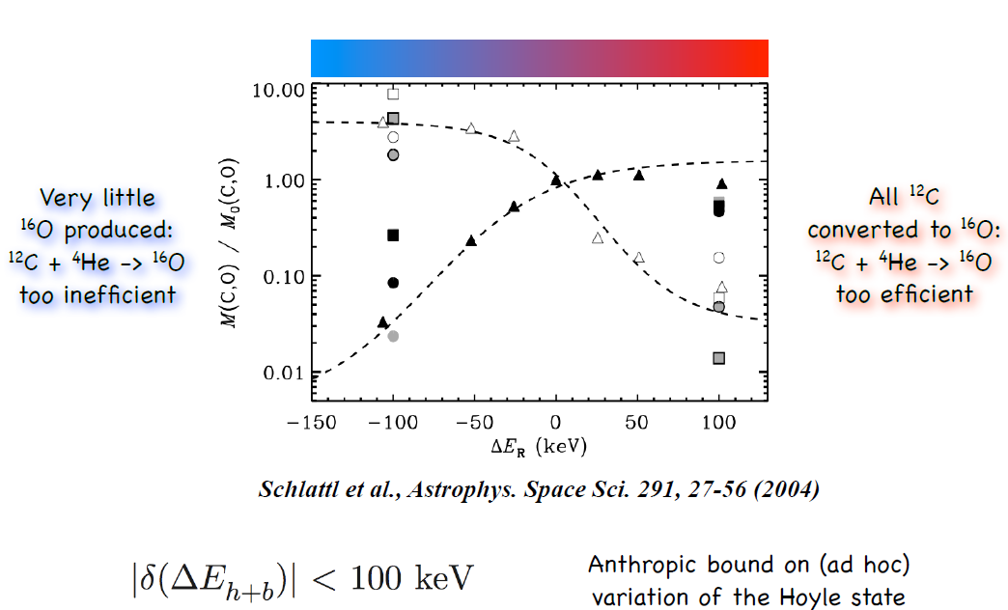

Life and fine-tuning of quark mass
Fine tuning of Hoyle state energy
Allowed Hoyle state energy variation ~ 25 %

Slide 18
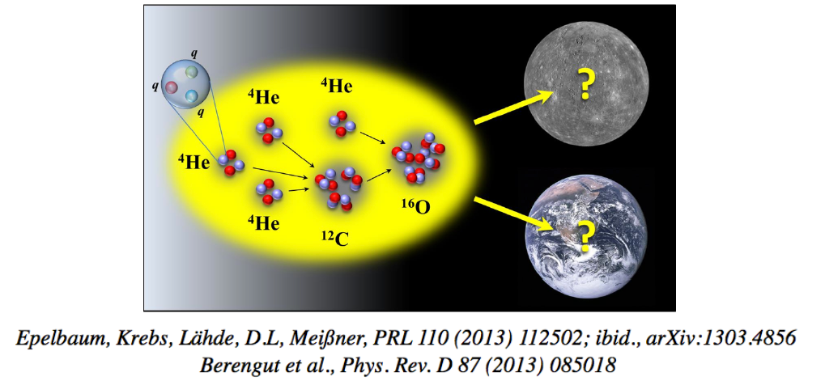
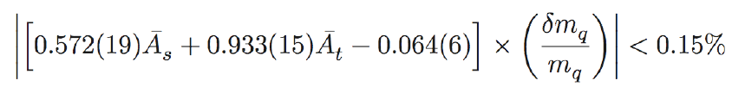
Life and fine-tuning of quark mass
→ Translates into : allowed quark mass variation 2-3 %

Slide 19
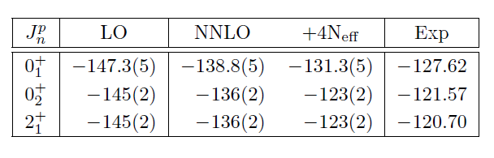
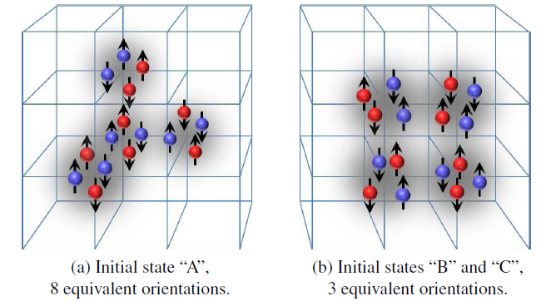



Spectrum and structure of ¹⁶O

Slide 20
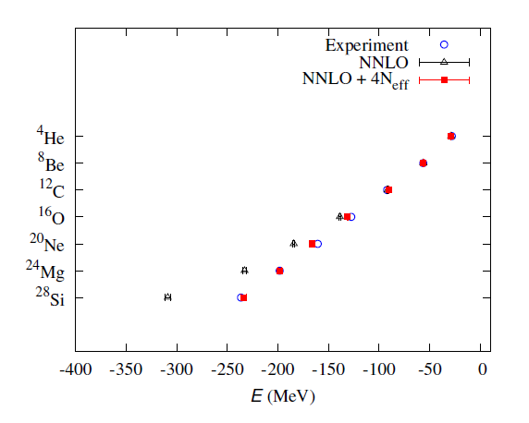

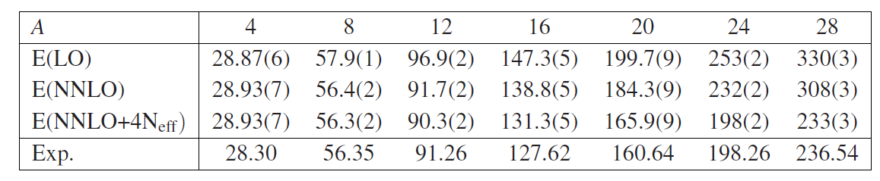
Towards Medium Mass Nuclei

Slide 21
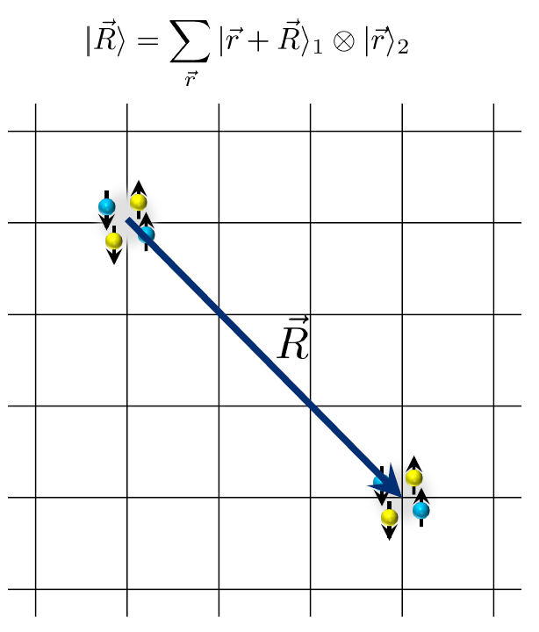
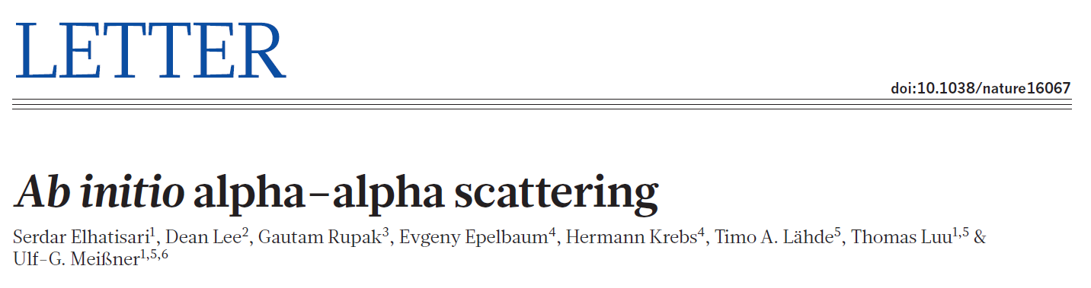




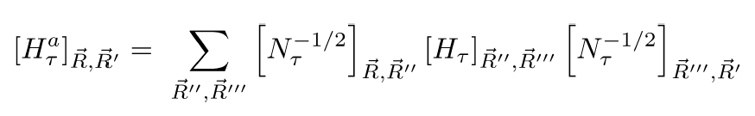
Ab-initio alpha-alpha scattering
Adiabatic projection method

Slide 22
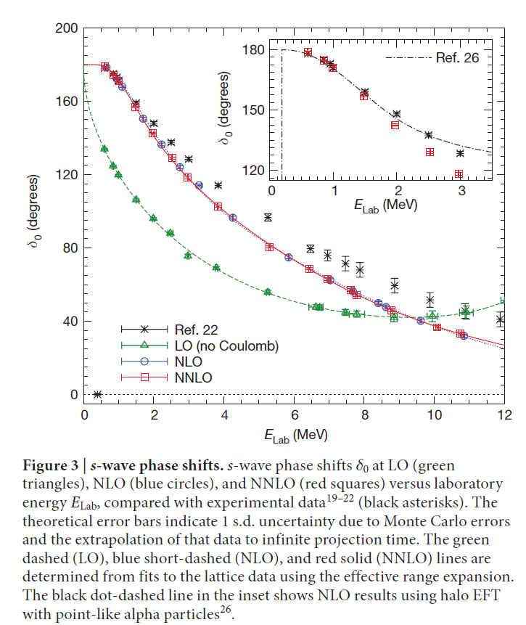
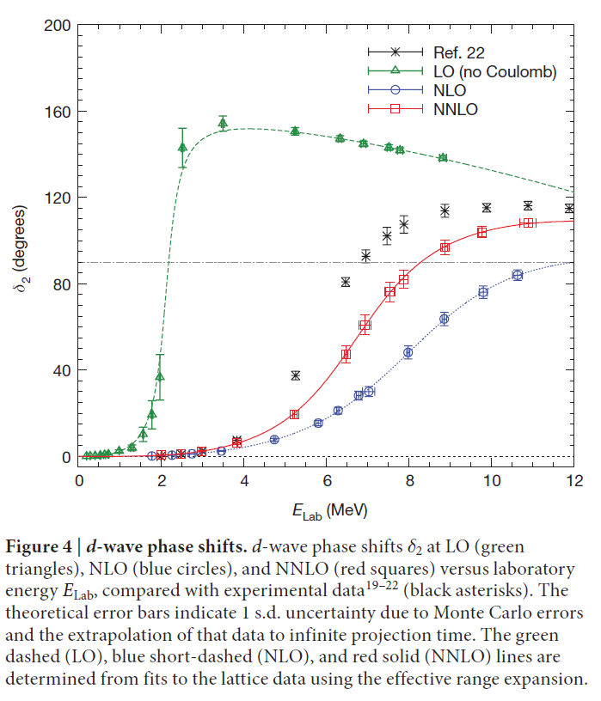
Ab-initio alpha-alpha scattering

Slide 23
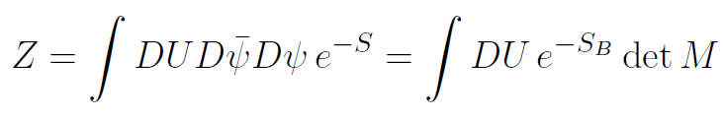

Sign Problem

Slide 24
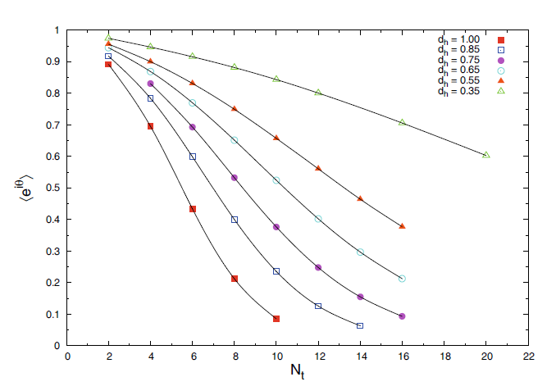
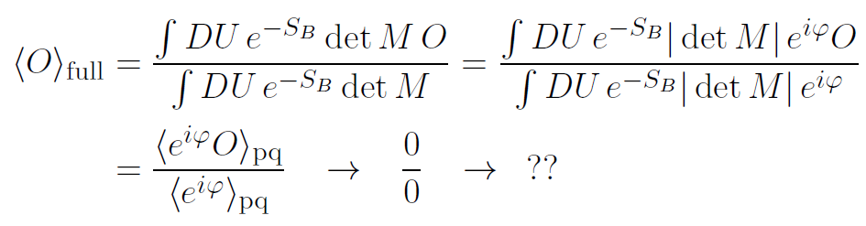
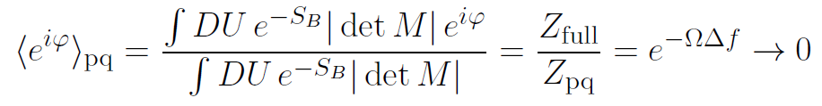
Sign problem

Slide 25

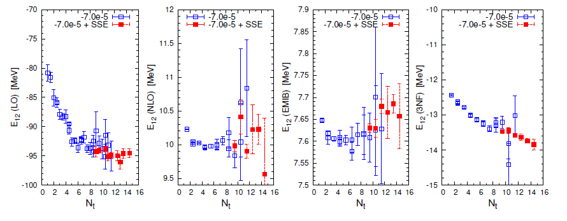
Symmetry Sign Extrapolation
SU(4) symmetry gives no sign problem.
→ Nuclear force have approximate SU(4) symmetry
→ SU(4) symmetry breaking introduce sign problem

Slide 26
New code: Non-local Lattice Hamiltonian
New Hamiltonian code :
introduce new non-local nucleon-nucleon interaction at leading order.
Smeared non-local creation, annihilation operator with nearest neighbor summation
All parameters are determined from:
n-p scattering phase shifts, deuteron energy
alpha-alpha s-wave phase shifts (phase shifts and deuteron energy are insensitive to non-locality.)

Slide 27
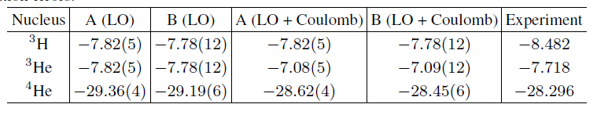
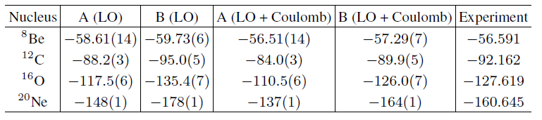
Non-local Lattice Hamiltonian
New non-local Lattice Hamiltonian code shows small sign problem.( Good quality compared to NNLO results)

Slide 28
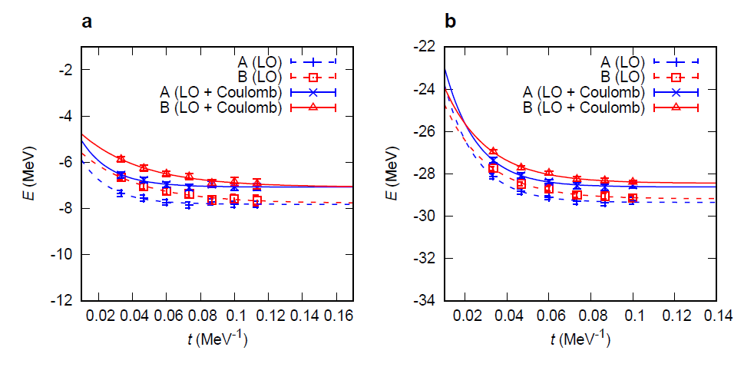
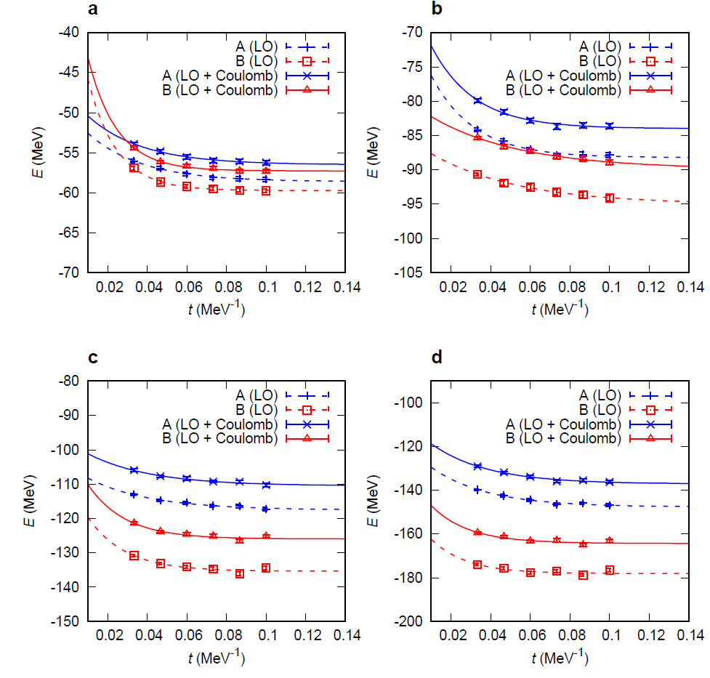
Non-local Lattice Hamiltonian
New non-local Lattice Hamiltonian code shows less sign problem.
Smeared non-local interaction
Smeared one-pion exchange interaction
New sampling method

Slide 29
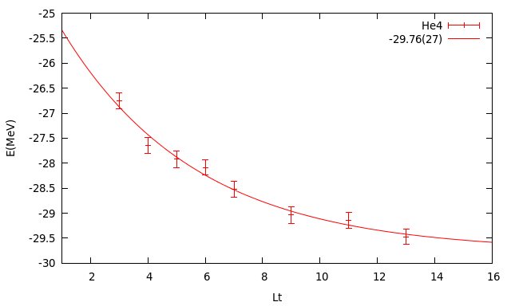
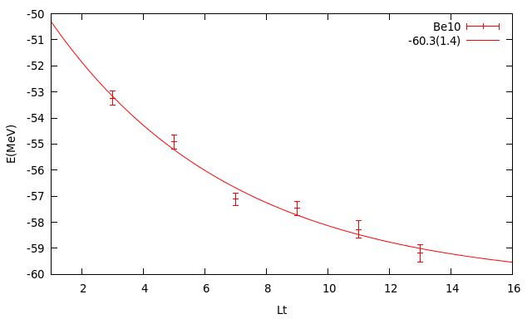
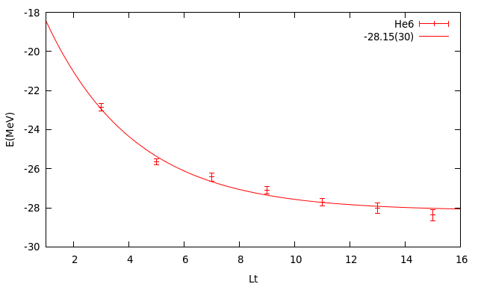
Results at RISP(Preliminary)
Collaboration with Dean Lee(NCSU)
Needs to reduce error bar at Large Lt, improve the convergence

Slide 30
Discussion
NLEFT can be an ideal tool for Nuclear Physics
NLEFT does not require truncated basis expansions, many-body perturbation theory, or any constraints on the nuclear wave function.
Alpha clustering emerges naturally
One of the largest sources of computational uncertainty is due to the ‘sign problem’, which have to be solved for broader application of NLEFT.
Towards:
Neutron-rich halo nuclei
Asymmetric nuclear matter
Limits of nuclear stability
Unification of structure and reaction: Triple alpha reactions.

