Slide 1
Introduction to Nuclear lattice effective field theory
Young-Ho Song
(RISP, Institute for Basic Science)
KISTI meeting, Daejeon, 2019.09.17

Slide 2
Outline
Introduction
Formalism
Status
Discussion
Review articles:
Lattice simulations for few- and many-body systems
Dean Lee , Prog.Part.Nucl.Phys. 63 (2009) 117-154
The long and winding road from chiral effective Lagrangians to nuclear structure
Ulf-G Meißner , e-Print: arXiv:1510.03230

Slide 3
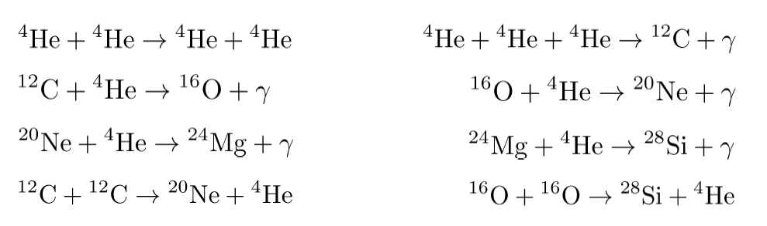
Questions of Nuclear Physics
Ultimate questions of Nuclear Physics :
How the nuclear force emerges from QCD(quarks and gluons)?
How can we explain the various nuclear phenomenon from the nuclear force?
How the various elements are generated in the Universe?
The recent progresses in ab-initio approach are promising
EFT : pionless EFT, chiral EFT, Halo EFT
Various Ab-initio methods: GFMC, NCSM, CC …
Unification of structure and reaction

Slide 4
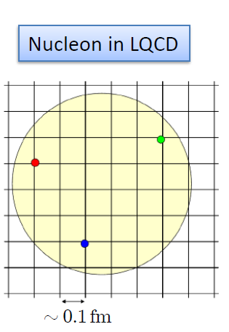

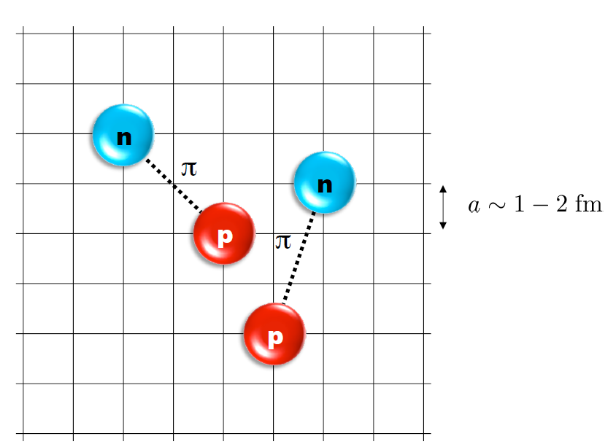
Nuclear Lattice Effective Field Theory

Slide 5
Characters of NLEFT
NLEFT does not require truncated basis expansions, many-body perturbation theory, or any constraints on the nuclear wave function.
Alpha clustering emerges naturally

Slide 6
Applications of NLEFT
Nuclear Matter : NLEFT started from nuclear matter calculation.
Cold atom, dilute fermion system
Nuclear Structure : published up to A<=28 for alpha-clusters. (current code have A<=40.) :
Computing time scales as ~ 79.7 A+7.11 A²
d, ³H, ³He, ⁴He, ⁶Li, ⁸Be, ¹²C, ¹⁶O,²⁰Ne, ²⁴Mg, ²⁸Si
First ab-initio calculation of Hoyle state
Cluster structure of ¹²C and ¹⁶O
Nuclear Scattering/Reaction:
NN scattering, N-D scattering
Alpha-alpha scattering
N-p radiative capture, p-p fusion

Slide 7




Lattice Method (Path Integral)

Slide 8
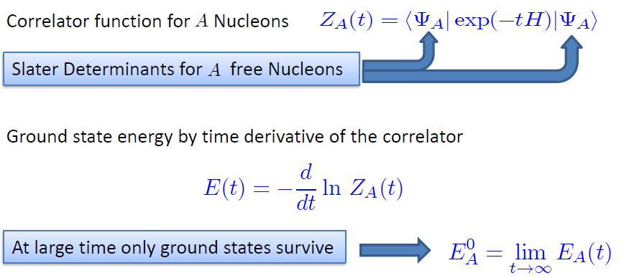
Transfer matrix method

Slide 9
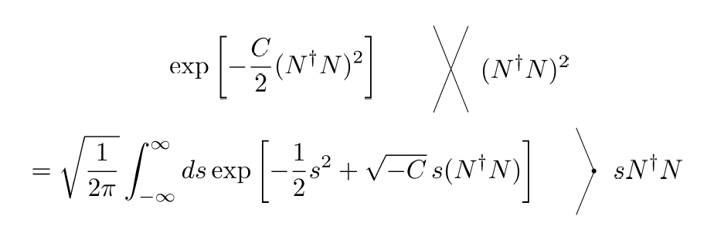
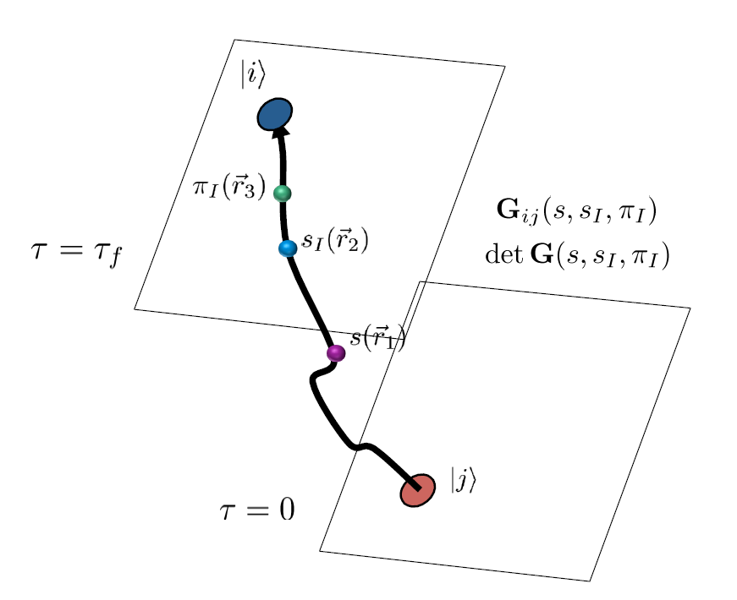
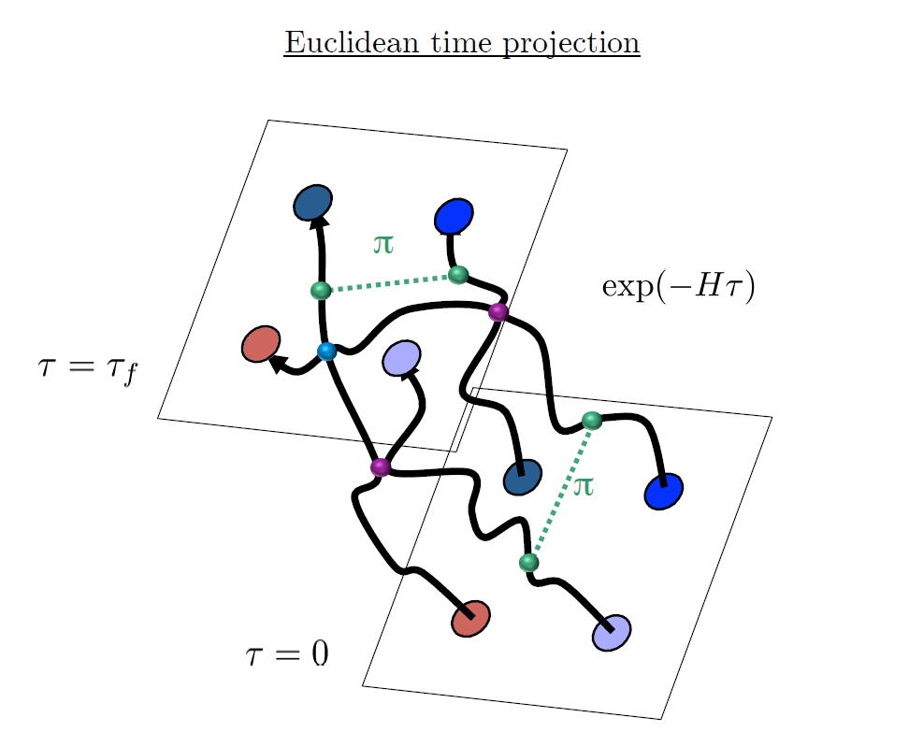
Auxiliary Field Monte Carlo

Slide 10
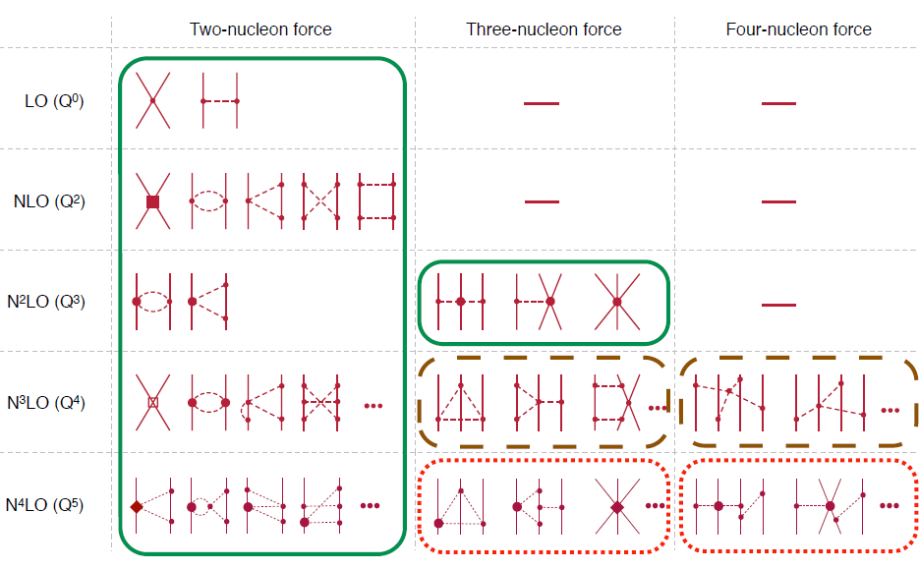
Chiral Effective Field Theory

Slide 11
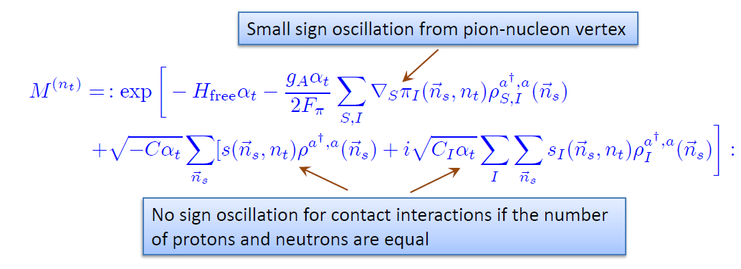
Transfer operator at LO
SU(4) symmetry gives no sign problem.
→ Nuclear force have approximate SU(4) symmetry

Slide 12
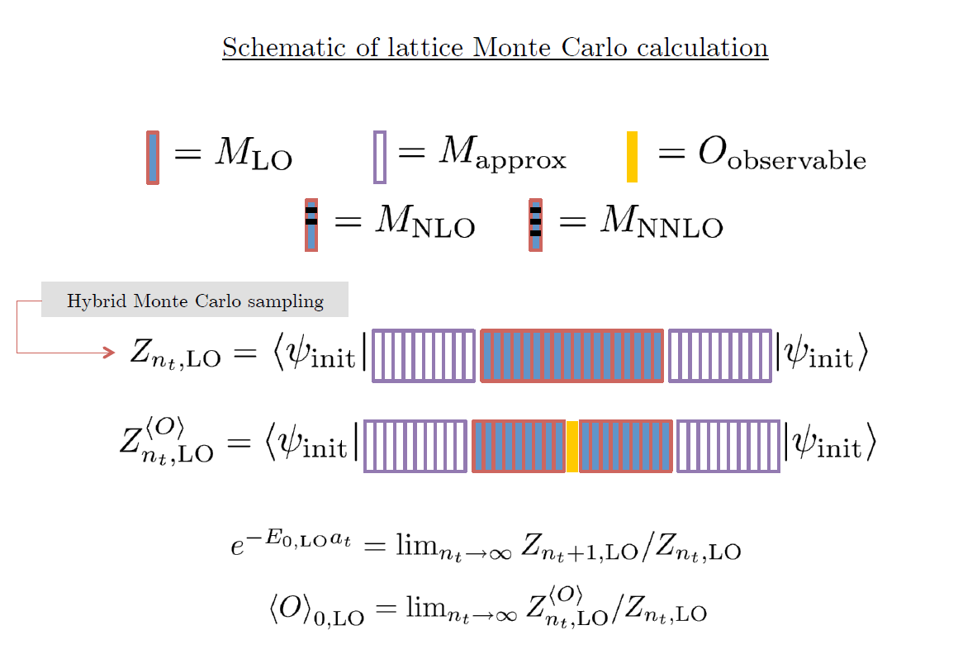

Slide 13
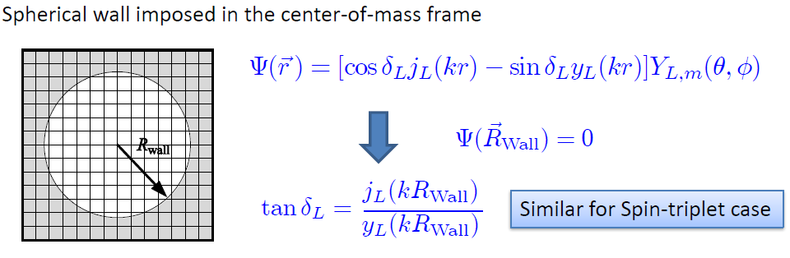


Low energy constants in lattice EFT
All LECs(parameters in the Hamiltonian) are fixed in A<=3
(They have to be fixed for given lattice regularization)
N-P scattering phase shifts, Deuteron binding energy
Triton binding energy, Triton beta decay.
Scattering phase shifts on the Lattice:
Luscher’s formula: two nucleon energy in cubic lattice

Slide 14
Applications of NLEFT
Nuclear Matter : NLEFT started from nuclear matter calculation.
Cold atom, dilute fermion system
Nuclear Structure : published up to A<=28 for alpha-clusters. (current code have A<=40.) :
Computing time scales as ~ 79.7 A+7.11 A²
d, ³H, ³He, ⁴He, ⁶Li, ⁸Be, ¹²C, ¹⁶O,²⁰Ne, ²⁴Mg, ²⁸Si
First ab-initio calculation of Hoyle state
Cluster structure of ¹²C and ¹⁶O
Nuclear Scattering/Reaction:
NN scattering, N-D scattering
Alpha-alpha scattering
N-p radiative capture, p-p fusion

Slide 15
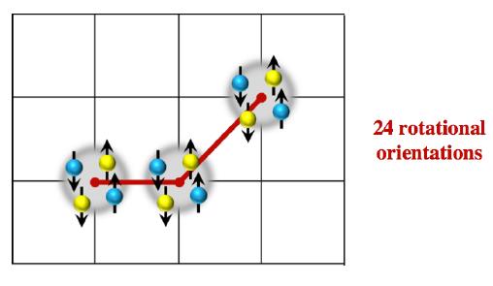
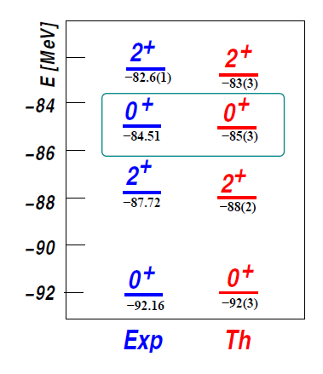
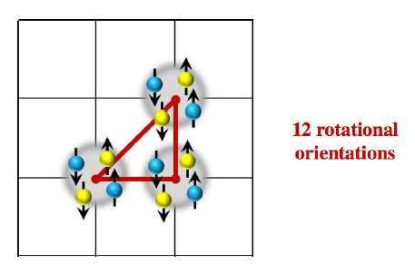

Ab initio calculation of Hoyle state and its structure
The first ab-initio calculation of
Hoyle state

Slide 16
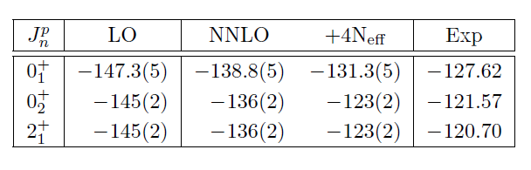
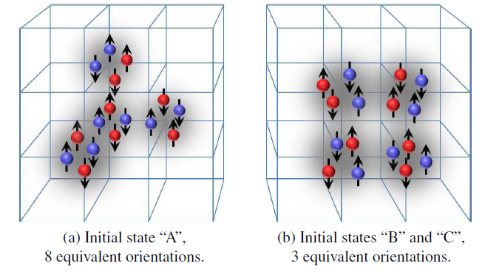



Spectrum and structure of ¹⁶O

Slide 17
New code: Non-local Lattice Hamiltonian
New Hamiltonian code :
introduce new non-local nucleon-nucleon interaction at leading order.
Smeared non-local creation, annihilation operator with nearest neighbor summation
All parameters are determined from:
n-p scattering phase shifts, deuteron energy
alpha-alpha s-wave phase shifts (phase shifts and deuteron energy are insensitive to non-locality.)

Slide 18
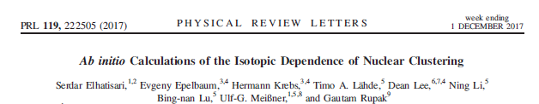
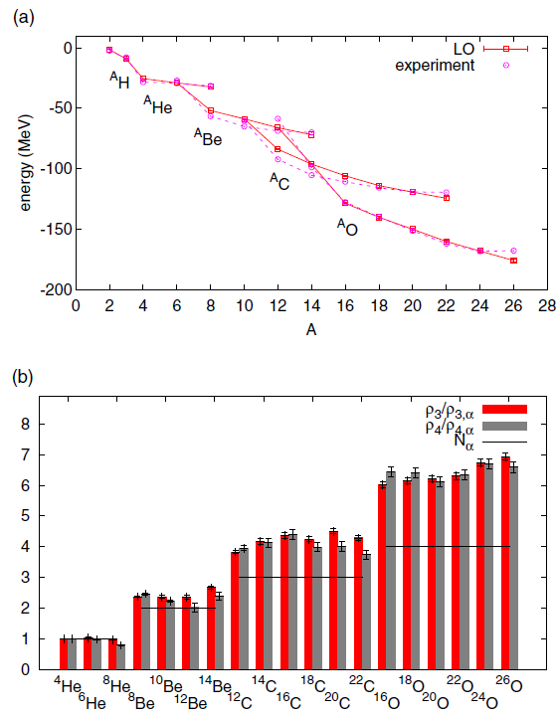
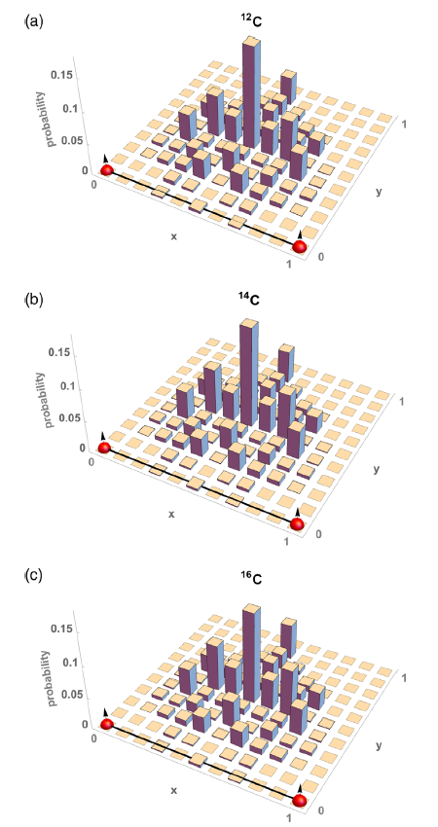
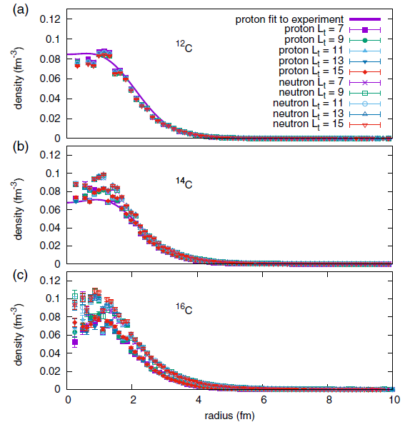

Slide 19
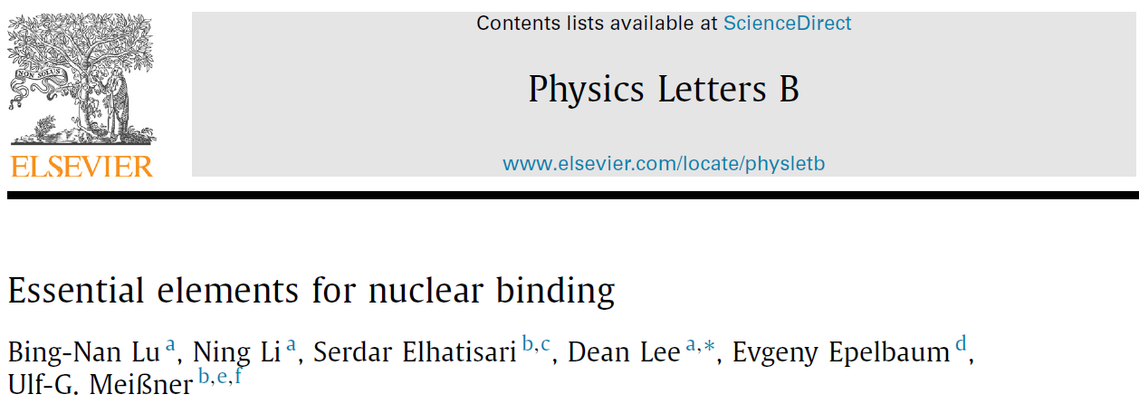
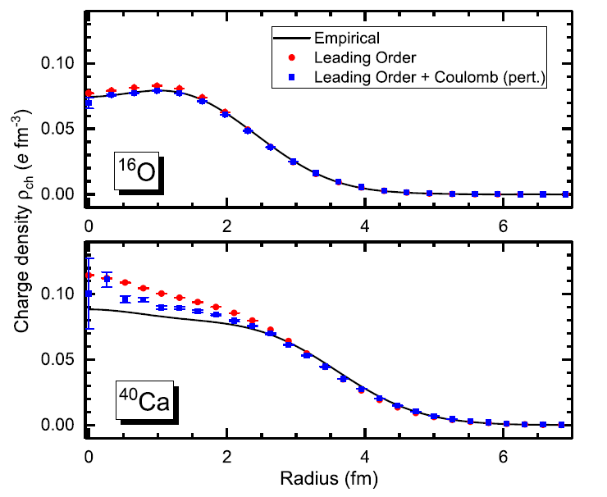



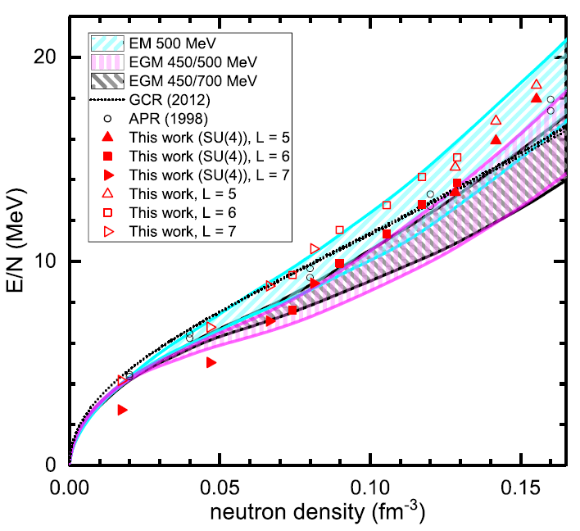
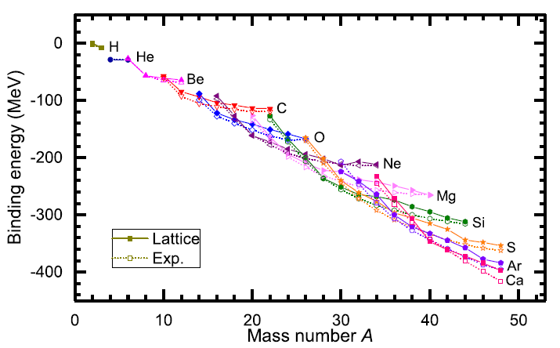

Slide 20
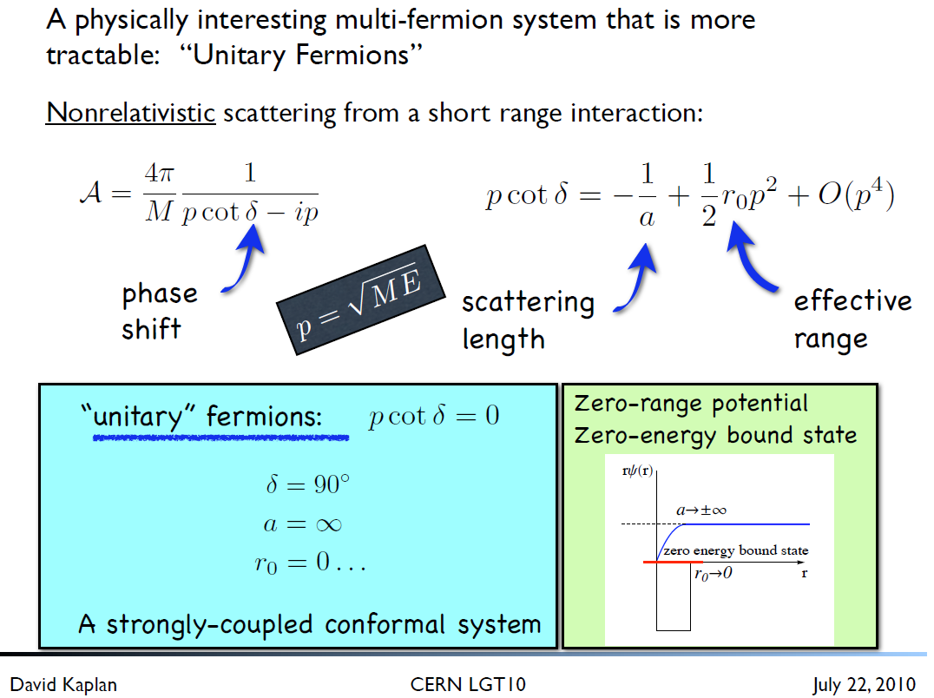
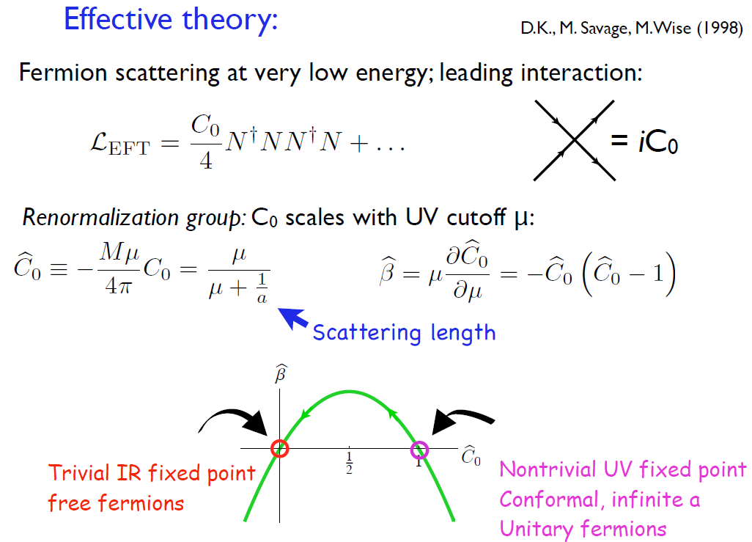
Unitary Fermion Gas in BCC lattice

Slide 21
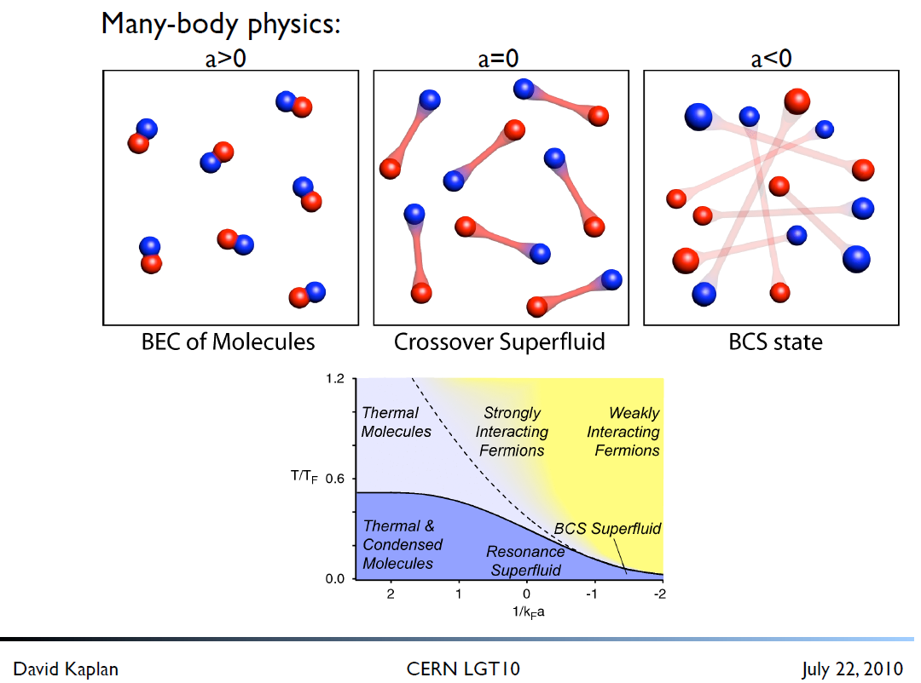



Slide 22
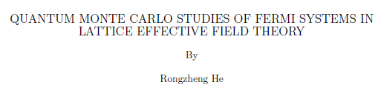
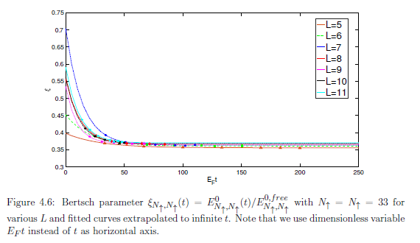
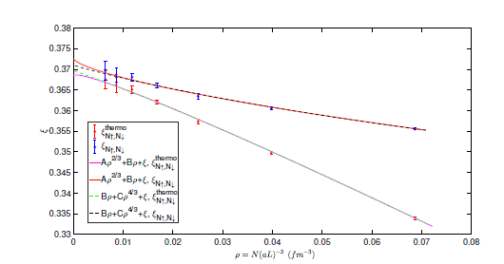
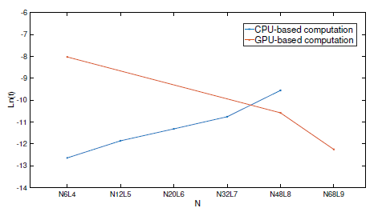
According to the Thesis:
They used 4096 parallel threads,
Each one of which involves
about 800 independent Euclidean time
Projections.
GPU based algorithm boost the
Computation speed compared to
CPU-based simulation.

Slide 23
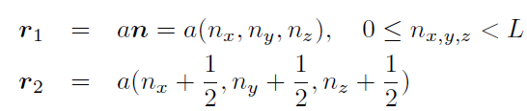
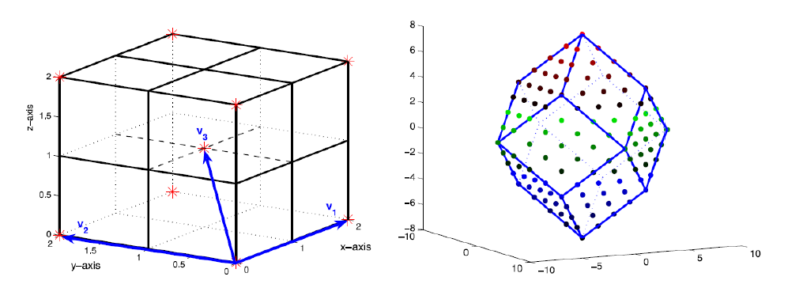



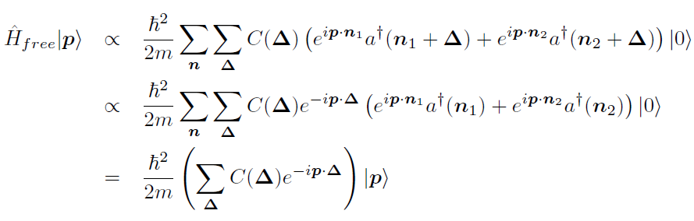
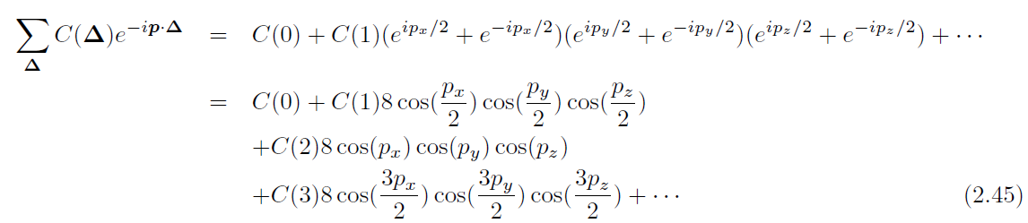

BCC lattice
1N momentum-eigen state

Slide 24
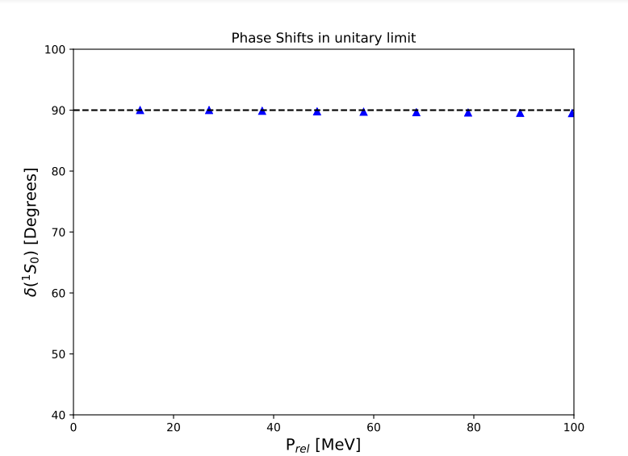
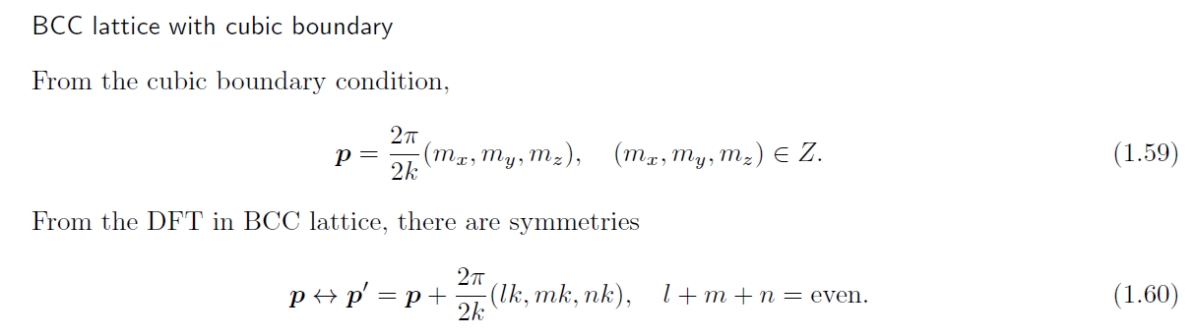
Unitary Fermion Gas in BCC lattice
c0_phys = -1.182326146423221*a^2 with a = 1/(150 MeV), and
sNL = -0.004156085667420.
a1s0 = 2.354422860283245e+08 fm, and
r1s0 = -1.425735355708342e-06 fm.
L = 50, Rin = 15.02, and Rout = 22.02.
However, I found some discrepancy in the exact MATLAB result
And Fortran MC code for two-nucleon system.
Currently working to solve the problem.

Slide 25
Discussion
NLEFT can be an ideal tool for Nuclear Physics
NLEFT does not require truncated basis expansions, many-body perturbation theory, or any constraints on the nuclear wave function.
Alpha clustering emerges naturally
New non-local contact interaction reduces sign-problem.
For a starter, work on Unitary Fermion Gas in BCC lattice is under progress.
Towards:
Neutron-rich halo nuclei
Asymmetric nuclear matter
Limits of nuclear stability
Unification of structure and reaction: Triple alpha reactions.

