Slide 1
Quantum Many-Body Calculations using Body-Centered Cubic Lattices
Young-Ho Song
(RISP, Institute for Basic Science)
KPS meeting(online), 2020.07.14

Slide 2
Outline
Introduction
Formalism
Results
Discussion

Slide 3
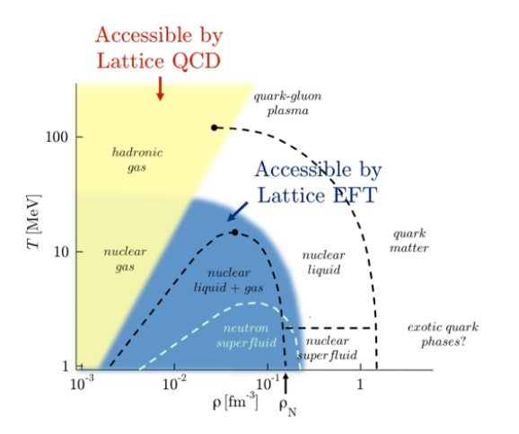
Unitary Fermion Gas in BCC lattice
Studying the bulk properties of many nucleon system
→ relation between realistic nuclear interaction and symmetric/asymmetric nuclear matter EOS.
→ requires very accurate nuclear force which reproduce both few-body system(NN scattering, binding energies)
And infinite nuclear matter (nuclear matter saturation )

Slide 4

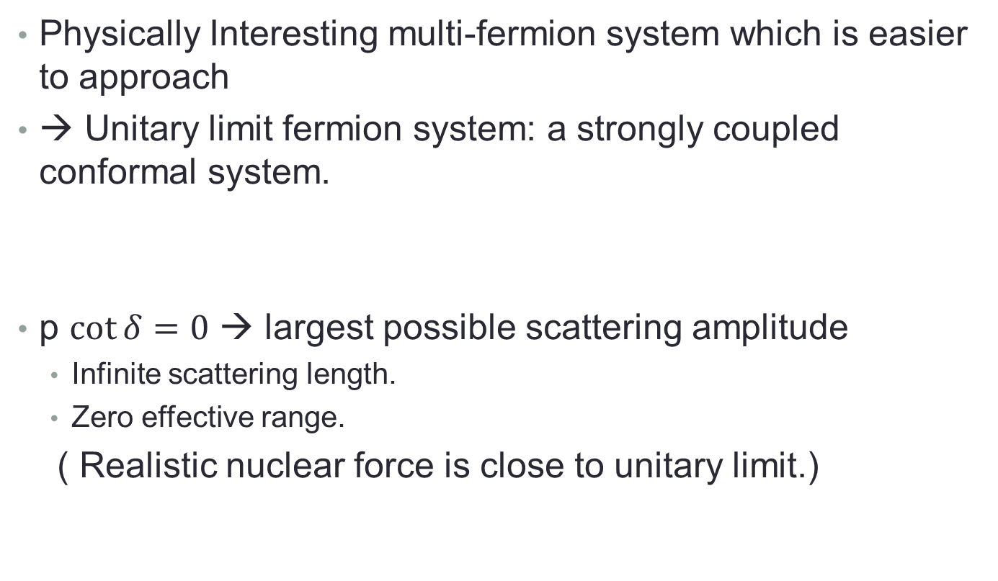
Unitary Fermion Gas in BCC lattice
Physically Interesting multi-fermion system which is easier to approach
→ Unitary limit fermion system: a strongly coupled conformal system.
p $\cot{δ}=0$ → largest possible scattering amplitude
Infinite scattering length.
Zero effective range.
( Realistic nuclear force is close to unitary limit.)

Slide 5
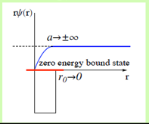
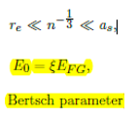
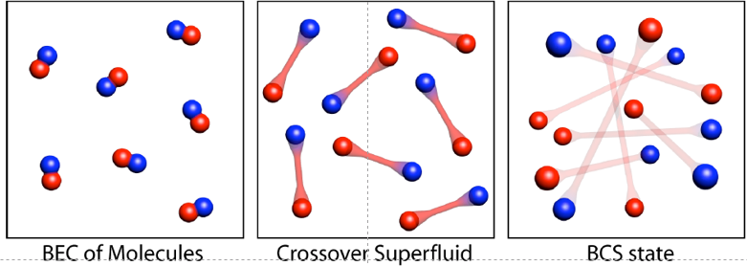
Unitary Fermion Gas in BCC lattice
Universality of unitary limit
Of many fermion system
→ Bertsch Parameter
Experiment in
Ultracold trapped atoms
(M. J. H. Ku et al, Science 335, 563-567 (2012).)
Bertch parameter ~ 0.376(4)
Many theoretical calculation exists including NLEFT.
Previous NLEFT calculation was done in cubic lattice.
Here we applied NLEFT in BCC lattice .

Slide 6
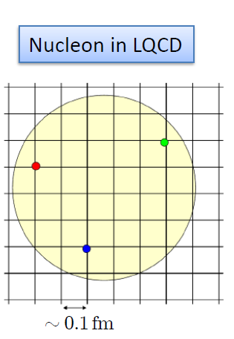

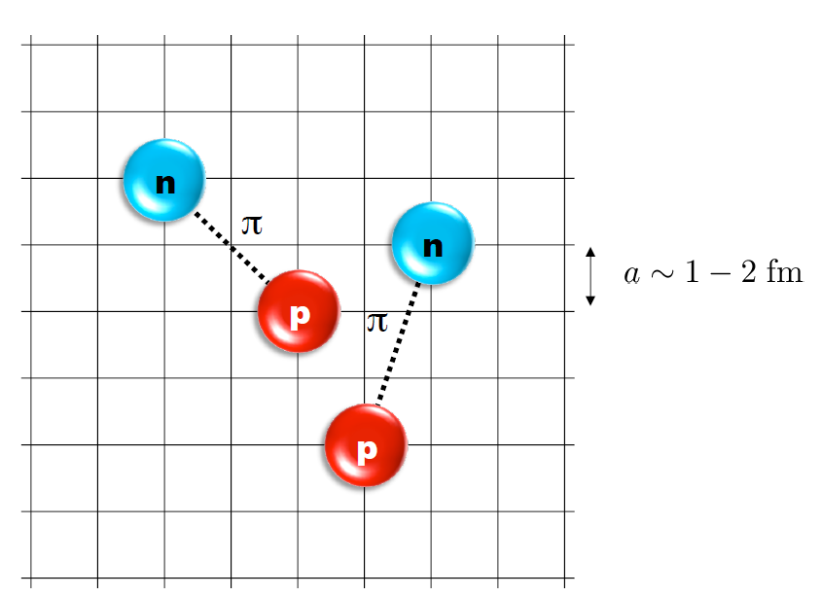
Nuclear Lattice Effective Field Theory
One of ab initio method for many fermion system

Slide 7
Characters of NLEFT
NLEFT is not a molecular dynamics
→ fully quantum mechanical.
NLEFT does not require truncated basis expansions, many-body perturbation theory, or any constraints on the nuclear wave function. Regularization/Truncation is in the lattice spacing.
Alpha clustering emerges naturally.

Slide 8
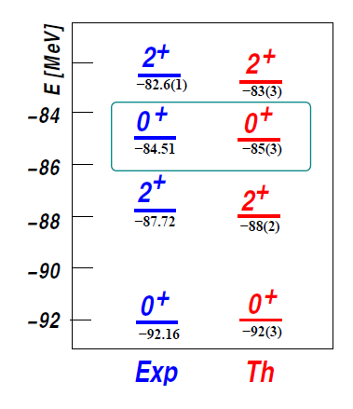

Applications of NLEFT
Has been successfully applied to
Nuclear matter, Cold atom, dilute fermion system
Finite nuclei (A<=50)
First ab-initio calculation of Hoyle state
Cluster structure of ¹²C and ¹⁶O
NN scattering, N-D scattering
Alpha-alpha scattering
radiative capture, fusion
Etc.
The first ab-initio calculation of
Hoyle state

Slide 9

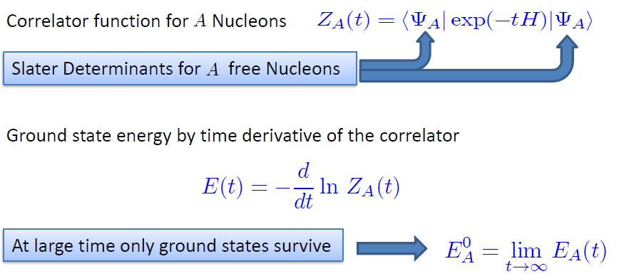
Path integral (transfer matrix method)

Slide 10
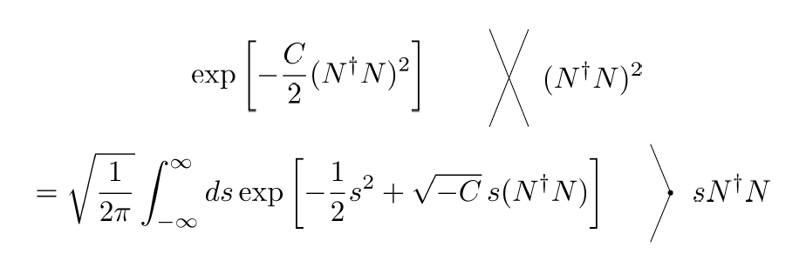
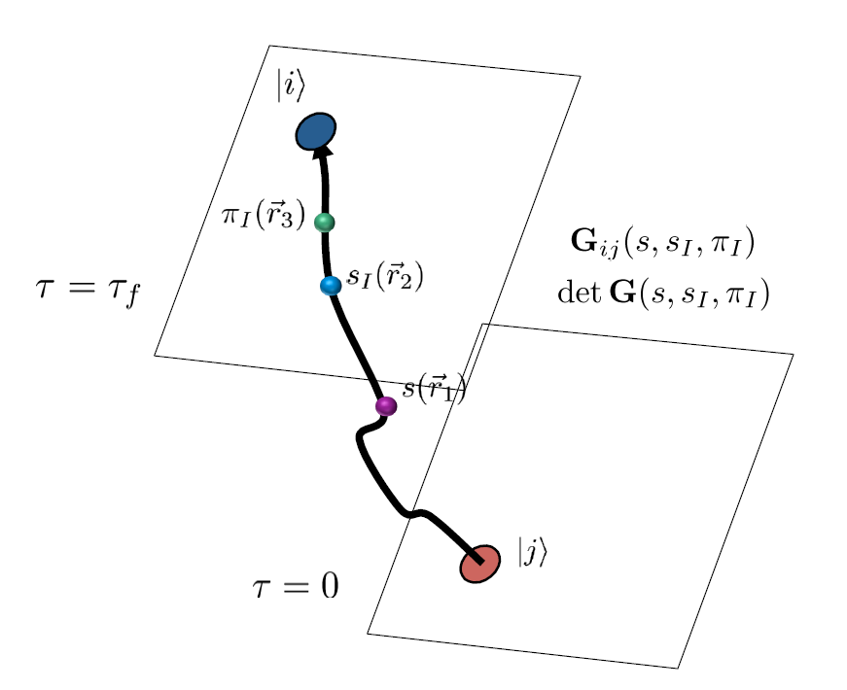
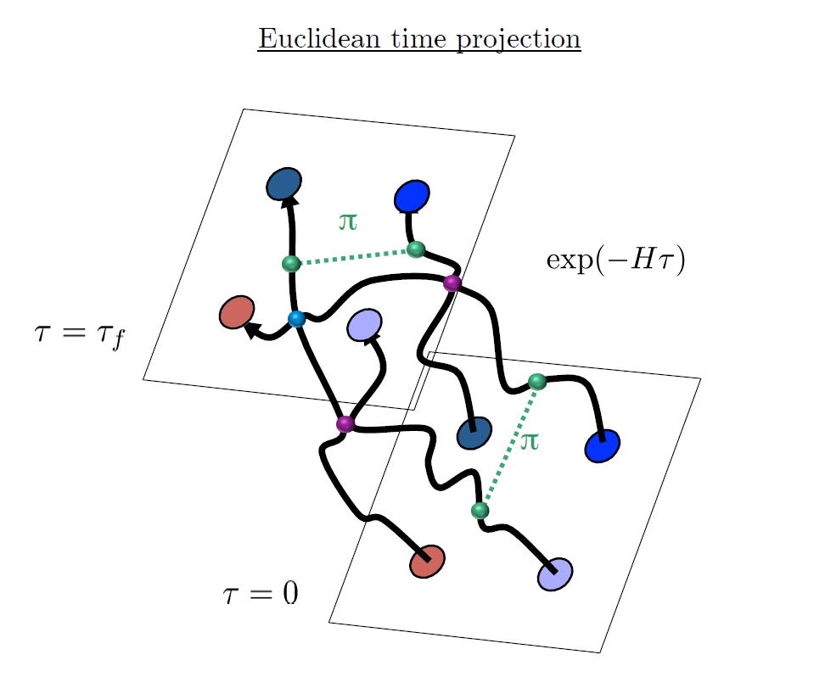
Auxiliary Field Monte Carlo

Slide 11
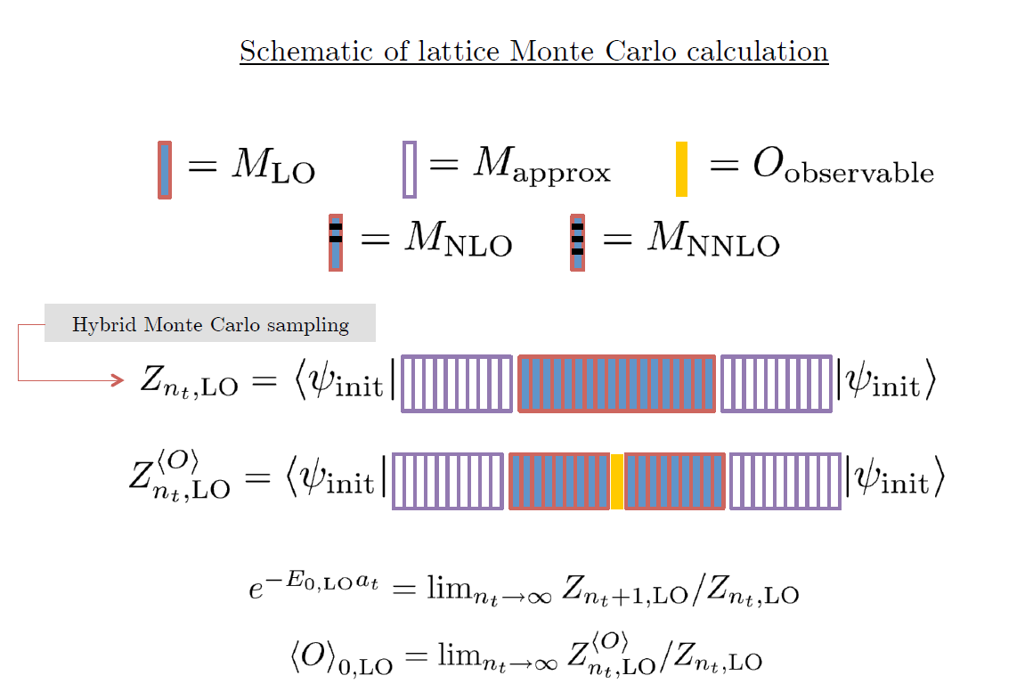

Slide 12
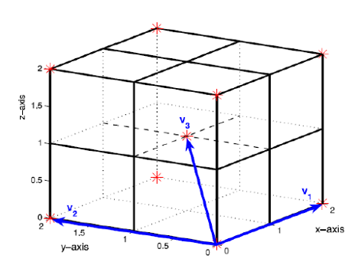
BCC lattice
Because of convenience all NLEFT calculation has been done on cubic lattice
Physical result should not depends on the specific lattice
structure. (lattice size, spacing, type)
BCC lattice is constructed as
Two cubic lattice
(shifted by (1/2,1/2,1/2) in lattice unit)
Lattice spacing a=1/100 MeV^-1
Lattice Time step at = 1/1000 MeV^-1
(For outer region at’=1/200 MeV^-1)

Slide 13



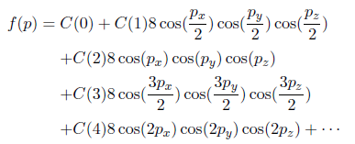


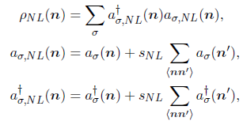
Unitary limit Hamiltonian in BCC

Slide 14
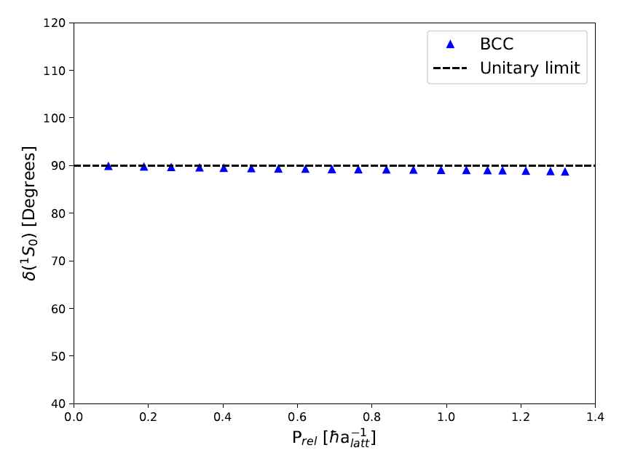
Unitary limit Hamiltonian in BCC
1S0 NN scattering phase shift is fitted
For unitary limit .
C0= -0.7449172 [l.u.]
sNL = - 0.0009533729
→
a0 = 125658 fm, r0 = 0.110 fm

Slide 15


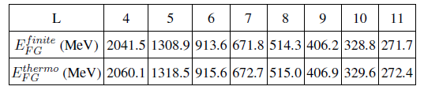
Results
N=66 neutrons (33 spin up, 33 spin down)
Ground state energy are calculated by using transfer matrix formalism
Euclidean time extrapolation
Free fermion gas energy can be defined in two way.
‘Finite’ : NLEFT result of free fermions
‘thermo’ : Thermodynamic limit expression of free fermion gas

Slide 16
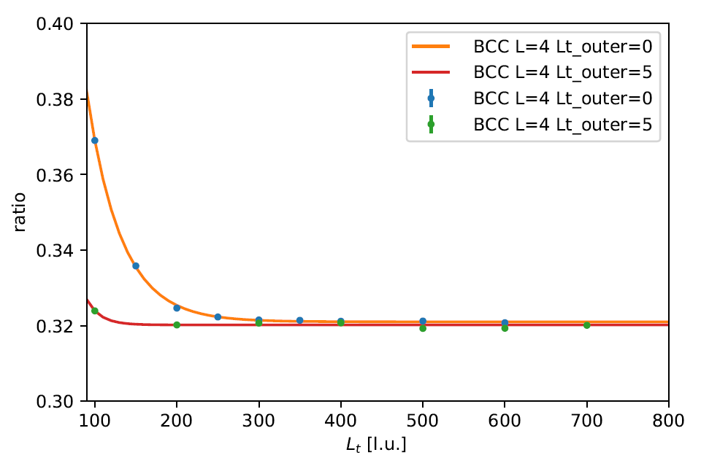
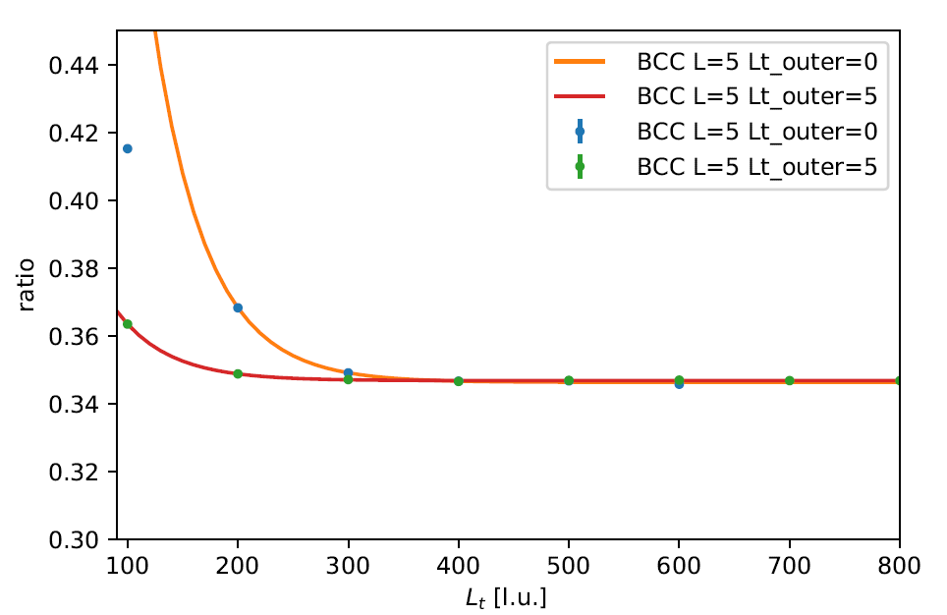
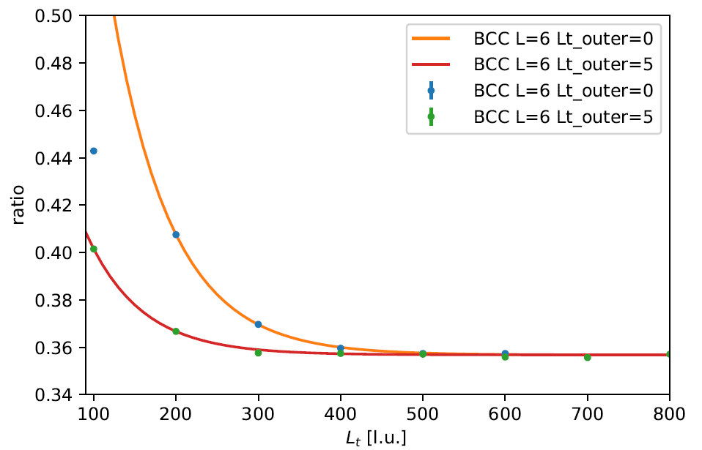
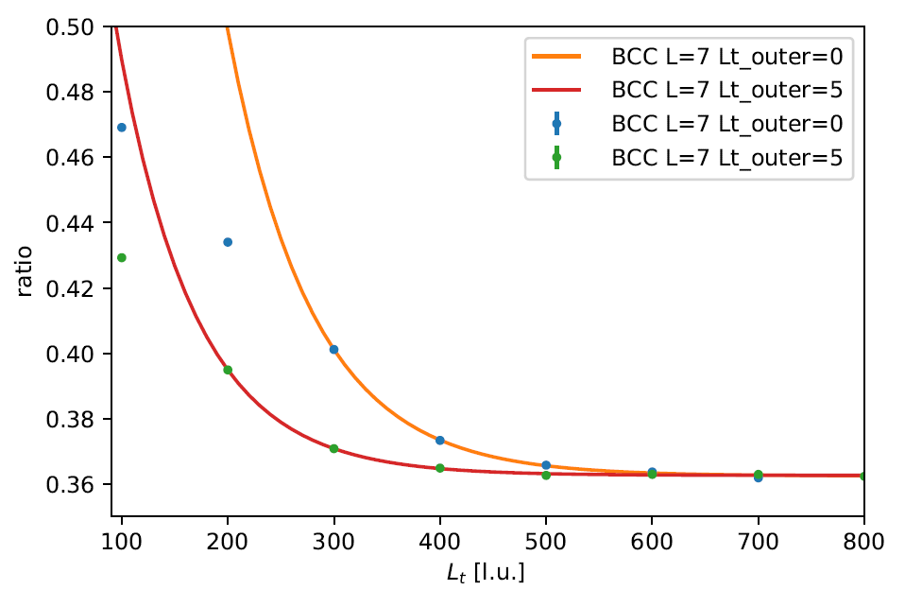
Results : Lt extrapolation

Slide 17
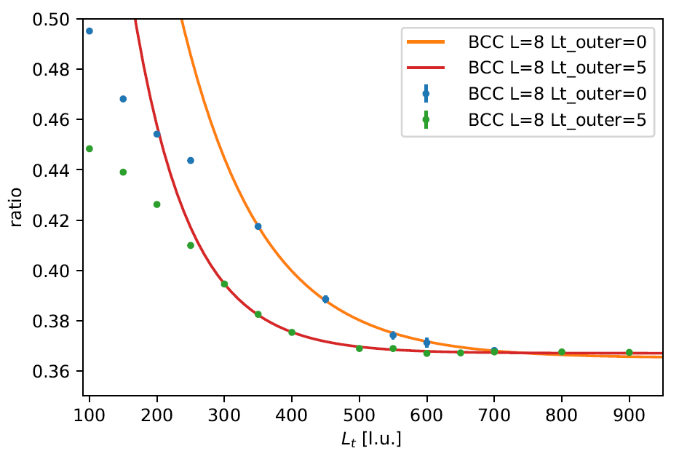
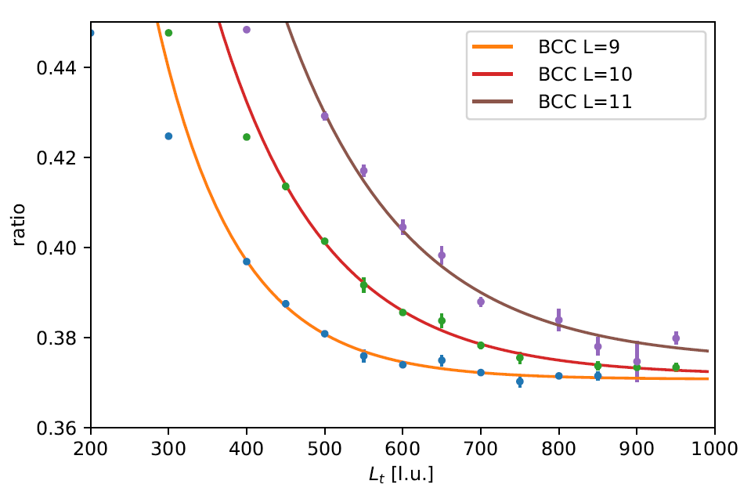
Results : Lt extrapolation

Slide 18
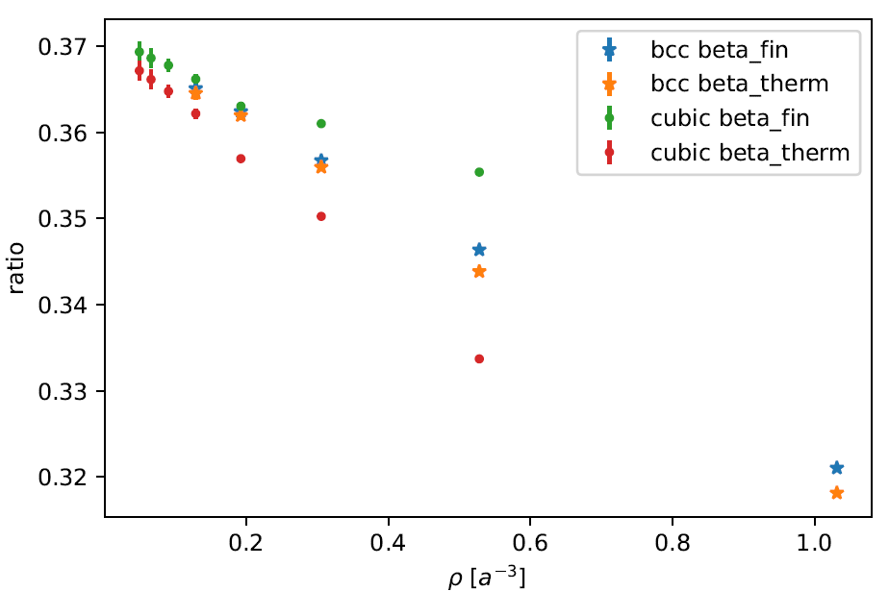
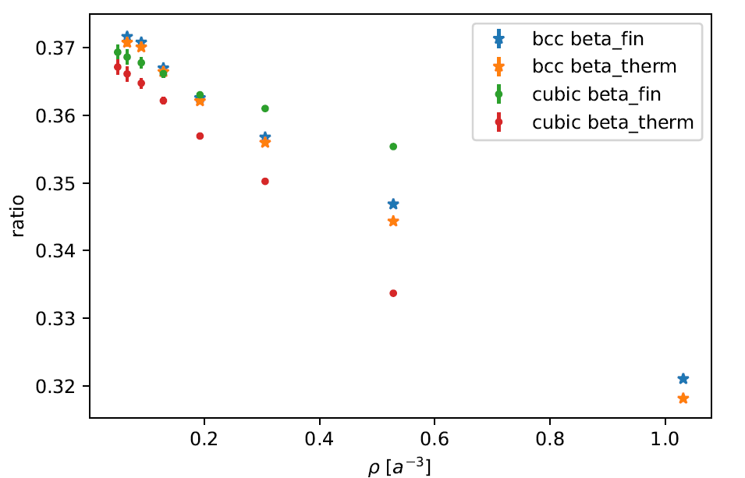
Results: L dependence
Lt_outer=0
Lt_outer=5

Slide 19
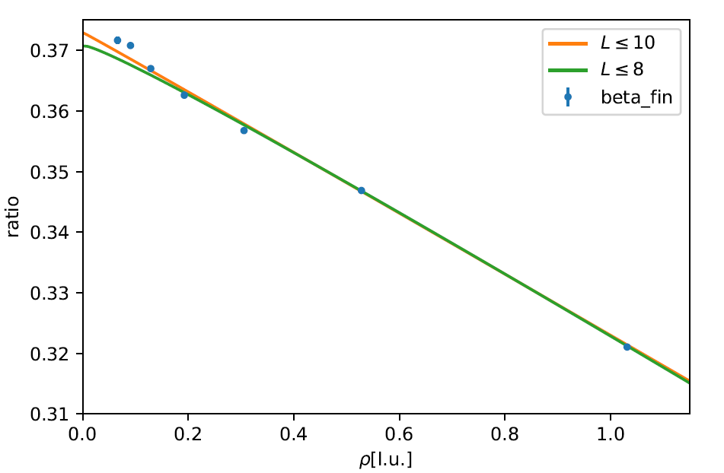





Results
NLEFT in Cubic lattice calculation :
Consistent with
QMC calculations : 0.366(2) in zero-temperature
0.367(7) zero-temperature extrapolation
Fixed node diffusion MC and DFT : upper bound 0.383(1)
Experiment : 0.376(4)

Slide 20
Discussion
We confirm the regularization independence of NLEFT calculation for Unitary Fermion Gas.
Bertsch parameter of UFG estimated 0.369(3) ~ 0.373(2)
BCC lattice calculation shows faster convergence between beta^finite and beta^therm. BCC lattice requires larger number of lattice points for the same lattice size. However, for the similar number of lattice points, computational cost is similar for BCC and cubic lattice.

