Slide 1


Carbon and Oxygen isotopes in
Nuclear Lattice Effective Field
Theory
Young-Ho Song (IRIS, IBS)
NLEFT collaboration
2024.12.01.-07., NTSE2024 , Pukyong Univ.

Slide 2
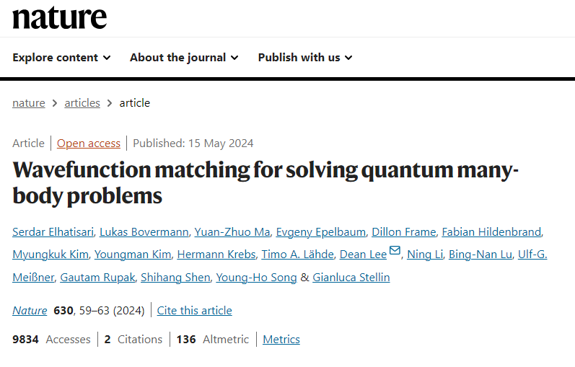
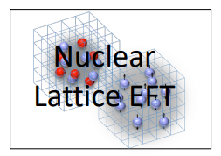
NLEFT
Collaboration
Members

Slide 3
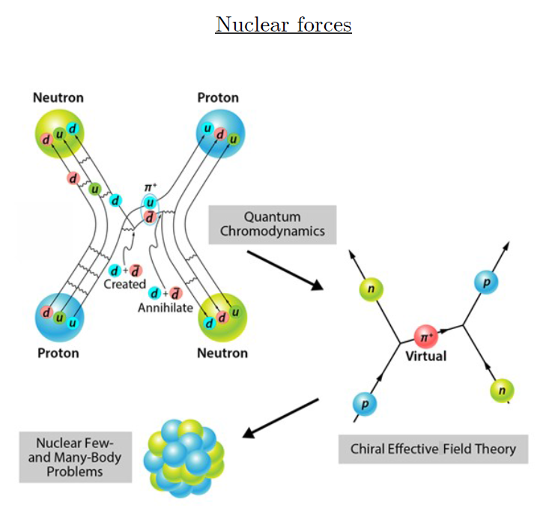
Ab-initio method
ab-initio Nuclear Physics
(1) nucleon degrees of freedom
(2) nucleon-nucleon interaction
Goal: predict wide range of nuclear phenomena (without parameter fitting, model assumption) from nuclear interaction (for 2-body,3-body, many-body, based on QCD)
Direct connection between
Nuclear Force ↔ Nuclear Phenomena
Consistent approach :
NN scattering, bound nuclei, reaction, nuclear matter
Dream: Lattice QCD
NN , NNN interaction
Effective interactions/models
(shell model, DFT, optical potential, collective excitation)

Slide 4
Ab initio Quantum many-body
Challenge to ab initio quantum many-body problem.
Requires:
1. Reliable theoretical tools
NLEFT : Auxiliary field Monte Carlo Method
→ Sign problem !
Goal 1 : reduce the sign problem in NLEFT calculation
2. Nuclear interaction which explain simultaneously scattering, binding energies, charge radius of wide range of nuclei and nuclear matter, neutron matter
Goal 2: find out what properties of nuclear interactions are necessary.

Slide 5
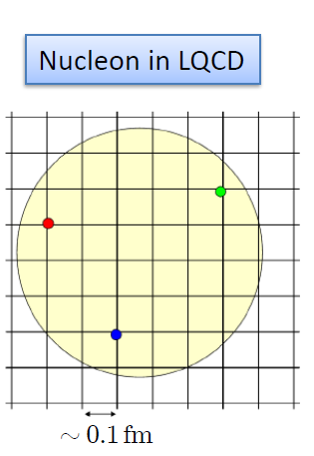

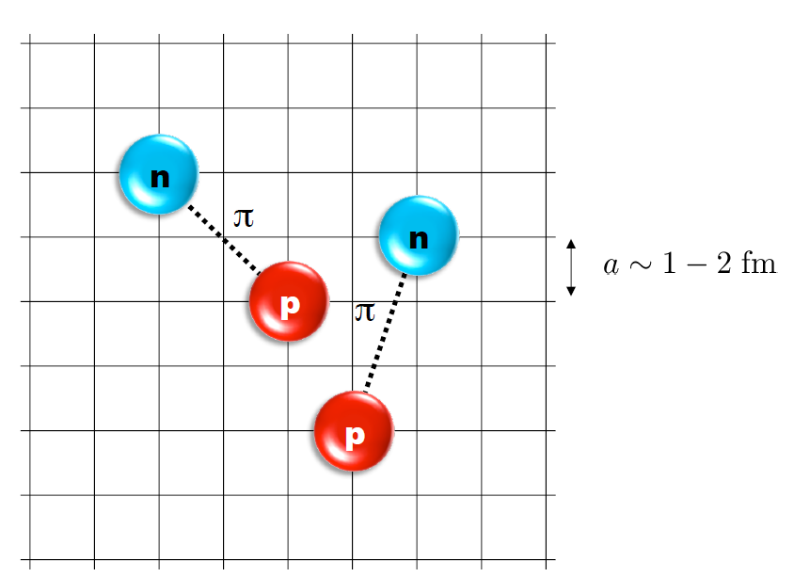
Nuclear Lattice Effective Field Theory
One of ab initio method for many fermion system

Slide 6
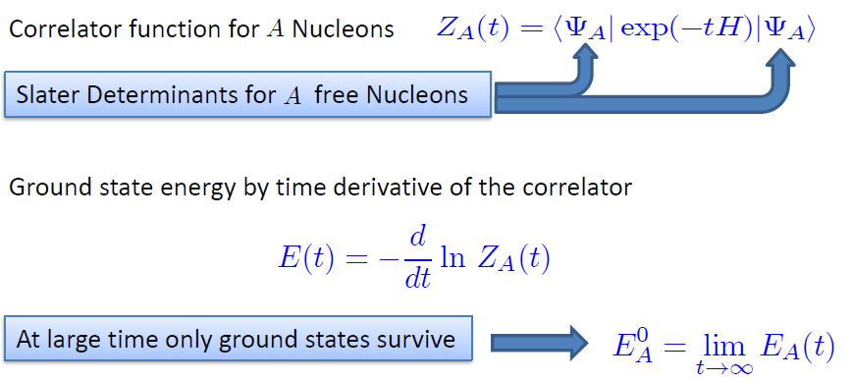

Path integral

Slide 7
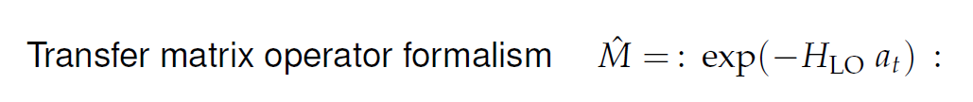
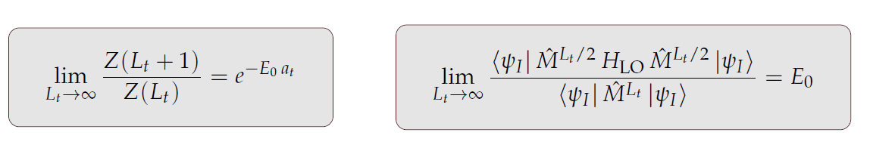
Transfer matrix
: O : represent Normal ordering.

Slide 8
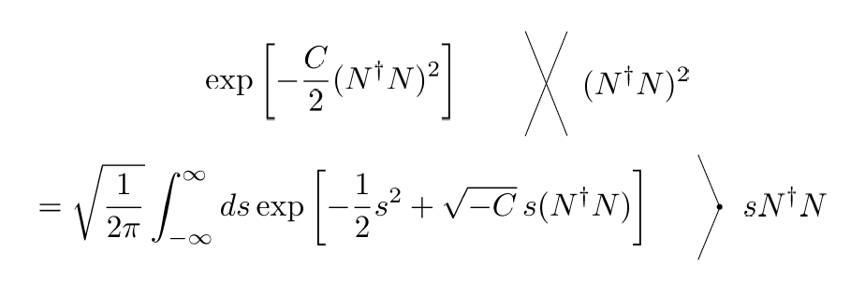
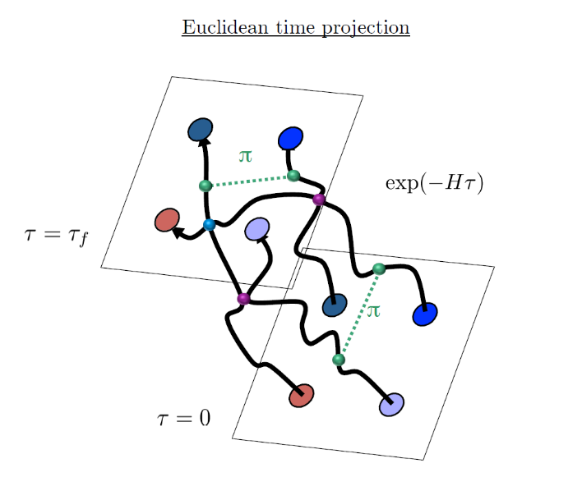
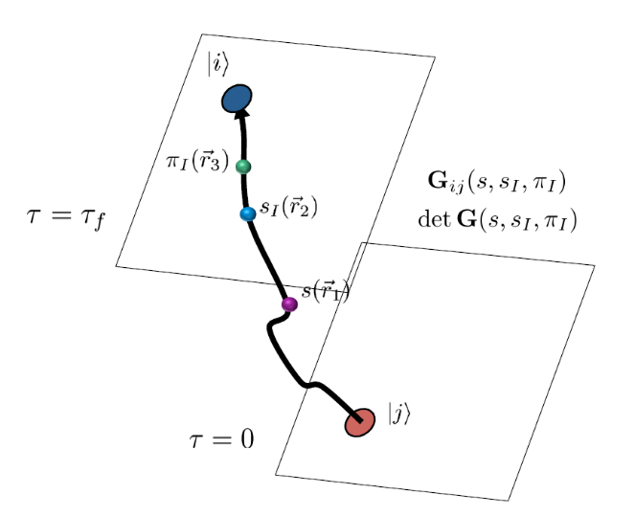
Auxiliary Field Monte Carlo
Interacting nucleons
Nucleons interacts with auxiliary fields
(no direct interaction
between nucleons)
computing fermion
Correlator amplitude
Integration
over auxiliary fields
M.C. integral
(sampling auxiliary field)

Slide 9
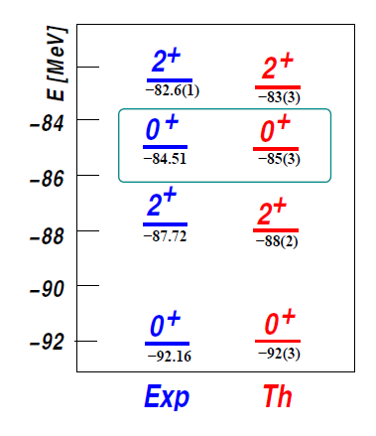

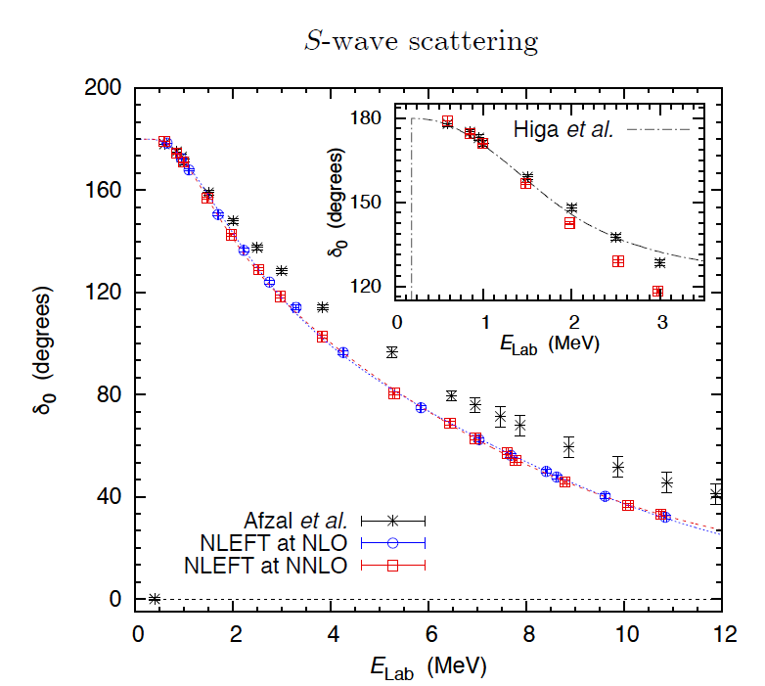
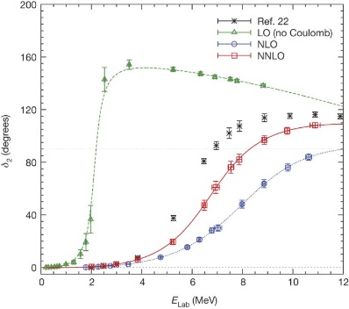
Applications of NLEFT
The first ab-initio calculation of
Hoyle state
Has been successfully applied to
Nuclear matter, Cold atom, dilute fermion system
Finite nuclei (A<=50)
First ab-initio calculation of Hoyle state
Cluster structure of ¹²C and ¹⁶O
NN scattering, N-D scattering
Alpha-alpha scattering
radiative capture, fusion
Etc.
Ab initio alpha-alpha scattering
( Nature 528, 111-114(2015))

Slide 10
Lattice Hamiltonian
We need to introduce a lattice scale in space and time:
momentum space cutoff ~ 150 MeV → lattice spacing a= 1.316 fm
Time cutoff ~ 1000 MeV
We need to determine coefficients of interaction for the lattice size. (regularization scale.)
Two-body interaction coefficients can be determined from phase shifts of np scattering.
Three-body interaction can be fixed from binding energy of A>=3.

Slide 11
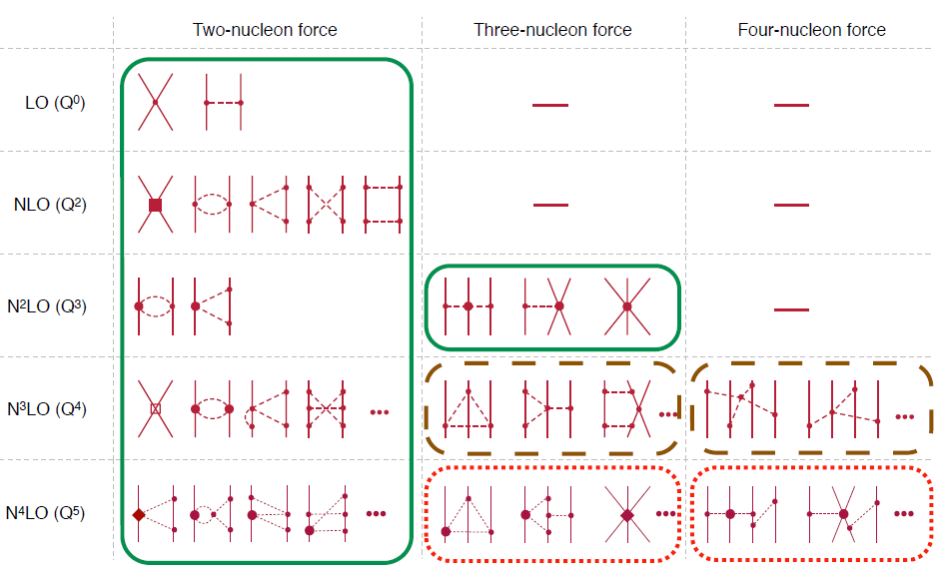
Chiral Effective Field Theory

Slide 12

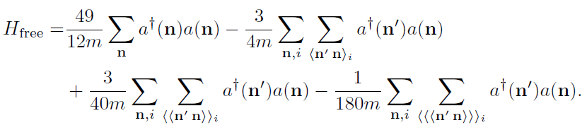
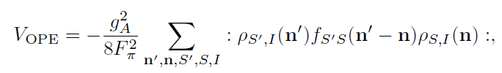

Lattice chiral Hamiltonian at Leading order
At Leading order, kinetic energy + contact interaction + one pion exchange
Kinetic
Long range OPE
Contact

Slide 13
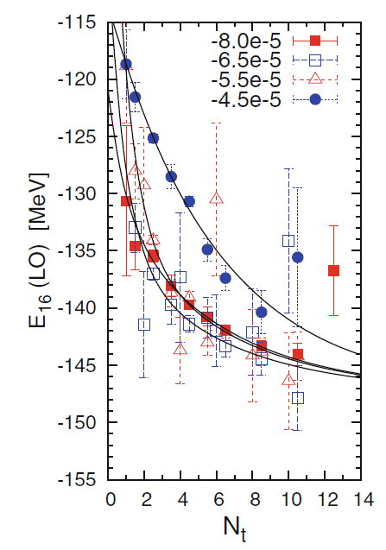
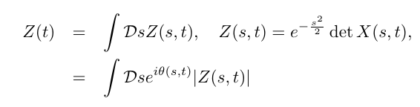

Sign problem in NLEFT
However, there is a difficulty in auxiliary MC calculation
We needs a large Euclidean time extrapolation
If the denominator’s sign oscillates rapidly
→ large uncertainty in the expectation value
→ sign problem
SU(4) symmetric interaction in isospin symmetric system
→ No sign problem

Slide 14
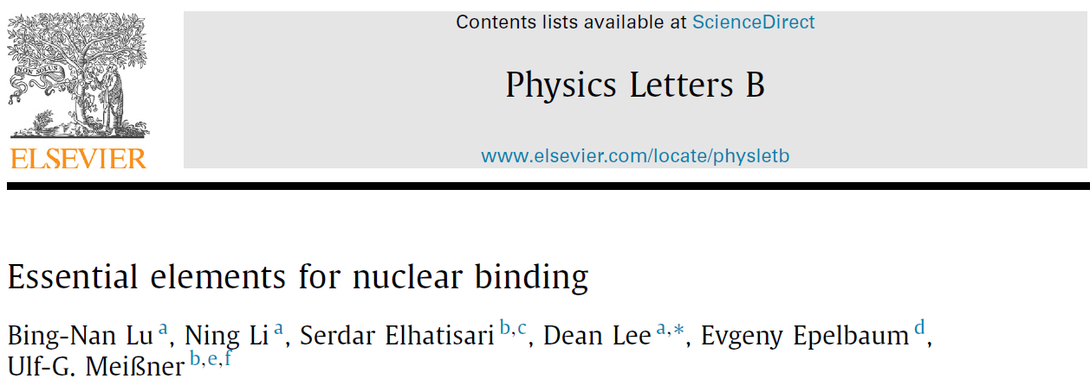



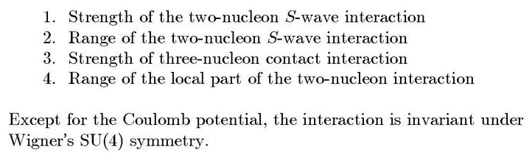
Minimal nuclear interaction
Which reproduce
Light nuclei
medium mass nuclei
neutron matter
simultaneously up to few percent error in binding energy and charge radius
Only Four parameters
No sign problem

Slide 15
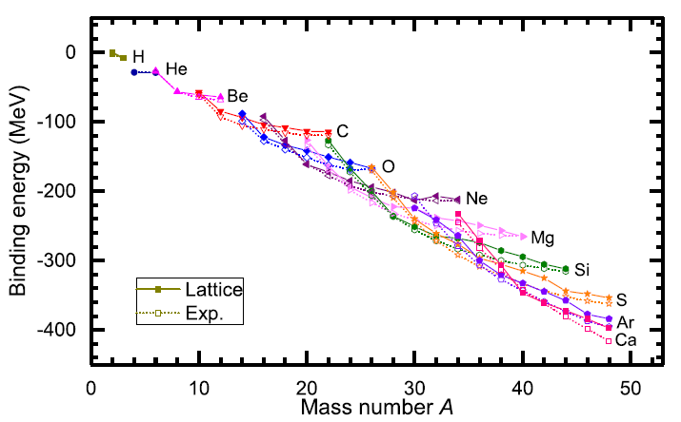
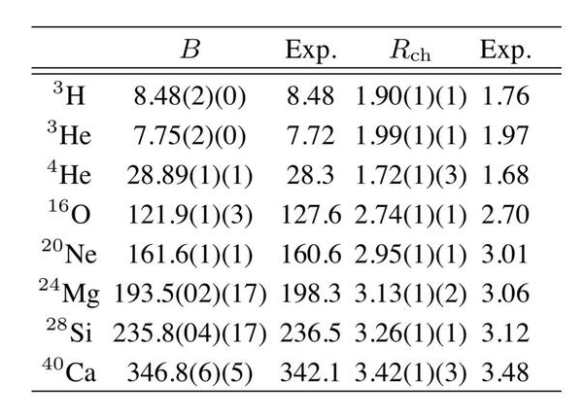
Can we improve the agreement by
Including higher order corrections?

Slide 16
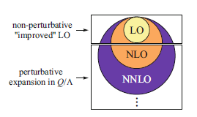
Lattice chiral Hamiltonian (N3LO)
Full N3LO Hamiltonian includes
Free Hamiltonian(Kinetic term)
Short range (nonlocal smeared) contact interactions up to Q^4 order
Isospin-breaking short range interactions
One pion exchange potential
Two pion exchange potential up to Q^4 order
Coulomb interaction
Long range isospin breaking interaction( isospin dependence in OPE)
Galilean Invariance Restoration (GIR) term (because of non-local interaction.)
Three nucleon interaction

Slide 17
Difficulty with full chiral interaction
Sign problem
NLEFT suffers sign problems at large Euclidean time limit
Large cancellation between positive and negative contributions→ large uncertainty.
SU(4) symmetric interaction does not have sign problem
One pion exchange and higher order chiral interaction, short range repulsion
Difficulty with Asymmetric nuclei
Needs a remedy to extend to neutron rich isotopes.
A new approach to reduce the sign problem.
→ Wave function matching

Slide 18
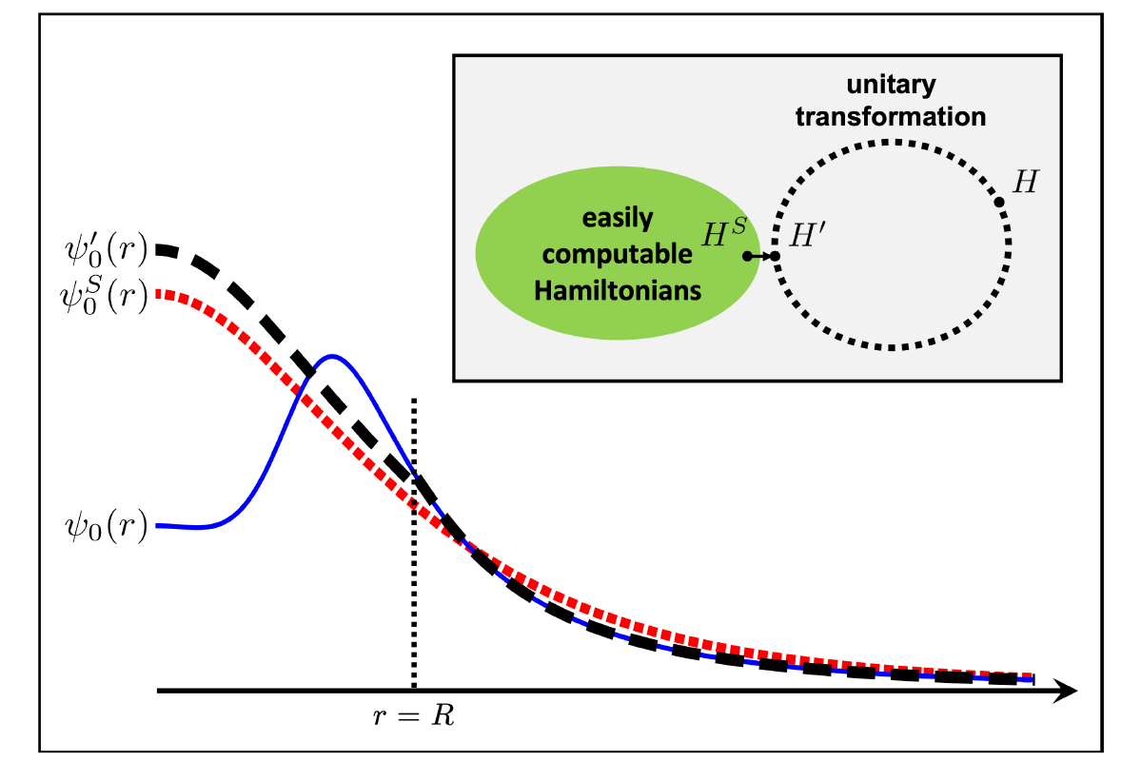


Wave function matching
H and H’ are fully equivalent to two-body observables
The goal is to make the perturbation expansion from “simple” wave function gives a good convergence
U is only active
At r < R

Slide 19
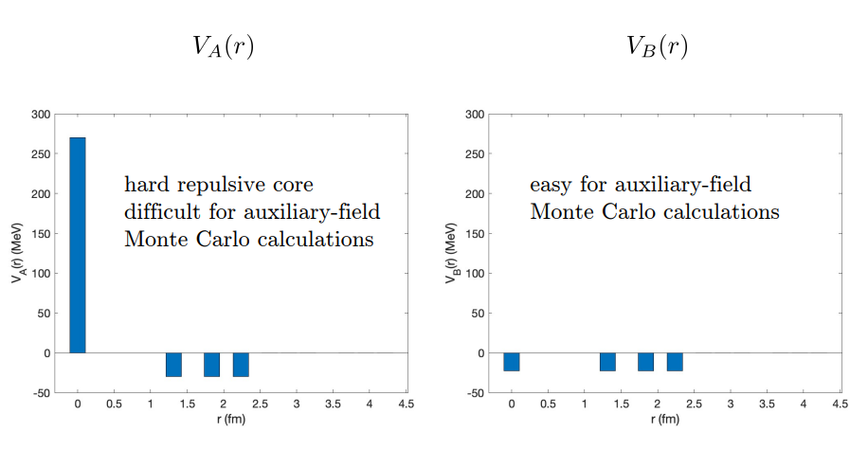
Wave Function Matching
From Dean Lee

Slide 20
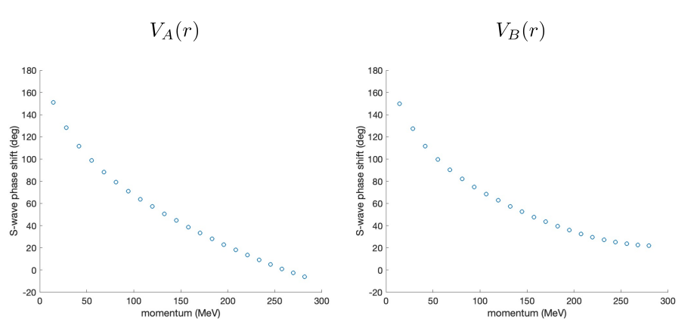
Wave Function Matching
Phase shifts from two interactions are different
From Dean Lee

Slide 21



Wave Function Matching
Introduce short range Unitary transformation
Two potentials V_A and V’_A are unitarily equivalent.
Same phase shifts.
H’_A has eigenvectors of H_B, but eigenvalues of H_A
From Dean Lee

Slide 22
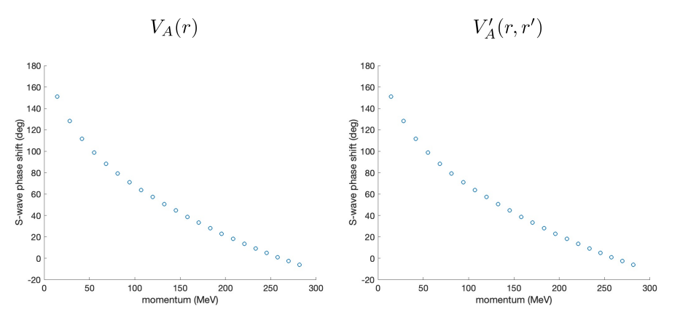
Wave Function Matching
Two potentials V_A and V’_A are unitarily equivalent.
Same phase shifts.
H’_A has eigenvectors of H_B, but eigenvalues of H_A
From Dean Lee

Slide 23
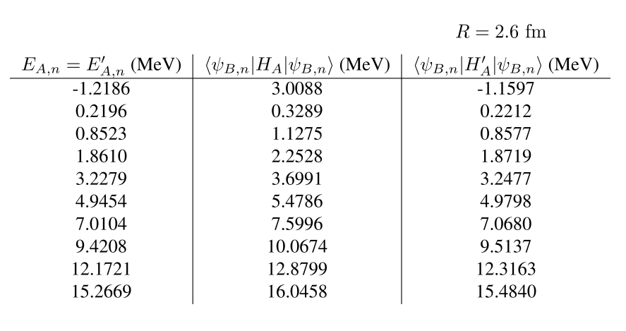
Wave Function Matching
Energy from Perturbation theory with H’_A works better.
Difference H_A- H’_A can be treated as a correction.
From Dean Lee

Slide 24

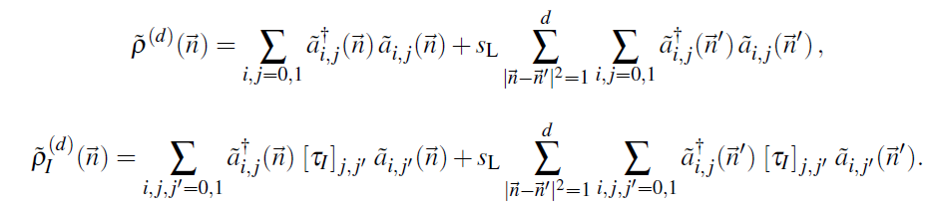

Wave function matching Hamiltonian
“Simple” Hamiltonian
(local,non-local smeared operators)

Slide 25

Wave function matching Hamiltonian
N3LO Hamiltonian
V_2N : short range NN interactions
W_2N: GIR restoration term for V_2N
V_2N,WFM : difference from H’-H
W_2N,WFM: GIR restoration correction to V_2N,WFM
V_3N : contains short range 3N interaction parameters(to be fitted)
and two pion exchange correction to 3N

Slide 26
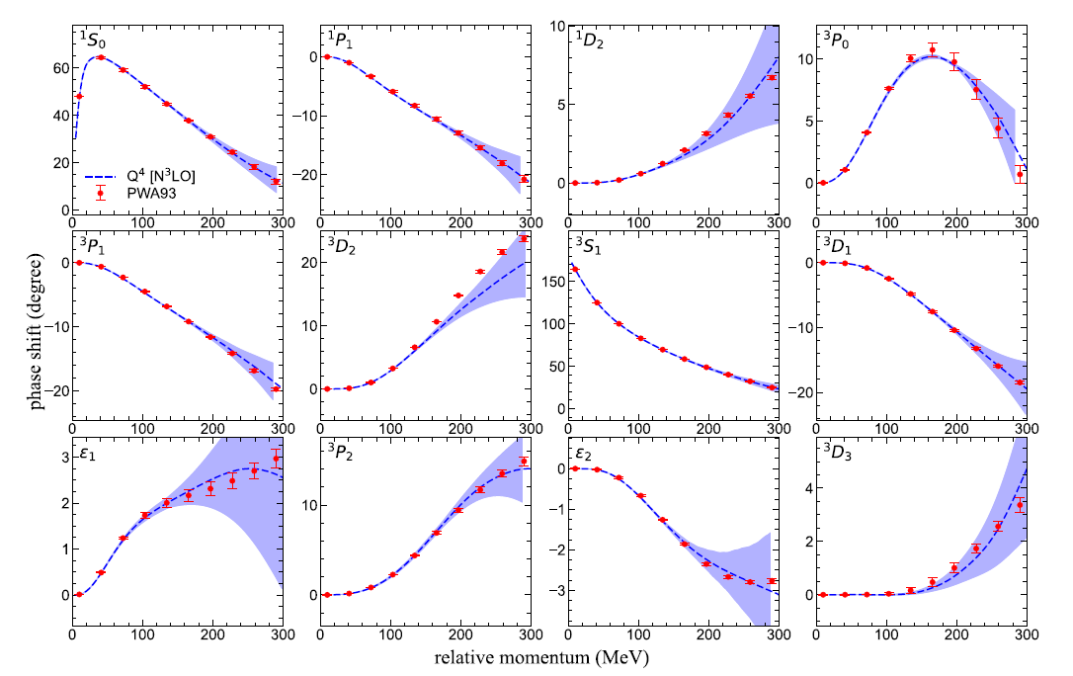
NN phase shifts from N3LO interaction
Original Chiral Hamiltonian, H,
is fitted to phase shifts. (up to N3LO)
H’ is computed : equivalent
to original Hamiltonian(gives the same phase shifts).

Slide 27
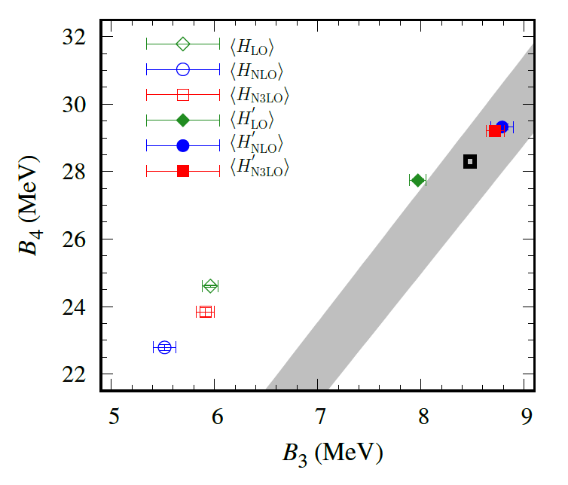
Tjon line from WFM method
Realistic two-body interaction
Correlation between 3-body and 4-body binding energy
Tjon Line
WFM approach gives binding energy lies on the Tjon line.
→ Accurate reproduction of B.E. requires 3-body force.

Slide 28
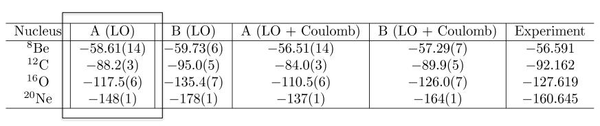
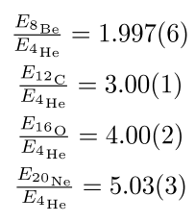
Tale of two interactions
Nearly identical two interactions can give quite different phase:
sensitivity to range and locality of interaction
PRL 117, 132501 (2016)
From presentation file by Dean Lee

Slide 29
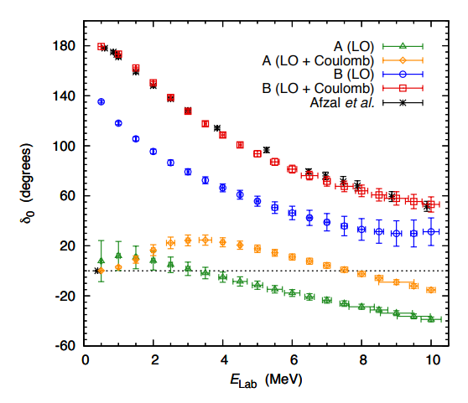
Tale of two interactions
Nearly identical two interactions can give quite different phase:
sensitivity to range and locality of interaction
Very different alpha-alpha scattering
PRL 117, 132501 (2016)
From presentation file by Dean Lee

Slide 30
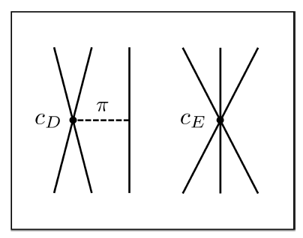


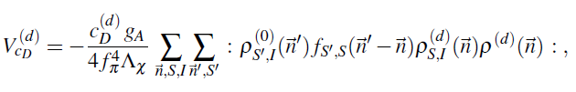
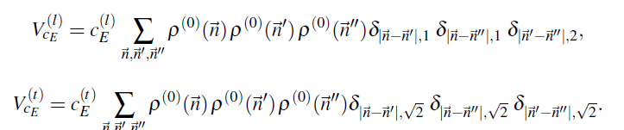





3-body force
NNLO
At N3LO:
TPE and
Adjustments to
cD and cE terms.

Slide 31
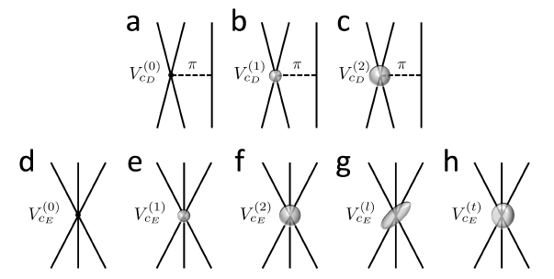
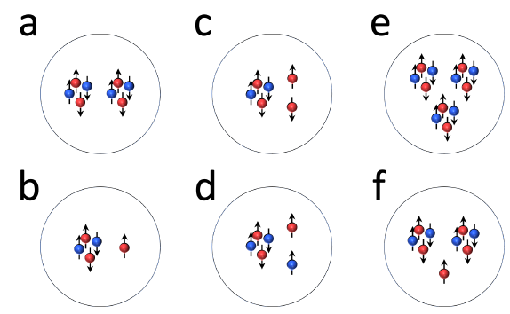
3-body force
Tune 3-body interaction to minimize errors
in binding energy
Just one additional parameter,
RMSD for the E/A
drops from 1.2 MeV to 0.4 MeV
Energies
Significant sensitivity to
the locality of 3N interactions.
We interpret they are related with
effective interactions
between alphas and nucleons.
Significantly high w/o additional 3-body terms
: alpha-alpha should be more attractive.

Slide 32
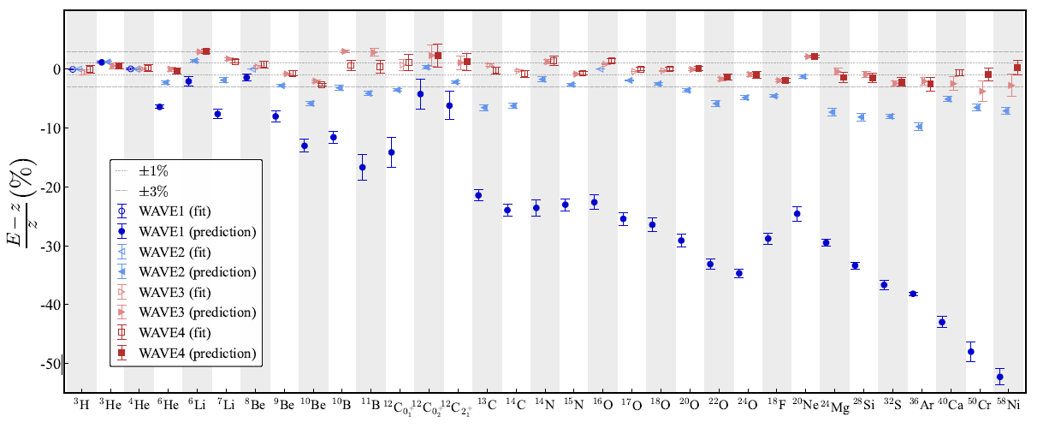
Determine 3-body force parameters
RMSD (MeV/nucleon): 1.2 → 0.3 →0.109 → 0.079

Slide 33
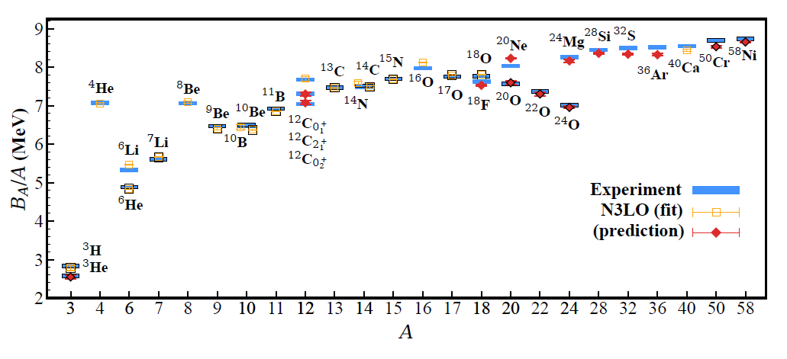
BE/A from WFM
RMSD ~ 0.1 MeV per nucleon

Slide 34
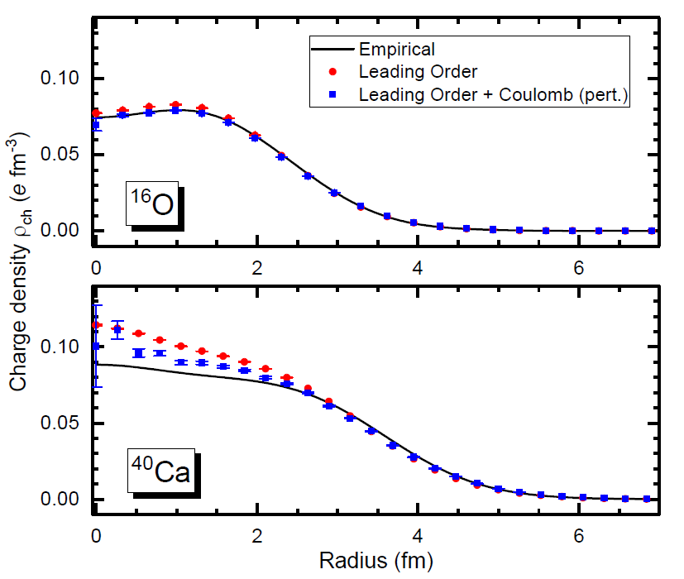
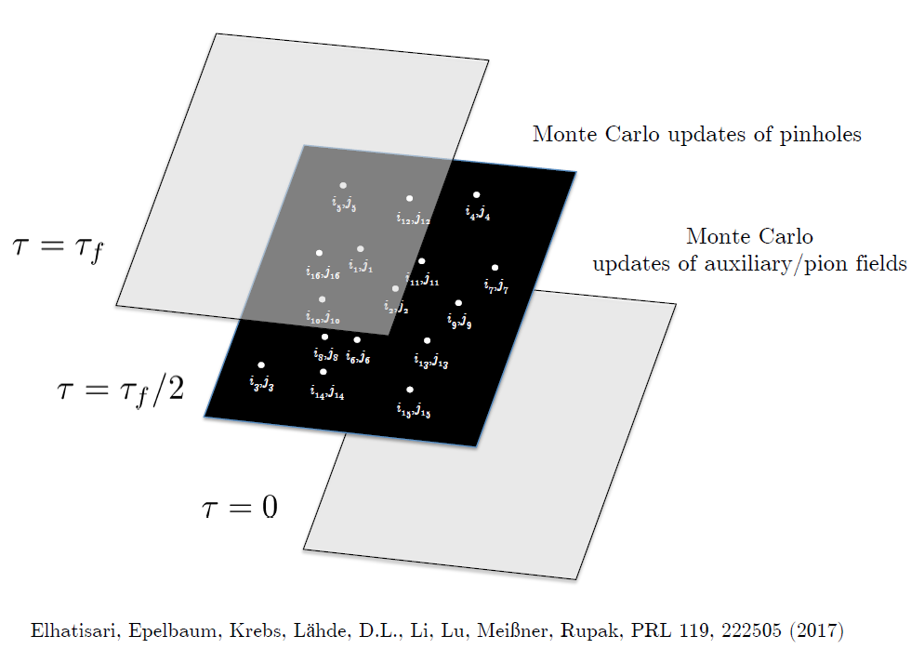
Pinhole Algorithm

Slide 35
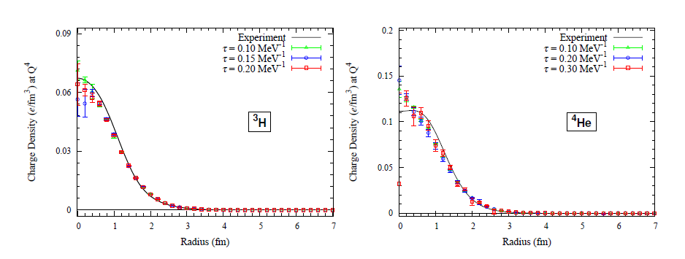
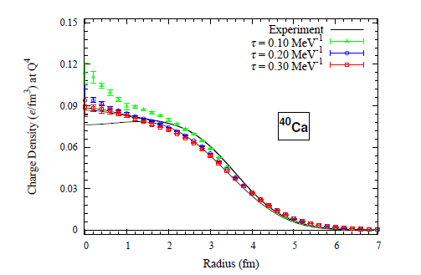
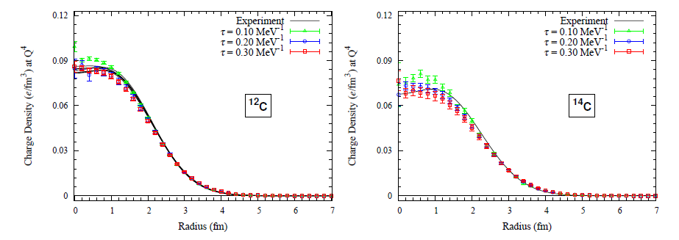
Charge density from WFM (Pinhole algorithm)

Slide 36
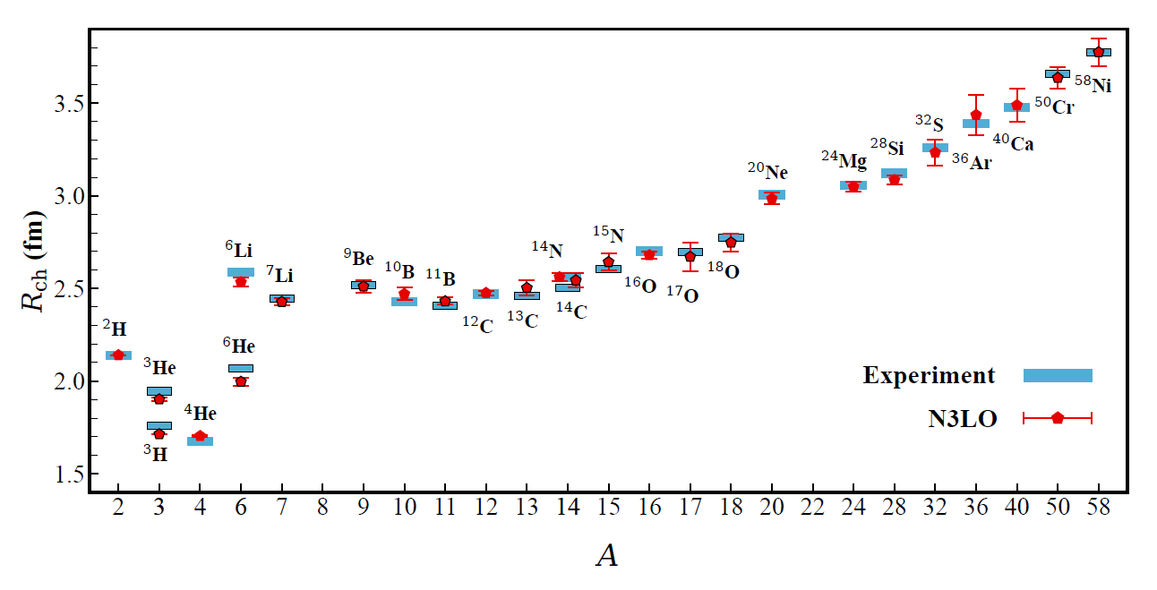
Charge Radius
No fitting! RMSD~ 0.03 fm

Slide 37
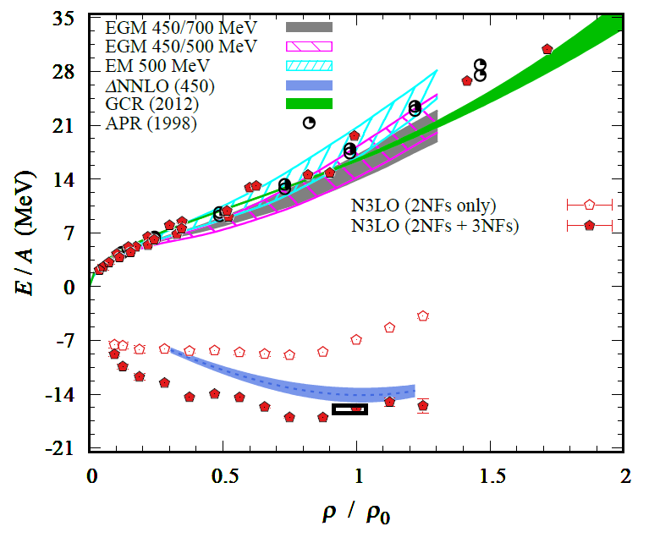
Nuclear/Neutron Matter
Neutron matter:
A=4~80
box size 6.6 ~ 13.2 fm.
Nuclear matter:
A=4 ~ 160
Box size 7.92~9.24 fm.
Uncertainties from
finite system size correction

Slide 38
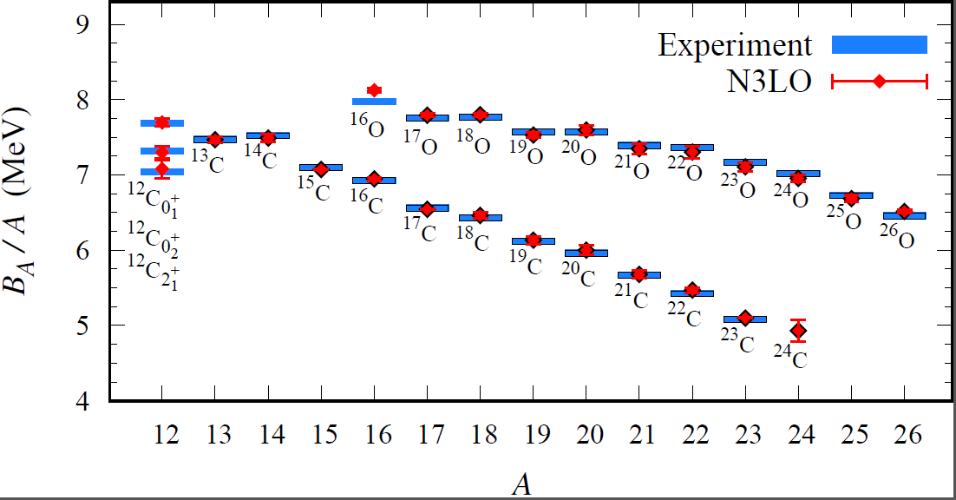
Carbon and Oxygen
Preliminary

Slide 39

Carbon and Oxygen
Preliminary

Slide 40
Finite Volume Effect
Lt=200 | L=10 |  |  | L=11 |  |  | Exp
 | E | err | S2n | E | err | S2n | E | S2n
24O | -167.600 | 1.126 |  | -171.880 | 0.501 |  | -168.952 | 6.920
25O | -168.790 | 0.424 |  | -169.670 | 0.551 |  | -168.195 | 3.453
26O | -171.530 | 0.587 | 4.430 | -172.380 | 0.459 | 0.500 | -168.934 | -0.018
27O | -169.960 | 0.450 | 1.170 | -166.930 | 0.566 | -2.740 | -166.995 | -1.200
Lt=200 result. (Not extrapolated results.)
Systematic Error from finite volume effects need to be studied.
L=11 improved Separation energy of 26O.
Preliminary

Slide 41

Carbon isotopes (Lt=200)

Slide 42

Oxygen isotopes (Lt=200)

Slide 43

Partial waves contributions (Lt=200)

Slide 44

Partial waves contributions (Lt=200)

Slide 45


Partial waves contributions (Lt=200)

Slide 46

LEC(or phase shift fit) dependence (Lt=200)
Z= 6

Slide 47
Summary
Wave function matching method seems to be promising
New method to improve the N3LO calculation of NLEFT:
reduced sign problem
promising results for wide range of observables in one scheme (same interaction and many-body method)
NN scattering
Binding energy (from 3H to 40Ca)
Symmetric Nuclear matter
Neutron matter
Carbon excited states
Carbon, Oxygen isotope up to dripline shows good agreement with experimental data
systematic error(finite volume effects) estimation may be necessary.

