Slide 1

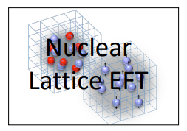

Carbon and Oxygen isotopes in
Nuclear Lattice Effective Field
Theory
Young-Ho Song (IRIS, IBS)
NLEFT collaboration(Myungkuk Kim, Youngman Kim, Kihyeon Cho,
Serdar Elhatisari, Dean Lee, Yuan-Zhuo Ma, Ulf-G. Meißner)
2025.04.21.-22., TOPTIER , CENS

Slide 2
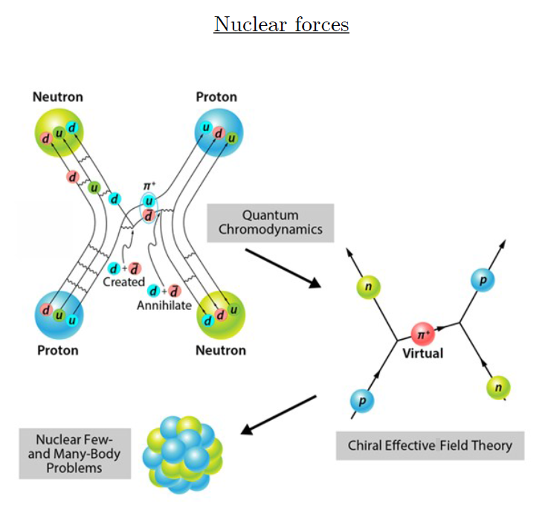
Ab-initio method
ab-initio Nuclear Physics
(1) nucleon degrees of freedom
(2) nucleon-nucleon interaction
Goal: predict wide range of nuclear phenomena (without parameter fitting, model assumption) from nuclear interaction (for 2-body,3-body, many-body, based on QCD)
Direct connection between
Nuclear Force ↔ Nuclear Phenomena
Consistent approach :
NN scattering, bound nuclei, reaction, nuclear matter
Dream: Lattice QCD
NN , NNN interaction
Effective interactions/models
(shell model, DFT, optical potential, collective excitation)

Slide 3
Ab initio Quantum many-body
Challenge to ab initio quantum many-body problem.
Requires:
1. Reliable theoretical tools
NLEFT : Auxiliary field Monte Carlo Method
→ Sign problem !
Goal 1 : reduce the sign problem in NLEFT calculation
2. Nuclear interaction which explain simultaneously scattering, binding energies, charge radius of wide range of nuclei and nuclear matter, neutron matter
Goal 2: find out what properties of nuclear interactions are necessary.

Slide 4
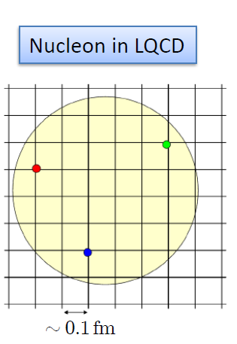

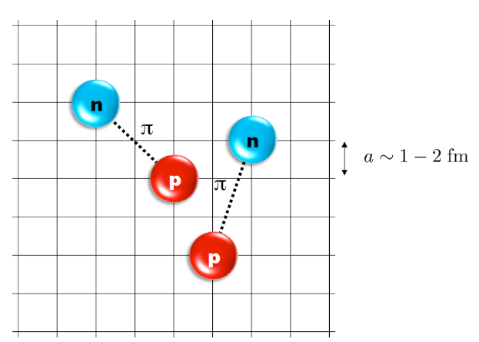
Nuclear Lattice Effective Field Theory
NLEFT = Chiral EFT + Lattice + Monte Carlo
Chiral EFT
2N interaction
3N interaction
Lattice
Lattice spacing a ~ 1 fm
Lattice size L ~ 10 a
Cutoff of the theory
Monte Carlo
Expectation value
by Auxiliary field MC
Polynomial scaling

Slide 5
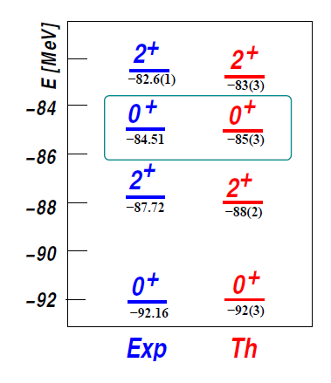

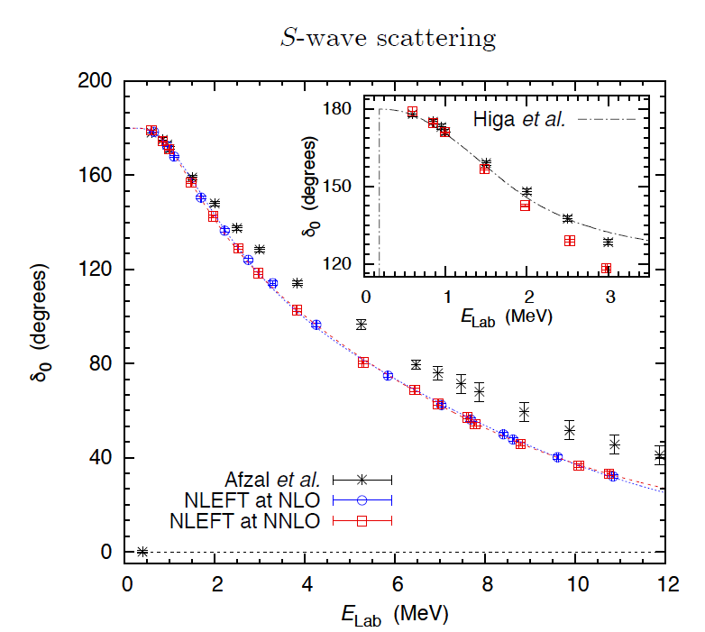
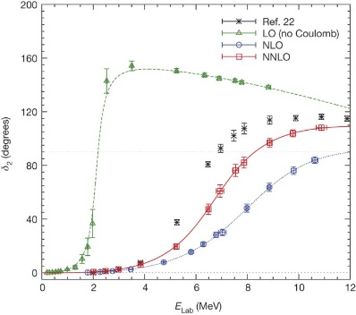
Applications of NLEFT
The first ab-initio calculation of
Hoyle state
Has been successfully applied to
Nuclear matter, Cold atom, dilute fermion system
Finite nuclei (A<=50)
First ab-initio calculation of Hoyle state
Cluster structure of ¹²C and ¹⁶O
NN scattering, N-D scattering
Alpha-alpha scattering
radiative capture, fusion
Etc.
Ab initio alpha-alpha scattering
( Nature 528, 111-114(2015))

Slide 6
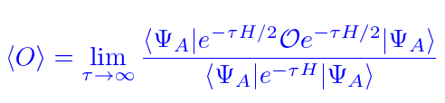

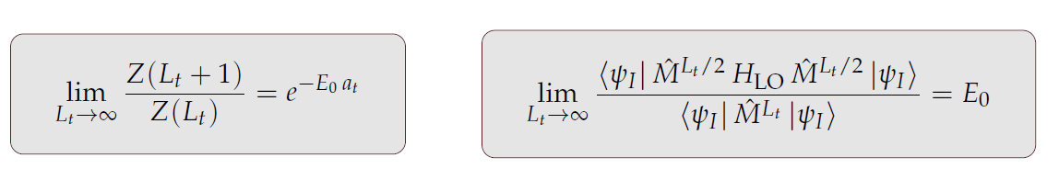
Auxiliary Field Monte Carlo
Expectation value of an observable by projecting WF at large Euclidean time
Discretization in Euclidean time evolution by transfer matrix

Slide 7
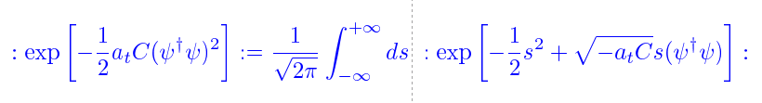
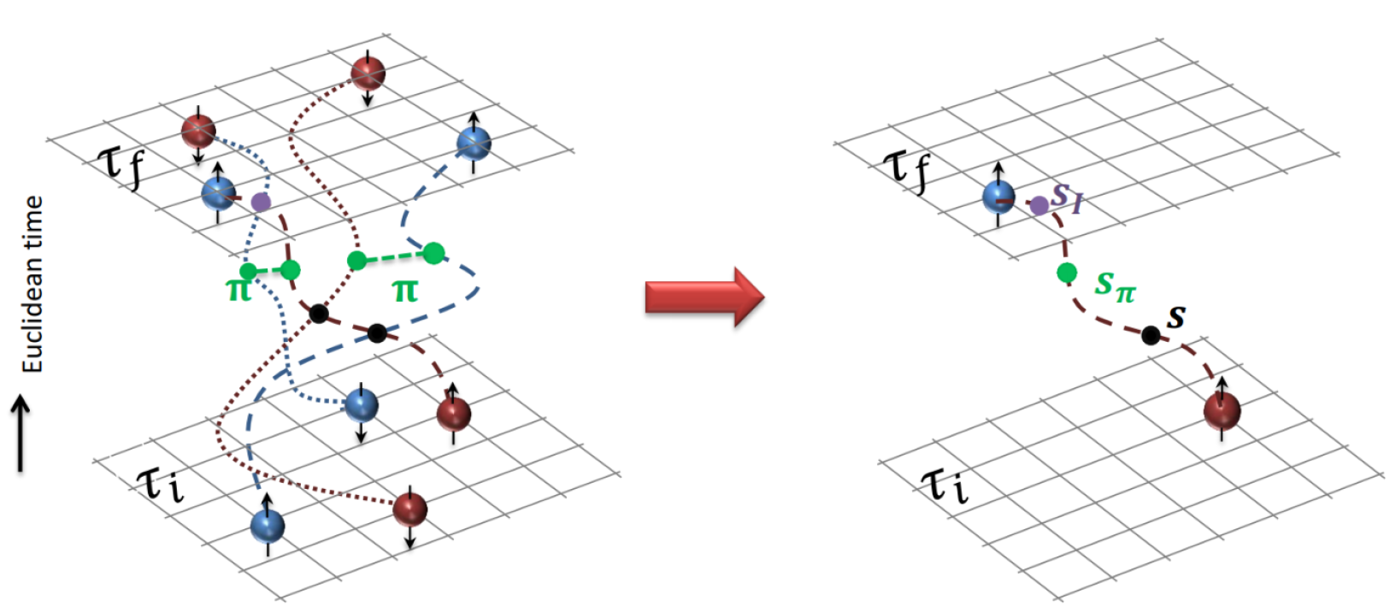
Auxiliary Field Monte Carlo
Transform transfer matrix via Gaussian integral of auxiliary fields
Interacting nucleons
Nucleons interacts with auxiliary fields
(no direct interaction
between nucleons)
computing fermion
Correlator amplitude
Integration
over auxiliary fields
M.C. integral
(sampling auxiliary field)

Slide 8
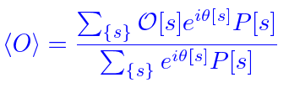


Auxiliary Field Monte Carlo
Auxiliary field integration → M.C. Sum of Auxiliary Fields Samplings
Probability and Phase factor
Sign oscillation from complex phase factor
→ Major limitation in practical calculation.

Slide 9
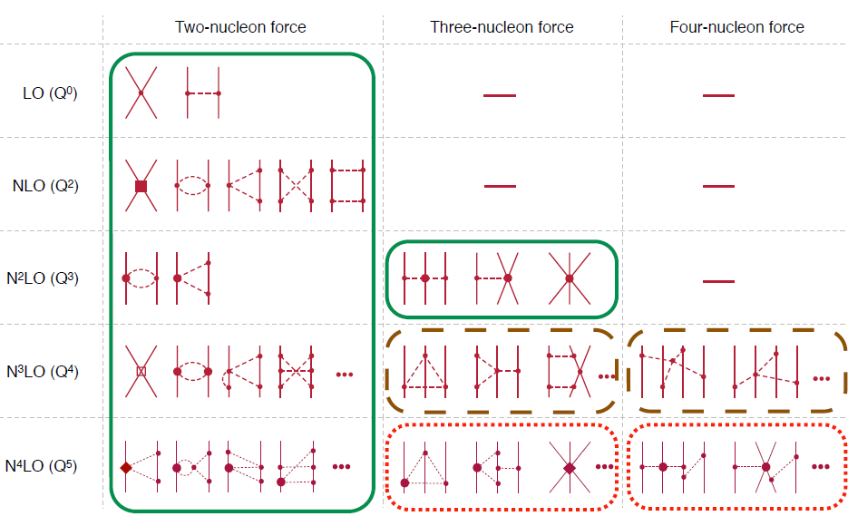
Chiral Effective Field Theory

Slide 10
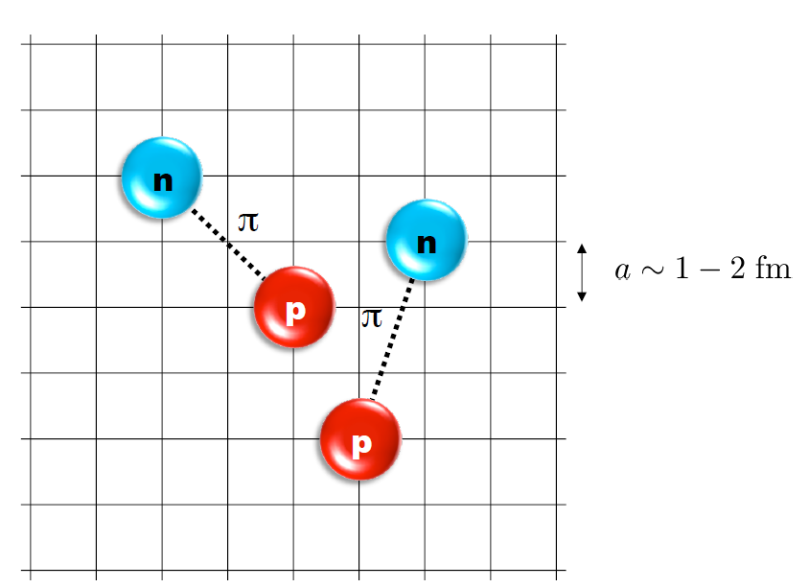
Lattice Hamiltonian
However, one cannot simply adopt the chiral interaction in continuum into lattice.
momentum space cutoff ~ 150 MeV → lattice spacing a= 1.316 fm
Time cutoff ~ 1000 MeV
We need to determine coefficients of interaction for the lattice size. (regularization scale.)
Two-body interaction coefficients can be determined from phase shifts of np scattering.
Three-body interaction can be fixed from binding energy of A>=3.

Slide 11
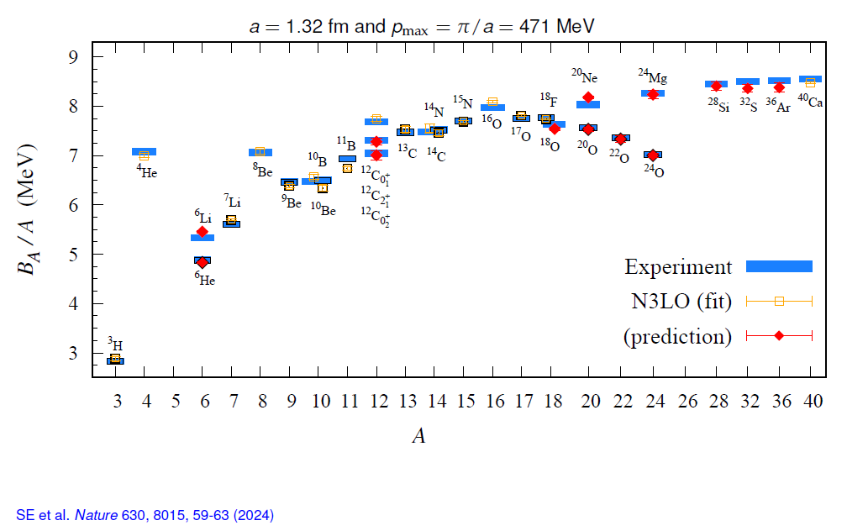
Applications of NLEFT
Energy of finite nuclei
Light-medium heavy nuclei (A<=50)
(non-perturbative) LO + (perturbative) higher order
Excited states
Hoyle state etc.
The first ab-initio calculation of
Hoyle state

Slide 12
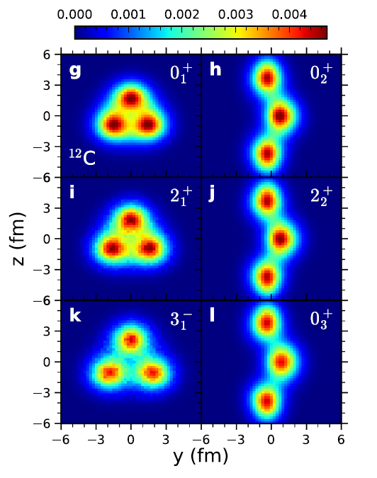
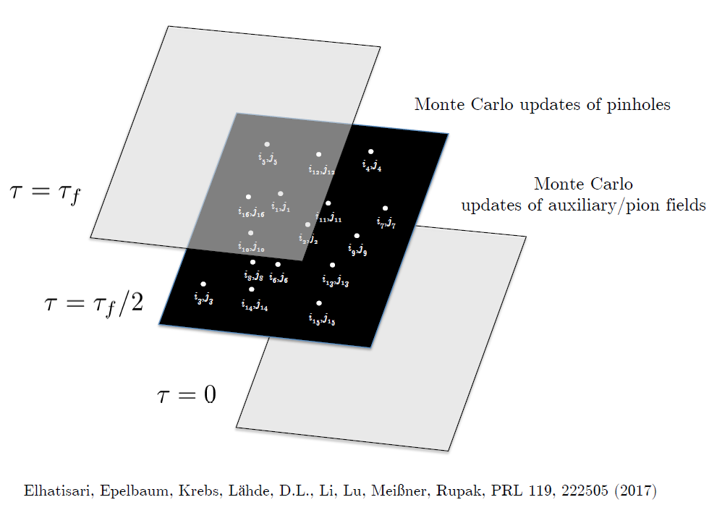
Applications of NLEFT
Charge density, Radius
Nuclear Clustering
Pinhole algorithm
SS et al. Nature Communications (2023) 14:2777

Slide 13
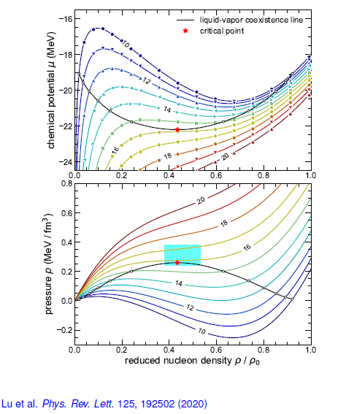
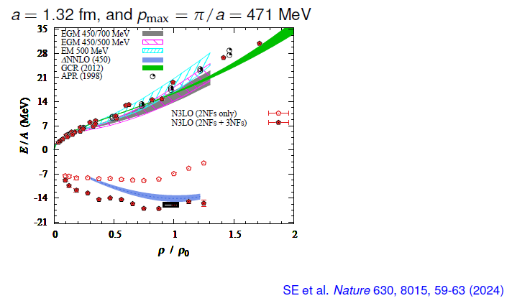
Applications of NLEFT
Nuclear matter
nucleons in periodic box
Thermo-dynamics:
pinhole-trace algorithm

Slide 14
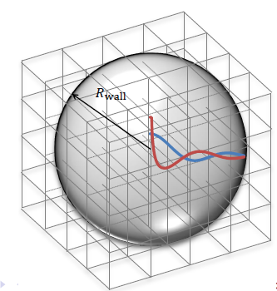
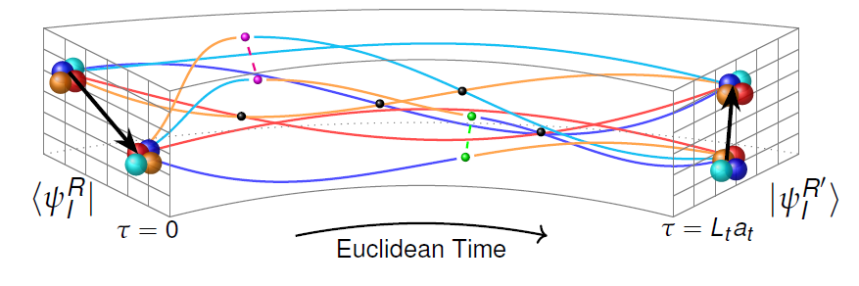
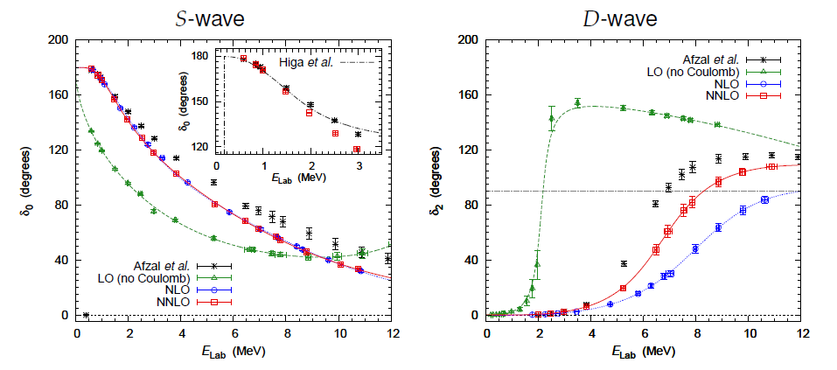
Applications of NLEFT
Scattering/Reaction
Spherical Wall method for phase shift
Adiabatic projection method
Beta decay
Ab-initio Alpha-alpha scattering
Alpha-Carbon ANC
Ab initio alpha-alpha scattering
SE et al. Nature 528, 111-114(2015))

Slide 15

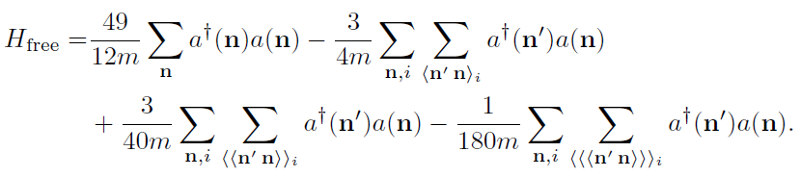
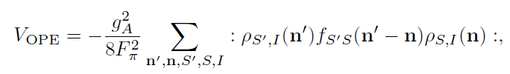

Lattice chiral Hamiltonian at Leading order
At Leading order, kinetic energy + contact interaction + one pion exchange
Kinetic
Long range OPE
Contact

Slide 16
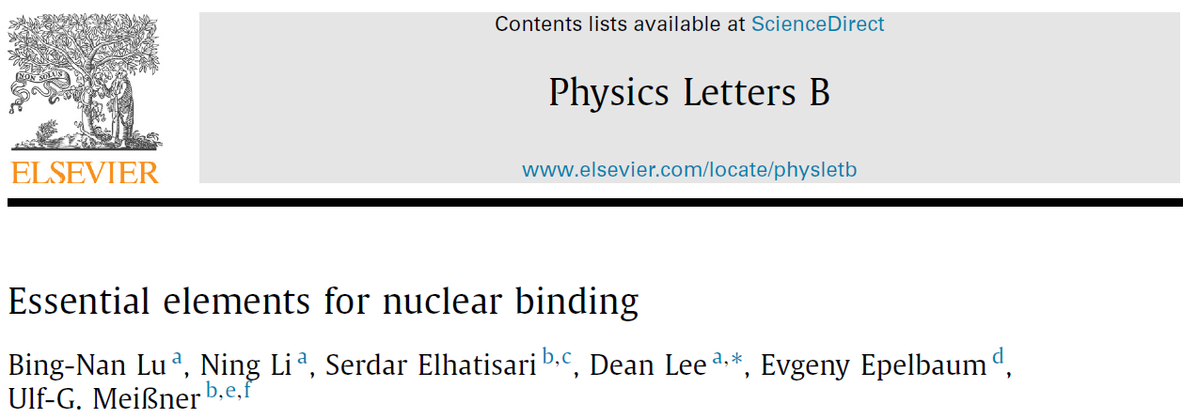



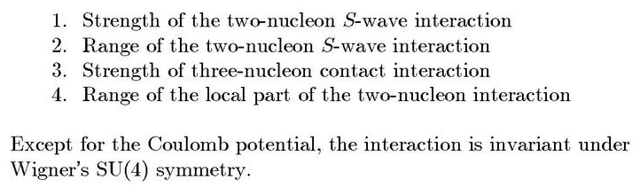
Minimal nuclear interaction
Which reproduce
Light nuclei
medium mass nuclei
neutron matter
simultaneously up to few percent error in binding energy and charge radius
Only Four parameters
No sign problem

Slide 17
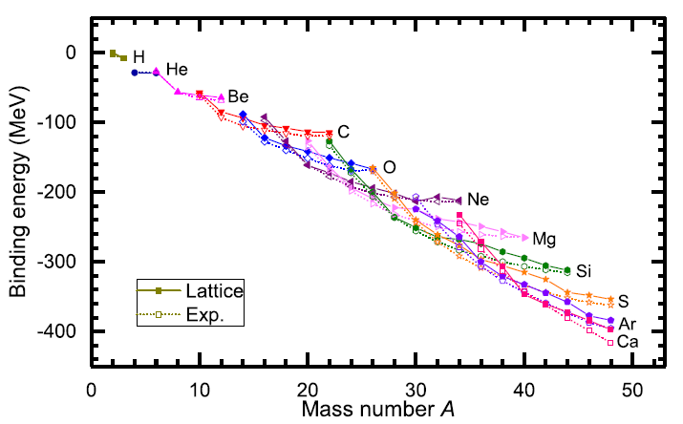
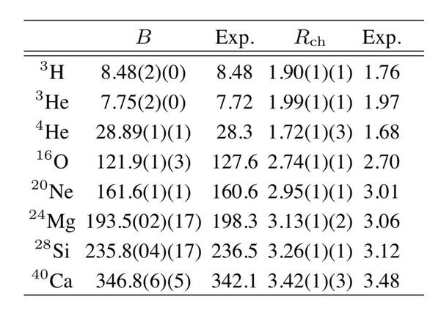
Can we improve the agreement by
Including higher order corrections?

Slide 18
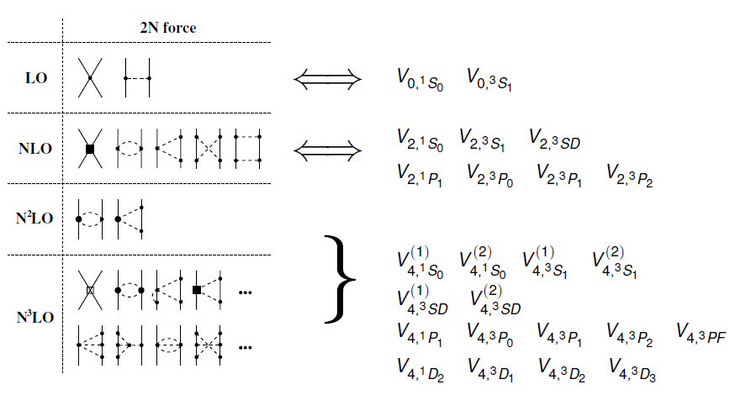
Lattice chiral Hamiltonian (N3LO)

Slide 19
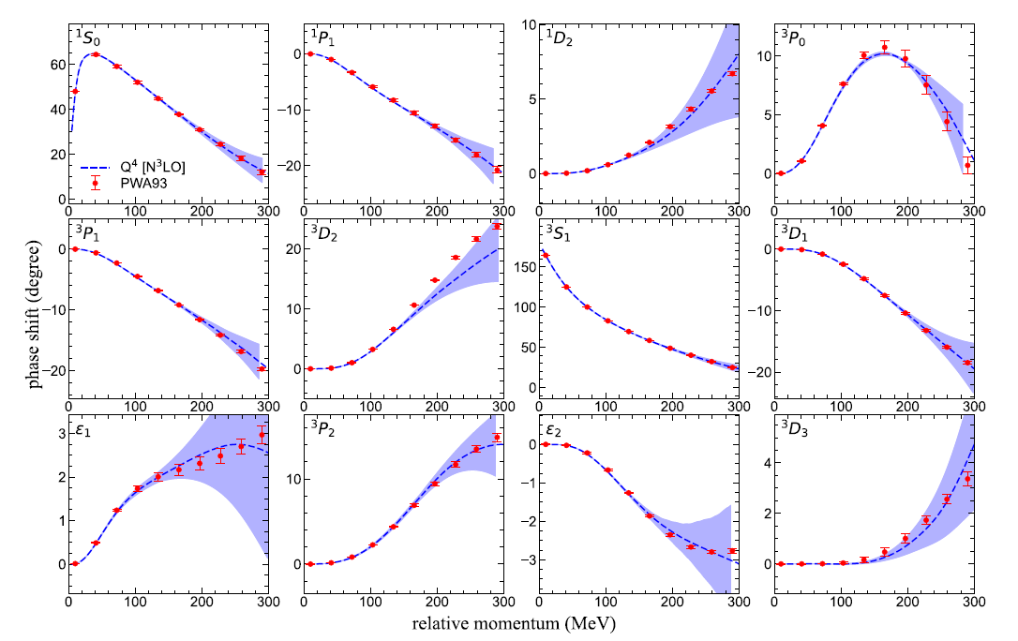
Lattice chiral Hamiltonian (N3LO)
Determine
Higher order NN
interaction
From the
phase shifts of NN scattering.

Slide 20
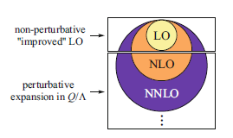
Lattice chiral Hamiltonian (N3LO)
Full N3LO Hamiltonian includes
Free Hamiltonian(Kinetic term)
Short range (nonlocal smeared) contact interactions up to Q^4 order
Isospin-breaking short range interactions
One pion exchange potential
Two pion exchange potential up to Q^4 order
Coulomb interaction
Long range isospin breaking interaction( isospin dependence in OPE)
Galilean Invariance Restoration (GIR) term (because of non-local interaction.)
Three nucleon interaction
Severe Sign problem
need to reduce the sign problem

Slide 21
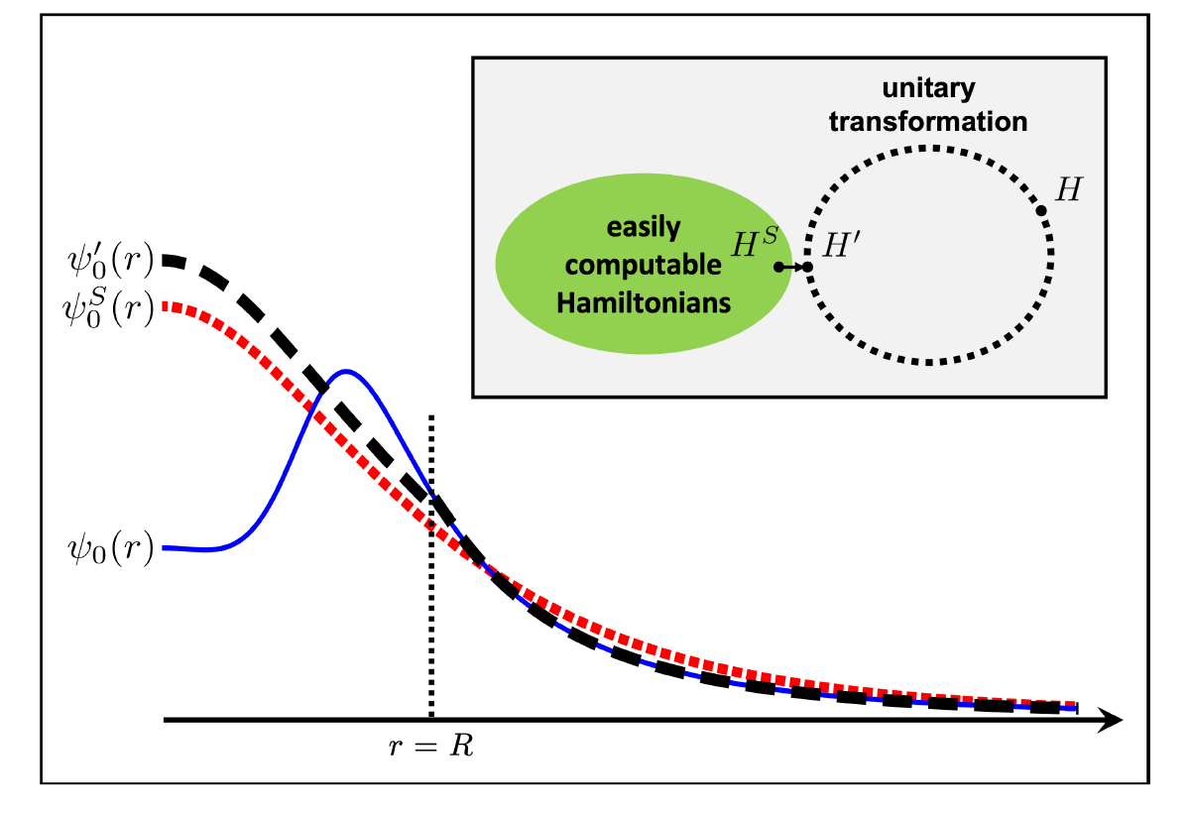




Wave function matching
H and H’ are fully equivalent to two-body observables
The goal is to make the perturbation expansion from “simple” wave function gives a good convergence
U is only active
At r < R
Two potentials V_A and V’_A are unitarily equivalent.
Same phase shifts.
H’_A has eigenvectors of H_B, but eigenvalues of H_A

Slide 22

Wave function matching Hamiltonian
N3LO Hamiltonian
V_2N : short range NN interactions
W_2N: GIR restoration term for V_2N
V_2N,WFM : difference from H’-H
W_2N,WFM: GIR restoration correction to V_2N,WFM
V_3N : contains short range 3N interaction parameters(to be fitted)
and two pion exchange correction to 3N

Slide 23
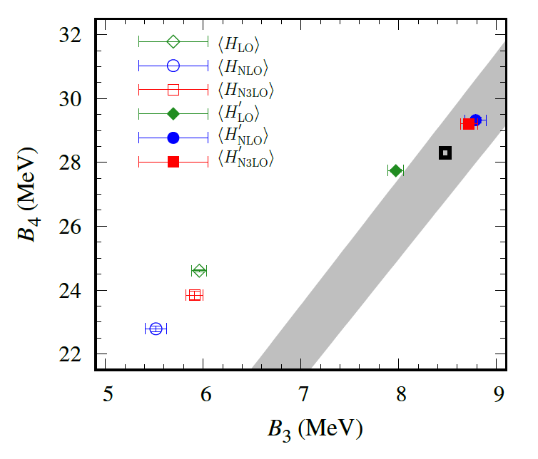
Tjon line from WFM method
Realistic two-body interaction
Correlation between 3-body and 4-body binding energy
Tjon Line
WFM approach gives binding energy lies on the Tjon line.
→ Accurate reproduction of B.E. requires 3-body force.

Slide 24
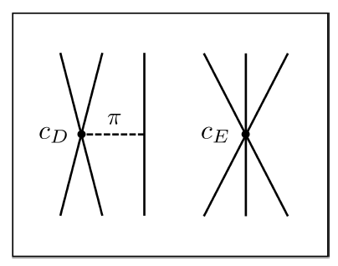


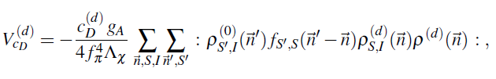
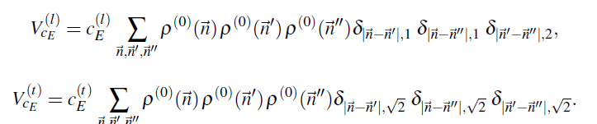





3-body force
NNLO
At N3LO:
TPE and
Adjustments to
cD and cE terms.

Slide 25
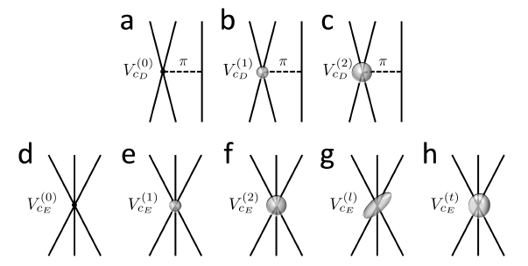
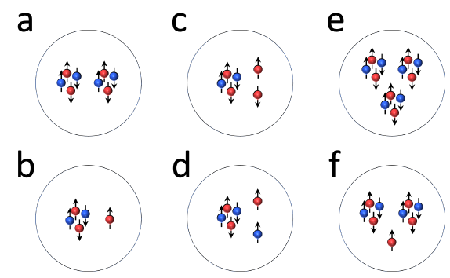
3-body force
Tune 3-body interaction to minimize errors
in binding energy
Just one additional parameter,
RMSD for the E/A
drops from 1.2 MeV to 0.4 MeV
Energies
Significant sensitivity to
the locality of 3N interactions.
We interpret they are related with
effective interactions
between alphas and nucleons.
Significantly high w/o additional 3-body terms
: alpha-alpha should be more attractive.

Slide 26
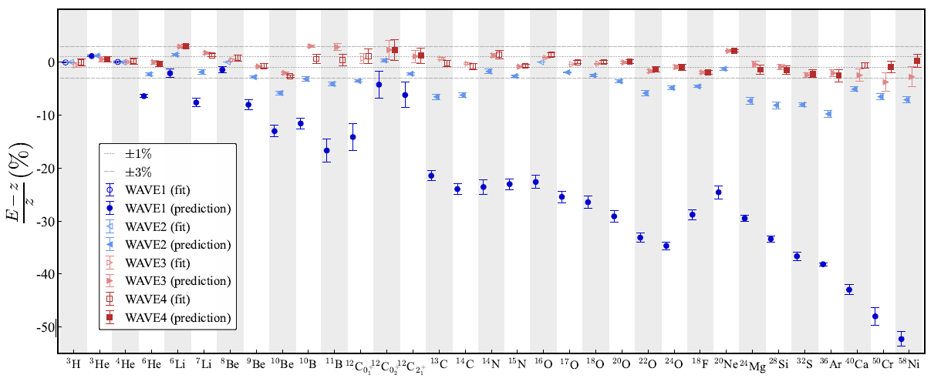
Determine 3-body force parameters
RMSD (MeV/nucleon): 1.2 → 0.3 →0.109 → 0.079

Slide 27
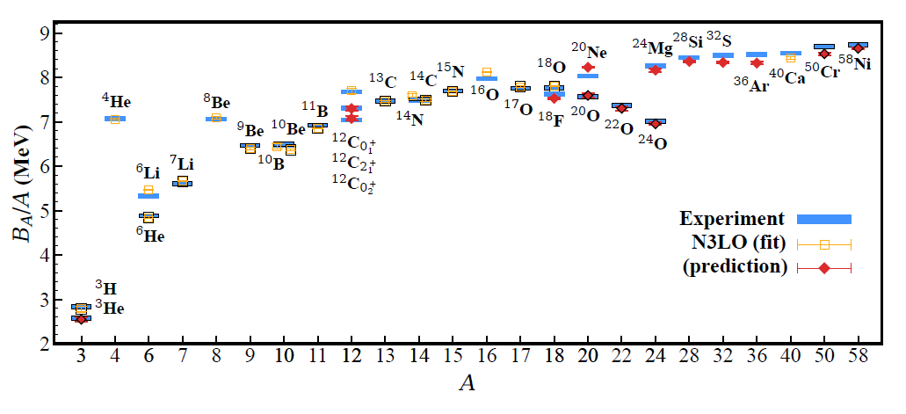
BE/A from WFM
RMSD ~ 0.1 MeV per nucleon

Slide 28
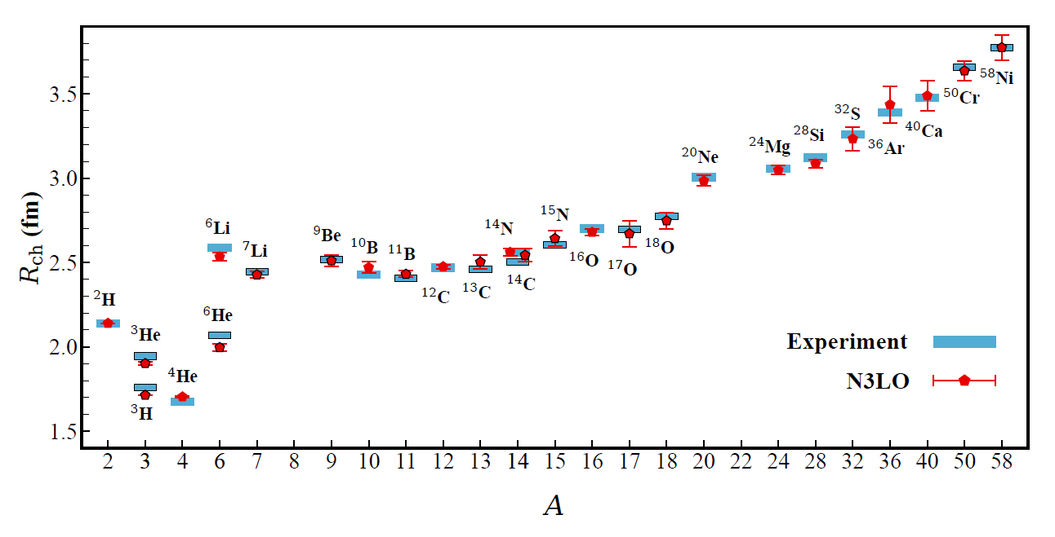
Charge Radius
No fitting! RMSD~ 0.03 fm

Slide 29
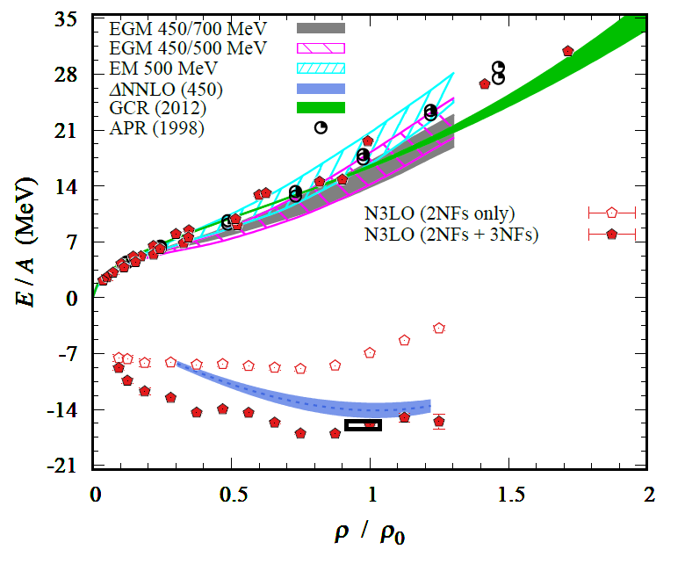
Nuclear/Neutron Matter
Neutron matter:
A=4~80
box size 6.6 ~ 13.2 fm.
Nuclear matter:
A=4 ~ 160
Box size 7.92~9.24 fm.
Uncertainties from
finite system size correction

Slide 30
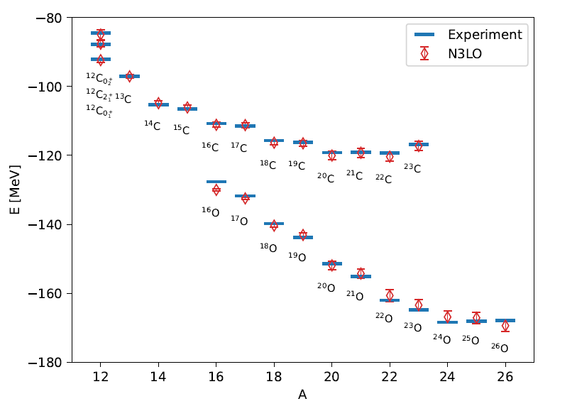
Carbon and Oxygen

Slide 31
Finite Volume Effect
Lt=200 | L=10 |  |  | L=11 |  |  | Exp
 | E | err | S2n | E | err | S2n | E | S2n
24O | -167.600 | 1.126 |  | -171.880 | 0.501 |  | -168.952 | 6.920
25O | -168.790 | 0.424 |  | -169.670 | 0.551 |  | -168.195 | 3.453
26O | -171.530 | 0.587 | 4.430 | -172.380 | 0.459 | 0.500 | -168.934 | -0.018
27O | -169.960 | 0.450 | 1.170 | -166.930 | 0.566 | -2.740 | -166.995 | -1.200
Lt=200 result. (Not extrapolated results.)
Systematic Error from finite volume effects need to be studied.
L=11 improved Separation energy of 26O.
Preliminary

Slide 32
Carbon isotopes (Lt=200)

Slide 33
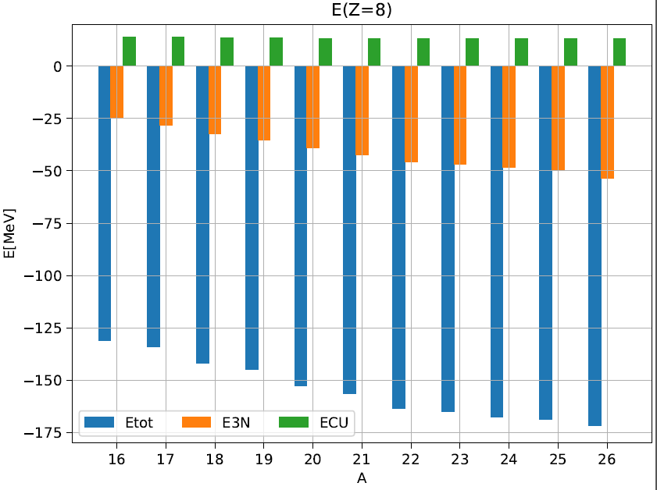
Oxygen isotopes (Lt=200)

Slide 34
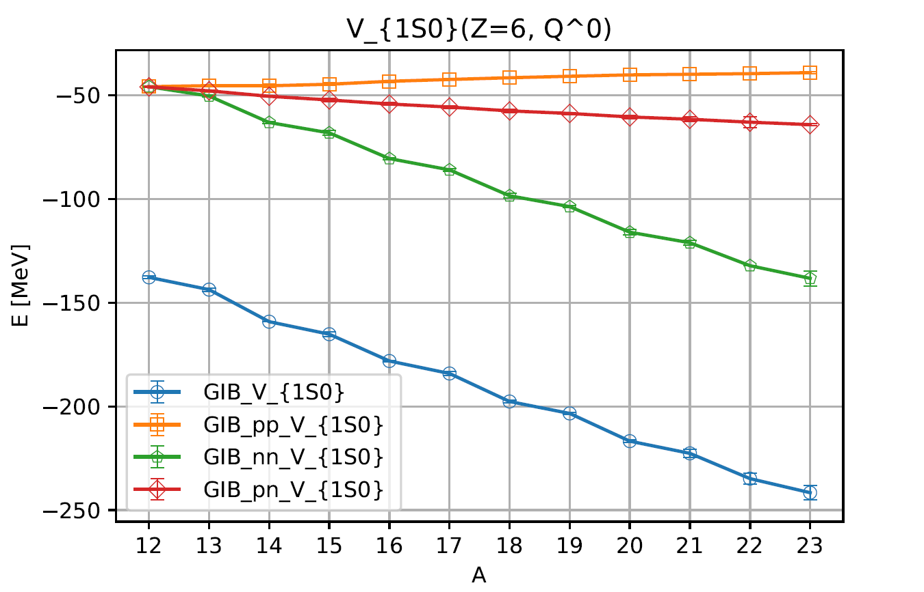
Partial waves contributions (Lt=200)

Slide 35
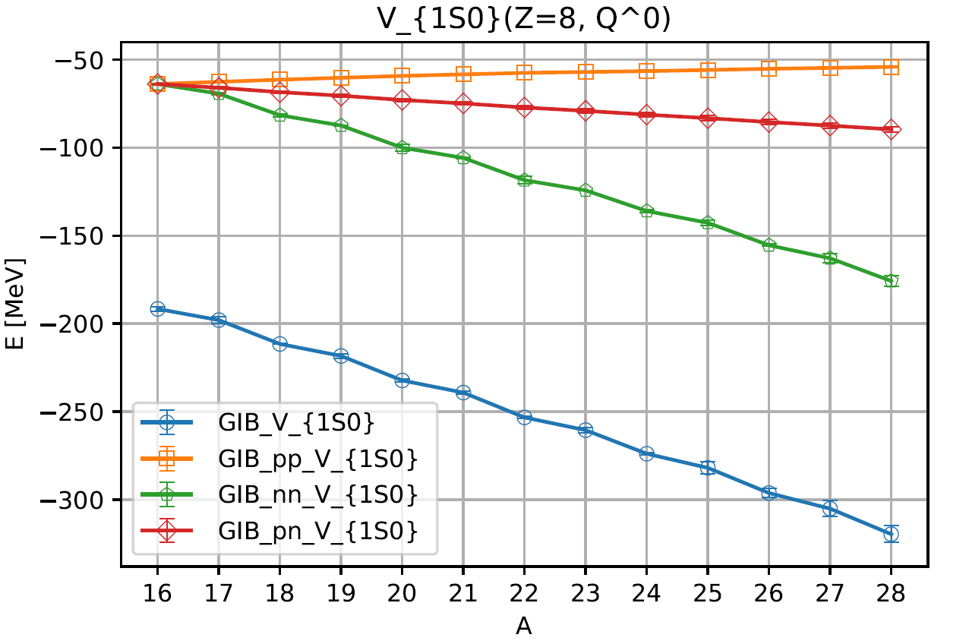
Partial waves contributions (Lt=200)

Slide 36
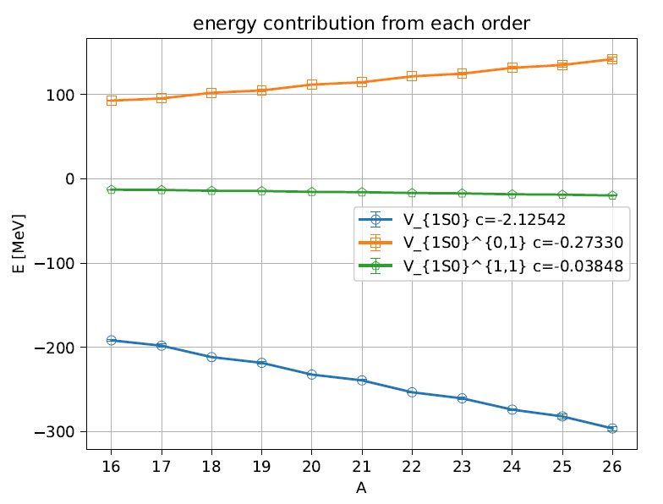
Partial waves contributions (Lt=200,Z=8)

Slide 37
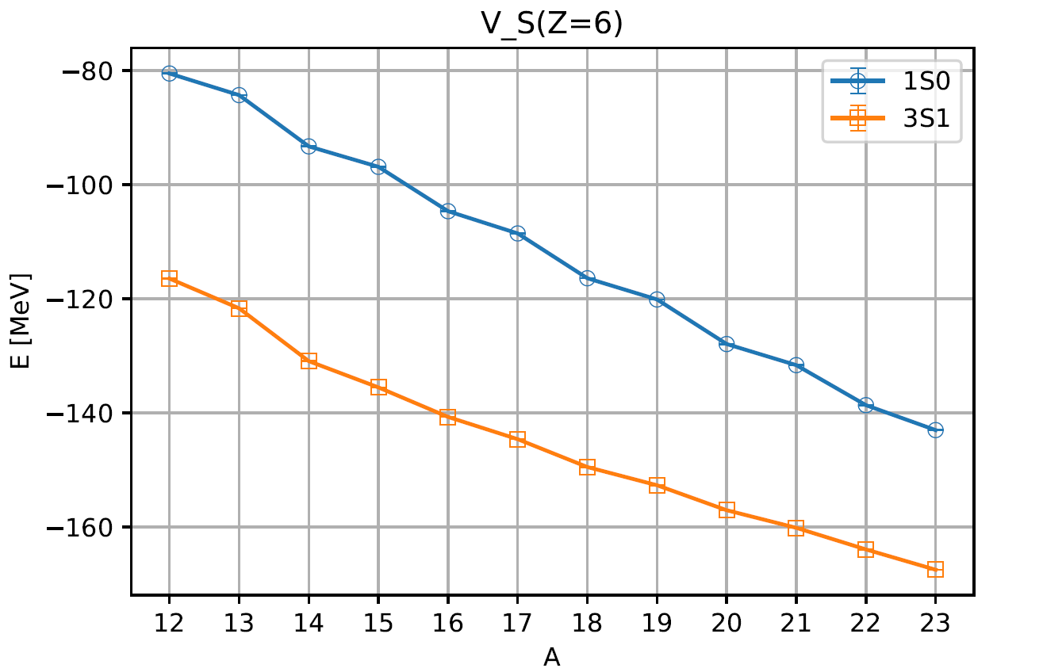
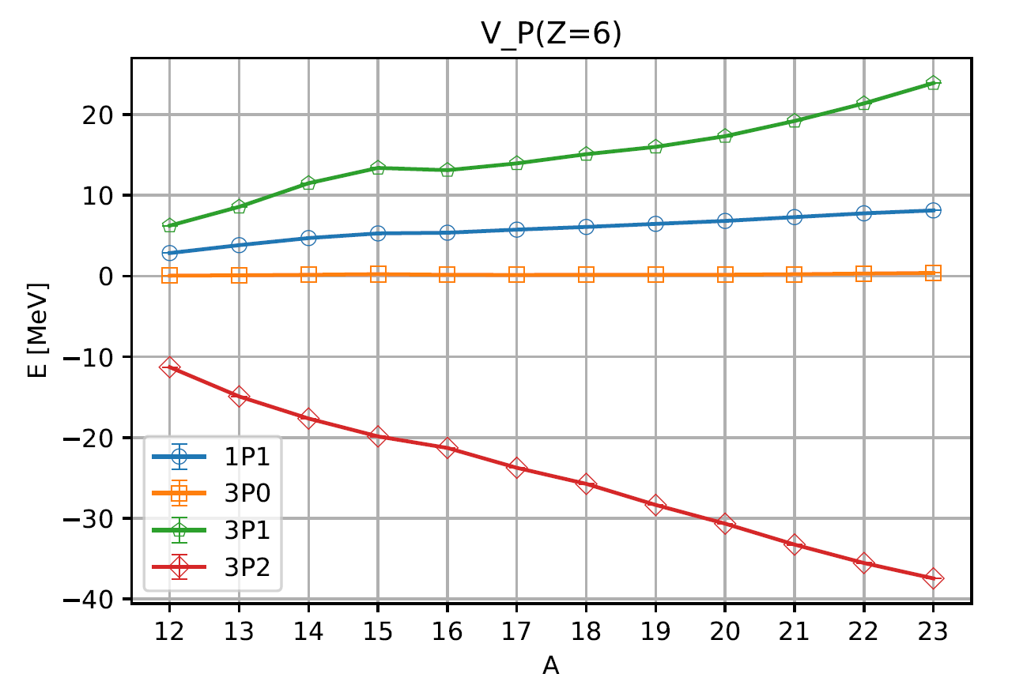
Partial waves contributions (Lt=200)

Slide 38





Measure of correlation
among extra neutrons
A(1,Tz) is a two nucleon annihilation operator
which gives isospin change by (1, Tz)
f(-1) : two proton operators ( two-body interaction) expectation value
f(0) : proton-neutron two-body interaction expectation value
f( 1) : two neutron operators ( two-body interaction) expectation value

Slide 39

Measure of correlation
among extra neutrons
If each of extra neutrons are uncorrelated with each other
Additional correlations produced by extra neutrons will be additive.
(only correlation with core neutrons )
→ Difference between left and right is
a measure of correlation between additional neutrons.

Slide 40
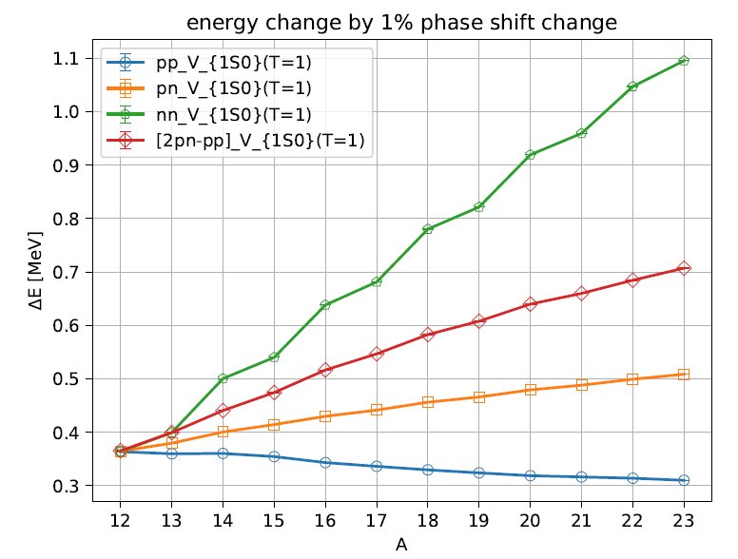
LEC(or phase shift fit) dependence (Lt=200)
1% Phase shift change
At p=150 MeV in 1S0
Z= 6
<pp1S0>
→ near constant
<nn1S0>
→ strong correlation among paired neutrons
Adding unpaired
one neutron
gives similar
slope for
<nn> and <2pn-pp>
Unpaired neutron
correlation with
core nucleons.

Slide 41

LEC(or phase shift fit) dependence (Lt=200)
Z= 8

Slide 42

LEC(or phase shift fit) dependence (Lt=200)
<pp 3P0> decrease faster
than <pp 1S0>
→ Correlation between alpha clusters may become weaker
Z= 6

Slide 43

LEC(or phase shift fit) dependence (Lt=200)
Slope change in 22O
→ closure of 1d5/2 subshell
Z= 8

Slide 44
Summary
Wave function matching method seems to be promising
Carbon, Oxygen isotope up to dripline shows good agreement with experimental data
systematic error(finite volume effects) estimation may be necessary.
Additional neutrons in 1S0 have strong pairing correlation
Unpaired neutrons correlated primarily to the nuclear core.

