Slide 1
Unitary limit in 3D results

Slide 2
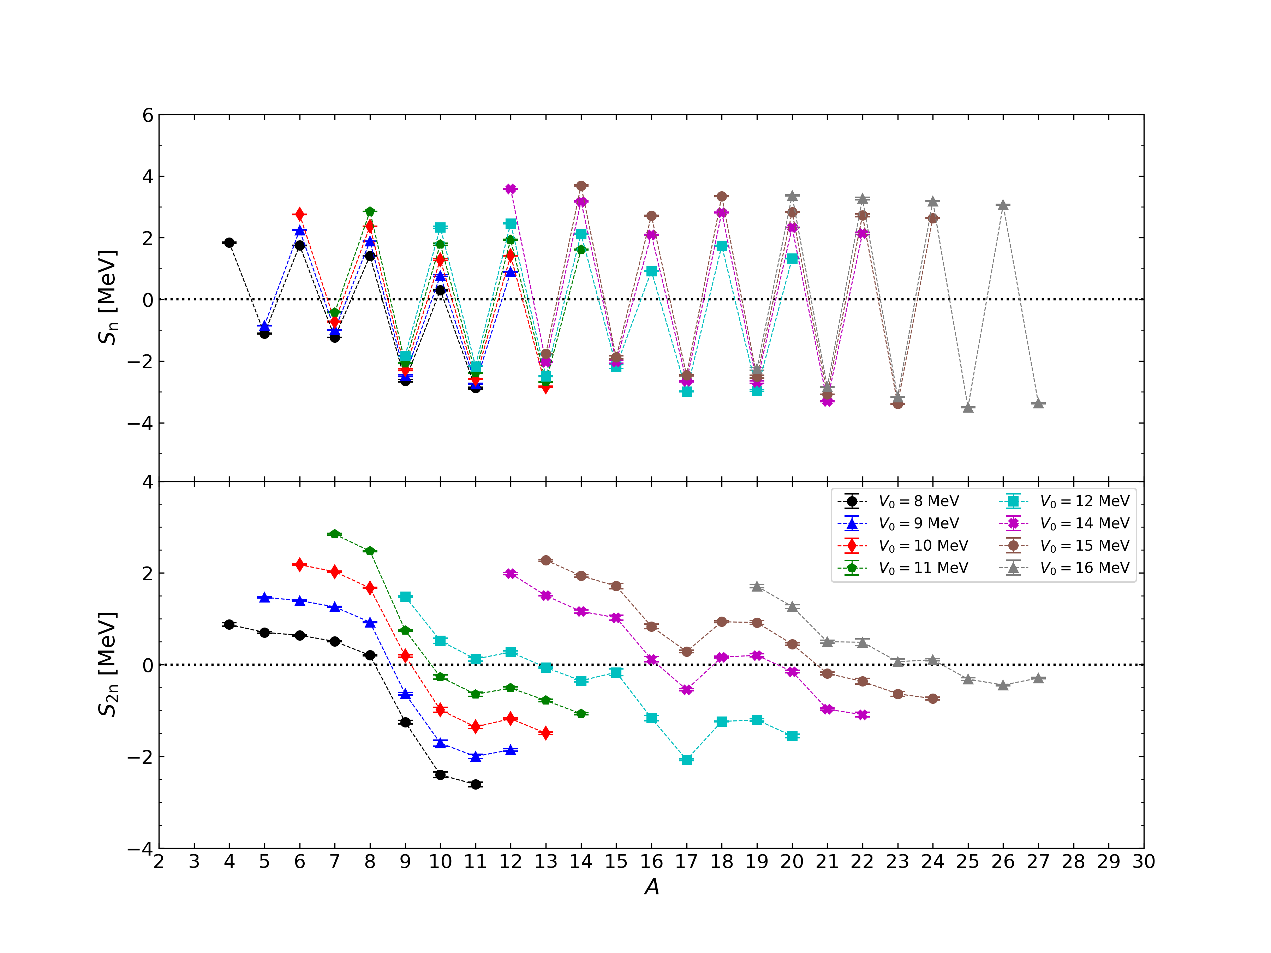

Slide 3
8 MeV | n=4 | 5 | 6 | 7 | 8 | 9 | 10 | 11
Sn | 1.84(1) | -1.109(8) | 1.749(4) | -1.235(3) | 1.412(4) | -2.63(4) | 0.30(2) | -2.87(2)
S2n | 0.87(3) | 0.70(2) | 0.64(1) | 0.507(6) | 0.20(1) | -1.25(3) | -2.40(6) | -2.61(4)
8 MeV | n=5 | 6 | 7 | 8 | 9 | 10 | 11 | 12
Sn | -0.850(5) | 2.246(6) | -0.987(5) | 1.886(3) | -2.47(3) | 0.77(2) | -2.74(2) | 0.89(1)
S2n | 1.47(2) | 1.39(1) | 1.261(7) | 0.927(5) | -0.63(3) | -1.71(6) | -2.00(4) | -1.85(3)

Slide 4
10 MeV | n=6 | 7 | 8 | 9 | 10 | 11 | 12 | 13
Sn | 2.755(7) | -0.718(9) | 2.369(1) | -2.28(2) | 1.28(3) | -2.58(1) | 1.415(9) | -2.83(2)
S2n | 2.18(1) | 2.02(1) | 1.67(1) | 0.19(2) | -0.98(5) | -1.35(3) | -1.17(2) | -1.49(2)
11 MeV | n=7 | 8 | 9 | 10 | 11 | 12 | 13 | 14
Sn | -0.42(1) | 2.852(2) | -2.06(2) | 1.78(3) | -2.392(8) | 1.93(1) | -2.68(1) | 1.61(1)
S2n | 2.84(2) | 2.48(1) | 0.75(1) | -0.26(5) | -0.64(5) | -0.51(3) | -0.78(2) | -1.07(2)

Slide 5
12 MeV | n=9 | 10 | 11 | 12 | 13 | 14 | 15 | 16 | 17 | 18 | 19 | 20
Sn | -1.83(1) | 2.34(3) | -2.168(4) | 2.47(1) | -2.49(1) | 2.12(1) | -2.17(6) | 0.92(1) | -2.99(1) | 1.74(1) | -2.96(3) | 1.324(9)
S2n | 1.49(2) | -0.52(5) | 0.12(4) | 0.27(3) | -0.06(2) | -0.35(3) | -0.16(7) | -1.16(6) | -2.07(2) | -1.237(8) | -1.20(3) | -1.55(3)
14 MeV | n=12 | 13 | 14 | 15 | 16 | 17 | 18 | 19 | 20 | 21 | 22
Sn | 3.58(1) | -2.034(6) | 3.17(2) | -2.02(5) | 2.09(1) | -2.66(2) | 2.81(1) | -2.68(4) | 2.33(1) | -3.30(1) | 2.14(3)
S2n | 1.99(2) | 1.506(6) | 1.16(3) | 1.02(5) | 0.119(6) | -0.54(2) | 0.17(2) | 0.21(3) | -0.15(3) | -0.97(2) | -1.08(5)

Slide 6
15 MeV | n=13 | 14 | 15 | 16 | 17 | 18 | 19 | 20 | 21 | 22 | 23 | 24
Sn | -1.765(6) | 3.68(2) | -1.88(5) | 2.71(1) | -2.47(2) | 3.35(1) | -2.51(4) | 2.83(1) | -3.078(4) | 2.73(4) | -3.387(1) | 2.64(1)
S2n | 2.27(2) | 1.94(3) | 1.71(6) | 0.84(5) | 0.28(3) | 0.93(2) | 0.92(4) | 0.44(3) | -0.19(3) | -0.36(6) | -0.64(5) | -0.73(3)
16 MeV | n=19 | 20 | 21 | 22 | 23 | 24 | 25 | 26 | 27
Sn | -2.25(5) | 3.37(2) | -2.840(6) | 3.27(4) | -3.168(6) | 3.18(1) | -3.50(1) | 3.06(1) | -3.37(2)
S2n | 1.71(3) | 1.27(4) | 0.50(3) | 0.49(7) | 0.06(6) | 0.11(2) | -0.31(3) | -0.44(2) | -0.29(2)

Slide 7
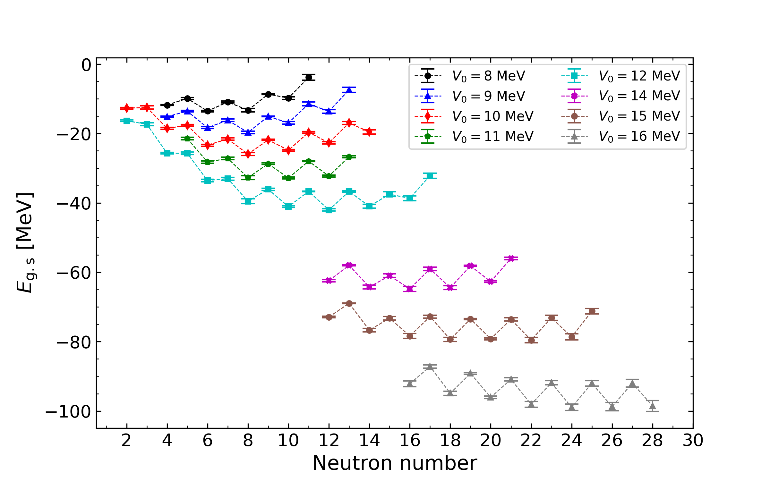

Slide 8
 | 2 | 3 | 4 | 5 | 6 | 7 | 8 | 9 | 10 | 11 | 12 | 13 | 14 | 15 | 16 | 17 | 18 | 19 | 20 | 21 | 22 | 23 | 24 | 25 | 26 | 27 | 28
8MeV |  |  | -11.8(2) | -9.9(2) | -13.5(2) | -10.9(2) | -13.3(5) | -8.6(1) | -9.8(4) | -3.8(8)
9MeV |  |  | -15.1(2) | -13.6(2) | -18.3(3) | -16.1(4) | -19.7(4) | -15.1(1) | -16.9(4) | -11.5(5) | -13.6(5) | -7.4(7)
10MeV | -12.7(2) | -12.5(4) | -18.5(3) | -17.6(2) | -23.3(3) | -21.6(3) | -25.6(4) | -21.8(2) | -24.8(2) | -19.6(2) | -22.7(4) | -17.0(4) | -19.5(6)
11MeV |  |  |  | -21.5(4) | -28.2(3) | -27.2(4) | -32.7(5) | -28.7(3) | -32.8(2) | -28.0(1) | -32.3(3) | -26.7(3)
12MeV | -16.3(3) | -17.3(4) | -25.6(3) | -25.7(4) | -33.5(4) | -33.0(4) | -39.5(7) | -36.1(3) | -41.1(2) | -36.7(1) | -42.0(3) | -36.7(1) | -41.0(5) | -37.5(7) | -38.7(7) | -32.1(7)
14MeV |  |  |  |  |  |  |  |  |  |  | -62.4(3) | -58.0(1) | -64.3(6) | -61.0(5) | -64.8(7) | -59.0(5) | -64.5(6) | -58.2(2) | -62.7(2) | -56.0(4)
15MeV |  |  |  |  |  |  |  |  |  |  | -72.9(2) | -69.0(1) | -76.7(5) | -73.3(5) | -78.4(7) | -72.8(4) | -79.4(6) | -73.5(2) | -79.2(3) | -73.6(4) | -79.6(8) | -73.1(7) | -78.7(9) | -71.2(8)
16MeV |  |  |  |  |  |  |  |  |  |  |  |  |  |  | -92.2(8) | -87.2(5) | -94.9(6) | -89.2(2) | -96.1(4) | -90.9(5) | -98.1(8) | -91.9(6) | -98.9(9) | -92.0(7) | -99(1) | -92(1) | -98(1)

Slide 9
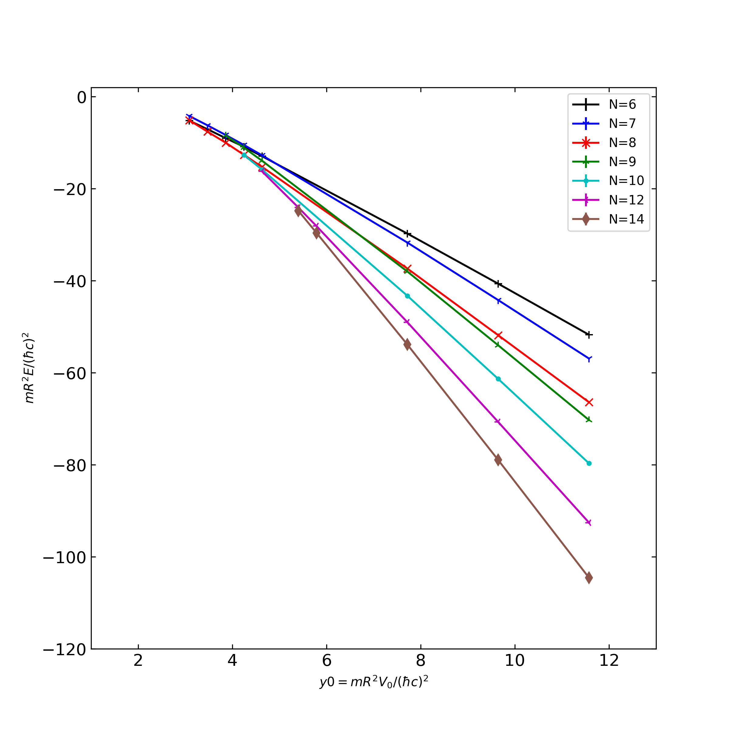
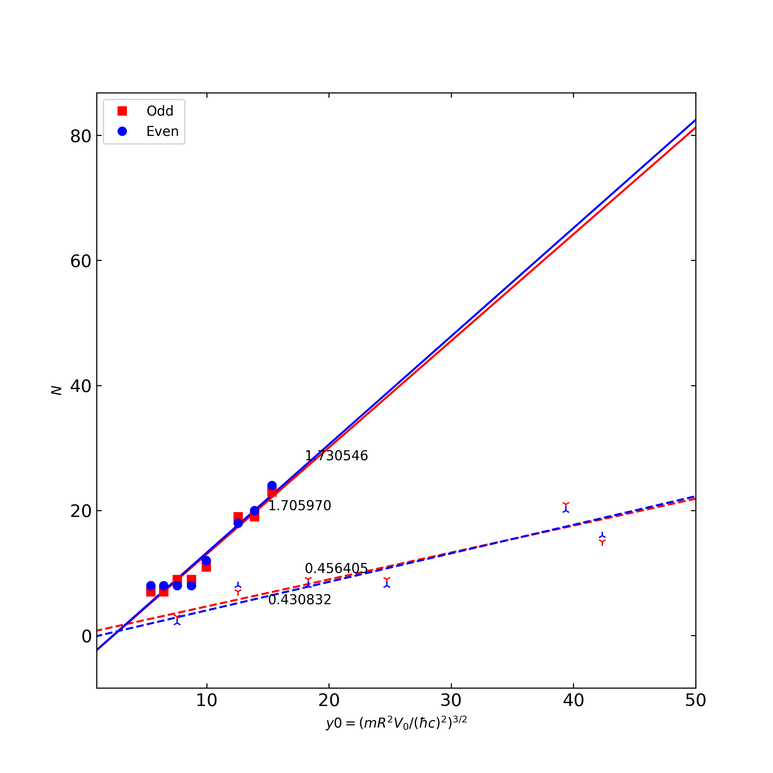

Slide 10
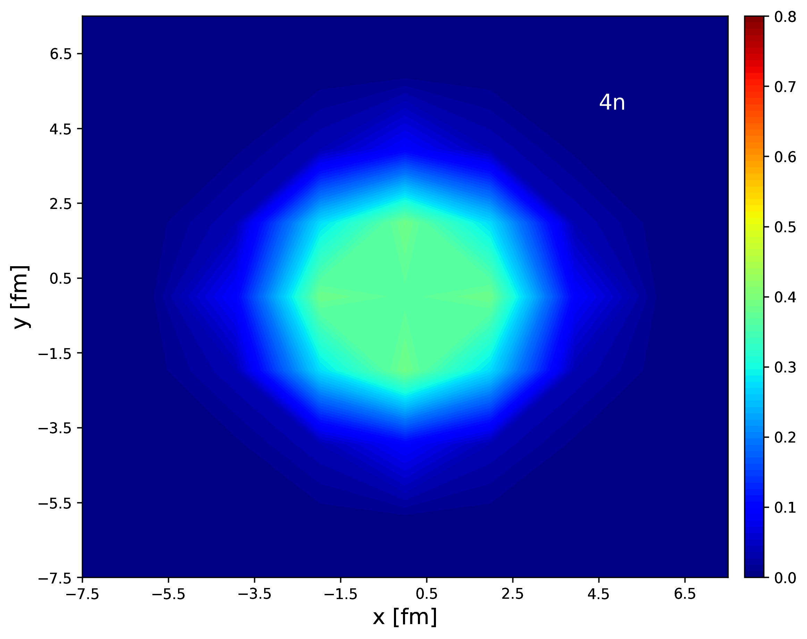
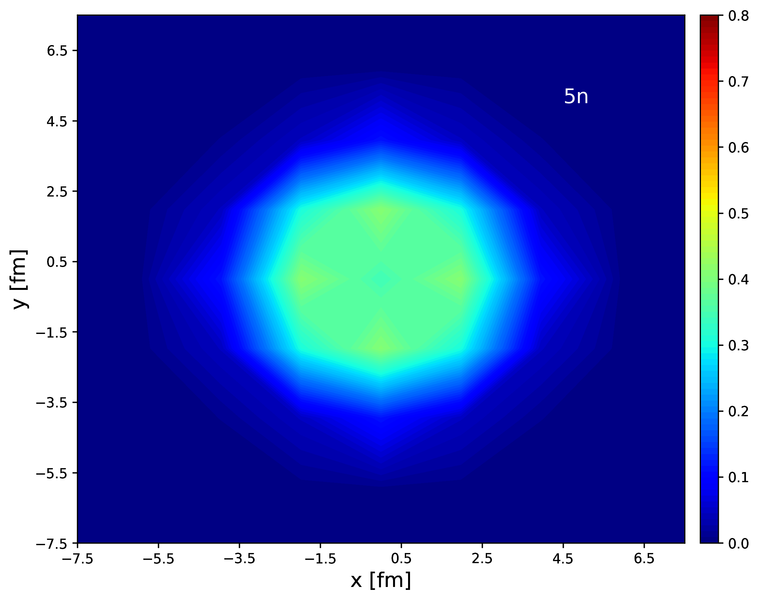
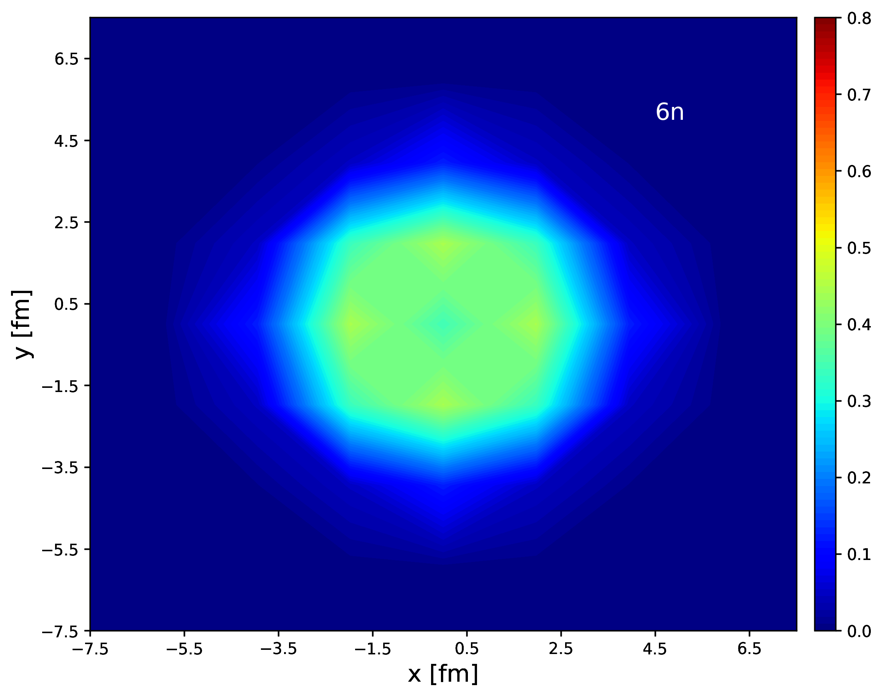
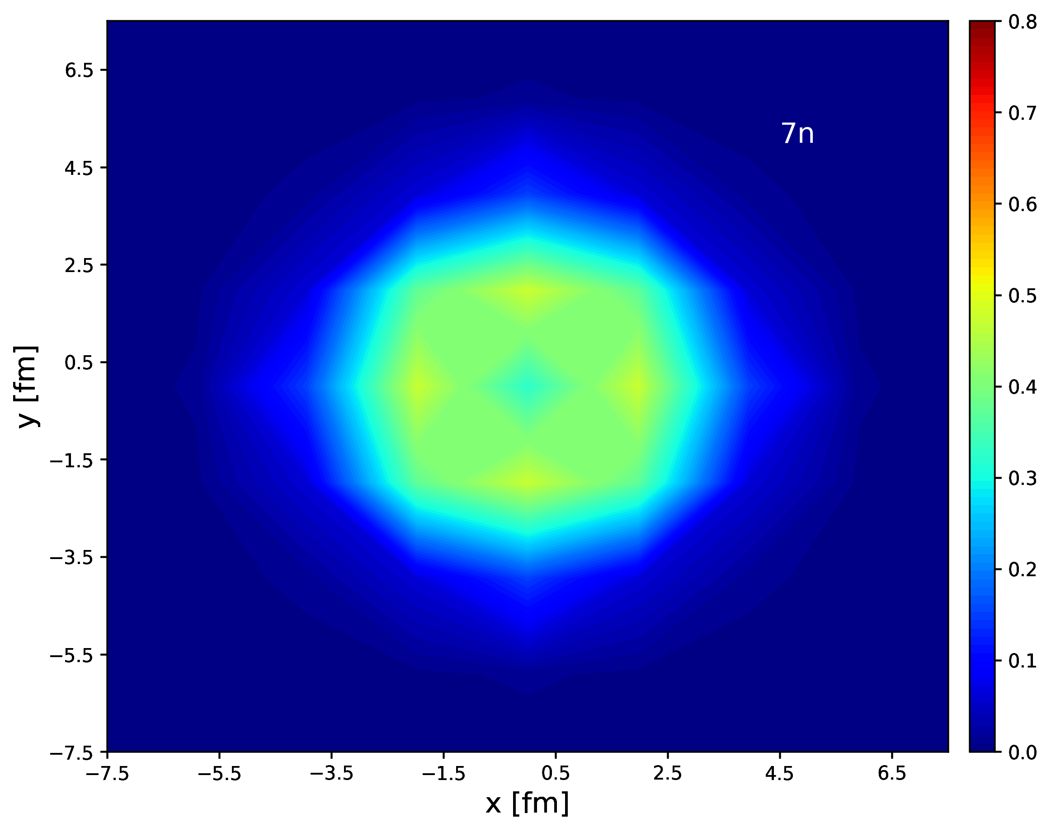
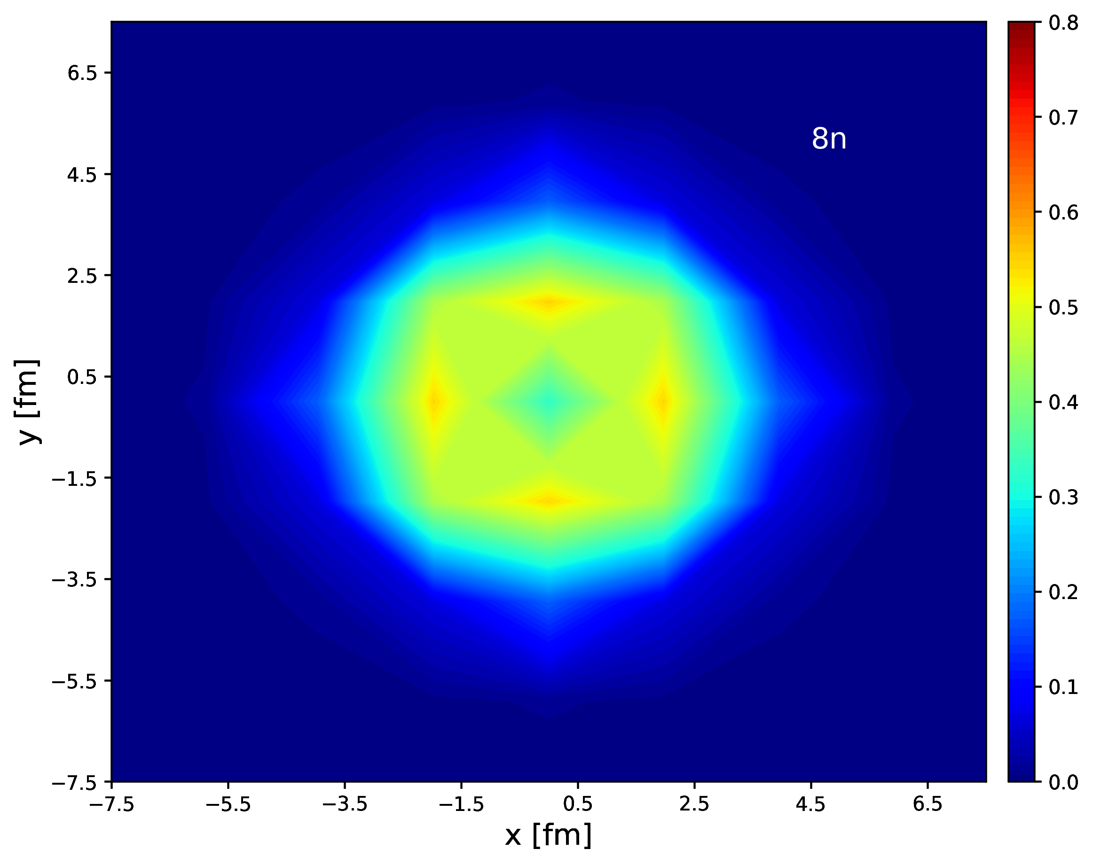
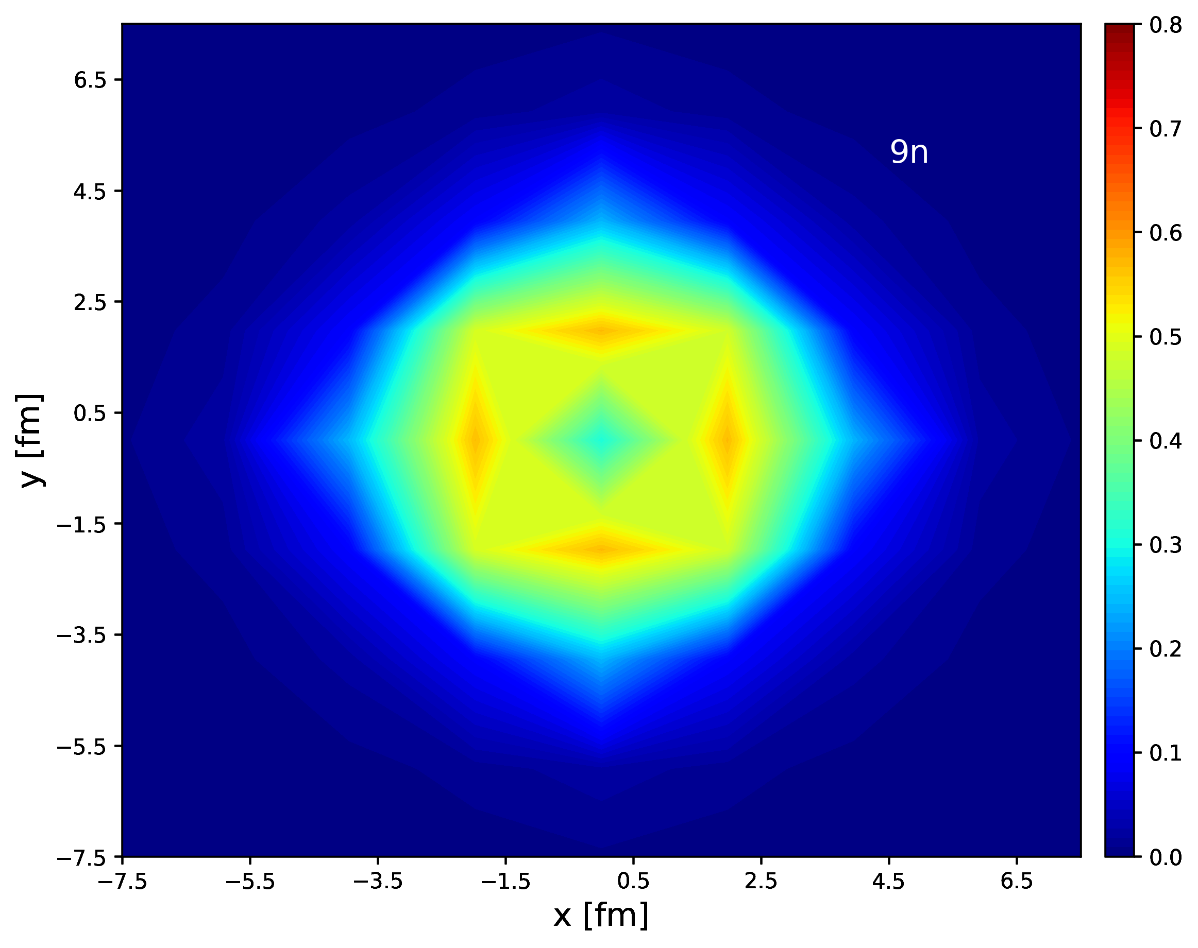
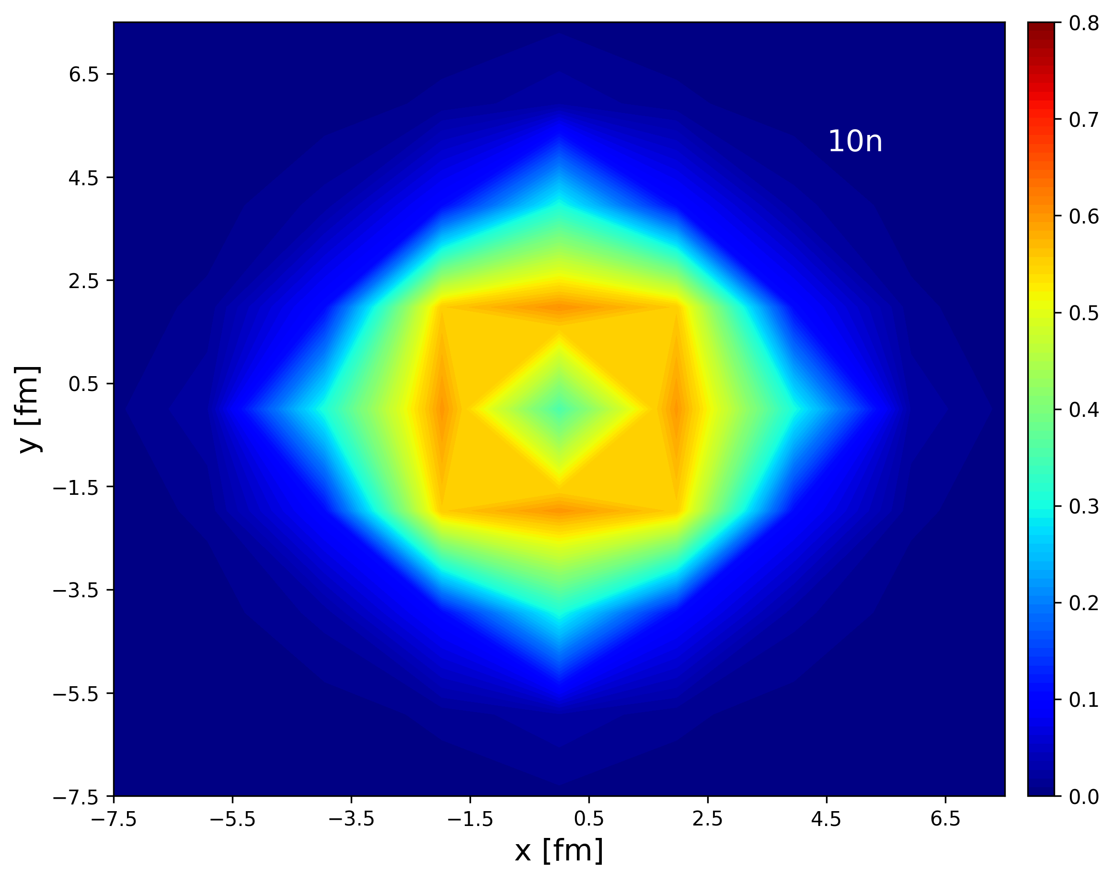

V0=8MeV density contour

Slide 11

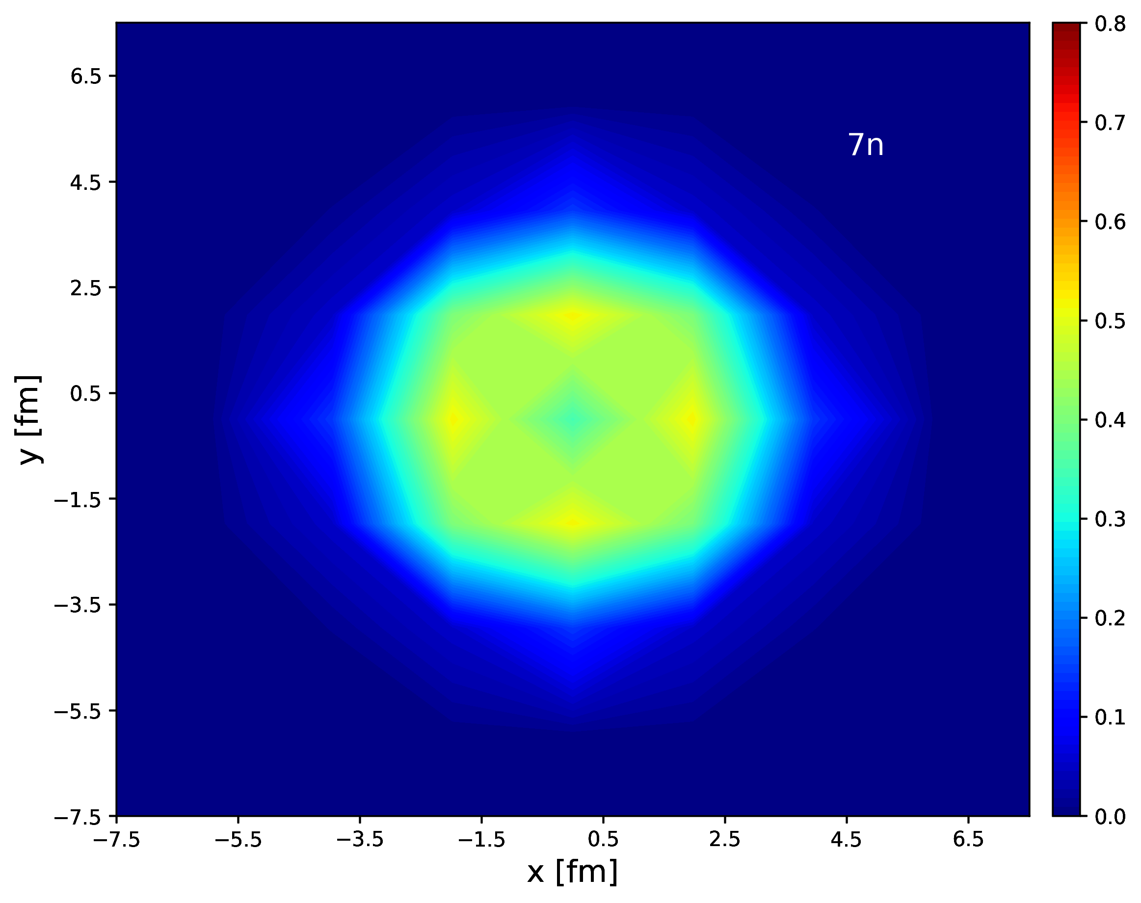
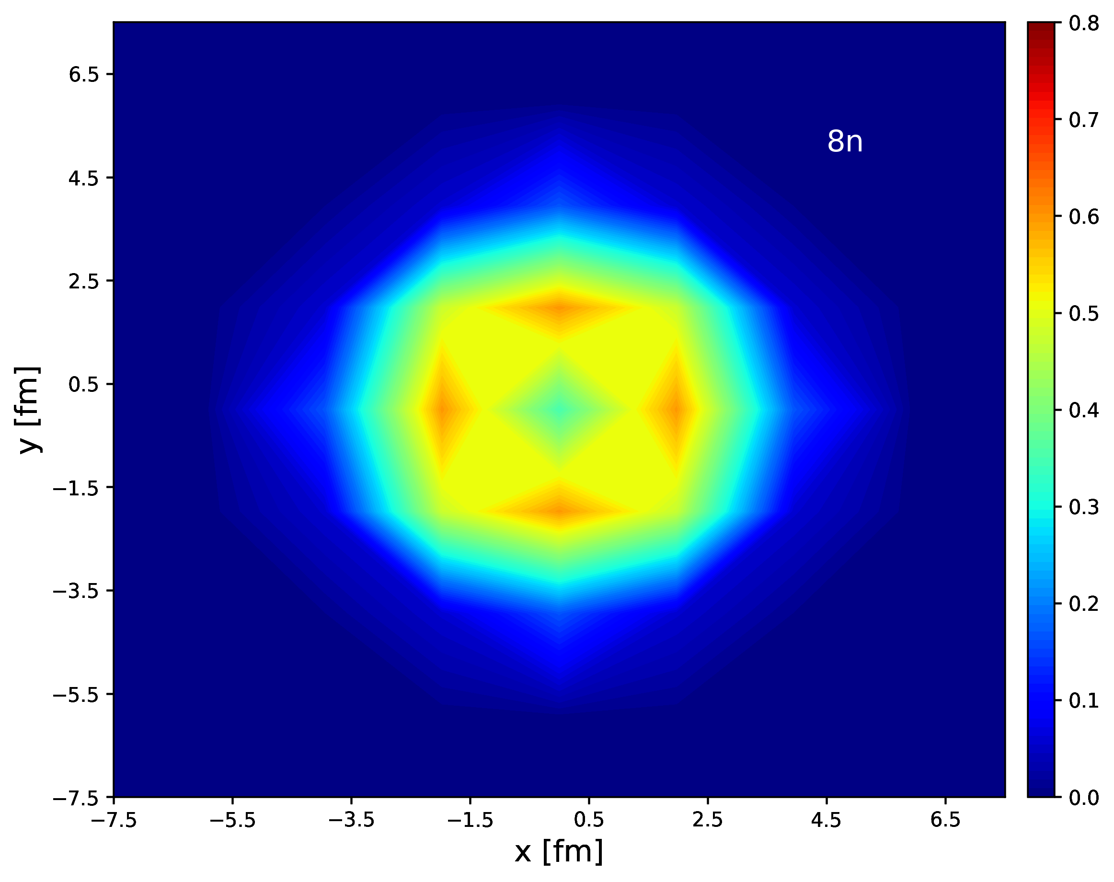

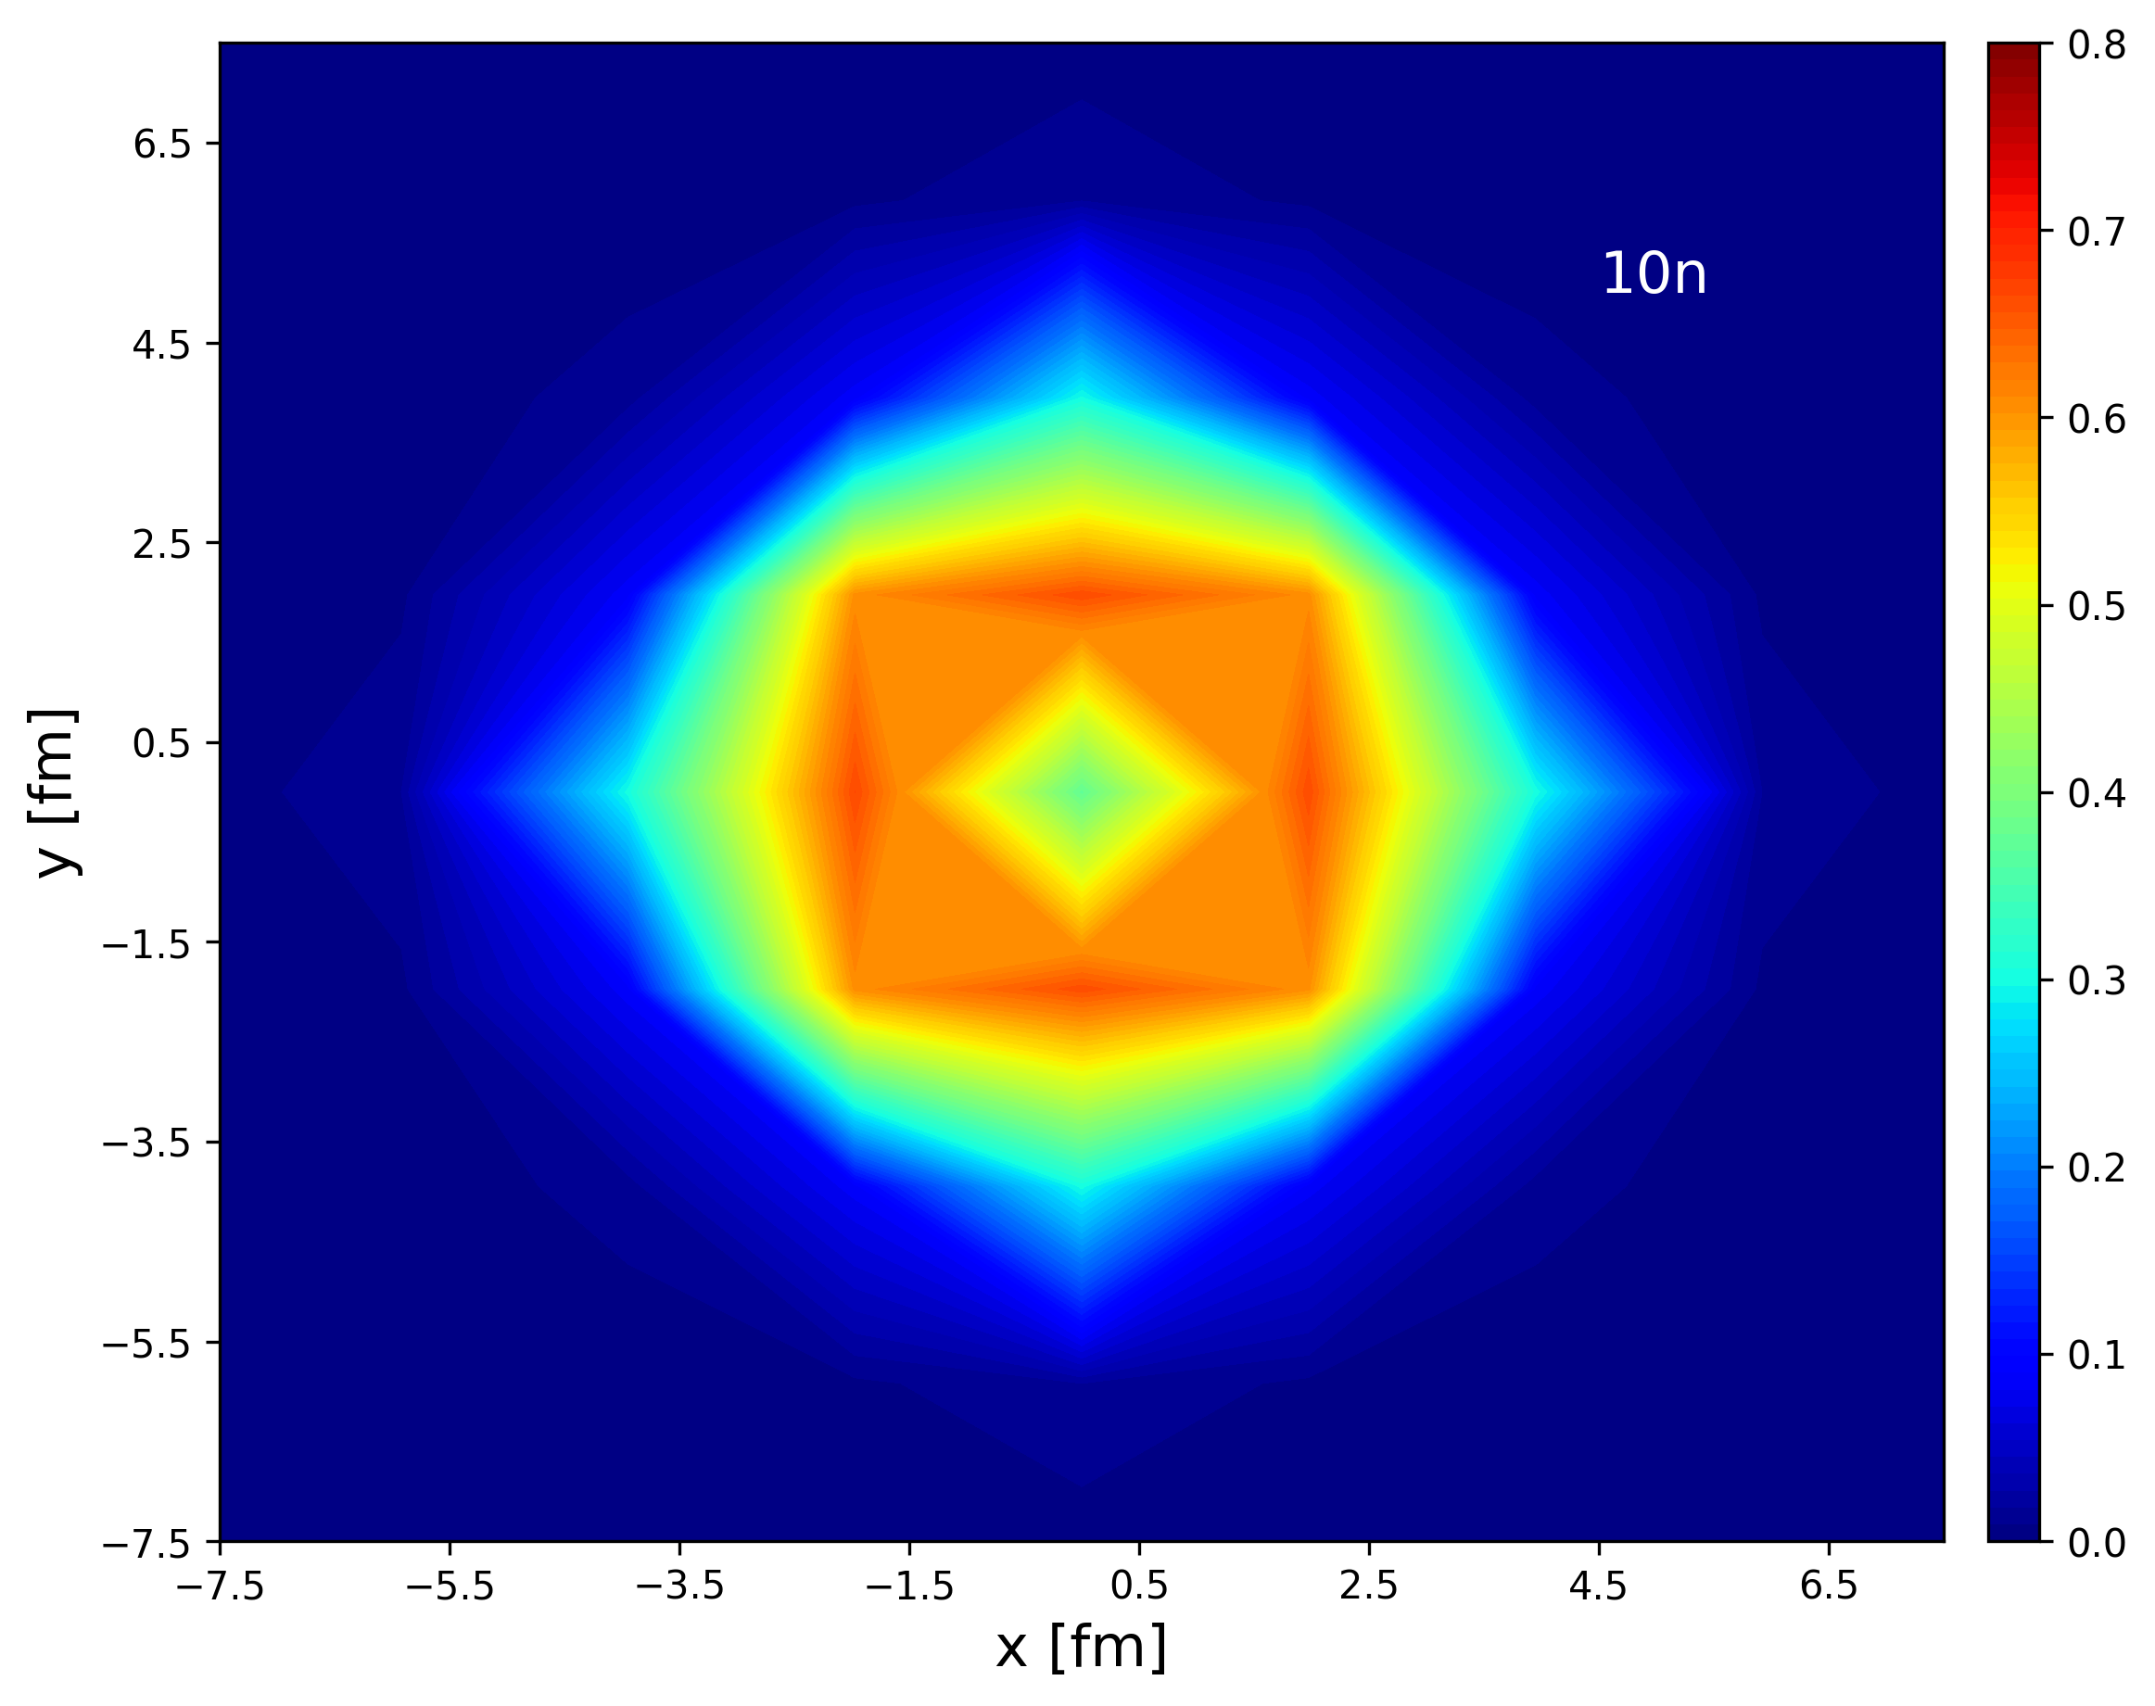

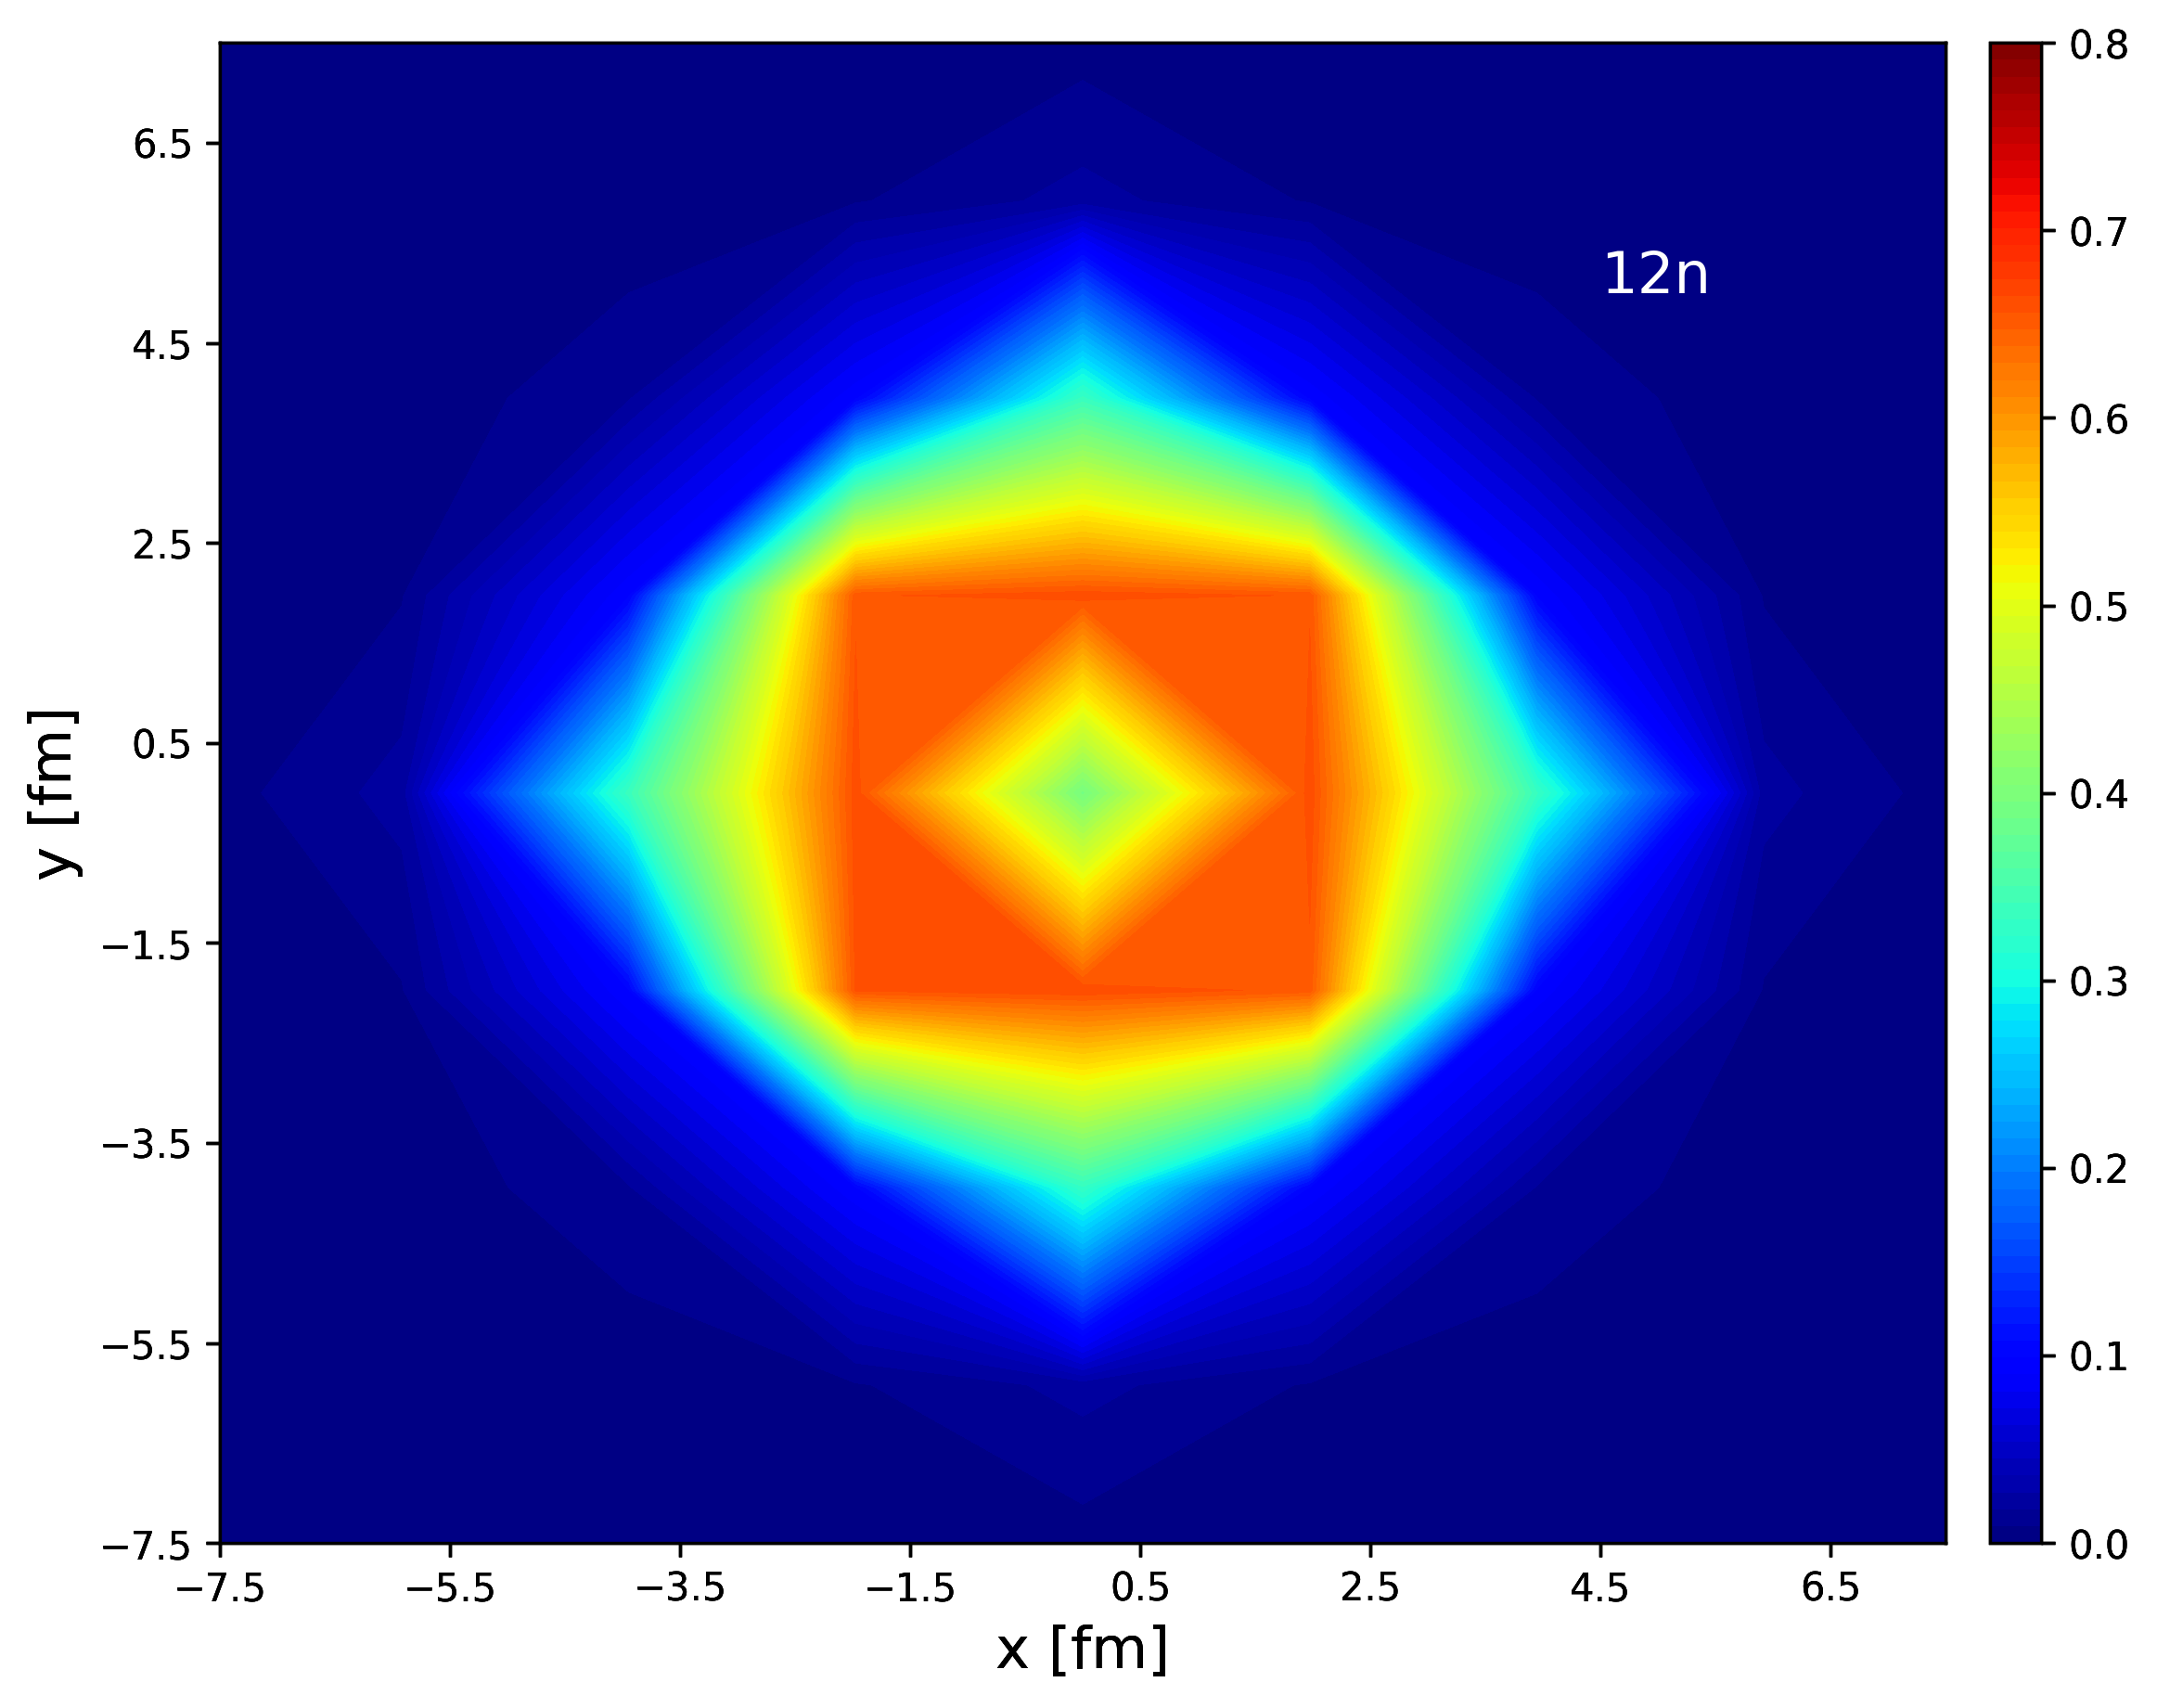
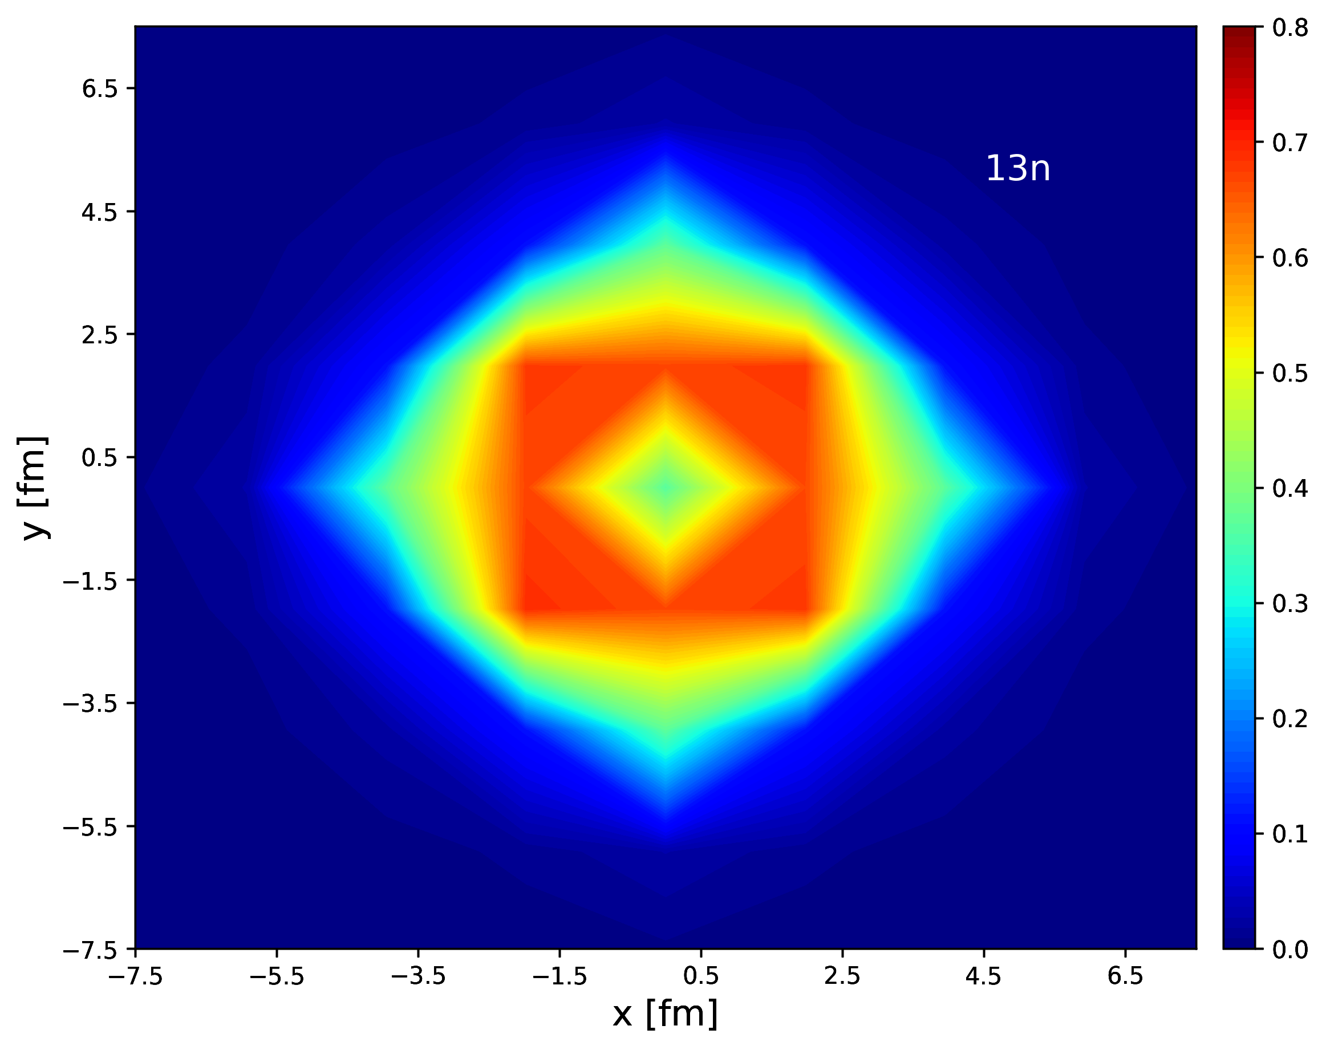
V0=10MeV density contour

