Slide 1



KOBRA Research
Collaboration meeting
Low Energy experimental systems team Theory Status report Young-Ho Song (RISP, Low Energy experimental systems team)

Slide 2

01
1. Current Status
사업 일반현황
사업 개요 및 내용
Low Energy Experimental systems team
3 theorists
Low energy Nuclear Structure and Reaction study
Various Subjects and theoretical tools
Young-Ho Song :
Effective Field Theory, Nuclear Structure and Reaction
Ik-Jae Shin :
ab initio Nuclear Structure (No-core Shell Model)
Panagiota Papakonstantinou :
Nuclear Structure( Density Functional Theory, RPA)

Slide 3
01
2. Research Areas
사업 일반현황
사업 개요 및 내용
Nuclear Force Study
Nucleon-Nucleon Interaction: Chiral Effective Interaction, pion-less Effective Field Theory
Power counting of chiral effective interaction
New NN interaction for ab initio calculation : DJ16
Faddeev method , di-baryon formalism, Halo/Cluster EFT
Symmetry Violating interaction : (EDM, spin-rotation)
3N interaction
Nuclear Force is fundamental in Nuclear Physics.
Need better understanding of NN and also 3N interaction
Effective Theory approach is model independent and systematic

Slide 4
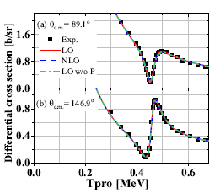
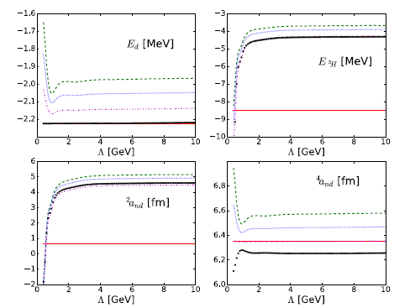
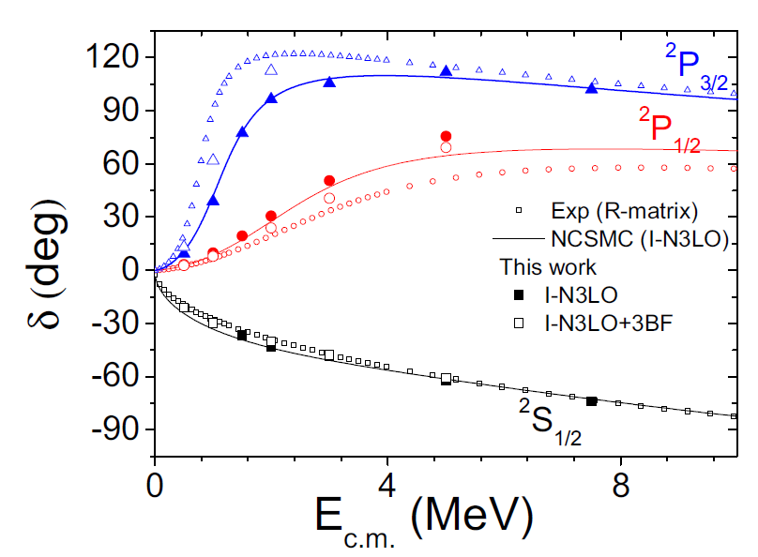
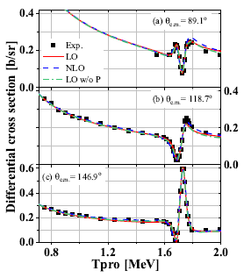
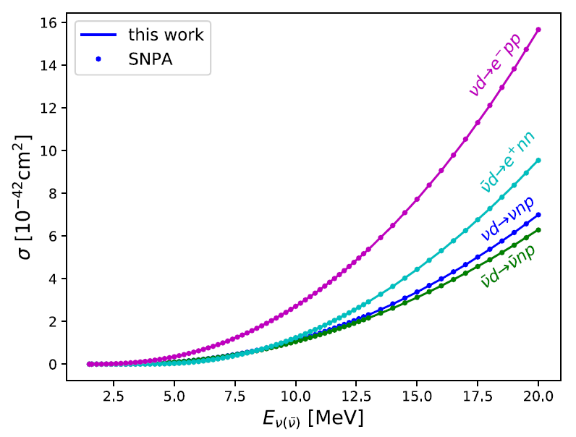
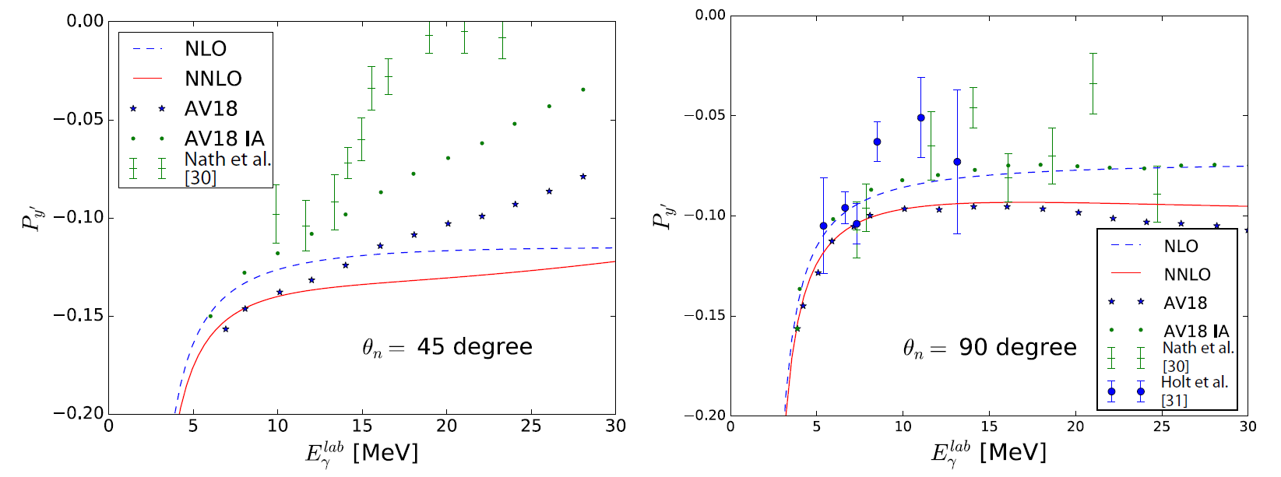
01
2. Research Areas
사업 일반현황
사업 개요 및 내용
Examples:
Triton, n-d scattering
N-4He scattering
Deuteron photodisintegration
Neutrino-deuteron reaction
P+12C scattering

Slide 5
01
2. Research Areas
사업 일반현황
사업 개요 및 내용
Nuclear Structure Study
Ab-initio No-core Shell Model
Ab-initio Nuclear Lattice Effective Field Theory
Coupled Cluster/in-medium SRG method
Density Functional Theory
Random Phase Approximation
Ab initio Nuclear structure study is important
For better understanding of nuclear force
← Directly connect nucleon-nucleon interaction to phenomena
For reliable prediction without free parameter
← towards dripline nuclei
Recent developments allows to access to heavier nuclei
Each method has its cons/pros
Density Functional Theory and RPA
Nuclear charts, dripline study
Collective Excitation

Slide 6
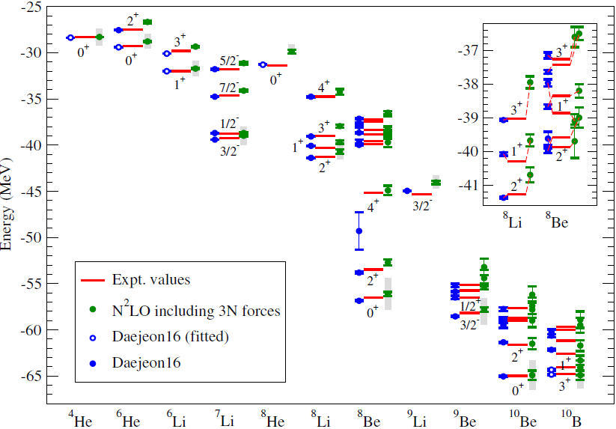
* ground state/excitation energies
* magnetic dipoles
* M1 transition
* matrix elements of GT
* rms radius
* electric quadrupoles
* E2 transition
Ab initio No-Core Shell Model
* nucleons as degrees of freedom (roughly A<20)
* using realistic inter-nucleon interactions
* with quantified approximation
A. M. Shirokov, I. J. Shin and et al., PRC98, 044624 (2018)
P. Maris I. J. Shin and J. P. Vary, Proceedings of NTSE-2018, p.168

Slide 7
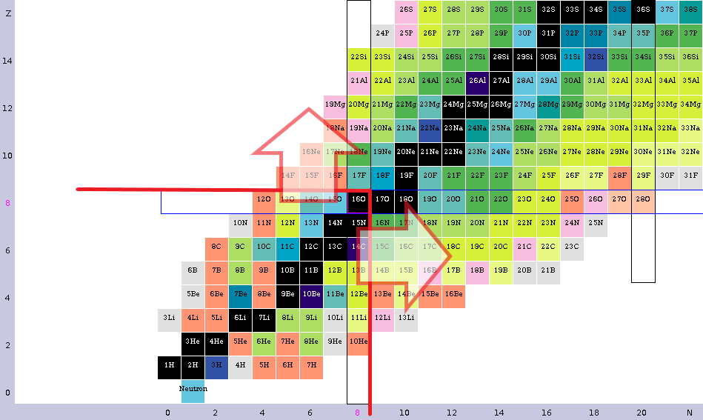
Ab initio No-Core Shell Model
* Structure (and/or Reaction)
> NCSM calculation (slightly) over Z=8 and/or N=8 - the spectrum of (16~19) [O, F, Ne, …] ex. p (¹⁸Ne,d )¹⁷Ne*(2p) , p (¹⁸Ne,t )¹⁶Ne , ...
BUT sd-shell nuclei should be considered carefully.

Slide 8
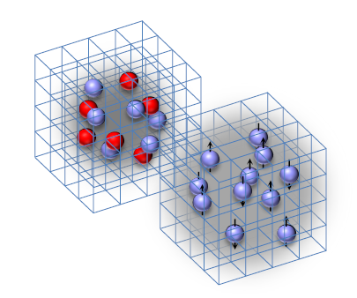
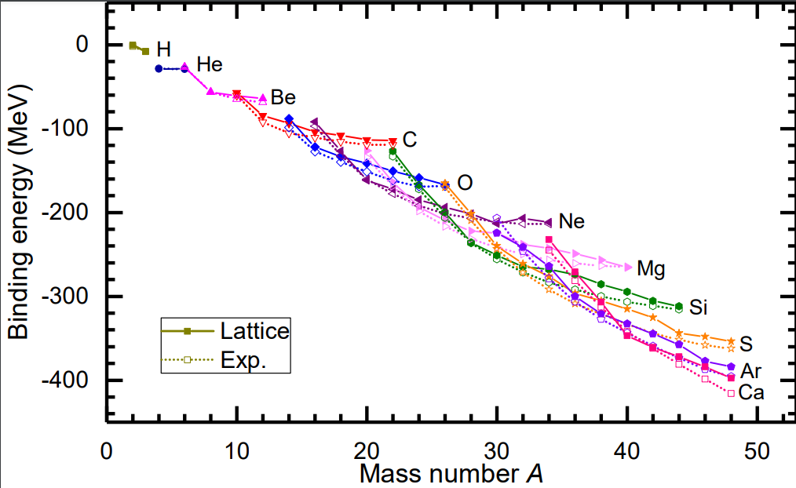
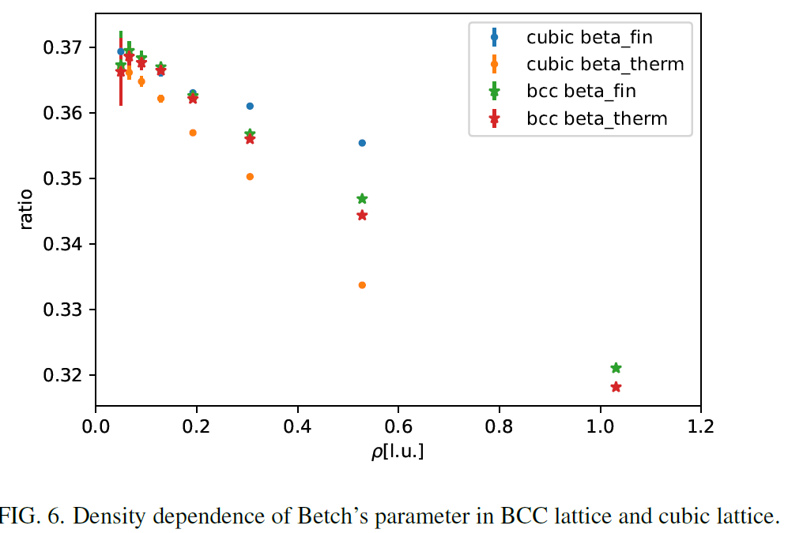
Ab initio Nuclear Lattice Effective Field Theory
* nucleons as degrees of freedom (roughly A < 60)
* finite lattice size 0.5~ 1 fm
* interaction are fitted to NN phase shifts

Slide 9
Energy density functional theory
KIDS framework
Korea-IBS-Daegu-SKKU
Connecting nuclear structure, nuclear equation of state, and compact stars
E.g., neutron skins, symmetry energy, neutron star mass-radius
DRHBc theory
Deformed relativistic Hartree-Bogoliubov
theory in continuum
Structure of loosely bound nuclei
Exotic shapes
E.g.:Neutron skins based on the APR EoS in the KIDS framework [PRC99,064319]
E.g.: Likely symmetry-energy parameters based on nuclear structure data and astronomical observations (ellipsis) and correlations from the literature (lines) [PRC103,034330]
E.g.: Shape coexistence in S isotopes; here, prolate and oblate ⁴⁸S; left half: neutrons; right: protons; units: [fm⁻³] [IJMPE30,2150009 and in progress]

Slide 10
Linear response theory: RPA and extensions
Giant and pygmy resonances
Structure and decay mechanisms
Using both phenomenological and realistic interactions (e.g., Daejeon16)
Used with KIDS to study the nuclear equation of state (compression modulus, symmetry energy)
E.g.: Giant and pygmy resonances of ⁶⁸Ni from RPA and using phenomenological effective interactions [PRC92,034311]
E.g.: Cumulative electric dipole polarizability of ⁶⁸Ni from RPA and using the APR EoS in the KIDS framework [in progress]
E.g.: Isospin character of low-energy dipole excitations in Ca isotopes based on RPA with phenomenological interactions [PLB709,270; PLB730,288]

Slide 11
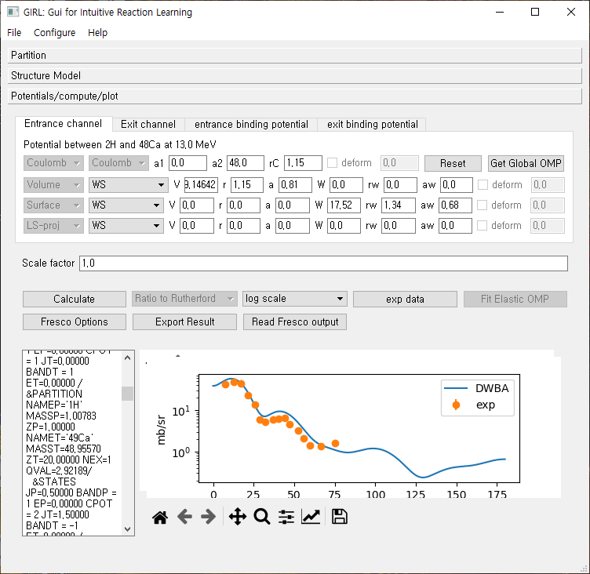
01
2. Research Areas
사업 일반현황
사업 개요 및 내용
Nuclear Reaction Study
Elastic/inelastic scattering
Transfer reaction
DWBA, ADWA, CDCC, Coupled Channel Methods
Combine Nuclear Structure + reaction
Development of GUI for easy access to Nuclear reaction codes

Slide 12
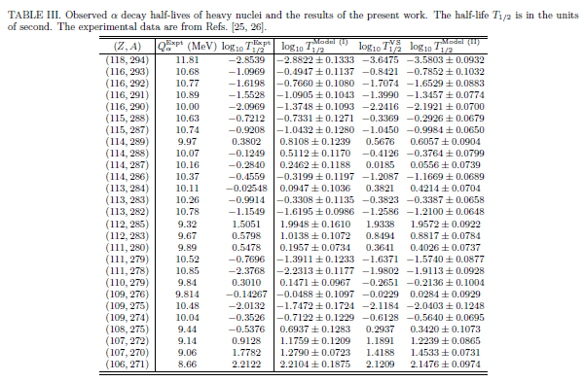
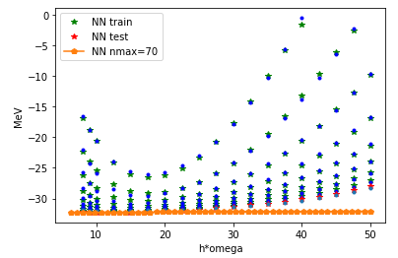
01
2. Research Areas
사업 일반현황
사업 개요 및 내용
New methods in Nuclear Physics
Application of Machine Learning to nuclear physics → nuclear mass, alpha decay, no-core shell model

