Slide 1


Carbon and Oxygen isotope chains in Nuclear Lattice Effective Field Theory
Young-Ho Song (IRIS, IBS)
NLEFT collaboration
Lattice QCD workshop on hadron and quark matter (LQCDW1) 2024.01.04-06, Sejong University, Seoul
https://indico.cern.ch/event/1356314/

Slide 2
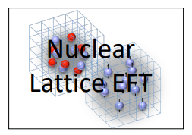
Nuclear Lattice Effective Field Theory Collaboration
Serdar Elhatisari(Gaziantep Islam Science and Technology)
Lukas Bovermann(Ruhr)
Evgeny Epelbaum (Bochum)
Dillon Frame (Juelich)
Fabian Hildenbrand(Darmstadt)
Hermann Krebs(Ruhr)
Timo A. Lähde (Juelich)
Dean Lee (MSU)
Ning Li(Sun Yat-sen)
Bing-Nan Lu( Graduate School of China Academy of Engineering Physic)
Myungkuk Kim(CENS,IBS)
Youngman Kim (CENS,IBS)
Young-Ho Song(IRIS,IBS)
Yuanzhuo Ma(Peking)
Ulf-G. Meißner (Bonn/Juelich)
Gautam Rupak(Mississippi State)
Shihang Shen (Juelich)
Gianluca Stellin( CEA Paris-Saclay)
And More…

Slide 3
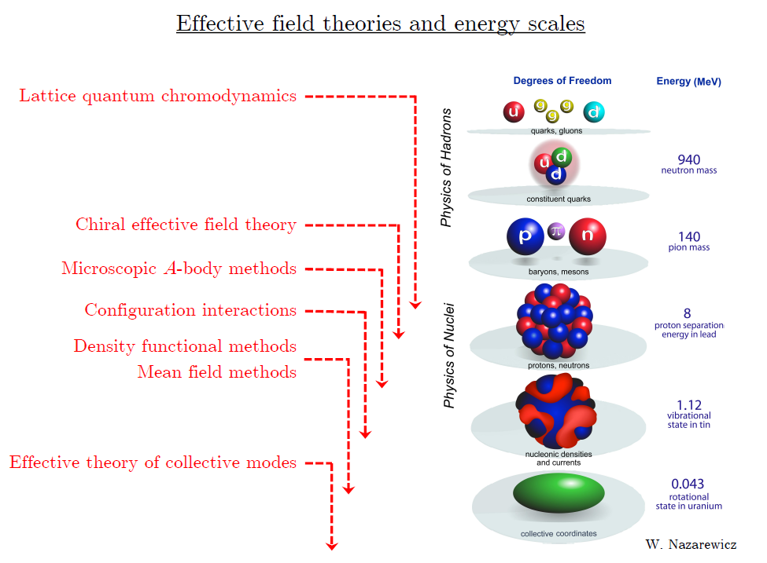
Ab initio
Nuclear
Theory

Slide 4
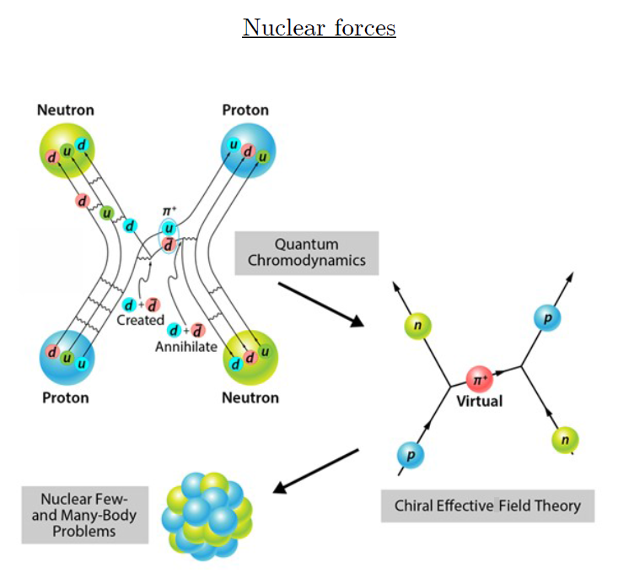
Ab-initio method
ab-initio Nuclear Physics
(1) nucleon degrees of freedom
(2) nucleon-nucleon interaction
Goal: predict wide range(structure, reaction, nuclear matter) of nuclear phenomena (without parameter fitting, model assumption) from nuclear interaction (for 2-body,3-body, many-body, based on QCD)
Direct connection between
Nuclear Force ↔ Nuclear Phenomena

Slide 5
Ab initio many-body
(ab initio) Nuclear physics is challenging.
Non-perturbative many body problem
Ab-initio nuclear many body methods
Greens function Monte Carlo(GFMC)
No-core shell model(NCSM)
Coupled Cluster (CC)
IM-SRG, VS-SRG
Nuclear Lattice Effective Field Theory(NLEFT)
And more
With recent progress in ab-initio methods
Binding energies for wide range of nuclei
Some reaction calculation for light nuclei.

Slide 6
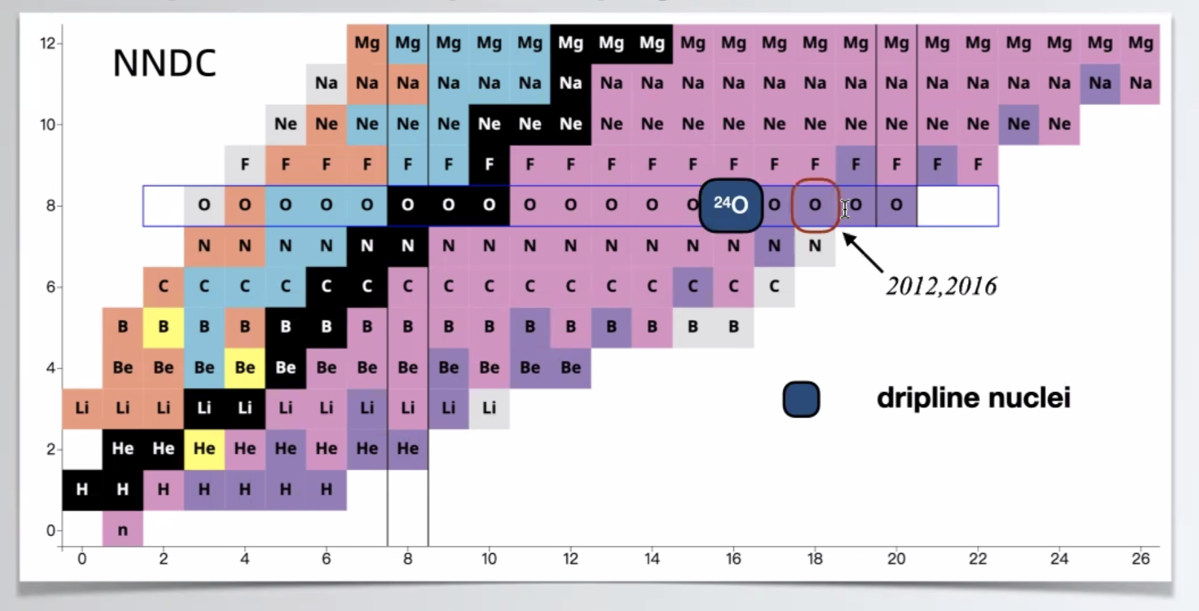
Dripline
Can we explain the dripline of Carbon, Oxygen isotopes in NLEFT?
Sensitive to nuclear force ? (Role of 3-body force?)

Slide 7
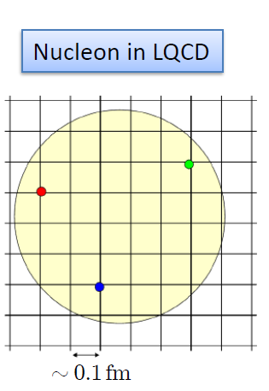

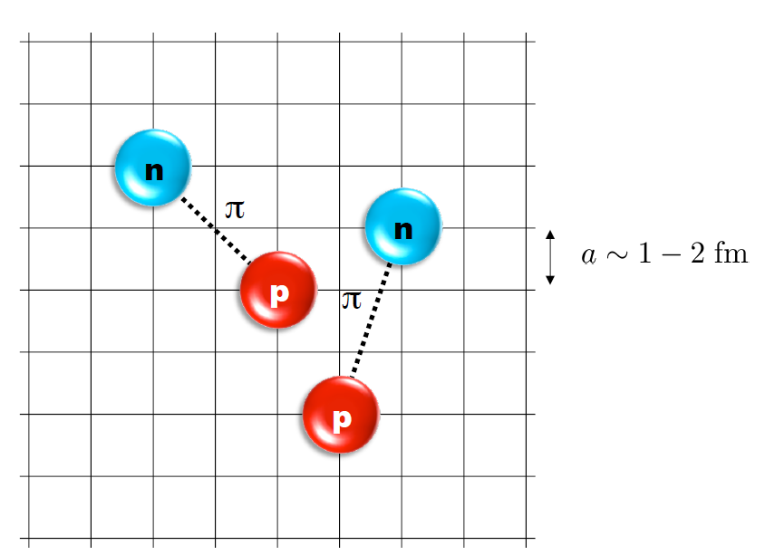
Nuclear Lattice Effective Field Theory
One of ab initio method for many fermion system

Slide 8
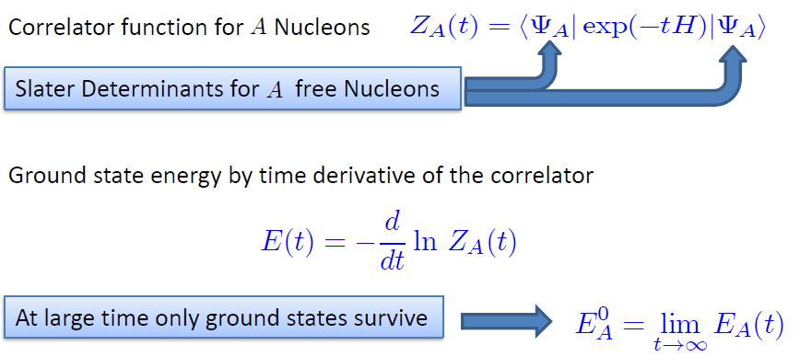

Path integral

Slide 9
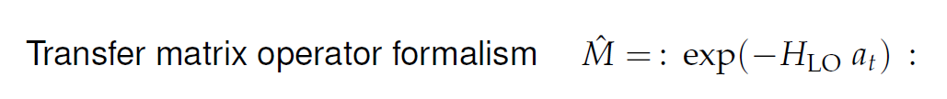
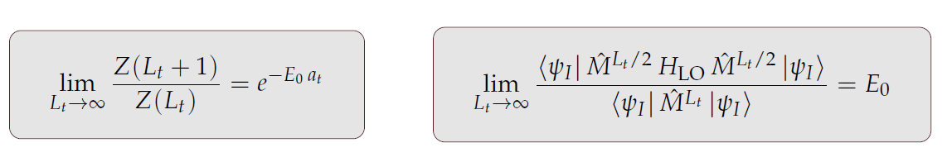
Transfer matrix

Slide 10
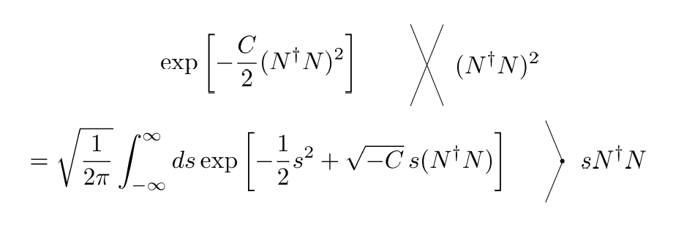
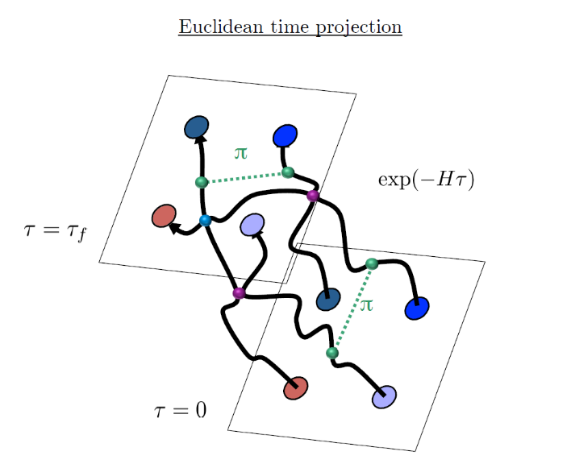
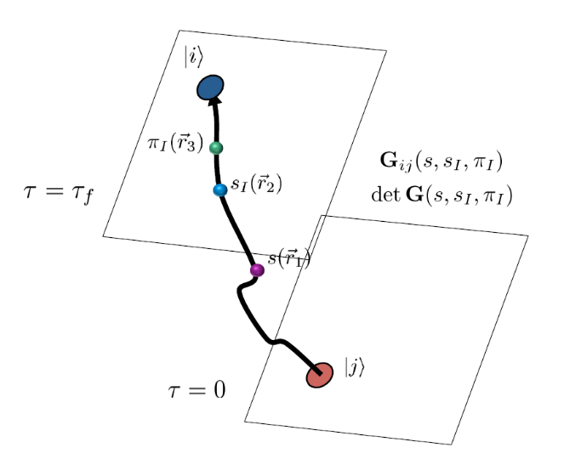
Auxiliary Field Monte Carlo
Interacting nucleons
Nucleons interacts with auxiliary fields
(no direct interaction between nucleons)
computing fermion
Correlator amplitude
Integration
over auxiliary fields
M.C. integral
(sampling auxiliary field)

Slide 11
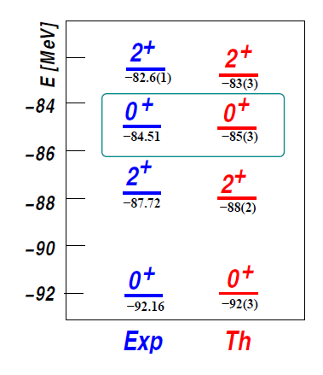

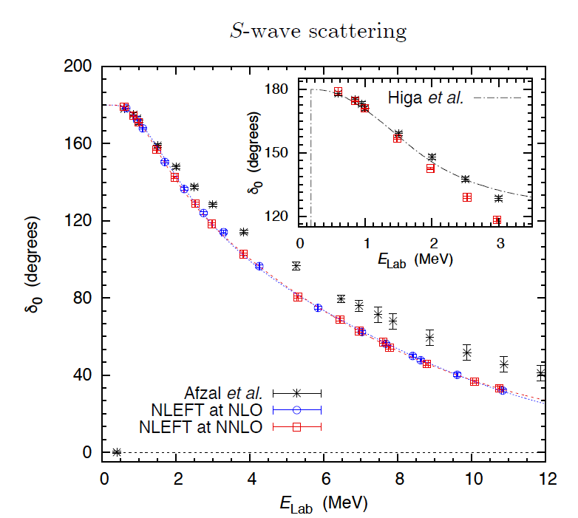
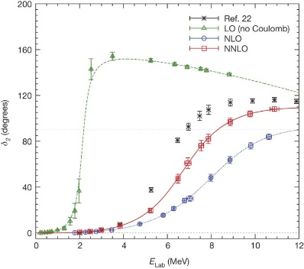
Applications of NLEFT
The first ab-initio calculation of
Hoyle state
Has been successfully applied to
Nuclear matter, Cold atom, dilute fermion system
Finite nuclei (A<=50)
First ab-initio calculation of Hoyle state
Cluster structure of ¹²C and ¹⁶O
NN scattering, N-D scattering
Alpha-alpha scattering
radiative capture, fusion
Etc.
Ab initio alpha-alpha scattering
( Nature 528, 111-114(2015))

Slide 12
Lattice Hamiltonian
We need to introduce a lattice scale in space and time:
momentum space cutoff ~ 150 MeV → lattice size a= 1.316 fm
Time cutoff ~ 1000 MeV
We need to determine coefficients of interaction for the lattice size. (regularization scale.)
Two-body interaction coefficients can be determined from phase shifts of np scattering.
Three-body interaction can be fixed from binding energy of A>=3.

Slide 13
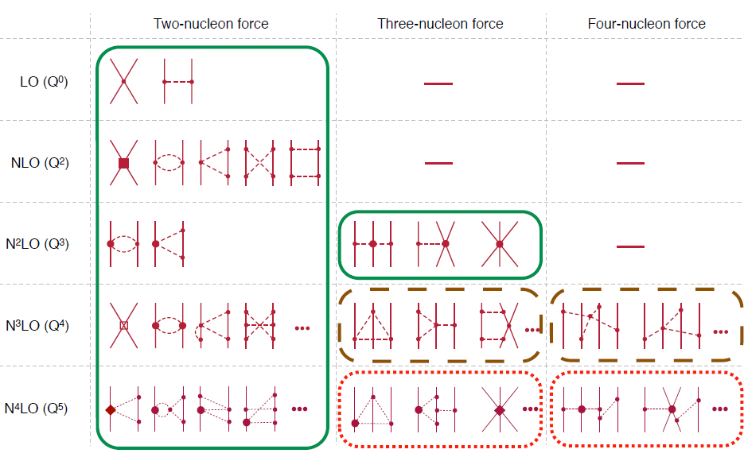
Chiral Effective Field Theory

Slide 14

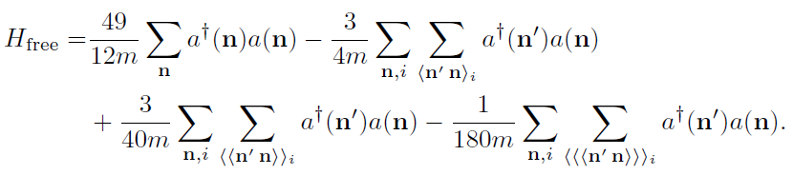
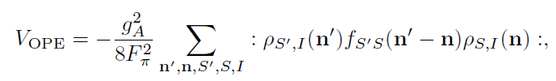

Lattice chiral Hamiltonian at Leading order
At Leading order, kinetic energy + contact interaction + one pion exchange
Kinetic
Long range OPE
Contact

Slide 15
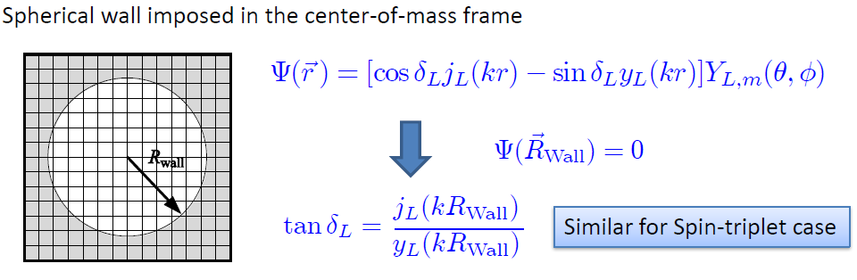
Low energy constants in lattice EFT
All LECs(parameters in the Hamiltonian) needs to be fixed
(They have to be fixed for given lattice regularization)
N-P scattering phase shifts, Deuteron binding energy
Scattering phase shifts on the Lattice: Wall method.
Phase shift can be obtained from
The energy spectrum of E(or k) in lattice and imposed Wall size.

Slide 16
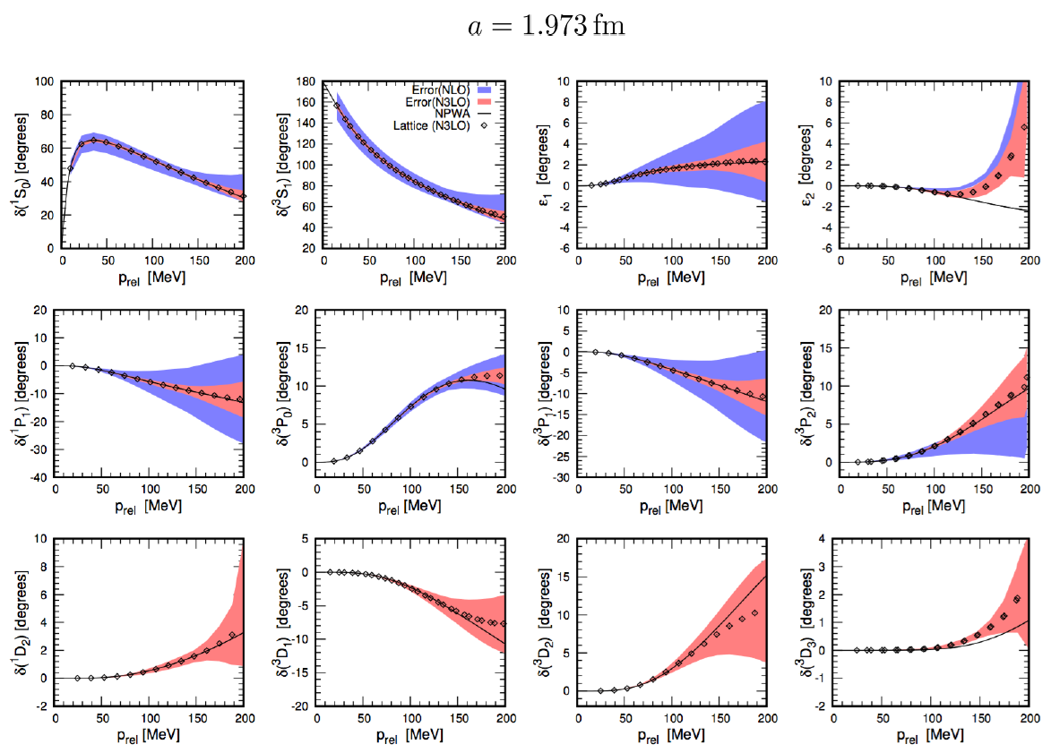
Determine LECs by fitting phase shifts of N-N scattering

Slide 17
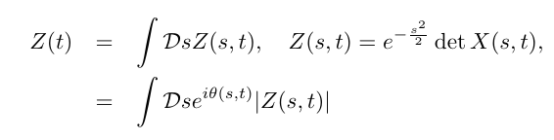

Sign problem in NLEFT
However, there is a difficulty in auxiliary MC calculation
We needs a large Euclidean time extrapolation
If the denominator’s sign oscillates rapidly
→ large uncertainty in the expectation value
→ sign problem
SU(4) symmetric interaction in isospin symmetric system
→ No sign problem

Slide 18
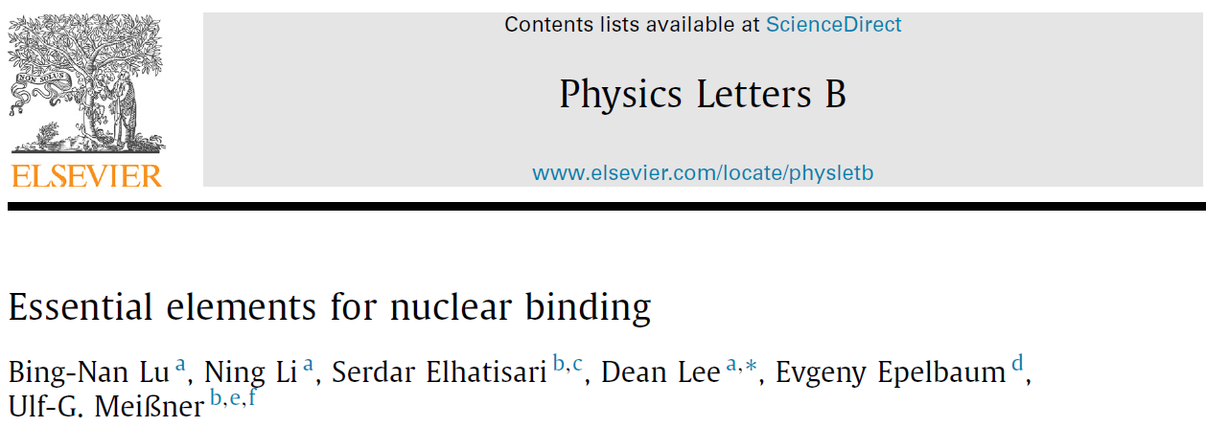



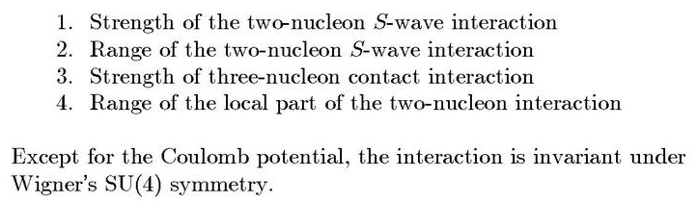
Minimal nuclear interaction
Which reproduce
Light nuclei
medium mass nuclei
neutron matter
simultaneously up to few percent error in binding energy and charge radius
Only Four parameters
No sign problem

Slide 19
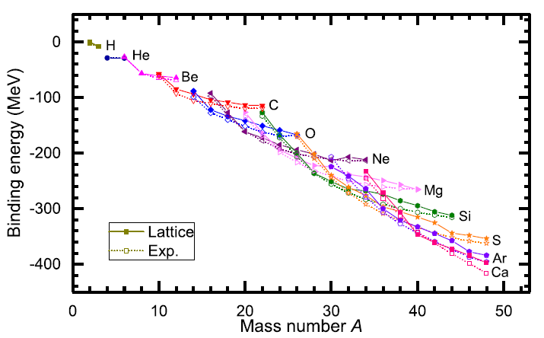
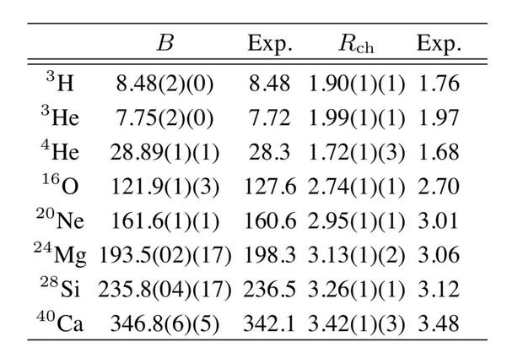
Can we improve the agreement by
Including higher order corrections?

Slide 20
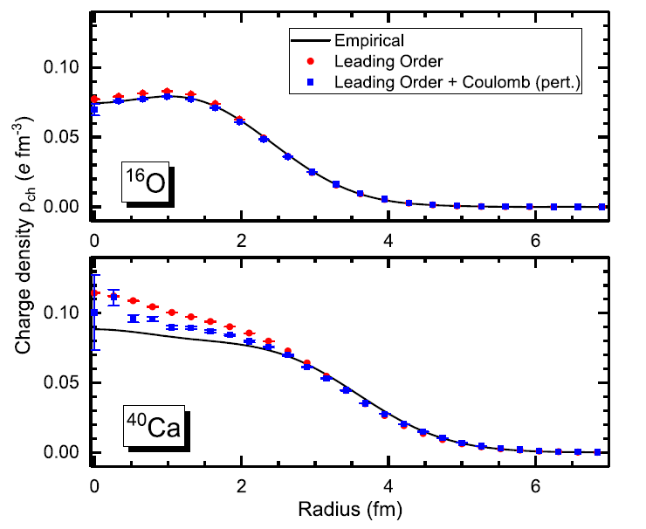
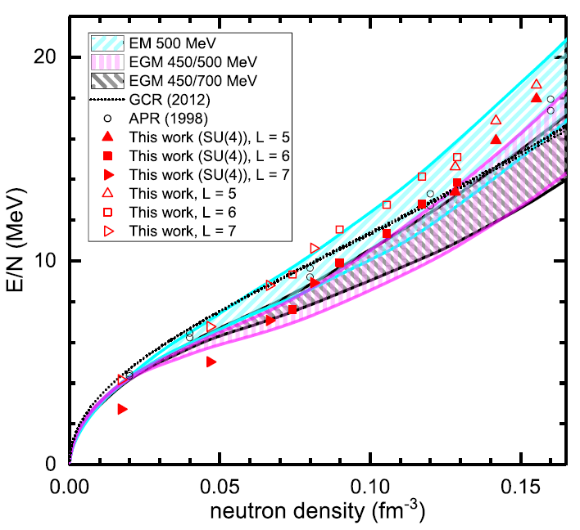
Can we improve the agreement by
Including higher order corrections?

Slide 21
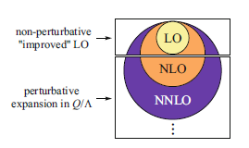
Lattice chiral Hamiltonian (N3LO)
Full N3LO Hamiltonian includes
Free Hamiltonian(Kinetic term)
Short range (nonlocal smeared) contact interactions up to Q^4 order
Isospin-breaking short range interactions
One pion exchange potential
Two pion exchange potential up to Q^4 order
Coulomb interaction
Long range isospin breaking interaction( isospin dependence in OPE)
Galilean Invariance Restoration (GIR) term (because of non-local interaction.)
Three nucleon interaction

Slide 22
Difficulty with full chiral interaction
Sign problem
NLEFT suffers sign problems at large Euclidean time limit
Large cancellation between positive and negative contributions→ large uncertainty.
SU(4) symmetric interaction does not have sign problem
One pion exchange and higher order chiral interaction, short range repulsion
Difficulty with Asymmetric nuclei
Needs a remedy to extend to neutron rich isotopes.
A new approach to reduce the sign problem.
→ Wave function matching Hamiltonian.

Slide 23
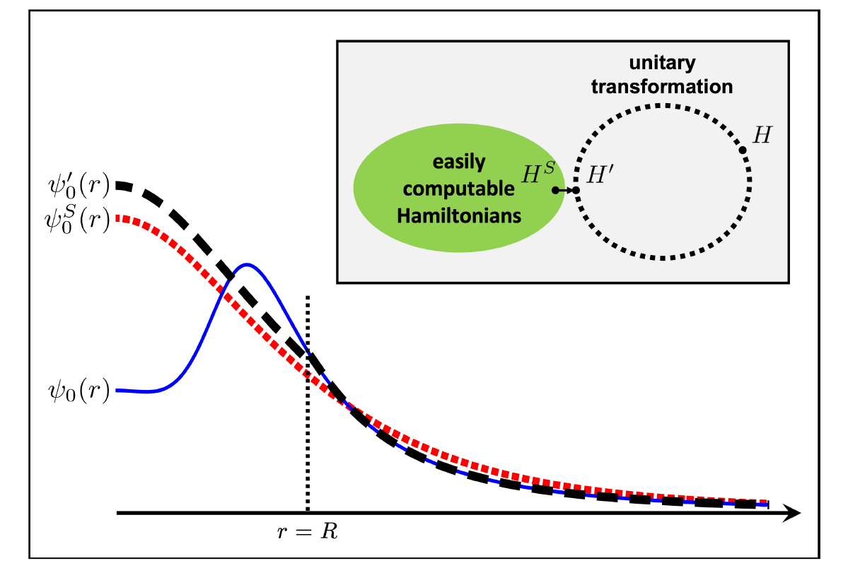



Wave function matching
H and H’ are fully equivalent to two-body observables
The goal is to make the perturbation expansion from “simple” wave function gives a good convergence
U is only active
At r < R

Slide 24
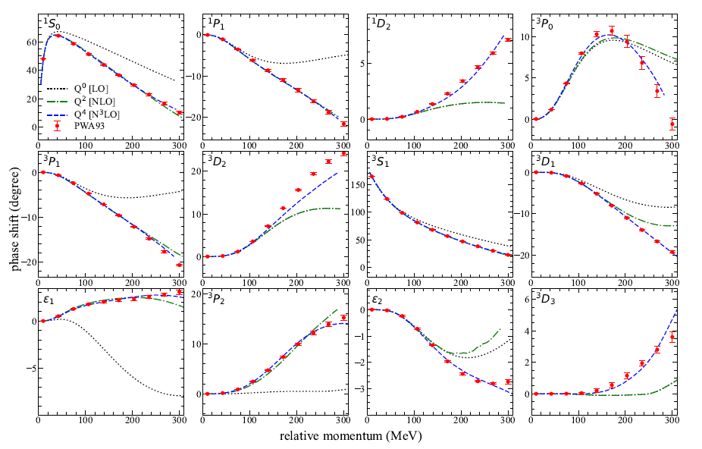
NN phase shifts from WFM
Original Hamiltonian is fitted to phase shifts.
H’ is equivalent to original Hamiltonian.

Slide 25

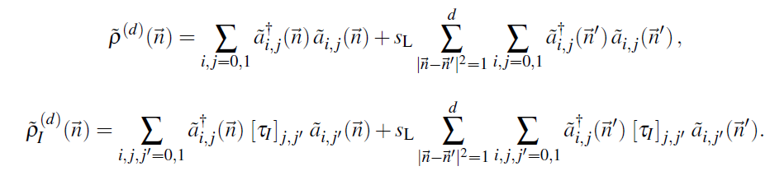

Wave function matching Hamiltonian
“Simple” Hamiltonian
(local,non-local smeared operators)

Slide 26

Wave function matching Hamiltonian
N3LO Hamiltonian
V_2N : short range NN interactions
W_2N: GIR restoration term for V_2N
V_2N,WFM : difference from H_s
W_2N,WFM: GIR restoration correction to V_2N,WFM
V_3N : contains short range 3N interaction parameters(to be fitted)
and two pion exchange correction to 3N

Slide 27
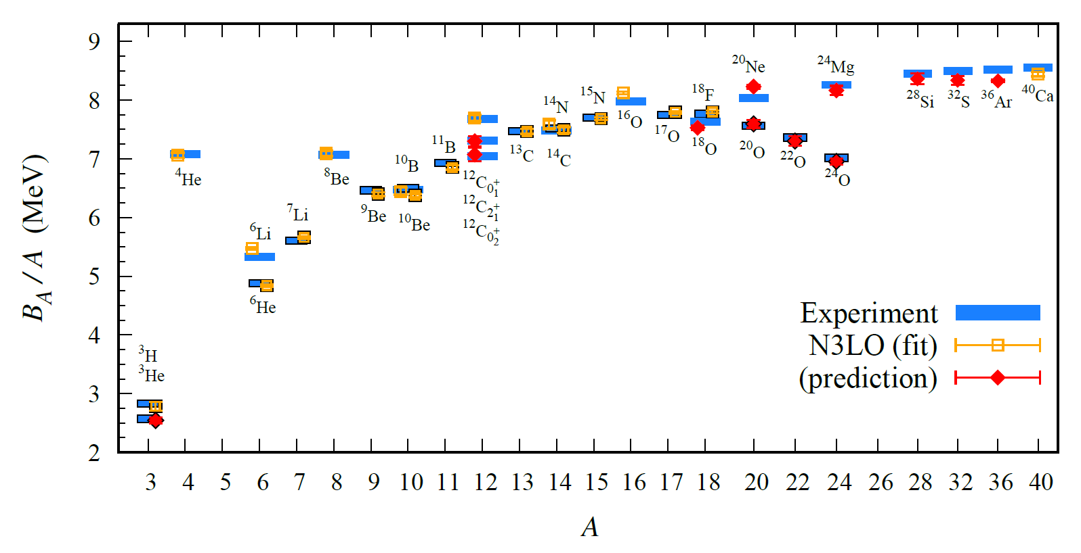
BE/A from WFM
Preliminary

Slide 28
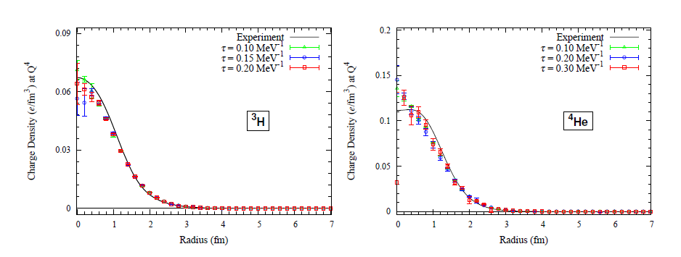
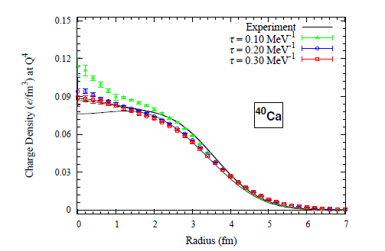
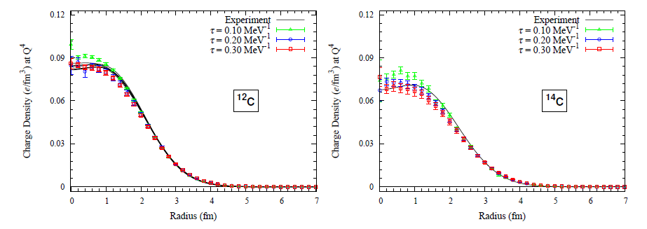
Charge density from WFM
Preliminary

Slide 29
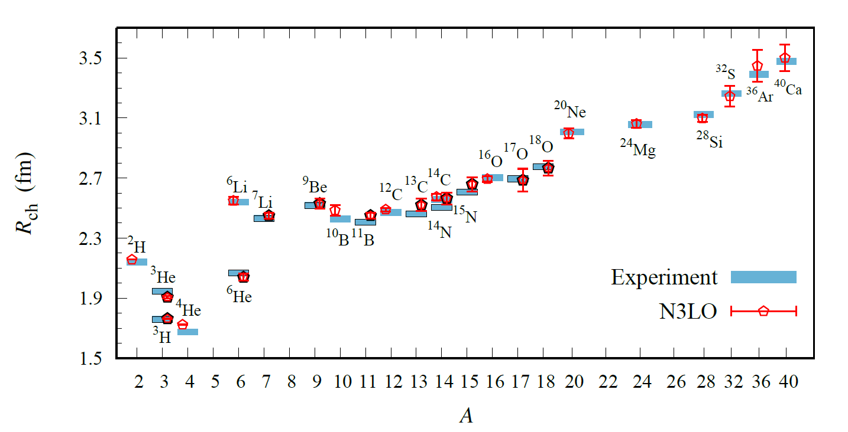
Charge Radius
Preliminary

Slide 30
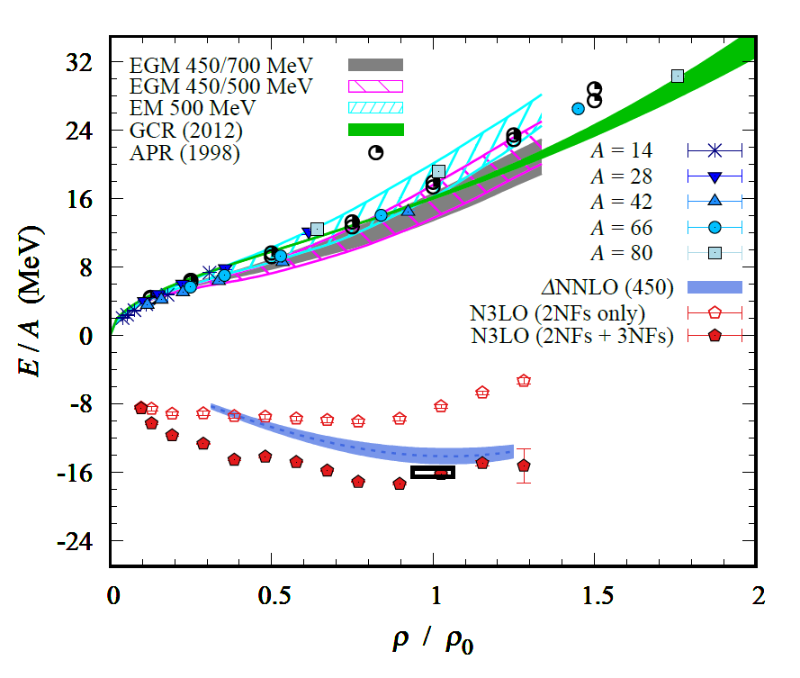
Nuclear/Neutron Matter
Neutron matter:
A=4~80
box size 6.6 ~ 13.2 fm.
Nuclear matter:
A=4 ~ 160
Box size 7.92~9.24 fm.
Preliminary

Slide 31
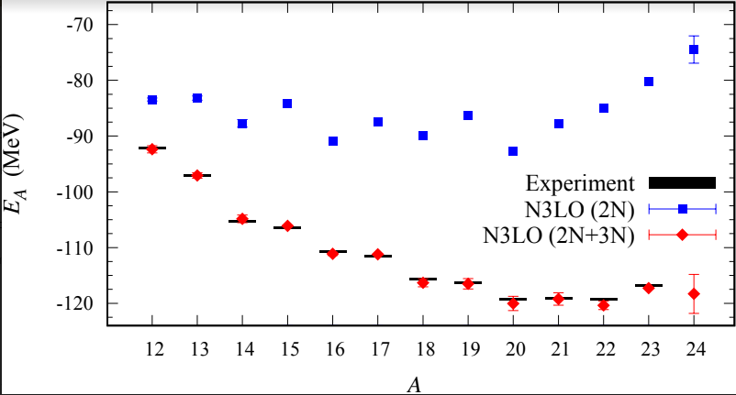
Carbon isotopes

Slide 32
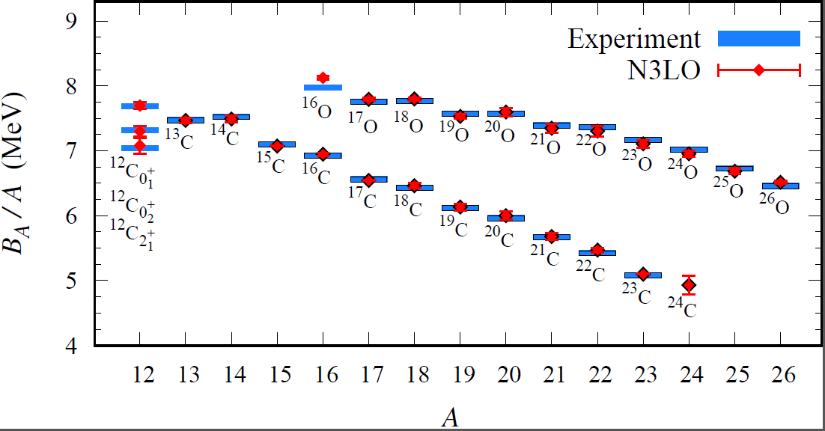
Carbon and Oxygen
Preliminary

Slide 33
Summary
Wave function matching method seems to be promising
New method to improve the N3LO calculation of NLEFT
Preliminary study shows promising results for wide range of observables in one scheme (same interaction and many-body method)
NN scattering
Binding energy (from 3H to 40Ca)
Symmetric Nuclear matter
Neutron matter
Dripline of Oxygen isotope.
Carbon excited states
Also, Carbon isotopes, odd Oxygen isotopes, Cluster structure, excited states will be studied.

