Slide 1


Introduction to Quantum Computing
Young-Ho Song (IRIS, IBS)
2026.04.03. CENS

Slide 2

Introduction
First of all, I am not an expert on the Quantum Computing.
The purpose is
(1) to introduce basics of Quantum Computing to student
It is possible that you already know better than me on the subject.
(2) to be on the same ground to start a further discussion on the application of Quantum Computing to nuclear physics.
For this purpose, I will only skim through some basics. I borrowed many materials from existing lectures, presentations, papers.
One specific goal is to understand a paper about quantum computing on nuclear physics.

Slide 3
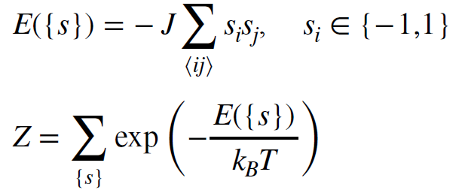
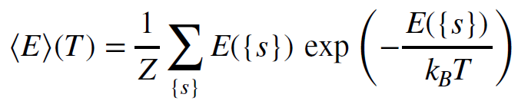
Why Quantum computer
Quantum computing: A type of computing where the programming model follows principles of quantum mechanics.
Why needed? There are problems whose computing requirement grows
non-polynomial way.
For example, classical Ising model
All possible spin configuration on N^3 lattice is
2^{N^3}
Suppose N=10 and n floating point operation per configuration
~ 10^{301} n floating point operation
If 10^{18} Flops/s → 10^{283} n seconds.
Thus exact calculation is not possible.( MC approach can be used.)

Slide 4
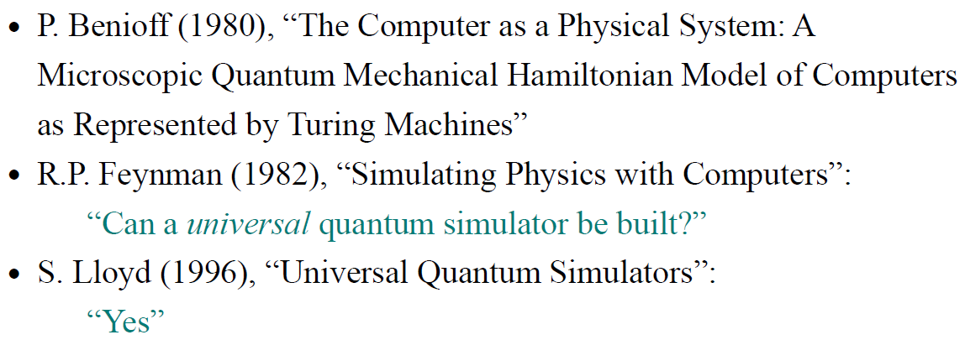
Why Quantum computer
Quantum computer can be faster than classical computer in some problems.
(Quantum supremacy)
Short history:

Slide 5
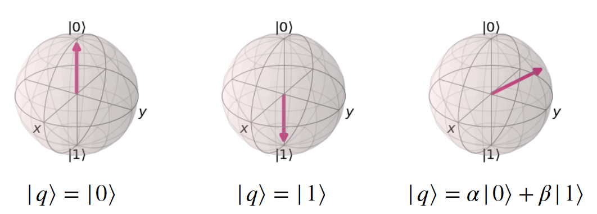
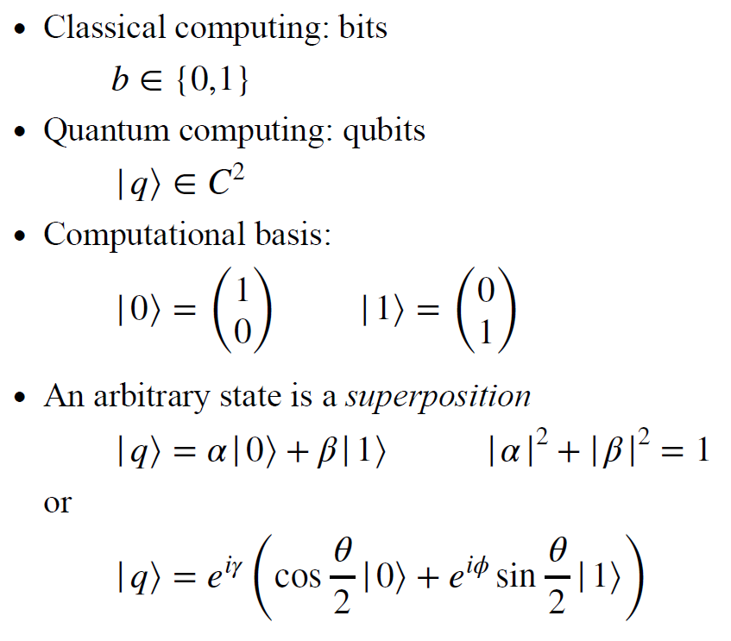
Single Qubit
Data are represented by qubits in Quantum Computer.
Bloch representation
Difference between classical bit and qubit
Single Classical bit can represent 0 or 1
Qubit can represent arbitrary superposition
→ complex numbers (or phase angles)

Slide 6

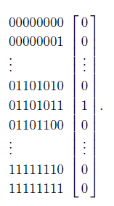
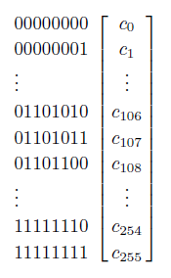


Multiple Qubits
N classical bits can represent 2^N different states
8 bits → 256 integers
N qubits (tensor product of qubits)
can represent (C^2)^N different states
8 qubits → 256 complex numbers
Superposition of 256 basis states
This requires entanglement between qubits
Measurement collapse to
One classical bits states

Slide 7
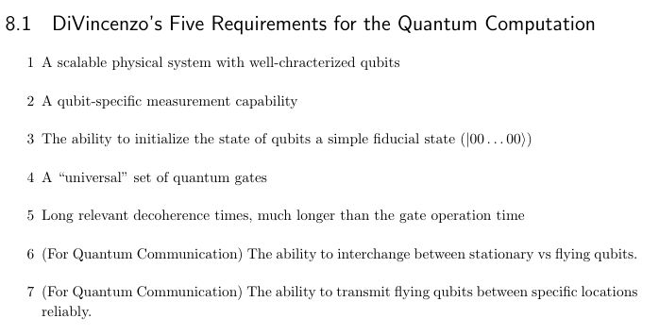
DiVincenzo’s requirements

Slide 8
Types of quantum computers
Any quantum system can be a candidate of building block of quantum computers:
usually two-level system
Simulator (Analog quantum computers) :
building an artificial many-body system with a similar Hamiltonian
Limited and specific set of controls
Ultracold atoms, Spin qubits , Superconducting qubits
Used as proxies (or simulators) for the many-body system one we wants to understand.
Computers ( Digital (gate-based) quantum computers):
individual control over particles/degrees of freedom by gate-based operation.
Internally, each gate is performed using an analog description.
Universal

Slide 9


Universal quantum gates
Classical computers can be built from elementary or basic logical gates.
Any Vector valued Boolean functions can be expressed as a combination of elementary gates.
Quantum computers can be built from universal quantum gates.
Gate Operation on qubits must be unitary

Slide 10

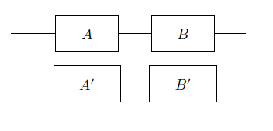
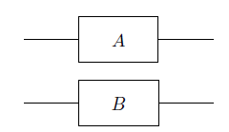

Universal quantum gates
Solovay-Kitaev theorem:
any unitary operation acting on n-qubits can be written as a sequence of universal gate set.
Universal gate set : one-qubit rotations Rx, Ry, Rz + two-qubit gate “CNOT”
Sequential operation on a single qubit = Unitary matrix
Parallel operations on multiple qubits = tensor product of matrices

Slide 11
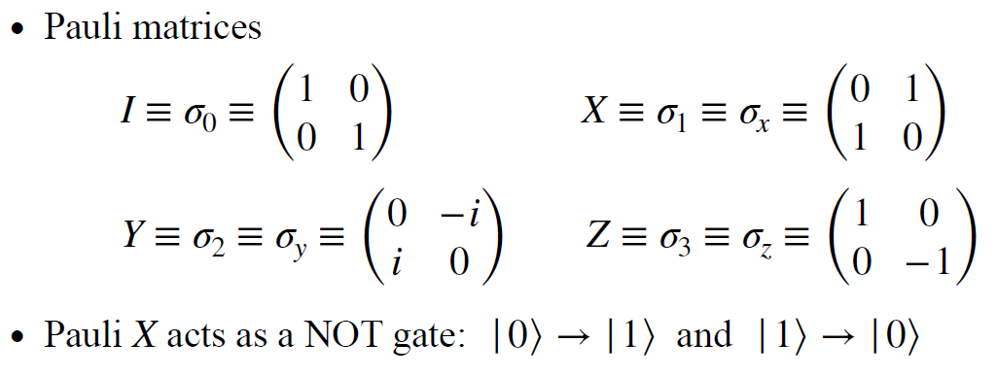
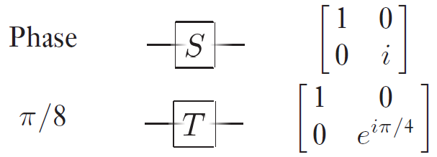
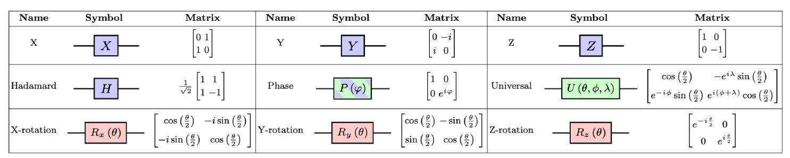
Single qubit Gates

Slide 12
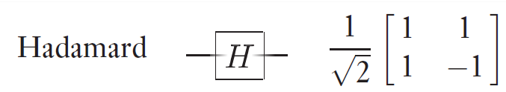
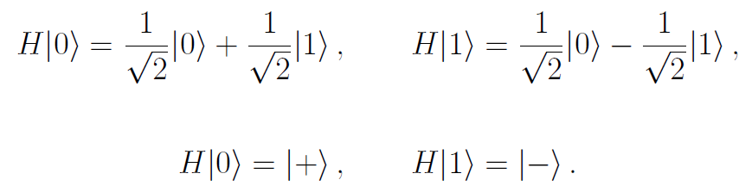
Single qubit Gates
Hadamard gate : pure (basis) state → mixed (Hadamard basis) state → pure state

Slide 13
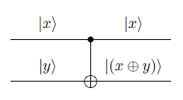
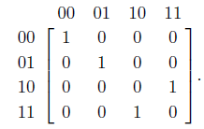
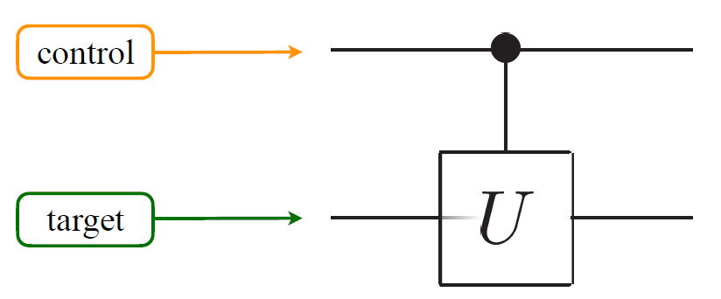

Two qubit Gates
CNOT gate : control bit
General controlled U-gate

Slide 14
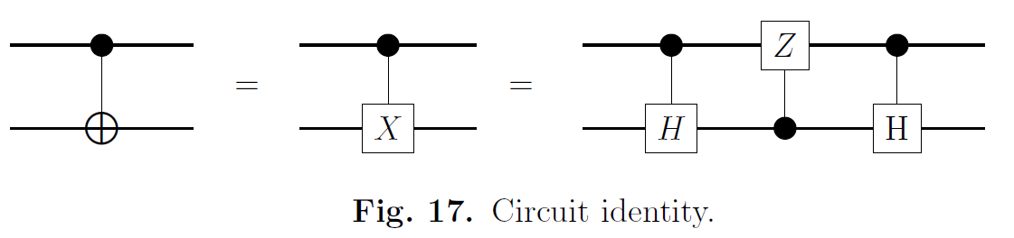

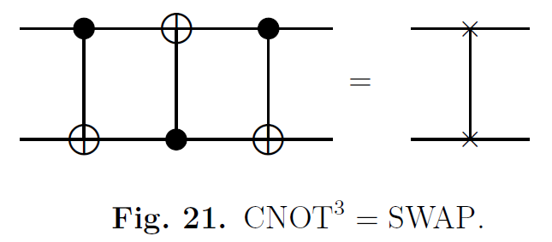
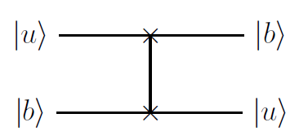
Two qubit Gates
CNOT gate : control bit
SWAP gate

Slide 15
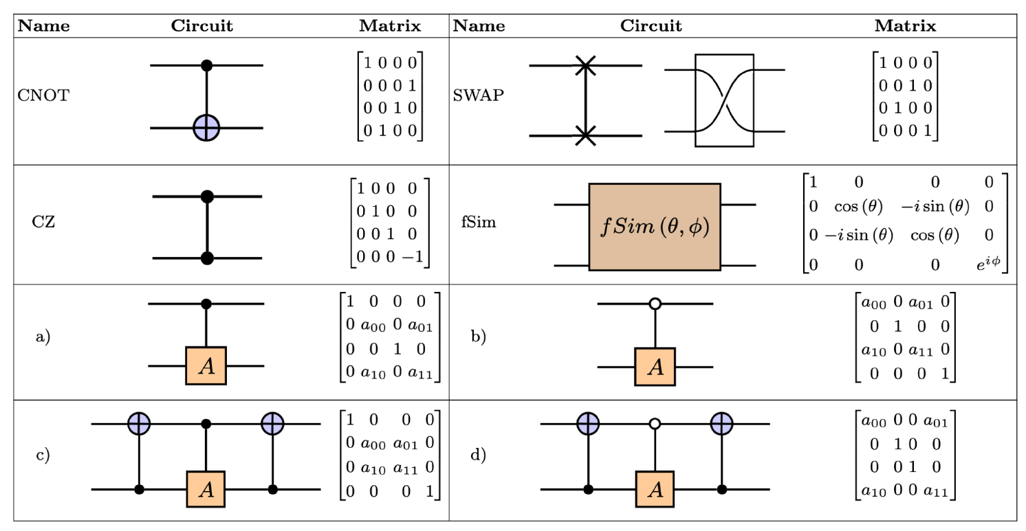
Two qubit Gates

Slide 16
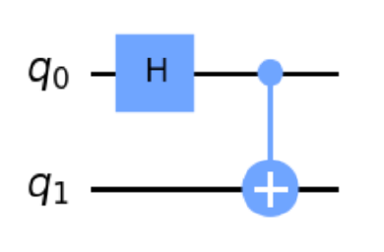

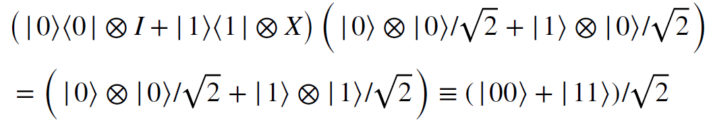
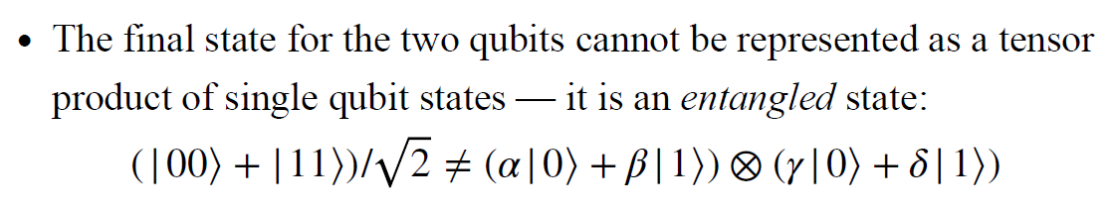
Two qubit Gates

Slide 17

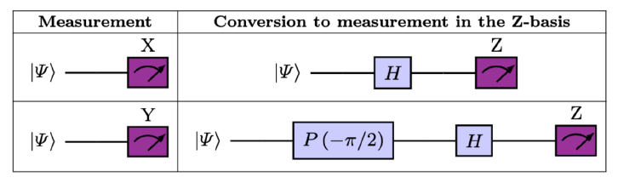
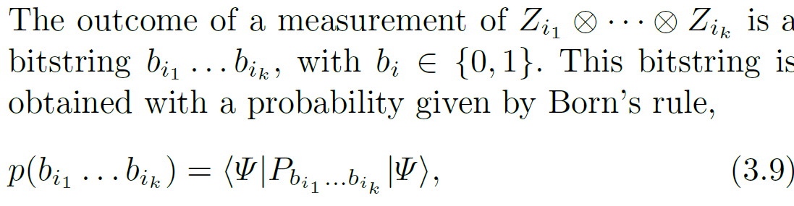

Measurements
Measurement
Any measurement on single qubit can be converted into
Z-basis
For n-qubit system, k-qubits measurement
Projects to the state

Slide 18

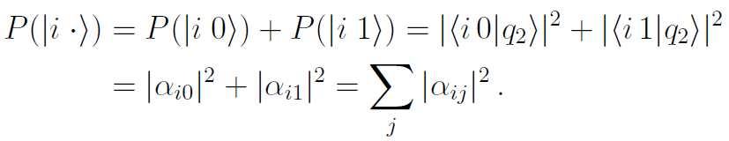

Measurements
Measurement
We may measure all qubits to extract
the probabilities of each basis bits strings
Or, we may design the circuits so that
the partial measurement of some qubits gives the desired information.
Partial measurement in 2 qubit system

Slide 19

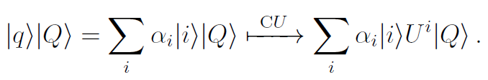
Measurements
Partial measurement in multiple qubits
Controlled-U gate

Slide 20
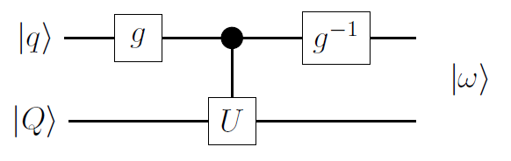
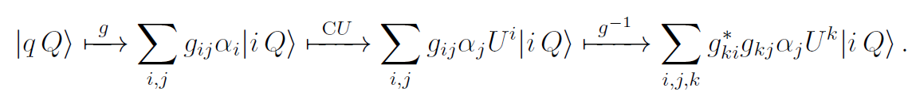
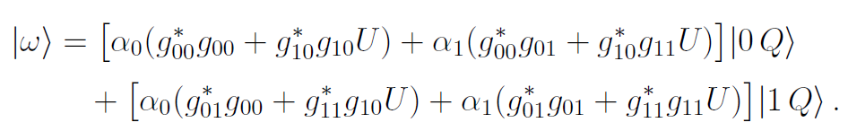
Measurements

Slide 21
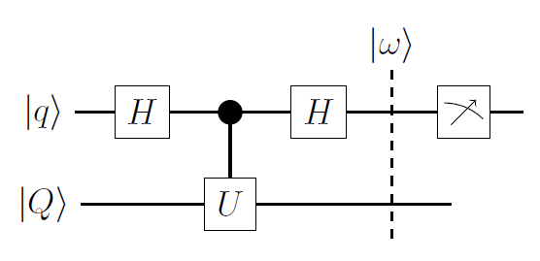
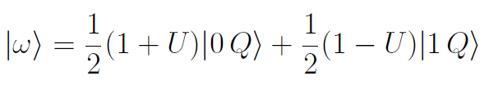
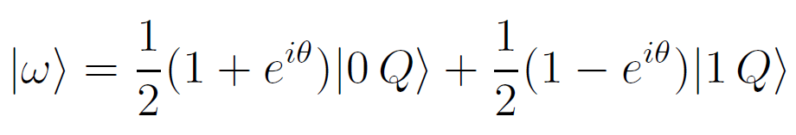

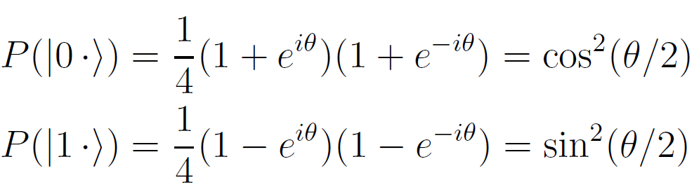
Measurements
If control qubit is prepare in |0>
If |Q> is an eigenstate of U,
We can measure eigenvalue of |Q>

Slide 22



Deutsch’s Algorithm
The first algorithm which shows quantum supremacy.
For given single bit Boolean function, determine whether it is constant or balanced.
constant
balenced
Classical circuits require two measurements (or queries) to answer the question.
Quantum circuits require one query.

Slide 23
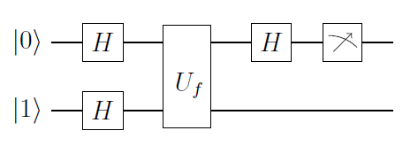

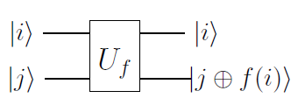



Deutsch’s Algorithm
Thus,
if we measure |0> → f is constant
If we measure |1> → f is balanced

Slide 24
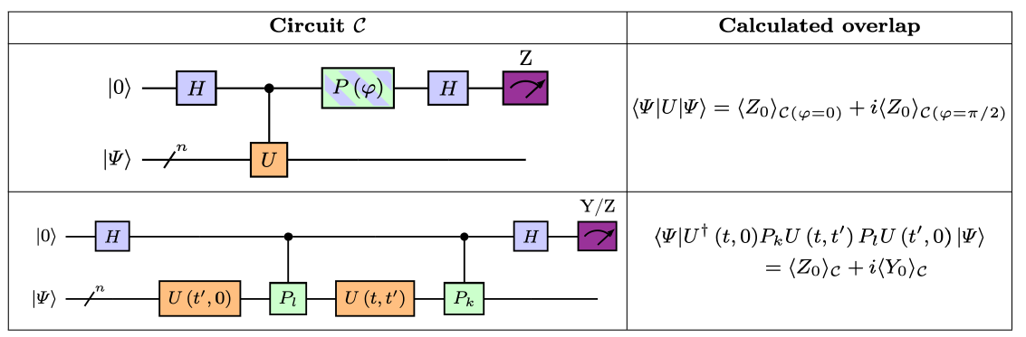
Circuit measurement
We can measure expectation value of unitary operator of entangled qubits |Psi>
Here <Z0> means average value of 0-th qubit measurement in Z-basis.

Slide 25
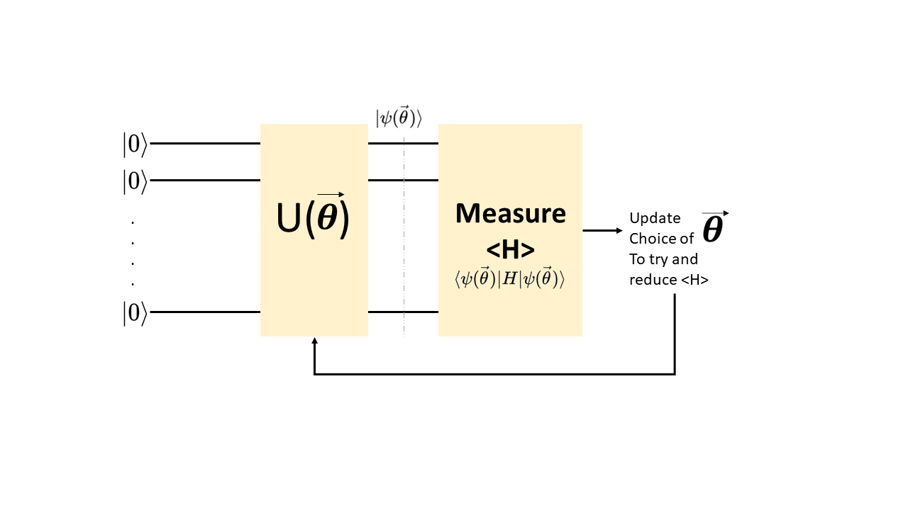
Variational Quantum Eigensolver
Design Circuits so that the measurement corresponds to the expectation value of Hamiltonian
Design Circuits so that the Unitary operator parameter corresponds to give variational wave function
Measure energy expectation value
update parameter to minimize the Hamiltonian expectation value
we have variational optimal wave function.

Slide 26
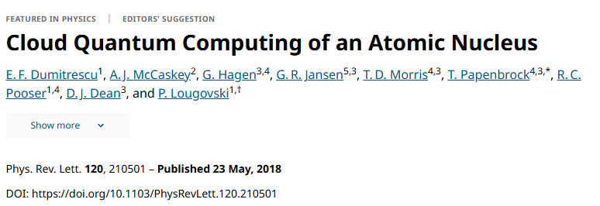

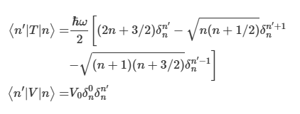


Simple VQE example
Deuteron eigenvalue in HO basis
Two-body
Consider only S-wave
HO basis
Pionless EFT

Slide 27

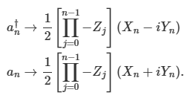

Simple VQE example
N=2 2-qubit system
Encoding:
Jordan-Wigner transformation :
creation/annihilation operators → Pauli operator sequences
However, Jordan-Wigner transformation or one-hot-encoding is not resource efficient.

Slide 28


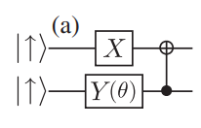
Simple VQE example
Variational Ansatz (Unitary coupled cluster Ansatz)

Slide 29
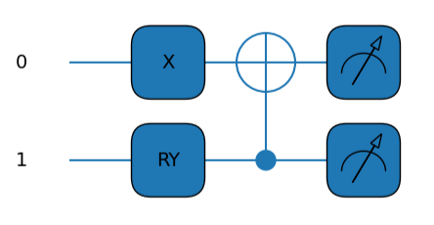
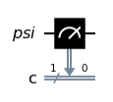


Simple VQE example
VQE circuits (Ansatz + Hamiltonian)
<Z> measurement
<X> measurement
= <HZH>
<Y> measurement
= <S X S^dagger >

Slide 30
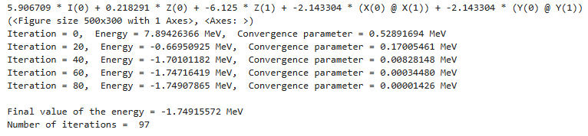
Simple VQE example
VQE circuits (Ansatz + Hamiltonian)
Python Qiskit + pennylane library
N=3 Hamiltonian
circuits gives
-2.0451 MeV

Slide 31



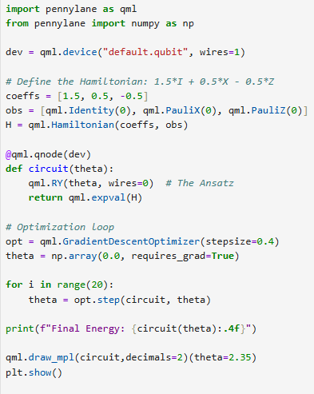
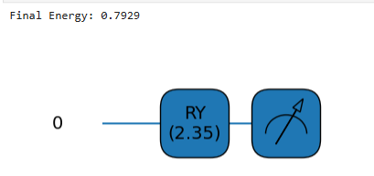
Simple VQE code example
In fact, 2x2 matrix eigenvalue problem can be solved with only 1 qubit

Slide 32
Untouched subjects
How to simplify the Hamiltonian to reduce required qubits?
How to encode the physical basis into qubits (encoding)?
How to convert Hamiltonian to Pauli matrices?
How to make a good ansatz of wave function in VQE?
How to construct efficient quantum circuits ?
How to remove noises in the quantum measurements?
What other quantum algorithms for nuclear physics?
Quantum simulators
Time evolution, Trotterization
And Many more

