Slide 1

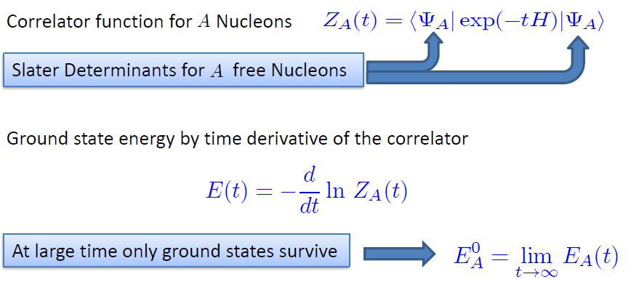
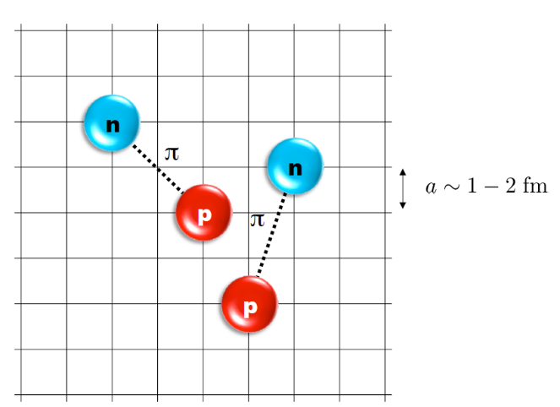
Nuclear Lattice Effective Field Theory
Can we understand properties of light nuclei, medium mass nuclei, nuclear/neutron matter at the same time based on nuclear interaction alone without any model?
NLEFT: ab initio method for many fermion system

Slide 2
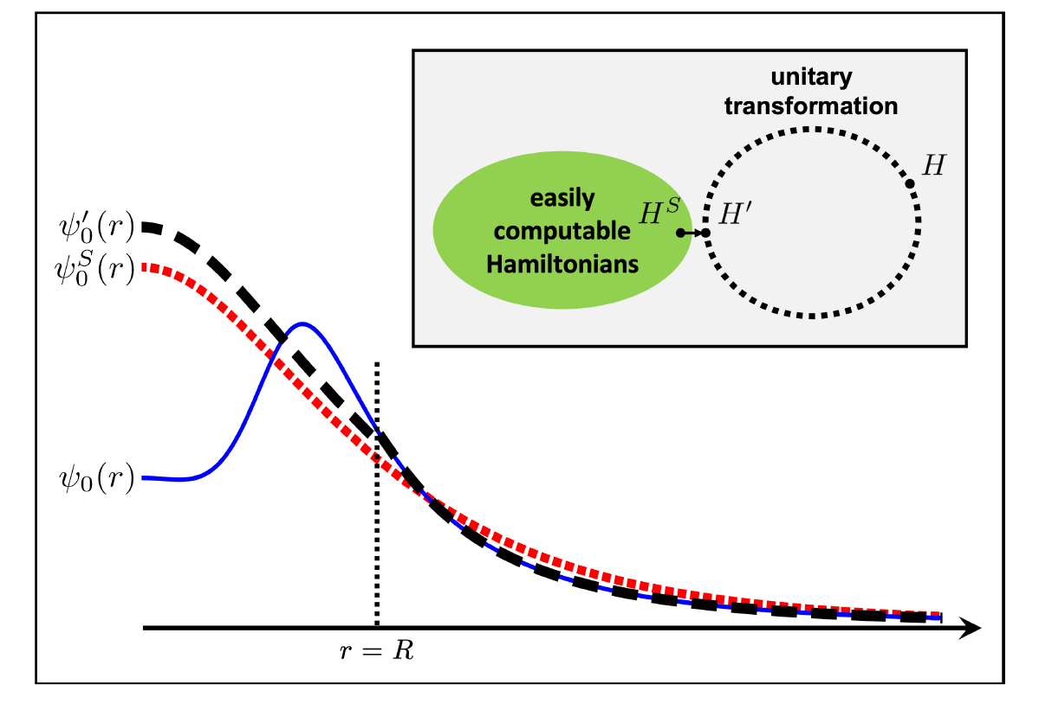



Wave function matching
Chiral EFT Hamiltonian up to NNNLO
for neutron rich isotope
→ Serious sign problem
New solution: Wave Function Matching
Introduce Unitary transformation such that the perturbation expansion from “simple” wave function gives a good convergence
Chiral Hamiltonian
2-body force from NN scattering phase shifts
3-body force from Binding Energy of Selected nuclei
U is only active
At r < R

Slide 3
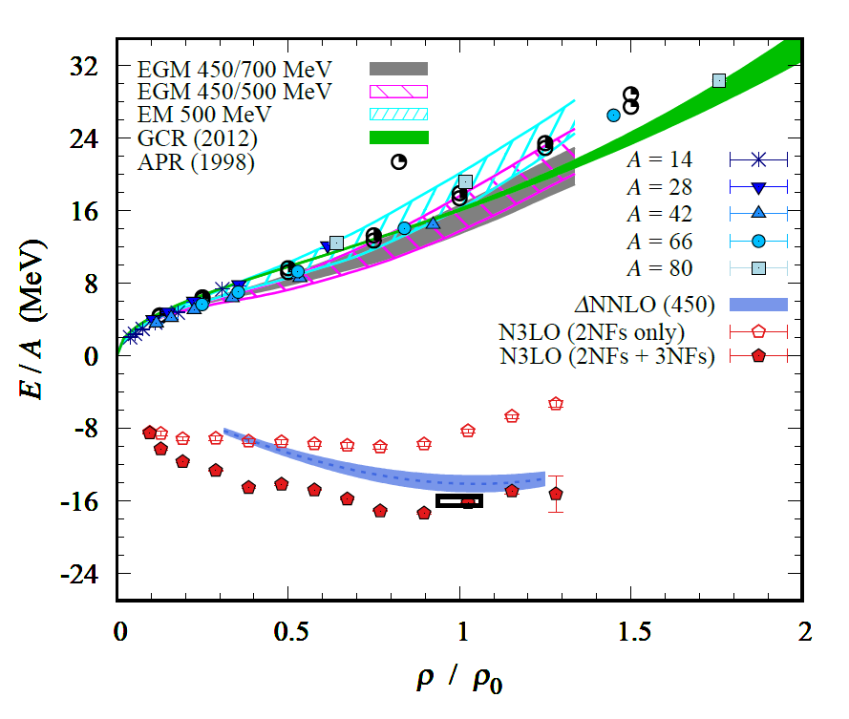
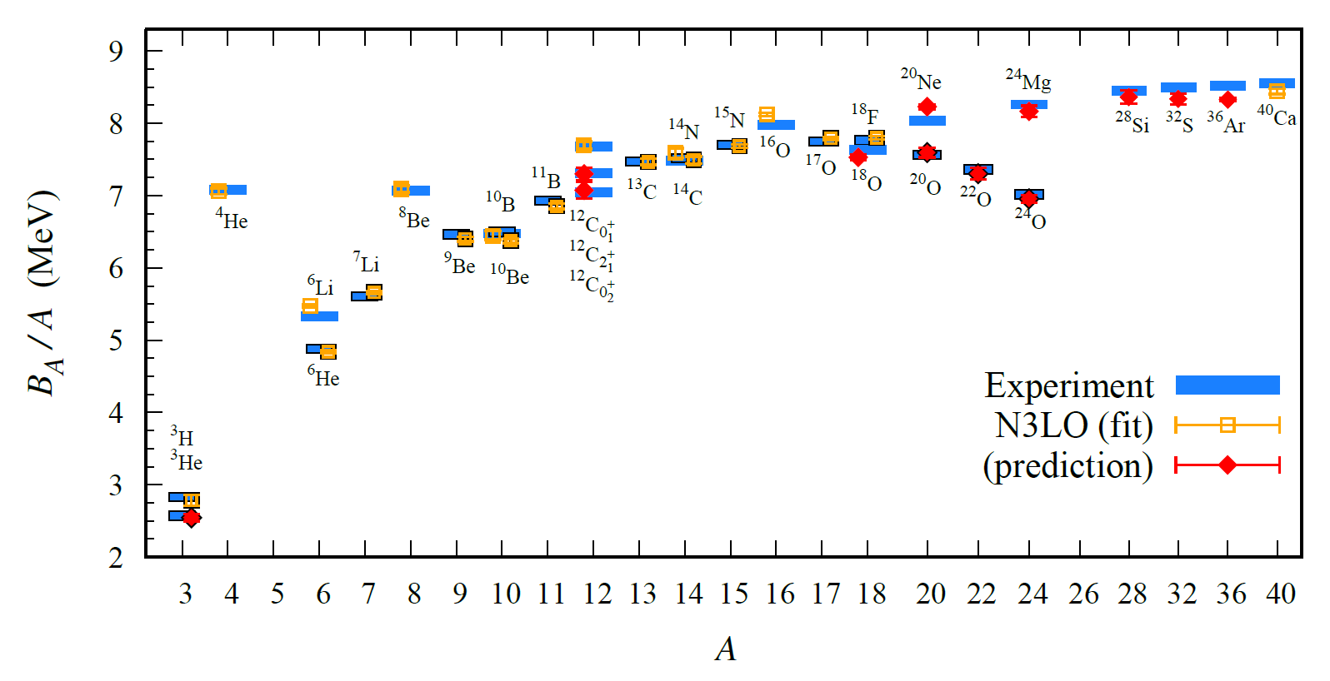
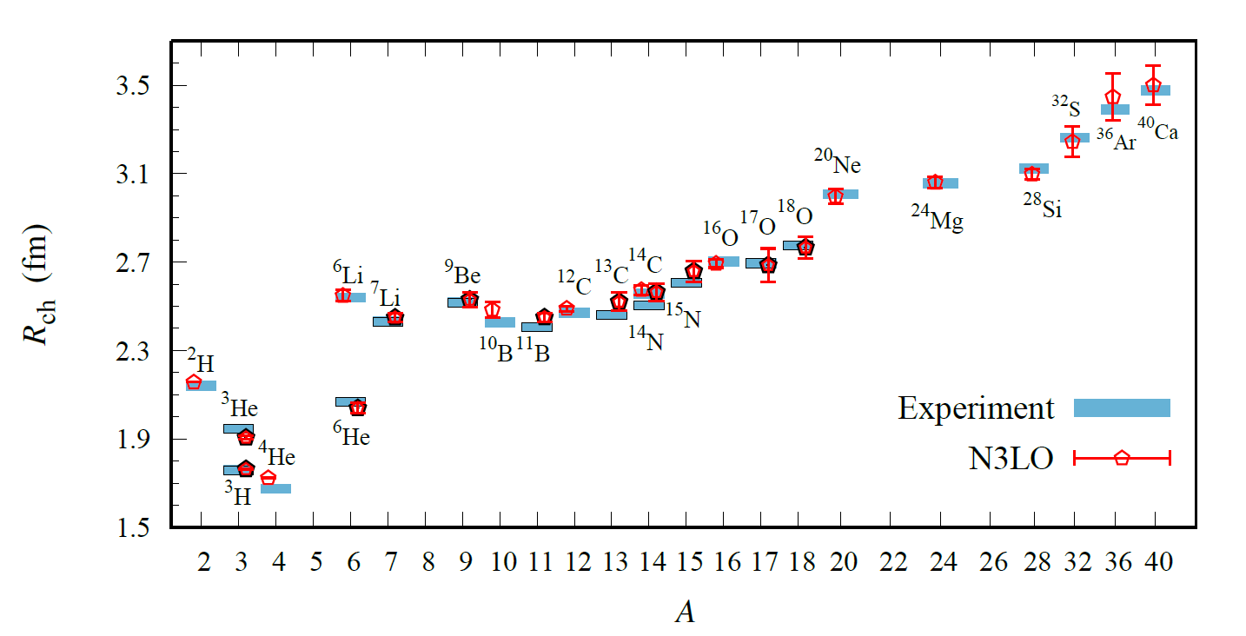
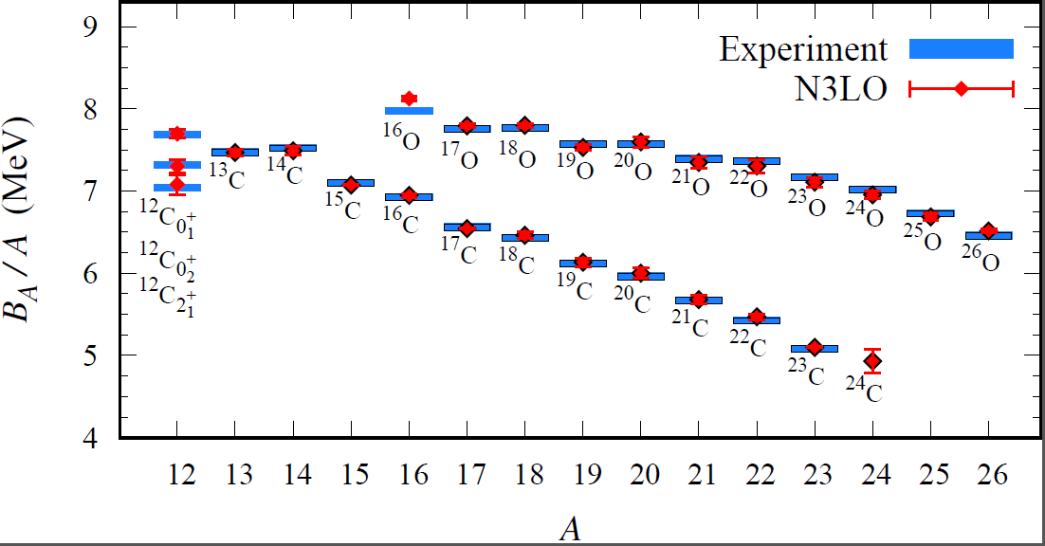
Results of NLEFT collaboration

