Slide 1


How to solve BHF equation
in nuclear matter
Young-Ho Song (IRIS, IBS)
CENS-IRIS collaboration 2023.08.29., CENS, IBS

Slide 2
Introduction
Many-body problem
Interacting A-nucleon system
H = T + V = T+U + (V – U)
H can have one-body, two-body, three-body… operators
Exact solution H |Psi> = E |Psi> is very difficult to get.
Many-body perturbation theory does not converge well.
How to compute the energy of nuclear matter with realistic interaction?
Finite box periodic boundary condition
Ab initio calculation with varying number of nucleons in the box
Brueckner-Hartree-Fock method
Non-perturbative sum of particular type of diagrams.
Most likely, some code to solve BHF in nuclear matter may be available.
I decided to write my own code which is easy to understand.
Main reference:
M. Haftel, F. tabakin, Nuclear Physics A158 (1970)1-42
K. Amos et al, Advances in Nuclear Phsyics, vol 25, chapter 3

Slide 3
Introduction
How to compute the energy of nuclear matter?
Independent particle model
Simplest : many-body problem to one-body problem
Approximation treating H ~ H0 = T+ U as one-body operator
Exact solution is known
→ Slater determinant of single particle wave functions
What is U ?
naive shell model : H.O. potential or W.S. potential
U simulate the mean effects of V as much as possible

Slide 4

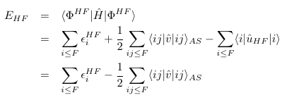


Introduction
Hartree-Fock method
Basically the same as independent particle model
→ Assumption: a Slater-determinant of single particle wave functions.
What is U? (H = T+V = T+U + V-U)
→ try to find the optimal U such that
(1) s.p. wave functions are determined by U
(2) Thus, Slater determinant is determined by U
(3) Choose U such that the <Psi| H| Psi> to be a variational minimum.
Note: |Psi> is an eigenstate of T+U, not H=T+V !

Slide 5

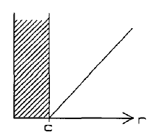
Introduction
Starting from HF, one can compute MBPT to compute energy corrections
However, naïve application of MBPT to realistic NN interaction raises a problem.
Many realistic NN interaction has a hard-core. (Very repulsive at short distance)
The matrix elements of potential for Slater-determinant becomes very large. → perturbative approach does not work.
Problem comes from ignoring correlation in w.f.

Slide 6


T-matrix
Non-perturbative treatment of two-body interaction is necessary.
→ incorporate correlation between two particles
→ two nucleon scattering in medium
But, even when matrix elements are large, their infinite sum can be finite.
Two nucleon scattering T-matrix in free space
Sum of infinite series of ladder diagrams
Scattering T-matrix is well defined/behaved
even when potential matrix element is large. (non-perturbative)
T-matrix converts free plane wave to scattering wave function.

Slide 7



T-matrix
Lippman-Schwinger equation
k : two-nucleon relative momentum
L-S equation for wave function
L-S equation for T-matrix

Slide 8
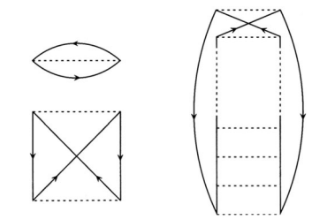
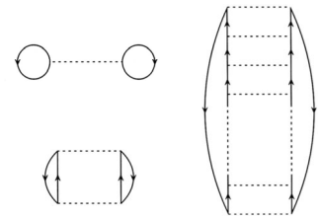



Brueckner-Hartree-Fock
Brueckner approach:
Sum all order of two-nucleon scattering (ladder diagrams) in medium
Replace matrix elements of V to matrix elements of G-matrix.
G-matrix is well defined even with hard-core interaction.

Slide 9

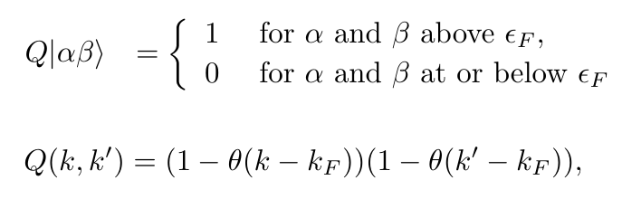
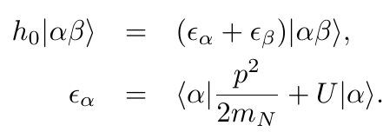
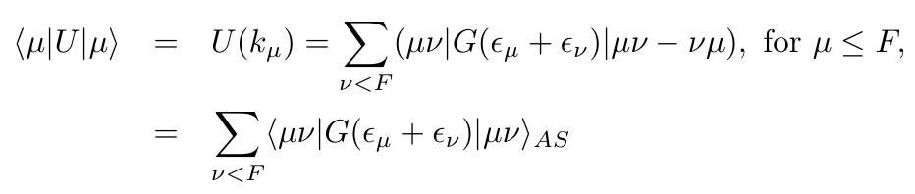
Brueckner-Hartree-Fock
Medium effects enters
(1) Pauli exclusion
(2) Dispersion relation( relation between energy and momentum)
BHF or BBG equation
Self consistent : s.p. wave function, energy, potential, g-matrix

Slide 10
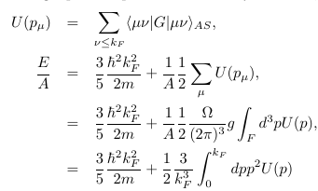
Nuclear matter
From symmetry of infinite nuclear matter
Wave function must be a plane wave. (No need to solve s. p. waves)
Dispersion relation will be changed. (One have to find self consistent potential U )
Energy of nuclear matter can be obtained from U

Slide 11

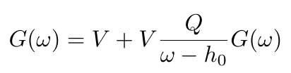



G-matrix calculation
CM momentum and relative momentum of two nucleons
G-matrix equation → integral equation
Same code can be used for scattering in free space.
Set U=0. Q=1. G matrix→ T matrix

Slide 12


Angle average approximation of Q
Q depends on the angle between relative momentum and CM momentum.
In general, Q can couple different relative angular momentum states
→ Simplification : angle average (no mixing between partial waves)

Slide 13


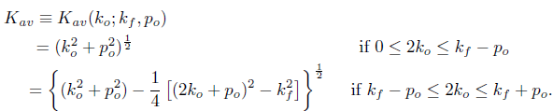


Angle average approximation of denominator
Denominator energy depends on the angle between momentum
Simplification: angle-averaged c.m. momentum prescription
When argument in potential is larger than Fermi momentum?
Standard choice
Continuous choice

Slide 14


Partial wave expansion of G-matrix
angular momentum conservation
→ better to use partial wave expansion.
When k0 is below Fermi momentum, the denominator never have pole.
→ G-matrix is real
When k0 is above Fermi momentum, the denominator can have pole
→ G-matrix becomes complex.

Slide 15


Integral equation
Discretize integral equation→ quadrature method
Pole of denominator→ Principal value integral

Slide 16
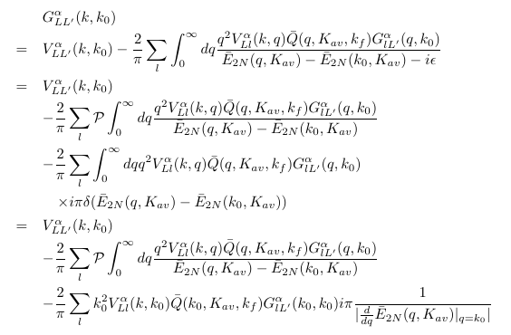

Integral equation
G-matrix equation

Slide 17
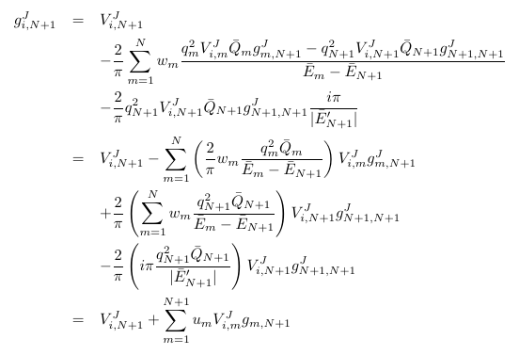
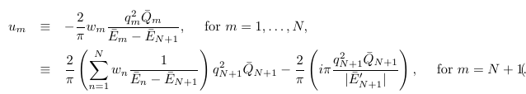
Integral equation
Discretized G-matrix equation (quadrature method)

Slide 18

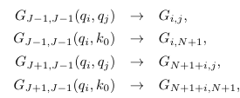


Solve g-matrix
G-matrix equation (without tensor interaction)
G-matrix equation (with tensor interaction for S=1)
G-matrix can be obtained by matrix inversion

Slide 19



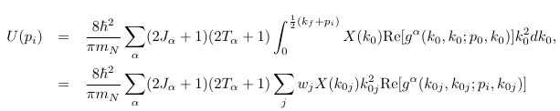

U(p) from g-matrix
For particular s.p. momentum
average CM momentum approximation

Slide 20

Algorithm
Choose interested values of U(p)
Start with initial U(p) → compute e(p)
(effective mass method, start with initial two parameters)
Compute g-matrix
calculate U(p) from obtained g-matrix
Check convergence of U(p) or e(p)
If not converged, repeat from (3) updating U(p) or effective mass

Slide 21
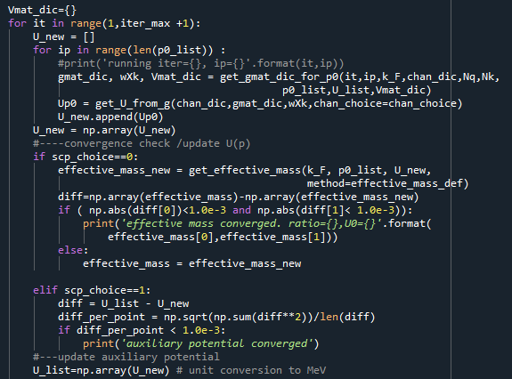
Code

Slide 22
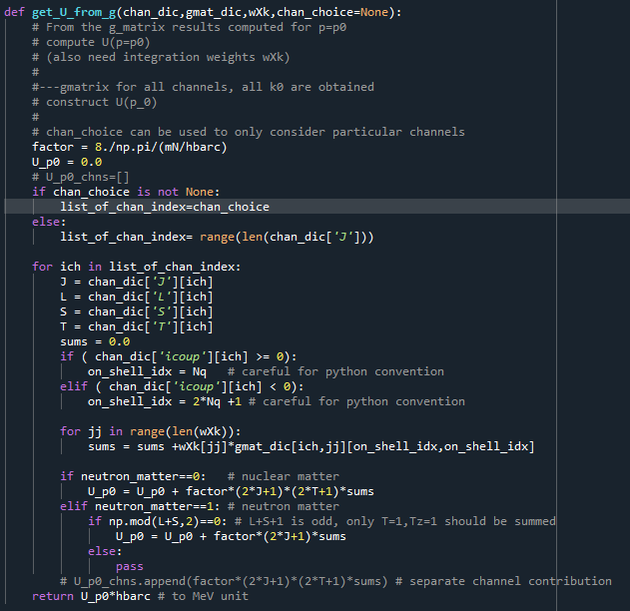
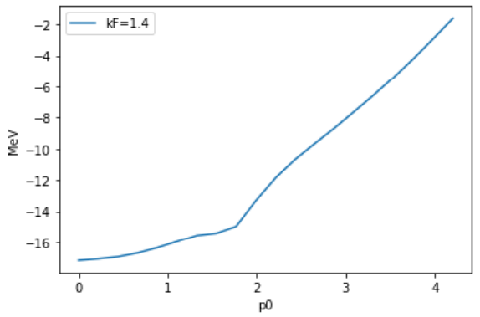
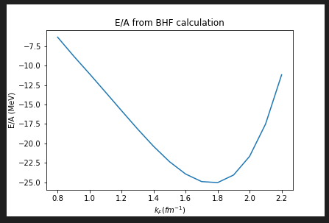
Code
Bonn B potential result

Slide 23
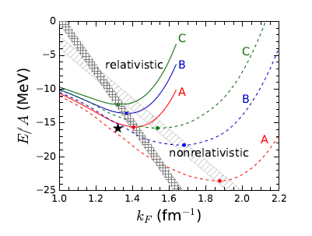
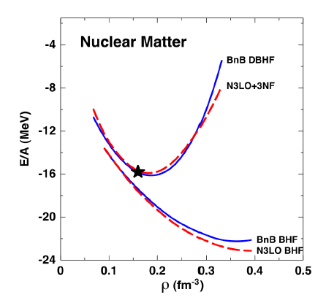
However…
It is well known that the BHF with realistic NN interaction does not give correct saturation property of Nuclear matter
To get better saturation, one have to
(1) Include 3 nucleon force, or
(2) relativistic Dirac BHF
Figures from
S. Shen et al., Progress in Particle and Nuclear Physics, 109, (2019), 103713

Slide 24
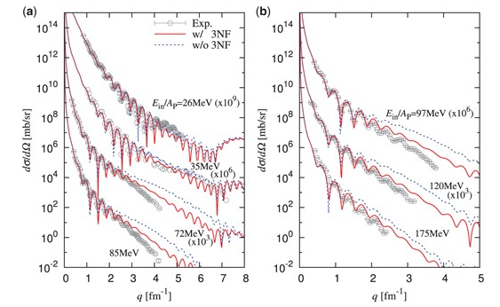
Plan
Include 3NF in chiral EFT
Compute optical potential by folding the g-matrix or self energy U(p)
→ In fact, similar work already exists.
Masakazu Toyokawa et al, Progress of Theoretical and experimental physics, (2018) 023D03
Figure from
The Reference
Masakazu Toyokawa et al
4He scattering on 208Pb.

Slide 25
How to use charge dependent interaction?
Some interactions are charge dependent (isospin symmetry is broken)
Nucleon mass difference in proton and neutron
Interactions are different between pp,np,nn
AV18, CDBonn, Chiral EFT
< p’, L’ |V(S,T,T_z,J)| p, L>
V_pp : T=1, T_z=1
V_nn : T=1, T_z= -1
V_np : T=1, T_z=0 if L+S=even
T=0, T_z=0 if L+S=odd

Slide 26
How to use charge dependent interaction?
Then for BHF?
g-matrix can have T,T_z dependence.
g^{J,ST}_{L’,L}(p’,p; E, K) → g^{L,ST,Tz}_{L’,L}(p’,p; E, K)
Mean potential U can be different for proton and neutron
Fermi energy can be different for proton and neutron
Fully consistent treatment of charge dependence in g-matrix is too complicate! ( Assumptions used for simplification may not hold.)
Will it impact on Symmetry energy?

Slide 27
How to get Optical potential for Nucleus-Nucleus scattering?
Mean potential U(p) can be considered as a optical potential for a nucleon in a nuclear matter.
G-matrix can be considered as an effective interaction between two nucleons in a nuclear matter.
U(p) and G-matrix provides imaginary parts (as like optical model).
One may use single folding or double folding on Nuclear density to get optical potential for nucleon-Nucleus or Nucleus-Nucleus scattering.
Approximate the interaction among nucleons with equivalent g-matrix in nuclear matter. (How to define equivalent?)
Usual double-folding is done for local potential in position space.
(How to convert
g^{LSJT T_z}_{L’L}(p’,p; p0, k0, k_F) <-> v( r ; omega , k_F) ?
what about T_z dependence? )

Slide 28
How to get Optical potential for Nucleus-Nucleus scattering?
In nuclear matter, (p0,k0,k_F) <-> (omega, Kav, k_F)
g^{LSJT T_z}_{L’L}(p’,p; p0, k0, k_F)
= g^{LSJT T_z}_{L’L}(p’,p; omega, Kav, k_F)
with omega = 1/m(k0^2 + Kav^2)
Kav= Kav(p0,k0,k_f)
In finite Nucleus-Nucleus,
V(r; Ein,rho) = sum_{op} operator * (radial function with density, energy dependence)
needs T_z dependence in operator or radial function.
How to match with g-matrix ?

Slide 29
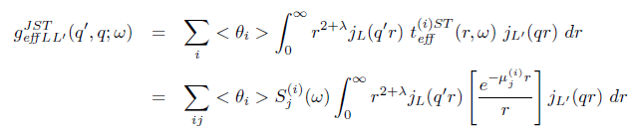

How to get Optical potential for Nucleus-Nucleus scattering?
In finite Nucleus-Nucleus,
For a projectile and target with Ein=E/A_proj, and distance s
What k_F value should be used?
What omega should be used?
What is the corresponding g-matrix? K and E ? Or (p0,k0) set?

