Slide 1


Numerical Quantum Mechanics:
Scattering problem
Young-Ho Song (IRIS, IBS)
2026.03.31. Yonsei University

Slide 2

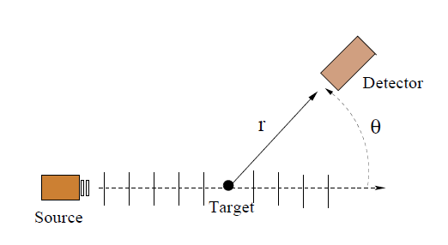
Introduction
Why Scattering(Reaction)?
We cannot directly observe quantum particles, nuclei, atoms
→To get information on the interaction between quantum particles, nuclei, atoms.
→To get information on the structure of quantum particles, nuclei, atoms.
→To measure reaction rates of particular interest.
( stars, nuclear reactors, production of radioactive isotopes)
How experiments are done?
→ Measure the distribution of products.
→ At far away from the reaction spot.

Slide 3
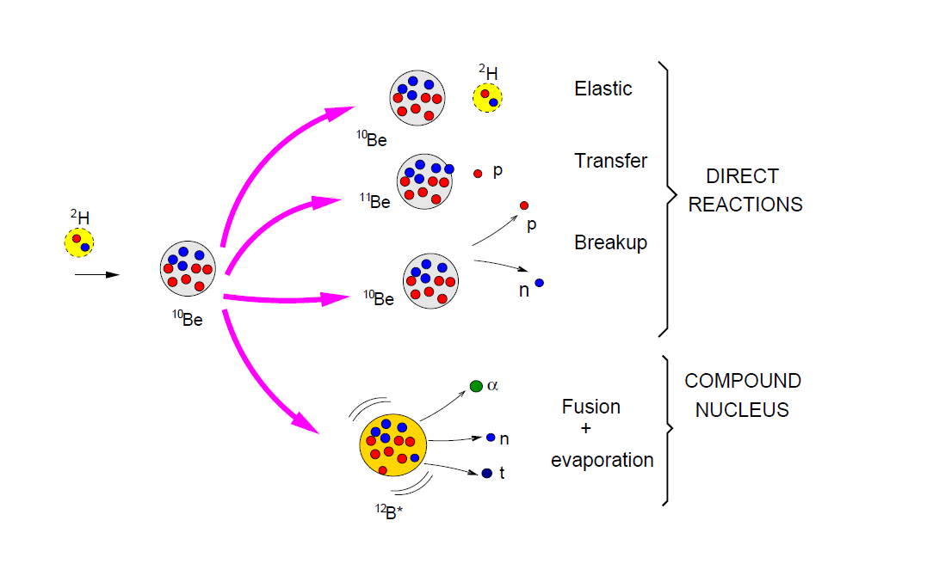
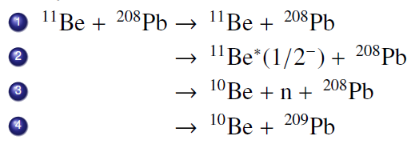
Types of Nuclear Reactions
Types of nuclear reaction
Elastic scattering
Non-Elastic scattering
Inelastic scattering
Rearrangement reactions
(transfer, knock out, fusion, fission …)
← we focus on elastic scattering here.

Slide 4

Introduction
How to relate it with quantum theory?
→ The distribution of the products will be determined from the wave function
→ Solve Schrödinger equation
Compare with experiments
→ What kind of interaction and states(structure) describes the experiments best?

Slide 5
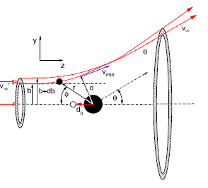
Cross section
Reaction Theory and Experiments can be compared with Cross Section
Measurement
(Number of particles detected in solid angle/sec)
= (Number of incident particles/sec)*(effective area)/(incident area)
= (Number of incident particles/sec)
*(effective area per target)*(number of target particle in area)/(incident area)
= (Number of incident particles/sec)
*(effective area per target)*(target particle number density)*(target thickness)
(Cross section) = (effective area per reaction)
does not depends on the experimental condition ( target thickness, beam size…)

Slide 6
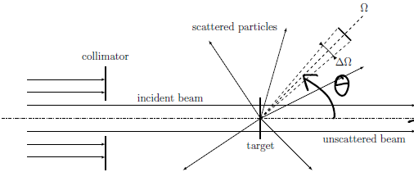


Cross section
Reaction Theory and Experiments can be compared with Cross Section
Differential cross section

Slide 7


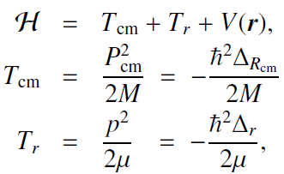
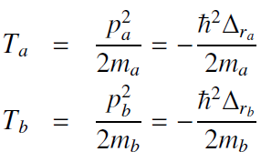




Schrödinger equation for central potential
Schrödinger equation of one-body in spherical symmetric potential
Two-body problem ←→ One-body problem

Slide 8


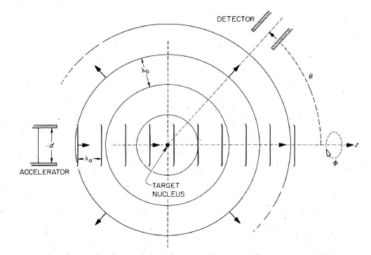
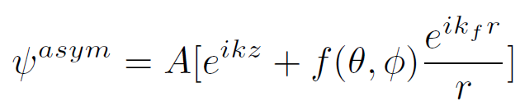
Schrödinger equation for central potential
Stationary scattering States
If interaction have finite range,
Asymptotic boundary condition
Incident wave + scattered wave
f : Scattering amplitude
f=0 , if there is no potential

Slide 9



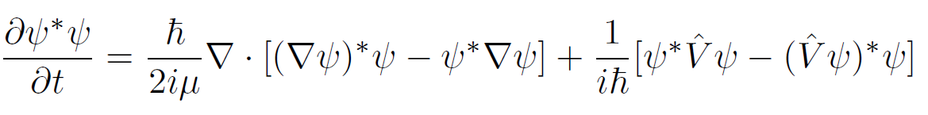

Schrödinger equation for central potential
From continuity eq. and Schrodinger eq.
The last term vanishes for local Hermitian interaction.
In general, interactions are non-local.
Free Current density
Plane wave Case : (density)*(velocity)

Slide 10
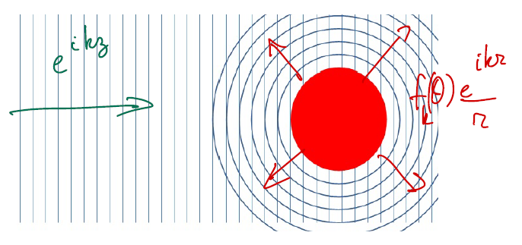

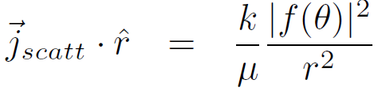
Schrödinger equation for central potential
Then incident flux and scattered flux at large distance
~ number of particles scattered in particular direction
~ differential cross section

Slide 11



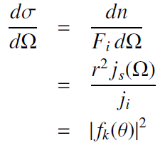
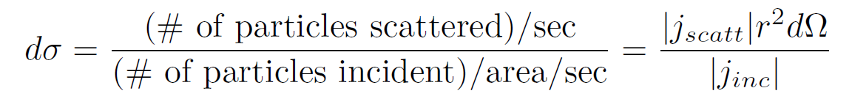
Schrödinger equation for central potential
Measurement
Theoretical cross section ← Scattering amplitude
(contains all information about V )

Slide 12





Partial Wave expansion
Central potential→ Partial Wave expansion of wave function
Spherical Harmonics

Slide 13

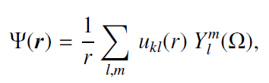
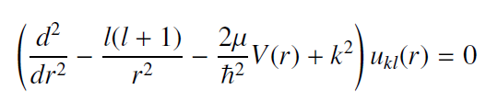

Schrödinger equation for central potential
Radial equation
We changed 3-d equation into 1-d equation
Full solution is a sum of different L solutions
Each L can be solved separately as 1-d equation. ← Easy !

Slide 14
Schrödinger equation for central potential
The same S.E.
Bound State Solution ( E< 0)
Discrete Energies : Not all E <0 gives solution.
Wave function can be normalized : exponential decay of w.f. at large distance
Scattering (unbound) State Solution ( E > 0)
Continuous energies : All E > 0 gives solutions.
Wave function is not normalized : no decay of w.f. at large distance
Same differential equation, but different boundary condition !

Slide 15
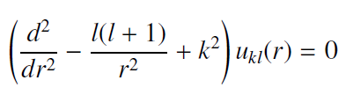
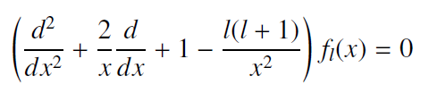

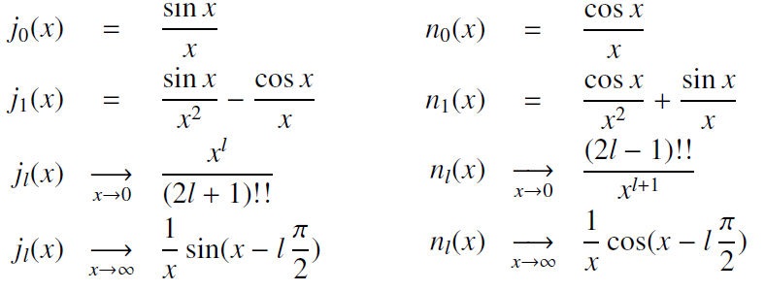
Free wave (Spherical Bessel Function)
No interaction : V = 0
Spherical Bessel equation
Solutions are
spherical Bessel (Neuman) functions.
Any combination of
Spherical Bessel function
And Neuman function is
a solution of the equation
Boundary condition
determines the specific solution.

Slide 16
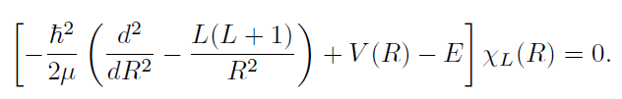
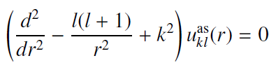
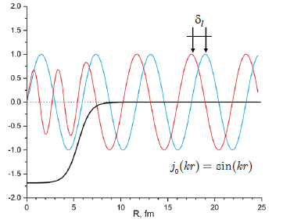
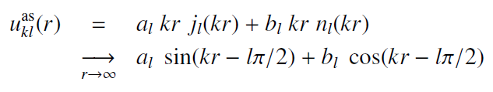

Phase Shift
Nuclear interaction is short-range (finite range)
→ Any solution with interaction behaves as like a free solution at large distance.
→ just shifted in phase.

Slide 17
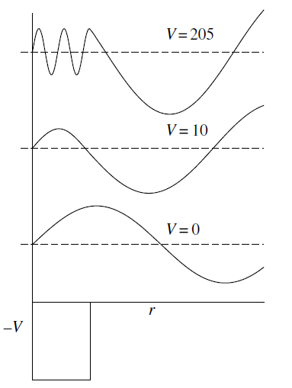
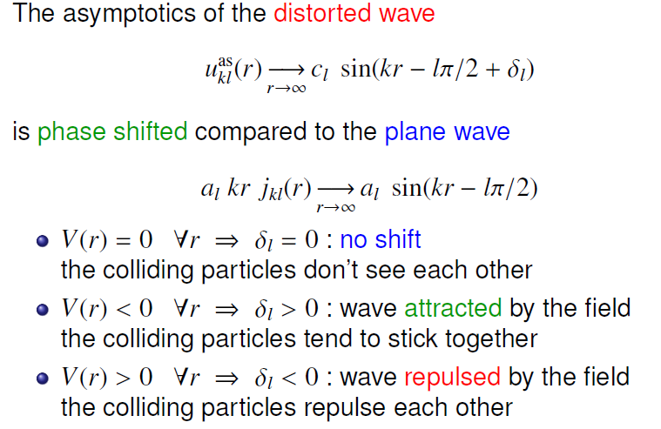
Schrödinger equation for central potential
Phase shift contains all information of the wave function at large distance.
How it is related to scattering amplitude?

Slide 18
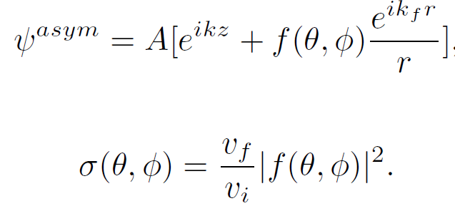
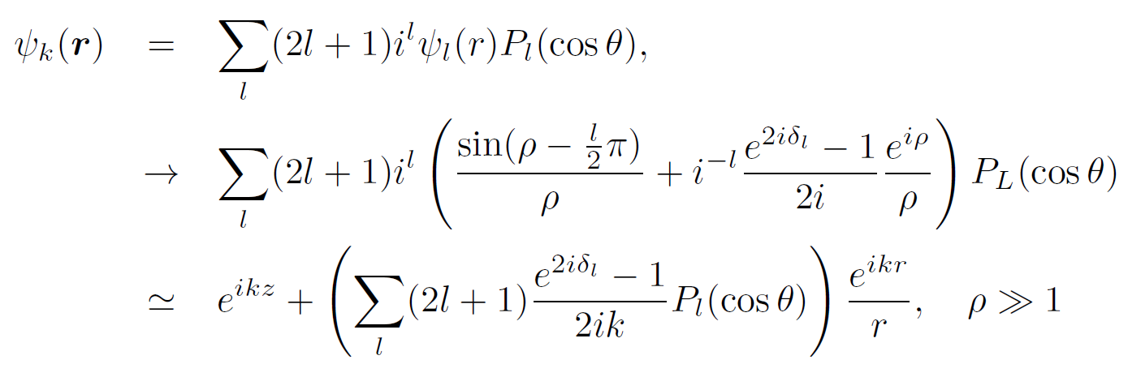
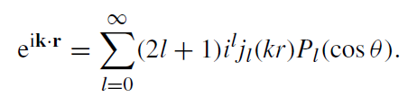

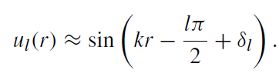
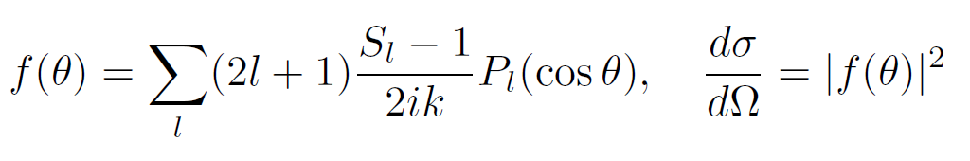
Schrödinger equation for central potential
S-matrix

Slide 19
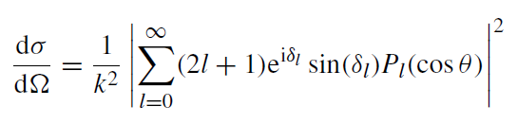
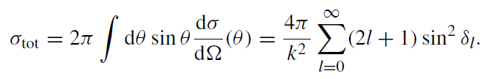
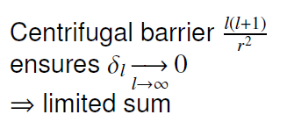
Schrödinger equation for central potential
Total (elastic) cross section

Slide 20




Differential equation
Numerical solution from Numerov, or RK4 methods.
Initial Value: one can use arbitrary values for scattering problem.
Internal solution r < a.
We want to determine phase shift from the wave function solution.

Slide 21
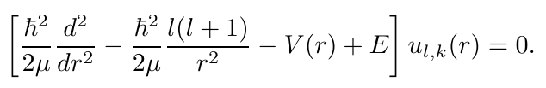
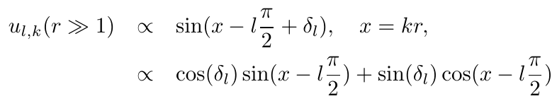
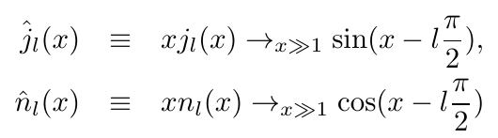


Differential equation
Because of r, it can be convenient to define Ricatti-Bessel, Ricatti-Hankel functions
Scipy convention

Slide 22
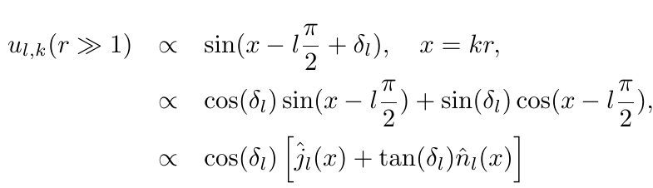
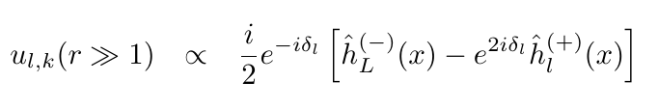
Differential equation
S-matrix is unknown yet.
We want to get S-matrix from
Boundary matching condition.

Slide 23
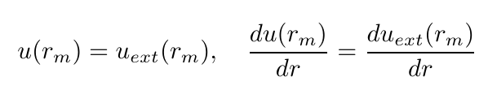
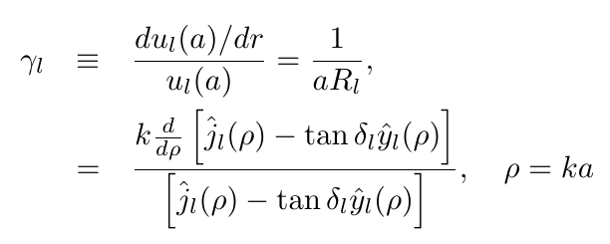
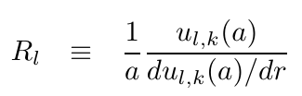
Differential equation
R-matrix

Slide 24
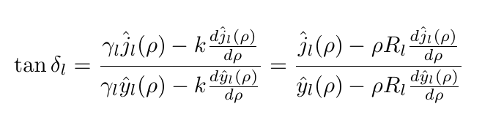
Differential equation
We can get gamma_l from numerical solution.

Slide 25
Scattering problem
solving radial Schrodinger equation for each L
→ numerical integration methods (Numerov, RK4 …)
2. Match boundary condition to determine phase shift for L
3. Compute cross section by summing each L contributions
Here, let us use RK4 method for ordinary differential equation.

Slide 26
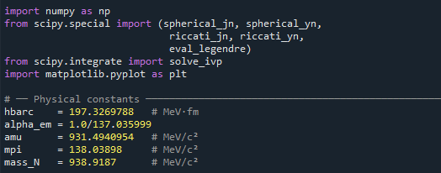
Code
Here we do not focus on the numerical algorithm, but develop a code to solve the scattering problem.
Let us use python and scipy package.
Spherical Bessel Function is available in scipy.special
ODE solver is available in scipy.integrate
Keep in mind of units : Let us use natural units and everything in fermi (and its powers).

Slide 27
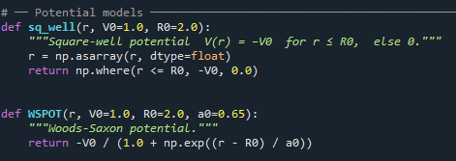
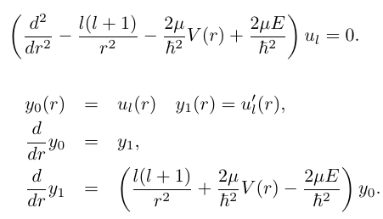
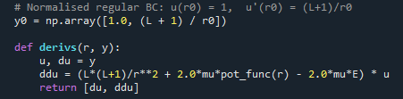
Code

Slide 28
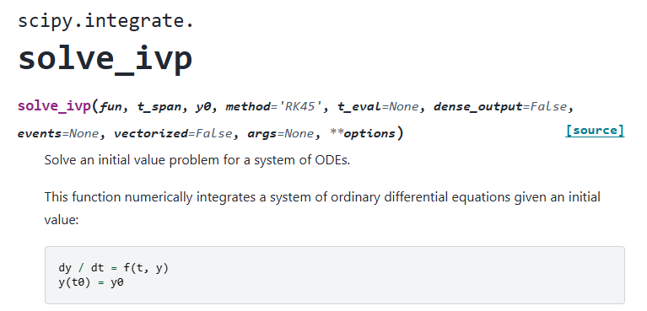
Code

Slide 29
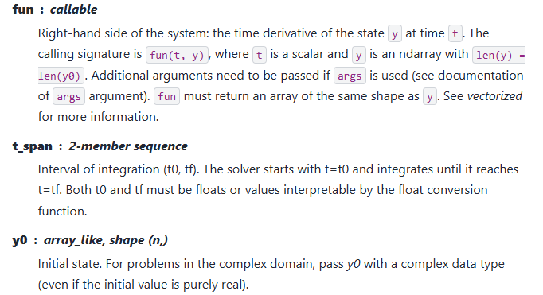
Code

Slide 30
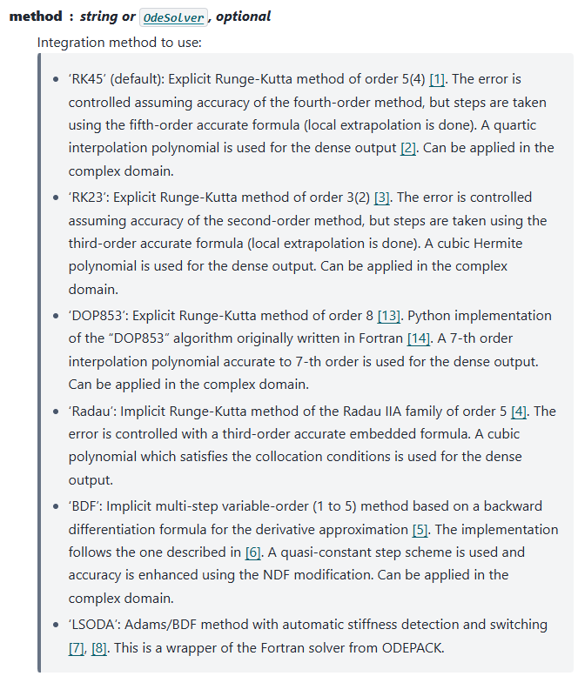
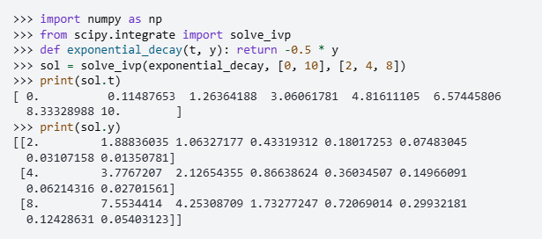
Code

Slide 31



Code
Initial condition
Scattering problem: one can choose arbitrary values for initial condition.
Bound state problem: one have to search
correct initial condition which gives bound state solution. (shooting method.)

Slide 32

Code
Solve matching condition for S-matrix

Slide 33

Code

Slide 34

Code

Slide 35

Code

Slide 36
Numerical Quantum Mechanics:
Harmonic Oscillator
Young-Ho Song (IRIS, IBS)
2026.03.31. Yonsei University

Slide 37
Basis expansion
The same radial equation describes both bound state and scattering state.
We solved Sch. Eq. as differential equation for each (L, E).
Bound state : we search binding energy which satisfies boundary condition.
→ Shooting method.
We can solve the same problem as matrix eigenvalue problem or variational method.

Slide 38





Basis expansion
Suppose the ortho-normal basis function exists,
Matrix eigenvalue problem

Slide 39


Variational theorem
Infinite number of basis function → Exact, not practical
Finite number of basis function → Approximation
Variational Theorem

Slide 40


1d Coordinate basis
In fact, coordinate space wave function can be
Considered as a kind of basis expansion.

Slide 41



1d Coordinate basis
Matrix elements of kinetic term:
finite difference approximation
Matrix elements of potential term:
local potential case

Slide 42




1d Coordinate basis
Bound state problem case.
Scattering problem is more complicate.

Slide 43

1d Coordinate basis
How to solve matrix eigenvalue problem?
There are many numerical algorithm
to solve the matrix eigenvalue problem
We are not going into details of each algorithm, but use scipy packages to solve the problem.

Slide 44



1d Coordinate basis

Slide 45




H.O. wave function
Consider Harmonic Oscillator Hamiltonian.
For simplicity, let us use natural units and set m=1, w=1

Slide 46


H.O. wave function
We could get the correct results for (L=0, N=400).
However, coordinate basis expansion is not practical
because the matrix size can be very large.
Better basis function which reduce the size of matrix
H.O. basis is commonly used.

Slide 47




HO basis
The Harmonic Oscillator wave functions are used in many cases,
HO wave function
1d H.O. ~ Hermite polynomial
3d H.O. ~ 3 Cartesian 1d H.O. or
~(Associate Laguerre polynomial)
*(Spherical Harmonics)

Slide 48



HO basis
H.O. basis is ortho-normal/ complete.
Good basis for bound state wave function:
exponential fall off at large r
Not good for continuum wave function
Analytic matrix elements available
Exact separation of C.M. motion in many-body w.f.

Slide 49



HO basis
Matrix elements for HO radial functions:
You can construct matrix elements in (radial) H.O. basis
Keep in mind of angular part (spherical harmonics).
Examples of matrix elements : Not going to prove these relations

Slide 50



HO basis
Matrix elements for HO radial functions

Slide 51


Woods-Saxon potential example
Let us consider Woods-Saxon potential.
For simplicity, let us compute potential matrix elements by simple trapezoidal integration.
Because we already know
exact solution for HO basis,

Slide 52

Woods-Saxon potential example

Slide 53


Woods-Saxon potential example
V=50; R=5; a=0.5
We can see a good convergence
with small number of basis (N~ 20)

