Slide 1



Oxygen isotopes in Nuclear Lattice Effective Field Theory
Young-Ho Song (RISP, IBS)
NLEFT collaboration
KPS meeting 2022.04.22, on-line

Slide 2
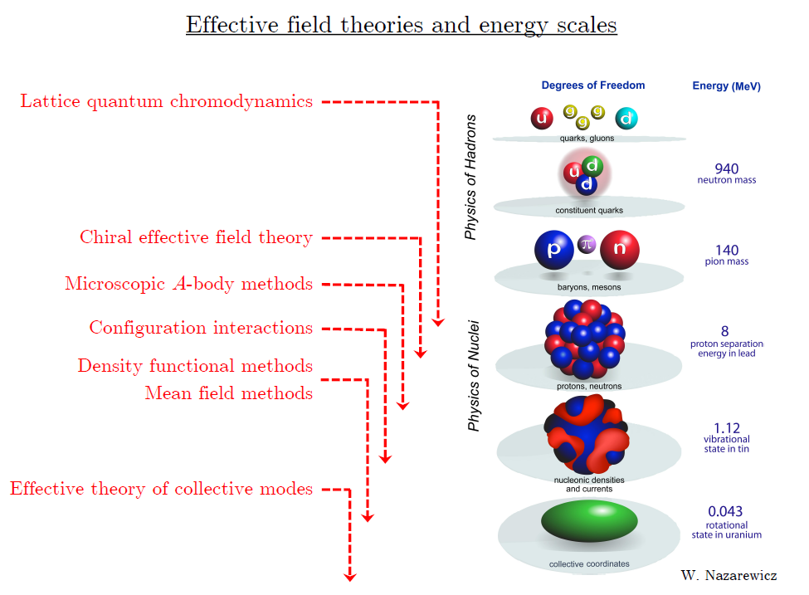
Ab initio
Nuclear
Theory

Slide 3
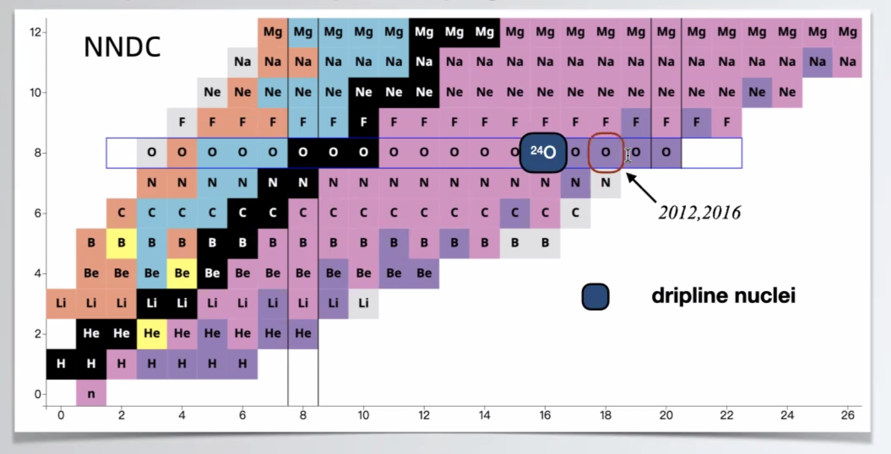

Slide 4
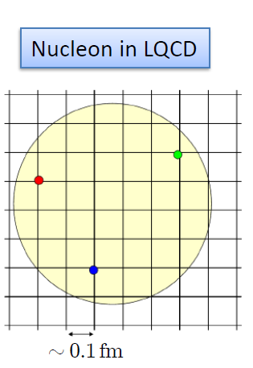

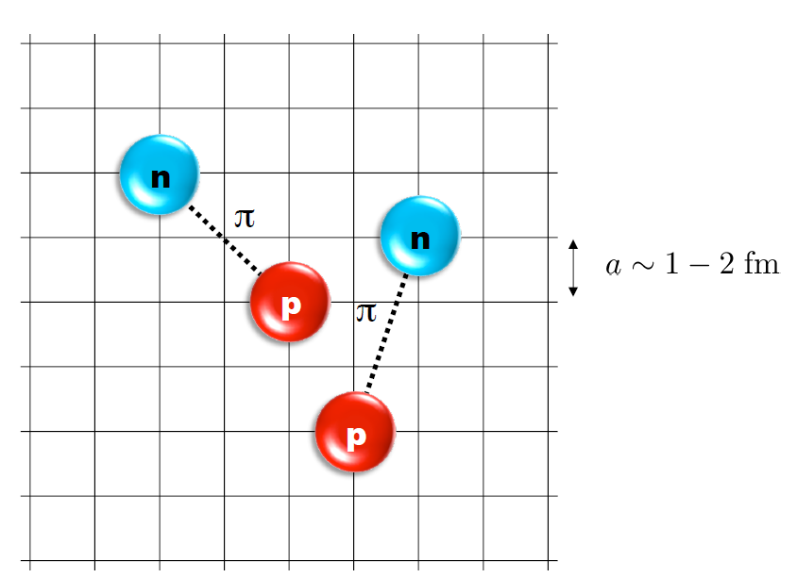
Nuclear Lattice Effective Field Theory
One of ab initio method for many fermion system

Slide 5
Characters of NLEFT
NLEFT is not a molecular dynamics
→ fully quantum mechanical.
NLEFT does not require truncated basis expansions, many-body perturbation theory, or any constraints on the nuclear wave function. Regularization/Truncation is in the lattice spacing.
Alpha clustering emerges naturally.

Slide 6

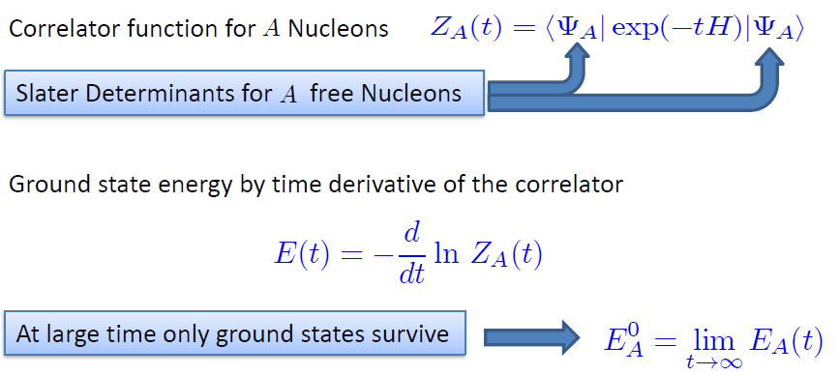
Path integral

Slide 7
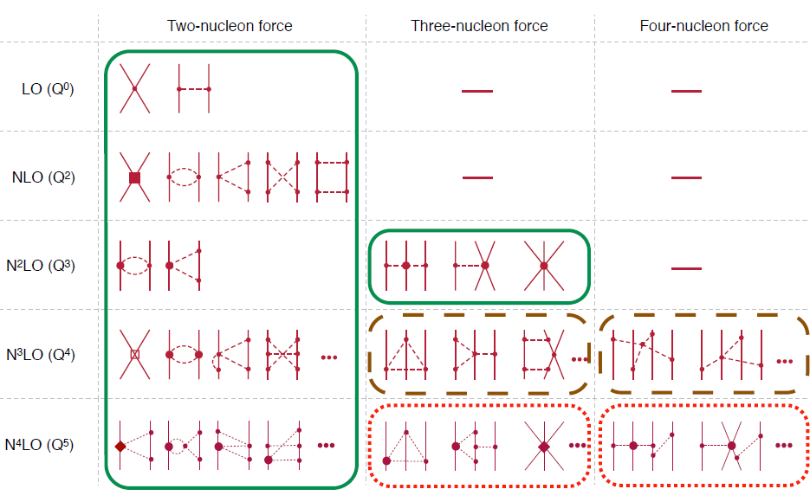
Chiral Effective Field Theory

Slide 8
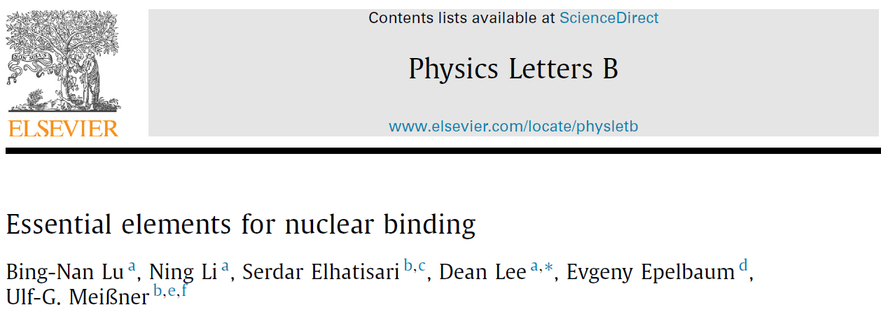
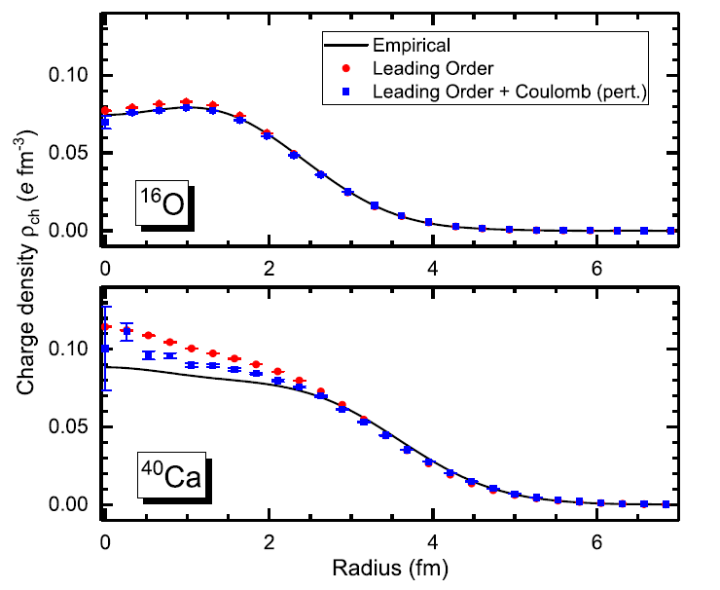



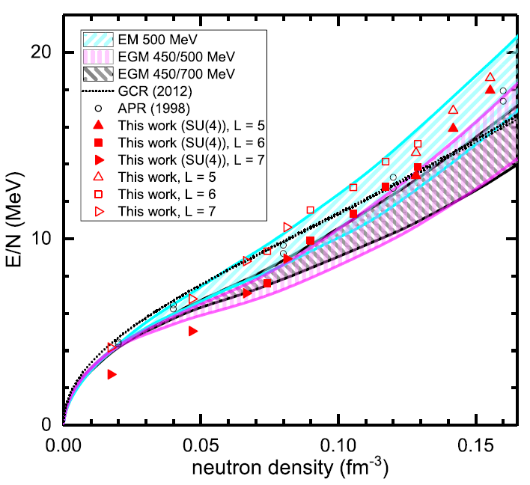
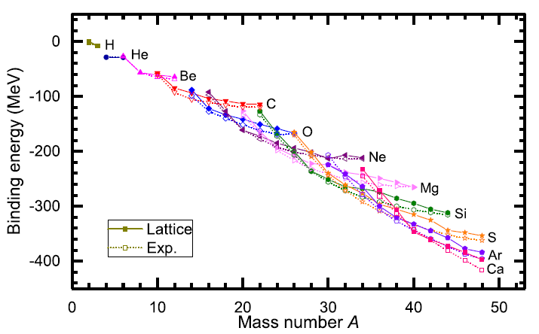

Slide 9
Difficulty with full chiral interaction
Sign problem
NLEFT suffers sign problems at large Euclidean time limit
SU(4) symmetric interaction does not have sign problem
One pion exchange and higher order chiral interaction
Asymmetric nuclei
Needs a remedy to extend to neutron rich isotopes.
A new approach to reduce the sign problem.
→ Wave function matching Hamiltonian.

Slide 10


Wave Function Matching Hamiltonian
Wave function matching by Unitary transformation
Original Hamiltonian has a strong repulsion at short distance
→ origin of the difficulty of non-perturbative calculation.
new “soft” Hamiltonian
such that the eigenstate wave function becomes
Same as “original” w.f. at long distance
Same as “soft” w.f. at short distance
“Soft” Hamiltonian is not the same as original Hamiltonian
Naturally need correction term
H_orig = H_soft + (H_orig - H_soft)
H_soft has better property for non-perturbative calculation

Slide 11
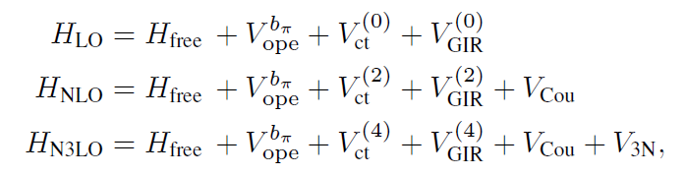

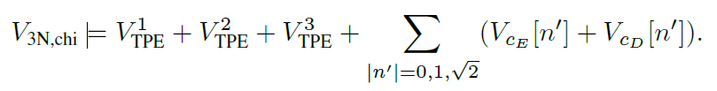
Lattice Hamiltonian

Slide 12


Lattice Hamiltonian

Slide 13
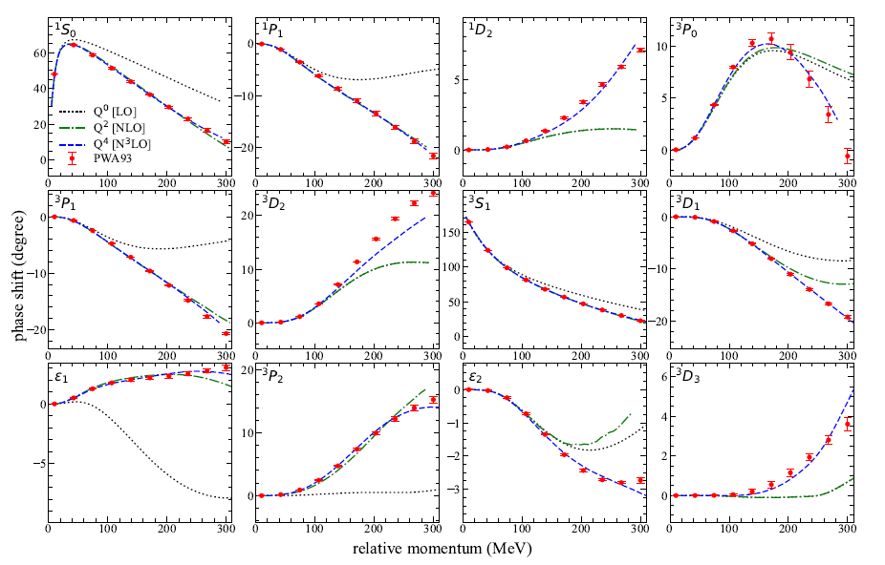

Slide 14
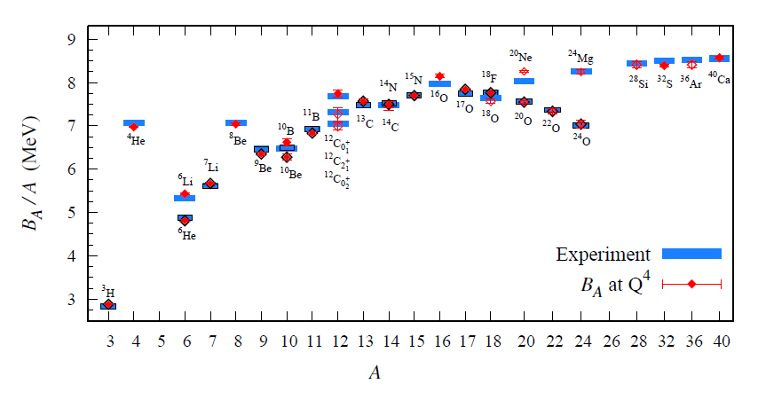
Preliminary

Slide 15
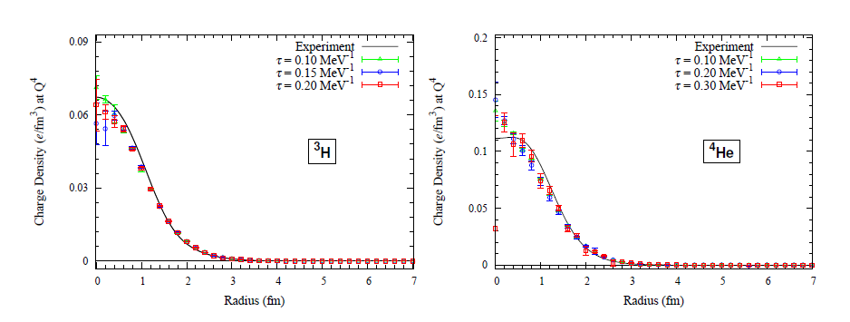
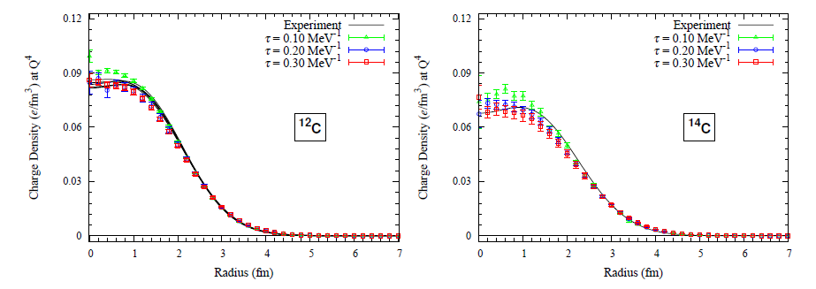
Preliminary

Slide 16
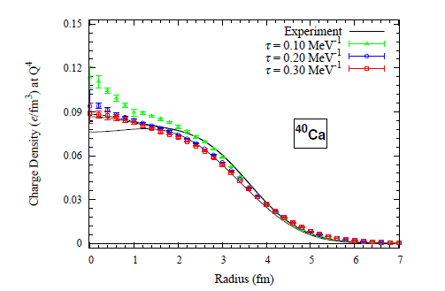
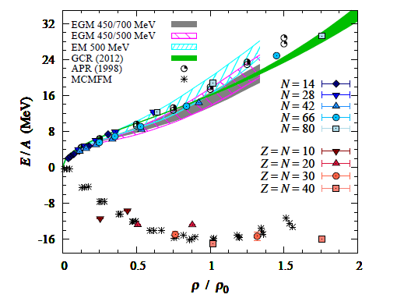
Preliminary

Slide 17
Oxygen isotopes in NLEFT

Slide 18
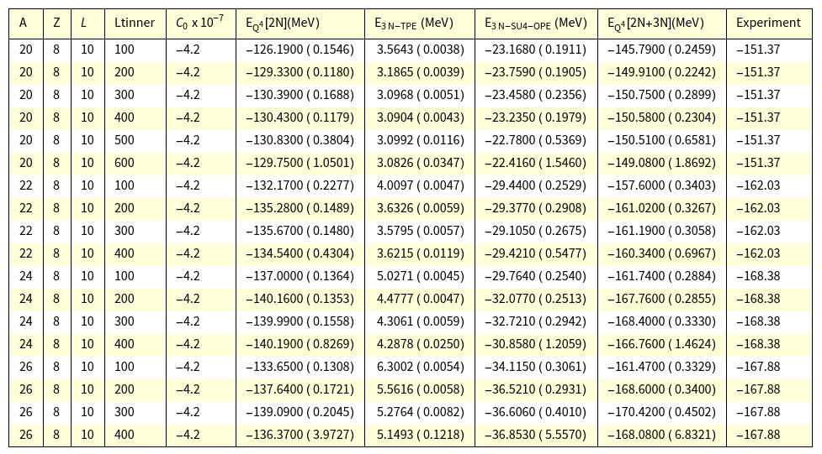
Preliminary

Slide 19
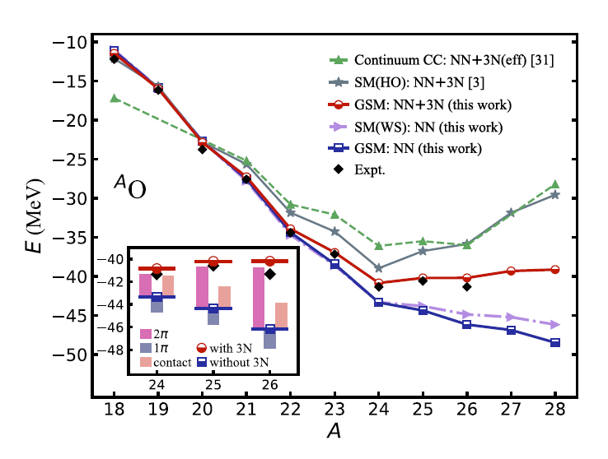

Gamow Shell model calculation

Slide 20
Summary
Wave function matching method
New method to improve the N3LO calculation of NLEFT
Preliminary study shows promising results for wide range of observables
NN scattering
Binding energy 3H-40Ca
Symmetric Nuclear matter
Neutron matter
Dripline of Oxygen isotope.

